Slide 1
Hospital acquired infections
Dr SUCHETA LAKHANI

Slide 2
HAI Definition
Infections acquired in the hospital by a patient:
Admitted for a reason other than infection
Infection was not present or incubating at admission
Symptoms - appear
  > 48 hr of admission (for clinical)
  2 calendar days (for surveillance)
Include
  Infections appearing after discharge
  Occupational infections among HCWs

Slide 3
Factors Affecting HAI
Immune status
Hospital environment
Hospital organisms
Diagnostic or therapeutic interventions
Transfusion
Poor hospital administration

Slide 4
Sources of HAIs
Endogenous source- patient’s own flora
Exogenous source
  Environmental sources
  Health care workers
  Other patients

Slide 5
Microorganisms implicated in HAIs
The ESKAPE pathogens-
  Enterococcus faecium
  Staphylococcus aureus
  Klebsiella pneumoniae
  Acinetobacter baumannii
  Pseudomonas aeruginosa
  Enterobacter species and Escherichia coli

Slide 6
Blood borne infections (BBIs)
HIV
Hepatitis B
Hepatitis C viruses
Transmitted by
  Blood Transfusion
  Needle /Other Sharp Injury /Splash

Slide 7
Modes of transmission of hospital-acquired pathogens.
Route |  | Description
Contact transmission
 | Direct contact | Skin to skin contact , MC
 | Indirect contact | Contaminated inanimate objects such as- Dressings, or gloves, instruments (e.g. stethoscope) Parenteral transmission through- NSI, splashes, saline flush, syringes, vials etc

Slide 8
Modes of transmission of hospital-acquired pathogens.
Route |  | Description
Inhalational mode
 | Droplet transmission | Droplets of >5 µm size can travel for shorter distance (<3 feet). Generated while coughing, sneezing, and talking Propelled for a short distance through the air and deposited on the host's body. E.g -bacterial meningitis, diphtheria, respiratory syncytial virus, etc.
 | Airborne transmission | Airborne droplet nuclei (≤ 5 µm size) or dust particles Remain suspended in the air for long time and can travel longer distance. This is more efficient mode than droplet transmission. E.g. Legionella, Mycobacterium tuberculosis, measles and varicella viruses.

Slide 9
Modes of transmission of hospital-acquired pathogens.
Route | Description
Vector | Via vectors such as mosquitoes, flies, etc. carrying the microorganisms Rare mode
Common vehicle | such as food, water, medications, devices, and equipment.

Slide 10
MAJOR TYPES OF HAIs
Catheter-associated urinary tract infection (CAUTI)
Central line-associated blood stream infection (CLABSI)
Ventilator-associated pneumonia (VAP)
Surgical site infection (SSI).

Slide 11
Catheter-associated urinary tract infection (CAUTI)
Risk factors
Advanced age
Female gender
Severe underlying disease
Placement of a urinary catheter for > 2 days.

Slide 12
CAUTI (cont..)
Organisms
Gram negative rods -majority of hospital acquired UTIs
E.coli is the MC organism implicated.
Gram-positive bacteria –may also cause UTI
S.aureus, enterococci - occasionally cause CAUTI.

Slide 13
Central line associated blood stream infection
(CLABSI)
Organisms
  CoNS, and S.aureus – Most common
  Followed by gram-negative rods and Candida.

Slide 14
CLABSI (cont..)
Risk factors
Patient related:
  Age (<1 yr and >60 yrs), malnutrition
  Low immunity
  Severe underlying disease
  Loss of skin integrity (burn or bed sore)
  Prolonged stay in ICUs
HCW related: poor IC practices such as HH.

Slide 15
Ventilator associated pneumonia
Risk factors for VAP
Device related: endotracheal intubation
Patient related:
  Prolonged ICU stay leading to colonization of hospital MDROs
  Aspiration of oropharyngeal flora due to various reasons such as semiconscious state, supine position etc
HCW related: poor IC practices such as HH

Slide 16
VAP (cont..)
Organisms:
Gram-negative rods such as Acinetobacter species and Pseudomonas
Other gram-negative
Gram positive bacteria

Slide 17
Surgical site infections (SSI)
Definition:
Develop at the surgical site within 30 days of surgery
Within 90 days for breast, cardiac and joint surgeries)
Under reported because 50% of SSIs develop after the discharge.

Slide 18
SSI (cont..)
Organisms
Surgical site wounds are classified as clean, clean-contaminated, contaminated or dirty.
For clean wound- The skin flora (MC- S.aureus.)
For other types- endogenous flora (anaerobes and GNB)

Slide 19
SSI (cont)
Risk factors for nosocomial wound infection include:
  Advanced age, obesity, malnutrition, diabetes
  Infection at a remote site that spread through blood stream
  Preoperative shaving of the site
  Inappropriate timing of prophylactic antimicrobial agent.
Note: The antimicrobial prophylaxis is usually given to the patient to prevent the seeding of organisms on the surgical site. It is given 1 hour prior to the incision, usually along with the induction of anesthesia.

Slide 20
Prevention oF HAIs
The preventive measures for HAIs can be broadly categorized into
  Standard precautions
  Transmission-based or specific precautions.

Slide 21
Standard precautions
Set of work practices used to minimize transmission of HAIs.
Measures to be used when providing care to/handling –
  All individuals
  All specimens (blood or body fluids)
  All needles and sharps

Slide 22
Components of standard precautions
Hand hygiene
Personal protective equipment
Biomedical waste including sharp handling
Spillage cleaning
Disinfection
Respiratory hygiene and cough etiquette

Slide 23
Hand Hygiene
Hands are the main source of transmission of infections during healthcare.
Hand hygiene is therefore the most important measure to avoid the transmission of harmful microbes and prevent healthcare-associated infections.

Slide 24
Types of Hand Hygiene Methods-
Hand Rub
Alcohol based (70–80% ethyl alcohol) and chlorhexidine (2–4%) based hand rubs are available.
Duration - 20–30 seconds.
Advantage: After a period of contact, it gets evaporated of its own hence drying of hands is not required separately
Indications:
  Indicated during routine rounds in the wards or ICUs
  In all the moments or situations requiring hand hygiene, except when the hands are visibly dirty or soiled, when it will be ineffective.

Slide 25
Types of Hand Hygiene Methods-
Hand Wash
Antimicrobial soaps (liquid, gel or bars) are available.
If facilities are not available, then even ordinary soap and water can also be used.
Duration - 40–60 seconds.
Indications:
  When the hands are visibly soiled with blood, excreta, pus, etc.
  Before and after eating
  After going to toilet
  Before and after shift of the duty.

Slide 26
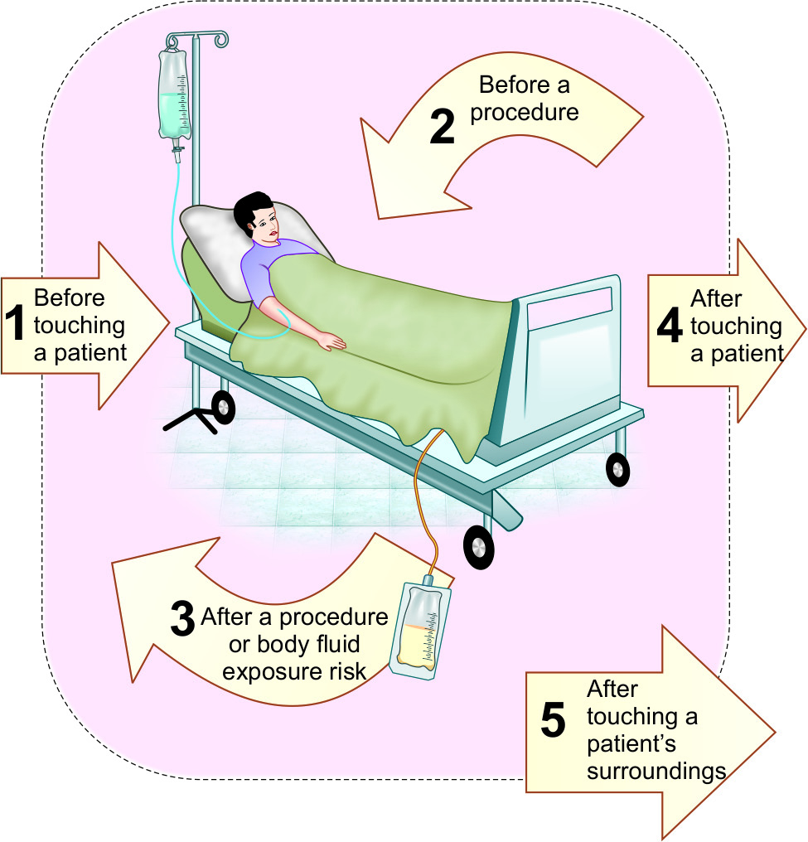
Five Moments for Hand Hygiene

Slide 27
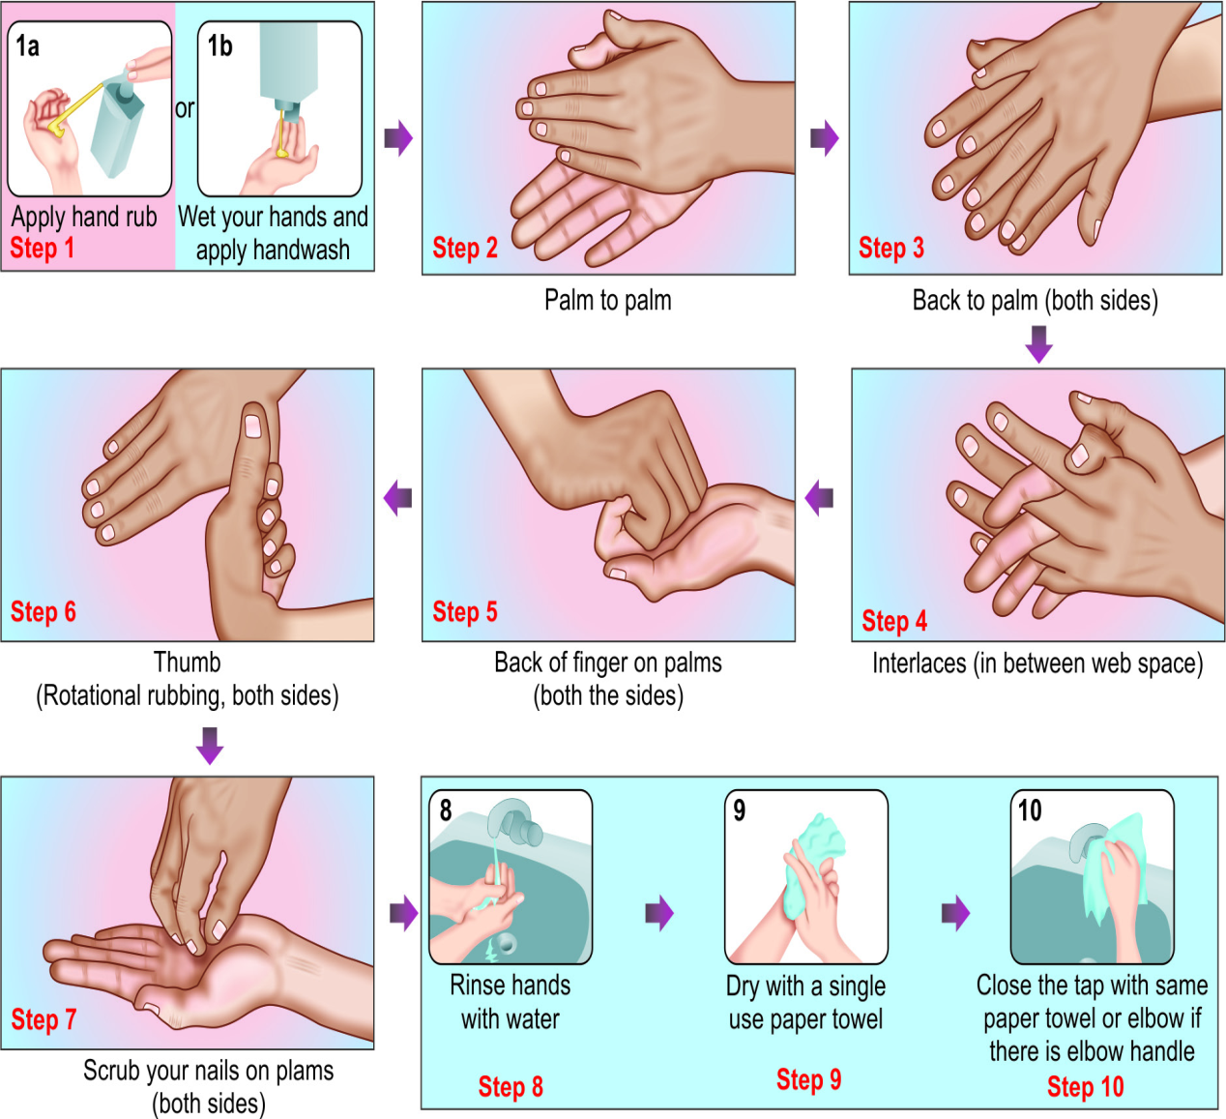
Steps of hand rubbing and hand washing (WHO)

Slide 28
Personal Protective Equipment (PPE)
Used to protect the skin and mucous membranes of HCWs from exposure to blood and/or body fluids
From the HCW’s hands to the patient during sterile and invasive procedures.

Slide 29
Personal protective equipment (PPE)
Gloves (non-sterile) | Used when there is a risk of infection to HCWs (e.g. while touching blood, body fluids, secretions, excretions of patients, items/equipment or environment).
Gloves (sterile) | Used when there is a risk of infection to HCWs as well as to the patients (during surgeries /invasive procedures).
Plastic apron | Used during surgeries
Gown | Used during surgeries and when soiling is likely to be expected.

Slide 30
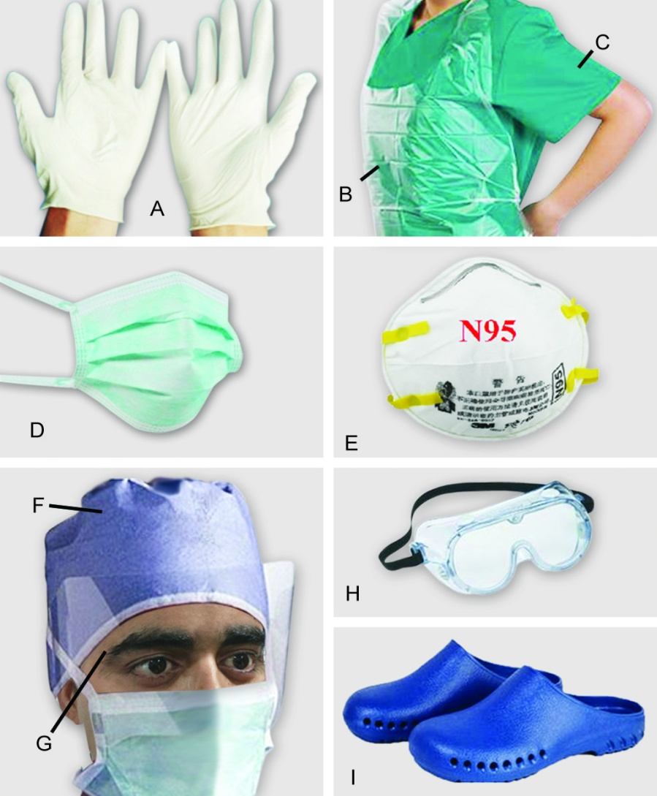
Personal protective equipment (PPE)
Personal protective equipment (PPE):
A. Gloves;
B. Plastic apron;
C. Gown;
D. Surgical mask;
E. N95 mask;
F. Cap;
G. Face shield;
H. Goggles;
I. Surgical shoes

Slide 31
Selection of appropriate PPE
Level of risk associated with contamination of skin, mucous membranes, and clothing by blood and body fluids during a specific patient care activity or intervention
Route of transmission of suspected organisms— contact, droplet and inhalation

Slide 32
Donning and Doffing
Donning (wearing)
Doffing (removing)
Gown
Mask or respirator
Goggles or face shield
Gloves
Gloves
Goggles or face shield
Gown
Mask or respirator

Slide 33
Spill management for blood and body fluids
Spill management of blood and body fluids: Bring the spill kit to the site of spillage, wear appropriate PPE (gloves and gown); put no entry sign board near the spill area.
If spillage is small (<10 mL):
  Wipe up spill immediately with absorbent material and discard into appropriate bin
  Wipe the area with 10% sodium hypochlorite and allow to dry
  Remove PPE and perform hand hygiene
If spillage is large (>10 mL):
  Place disposable paper towels over spill to absorb the spillage
  and then pour 10% sodium hypochlorite on top of absorbent paper towels and leave for 15 minutes.
  Remove the absorbent papers; put fresh disposable paper towels to clean the area and then discard these into appropriate waste bin.

Slide 34
Respiratory hygiene and cough etiquette
Should be followed by anyone with signs and symptoms of a respiratory infection, regardless of the cause.
  Cover the nose/mouth with single-use tissue paper when coughing, sneezing, wiping and blowing noses
  If no tissues are available, cough or sneeze into the inner elbow rather than the hand
  Follow hand hygiene after contact with respiratory secretions and contaminated objects/materials
  Keep contaminated hands away from the mucous membranes of the eyes and nose

Slide 35
Respiratory hygiene and cough etiquette
In high-risk areas of airborne transmission such as pulmonary medicine OPD:
  Give mask to the patients with cough and make separate queue away from the general queue
  Sputum collection should be done in an open space or in a well- ventilated room

Slide 36
Transmission-based precautions
(specific precautions)
Contact Precautions
Droplet Precautions
Airborne Precautions

Slide 37
Specific precautions
Type | Indication | Isolation | Gloves | Gown | Mask | Eye protection | Handling of equipment | Visitors
Contact | MDROs, C.difficile Diarrheal pathogens Highly contagious skin infections | Essential | Essential | Essential | Surgical mask- Required if infectious agent is also transmitted by droplet | As required** | Single use or reprocess before reuse on next patient | Same precautions as for staff

Slide 38
Specific precautions
Type | Indication | Isolation¹ | Gloves | Gown | Mask | Eye protection | Handling of equipment | Visitors
Droplet | Respiratory syncytial virus, Mycoplasma Parainfluenza Pertussis Plague, Meningococcus | Essential | As required* | If soiling likely | Surgical mask is essential | As required** | Same as contact | Restrict visitor numbers and precautions same as for staff

Slide 39
Specific precautions
Type | Indication | Isolation¹ | Gloves | Gown | Mask | Eye protection | Handling of equipment | Visitors
Airborne | Pulmonary TB, Chicken pox Measles SARS | Essential (negative pressure) | As required* | If soiling likely | N95 respirator essential | As required** | Same as contact | Restrict visitor numbers and precautions same as for staff

Slide 40
Hospital infection control committee
Core Committee members
Chairperson: MS
Member Secretary: HOD, Dept. of Microbiology
Hospital Infection Control Officer
Nursing Superintendent
Infection Control Nurses
Infection Control Lab technician
Data entry operators
Other Committee members
HODs of all clinical departments
Biomedical waste management in-charge
ART Clinical In Charge
CSSD in-charge
Linen and Landry in-charge
Central store in-charge
Engineer representative
Pharmacy in-charge
Sanitary Superintendent
Kitchen in-charge

Slide 41
HICC Activities
Education
HAI Surveillance
Staff Health Care (Needle stick injury & hepatitis B vaccination)
Hand Hygiene Audit
Bundle care audit
Antimicrobial Stewardship Programme
Environmental Surveillance (water, air , surface and milk)
Staff Surveillance for MRSA and other MDROs
AMR Surveillance
Formulating Disinfectant policy
HICC Meeting, once monthly

Slide 42
Biomedical Waste
Definition:
Wastes that are generated during the laboratory diagnosis, treatment or immunization of human beings or animals, or in research activities pertaining thereto, or in the production of biologicals.

Slide 43
Waste Generated in Hospitals
General waste (80%)
Pathological and infectious waste (15%)
Chemical and pharmaceutical waste (3%)
Sharp waste (1%)
Less than 1% accounts for special waste such as cytotoxic drug, radioactive waste, broken thermometers and used batteries.

Slide 44
Situation in India
According to the Ministry of Environment and Forests gross generation of biomedical waste in India is about 4,05,702 kg/day
Of which only 2,91,983 kg/day is properly disposed
28% of the wastes is left untreated and not disposed, finding its way in dumps or water bodies and re-enters our system.
Karnataka tops the chart among all the states in generation of biomedical waste.

Slide 45
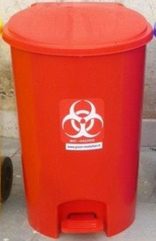
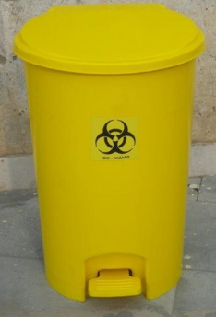
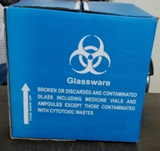
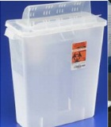

Slide 46
Biomedical waste Management Rule, India 2016
Category | Type of waste | Type of Bag/ container | Treatment/ Disposal options
Yellow infectious non- plastic waste | Human anatomical waste | Yellow coloured non chlorinated plastic bags | Incineration/ Plasma pyrolysis/ deep burial
 | Animal anatomical waste
 | Soiled waste |  | Incineration/ Plasma Pyrolysis/ deep burial/ autoclaving or hydroclaving + shredding/mutilation
 | Expired/ discarded medicines- pharmaceutical waste, cytotoxic drugs | Yellow coloured containers/ non chlorinated plastic bags | Incineration (cytotoxic drugs at temperature > 1200⁰C)

Slide 47
Biomedical waste Management Rule, India 2016
Category | Type of waste | Type of Bag/ container | Treatment/ Disposal options
Yellow infectious non- plastic waste | Chemical liquid waste | Separate collection system leading to effluent treatment system | Pre-treated before mixing with other wastewater
 | Discarded linen contaminated with blood/ body fluids | Non-chlorinated yellow plastic bags/ suitable packing material | Non- chlorinated chemical disinfection followed by incineration/ plasma pyrolysis
 | Microbiology, other clinical lab waste, blood bags, live/ attenuated vaccines | Autoclave safe plastic bag/ container | Pre-treat to sterilize with non-chlorinated chemicals on-site as per NACO/ WHO guidelines + Incineration.

Slide 48
Biomedical waste Management Rule, India 2016
Category | Type of waste | Type of Bag/ container | Treatment/ Disposal options
Red | Infectious plastic waste (Recyclable) | Red coloured non-chlorinated plastic bags or containers | Autoclaving/ micro-waving/ hydroclaving + shredding Mutilation/ sterilization+ shredding. Treated waste sent to registered or authorized recyclers or for energy recovery or plastics to diesel or fuel oil or for road making,

Slide 49
Biomedical waste Management Rule, India 2016
Category | Type of waste | Type of Bag/ container | Treatment/ Disposal options
White (Translucent) | Waste sharps including metal sharp | Puncture proof, Leak proof, tamper proof containers | Autoclaving/ dry heat sterilization+ shredding/ mutilation Encapsulation in metal container or cement concrete Sanitary landfill/ designated concrete waste sharp pit

Slide 50
Biomedical waste Management Rule, India 2016
Category | Type of waste | Type of Bag/ container | Treatment/ Disposal options
Blue | Glassware Metallic body implants | Cardboard boxes with blue colored marking | Disinfection (by soaking the washed glass waste after cleaning with detergent and Sodium Hypochlorite treatment)/ through autoclaving/ microwaving/ hydroclaving + recycling

Slide 51
TREATMENT AND DISPOSAL METHODS-
Incineration
Method of choice of disposal of biomedical waste.
High temperature dry oxidation process that reduces organic and combustible waste into nonorganic incombustible matter, resulting in a very significant reduction of waste volume and weight

Slide 52
Incineration
Incineration done for:
  Those wastes that cannot be reused, recycled or disposed off in a landfill site, for example, human and animal anatomical waste, microbiological waste, solid non-plastic infectious waste
Incineration should not be done for:
  Pressurized gas containers
  Reactive chemical waste
  Halogenated plastics such as PVC (polyvinyl chloride)
  Waste with heavy metals such as mercury, silver salts, radiographic waste, broken thermometers.

Slide 53
Autoclave
For ease and safety in operation, the system should be horizontal type and exclusively designed for the treatment of biomedical waste.
For optimum results, pre-vacuum-based system is preferred against the gravity type system.
Tamper-proof control panel with efficient display and recording devices for critical parameters such as time, temperature, pressure, date and batch number, etc.

Slide 54
Chemical Disinfection
Chemicals such as sodium hypochlorite (1–2%) are added to waste to kill or inactivate the pathogens within it.

Slide 55
Effluent Treatment Plant
Liquid effluent generated during the process of washing containers, vehicles, floors, etc. is first subjected to chemical treatment and then disposed in effluent treatment plant.

Slide 56
Microwaving
In microwaving, microbial inactivation occurs as a result of the thermal effect of electromagnetic radiation.
Intermolecular heating process
Heating occurs inside the waste material in the presence of steam
Efficacy should be monitored regularly.

Slide 57
Shredder
Waste are deshaped or cut into smaller pieces so as to make the wastes unrecognizable.
Helps in prevention of reuse of biomedical waste
Acts as identifier that the waste has been disinfected and is safe to dispose off.

Slide 58
Sanitary Landfill
Small deep burial pit of 2 meters depth.
Should be half filled with waste, then covered with lime within 50 cm of the surface, before filling the rest of the pit with soil.
Designed for disposal of hospital waste.

Slide 59
Differences between Biomedical Waste Rule 1998 and 2016
 | BMW Rule 1998 | BMW Rule 2016
Categories | Ten | Four
Overlapping of category | Yes | No
Incinerator | May have only one chamber | Upgrade to have secondary chamber
Chlorinated Bags | Using it | Phase out in two years
Cytotoxic drugs | Black colour bag | Yellow bag
Majority of idea | Discarding the BMWs | For recycling

