Slide 1
Anatomy of mitral valve
Echocardiographic evaluation
Dr. Cinosh Mathew
Associate Professor
Dept of Cardiology
SBKS MI & RC

Slide 2
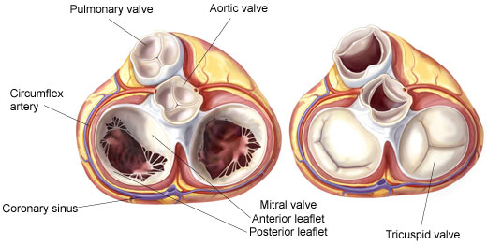

Slide 3
The mitral valve was the first of the four cardiac valves to be evaluated with echocardiography.
This was due to the relatively high prevalence of rheumatic heart disease and the relatively large excursion of the mitral valve leaflets, which made them an easier target for early M-mode techniques

Slide 4
The mitral valve has a triple function:
it regulates blood flow towards the left ventricle during diastole at low pressure gradient while preventing systolic backflow towards the left atrium
it contributes to the formation of the left ventricular outflow tract during systole and
its integrity is essential to maintain normal size, geometry and function of the left ventricle.

Slide 5
The mitral valve, located between the left atrium and left ventricle, is a functional complex that relies on normal morphology, geometrical relations and function of all its constituents: the left atrium, the mitral annulus, the mitral leaflets, the subvalvular apparatus (tendinous chords and papillary muscles) and the left ventricle.

Slide 6
It is important to recognize that the leaflets of the mitral valve constitute only a portion of the mitral valve apparatus and that diseases resulting in mitral dysfunction often are caused by abnormalities in the overall apparatus rather than in the actual leaflets.

Slide 7
Mitral Valve Morphology
Normal mitral valve function depends on perfect function and complex interaction between various structures
The broader concept of “mitral valve complex” allows a better characterization of both normal and abnormal valvular function.
Mitral annulus |  | Mitral valve | Mitral valve complex
Mitral leaflets
Chordae tendineae | Sub valvular apparatus
Papillary muscles
Left Ventricular wall
Left atrium

Slide 8
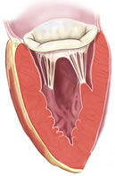
Five components
annulus
leaflets
commissures
chordae tendineae
papillary muscles

Slide 9
Mitral Valve Morphology
MITRAL ANNULUS
  The mitral annulus constitutes the anatomical junction between the LV and the LA, and serves as insertion site for the leaflet tissue.
  It is oval and saddle shaped.
  The mitral annulus is a fibrotic ring that consists of an anterior part and a posterior part

Slide 10
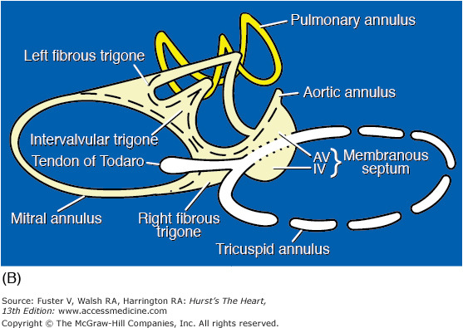

Slide 11
  The anterior portion of the mitral annulus is attached to the fibrous trigones and is generally more developed than the posterior annulus.
  The aortic-mitral curtain is a fibrous structure that connects the anterior mitral annulus intimately with the aortic valve annulus (at the level of the left and non-coronary cusps)
  The annulus is deficient anteriorly at the level of the aorto mitral curtain.

Slide 12
  The posterior part of the mitral annulus is not enforced and rather discontinuous (making it prone to dilatation)
  Both parts of annulus may dilate in pathological conditions
  The antero-posterior diameter forms the minor axis and the inter-commissural distance refers to the major axis

Slide 13
Assessment of mitral annular diameters
identifying the mechanism of valvular insufficiency,
is useful to determine the type of mitral valve intervention in case of dysfunction and
is of interest to size mitral valve prosthesis or annuloplasty ring.

Slide 14
Mitral Valve Morphology
MITRAL ANNULUS
  The anterior-posterior diameter can be measured using real-time 3D or by conventional 2D in the parasternal long-axis view.
  Conventionally, a parasternal long axis transthoracic view has been advocated for measuring minor annular diameter

Slide 15
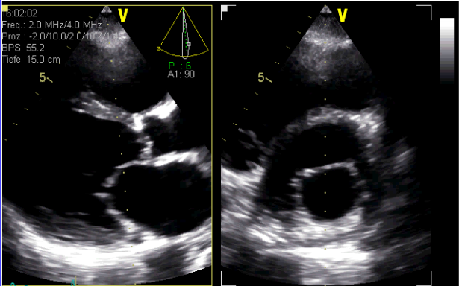

Slide 16
More appropriate measurement of the minor axis (antero-posterior diameter) of the mitral annulus can be performed at end-systole during transthoracic echocardiography in the apical long axis view (3-chamber view) or its transoesophageal equivalent, found at mid-oesophageal level with 135° tilt of the probe

Slide 17
The major axis (inter-commissural diameter) of the mitral annulus is found at a bicommissural 2-chamber transthoracic echocardiographic view (when P1-A2-P3 mitral leaflet scallops are visualized) or a mid-oesophageal bicommissural view at 45-60° during transoesophageal echocardiography

Slide 18
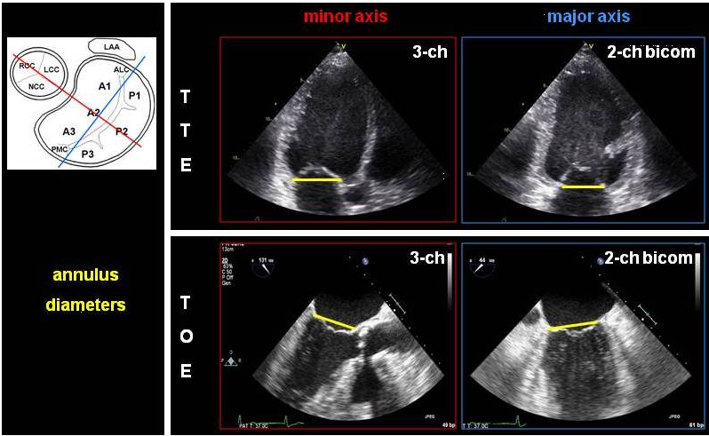

Slide 19
Mitral Valve Morphology
MITRAL ANNULUS
  The orifice at the level of the left AV junction is ovoidal with a longer intercommissural (IC) and a shorter septal-to-lateral axis (SL).
  Body-weight-corrected data are: 0.39-0.59 mm/kg for the IC and 0.32-0.48 mm/kg for the SL diameters respectively .
  However, dimensions are underestimated “in vivo” by 2D ECHO as compared by 3D ECHO and with MRI.
  Annular dilatation is present when
    the ratio annulus/anterior leaflet during diastole is >1.3
    the diameter is ≥ 35 mm

Slide 20
MITRAL ANNULUS
  The annulus depicts complex modifications during the cardiac cycle
  Annular flexion - a 23-40% variation in the annular circumference between the systolic and diastolic configuration
  Excursion Or Annular Descent - movement in apical-to-basal direction
  The Rotation represents the torque movement while the complex 3D modifications in shape are called, Folding of the annulus.
  All such modifications are reduced or disappear with the use of rigid annuloplasty rings, postoperative fibrosis or extensive reduction of the posterior annulus.

Slide 21
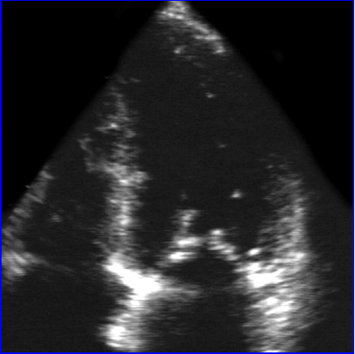
Mitral Valve Morphology
MITRAL ANNULUS
  Changes to be observed are
        Mitral annulus diameter
        Mitral annular motion
        Calcification
        Perivalvular Leak
        (Prosthetic Valves)

Slide 22
Mitral leaflets
The mitral valve consists of an anterior and posterior leaflet that converge at the posteromedial and anterolateral commissures
  Line of contact between leaf lets is termed as coaptation line
  Region of leaf let overlap is called zone of apposition

Slide 23
The largest part of the atrial floor is formed by the anterior mitral valve leaflet.
Normal leaflets are thin and pliable structures with a thickness <5 mm
Normal mitral valve area is 4 to 5 cm2

Slide 24
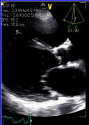
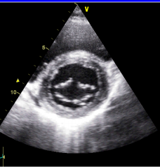
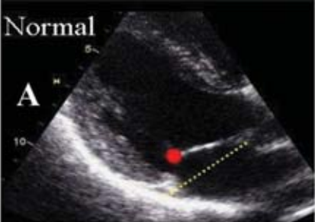
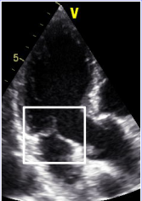
Mitral Valve Morphology
MITRAL VALVULAR LEAFLETS
Leaflets
Commisure
Coaptation line
Zone of
apposition

Slide 25
Mitral Valve Morphology
Posterior mitral leaf let
  The posterior leaflet has a quadrangular shape
  Attached to approximately two-thirds of the annular circumference.
  The posterior leaflet typically has two well defined indentations which divide the Leaflet into three individual scallops as P1,P2,P3.

Slide 26
  The P1 scallop corresponds to the external anterolateral portion of the posteror leaflet. close to the anterior commissure and the left atrium (LA) appendage.
  The P2 scallop medium and more developed.
  The P3 scallop is internal and close to posterior comissure and tricuspid annulus

Slide 27
Mitral Valve Morphology
Anterior mitral leaf let
  Anterior leaf let has semicircular shape
  Is in continuity with non coronary cusp of aortic valve
  The free edge of leaf let is not having any indentation but divided into three segments A1 A2 A3 corresponding to posterior leaf let

Slide 28
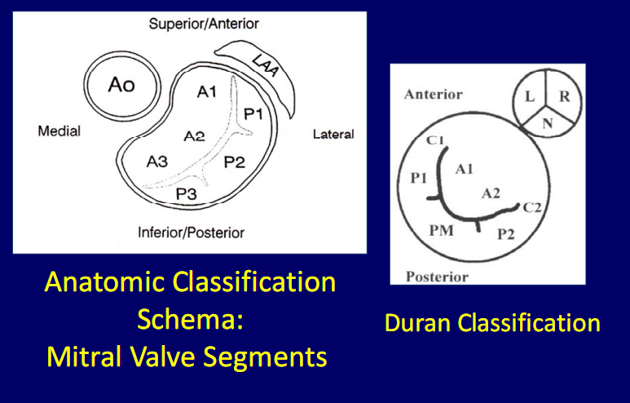

Slide 29
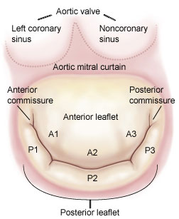

Slide 30
Mitral Valve Morphology
By Echocardiography,
  The presence and the extent of inadequate tissue
  Of excess leaflet tissue and the precise localization of the leaflet lesions should be analysed.
  Describing the mitral valve segmentation is particularly useful to precisely define the anatomical lesions and the prolapsing segments in patients with degenerative MR
    TEE still remains the recommended approach
    TTE predict accurately valve reparability.

Slide 31
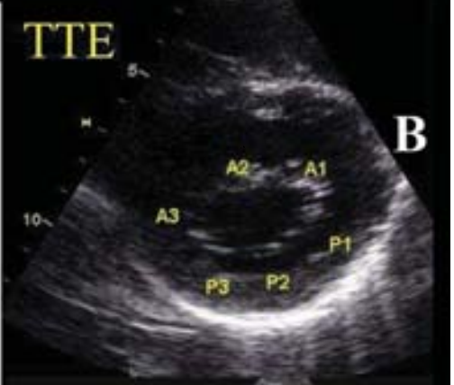
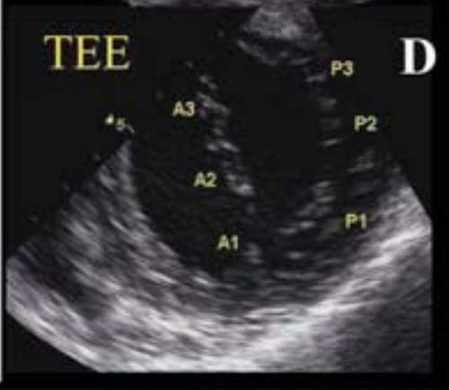
Mitral Valve Morphology
SCALLOP ANALYSIS
TTE - PSAX
TEE – TRANSGASTRIC VIEW IN 0

Slide 32
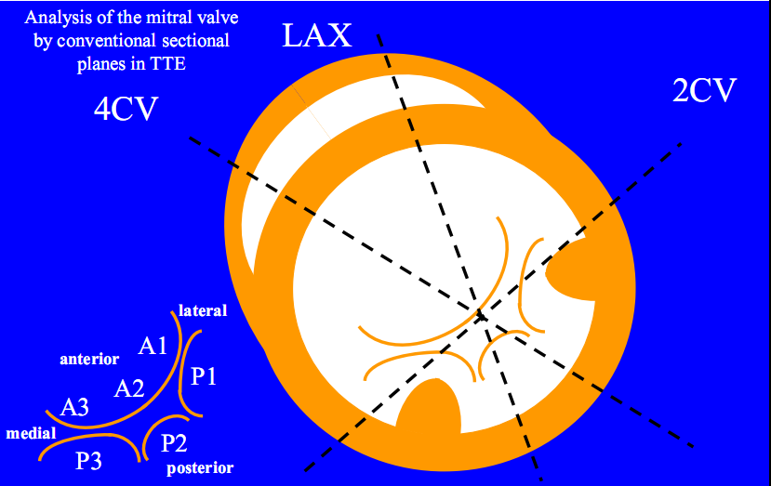
Mitral Valve Morphology
SCALLOP ANALYSIS BY TTE

Slide 33
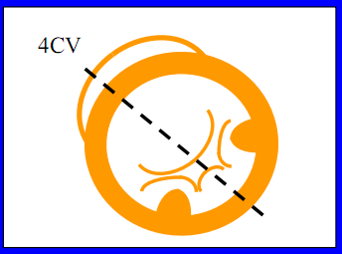
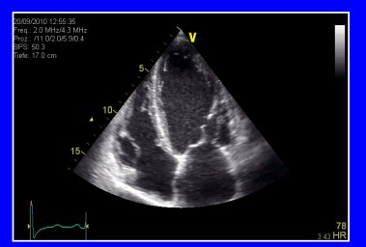
Mitral Valve Morphology
SCALLOP ANALYSIS BY TTE

Slide 34
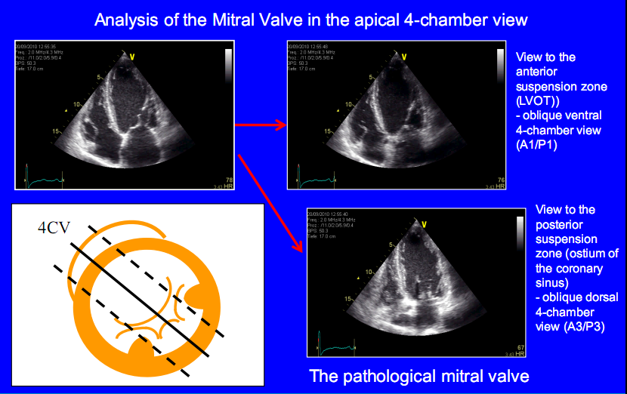
Mitral Valve Morphology
SCALLOP ANALYSIS BY TTE

Slide 35
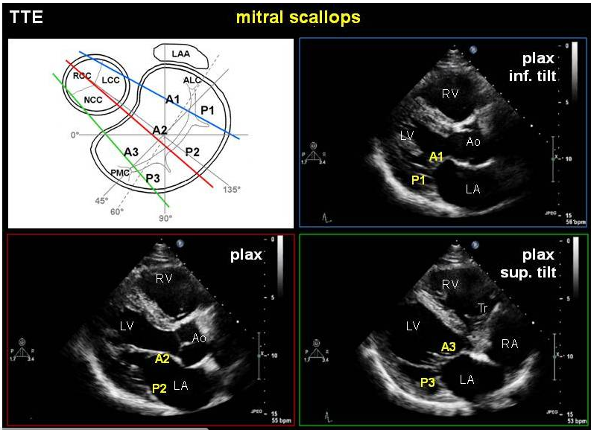

Slide 36
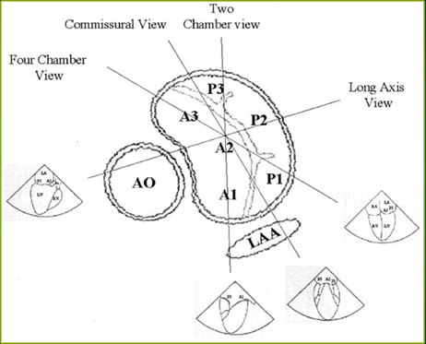
Mitral Valve Morphology
SCALLOP ANALYSIS BY TEE
Mid-esophageal 4C View
  A3 and A1
Commisural View
  P3-A2-P1
Two Chamber View
  P3-A1
Long Axis View
  A2
Transgastric Views (Short)
  Posteromedial commissure
  Anterolateral commissure
Transgastric Views (Long)
  Chordae Tendinae
  Papillary Muscle

Slide 37
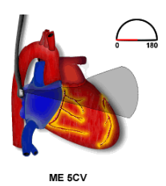
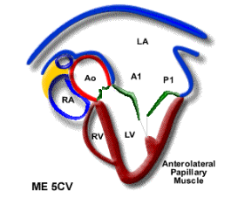
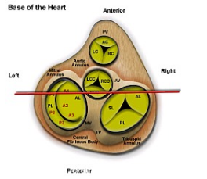
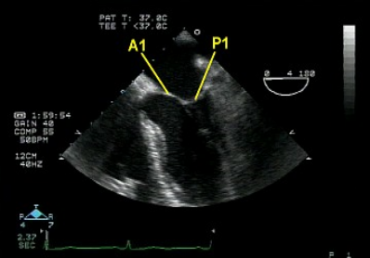
Mitral Valve Morphology
SCALLOP ANALYSIS BY TEE
ME 5CV - Anteriorly Directed

Slide 38
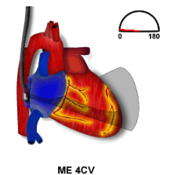
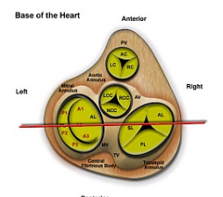
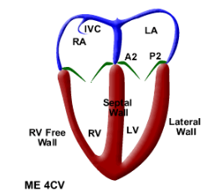
Mitral Valve Morphology
SCALLOP ANALYSIS BY TEE
ME 4CV - Neutrally Directed

Slide 39
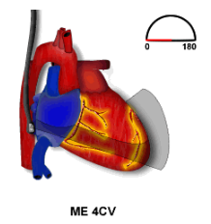
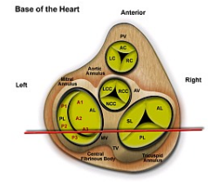
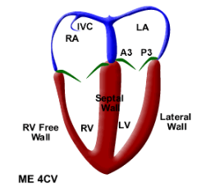
Mitral Valve Morphology
SCALLOP ANALYSIS BY TEE
ME 4CV - Posteroirly Directed

Slide 40
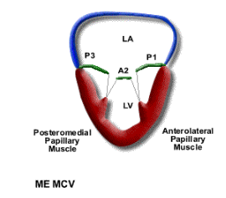
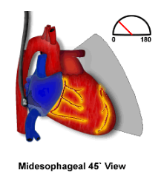
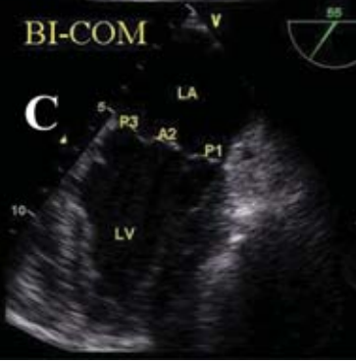
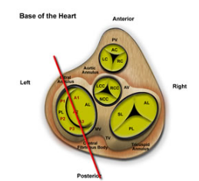
Mitral Valve Morphology
SCALLOP ANALYSIS BY TEE

Slide 41
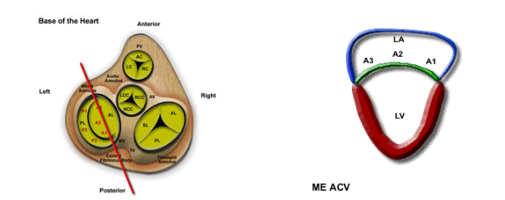
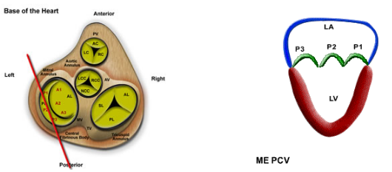
Mitral Valve Morphology
SCALLOP ANALYSIS BY TEE

Slide 42
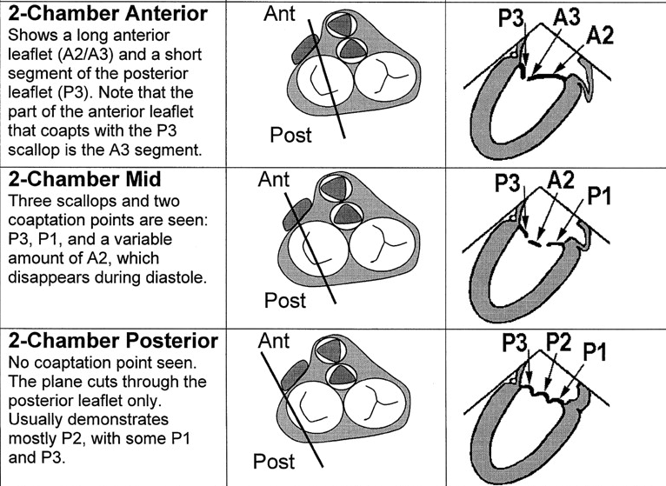
Mid-esophageal Views
(Transducer @ ~60°)

Slide 43
TEE is probably the method of choice
Multiple views are available which permit to precisely determine the localization and the extent of prolapse.
The 'en face' view seen from the LA perspective is identical to the surgical view in the operating room.
This view allows to perfectly analysing the extent of commissural fusion in rheumatic MR.

Slide 44
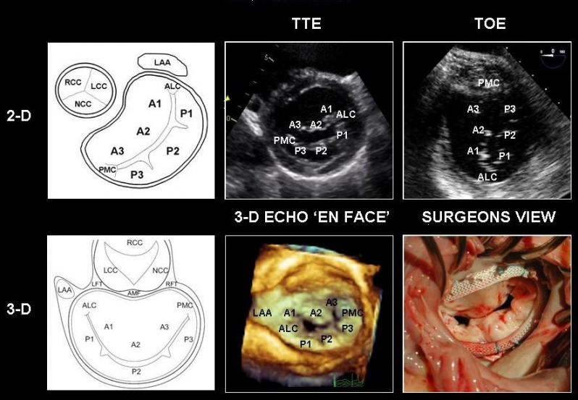

Slide 45
Chordae tendinae
  There are three sets of chordae arising from the papillary muscles. They are classified according to their site of insertion between the free margin and the base of leaflets.
  Marginal chordae (primary chordae) are inserted on the free margin of the Leaflets and function to prevent prolapse of the leaflet margin.

Slide 46
  Intermediate chordae (secondary chordae) insert on the ventricular surface of the leaflets and relieve valvular tissue of excess tension. Often two large secondary or ‘strut’ chordae can be individualized. They may be important in preserving ventricular shape and function.
  Basal chordae (tertiary chordae) are limited to the posterior leaflet and connect the leaflet base and mitral annulus to the papillary muscle.

Slide 47
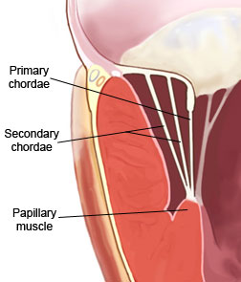

Slide 48
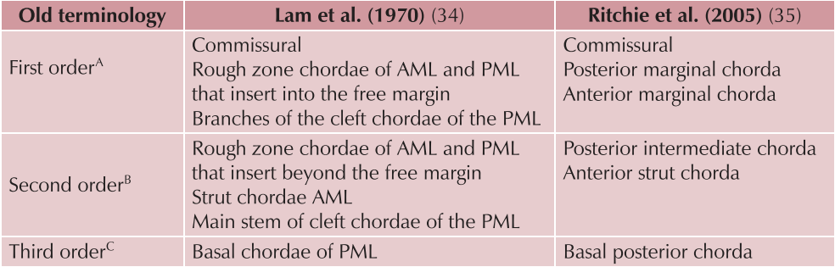
Mitral Valve Morphology
Chordae tendineae

Slide 49
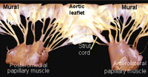

Slide 50
Commisural chordae arise from ALPM &PMPM and branch in a fan like fashion and insert onto both commisures .
These chordae divide about 3 times before their final attachments leading to around 120 chordal attachment to both leaflets .

Slide 51
Chordae tendineae
      Thickening
      Fusion
      Calcification
      Elongation
      Rupture

Slide 52
Papillary muscles
The papillary muscles of the LV are three types
1. Completely tethered papillary muscle: In this type papillary muscle was fully adherent to the subjacent ventricular myocardium and protruded very little into the ventricular cavity with few trabecular attachments.

Slide 53
  2. Finger like papillary muscle: in this type one third or more of the body of the papillary muscle protruded freely into the ventricular cavity with very few or no trabecular attachments.
  3. Mixed type papillary muscle: This papillary muscle had part of the body protruding freely into the ventricular cavity but also with considerable trabecular attachments and tethering.

Slide 54
The posteromedial PM gives chords to the medial half of both leaflets (i.e. posteromedial commissure, P3, A3 and half of P2 and A2). Similarly, the anterolateral PM chords attach to the lateral half of the MV leaflets (i.e. anterolateral commissure, A1,P1 and half of P2 and A2)

Slide 55
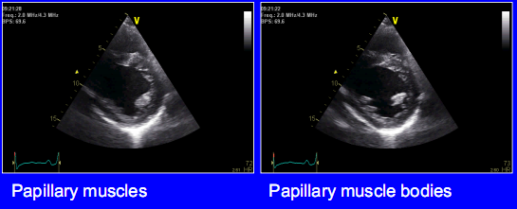
Mitral Valve Morphology
Papillary muscles
TTE - PSAX VIEW

Slide 56
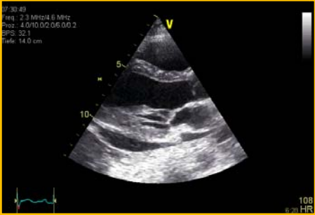
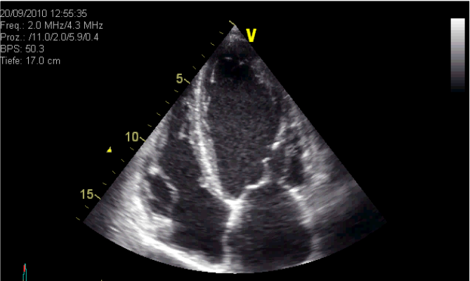
Mitral Valve Morphology
Papillary muscles
TTE - PLAX VIEW
TTE – APICAL 4C VIEW

Slide 57
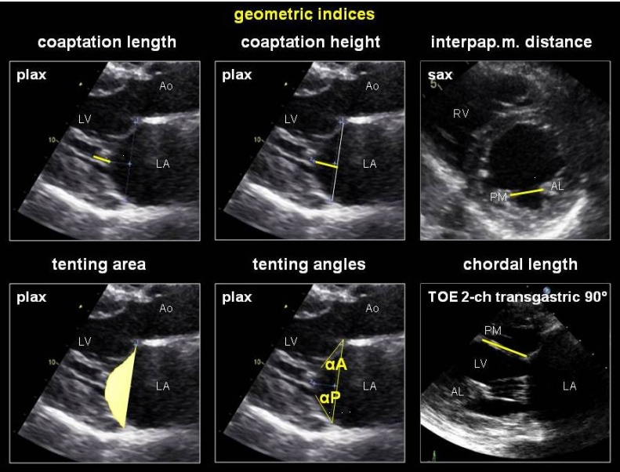
Mitral geometric indices

Slide 58
3 d echo
Real-time 3-dimensional echocardiography of the mitral valve allows easy identification of different anatomical segments of the mitral valve, including both commissures
The `en face` view of the mitral valve can be constructed and refers to exposure of the mitral valve from the atrial perspective, similar to the surgeons view during mitral valve surgery.

Slide 59
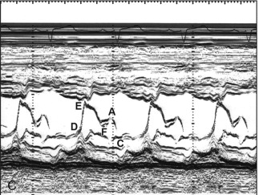
Normal mitral valve M mode

Slide 60
Thank you

