Slide 1
Ischemic Heart Disease
DR.KUNTAL PATEL
PATHOLOGY

Slide 2
Objectives:
INTRODUCTION
EPIDEMIOLOGY
PATHOGENESIS
TYPES
MORPHOLOGY
TREATMENT

Slide 3
Ischemic Heart Disease
IHD is the generic designation for a group of closely related syndromes resulting from myocardial ischemia—an imbalance between the supply (perfusion) and demand of the heart for oxygenated blood
Ischemia comprises not only insufficiency of oxygen, but also reduced availability of nutrient substrates and inadequate removal of metabolites

Slide 4
IHD
In more than 90% of cases, the cause of myocardial ischemia is reduction in coronary blood flow due to atherosclerotic coronary arterial obstruction. Thus, IHD is often termed coronary artery disease (CAD) or coronary heart disease.
The syndromes of IHD are only the late manifestations of coronary atherosclerosis that probably began during childhood or adolescence

Slide 5
IHD
The clinical manifestations of IHD can be divided into four syndromes:
Myocardial infarction (MI), the most important form of IHD, in which the duration and severity of ischemia is sufficient to cause death of heart muscle.
2.Angina pectoris, in which the ischemia is less severe and does not cause death of cardiac muscle. Of the three variants—stable angina, Prinzmetal angina, and unstable angina—the latter is the most threatening as a frequent harbinger of MI.
3.Chronic IHD with heart failure.
4.Sudden cardiac death.

Slide 6
Epidemiology.
IHD in its various forms is the leading cause of death for both males and females in the United States and other industrialized nations.
This decline is a spectacular achievement that has resulted primarily from
(1) prevention achieved by modification of determinants of risk, such as smoking, elevated blood cholesterol, hypertension, and a sedentary lifestyle
(2) diagnostic and therapeutic advances, allowing effective, and safer treatments, including new medications, coronary care units, thrombolysis for MI, percutaneous transluminal coronary angioplasty (PTCA), endovascular stents, coronary artery bypass graft (CABG) surgery, and improved control of arrhythmias.
Additional risk reduction may potentially be associated with maintenance of normal blood glucose levels in diabetic patients, control of obesity, and aspirin prophylaxis in middle-aged men

Slide 7
Pathogenesis.
The dominant cause of the IHD syndrome is insufficient coronary perfusion relative to the myocardial demand, due to chronic, progressive atherosclerotic narrowing of the epicardial coronary arteries, and variable degrees of superimposed acute plaque change, thrombosis and vasospasm.
The individual elements are discussed below:

Slide 8
CHRONIC ATHEROSCLEROSIS
More than 90% of patients with IHD have atherosclerosis of one or more of the coronary arteries. The clinical manifestations of coronary atherosclerosis are generally due to progressive encroachment of the lumen leading to stenosis (chronic, "fixed" obstructions) or to acute plaque disruption with thrombosis (generally both sudden and dynamic), which compromises blood flow.

Slide 9
Contd….
A fixed obstructive lesion of 75% or greater generally causes symptomatic ischemia induced by exercise; with this degree of obstruction, the augmented coronary flow provided by compensatory vasodilation is no longer sufficient to meet even moderate increases in myocardial demand.
A 90% stenosis can lead to inadequate coronary blood flow even at rest. Slowly developing occlusions may stimulate collateral vessels over time, which protect against distal myocardial ischemia and infarction even with an eventual high-grade stenosis.

Slide 10
CONTD…
Although only a single major coronary epicardial trunk may be affected, two or all three—lateral anterior descending (LAD), left circumflex (LCX), and right coronary artery (RCA)—are often involved.
Sometimes the major secondary epicardial branches are also involved (i.e., diagonal branches of the LAD, obtuse marginal branches of the LCX, or posterior descending branch of the RCA), but atherosclerosis of the intramural branches is rare.

Slide 11
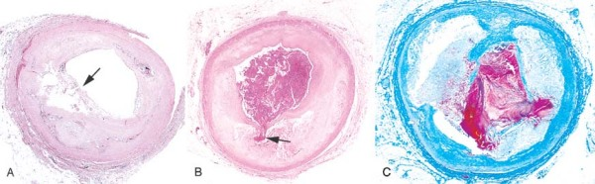
Role of Acute Plaque Change.
In most patients the myocardial ischemia underlying unstable angina, acute MI, and (in many cases) sudden cardiac death is precipitated by abrupt plaque change followed by thrombosis .Thus, these important manifestations are termed the acute coronary syndromes. Most often, the initiating event is disruption of previously only partially stenosing plaques with any of the following:
Rupture/fissuring, exposing the highly thrombogenic plaque constituents
Erosion/ulceration, exposing the thrombogenic subendothelial basement membrane to blood
Hemorrhage into the atheroma, expanding its volume.
Figure Atherosclerotic plaque rupture. A, Plaque rupture without superimposed thrombus, in patient who died suddenly. B, Acute coronary thrombosis superimposed on an atherosclerotic plaque with focal disruption of the fibrous cap, triggering fatal myocardial infarction. C, Massive plaque rupture with superimposed thrombus, also triggering a fatal myocardial infarction.

Slide 12
The structure and composition of a plaque are dynamic and contribute to a propensity to disruption. Plaques that contain large areas of foam cells and extracellular lipid, and those in which the fibrous caps are thin or contain few smooth muscle cells or have clusters of inflammatory cells, are more likely to rupture, and are therefore called "vulnerable plaques.“
The balance of synthetic and degradative activity of collagen, the major structural component of the fibrous cap, accounts for its mechanical strength and determines plaque stability and prognosis.
Collagen is produced by smooth muscle cells and degraded by the action of metalloproteinases, enzymes elaborated by macrophages in atheroma.
Thus, there is considerable evidence that inflammation destabilizes the mechanical integrity of plaques . Moreover, drugs such as statins (inhibitors of HMG Co-A reductase, a key enzyme in the synthesis of cholesterol) that reduce clinical events associated with IHD, are thought to stabilize plaques by their lipid-lowering effect, as well as by reducing plaque inflammation

Slide 13
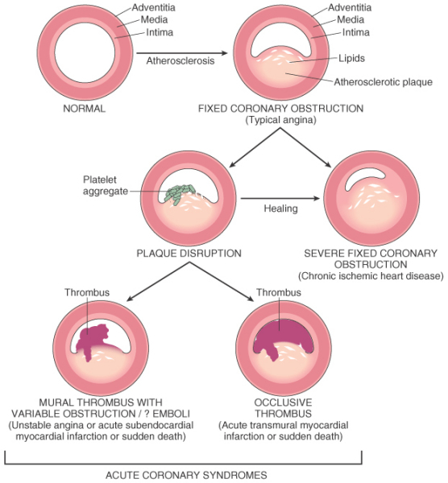

Slide 14
CONSEQUENCES OF MI
Stable angina results from increase in myocardial oxygen demand that outstrip the ability of stenosed coronary artery to increase oxygen delivery
Unstable angina is caused by plaque rupture complicated by partially occlusive thrombosis and vasoconstriction
Sudden cardiac death due to disrupted plaque causing regional myocardial ischaemia that causes ventricular arrthymia

Slide 15
ANGINA PECTORIS
AP is characterised by paroxysmal and usually recurrent attacks of substernal or precordial chest discomfort caused by transient myocardial ischaemia that falls short of inducing myocyte necrosis.
3 types- stable angina
- prinzmetal variant angina
- unstable cresendo angina

Slide 16
STABLE ANGINA
Most common form
Caused by an imbalance in coronary perfusion relative to myocardial demand
Usually relived by rest or administering a strong vasodilator

Slide 17
PRINZMETAL VARIANT ANGINA
Uncommon form of episodic myocardial ischemia that caused by coronary artery spasm
Although individual with PA may have significant atherosclerosis the anginal attacks are unrelated to physical activity, heart rate or blood pressure
Responds to vasodilators

Slide 18
UNSTABLE/ CRESENDO ANGINA
Pattern of increasingly frequent pain, often prolonged duration, that is precipated by progressively lower levels of physical inactivity or that even occurs at rest
Caused by disruption of an atherosclerotic plaque with superimposed partial thrombosis and possibly embolization or vasospasm

Slide 19
MYOCARDIAL INFARCTION
MI, also known as "heart attack," is the death of cardiac muscle due to prolonged severe ischemia.
MI frequency increases with increasing age
Premenopausal women are by far more protected from MI

Slide 20
PATHOGENESIS OF MI
CORONARY ARTERY OCCULUSION
Following are the sequence of events:
Sudden change in atheromatous plaque- intraplaque hemorrhage, erosion, ulceration, rupture or fissuring
When exposed to subendothelial collagen and necrotic plaque contents, platelets adhere, become activated, release their granule contents and aggeregate to form microthrombi

Slide 21
CONTD…..
Vasospasm is stimulated by mediators released from platelets
Tissue factor activates the coagulation pathway, adding to the bulk of the thrombus
Frequently within minutes, the thrombus evolves to completely occlude the lumen of the vessel

Slide 22
Contd…
In approx. 10% cases transmural infarcts occur in absence of typical coronary vascular pathology. The reduced coronary flow in such cases is due to:
Vasospasm with or without atheroscleosis perhaps in association with plt aggregation
Emboli from lt atrium
Ishaemia without detectable coronary atherosclerosis & thrombosis may be caused by disorders of small intramural coronary vessels

Slide 23
MYOCARDIAL RESPONSE
The principal early biochemical consequence of myocardial ischemia is the cessation of aerobic glycolysis (and therefore initiating anaerobic glycolysis) within seconds, leading to inadequate production of high-energy phosphates (e.g., creatine phosphate and adenosine triphosphate) and accumulation of potentially noxious breakdown products (such as lactic acid). Myocardial function is exceedingly sensitive to severe ischemia; striking loss of contractility occurs within 60 seconds of onset of ischemia. This can precipitate acute heart failure long before myocardial cell death.

Slide 24
Nevertheless, these early changes are potentially reversible, and cell death is not immediate. As demonstrated experimentally, only severe ischemia lasting at least 20 to 40 minutes or longer leads to irreversible damage (necrosis) of some cardiac myocytes. Ultrastructural evidence of irreversible myocyte injury (primary structural defects in the sarcolemmal membrane) develops only after 20 to 40 minutes in severely ischemic myocardium (with blood flow of 10% or less of normal)

Slide 25
Approximate Time of Onset of Key Events in Ischemic Cardiac Myocytes
Feature Time
Onset of ATP depletion Seconds
Loss of contractility <2 min
ATP reduced
to 50% of normal 10 min
to 10% of normal 40 min
Irreversible cell injury 20–40 min
Microvascular injury >1 hr

Slide 26
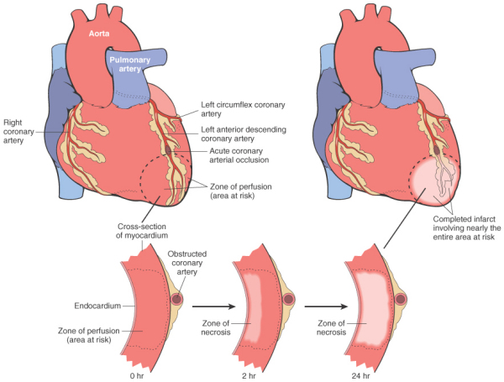

Slide 27
Specific morphologic features of an acute myocardial infarct depend on:
The location, severity, and rate of development of coronary atherosclerotic obstructions
The size of the vascular bed perfused by the obstructed vessels
The duration of the occlusion
The metabolic/oxygen needs of the myocardium at risk
The extent of collateral blood vessels
The presence, site, and severity of coronary arterial spasm
Other factors, such as alterations in blood pressure, heart rate, and cardiac rhythm.

Slide 28


MI - Types
Transmural
Full thickness
Superimposed thrombus in atherosclerosis
Focal damage
Sub-endocardial
Inner 1/3 to half of ventricular wall
Decreased circulating blood volume( shock, Hypotension, Lysed thrombus)
Circumferential

Slide 29
FREQUENCIES OF INVOLVEMENT OF ARTERIES
LEFT ANTERIOR DESCENDING – 40-50 %
RIGHT CORONARY ARTERY- 30- 40%
LEFT CIRCUMFLEX ARTERY- 15-20%

Slide 30
Evolution of Morphologic Changes in Myocardial Infarction
Time |  | Gross Features |  | Light Microscope | Electron Microscope
Reversible Injury
0–½ hr |  | None |  | None | Relaxation of myofibrils; glycogen loss; mitochondrial swelling
Irreversible Injury
½–4 hr | None |  | Usually none; variable waviness of fibers at border |  | Sarcolemmal disruption; mitochondrial amorphous densities
4–12 hr | Occasionally dark mottling |  | Beginning coagulation necrosis; edema; hemorrhage
12–24 hr | Dark mottling |  | Ongoing coagulation necrosis; pyknosis of nuclei; myocyte hypereosinophilia; marginal contraction band necrosis; beginning neutrophilic infiltrate

Slide 31
1–3 days | Mottling with yellow-tan infarct center | Coagulation necrosis, with loss of nuclei and striations; interstitial infiltrate of neutrophils
3–7 days | Hyperemic border; central yellow-tan softening | Beginning disintegration of dead myofibers, with dying neutrophils; early phagocytosis of dead cells by macrophages at infarct border
7–10 days | Maximally yellow-tan and soft, with depressed red-tan margins | Well-developed phagocytosis of dead cells; early formation of fibrovascular granulation tissue at margins
10–14 days | Red-gray depressed infarct borders | Well-established granulation tissue with new blood vessels and collagen deposition
2–8 wk | Gray-white scar, progressive from border toward core of infarct | Increased collagen deposition, with decreased cellularity
>2 mo | Scarring complete | Dense collagenous scar

Slide 32
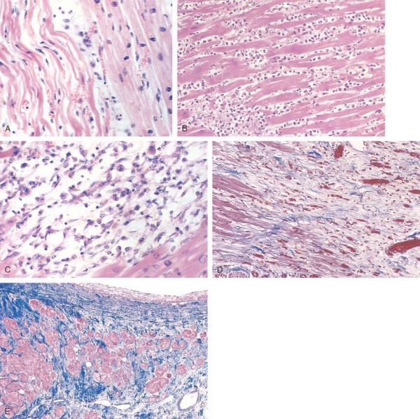
Microscopic features A, One-day-old infarct showing coagulative necrosis along with wavy fibers compared with adjacent normal fibers . B, Dense polymorphonuclear leukocytic infiltrate in area of acute myocardial infarction of 3 to 4 days' duration. C, Nearly complete removal of necrotic myocytes by phagocytosis . D, Granulation tissue characterized by loose collagen and abundant capillaries. E, Well-healed myocardial infarct with replacement of the necrotic fibers by dense collagenous scar. A few residual cardiac muscle cells are present.

Slide 33
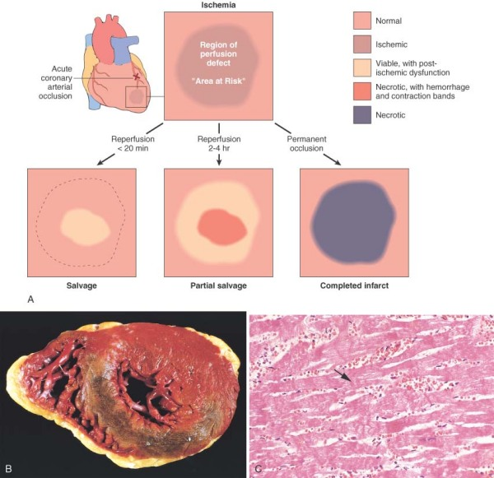
INFARCT MODIFICATION BY REPERFUSION
B, Gross and C, microscopic appearance of myocardium modified by reperfusion. B, Large, densely hemorrhagic, anterior wall acute myocardial infarction from patient with left anterior descending artery thrombus treated with streptokinase intracoronary thrombolysis (triphenyl tetrazolium chloride-stained heart slice). C, Myocardial necrosis with hemorrhage and contraction bands, visible as dark bands spanning some myofibers (arrow). This is the characteristic appearance of markedly ischemic myocardium that has been reperfused

Slide 34
CLINICAL FEATURES
MI PATIENTS PRESENTS WITH RAPID, WEAK PULSE AND PROFUSE SWEATING
DYSPNEA DUE TO IMPAIRED CONTRACTION RESULTING IN PULMONARY CONGESTION AND EDEMA

Slide 35
LABORATORY EVALUATION
MYOGLOBIN- EARLIEST MARKER TO RISE
CARDIAC TROPONIN T AND I- MOST SENSITIVE AND SPECIFIC
BOTH BEGIN TO RISE BY 2-4 HRS AND PEAK AT 48 HRS
CK- MB- SENSITIVE BUT NOT SPECIFIC
BEGINS TO RISE WITHIN 2-4 HRS OF ONSET OF MI, PEAKS AT 24 HRS AND RETURNS TO NORMAL WITHIN 72 HRS
LACTATE DEHYDROGENASE

Slide 36
COMPLICATIONS AND CONSEQUENCES OF MI
CONTRACTILE DYSFUNCTION
ARRHYTHMIAS
MYOCARDIAL RUPTURE- DUE TO SOFTENING AND WEAKENING OF THE NECROTIC AND SUBSEQUENTLY INFLAMED MYOCARDIUM
PERICARDITIS
RIGHT VENTRICULAR INFARCTION
INFARCT EXTENSION

Slide 37
CONTD…
INFARCT EXPANSION
MURAL THROMBUS
VENTRICULAR ANEURYSM
PAPILLARY MUSCLE DYSFUNCTION
PROGRESSIVE LATE HEART FAILURE

Slide 38
CONTD..
IN ADDITION TO THE SEQUENCE OF REPAIR OF INFARCTED TISSUE, THE NON INFARCTED SEGMENTS OF VENTRICLE UNDERGO DILATATION AND HYPERTROPHY
THIS COLLECTIVELY IS KNOWN AS VENTRICULAR REMODELLING

Slide 39
CHRONIC IHD
USED HERE TO DESCRIBE PROGRESSIVE HEART FAILURE AS A CONSEQUENCE OF ISCHAEMIC MYOCARDIAL DAMAGE
AKA ISCHEMIC CARDIOMYOPATHY
USUALLY APPEARS POSTINFARCTION DUE TO FUNCTIONAL DECOMPENSATION OF HYPERTROPHIED NON INFARCTED MYOCARDIUM

Slide 40
MORPHOLOGY OF CHRONIC IHD
HEARTS FROM PT. ARE USUALLY ENLARGED AND HEAVY DUR TO LT. VENTRICULAR HYPERTROPHY
MURAL ENDOCARDIUM HAVE PATCHY, FIBROUS THICKENINGS AND MURAL THROMBI
MICROSCOPICALLY- MYOCARDIAL HYPERTROPHY, DIFFUSE SUBENDOCARDIAL VACUOLIZATION AND FIBROSIS

Slide 41
SUDDEN CARDIAC DEATH
DEFINED AS UNEXPECTED DEATH FROM CARDIAC CAUSES IN INDIVIDUALS WITHOUT SYMPTOMATIC HEART DISEASE
CAUSES: 1. ATHEROSCLEROTIC CAUSES- ACUTE MI
2. NON ATHEROSCLEROTIC CONDITIONS

Slide 42
NON ATHERSCLEROTIC CONDITIONS
Congenital structural or coronary arterial abnormalities
Aortic valve stenosis
Mitral valve prolapsed
Myocarditis
Dilated or hypertrophic cardiomyopathy
Pulmonary hypertension
Hereditary or acquired abnormalities of the cardiac conduction system
Isolated hypertrophy, hypertensive or unknown cause.

Slide 43
THUS DEATHS IN ARE RESULT OF MYOCARDIAL ISCHEMIA INDUCED IRRITABILITY THAT INITIATES VENTRICULAR ARRHYTHMIAS.

Slide 44
William R. Lewis, A. Gray Ellrodt, Eric Peterson, Adrian F. Hernandez, Kenneth A. LaBresh,
Christopher P. Cannon, Wenqin Pan, and Gregg C. Fonarow.
Circ Cardiovasc Qual Outcomes. 2009;2:633-641
TITLE OF STUDY AND DESIGN | NAME OF AUTHOR | AIM | RESULT | CONCLUSION
Trends in the Use of Evidence-Based Treatments for Coronary Artery Disease Among Women and the Elderly LEVEL I | William R. Lewis, A. Gray Ellrodt, Eric Peterson, Adrian F. Hernandez, Kenneth A. LaBresh, Christopher P. Cannon, Wenqin Pan, and Gregg C. Fonarow | Significant disparities have been reported in the application of evidence-based guidelines in the treatment of coronary artery disease (CAD) in women and the elderly. We hypothesized that participation in a quality-improvement program could improve care for all patients and thus narrow treatment gaps over time. | The authors suggest that quality-improvement programs can improve adherence to guidelines among women and the elderly nearly eliminating treatment gaps. The authors offer new information about the opportunities for improvement in adherence that are larger with measures such as lipid lowering therapy, angiotensin-converting enzyme inhibitor treatment, and tobacco cessation counseling compared to other individual guidelines such as aspirin and β-blocker treatment. | Among hospitals participating in Get With the Guidelines–CAD, guideline adherence has improved substantially over time for both women and men and younger and older CAD patients, with only slight age and sex differences in some measures persisting.

Slide 45
MCQ
Which of the following is less likely to be a manifestations of ischemic heart disease
A. Myocardial infarction
B. Chronic ischemic heart disease
C. Sudden cardiac death
D. Myocarditis
E. Angina pectoris

Slide 46
MCQ
Kussmaul’s sign is seen in:
i.) Constrictive pericarditis
ii.) Right-sided heart failure
iii.) Obstruction of superior vena cava
iv.) Tricuspid stenosis
v.) Hypertrophic cardiomyopathy

Slide 47
MCQ
Causes of imbalance between myocardial oxygen supply and demand include:
i.) Atherosclerotic coronary artery disease
ii.) Coronary artery spasm
iii.) Aortic stenosis
iv.) Dilated cardiomyopathy
v.) Buerger’s disease

Slide 48
THANK YOU

