Slide 1
CARDIAC RESUSCITATION
BY
Dr. jayesh Rawal
Professor
Department of Cardiology
SBKS MI & RC

Slide 2
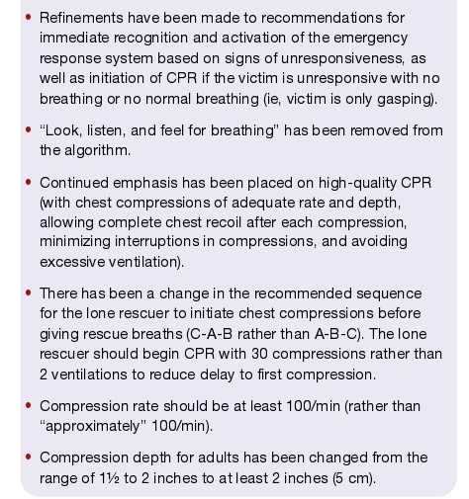
Cardiac resuscitation
AHA
GUIDELINES
2010:
CPR ECC
Dr Vijay Bang

Slide 3
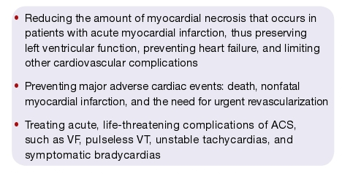
CARDIAC RESUSCITATION
AHA GUIDELINES 2010:
CPR ECC
Dr Vijay Bang

Slide 4
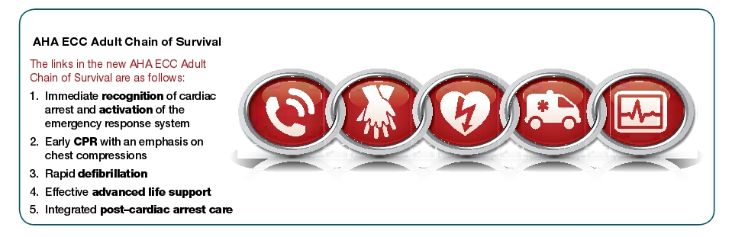
CARDIAC RESUSCITATION
AHA GUIDELINES 2010:
CPR ECC
Dr Vijay Bang

Slide 5
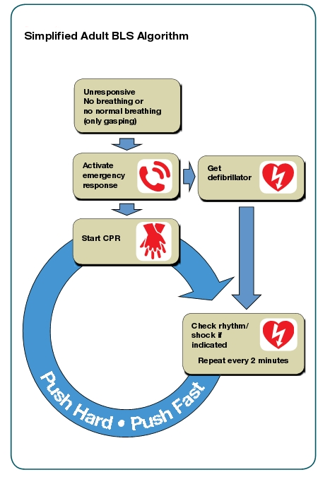
CARDIAC RESUSCITATION
AHA
GUIDELINES
2010:
CPR ECC
Dr Vijay Bang

Slide 6
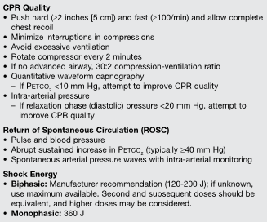
ACLS
Dr Vijay Bang

Slide 7
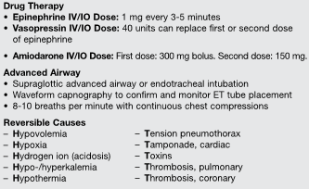
ACLS
Dr Vijay Bang

Slide 8
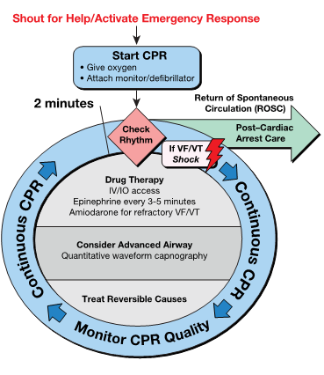
CARDIAC RESUSCITATION
ACLS
Dr Vijay Bang

Slide 9
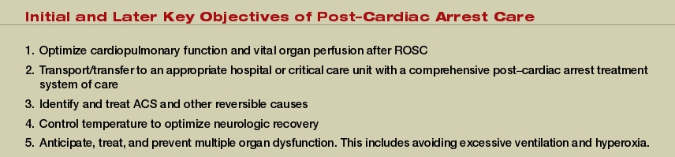
CARDIAC RESUSCITATION
Dr Vijay Bang

Slide 10
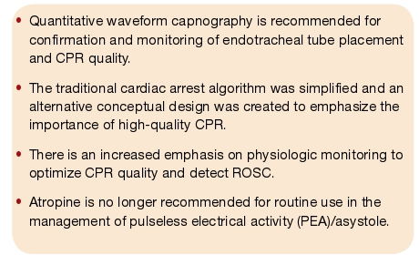
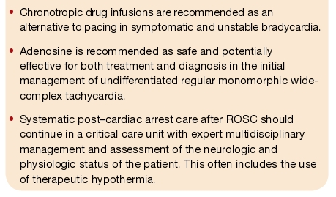
SUMMARY
CPR ECC
Dr Vijay Bang

Slide 11


