Slide 1
INFECTIVE ENDOCARDITIS AND RHD
DR. KUNTAL PATEL

Slide 2
INFECTIVE ENDOCARDITIS
Infective endocarditis (IE) is a infection characterized by colonization or invasion of the heart valves or the mural endocardium by a microbe.
leads to the formation of vegetations composed of thrombotic debris and organisms, often associated with destruction of the underlying cardiac tissues.
The aorta, aneurysmal sacs, other blood vessels, and prosthetic devices can also become infected.
most cases are caused by bacterial infections (bacterial endocarditis).

Slide 3
It classified into acute and subacute forms.
Acute infective endocarditis is typically caused by infection of a previously normal heart valve by a highly virulent organism that produces necrotizing, ulcerative, destructive lesions.
These infections are difficult to cure with antibiotics and usually require surgery.
Death within days to weeks ensues in many patients with acute IE, despite treatment.

Slide 4
In subacute IE the organisms are of lower virulence.
These organisms cause insidious infections of deformed valves that are less destructive and cures with antibiotics.

Slide 5
Etiology and Pathogenesis.
Endocarditis is caused most commonly (50% to 60% of cases) by Streptococcus viridans, which is part of the normal flora of the oral cavity.
More virulent S. aureus organisms commonly found on the skin can infect either healthy or deformed valves and are responsible for 10% to 20% of cases; S. aureus is the major offender in intravenous drug abusers with IE.
Other remaining bacteria includes enterococci so-called HACEK group (Haemophilus, Actinobacillus, Cardiobacterium, Eikenella, and Kingella).

Slide 6
Cont.
Prosthetic valve endocarditis is caused most commonly by coagulase-negative staphylococci (e.g., S. epidermidis).
Other agents causing endocarditis include gram-negative bacilli and fungi.
In about 10% to 15% of all cases of endocarditis, no organism can be isolated from the blood (“culture-negative” endocarditis).
The factors predisposing the endocarditis are
from a dental or surgical procedure
a contaminated needle shared by intravenous drug users
breaks in the epithelial barriers of the gut, oral cavity, or skin.

Slide 7
Morphology
The hallmark of IE is the presence of friable, bulky, potentially destructive vegetations containing fibrin, inflammatory cells, and bacteria or other organisms on the heart valves.
The aortic and mitral valves are the most common sites of infection.
The vegetations may be single or multiple and may involve more than one valve.
Vegetations sometimes erode into the underlying myocardium and produce an abscess (ring abscess).

Slide 8
Cont.
Emboli may be shed from the vegetations, abscesses often develop at the sites where the emboli lodge, leading to sequelae such as septic infarcts or mycotic aneurysms.
The vegetations of subacute endocarditis are associated with less valvular destruction than those of acute endocarditis.
Microscopically, the vegetations of typical subacute IE often have granulation tissue indicative of healing at their bases. With time, fibrosis, calcification, and a chronic inflammatory infiltrate can develop.

Slide 9
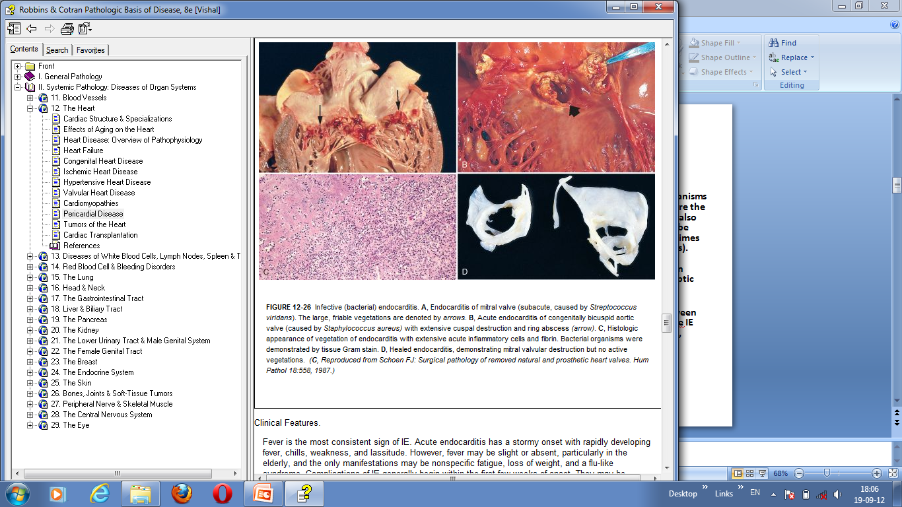

Slide 10
Clinical Features.
Fever is the most common sign of IE.
Acute endocarditis has a stormy onset with rapidly developing fever, chills, weakness, and lassitude.
fever may be slight or absent with fatigue, loss of weight, and a flu-like syndrome in the elderly .
Complications of IE begin within the first few weeks of onset.
For example: glomerulonephritis caused by the deposition of antigen-antibody complexes.
Murmurs are present in 90% of patients.

Slide 11
Earlier diagnosis and treatment has eliminated some previously common clinical manifestations of IE.
For Example:
1. micro-thromboemboli (manifest as subungual hemorrhages),
2. erythematous or hemorrhagic nontender lesions on the palms or soles (Janeway lesions),
3. subcutaneous nodules in the pulp of the digits (Osler nodes),
4. retinal hemorrhages in the eyes (Roth spots).

Slide 12
Diagnostic Criteria for Infective Endocarditis
Diagnosis by these guidelines, often called the Duke Criteria, requires either pathologic or clinical criteria; if clinical criteria are used,
2 major,
1 major + 3 minor, or
5 minor criteria are required for diagnosis.

Slide 13
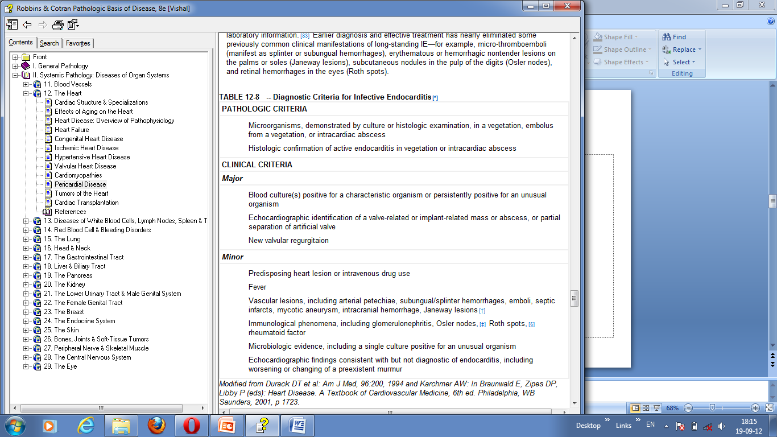
Diagnostic Criteria for Infective Endocarditis

Slide 14
NONINFECTED VEGETATIONS
Noninfected (sterile) vegetations are caused by nonbacterial thrombotic endocarditis and the endocarditis of systemic lupus erythematosus (SLE), called Libman-Sacks endocarditis
Nonbacterial Thrombotic Endocarditis (NBTE)
NBTE is characterized by the deposition of small sterile thrombi on the leaflets of the cardiac valves.
The lesions are 1 mm to 5 mm in size, and occur singly or multiply along the line of closure of the leaflets or cusps.
Histologically they are composed of bland thrombi that are loosely attached to the underlying valve.
The vegetations are not invasive and do not elicit any inflammatory reaction but they may be the source of systemic emboli that produce infarcts in the brain, heart, or elsewhere.

Slide 15
Cont.
NBTE is often encountered in debilitated patients, like in cancer or sepsis—hence also called as marantic endocarditis.
It occurs with deep venous thromboses, pulmonary emboli and systemic hypercoagulable state.
Endocardial trauma by an indwelling catheter, is predisposing condition of right-sided valvular and endocardial thrombotic lesions.

Slide 16
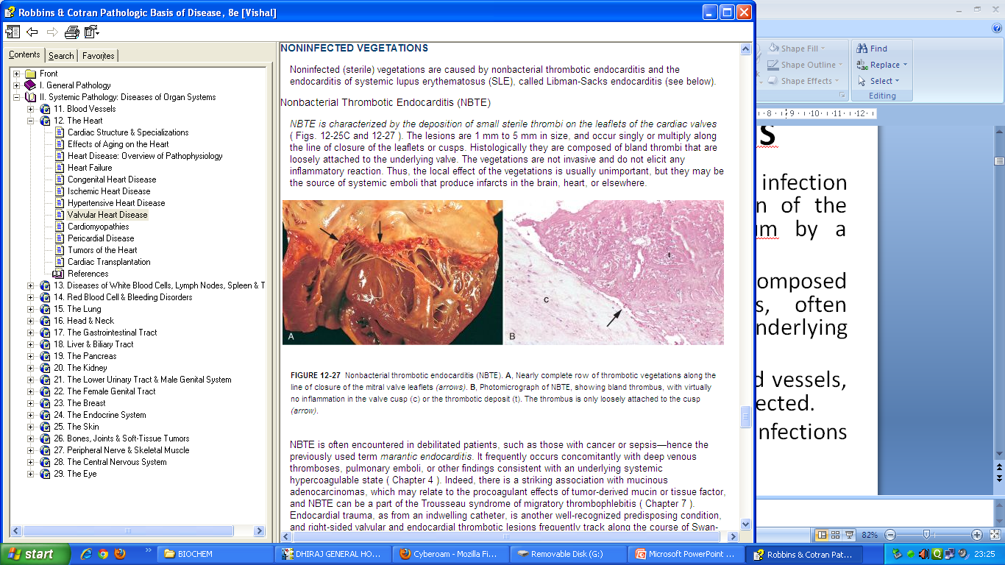

Slide 17
Endocarditis of Systemic Lupus Erythematosus (Libman-Sacks Disease)
Mitral and tricuspid valvulitis with small, sterile vegetations, called Libman-Sacks endocarditis, is occasionally encountered in SLE.
The lesions are small (1–4 mm in diameter) single or multiple, sterile, pink vegetations that often have a warty (verrucous) appearance.
They may be located on the undersurfaces of the atrioventricular valves, on the valvular endocardium, on the chords, or on the mural endocardium of atria or ventricles.

Slide 18
Cont.
Histologically the vegetations consist of a finely granular, fibrinous eosinophilic material that may contain hematoxylin bodies, homogeneous remnants of nuclei damaged by anti-nuclear antigen bodies.
An intense valvulitis may be present, characterized by fibrinoid necrosis of the valve substance.
Thrombotic heart valve lesions with sterile vegetations or rarely fibrous thickening commonly occur with the antiphospholipid syndrome , which can also lead to a hypercoagulable state.
The mitral valve is more frequently involved than the aortic valve.

Slide 19
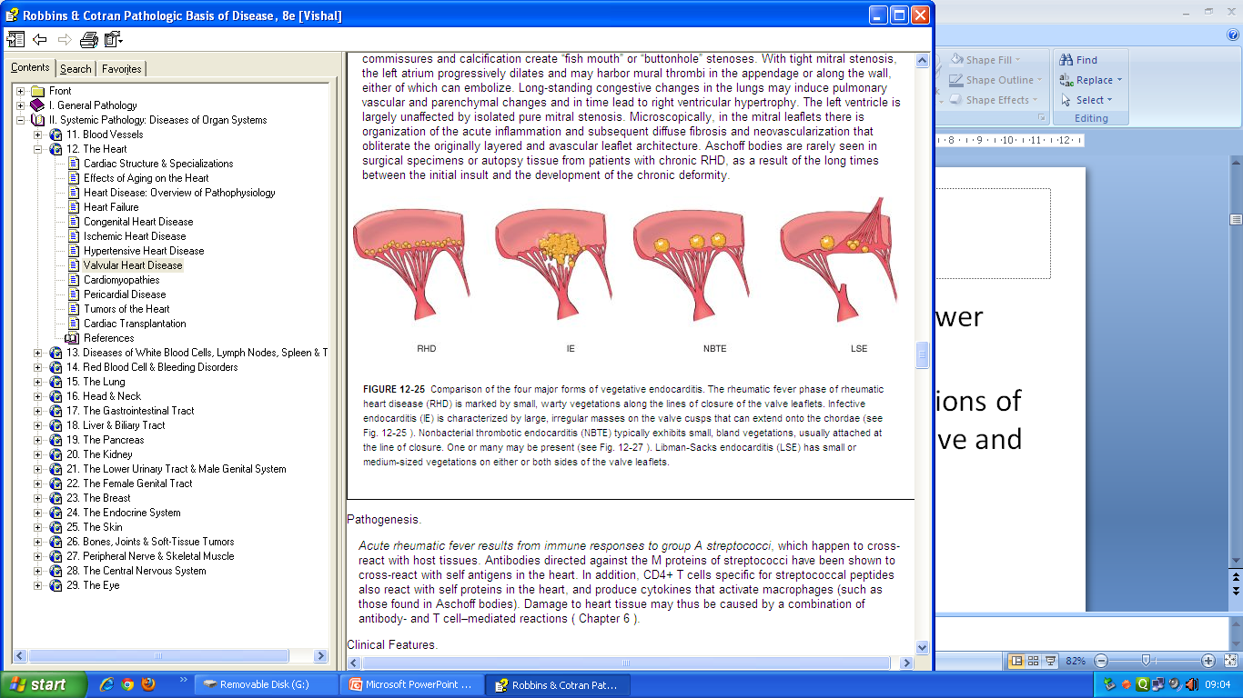

Slide 20
COMPLICATIONS OF ARTIFICIAL VALVES
Replacement of damaged cardiac valves with prostheses is a common and often lifesaving mode of therapy.
Artificial valves are primarily of two types:
(1) mechanical prostheses, consisting of different kinds of rigid mechanical valves, such as caged balls, tilting disks, or hinged semicircular flaps that are composed of nonphysiologic material
(2) tissue valves, usually bioprostheses, consisting of chemically treated animal tissue, especially porcine aortic valve tissue, which has been preserved in a dilute glutaraldehyde solution and subsequently mounted on a prosthetic frame.
Tissue valves are flexible and function similarly to natural semilunar valves.

Slide 21
Complications
60% of substitute valve recipients develop a serious prosthesis-related problem within 10 years
Thrombosis/thromboembolism
Anticoagulant-related hemorrhage
Prosthetic valve endocarditis
Structural deterioration (intrinsic) Wear - Wear, fracture, poppet failure in ball valves, cuspal tear, calcification
Other forms of dysfunction - Inadequate healing (paravalvular leak), exuberant healing (obstruction), disproportion, hemolysis, noise

Slide 22
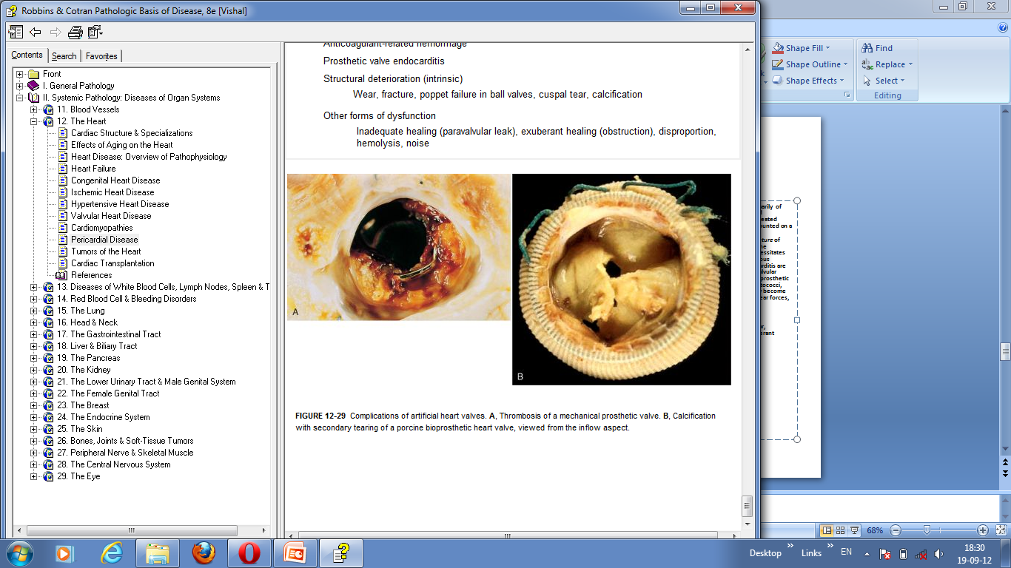

Slide 23
1. formation of vegetations composed of all except,
A. thrombotic debris
B. organisms
C. destructed material of the underlying cardiac tissues
D. Necrosis

Slide 24
2. HACEK group , composed of all except
A. Haemophilus,
B. Actinobacillus,
C. Coccobacilli,
D. Eikenella, and
E. Kingella.

Slide 25
3. Libman-Sacks Disease is associated with
A. SLE
B. Connective tiissue disease
C. Infective endocarditis
D. Myocardial infarction

Slide 26
4. Diagnostic Criteria for Infective Endocarditis is classified as,
A. Jack’s criteria
B. Mike’s criteria
C. Duke’s criteria
D. Sid’s criteria

Slide 27
1-D
2-C
3-A
4-C

Slide 28
RHD

Slide 29
Cardiovascular Morbidity and Mortality in Women Diagnosed With Rheumatoid Arthritis
Authors. | Methods. | Results. | Conclusions.
Daniel H. Solomon, Elizabeth W. Karlson, Eric B. Rimm, Carolyn C. Cannuscio, Lisa A. Mandl, JoAnn E. Manson, Meir J. Stampfer, Gary C. Curhan Circulation. 2003;107:1303-1307 | A prospective cohort study was conducted among the 114 342 women participating in the Nurses’ Health Study who were free of cardiovascular disease and rheumatoid arthritis at baseline in 1976. All self-reported cases of rheumatoid arthritis were confirmed by medical record review. Fatal and nonfatal myocardial infarctions and strokes were similarly confirmed. Multivariate pooled logistic regression was used to adjust for potential cardiovascular risk factors. | Five hundred twenty-seven incident cases of rheumatoid arthritis and 3622 myocardial infarctions and strokes were confirmed during 2.4 million person-years of follow-up. For stroke, the adjusted relative risk was 1.48 (95% CI, 0.70 to 3.12). Women who had rheumatoid arthritis for at least 10 years had a risk for myocardial infarction of 3.10 (95% CI, 1.64 to 5.87). | In this large prospective cohort of women, participants with rheumatoid arthritis had a significantly increased risk of myocardial infarction but not stroke compared with those without rheumatoid arthritis.

Slide 30
THANK YOU

