Slide 1
Research – Epidemiological Studies
Dr Niraj Pandit
Professor and Head

Slide 2
WHY WE DO RESEARCH ?
BURDEN OF ILLNESS
OR
DISEASE MAGNITUDE
CAUSATION
AETIOLOGY
RISK FACTORS
PROGNOSTIC FACTORS
EVALUATION
AND MONITORING OF PROGRAMMES
DISEASE
EFFICIENCY
OF
INTERVENTIONS
EFFICACY / EFFECTIVENESS OF INTERVENTIONS

Slide 3
RESEARCH DESIGN
1. Observational studies
Descriptive Studies
Case studies and Case series
Surveys
    Cross Sectional
    Longitudinal
B. Analytical Studies
Observational
    Case control
    Cohort study
2. Experimental

Slide 4


Case Series
Australian gynaecologist, Dr. McBride of Sydney, suspected that thalidomide was the cause of limb and bowel malformations in three children he had seen at Crown Street Women's Hospital. 1956

Slide 5

Pneumocystis carinii pneumonia and mucosal candidiasis in previously healthy homosexual men: evidence of a new acquired cellular immunodeficiency
1981 Dec 10;305(24):1425-31.
MS Gottlieb, R Schroff, HM Schanker, JD Weisman, PT Fan, RA Wolf, and A Saxon

Slide 6
Case Reports/ Case Series
The most basic descriptive study.
Hypothesis generating.
Rarely the evidence can even be strong!!

Slide 7

Cross sectional
Retrospective
Prospective
Ambidirectional

Slide 8
Surveys
Pre planned, single group studies conducted on population or samples from population.
Used to describe in quantitative terms the disease burden.
Prevalence and incidence are obtained from surveys.
The denominator i.e. the population at risk should be clearly
defined.
Generates hypothesis with regard to cause and effect but
cannot prove the association.

Slide 9
Surveys
Cross sectional survey
  a one time measurement conducted on a sample derived from a population
  Usually done to estimate prevalence and to describe
  disease spectrum.
  The prevalence thus computed is called point prevalence.
Prevalence = No. of persons with disease
Population at risk

Slide 10
Surveys
Longitudinal Survey
A group of subjects under surveillance over a period of time.
Intended to measure new cases occur over a specified duration
Denominator is the product of population at risk and the duration of
observation.
Longitudinal surveys are single group cohorts of people at risk of
developing a disease.
Incidence rate = Number of new cases occurring over the period
Population at risk

Slide 11
Requisites of a survey:
Study population to be clearly defined
Sample if any should be appropriate and large enough to
measure the disease and will depend on disease frequency.
Pre-tested questionnaire to obtain all relevant information
should be designed
Criteria for diagnosis of disease should be laid down.

Slide 12
Observational Study Design:
Comparative studies in populations used to study prognosis,
risk and causation
Investigators observe events in specified population and
come to conclusions.
Types
- Case control study
- Cohort study
- Ecological study

Slide 13
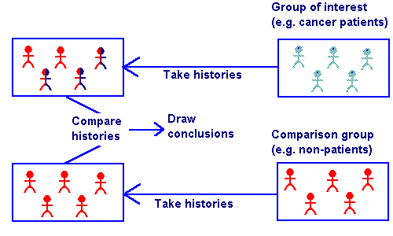
Case Control Studies

Slide 14
Case Control Studies

Slide 15
Advantages:
Easier, cheaper and more feasible.
Useful to study rare diseases.
Most useful for diseases with prolonged exposure time..
Can look at multiple risk factors.

Slide 16
Limitations:
Choice of controls sometimes difficult Eg. Cancer, CAD
Cannot compute risk of disease.
Temporality questionable.

Slide 17
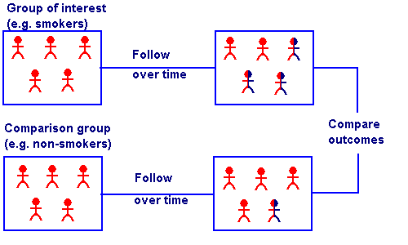
Cohort Studies

Slide 18
Cohort Studies

Slide 19
Cohort Studies

Slide 20
Cohort Studies

Slide 21
Advantages:
  Temporality as in real life.
  Useful for diseases with high prevalence
  When one exposure gives risk to multiple diseases
  When exposure is rare
  Measures absolute and relative risk of disease.

Slide 22
Limitations:
  Slow, time consuming, costly.
  Not useful in diseases with long latency.
  Difficult to assess independent effect of multiple risk
  factors.
  Eg. Framingham study
  .

Slide 23
Other Observational Studies:
Ecological studies
Measures combined occurrence of risk factors and disease in a population
Individual exposure and disease relationship cannot be assessed.
Eg: Occupational and industrial exposure to toxins, Environmental risk.

Slide 24
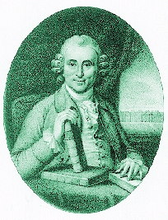
James Lind, 1753
Twelve sailors with scurvy
Pairs treated with
    cider
    elixir vitriol
    vinegar
    sea water
    2 oranges & lemon
    nutmeg
Pair on citrus well after 1 week

Slide 25
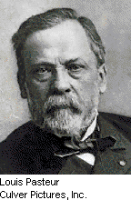
Pasteur’s vaccine (1881) for anthrax: proof of efficacy
Control group and experimental group
Experimental sheep (25) with vaccine twice
Both groups implanted with anthrax bacilli
Result
  All vaccinated animals healthy
  All controls dead or dying

Slide 26
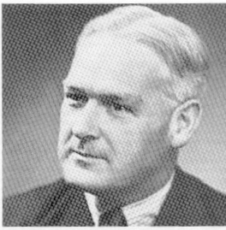
MRC trial of Streptomycin in TB 1948
Patients randomly allocated to streptomycin or placebo
Results favoured streptomycin (p=0.0001)
  bed rest only: 4/52 cured
  bed rest + streptomycin: 28/55 cured
Bradford Hill

Slide 27
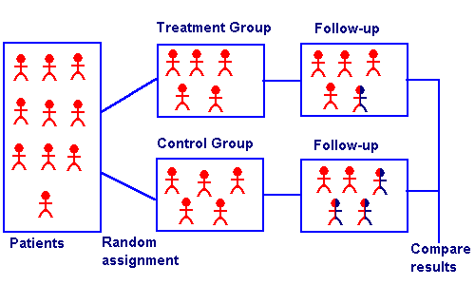
Randomized Controlled Trials

Slide 28
Experimental Studies:
  The investigator controls exposure and monitors appropriate outcomes in groups of patients.
  Used for studying treatment effects, usefulness of community intervention, usefulness of diagnostic tests etc.
  A well designed clinical trial (Randomized Controlled Trial) or Community Intervention Trial (CIT) are considered as gold standards for deriving conclusions in medical research.

Slide 29
Limitation
Randomization may not be appropriate or ethical in certain settings.
Bias could occur if the investigators are not blinded to exposure and outcome
Expensive, difficult to execute, requires close monitoring.
Appropriate sample sizes are a prerequisite or else one may end up with false negative conclusions.

Slide 30
STUDY QUESTIONS AND APPROPRIATE DESIGNS
Type of Question Appropriate Study Design
Burden of illness
- Prevalence Cross Sectional Survey
- Incidence Longitudinal survey
Causation, Risk & Prognosis Case Control Study,
Cohort study
Occupational risk,
Environmental Risk Ecological studies
Treatment Efficacy Randomized Controlled study
Diagnostic Test Evaluation Randomized Controlled study
Cost Effectiveness Randomized Controlled study

Slide 31
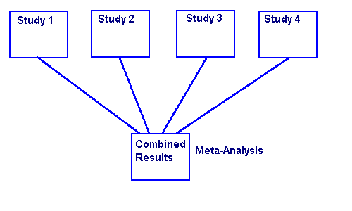
Meta-Analysis

Slide 32
Meta-Analysis

Slide 33
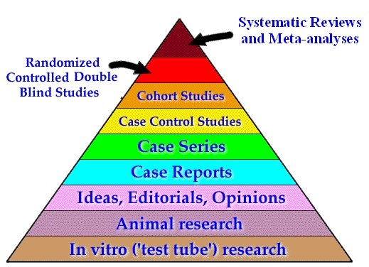
Evidence Pyramid

Slide 34
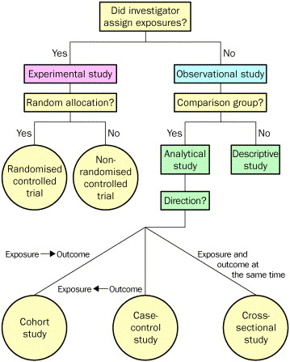
Summary
Source: The Lancet 2002; 359:57-61 (DOI:10.1016/S0140-6736(02)07283-5)

Slide 35
Thank you!

