Slide 1
Arterial Pulse
Dr Tejas Shah
Assistant Professor
Department of Cardiology
SBKS MI & RC

Slide 2
Definition
It is the pressure wave which travels along the walls of arteries when blood is ejected from left ventricle into aorta during systole.
When this pressure wave travels along walls of arteries → expansion of art. walls → palpated as arterial pulse.
First portion of central aortic pulse wave: Peak velocity of blood ejected during early systole (stored in central aorta).
Mid to late systolic portion of normal pulse wave: Blood moving from central aorta to periphery.
  Simultaneous reflection of pulse wave returning from arteries of upper body.

Slide 3
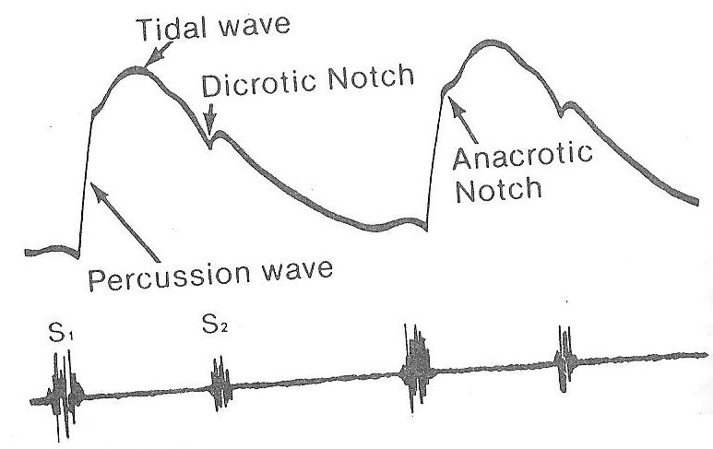
Pulse wave
Two positive deflections during
systole (upstroke), one deflection during
diastole (descending limb).
  First positive: during systole: Percussion wave. Impulse generated by LV ejection. Early systolic component.
  Second positive: Tidal wave. Reflection from upper part of body. Later peak.
  Diastolic/Dicrotic wave: Reflection from lower part of body.

Slide 4
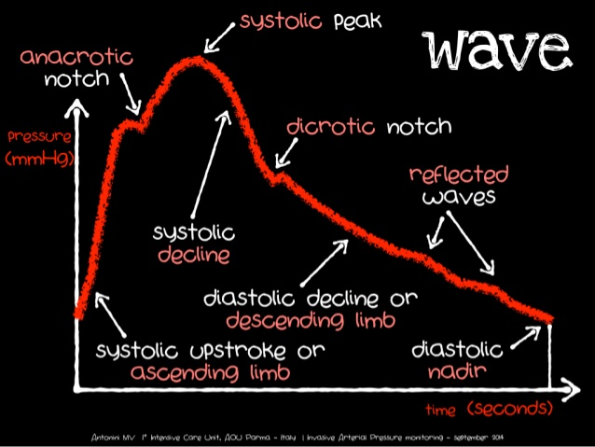

Slide 5
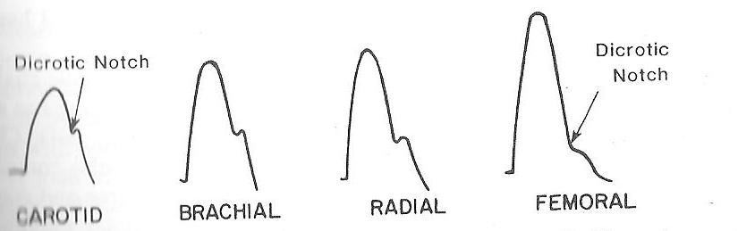
Central arterial pulse:
  Ascending aorta
  Innominate arteries
  Carotid arteries: Most accurate representation of central aortic pulsation.
Peripheral arterial pulse:
  Brachial arteries: Most suitable
  Radial arteries
  Femoral arteries
Normal aortic pulse wave reaches
  Carotids at 30 ms, Brachials at 60 ms, Radials at 80 ms, Femorals at 75 ms
Pulse pressure increases as pulse wave travels peripherally.

Slide 6
EXAMINATION OF ARTERIAL PULSE
All major arterial pulses should be B/L examined for:
  Rate
  Rhythm
  Character
  Volume
  Condition of vessel wall (thickness)
  Equal or inequality
  Presence or absence of delay of the femoral pulses compared with radials
Auscultation over major arteries: Bruit or Transmission of cardiac murmur (e.g. AS)

Slide 7
A) RATE of Pulse
Normal range of sinus rhythm: 60-100 beats/min.
  Bradycardia
  Tachycardia or
  Pulse deficit.

Slide 8
Bradycardia
Sinus: <60/min.
Causes:
Physiological: Asymptomatic. Athletes and during sleep.
Pharmacological: Beta-blockers, amiodarone, lithium.
Pathological:
  Cardiac: Inferior wall MI, SA block, vasovagal syncope.
  Non – cardiac: Myxedema, raised ICT, hypothermia, enteric fever.
Bradyarrhythmias: AV conduction abnormalities. Second degree AV block and CHB.

Slide 9
TACHYCARDIA
Sinus tachycardia: >100/min.
Causes:
Physiological:
  Infancy and early childhood
  Exercise, anxiety, excitement, other emotional stress.
Pharmacological:
  Drugs: Amyl nitrate, epinephrine, isoproterenol, atropine.
  Intoxicants: Alcohol, nicotine, caffeine.
Pathological:
  Cardiac: CCF, Acute MI, PE, Myocarditis, Shock.
  Non – Cardiac: Fever, anemia, thyrotoxicosis, hemorrhage, hypotension, hypoxemia.

Slide 10
Tachyarrhythmias:
  Regular pulse: Mostly supraventricular origin.
  Irregular: Ventricular tachycardia or AV dissociation.
  Irregularly irregular: AF or MAT.

Slide 11
Pulse deficit
Difference between the radial pulse rate and heart rate.
>6/min in AF
<6/min in PVCs.
Mechanism: Diastole is shortened → stroke volume is insufficient to open aortic valve → non – existent arterial pulse in spite of cardiac contraction.
  Diastole becomes longer in subsequent cardiac cycles → Stroke volume gradually increases → arterial pulse is felt.

Slide 12
B) Rhythm of pulse
Normal: Regular
Regularly irregular pulse | Irregularly irregular pulse
Sinus arrhythmia | AF
Pulsus bigeminus | MAT
Pulsus alternans | Frequent PVCs
1st and 2nd degree heart block

Slide 13
Sinus arrhythmia: Variation between the longest and the shortest cycle (P-P interval) exceeds 0.12 sec.
Phasic sinus arrhythmia: Inspiration → Pulse rate increases → Cycle length shortens and vice versa with expiration.
Non – phasic: Unrelated to respiration – Digitalis toxicity.
PVCs: At regular intervals (bigeminy or trigemini pattern) – Regularly irregular pulse.
Physiological: Exercise
Pharmacological: Digoxin toxicity, alcohol, nicotine, caffeine.
Cardiac: CAD – Acute MI, Post thrombolysis or PTCA, myocarditis, cardiomyopathy, MVP.
1st and 2nd degree heart blocks: Acute MI, myocarditis, digitalis, beta blockers.

Slide 14
Irregularly regular pulse:
  Pulsus bigeminus
  Pulsus alternans.
Pulsus bigeminus:
  Irregular rhythm caused by premature contractions (usually VPCs) → alteration in strength of pulse.
  Weak beat (VPC) always follows the short interval → long compensatory pause → stronger beat than normal pulse.
  Also seen in AV blocks and atrial flutter with block.

Slide 15
Pulsus alternans:
  Regular rhythm.
  Strong beat (more no. of contractile elements) alternates with a weak beat (loss of contractile elements).
  Sign of severe LV dysfunction.
  E.g.: Severe AS with failure, DCM, myocarditis, acute pulmonary embolism, severe PS.

Slide 16
C) Volume of Pulse
Idea of Pulse pressure which depends on stroke volume and compliance of arteries.
Pulsus Parvus:
  Low volume, small amplitude: Small weak pulse.
  Decreased stroke volume, e.g. AS with pulsus tardus.
  Pulsus parvus et tardus: Small pulse with delayed systolic peak (Severe AS).
  Severe heart failure.
  Best detected by palpating the carotids.
Pulsus Magnus:
  High volume, large amplitude.
  Increased stroke volume, e.g. AR.

Slide 17
Hyperkinetic or bounding pulse:
  Increased stroke volume and rapid ejection from LV.
  Hyperkinetic circulatory states.
D) Condition of vessel wall
Examined by flattening the artery by digital pressure and sliding it sideways.
Atherosclerotic vessel is thickened, rigid and tube like.

Slide 18
E) Radial pulse synchronicity
Whether equal on both sides.
Diminished or absent on one side:
  Takayasu’s arteritis.
  Thoracic outlet syndrome.
  Subclavian steal syndrome.
  Chronic atherosclerosis.
  Coarctation of aorta (if proximal vessels are also involved).
  Dissection of aorta.
F) Absent or Delayed femoral pulsations
Coarctation of Aorta: Due to delay in rate of rise (amplitude).
  Femoral arterial pulse is distinctly delayed.
  Reduced volume of femoral arterial pulse.
Occlusive disease of bifurcation of aorta, common iliac or external iliac arteries.

Slide 19
G) Character of Pulse
Best evaluated by palpation of carotid pulse.
ABNORMAL TYPE OF PULSES DEPENDING UPON THE CHARACTER
a) Pulsus Tardus:
  Slow rising.
  Delayed systolic peak (near to S2).
  Frequently associated with a thrill in carotids (carotid shudder) – AS.
  Often occurs with Pulsus Parvus (i.e. pulsus parvus et tardus).
  Better appreciated by simultaneous auscultation and carotid palpation.
  AS – Pulsus Tardus → Pressure gradient of atleast 70 mm Hg.

Slide 20
G) Character of Pulse
b) Water – Hammer (Collapsing) or Corrigan Pulse:
  Rapid upstroke (percussion wave) f/b rapid descent (collapse).
  Indicates low systemic vascular resistance.
  Best appreciated in radial pulse.
  E.g.: AR, PDA, RSOV.

Slide 21
G) Character of Pulse
c) Twice Beating Pulse:
  Two palpable arterial pulses per cardiac cycle.
  Includes anacrotic pulse, pulsus bisferiens and dicrotic pulse.
Anacrotic Pulse: Slow rising (pulsus tardus), distinct notch (anacrotic) on upstroke of carotid pulse with two separate waves (anacrotic and percussion).
    Palpated well.
    AS.
    Lower the notch, severe the AS.
    Presence of anacrotic pulse indicates minimum pressure gradient of 70 mm Hg.

Slide 22
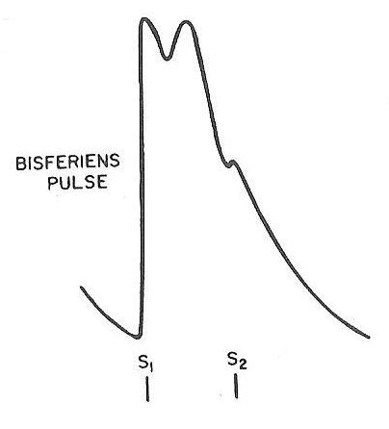
Bisferiens pulse: Two systolic peaks (percussion and tidal waves) separated by a distinct midsystolic dip.
Causes and mechanism:
Conditions in which large stroke volume is rapidly ejected from the LV as in severe AR, PDA, hyperkinetic circulatory states.
  Initial percussion wave is exaggerated and the tidal wave also becomes prominent.
Combination of slow rising and collapsing pulse: AS + AR.
HOCM: Usually recordable than palpable. Indicates significant obstruction.
  Detection: Best by carotids palpation.
  Apply graduated pressure or completely obliterate the pulse and gradually release it to appreciate the two waves.

Slide 23
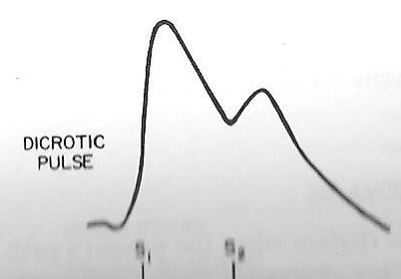
Dicrotic pulse:
  Two peaks. One in systole (percussion wave) and other in diastole (dicrotic wave) immediately after S2.
  Detectable delay between the two palpable peaks is much longer than in bisferiens pulse.
  Low output states: Enteric fever, cardiomyopathy, cardiac tamponade, myocarditis, hypovolemic shock, during IABP.
  Pulsus alternans and S3 and S4 gallops commonly occur in patients with a dicrotic pulse who have underlying pump dysfucntion.
Detection: Carotids and radial artery.
  During inspiration and with inhalation amylnitrate.
  Unusual with systolic BP >130 mm Hg.
  S2 separates the two components of dicrotic pulse..

Slide 24
Abnormal Variants

Slide 25
Hyperkinetic pulse
Larger than normal amplitude.
Increased LV ejection velocity, stroke volume or arterial pressure.
Also in case of decreased arterial compliance – arterial wall thickening.
Enhanced sympathetic activity – smoking, caffeine.
High output states: Anxiety, anemia, thyrotoxicosis, exercise.
Typical of AR.

Slide 26
Hypokinetic Pulse
Low cardiac output.
Decreased LV stroke volume → shorter LV ejection time → Less blood to inject.
Impaired LV function or overt CCF.
Intense vasoconstriction: Small pulse amplitude, normal stroke volume.
It is important to asses the rate of rise of hypokinetic pulse.
  Normal upstroke (unsustained) → decreased stroke volume without LV outflow obstruction.
  Slow rising (sustained) pulse → strongly suggests AS.

Slide 27
Pulsus Alternans
During sinus rhythm.
Patients’ peak systolic arterial pressure and pulse volume are alternately strong and weak.
Beat-to-beat alternation in developed LV pressure caused by changing ejection dynamics.
ALWAYS INDICATES SEVERE LV DYSFUNCTION.
Associated S3 gallop and other signs of LV failure are commonly found.
Easily detected – On deep inspiration or abrupt upright posture. (Decreased venous return and stroke volume).
Not related to electrical alternans.

Slide 28
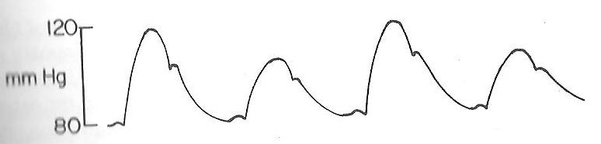
Every other beat has a lower systolic pressure. The rate of rise of the
second pulse is slower, relating to decreased contractile force in the
alternate beats.

Slide 29
Pulsus Paradoxus
Apparent paradox of disappearance of pulse during inspiration despite the presence of heart beat.
Marked and exaggerated inspiratory fall in systolic BP.
Causes:
    Physiological: Pregnancy, extreme obesity.
    CVS: Cardiac tamponade, Effusive CP (50% cases), Massive pulmonary embolism, RCM.
    RS: Severe emphysema.
  Absence of pulsus paradoxus: ASD, VSD, AR. Aortic dissection causing both AR and pericardial tamponade.

Slide 30
Characteristic features of Pulse in Common Clinical Conditions

Slide 31
Aortic stenosis
Obstruction to LV ejection → characteristic alterations of aortic pressure.
Best detected in carotid artery.
Valvular AS – Slow rising (pulsus parvus), delayed peak (pulsus tardus), small volume, palpable thrill and displays a prominent anacrotic notch.
Palpable thrill (or shudder) – occurs on arterial pulse upstroke. Represents turbulence created by ejection of blood across a narrow and distorted valve orifice.
ANACROTIC PULSE
Arterial pulse in AS is often called anacrotic.
Anacrotic (upbeating) – Exaggerated anacrotic shoulder in AS.
Produced by the jet effect jet effect of blood flow across the abnormal valve or the decreased velocity of blood flow during early ejection.

Slide 32
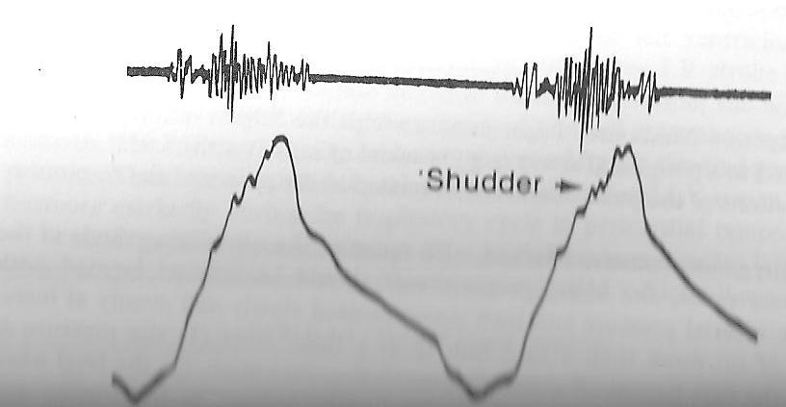
Delayed upstroke and the jagged contour representing a palpable shudder
or transmitted thrill. Pulse volume is usually decresed as well
(pulsus parvus and tardus).

Slide 33
PULSUS PARVUS et TARDUS
Typical AS pulse – Small volume and slow rising.
Normal volume and rapid rise of pulse practically excludes significant valvular AS in most of the subjects.
  False positive : CCF, Cardiomyopathy or MS → Small volume pulse, functional non-specific systolic ejection murmur.
  False negative : AS with AR/systemic hypertension, and children or young adults.
Mild AS with severe LV systolic dysfunction: Carotid pulse may suggest more severe AS than is actually present.

Slide 34
SUPRAVALVULAR AS
Produces differential streaming of central aortic blood flow.
Rt. Carotid pulse is relatively normal.
Lt. Carotid pulse has characteristic findings of aortic valve obstruction.
This underscores the importance of routine palpation of both carotid pulses.

Slide 35
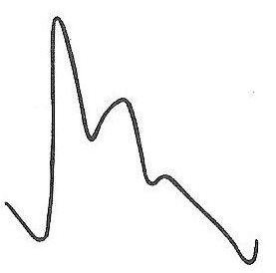
HYPERTROPHIC CARDIOMYOPATHY
Characteristically brisk rate of rise – tapping quality.
More pronounced with large LV-aoritc gradients.
Second systolic peak – bifid or spike and dome pattern.
  Mainly recorded, less often palpated.
COARCTATION OF AORTA
In all cases of significant coarctation – femoral pulses are small in volume and markedly delayed.

Slide 36
AORTIC REGURGITATION
Increased stroke volume, rapid rate of ejection, decreased peripheral resistance → high volume, bounding arterial pulse with characteristic collapsing quality.
High pulse pressure – systemic arteries may appear to swell or pulsate.
Elevation of arm: accentuates hyperkinetic and collapsing pulse in brachial artery.
Bisferiens pulse is common: s/o Hemodynamically significant degree of AR.
  This pulse may disappear with onset of CCF or decreased LV stroke volume.

Slide 37
Take home message
Carotid, radial, brachial and femoral pulses should be routinely examined bilaterally to ascertain any differences in the pulse amplitude, contour, or upstroke.
Examination of the carotid pulse provides the most accurate representation of changes in the central aortic pulse.
The brachial arterial pulse is examined to assess the volume and consistency of the peripheral vessels.
Careful bedside examination of the arterial pulse in certain conditions, such as aortic valve disease, HCM and pericardial tamponade can be of great importance in making a proper diagnosis.

