Slide 1
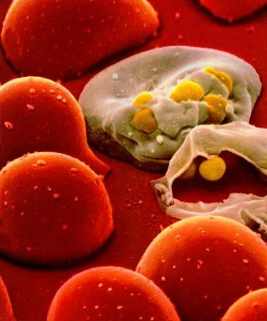
The 21st century pandemic
HIV/AIDS
Dr. Grishma Chauhan,
Professor,
Community Medicine dept.

Slide 2
Natural History of HIV/AIDS
HIV was first clinically observed in 1981 in the United States
1982 – First use of term “AIDS”
1983 – Virus isolated and identified.
1985 – HIV Ab testing available.
1987 – First FDA approved drug (Zidovudine) NRTI.
1988 – World Health Organization(WHO) Declared December 1st as “World AIDS Day”
Approx. 40 million people living with HIV/AIDS worldwide according to 2018
7.7million people died of AIDS-related illnesses worldwide in 2018
South Africa was the 1st country having 6,200,000 people living with HIV.
India was the 3rd country having 2,400,000 people living with HIV

Slide 3
India
As per released, India HIV Estimation 2017 report, National adult (15–49 years) HIV prevalence in India is estimated at 0.22%.
The total number of people living with HIV (PLHIV) in India is estimated at 21.40 lakhs.
India is estimated to have around 88,000 new HIV infections in 2017, showing new HIV infection decline by 85% since the peak of 1995 and by 27% between 2010-2017.
Compared to neighbouring countries, India has made good progress in reducing new HIV infections by half since 2001.
Despite free antiretroviral treatment being available, uptake remains low as many people face difficulty in accessing clinics

Slide 4
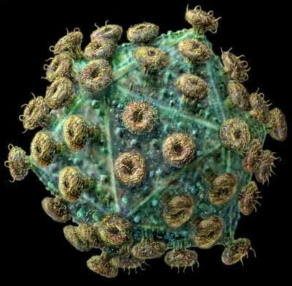
HIV VIRUS

Slide 5
What is HIV?
H -uman
Found only in humans
Transmitted among humans
Preventable by humans
I -mmunodeficiency
Body lacks ability to fight off infections
V -irus
Type of germ
Lives and reproduces in body cells
The virus attacks and eventually overcomes the body’s immune system. The immune system is usually able to defend the body against infections.

Slide 6
AIDS
A-cquired; received, not inherited (does not run in families)
I-mmuno; protected from (in this case the system protects the body from disease- related with immune system)
D-eficiency, - a lack of immune response
S-yndrome; – a group of symptoms or diseases

Slide 7
WHAT IS AIDS ??
1. The Late stage of HIV infection
2. A group of symptoms & signs of disease that occur together.
3. Severe immune system breakdown
4. Less than 200 T cells (or CD4 cells).
Normal 1000

Slide 8

  HIV is the infectious stage of the condition, AIDS is the disease phase.

Slide 9
HIV Transmission
HIV enters the bloodstream through:
  Open Cuts
  Breaks in the skin
  Mucous membranes
  Direct injection

Slide 10
Routes of Transmission of HIV
Sexual Contact: Male-to-male
Male-to-female or vice versa
Female-to-female
Blood Exposure: Injecting drug use/needle sharing
Transfusion of blood products
Perinatal: Transmission from mother to baby
Breastfeeding

Slide 11
Routes of Transmission of HIV
Occupational Transmission
Health care worker/ hospital staff
Laboratory workers
Other routes
    Organ transplantation
    Artificial insemination
    Needle-prick

Slide 12
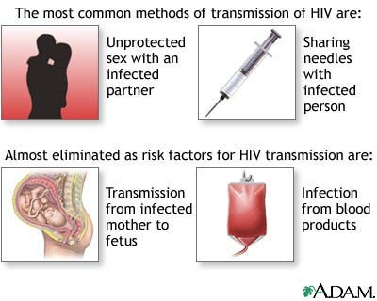

Slide 13
HIV Transmission
Common body fluids that are means of transmission:
    Blood
    Semen
    Vaginal Secretions
    Breast Milk

Slide 14
HIV in Body Fluids
Blood
18,000
Semen
11,000
Vaginal
Fluid
7,000
Amniotic
Fluid
4,000
Saliva
1
Average number of HIV particles in 1 ml of these body fluids

Slide 15

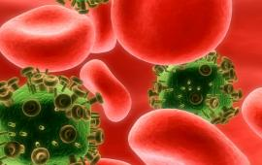
HIV-Infected T-Cell
HIV
Virus
HIV Infected
T-Cell
New HIV
Virus
T-Cell

Slide 16
What is the “Window Period?”
The time period between a person’s exposure & actual infection with HIV and until antibodies are detectable in the body.
This is the period of time after becoming infected when an HIV test is negative.
After three months there are usually enough antibodies to show on an AIDS test.
90 percent of cases test positive within three months of exposure
10 percent of cases test positive within three to six months of exposure

Slide 17
Window Period
When a person gets infected it may take 6 weeks or up to 3 months before antibodies to HIV are detected in the blood
The HIV test looks for antibodies. When these antibodies are detected the person is diagnosed HIV positive
Sometimes the test shows negative even the person is positive because the test was done during the window period

Slide 18
HIV and the Immune System
A person can be HIV infected and not have AIDS if the person’s immune system is intact.
Often this period is from 8-10 years.
Has no symptoms, person is a carrier.
After this period, the immune system begins to lose the fight.
At this point the person has AIDS

Slide 19
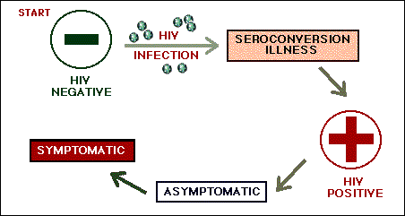
Signs And Symptoms
The clinical consequence of HIV infection comprises of a spectrum ranging from an acute syndrome with primary infection to a prolonged asymptomatic stage to advanced disease.
Incubation period: 2 to 10 yrs.

Slide 20
HIV Infection and Antibody Response
---Initial Stage----
---------------Intermediate or Latent Stage--------------
---Illness Stage---
Flu-like Symptoms
Or
No Symptoms
Symptom-free
AIDS Symptoms
----
Infection
Occurs
----
<

Slide 21
The Acute HIV Syndrome
Follows 3-6 wks following primary infection
Notes:
Lasts for 2 weeks

Slide 22
Signs And Symptoms
Second phase-
Asymptomatic contact
  Initial HIV inf. or after illness of inf.
  No symptoms
  Last 2 to 10 yrs.

Slide 23
Signs And Symptoms
Third phase-
PGL (Persistent Generalized Lymphadenopathy)
    Enlargement of lymph nodes.
      outside the inguinal area
      more than 2 areas

Slide 24
Signs And Symptoms
Fourth phage-Overt Manifestation of AIDS
ARC(AIDS-related complex):
fever, loss of weight, anorexia, diarrhea plus PGL
Nervous system symptoms:
headache, convulsion, paralysis, progressive dementia
Rare opportunistic infection.
Unusual malignant tumors.
Pneumonia.

Slide 25
Common manifestation of AIDS
  Lung infection:
  P. Carinii pneumonia
  Gastrointestinal infection:
  Candidiasis of mouth
  or oesophagus
  Skin infection:
  Kaposi’s sarcoma - red or violet macules or papules
  Central nervous System Infection:
  Toxoplasmosis
  Dementia
  Meningitis
  Primary CNS Lymphomas.
  Progressive Multifocal Leucoencephalopathy.

Slide 26
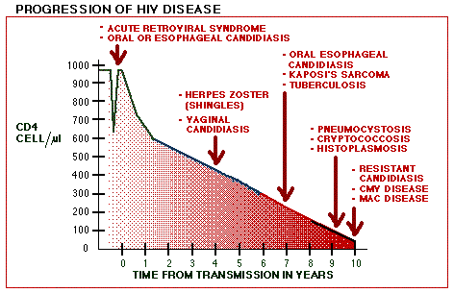
HIV disease progression

Slide 27
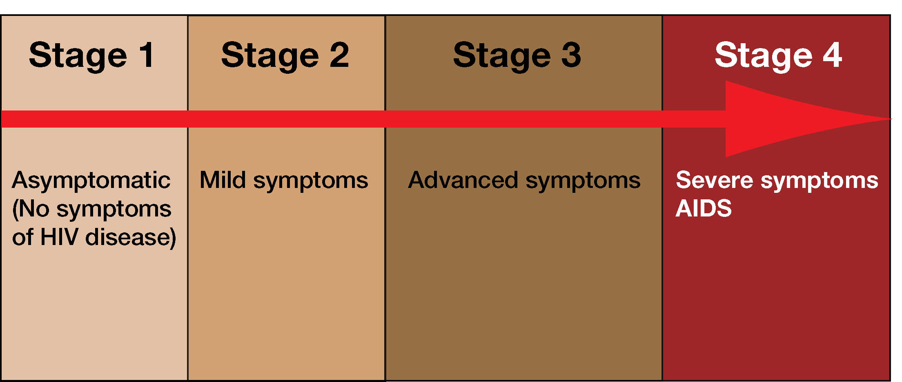
WHO HIV clinical stages
Short, flu-like illness occurs 1-6 weeks after infection
Infected person can infect other people
Average- 10 years
Mild symptoms
HIV in blood drops to very low levels
Antibodies are detectable in the blood
The immune system deteriorates
Opportunistic infections (OI)start to appear
Rapid decline in the number of CD4⁺ T cells
Opportunistic infections become severe and cancer may develop
Notes:
As we have indicated, HIV infection progresses through stages. The World Health Organization (WHO) has developed a system to describe the different stages of HIV infection. (In the USA, the CDC has a different (but very similar) system for describing the stages of HIV infection)
Sometimes people wonder about the differences between HIV infection and AIDS. As the stages 1–3 show, a person may be HIV-infected and not have AIDS. It is common for adults to have HIV infection but not AIDS for several years
A more detailed table of these stages includes the specific illnesses seen at each stage.

Slide 28
What happens to someone with fully involved AIDS?
Immune system breaks down => Hospital ??
Cause of death - a variety of normally preventable diseases. Some are:
a. HIV wasting syndrome
b. Pneumonia
c. Toxoplasmosis
d. Kaposi’s sarcoma
e. Mycobacterium Avium complex
f. Invasive cervical cancer etc..

Slide 29
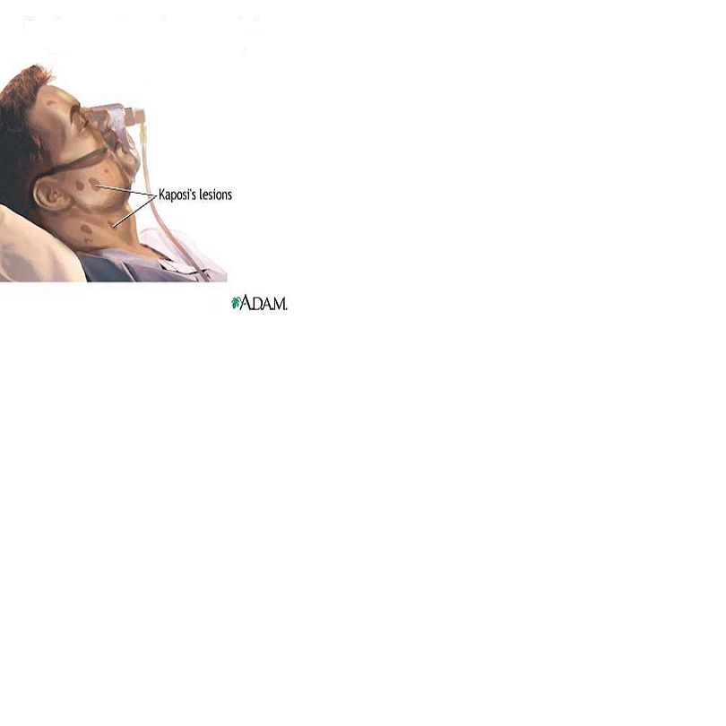
Opportunistic Infections associated with AIDS
Bacterial infections
Tuberculosis (TB)
Herpes Simplex
Herpes Zoster
Vaginal candidiasis
Hairy leukoplakia
Kaposi’s sarcoma

Slide 30
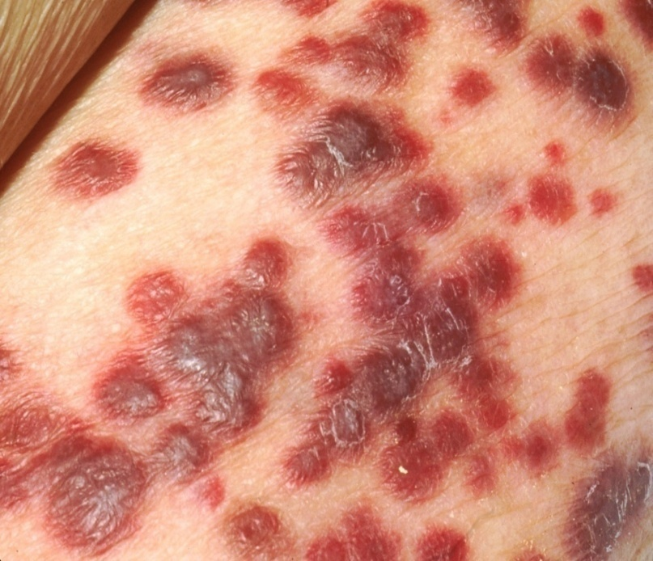
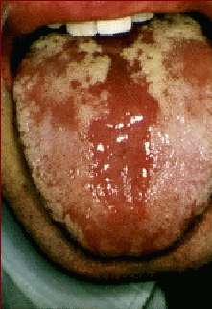
Kaposis’s sarcoma
Candidiasis Of Mouth

Slide 31
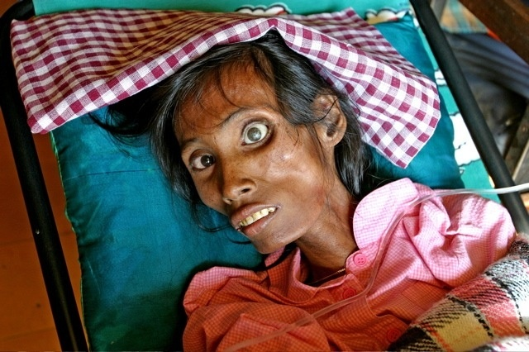
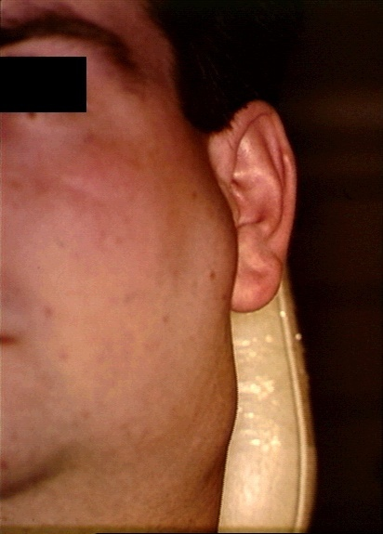
Extreme Wt loss
Lymphadenopathy

Slide 32
Laboratory Diagnosis
ELISA- Screening test
Western blot –Confirmatory test
CBC- Anemia, Neutropenia, Thrombocytopenia common with advanced HIV infection
Absolute CD4 count-Predicator for HIV progression (OI is more with CD4<200 cells/ul
HIV viral load tests- measures replicating virus.
B2- Microglobulin- level measures progression of disease
p24 antigen-indicates active HIV replication

Slide 33
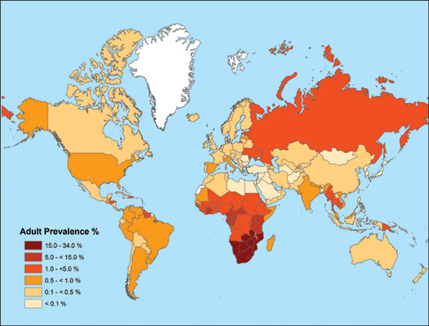
AIDS Worldwide

Slide 34
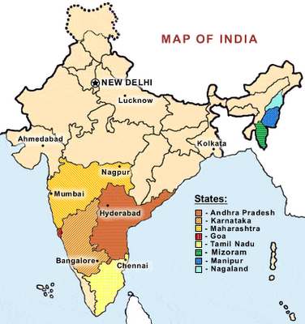
AIDS In India

Slide 35
Key terms in HIV Epidemic
HIGH RISK GROUP
Female Sex Worker(FSW)
Men who have Sex with Men(MSM)
Transgender
Injecting drug users(IDU)
BRIDGE POPULATION
Migrant
Truckers
VULNERABLE
POPULATION
Women having casual partners
Spouses of high risk groups
Youth
KEY POPULATION
HRG
Vulnerable Population
PLHA

Slide 36
Indian epidemic: Characteristics
India’s highly heterogeneous epidemic is largely concentrated in only a few states;
Among the States/UTs, in 2017, Mizoram has shown the highest estimated adult HIV prevalence of 2.04% followed by Manipur (1.43%) Nagaland (1.15%) Telangana (0.70%) and Andhra Pradesh (0.63%)
Besides these States, Karnataka (0.47%), Goa (0.42%), Maharashtra (0.33%) and Delhi (0.30%) have shown estimated adult HIV prevalence greater than the national prevalence (0.22%), while all other States/UTs have levels of adult HIV prevalence below 0.22%.
Adult prevalence – 0.22% (2017)
Men- 0.25% Women -0.19% Children –7%
Urban > Rural

Slide 37
Classification of states
High prevalence
  >5% in HRG & >1% in ANC
Moderate prevalence
  >5% in HRG & <1% in ANC
Low prevalence
  <5% in HRG & <1% in ANC

Slide 38
Classification of districts
Districts are classified into four categories A to D
Category A:
>1% ANC prevalence in district in any of the sites in the last 3 years.
Category B:
  < 1% ANC prevalence in all the sites during last 3 years with
  > 5% prevalence in any HRG site (STD/FSW/MSM/IDU)
Category C:
< 1% ANC prevalence in all sites during last 3 years with
< 5% in all HRG sites, with known hot spots (Migrants, truckers, large aggregation of factory workers, tourist etc.,)
Category D:
  < 1% ANC prevalence in all sites during last 3 years with
  < 5% in all HRG sites with no known hot spots OR no or poor HIV data

Slide 39
PREVENTION OF HIV/AIDS

Slide 40

Risk factors
Anyone of any age, race, sex can be infected with HIV,
but you're at greatest risk of HIV/AIDS if person,
Has unprotected sex with multiple partners. Unprotected sex means having sex without using a new latex or polyurethane condom every time.
Has unprotected sex with someone who is HIV-positive.
Has another sexually transmitted disease, such as syphilis, herpes, Chlamydia, gonorrhea or bacterial vaginosis.
Shares needles during intravenous drug use.
Received a blood transfusion or blood products before 1985 policy.

Slide 41
Cont..
Newborns or breast fed children whose mothers tested
positive for HIV but did not receive treatment also are
at high risk.
Fastest growing method of HIV transmission:
heterosexual contact.
Heterosexual transmission is easier from men to
women than from women to men
Risk of acquiring for women is greater if contact occurs during menstruation
Uncircumcised men are more likely to be sero positive and contract HIV during sex

Slide 42
Preventive measures
There's no vaccine to prevent HIV infection and no cure for AIDS.
Prevention includes educating yourself about HIV and avoiding any behavior that allows HIV-infected fluids — blood, semen, vaginal secretions and breast milk — into your body.
HIV-negative Individual prevention:
Educate yourself and others.
Know the HIV status of any sexual partner.
Use a new latex or polyurethane condom every time you have intercourse.
Consider male circumcision.
Use a clean needle.
Be cautious about blood products.
Get regular screening tests.

Slide 43
Cont..
HIV positive individual prevention:
Follow safe-sex practices.
Tell your sexual partners you have HIV.
If your partner is pregnant, tell her you have HIV.
Tell others who need to know.
Don't share needles or syringes.
Don't donate blood or organs.
Don't share razor blades or toothbrushes.
If you're pregnant, get medical care properly.

Slide 44
Prevention Of HIV/AIDS
Traditionally, prevention is described as being at three levels:
Primary
Secondary
Tertiary

Slide 45
Primary
Primary HIV prevention refers to activity focused on preventing uninfected people becoming infected.
Secondary
Secondary HIV prevention aimed at enabling people with HIV to stay well (e.g. testing to allow people to know their status; welfare rights advice; lifestyle behaviour ; anti–discriminatory lobbying).
Tertiary
Tertiary HIV prevention aims to minimise the effects of ill–health experienced by someone who is symptomatic with HIV disease (e.g. the prophylactic use of drugs and complementary therapies )

Slide 46
Two Approaches To Disease Prevention
Risk avoidance
Risk- reduction or “remedies” interventions

Slide 47
Risk Avoidance & Risk Reduction
Approaches | Sex | Injection | Transfusion | Pregnancy
Risk Avoidance | Abstinence, Mutual Monogamy | Safe And Appropriate Use Of Injections | Reduce Unnecessary Transfusions | Routine HIV Antibody Screening Interventions
Risk Reduction | Condom STD Rx | Sterile Syringes | Quality Blood For Transfusions | Short-course Monotherapy Zidovudine , Nevirapine To Mothers And Babies Elective Caesarean Delivery Breastmilk Replacement

Slide 48
ABC Strategy
 | Avoid exposure | bstinence Mutual faithfulness
 | Reduce exposure | e faithful (Partner reduction)
 | Block exposure effectively | ondom use
A
A
B
B
C
C

Slide 49
HIV Testing and Counselling
VCTC
Voluntary Counseling and Testing Centres
People motivated were referred to these Centres
VCCTC
Voluntary Confidential Counseling and Testing Centres
Emphasis on maintaining confidentiality
ICTC
Integrated Counseling and Testing Centres
Integration of VCCTC + PPTCT
Provider Initiated Counseling and Testing Centres
PITC

Slide 51
Working pattern of ICTC
HIV Suspect
ICTC
Counselor
Reason for testing
Risk Assessment
consent
Pre-test COUNSELING
BLOOD TEST
HIV -ve
HIV +ve
Post test COUNSELING
confirmed
Change risky life pattern
Preventive measures
Post test COUNSELING
ART
PPTCT
Drop-in Centres

Slide 52

PPTCT :4 Pronged approach
Prevention of HIV in women
Prevention of unintended pregnancies in HIV+ women
Prevention of HIV transmission from HIV+ women to infants
Provision of care, treatment and support to mothers living with HIV and their families

Slide 53
PPTCT

Slide 54
Cont..

Slide 55
PPTCT (Cont.)
Without any intervention risk of transmission of HIV from infected mother to her child is between 20-45%.
SD-NVP is highly effective in reducing risk of transmission from about 45% to less than 10%
Multiple drugs for PPTCT can reduce transmission to less than 5% if started early in pregnancy and continued throughout period of delivery and breast feeding.
In 2017, 60% of pregnant women living with HIV received PPTCT services, a 20% increase on 2016 levels.

Slide 56
Establish HIV Status of Pregnant Women
Known HIV infected case and already receiving ART
newly detected HIV infection
HIV -ve
From ICTC collect the blood
Sample for CD4 and sent it to ART center and refer women to there
Repeat HIV as per guidelines for window period &h/o risk factor
Continue ART
ART Center: Initiate ART to HIV +ve pregnant mother regardless of WHO Clinical Stage and CD4counts
Preferred Regimen : TDF+3TC+EFV
ART center will collect sample for baseline and other investigations

Slide 57
Continued
Mother :Continue ART during labour and delivery(intrapartum)
Continue ART
Mother: Continue ART(Postpartum)
Infant: Daily NVP from birth until 6 weeks of age then stop
(Irrespective of choice of infant feeding)
Exclusive BF/RF

Slide 61
Classification of Antiretroviral (ART) Drugs
NRTI (Nucleoside Reverse Transcriptase Inhibitors)
NtRTI (Nucleotide Reverse Transcriptase Inhibitors)
NNRTI ( Non-Nucleoside Reverse Transcriptase Inhibitors)
PI (Protease Inhibitors)
INSTI (Integrase strand transfer inhibitors): Raltegravir, Elvitegravir

Slide 62
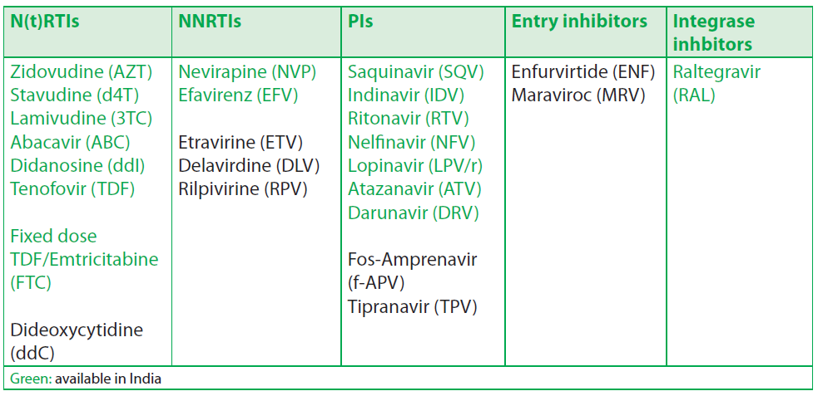
Highly Active Anti Retroviral Therapy(HAART)

Slide 63
HAART Regimens
H
FIRST LINE
2NRTI+ 1NNRTI
PREFFERED REGIMEN
TDF + 3TC (or FTC) + EFV
SECOND LINE
2NRTI+ RITONAVIR BOOSTED PI
PREFFERED REGIMEN
TDF + 3TC (or FTC) + ATV/RTV
THIRD LINE
INTEGRASE INHIBITOR+2ND GENERATION NNRTI+ PI
PREFFERED REGIMEN
RAL +ETV+RTV/DRV

Slide 64
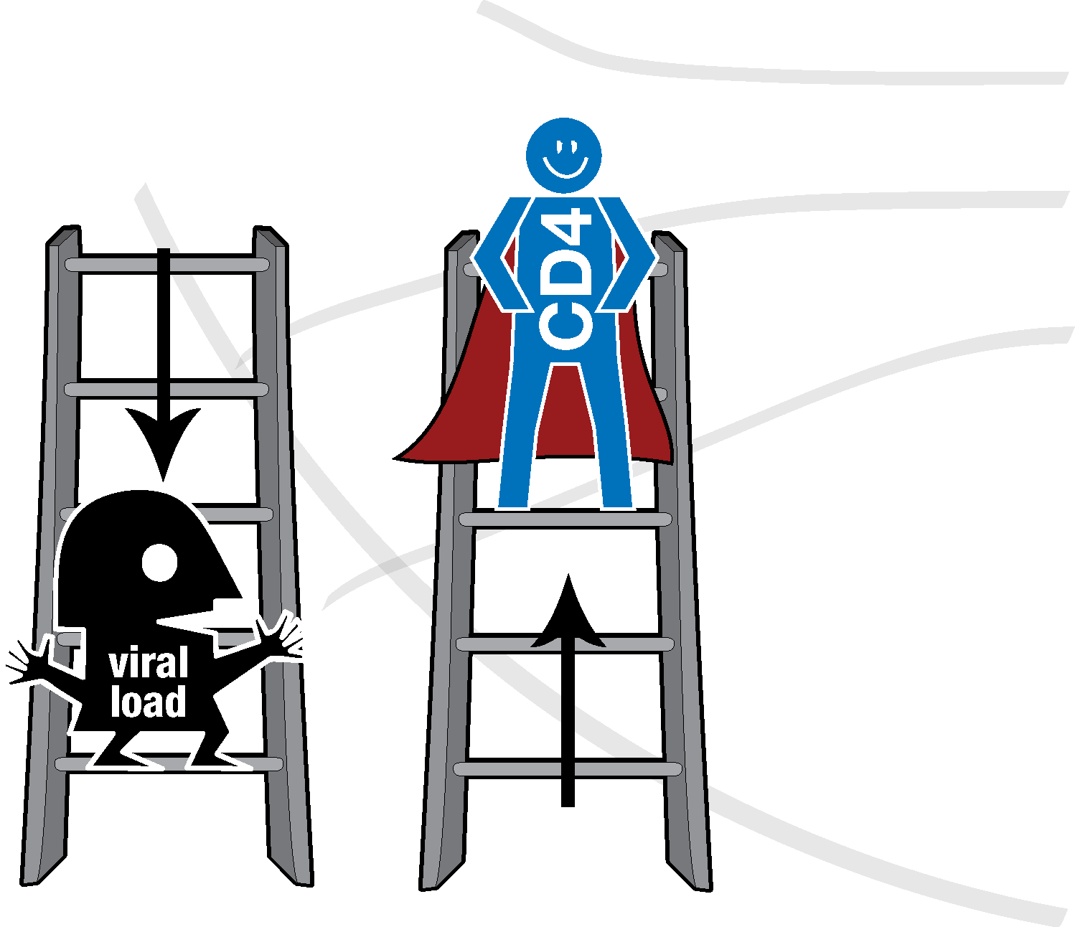
Goals of ARV Therapy
Reduce HIV-associated morbidity and prolong the duration and quality of survival,
Restore and preserve immunologic function
Maximally suppress plasma HIV viral load
Prevent HIV transmission

Slide 65
Treatment of AIDS & Life Expectancy
Treatment helps people live longer.
a. In 1993 = less than 7 years
b. In 2006 = 20 years or more…
….if properly treated
c. New drugs are the cause of the increase survival.

Slide 66
ART coverage
In 2017, 56% of people living with HIV were on treatment a significant rise from 2013, when coverage stood at just 36%.
In 2017, India adopted ‘test and treat’, following WHO guidance, which means anyone testing positive for HIV is now eligible for treatment, regardless of their CD4 count.
Despite the rise in treatment coverage, many people living with HIV still have difficulty accessing the clinics, emphasizing the importance of initiatives such as the Link Workers Scheme (LWS).
LWS – a NACO programme - works across 18 states, training people from at-risk populations to link communities with HIV information, commodities and services.

Slide 67
STI and HIV – The Link
Persons with a history of STIs are more likely to get HIV because:
    persons with STIs are more likely to have sores and small breaks in the skin and lining of their genitals.
    HIV can more easily enter the body through these breaks.

Slide 68
ALL STIs are Preventable
Most STI’s are treatable
But
HIV/AIDS CANNOT BE CURED

Slide 69
HIV: Prophylaxis-General
Standard Precautions:
Hand washing
Use of protective barriers e.g- gloves,masks,goggles,gowns
Safe handling and safe disposal of sharps
Respiratory hygiene and cough etiquettes
Safe decontamination and disposal of contaminated waste

Slide 70
Post-exposure Prophylaxis
Comprehensive management given to minimize the risk of infection following potential exposure to blood-borne pathogens e.g. HIV.
This includes:
1. First aid
2. Counseling
3. Risk assessment
4. Relevant laboratory investigations based on informed
consent of the exposed person.
5. Depending on the risk assessment, the provision of short
term (4 weeks) of ART.
6. Follow up and support

Slide 71
Post-exposure Prophylaxis
Post-exposure prophylaxis (PEP) has its greatest effect if begun within 2 hours of exposure. There is little benefit if started >72 hours.
The prophylaxis needs to be continued for 4 weeks (28 days).
Preferred PEP regimen :
Initially:
  2 drug regimen (Zidovudine + Lamivudine)
  then 3 drug regimen : after expert opinion ( AZT + 3TC + NVP)
Clinical follow-up: the exposed person must be monitored for the eventual appearance of signs indicating an HIV. These symptoms almost always appears within 3 to 6 weeks after exposure.
Laboratory follow-up : after exposure testing at 3 months
and 6 months is recommended.

Slide 72
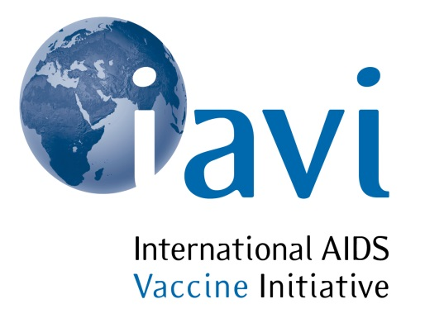
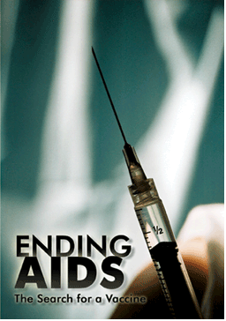
HIV Vaccine
Need
Despite the remarkable achievements in development of anti-retroviral therapies and recent advances in new prevention technologies, the rate of new HIV infections continues to outpace efforts on prevention and control.
Challenges
H.I.V. mutates rapidly; H.I.V. mutates in one day as much as influenza viruses do in a year.
The virus has developed multiple mechanisms to evade the body’s defenses
Targets the very cells (CD4) that coordinate the immune response to viral infections.
Broadly neutralising antibodies usually appear between 2-- 4 years but by that time the antibodies cannot save them because they are overwhelmed by the mutating virus.

Slide 73
HIV Vaccine:the new hope
AIDSVax
Recombinant protein (HIV gp120) adjuvant with alum
Failed in Phase II trials
Failed in MSM
Paradoxically increased the risk of infection among uncircumcised men with exposure to the virus used in the vaccine.
Recombinant adeno associated virus vaccine(rAAV)
Recombinant adenovirus type-5 vaccine containing HIV gag, pol and nef genes
vaccine with the greatest promise till date.
31% efficacy in Phase III trials
RV144
Canarypox vector prime + monomeric gp120 boost

Slide 74
National AIDS Control Programme-NACP
HIV infection first detected in India in 1986, when 10 HIV positive samples were found from a group of 102 female sex workers from Chennai.
  In 1986 Government set up an AIDS Task Force under ICMR and established a National AIDS Committee (NAC) chaired by Secretary, Department of Health and Family Welfare.
In 1987, National AIDS Control Programme was initiated, with help from the World Bank.
In 1989, a Medium Term Plan for AIDS Control was developed with the support of the WHO.

Slide 75
AIDS Control Programme in India
First National AIDS Control Programme
(NACP-I) was launched in 1992.
NACP-II launched in 1999: decentralization of programme implementation to State level and greater involvement of NGOs.
NACP- III implemented during 2007-2012: scaling up HIV prevention interventions for HRG and general population, and integrate them with Care, Support & Treatment services.
NACP-IV has been developed for the period 2012-2017

Slide 76
NACP-IV
Launched on 12 February 2014
Total budget outlay Rs 14295 crores.
Goal: Accelerate Reversal and Integrate Response

Slide 77
NACP-IV
Objective 1:
Reduce new infections by 50% (2007 Baseline of NACP III)
Objective 2:
Provide comprehensive care and support to all persons living with HIV/AIDS and treatment services for all those who require it.

Slide 78
NACP – IV: Priorities
Preventing new infections
Preventing of Parent to child transmission
Focusing on IEC strategies for behaviour change in HRG, awareness among general population and demand generation for HIV services
Providing comprehensive care, support and treatment to eligible PLHIV
Integrating HIV services with health systems in a phased manner
Reducing stigma and discrimination through greater involvement of people living with HIV(GIPA)

Slide 79
NACP IV Strategies
Prevention is the main stay
Care, Support and Treatment
High risk populations
Low risk populations
People living with HIV/AIDS
Needle-Syringe Exchange Programme and Opioid Substitution Therapy for IDUs
Targeted Interventions for High Risk Groups (FSW, MSM, IDU, Truckers & Migrants)
Link Worker Scheme for rural population
Prevention & Control of Sexually Transmitted Infections
IEC, Social Mobilization & Mainstreaming
Condom promotion
Blood safety
Counselling & Testing Services (ICTC, PPTCT, HIV/TB)
First line & second line ART
Care &Support Centres
HIV-TB Coordination
Focus on PPTCT
Treatment of Opportunistic Infections
Strategic Information Management
Capacity Building
Notes:
ICTC: Integrated Counseling and Testing Centres about 5000 in numbers
PPTCT: Prevention of Parent to Child Transmission Centres for antenatal mothers
Opportunistic infections are mainly tuberculosis, chronic diarrhoea, skin infections, pneumonias, fungal and viral infections like herpes etc

Slide 80
NACP-IV Challenges
Emerging Epidemics in certain low prevalence states and districts due to Migration from high prevalence areas.
Major challenge for the programme will be to ensure that the treatment requirements are fully met without sacrificing the needs of prevention
Regions with different maturity levels of the epidemic will require different resources and services

Slide 81
NACP-IV Challenges
International finances for HIV/AIDS programme are shrinking.
Stigma and Discrimination that is still prevailing against the vulnerable population, persons and families infected and affected with HIV.

Slide 82
“It is bad enough that people are dying of AIDS, but no one should die of ignorance.”

Slide 83


Slide 84
MCQ Test

Slide 85
1) World AIDS day is on:
A) 1st may
B) 31st October
C) 1st December
D) 29th may

Slide 86
2) the most common mode of HIV transmission in India is:
A) blood transfusion
B) mother to child transmission
C) sexual transmission
D) use of unsterile syringes and needles

Slide 87
3) Window period for HIV infection is:
A) 3-12 weeks
B) 8-20 weeks
C) 6-24 weeks
D) none

Slide 88
4) WHO stage IV HIV includes all except
A) toxoplasmosis
B) pneumocystis carinii
C) HIV wasting syndrome
D) oral thrush

Slide 89
5) Which of the following is used to prevent transmission of HIV from an infected pregnant mother to newborn child?
A) lamivudine
B) nevirapine
C) stavudine
D) didanosine

Slide 91
Answers
1.C
2.C
3.A
4.D
5.B

Slide 92
Basic Definitions And Meanings
HIV is “Human Immunodeficiency Virus”,it is the virus that cause AIDS.
Human means that it affects only humans and lives only in humans.
The virus does not live in toilets, mosquitoes, cups, spoons, on bed sheets or towels that people with HIV might have used.
Immunodeficiency refers to lack(deficiency) or breakdown of immune system. The “immune system” is the body’s resistance or the body’s defense force for fighting off infections.

Slide 93
The virus attacks and eventually overcomes the body’s immune system. The immune system is usually able to defend the body against infections.
A virus is a germ.
What is AIDS?
AIDS means “Acquired Immunodeficiency Syndrome”
To acquire means to “get or develop over a period of time”
The immune system breaks down gradually over time.

Slide 94
It gets deficient or less and less efficient, under relentless attack by the multiplying number of virus in the body.
Syndrome refers to the group or collection of signs and symptoms of indication of diseases in a person who has AIDS.
  HIV is the infectious stage of the condition, AIDS is the disease phase.

Slide 95
Testing Options for HIV
Administration
Blood
Urine
Oral

Slide 96

Blood Detection Tests
Enzyme-Linked Immunosorbent Assay/Enzyme Immunoassay (ELISA/EIA)
Radio Immunoprecipitation Assay/Indirect Fluorescent Antibody Assay (RIP/IFA)
Polymerase Chain Reaction (PCR)
Western Blot Confirmatory test

Slide 97
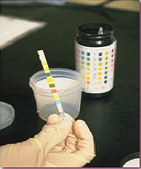
Urine Testing
Urine Western Blot
  As sensitive as testing blood
  Safe way to screen for HIV
  Can cause false positives in certain people at high risk for HIV

Slide 98
Oral Testing
Orasure
  The only FDA approved HIV antibody.
  As accurate as blood testing
  Draws blood-derived fluids from the gum tissue.
  NOT A SALIVA TEST!

Slide 99
HIV prevention based on ARV drugs
Oral pre-exposure prophylaxis
Serodiscordant couples | daily oral PrEP ( TDF or TDF + FTC)
Men and transgender women | daily oral PrEP (Specifically TDF + Emtricitabine)
ART for prevention among serodiscordant couples | PLHIV in serodiscordant couples who start ART for their own health, ART is also recommended to reduce HIV transmission to the uninfected partner. HIV-positive partners with a CD4 count ≥350 cells/mm3.

Slide 100
Post-exposure prophylaxis for occupational and non-occupational exposure to HIV
Post-exposure prophylaxis for women within 72 hours of a sexual assault | Recommended duration of PoEP is 28 days, First dose as soon as possible within 72 hours The choice based on first-line ART regimen.

Slide 101
Delivery of HIV treatment and care
LINK ART PLUS CENTRES(LAC PLUS)
ARV drug dispensing
Enrolment of PLHIV in HIV care and treatment (Pre-ART Care)
Monitoring of PLHIV on ART
Baseline lab tests
Counseling on adherence, nutrition & prevention
ART PLUS CENTRES
Assessment and initiate treatment for alternate first line and second line
Accessible and facilitate delivery of second line ART
Viral load testing

Slide 102
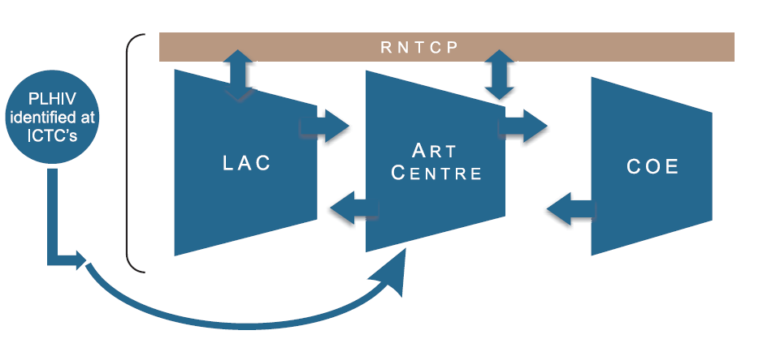
Delivery of HIV treatment and care
THREE TIER STRUCTURE

Slide 103
COE
CENTRES OF EXCELLENCE
Provision of second line and alternative first line ART
Training, research and monitoring of ART centers linked to them
COMMUNITY CARE CENTRES
Counseling for ARV treatment preparedness and drug adherence, nutrition and prevention
treatment of OI
referral and outreach services for follow-up
Social support services
ART CENTRES
CD4 Testing
Pre ART care and counseling
ART provision
Treatment of OI
DROP IN CENTRES
Psychosocial support
Counseling
Sharing and caring
Referrals to ICTC, DOTS
Needle and syringe exchange
LINK ART CENTRES
Accessible and facilitate delivery of ART
Monitoring patients on ART
Counseling on adherence, nutrition & prevention

Slide 104
PMTCT program option | Pregnant and breastfeeding women with HIV |  | HIV-exposed infant
Use lifelong ART for all pregnant and breastfeeding women (“Option B+”) | Regardless of WHO clinical stage or CD4 |  | Breastfeeding | Replacement feeding
 | Initiate ART and maintain after delivery & cessation of breastfeeding |  | Up to 6 weeks of infant prophylaxis with once-daily NVP | Up to 6 weeks of infant prophylaxis with once-daily NVP
Use lifelong ART only for pregnant and breastfeeding women eligible for treatment (“Option B”) | Eligible for Treatment (CD4 Count) | Not eligible for treatment
 | Initiate ART and maintain after delivery and cessation of breastfeeding | Initiate ART and stop after delivery and cessation of Breastfeeding

