Slide 1
RHEUMATIC FEVER AND RHEUMATIC HEART DISEASE

Slide 2
RHEUMATIC FEVER AND RHEUMATIC HEART DISEASE
Rheumatic fever (RF) is an acute, immunologically mediated, multisystem inflammatory disease that occurs a few weeks after an episode of group A streptococcal pharyngitis.
Acute rheumatic carditis is a frequent manifestation during the active phase of RF and may progress over time to chronic rheumatic heart disease (RHD), of which valvular abnormalities are key manifestations.
RHD is characterized principally by deforming fibrotic valvular disease, particularly mitral stenosis, of which it is virtually the only cause.

Slide 3
The incidence and mortality rate of RF and RHD have declined remarkably in many parts of the world over the past century, as a result of improved socioeconomic conditions and rapid diagnosis and treatment of streptococcal pharyngitis.
Nevertheless, in developing countries, and in many crowded, economically depressed urban areas in the Western world, RHD remains an important public health problem, affecting an estimated 15 million people.

Slide 4
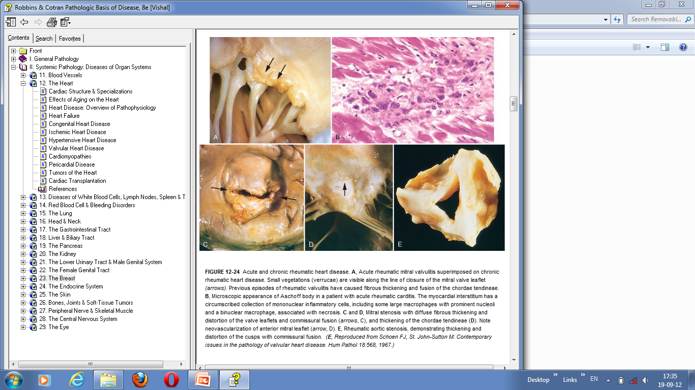

Slide 5
Morphology.
During acute RF, focal inflammatory lesions are found in various tissues. Distinctive lesions occur in the heart, called Aschoff bodies, which consist of foci of lymphocytes (primarily T cells), occasional plasma cells, and plump activated macrophages called Anitschkow cells (pathognomonic for RF). These macrophages have abundant cytoplasm and central round-to ovoid nuclei in which the chromatin is disposed in a central, slender, wavy ribbon (hence the designation “caterpillar cells”), and may become multinucleated.

Slide 6
During acute RF, diffuse inflammation and Aschoff bodies may be found in any of the three layers of the heart, causing pericarditis, myocarditis, or endocarditis (pancarditis).
Inflammation of the endocardium and the left-sided valves typically results in fibrinoid necrosis within the cusps or along the tendinous cords. Overlying these necrotic foci are small (1- to 2-mm) vegetations, called verrucae, along the lines of closure.
Subendocardial lesions, perhaps exacerbated by regurgitant jets, may induce irregular thickenings called MacCallum plaques, usually in the left atrium.

Slide 7
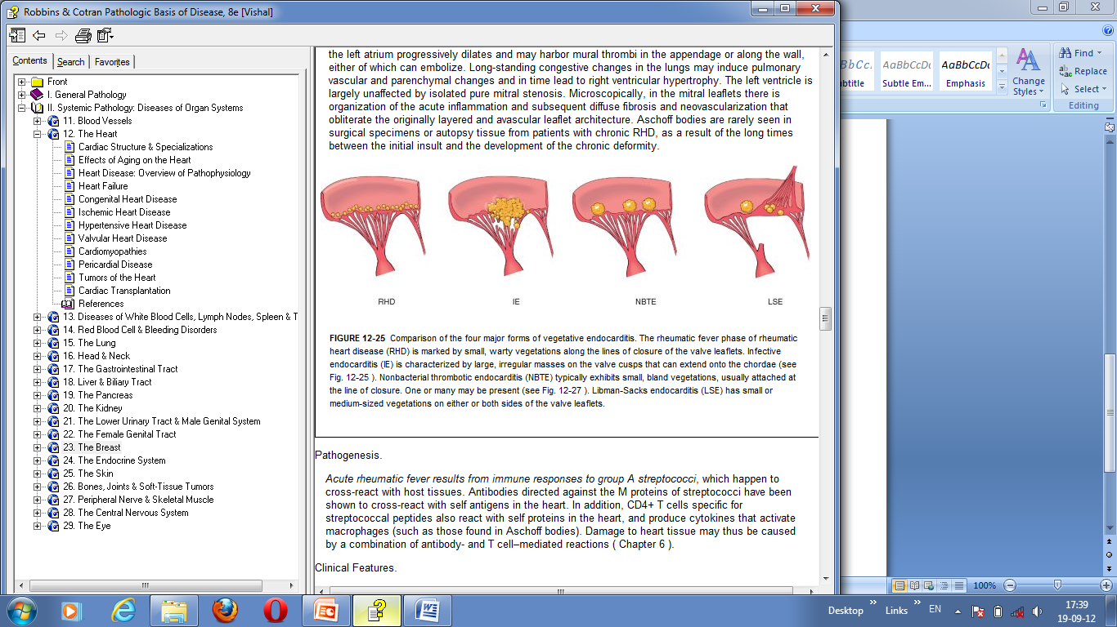
The rheumatic fever phase of rheumatic heart disease (RHD) is marked by small, warty vegetations along the lines of closure of the valve leaflets

Slide 8
The cardinal anatomic changes of the mitral valve in chronic RHD are leaflet thickening, commissural fusion and shortening, and thickening and fusion of the tendinous cords.
In chronic disease the mitral valve is virtually always involved. The mitral valve is affected alone in 65% to 70% of cases, and along with the aortic valve in another 25% of cases.
Tricuspid valve involvement is infrequent, and the pulmonary valve is only rarely affected.

Slide 9
Fibrous bridging across the valvular commissures and calcification create “fish mouth” or “buttonhole” stenoses. With tight mitral stenosis, the left atrium progressively dilates and may harbor mural thrombi in the appendage or along the wall, either of which can embolize.
Long-standing congestive changes in the lungs may induce pulmonary vascular and parenchymal changes and in time lead to right ventricular hypertrophy. The left ventricle is largely unaffected by isolated pure mitral stenosis.

Slide 10
Microscopically, in the mitral leaflets there is organization of the acute inflammation and subsequent diffuse fibrosis and neovascularization that obliterate the originally layered and avascular leaflet architecture.
Aschoff bodies are rarely seen in surgical specimens or autopsy tissue from patients with chronic RHD, as a result of the long times between the initial insult and the development of the chronic deformity.

Slide 11
Pathogenesis.
Acute rheumatic fever results from immune responses to group A streptococci, which happen to cross-react with host tissues.
Antibodies directed against the M proteins of streptococci have been shown to cross-react with self antigens in the heart.
In addition, CD4+ T cells specific for streptococcal peptides also react with self proteins in the heart, and produce cytokines that activate macrophages (such as those found in Aschoff bodies). Damage to heart tissue may thus be caused by a combination of antibody- and T cell–mediated reactions .

Slide 12
Clinical Features
RF is characterized by a constellation of findings that includes as major manifestations:
(1) migratory polyarthritis of the large joints,
(2) pancarditis,
(3) subcutaneous nodules,
(4) erythema marginatum of the skin
(5) Sydenham chorea, a neurologic disorder with involuntary rapid, purposeless movements.
The diagnosis is established by the so-called Jones criteria: evidence of a preceding group A streptococcal infection, with the presence of two of the major manifestations listed above or one major and two minor manifestations (nonspecific signs and symptoms that include fever, arthralgia, or elevated blood levels of acute-phase reactants).[

Slide 13
Acute RF typically appears 10 days to 6 weeks after an episode of pharyngitis caused by group A streptococci .
It occurs most often in children between ages 5 and 15, but first attacks can occur in middle to later life. Although pharyngeal cultures for streptococci are negative by the time the illness begins, antibodies to one or more streptococcal enzymes, such as streptolysin O and DNase B, can be detected in the sera of most patients with RF.
The predominant clinical manifestations are carditis and arthritis, the latter more common in adults than in children.

Slide 14
Clinical features related to acute carditis include pericardial friction rubs, weak heart sounds, tachycardia, and arrhythmias. Myocarditis may cause cardiac dilation that can evolve to functional mitral valve insufficiency or even heart failure.
Arthritis typically begins with migratory polyarthritis (accompanied by fever) in which one large joint after another becomes painful and swollen for a period of days and then subsides spontaneously, leaving no residual disability.

Slide 15
Clinical manifestations appear years or even decades after the initial episode of RF and depend on which cardiac valves are involved.
After an initial attack there is increased vulnerability to reactivation of the disease with subsequent pharyngeal infections, and the same manifestations are likely to appear with each recurrent attack. Damage to the valves is cumulative. Turbulence induced by ongoing valvular deformities begets additional fibrosis.

Slide 16
In addition to various cardiac murmurs, cardiac hypertrophy and dilation, and heart failure, individuals with chronic RHD may suffer from arrhythmias (particularly atrial fibrillation in the setting of mitral stenosis), thromboembolic complications, and infective endocarditis .
The long-term prognosis is highly variable. Surgical repair or prosthetic replacement of diseased valves has greatly improved the outlook for persons with RHD.

Slide 17
R. Krishna Kumar & R. Tandon
Indian J Med Res 137, April 2013, pp 643-658
Article | Author and journal | Aim | Result | Conclusion
Rheumatic fever & rheumatic heart disease: The last 50 years LEVEL 1 | R. Krishna Kumar & R. Tandon Indian J Med Res 137, April 2013, pp 643-658 | Rheumatic fever (RF) and rheumatic heart disease (RHD) continue to be a major health hazard in most developing countries as well as sporadically in developed economies. Despite reservations about the utility, echocardiographic and Doppler (E&D) studies have identified a massive burden of RHD suggesting the inadequacy of the Jones’ criteria updated by the American Heart Association in 1992. Subclinical carditis has been recognized by E&D in patients with acute RF without clinical carditis as well as by follow up of RHD patients presenting as isolated chorea or those without clinical evidence of carditis | Paediatric and juvenile mitral stenosis (MS), upto the age of 12 and 20 yr respectively, severe enough to require operative treatement was documented. These negate the belief that patients of RHD become symptomatic ≥20 years after RF as well as the fact that congestive cardiac failure in childhood indicates active carditis and RF. Pathogenesis as well as susceptibility to RF continue to be elusive. Prevention of RF morbidity depends on secondary prophylaxis which cannot reduce the burden of diseases. | Primary prophylaxis is not feasible in the absence of a suitable vaccine. Attempts to design an antistreptococcal vaccine utilizing the M-protein has not succeeded in the last 40 years. Besides pathogenesis many other questions remain unanswered.

Slide 18
Which one of the following laboratory investigation is used to diagnose acute
rheumatic fever?
a) ECG b) CXR
c) ASO titer d) Throat culture
e) There is no specific diagnostic laboratory test
Major organ/s affected by rheumatic fever with long-term sequel is
a) Heart c) Skin
b) Joint d) CNS e) All
The commonest valve involved in ARF and/or rheumatic heart disease
a) Mitral valve c) Tricuspid valve
b) Aortic valve d) pulmonary valve
One of the following is not a clinical feature of acute rheumatic fever
a) Migratory arthritis
b) Carditis
c) Sydenham’s chorea
d) None

Slide 19
THANK YOU

