Slide 1
Last Lecture
Epidemiology
Diff epidemiological study – Classification
Case Control study – Basic, Analysis

Slide 2
Cohort Study
Dr. Nilesh G. Patel

Slide 3
Basic Scientific Method
Identify the problem
central to beginning the method of actually solving the problem,
Formulate the hypothesis
outcome statement to test, Review of Literature
Develop the plan of research
what do you need to do to test this hypothesis?
(Methodology, participants, data gathering, analysis)
Collecting and analyzing the data
Interpreting the results and forming conclusions
does the evidence support the hypothesis

Slide 4
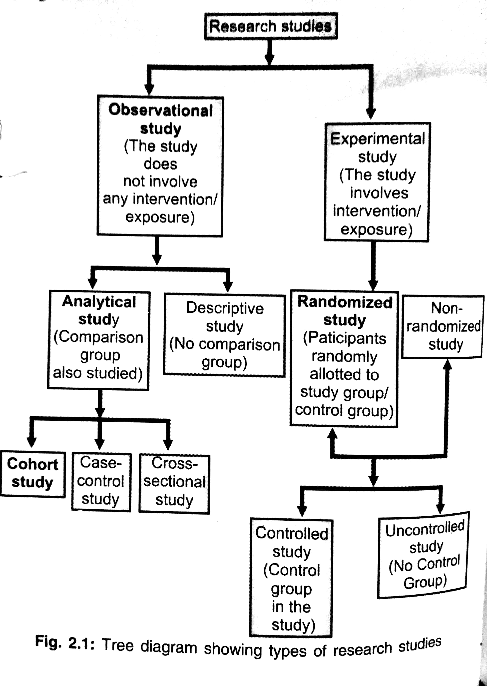
Research studies

Slide 5
Design of Cohort study
Exposure
(People with Exposure)
Population
Comparison gp
(People without Exposure)
Direction of inquiry
No Disease
Disease
Disease
No Diasese
Time- Forward

Slide 6
Concept of cohort
The cohort is defined as a group of people who share a common characteristic or experience within a defined time period.
Marriage cohort,
Birth cohort,
Exposure cohort
Occupation cohort…..

Slide 7
Comparison Group
It may be general population from which the cohort is drawn,
or
it may be another cohort of persons thought to have had little or no exposure to the substance in question but otherwise similar

Slide 8
Indication for cohort study
When there is good evidence of an association between exposure and disease after descriptive & case-control study.
When exposure is rare, but the incidence of disease is high among exposed
When attrition of study population is minimized.
When ample funds are available.

Slide 9
Pre-requisite
Cohort must be free from the disease under study
Both group should equally susceptible to the disease under study.
Both group should be comparable
Diagnostic & eligibility criteria of the disease must be defined before hand.

Slide 10
Types of cohort studies
Prospective cohort studies – current or concurrent cohort studies
Retrospective cohort studies - historical cohort studies, prospective study in retrospect, non-concurrent prospective study
A combination of retrospective and prospective cohort studies.

Slide 11
Basic steps
Selection of study objects
Obtaining data on exposure.
Selection of comparison group.
Follow up.
Analysis

Slide 12
Selection of study objects
General population
Special groups

Slide 13
2. Obtaining data on exposure
Information about exposure may be obtained directly from
Cohort members
Review of records
Medical examination / test
Environmental surveys.

Slide 14
Information on Exposure
Classification
Exposed or not
Level of exposure

Slide 15
3. Selection of comparison groups
Internal comparison-
2 cigarettes per day Vs 2 packs/day
External comparison-
Cohort of radiologist Vs Ophthalmologist
Comparison with general population rate-
Disease rate in general population

Slide 16
4. Follow up
Procedure required are
Periodic medical examination of each member of cohort
Reviewing physician and hospital records
Routine surveillance of death records
Mailed questionnaire or telephone calls periodic home visits

Slide 17
5. Analysis
Incidence rate of outcome among exposed and non exposed
Estimation of risk

Slide 18
Estimation of risk
Relative Risk
Attributable risk
Population attributable risk

Slide 19
Relative Risk/Risk Ratio
Incidence amongst exposed
Incidence amongst exposed
Relative Risk =
Relative Risk =
Incidence amongst non-exposed
Incidence amongst non-exposed

Slide 20
Framework
 | Lung CA | No CA lung | Total
Smoker | 500 | 500 | 1000
Non smoker | 100 | 900 | 1000
Total | 600 | 1400 | 2000
Incidence amongst exposed = 500/1000 = 50%
Incidence amongst non exposed =100/1000 = 10%

Slide 21
Incidence amongst exposed
Relative Risk =
Incidence amongst non-exposed
= 50/10
=5
Smokers have 5 times higher risk of CA lung as compared to non-smokers

Slide 22
Relative Risk (RR)
Direct measure of strength of association between the suspected cause & effect.
RR of one indicates no association
>1 indicates positive association between exposure & effect.
Larger the RR, greater the strength of association.

Slide 23
Attributable risk
Difference in incidence rates of disease between an exposed group and non exposed group.
A.R.=
Incidence of Disease in Exposed (MINUS)-
Incidence of Disease in NOT Exposed x 100
Incidence of Disease in Exposed
80% of lung cancer cases among smokers are due to smoking.

Slide 24
Population Attributable risk
Difference in incidence rates of disease between an exposed group and non exposed group.
A.R.=
Incidence of Disease in Population (MINUS)-
Incidence of Disease in NOT Exposed x 100
Incidence of Disease in Population

Slide 25
R.R. V/s A.R.
RR important in etiological enquiries
Larger the RR stronger the association between cause and effect.
AR gives the impact of successful preventive or public health programme might have in reducing the problem.

Slide 26
PROSPECTIVE STUDY: PROS & CONS
PROS
CONS
Less variability to bias
No recall necessary
(no recall BIAS)
Incidence determined
Relative risk more accurate
Consistent disease definitions & symptoms.
Longer time
Common disease only
Expensive
Ethical concern
A high drop-out rate
Volunteers needed
A large no. of subjects needed
Notes:
This slide presents the pros and cons of the prospective study.

Slide 27
Kannel WB, McGee DL. Diabetes and cardiovascular disease: the Framingham study. Jama. 1979 May 11;241(19):2035-8.

Slide 28
1) A study began in 1970 with a group of 5000 adults in Delhi who were asked about their alcohol consumption. The occurrence of cancer was studied in this group between 1990-1995. This is an example of:
(a) Cross-sectional study
(b) Retrospective cohort study
(c) Concurrent cohort study
(d) Case-control study

Slide 29
2) TATA memorial hospital conducted a cohort study on 7000 subjects who were smokers over a ten-year period & found 70 subjects developed lung cancer. Concurrent evaluation of general population in the catchment area of hospital, out of 7000 non-smoker subjects only 7 developed lung cancer. The RR for developing lung cancer is:
(a) 1
(b) 10
(c) 100
(d) 0.1

Slide 30
3) Several studies have shown that 85% of cases of lung cancer are due to cigarette smoking. It is a measure of:
(a) Incidence rate
(b) Relative risk
(c) Attributable risk
(d) Population attributable risk

Slide 31
4) The incidence of carcinoma cervix in women with multiple sexual partners is 5 times the incidence seen in those with a single partner. Based on this, what is the attributable risk?
(a) 20%
(b) 40%
(c) 50%
(d) 80%

Slide 32
5) Attribute risk gives a better idea of:
(a) Strength of association between cause and effect
(b) Impact of successful preventive health programme
(c) Assessing aetiological role or factor in disease
(d) Potential public health importance of disease

Slide 33
Answers
C
B
C
D
B

