Slide 1
RCH-1-Introduction
Dr. Niraj Pandit
Professor, Community Medicine

Slide 2
History of RCH Programme
1950 – MCh service through PHC
1952 – National Family Planning Programme
1962 – Central Family Planning institute, ND
1965- ICMR grant permission to Lippes loop
1966- National Hospital Post partum programme
1967 – small family norm committee
1972 – MTP act passed
1977- National family welfare programme
1992- CSSM programme
1997 – RCH –I
2003- RCH –II
2006 NRHM

Slide 3
Objectives of RCH
Health Outcome Goals established in the 12th Fiver Year Plan
  Reduction of Infant Mortality Rate (IMR) to 25 per 1,000 live births by 2017
  Reduction in Maternal Mortality Ratio (MMR) to 100 per 100,000 live births by 2017
  Reduction in Total Fertility Rate(TFR) to 2.1 by 2017

Slide 4
Components of RCH
Maternal Health
Infant and Child Health
Services for couples
Services for adolescent health
Quality improving services

Slide 5
Antenatal Care -Objectives
Promote and maintain the physical, mental and social health of mother and baby by providing education on nutrition, personal hygiene and birthing process
Detect and manage high risk & complications during pregnancy, whether medical, surgical or obstetrical thus reduce mortality & morbidity
Develop birth preparedness and complication readiness plan
Help prepare mother to breastfeed successfully, experience normal puerperium, and take good care of the child physically, psychologically and socially

Slide 6
ANC visit
Ideal ANC visit – once every month till 7 month, twice month in next month and weekly till delivery
Minimum ANC as per programme – 4 visit
Early registration
First visit – history taking, investigations, records (mamta card)

Slide 7
Risk approach
Identify High risk pregnancy
  Elderly primi (more than 30 yr)
  Adolescent pregnancy (teen pregnancy)
  Short stature (140 cm or less)
  Twins pregnancy, hydroamnios
  Anaemia, eclampsia, pre-eclampsia
  Antepartum haemorrhage
  Previous still birth history or BOH, Previous LSCS
  Elderly grand multipara
  Pregnancy with diseases
  Malpresentation

Slide 8
ANC advice
Warning sings
Diet
Personal hygiene
Drugs
Radiation
Child care
Family planning
Give clear instruction to mother
  Swelling on feet with face
  Fit (convulsion)
  Headache
  Blurring of vision
  Bleeding P/V
  Any unusual symptom

Slide 9
Other ANC advise
Specific to diseases
other
Anemia
Nutritional deficiencies
Tetanus
Syphilis
G.Measles
Rh status
HIV infection
Genetic screening
Mental preparation
Delivery plan
Family planning advise
Child care

Slide 10
Scientific basis for the content of routine antenatal care. Philosophy or scientific?
Title of study | Journal | Method | Result / conclusion
Scientific basis for the content of routine antenatal care. I. Philosophy, recent studies, and power to eliminate or alleviate adverse maternal outcomes. Level of evidence – Higher level – as review of RCT | Acta Obstet Gynecol Scand. 1997 Jan;76(1):1-14 | Review of recent literature, especially randomized controlled trials. | Counselling and advice on what to do is the best option. It is uncertain whether early detection of pre-eclampsia will reduce the incidence of eclampsia. there is no evidence that anti-hypertensive treatment of mild pre-eclampsia will prevent more severe disease

Slide 11
Intranatal care
Child birth is normal physiological phenomena.
Objectives
Thorough asepsis
  Minimum injury to mother and child
  Readiness to deal with complications – prolongedlabour, APH, convulsions, malpresentation, prolapse of cord
  Care of baby at delivery – resuscitation ,care of Cord, care of eyes

Slide 12
Delivery place
Home delivery –
Institutional delivery

Slide 13
Home delivery
Advantage
  Female delivers in familiar surroundings and removes the fear of hospital delivery
  Chances of cross infection are less
  She may keep an eye on household affairs
Disadvantage –
  Mother may have less medical and nursing supervision
  Less rest
  Resume domestic duties v soon
  Diet may be neglected

Slide 14
Institutional delivery
About 1% deliveries tend to be abnormal and 4% difficult labour requires services of doctor.
Rooming in –keeping baby’s crib by mother’s side
Bedding in – keeping baby in mother’s bed
Kangaroo care

Slide 15
5 clean for INC
Complications like septicemia , tetanus prevented with emphasis is on cleanliness
  Clean hands and fingernails
  Clean surface
  Clean cutting
  Clean cord
  Clean birth canal

Slide 16
MCQ test
1. MTP act implemented in India in
  A. 1970
  B. 1972
  C. 1975
  D. 1977

Slide 17
2. All of the following are 5 cleans except –
  A. clean cord
  B. clean nose
  C. clean surface
  D. clean canal

Slide 18
3. which are the warning signs of antenatal period
  A. sever headache
  B. oedema face and feet
  C. blurring of vision
  D. all of above

Slide 19
4. Which investigation must be avoid during ANC care?
  A. blood syphilis
  B. urine R & M
  C. Blood grouping
  D. X-ray abdomen

Slide 20
5. Which of following are high risk pregnancy?
  A. elderly primigravida
  B. adolescent pregnancy
  C. pregnancy with high sugar
  D. all of above

Slide 21
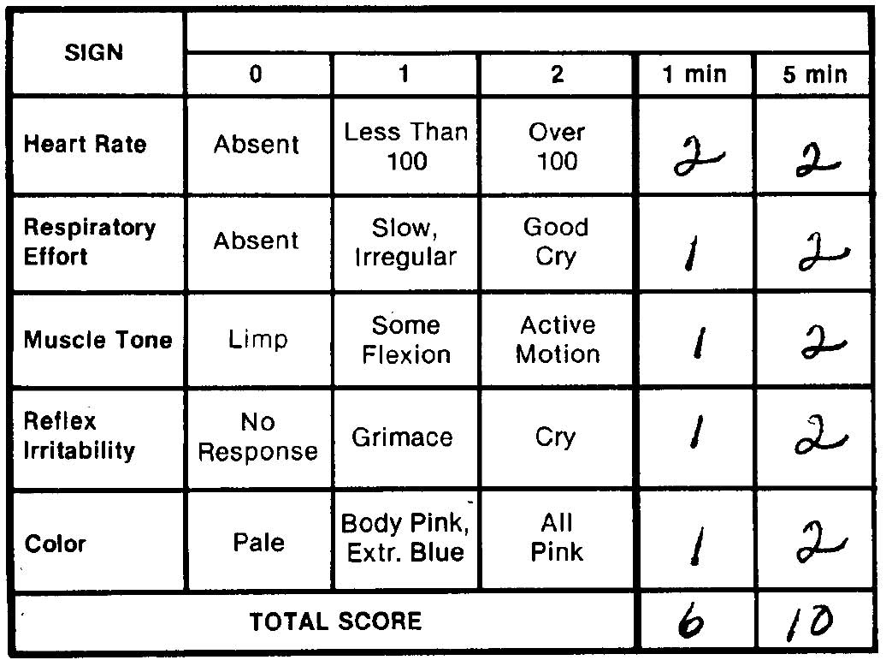
Apgar score

