Slide 1
RCH-2-Postnatal care
Dr.Niraj Pandit
Professor
Community Medicine Department

Slide 2
Postnatal care
Care of newborn and mother after delivery
It is responsibility of obstetrician and pediatrician which is called as perinatology.
objectives
  To prevent complications of postpartum period.
  To provide care for rapid restoration of the mother to optimum health.
  To check adequacy of breast feeding.
  To provide family planning services.
  To provide basic health education to mother/ family.
  Child care including immunization

Slide 3
Complications of postpartal period
Puerperal sepsis – is infection of genital tract within 6 weeks after delivery.
Thrombophlebitis – is infection of leg veins frequently associated with varicose veins .
Secondary hemorrhage –bleeding from vagina anytime from 6 hours to 6 weeks
UTI , mastitis

Slide 4
Restoration of mother to optimum health
Postnatal examination – twice a day during first 3 days then once a day till umbilical cord drops off . At the end of 6 weeks check up for involution of uterus.
Further visits every month during first 6 months there after once in 2 – 3 months till end of 1 year . In rural areas 3-6 visits should be made .
Anemia
Nutrition
Postnatal exercises
Psychological factors- postpartum psychosis
Social – raise the child in good family atmosphere

Slide 5
Care of Baby
Immediate care
  Apgar score
  Care of cord
  Care of eyes
  Body temperature
  Breast feeding
  Screening of newborn for congenital malforamtion
  Measurements of baby – weight, length, head circumference, span, chest circumference
Early neonatal care
Late neonatal care

Slide 6
Examination of baby
The first examination is made soon after birth, and preferably in the delivery room.
This examination is (a) to ascertain that the baby has not suffered injuries during the birth process; (b) to detect malformations especially those requiring urgent treatment; and (c) to assess maturity.
(a) cyanosis of the lips and skin; (b) any difficulty in breathing (c) imperforated anus; (d) persistent vomiting; (e) signs of cerebral irritation such as twitchings, convulsions, neck rigidity, bulging of anterior fontanel, and (g) temperature instability.

Slide 7
At risk baby
Neonatal infection - NEONATAL TETANUS, CONGENITAL SYPHILIS, NEWBORN WITH AN HBV POSITIVE MOTHER, NEWBORN WITH AN HIV POSITIVE MOTHER
Based on various measurements
Congenital malformation

Slide 8
Breast feeding
Exclusive Breast feeding for 6 months
Breast feeding for 2 years
No bottle feeding
Complementary feeding at 6 months
Under normal conditions, Indian mothers secrete 450 to 600 ml of milk daily with 1.1 gm protein per 100 ml. The energy value of human milk is 70 kcals per 100 ml

Slide 9
Advantages of BF
Health outcomes
  Infant – short term
  Infant – long term
  Maternal
Economic
Environmental

Slide 10
Protein composition of human colostrum and mature breast milk (per litre)
From: Worthington-Roberts B, Williams SR. Nutrition in Pregnancy and Lactation, 5th ed. St. Louis, MO, Times Mirror/Mosby College Publishing, p. 350, 1993.

Slide 11
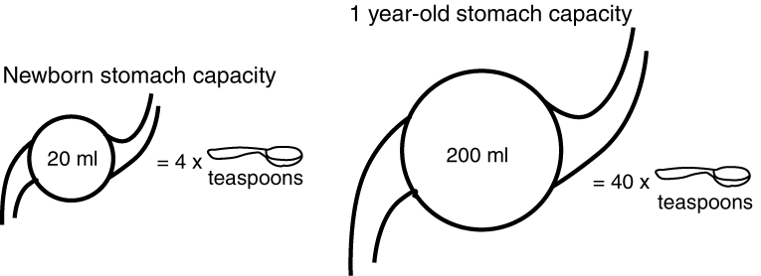
The perfect match: quantity of colostrum per feed and the newborn stomach capacity
Adapted from: Pipes PL. Nutrition in Infancy and Childhood, Fourth Edition. St. Louis, Times Mirror/Mosby College Publishing, 1989.

Slide 12
Medically indicated Exceptions
There are rare exceptions during which the infant may require other fluids or food in addition to, or in place of, breast milk. The feeding programme of these babies should be determined by qualified health professionals on an individual basis.

Slide 13
Family Planning
Post partum sterilization is recommended on 2nd day after delivery
IUD and conventional contraceptives should be used during lactation

Slide 14
Other key education
Hygiene – personal and environmental
Immunization
Feeding for mother and infant
Birth registration
Importance of health check up

Slide 15
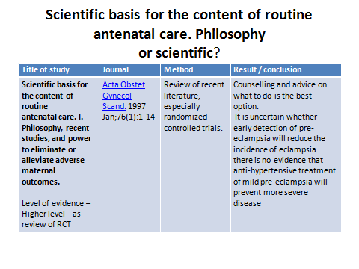

Slide 16
Exam time
Please take paper and write ur name &roll number
Write answer clearly
Each question carry 1 marks
No negative marking
1 min for one question

Slide 17
1. How many ANC visit minimum recommended under programme RCH?
  A – 2
  B – 3
  C – 4
  D - 8

Slide 18
2. What are high risk pregnancy?
  A- Elderly grand multipara
  B – Rh –ve mother
  C – Weight of mother <40 kg
  D – Height of mother > 145 cm

Slide 19
3. Write two warning sing symptoms of pregnancy
  A Headache
  B Convulsion
  C -Edema feet
  Weight gain 8 kg during pregnancy period

Slide 20
4. Exclusive Breast feeding means
  A – Infant on only BF for 4 months
  B- Infant on only BF for 6 months
  C – Infant on BF + top feed for first six months
  D Non of above

Slide 21
5. What duration is known as postnatal care?
  A. 3 weeks post delivery
  B. 6 weeks post delivery
  C. 9 weeks post delivery
  D. Conception to delivery

