Slide 1
RCH-3-Growth chart
Dr.Niraj Pandit
Professor
Community Medicine Department

Slide 2
RCH – Infant & child part
Growth & Development
Care of pre-school children
Problems of pre-school children
Programmes for pre-school children
Programme for school children

Slide 3
Growth & Development
Growth - Concept
Development – Concept
Determinants of growth & Development
  Genetic
  Nutrition
  Gender
  Physical environment
  Infections & parasites
  Economic factors

Slide 4
Method of assessment
Concept of normality
Measurements of growth – weight, length -height, head circumference, span etc.
Weight for age, length-height for age, weight for height
Development – motor, social, adaptive, language

Slide 5
Growth chart
Definition: It is a visible display of a child’s physical growth and development.
First designed by David Morley .
Growth chart offers a simple and inexpensive way of monitoring weight gain.
Any deviation from “normal” detected by comparison with reference curves

Slide 6
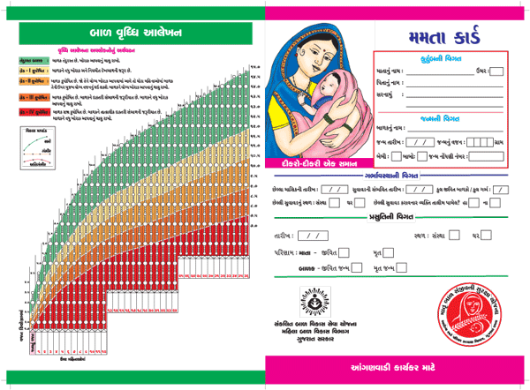

Slide 7
Growth chart in India
It has four reference curves.
Top most curve – 80 %of the median (50th percentile) of the WHO reference standard
Lower lines represent 70% ,60% and 50% of the standard.
80% median weight approximately equal to 2 SD below the median which is the conventional lower limit of “normal range”.
Purpose of reference curve – indicates degree of malnutrition.

Slide 8
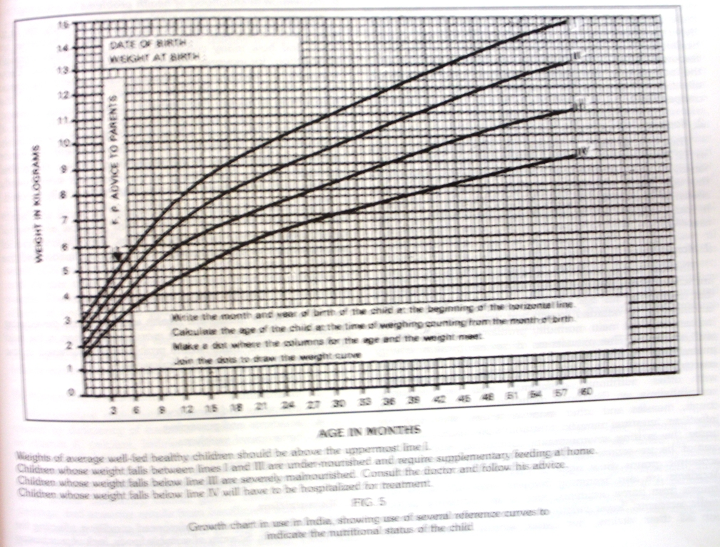

Slide 9
Uses of growth chart
Growth monitoring
Diagnostic tool
Planning and policy making
Educational tool
Tool for action
Evaluation
Tool for teaching

Slide 10
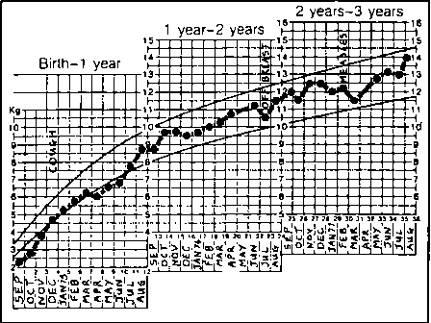

Slide 11
Care of pre-school children
Large number – 12% of population
Mortality –
Morbidity
Growth & development
Accessibility to services
Prevention of major problems of adulthood

Slide 12
Children health problems
LBW
Malnutrition
Infection & parasitosis
Accidents & poisoning
Behavioural problems

Slide 13
Programmes for pre-school
Immunization
Vit-A supplementation programme
ICDS
Diarrhoeal diseases control programme
ARTI control programme

Slide 14
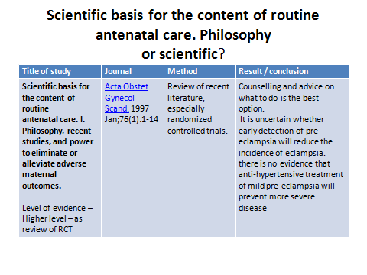

Slide 15
1. Pre-school age is
  A – 0-3 yr
  B – 1-3 yr
  C – 1-4 yr
  D – 0-6 yr

Slide 16
2. What are NOT the uses of growth chart?
  A- Education tool
  B – diagnostic tool
  C – developmental tool
  D – Evaluation tool

Slide 17
3. What do you mean by development?
  A linear increasing size
  B horizontal increasing size
  C Brain growth
  D Skill acquirement

Slide 18
4. Apgar score includes
  A – Skin color
  B- Muscle tone
  C – reflexes
  D – none of above

Slide 19
5. Pentavalent vaccine includes all except
  A. Hepatitis-A
  B. Pertussis
  C. Hib
  D. diphtheria

