Slide 1
RCH-4-School Health Programme
Dr.Niraj Pandit
Professor
Community Medicine

Slide 2
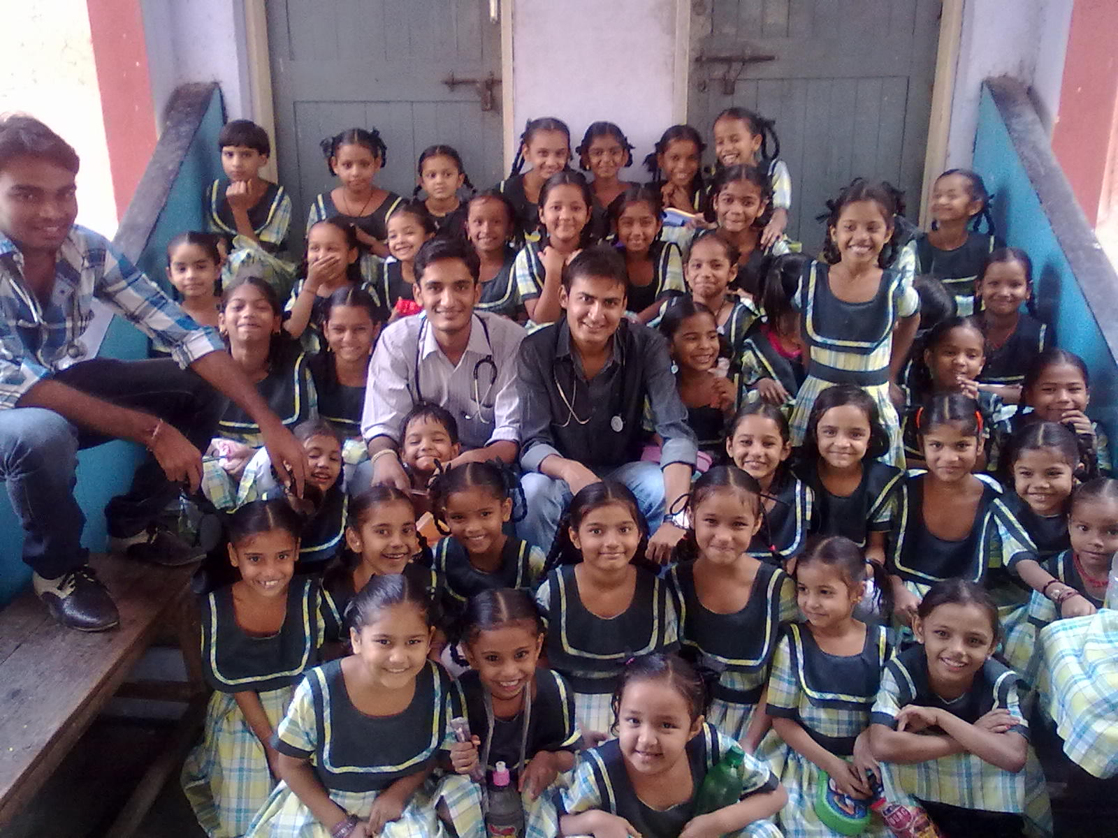
School Health Program

Slide 3
A planned and coordinated school-based program that is designed to enhance child and adolescent health.
It is organised by Gujarat government every year.

Slide 4
Why?
They constitute a big sector of the population (about 1/6). This sector is easily reached through schools, as by law, children are compelled to attend schools and spend about half of their day for a period of 12 years.
School students are considered a vulnerable group. They are growing exposed physiologic, mental and emotional stress at home or school.

Slide 5
School pupils are very active &curious so liable to accidents.
Health status of pupils is a strong determinant of their school achievement.
Pupils are affected by school environment.
School years are the best opportunity for health education.
We can reach parents through their children. Some children attend school with different health problems, could be early discovered and treated.

Slide 6
Component Of School Health Program
School health services
School health education
Parents awareness

Slide 7
Team of School health
Teacher
Doctor
Health worker
Administrator of school
Anganwadi workers
ASHA workers

Slide 8
Benefits of
School health program
Get clear idea about the overall health status of children.
Improvement in overall health standard of children.
Can detect children who need special care because of their health status
Communicable diseases can be prevented.
Reduce absence of children due to sickness in school.
Data obtained from the school health program is useful for community health statistics.
Can change the unhealthful behaviors of the children.
Can get a baseline data for further follow up of children’s health status.

Slide 9
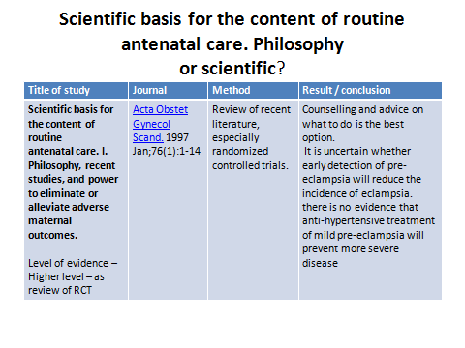

Slide 10
1. School age children is
  A – 3-13 yr
  B – 5-17 yr
  C – 1-17 yr
  D – 6-20 yr

Slide 11
2. What are the components of school health services?
  A- School health service
  B – Health education
  C – Parent education
  D – all of above

Slide 12
3. School health programme is important because …
  A They represent big population in country
  B They are vulnerable
  C school years are best opportunity for health education
  D all of above

Slide 13
4. All of following are playing important role in school health programme, Except…
  A – School teacher
  B- Doctor
  C – parents
  D – health worker

Slide 14
5. If we think school health programme as research, which type of research best suit?
  A. Observational study
  B. case control study
  C. Cohort study
  D. RCT

