Slide 1
ANDROGENS

Slide 2
Introduction
Testosterone is the principal secreted androgen both in men and women
Androstenedione and dehydroepiandrosterone(DHEA) are also secreted.
In men it is produced in the leydig cells of the testes
In women, it is secreted by the corpus luteum and adrenal cortex.

Slide 3
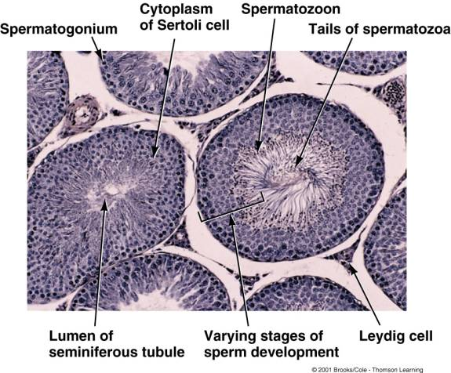

Slide 4
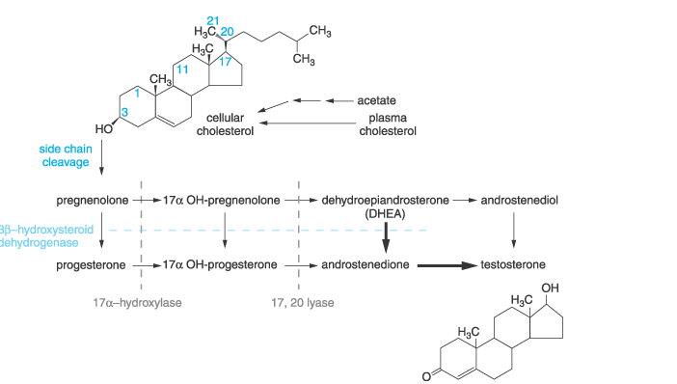

Slide 5
SECRETION
IN -UTERO OF A MALE BABY
In the first trimester ,the fetal testes begin to secrete testosterone, probably stimulated by human chorionic gonadotropin (hCG) from the placenta
Beginning of the second trimester, the value is close to that of midpuberty, about 250 ng/dl
Testosterone production then falls by the end of the second trimester, but by birth the value is again about 250 ng/dl

Slide 6
The testosterone value falls again in the first few days after birth, but it rises peaks again at about 250 ng/dl at 2 to 3 months after birth and falls to <50 ng/dl by 6 months, where it remains until puberty
From about age 12 to 17 years, the serum testosterone concentration is 500 to 700 ng/dl in men, compared to 30 to 50 ng/dl in women!!

Slide 7
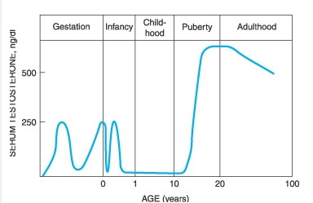

Slide 8
TRANSPORT
Sex hormone-binding globulin (SHBG) binds about 40% of circulating testosterone with high affinity
Albumin binds almost 60% of circulating testosterone with low affinity, leaving approximately 2% unbound or free
In some testosterone assays, the latter two components are considered as "bioavailable" testosterone.

Slide 9
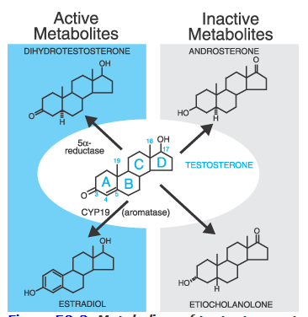
Metabolism of testosterone
androsterone, androstanedione,
and androstanediol

Slide 10
Physiological and Pharmacological Effects of Androgens
Testosterone can act as an androgen :
  Directly, by binding to the androgen receptor
  Indirectly by conversion to dihydrotestosterone, which binds to the androgen receptor even more avidly than testosterone.
As estrogen by conversion to estradiol, which binds to the estrogen receptor

Slide 11
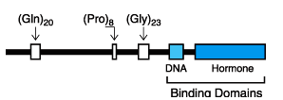
Physiological and Pharmacological Effects of Androgens
Effects That Occur Via the Androgen Receptor
Testosterone and dihydrotestosterone act as androgens via a single androgen receptor
Officially designated NR3A-is a member of the nuclear receptor superfamily
Comprised of an amino-terminal domain, a DNA-binding domain, and a ligand-binding (Hormone)domain

Slide 12
Physiological and Pharmacological Effects of Androgens
Effects That Occur Via the Estrogen Receptor
Mediated by its conversion to estradiol, catalyzed by the CYP19 enzyme complex

Slide 13
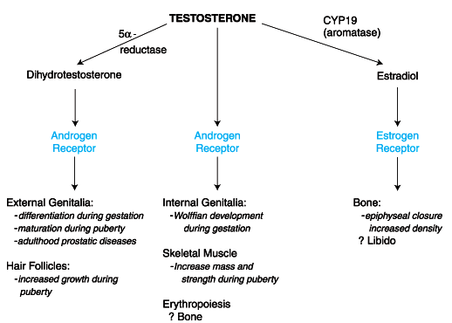

Slide 14
Effects of Androgens at Different Stages of Life
In Utero
Fetal testes, stimulated by HCG, begin to secrete testosterone at 8th week of gestation.
Stimulates the nearby wolffian ducts to differentiate into the male internal genitalia: the epididymis, vas deferens, and seminal vesicles.
Testosterone is converted to dihydrotestosterone, which causes the development of the male external genitalia-the penis, scrotum and the prostate.

Slide 15
Effects of Androgens at Different Stages of Life
Puberty
In Men begins at a mean age of 12 years.
The increased secretion of FSH and LH stimulates the testes, so, not surprisingly, the first sign of puberty is an increase in testicular size.
The increase in testosterone production by Leydig cells, along with the effect of FSH on the Sertoli cells, stimulates the development of the seminiferous tubules, which eventually produce mature sperm.
The phallus enlarges in length and width, the scrotum becomes rugated, and the prostate begins secreting the fluid it contributes to the semen.

Slide 16
Effects of Androgens at Different Stages of Life
Puberty
The skin becomes coarser and oilier due to increased sebum production, which contributes to the development of acne.
Sexual hair begins to grow, initially pubic and axillary hair, then hair on the lower legs, and finally other body hair and facial hair.
Muscle mass and strength increase, especially of the shoulder girdle, and subcutaneous fat decreases.
Epiphyseal bone growth accelerates, resulting in the pubertal growth spurt, but epiphyseal maturation leads eventually to a slowing and then cessation of growth.

Slide 17
Effects of Androgens at Different Stages of Life
Puberty
Bones also become thicker.
Erythropoiesis increases, resulting in higher hematocrit and hemoglobin concentrations in men than boys or women.
The larynx thickens, resulting in a lower voice.
Libido develops.

Slide 18
Effects of Androgens at Different Stages of Life
Adulthood
The serum testosterone concentration and the characteristics of the adult male are largely maintained during early adulthood and midlife.
One change during this time is the gradual development of male pattern baldness, beginning with recession of hair at the temples and the vertex.
Gradual development of benign prostatic hyperplasia. This development is mediated by the conversion of testosterone to dihydrotestosterone by 5α-reductase II within prostatic cells
Development of cancer - rare . This dependency is the basis of treating metastatic prostate cancer by lowering the serum testosterone concentration or by blocking its action.

Slide 19
Consequences of Androgen Deficiency
During Fetal Development
Testosterone deficiency in a male fetus during the first trimester in utero causes incomplete sexual differentiation.
Testosterone deficiency in the first trimester results only from testicular disease, such as deficiency of CYP17 (17a-hydroxylase);
Complete deficiency - Results in entirely female external genitalia
Less severe - Results in incomplete virilization of the external genitalia proportionate to the degree of deficiency.
Also leads to failure of the wolffian ducts to differentiate into the male internal genitalia,
Abnormal 5a-reductase results in incomplete virilization of the external genitalia in utero but normal development of the male internal genitalia, which requires only testosterone

Slide 20
Consequences of Androgen Deficiency
During Fetal Development
Testosterone deficiency during the third trimester, caused either by
  A testicular disease or
  A deficiency of fetal LH secretion
Two known consequences.
  The phallus fails to grow normally - microphallus, is a common occurrence in boys later discovered to be unable to secrete LH due to abnormalities of GnRH synthesis.
  The testes fail to descend into the scrotum - cryptorchidism, occurs commonly in boys whose LH secretion is subnormal

Slide 21
Therapeutic Androgen Preparations
Testosterone undergoes rapid hepatic metabolism, and hence the preparations are supposed to bypass the liver.
1.Testosterone Esters
Esterifying a fatty acid to the 17a hydroxyl group of testosterone more lipophylic
testosterone enanthate (heptanoate) or cypionate (cyclopentylpropionate)

Slide 22
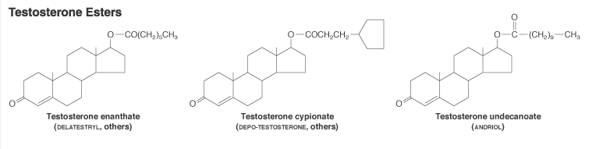
The undecanoate ester of testosterone when dissolved in oil and ingested orally, is absorbed into the lymphatic circulation, thus bypassing initial hepatic metabolism.

Slide 23
2.Alkylated Androgens
17α-alkylated androgens are androgenic when administered orally; however, they are less androgenic than testosterone itself.
  Greater anabolic effect that androgenic effect
3.Transdermal Delivery Systems
Chemicals called excipients are used to facilitate the absorption of native testosterone across the skin in a controlled fashion.
ANDRODERM,ANDROGEL, TESTIM

Slide 24
THERAPEUTIC USES
Hypogonadism
Male Senescence
Female Hypogonadism
Enhancement of Athletic Performance
Tetrahydrogestrinone (THG), a potent androgen -designed and synthesized in order to avoid detection by anti-doping laboratories on the basis of its novel structure and rapid metabolism.

Slide 25
SIDE - EFFECTS
All androgens suppress gonadotropin secretion when taken in high doses and thereby suppress endogenous testicular function
decreased sperm production and fertility
High doses, androgens that can be converted to estrogens gynaecomastia
The 17a-alkylated androgens are the only androgens that cause hepatotoxicity
  specifically to decrease high-density lipoprotein (HDL) cholesterol and increase low-density lipoprotein (LDL) cholesterol
Virilization, including facial and body hirsutism, temporal hair recession in a male pattern, and acne.

Slide 26
SIDE - EFFECTS
Boys experience phallic enlargement, and women experience clitoral enlargement
Boys and girls whose epiphyses have not yet closed experience premature closure and stunting of linear growth.
Male Contraception
Blood dyscariasis

Slide 27
Author | Results | Journal | level
Ilpo Huhtaniemi | Late‑onset hypogonadism: current concepts and controversies of pathogenesis, diagnosis and treatment | asian Journal of Andrology (2014) 16, 192–202 © 2014 AJA, SIMM & SJTU. All rights reserved 1008-682 | Level 2

Slide 28
Tripathi KD, Essentials of medical pharmacology, 6th edition, Jaypee publication New Delhi
Goodman and Gilman's the Pharmacological Basis of Therapeutics. 11th ed. New York, NY: McGraw-Hill; 2006

Slide 29
THANK YOU

