Slide 1
RCH-5-Adolescent Health
Dr.Niraj Pandit
Professor
Community Medicine

Slide 2
Adolescent Health
1. Adolescent nutrition; iron and folic acid supplementation
2. Facility-based adolescent reproductive and sexual health services (Adolescent health clinics)
3. Information and counseling on adolescent sexual reproductive health and other health issues
4. Menstrual hygiene
5. Preventive health checkups

Slide 3
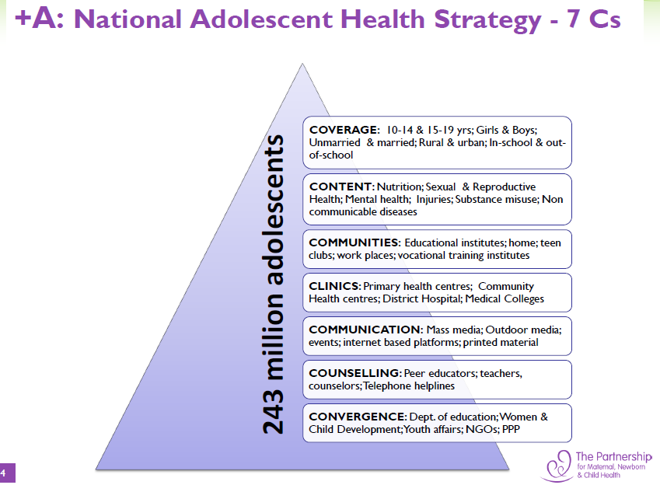

Slide 4
New Initiative: National Iron Plus Initiative
Children
6-60 months: IFA administered biweekly, on fixed days , under direct supervision of ASHAs ; 5-10 years: at AWC & through schools
Adolescent
NEW COMPONENT
Reproductive Age group
NEW COMPONENT
Pregnant & lactating women
As part of the antenatal care package, at all levels of health facilities , sub centre and outreach
IFA to be distributed by ASHA during doorstep delivery of contraceptives; IFA tablets to be given for 52 weeks each year
Weekly IFA supplementation (WIFS) for both adolescents boys & girls in Government/Government aided/municipal schools

Slide 5
Adolescent Friendly Health Services (Adolescent Health Clinics)
Services at sub centre: ANM
Adolescent Information and Counseling Centre will be made functional by MO and ANM at PHC on weekly basis.
At CHC, DH/SDH/ and Medical College: Adolescent Health Clinics(daily basis)
Special focus will be given to establishing linkages with Integrated Counseling and Testing Centres (ICTCs) and making appropriate referrals for HIV testing and RTI/STI management

Slide 6

Scheme for promotion of menstrual hygiene among adolescent girls in rural India:
This scheme promotes better health and hygiene among adolescent girls
Sanitary napkins are provided under NRHM’s brand ‘Free days’.
These napkins are being sold to adolescent girls by ASHAs

Slide 7
Preventive health checkups and screening for diseases, deficiency and disability
Components of School Health Programme include screening, basic health services and referral
Bi-annual health screening is undertaken for students (6–18 years age group)
Implementation of School Health Programme
Team consist of:
- 2 Medical Officers
(MBBS / Dental / AYUSH qualified)
- 2 paramedics
(one ANM and any one of the following Pharmacist/ Ophthalmic Assistant/Dental assistant

Slide 8
Services to couple
National Family Welfare Programme
Quality Services
Prevention of RTI/STI including HIV/AIDS

Slide 9
Components of RCH
Maternal Health
Infant and Child Health
Services for couples
Services for adolescent health
Quality improving services

Slide 10
Quality improving services
Infrastructure development - IPHS
Human resource management - IPHS
ASHA
Janani Suraksha Yojana
Janani Shishu Suraksha Yojana – Bal Shakha
Up gradation of PHC to EOC & EmOC
Training of Dais
Involvement of ISM
Paradigm shift in management of programme

Slide 11
Indian Public Health Standard
With objective of improving quality care IPHS implemented at various level
  IPHS for PHC
  IPHS for CHC
  IPHS for District Hospitals and various other level
IPHS is focusing on services, manpower, infrastructure, monitoring evaluation and feedback

Slide 12
ASHA – Accredited Social Health Activist
Objective - To provide accessible, affordable, accountable, effective and reliable primary health care and bridging the gap in rural health care through creation of ASHA
Focus on
  Reduction in Infant Mortality Rate (IMR) and Maternal Mortality Ratio (MMR)
  Universal access to public health services such as Women’s health, child health, water, sanitation & hygiene, immunization, and Nutrition.
  Prevention and control of communicable and non-communicable diseases, including locally endemic diseases

Slide 13
ASHA
Resident of the village, a woman (M/W/D) between 25-45 years, with formal education up to 8th class, having communication skills and leadership qualities.
One ASHA per 1000 population.
Chosen by the panchayat to act as the interface between the community and the public health system.
Bridge between the ANM and the village.
Honorary volunteer, receiving performance based compensation .

Slide 14
Responsibility of ASHA
To create awareness among the community regarding nutrition, basic sanitation, hygienic practices, healthy living.
Counsel women on birth preparedness, imp of safe delivery, breast feeding, complementary feeding, immunization, contraception, STDs
Encourage the community to get involved in health related services.
Escort/ accompany pregnant women, children requiring treatment and admissions to the nearest PHC’s.
Primary medical care for minor ailment such as diarrhea, fevers
Provider of DOTS.

Slide 15
Monitoring & Evaluation
The public health managers have to monitor the programme.
They have to evaluate the effectiveness of the programme with the following indicators.

Slide 16
ACCESSIBILITY INDICATOR
No. of eligible couples registered/ANM
No. of Antenatal Care sessions held as planned
% of sub Centers with no ANM
% of sub Centers with working equipment of ANC
% ANM/TBA without requisite skill
% Sub centers with DDKs
% of sub centers with infant weighing machine
% Sub centers with vaccine supplies
% Sub centers with ORS packets
% Sub centers with FP supplies

Slide 17
QUALITY INDICATOR
% Pregnancy registered before 12 weeks
% ANC with 5 visits
% ANC receiving all RCH services
% High-risk cases referred
% High-risk cases followed up
% Deliveries by ANM/TBA
%PNC with 3 PNC visits
% PNC receiving all counselling
% PNC complications referred
% Eligible couple offered FP choices
% Women screened for RTI/STDs
% Eligible couple counselled for prevention of RTI/STDs
% ADD given ORS
% ARI treated
% Children fully immunized

Slide 18
IMPACT INDICATOR
% Deaths from maternal causes
Maternal mortality ratio
Prevalence of maternal morbidity
% Low birth weight
Neo-natal mortality ratio
Prevalence of postnatal maternal morbidity
% Baby breast-feeds within 6 hrs of delivery
Couple protection rate
Prevalence of terminal method of sterilization
Prevalence of spacing method
% Abortion related morbidity
Prevalence of ADD
Prevalence of ARI
Prevalence of RTI/ST

Slide 19
Revision of RCH
ANC / INC /PNC
LBW baby
Kangaroo care
Infant feeding (BF / Weaning / IYCF guideline)
Growth & Development (Growth chart)
School Health service

Slide 20
Indicators of MCH care
  Maternal Mortality rate/ratio
  Perinatal mortality rate
  Neonatal mortality rate
  Post-neonatal mortality rate
  IMR
  1-4 years mortality rate
  Under 5 mortality arate
  Child survival rate

Slide 21
IMNCI
ICDS
Adolescent health – Kishori Shakti Yojana
Geriatrics – Gerontology
UIP / EIP
NRHM- NUHM – NHM
ASHA
Janani (Shishu) Suraksha Yojana

Slide 22
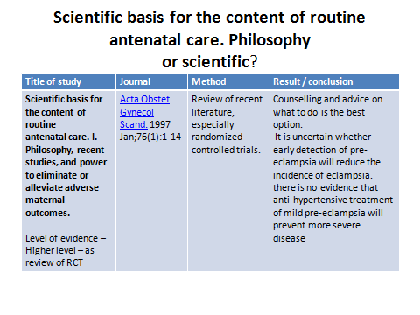

Slide 23
Exam time
Please take paper and write ur name &roll number
Write answer clearly
Each question carry 1 marks
No negative marking
1 min for one question

Slide 24
What is eligible couple & target couple?

Slide 25
All of following are quality indicators of RCH EXCEPT
A. % High-risk cases referred
  B. % High-risk cases followed up
C. % Deliveries by ANM/TBA
D. % Low birth weight

Slide 26
Write two warning sing symptoms of pregnancy
  A Headache
  B Convulsion
  C -Edema feet
  D. Weight gain 8 kg during pregnancy period

Slide 27
PHC catering ___________ population in hilly area
Sub-center catering _________ population in normal plain area

Slide 28
Write two responsibilities of ASHA worker.

