Slide 1
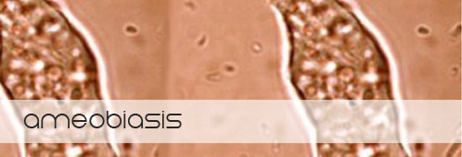
Part 1

Slide 2
Amebiasis
Amebiasis is a protozoal infection of the intestinal tract that occurs due to ingestion of foods or water contaminated with Entameba Histolytica cysts

Slide 3
LIFE CYCLE
Entamoeba histolytica exists in two forms:
Cysts (infective):
can survive outside the human body.
transform to trophozoites.
2. Trophozoites (non-infective; invasive):
  Can reproduce
  They may feed on intestinal bacteria or invade and ulcerate wall of large intestine, and may migrate to liver or other tissues.
  transform to cysts which are excreted in feces.

Slide 4
Life Cycle
Cysts ingestion.
Formation of trophozoites
Penetration of intestinal wall
Multiplication of trophozoites within colon wall.
Systemic invasion.
Cyst formation in rectum and excretion in feces.

Slide 5
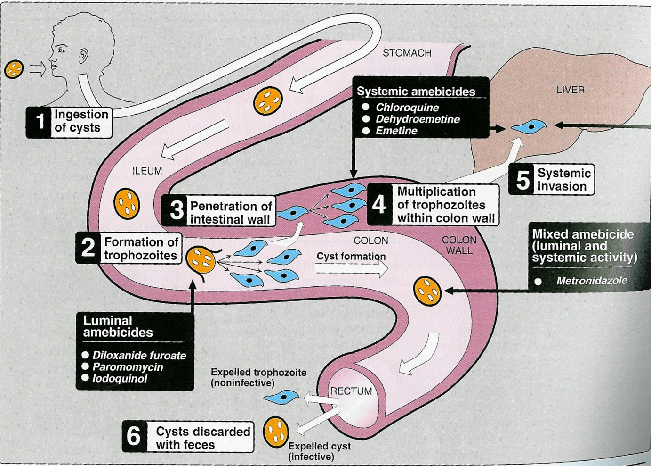
LIFE CYCLE

Slide 7
Clinical presentations
Asymptomatic Intestinal infection
(Carriers, passing cysts)
Mild to moderate intestinal disease
(Nondysenteric Colitis)
Severe Intestinal infection (Dysentery)
Hepatic abscess, ameboma (localized granulomatous lesion of colon) and other extraintestinal disease

Slide 8
ANTIAMEBIC DRUGS
▪ Luminal Amebicides
▪ Tissue or systemic amebicides
▪ Mixed Amebicides

Slide 9
LUMEN AMOEBICIDES
Acts on the parasites in the lumen of the bowl.
used for treatment of asymptomatic amebiasis.
Include
Diloxanide Furoate
Iodoquinol
Antibiotics
- Paromomycin
- Tetracyclines
- Erythromycin

Slide 10
Tissue Amoebicides (systemic)
acts on the intestinal wall and liver (or any other extra-intestinal tissue).
Used for treatment of systemic form of the disease (intestinal wall infection or liver abscesses).
Emetine
Dehydroemetine
Chloroquine (liver only)

Slide 11
Mixed amoebicides
Effective against both luminal and systemic forms of the disease. Although luminal concentration is too low for single drug –treatment.
Metronidazol
Tinidazole

Slide 12
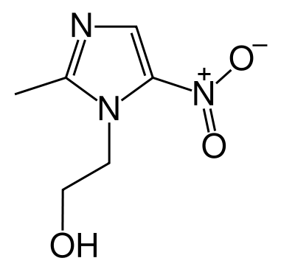
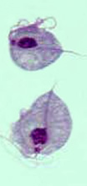
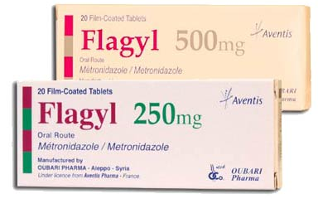
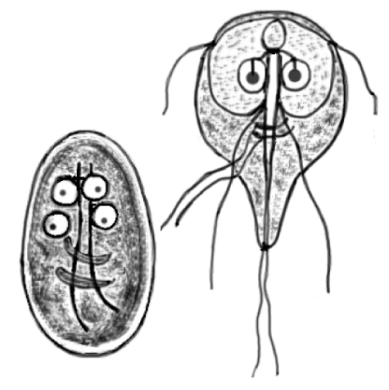
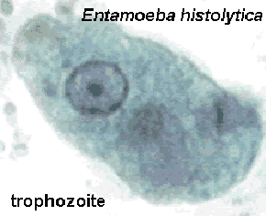
METRONIDAZOLE : Mixed amebicidal
Broad spectrum cidal activity against --- Protozoa – E. histolytica, T. vaginalis, G. lamblia
Anaerobic bacteria – B.fragilis, C.perfringes, H.pylori, Cl. difficile
G. lamblia
T. vaginalis

Slide 13
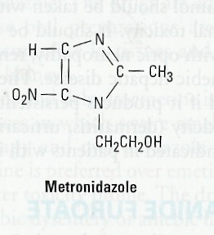
METRONIDAZOLE
Mixed amoebicide.
Drug of choice for intestinal &
extraintestinal amoebiasis.
Acts on trophozoites.
Has no effect on cysts.

Slide 14
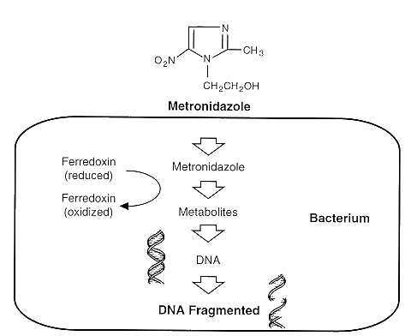
Anaerobic condition
Nitro group of metronidazole is reduced by redox proteins leading to cytotoxic reduced product that binds to DNA and proteins resulting into parasite death.

Slide 15
Pharmacokinetics
Given orally or IV.
Absorption is rapid and complete.
▪ Due to rapid absorption from GIT, not reliably effective against luminal parasites.
Wide distribution to all tissues and body fluids (CSF, saliva, milk).
Plasma protein binding is low ( < 20%).
Plasma half life is 8 h

Slide 16
Pharmacokinetics
Metabolized in liver by mixed function oxidase followed by glucouroidation.
Excreted in urine as unchanged drug plus metabolites.
Clearance is decreased in liver impairment.
Tinidazole has longer duration, simpler dosing regimen, less toxicity, than metronidazole, but is equally active.

Slide 17
Clinical Uses
Amoebiasis
Extraluminal amoebiasis (combined with luminal amebicide)
  Invasive dysentery & liver abscess-800 mg TDS for 7-10 days
  Mild cases-400 mg TDS for 7-10 days

Slide 18
Giardiasis
alcoholism
Trichomoniasis-2 g single dose
Broad spectrum of Anaerobic bacteria e.g.,
  Helicobacter pylori infection
  Pseudomembranous colitis (Clostridium defficile)
  After colorectal or pelvic surgery
  Brain abscess, endocarditis
  Generally used in combination with gentamicin or cephalosporins

Slide 19
Acute necrotizing ulcerative gingivitis-trench mouth
  Metronidazole+ amoxicillin
  Tinidazole -Ornidazole-long half life
  Secnidazole

Slide 20
Adverse effects
1. GIT:
Nausea
Vomiting
Dry mouth
Metallic taste
Diarrhoea
Oral Thrush (Moniliasis, yeast infection).

Slide 21
Adverse effects
2. CNS: Neurotoxicological effect
  Insomnia, dizziness
  peripheral neuropathy, paresthesia
  encphalopathy, convulsion ( IV infusion, rare).
  3. Dysuria, dark urine.
  4. Neutropenia
  5. Disulfiram-like effect if taken with alcohol.

Slide 22
disulfiram like -effect
When metronidazole is given with alcohol abdominal distress, nausea, vomiting, flushing, or headache, tachycardia, hyperventilation
alcohol aldehyde
dehydrogenase dehydrogenase
Ethanol Acetaldehyde Acetate

Slide 23
Drug interactions:
Enzyme inhibitors (cimetidine, ketoconazole)
increase duration of action of metronidazole
Inducers (phenytoin and phenobarbitone).
inhibits CYP family 2C9 & 3A4
potentiate anticoagulant effect of warfarin.
potentiates lithium toxicity.

Slide 24
CONTRAINDICATIONS / PRECAUTIONS:
▪ Pregnancy and nursing women.
▪ Alcohol intake
▪ CNS diseases
▪ Severe hepatic disease
Severe renal disease

Slide 25
EMETINE AND DEHYDROEMETINE
Chemistry:
Emetine hydrochloride is a plant alkaloid derived from ipeca.
Dehydroemetine is a synthetic analogue
Pharmacokinetics:
Erratic oral absorption.
Given preferably subcutaneously but could be given by IM, NEVER I.V.
Plasma half life is 5 days.

Slide 26
EMETINE
Concentrated in Liver, Lungs, Spleen, Kidney, Cardiac muscle and Intestinal wall.
Metabolized & Excreted slowly via kidney so it has a cumulative effect.
Trace amounts could be detected in urine 1-2 month after last dose.
Should not be used for more than 10 days (usually 3-5 days).

Slide 27
Mechanism
Act on tissue trophozoites causing irreversible block of protein synthesis.

Slide 28
Adverse Effects
Dehydroemetine is less toxic than emetine
pain at site of injection, abcesses.
GIT: nausea, vomiting, diarrhoea.
Neuromuscular weakness
Serious toxicities: cardiotoxicity
- cardiac arrhythmias,
- Hypotension
- heart failure

Slide 29
Clinical Uses
Amoebic liver abscess.
Intestinal wall infections.
Severe forms of amebiasis acute amoebic dysentery dehydroemetine is preferable due to less toxicity (3-5 days).

Slide 30
References
Tripathi KD, Essentials of medical pharmacology, 6th edition, Jaypee publication New Delhi
Lauraence DR, Bennett TN and Brown MJ. Unwanted effects and adverse drug reactions. Clinical Pharmacology 8th edn. Churchill Livingstone 1997

Slide 31
S. B. PENICK; RUSSELL N. CARRIER; JUDITH B. SHELDON | Results | Journal | level
S. B. PENICK; RUSSELL N. CARRIER; JUDITH B. SHELDON | Metronidazole in the Treatment of Alcoholism | The American Journal of Psychiatry, VOL. 125 | Level 1

