Slide 1
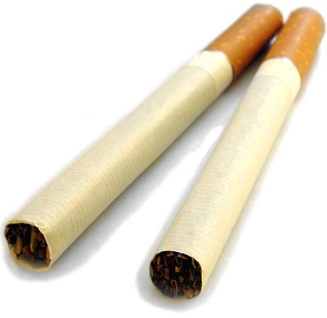
Smoking & Lung Cancer
Prepared by:
Dr.Manish Kathad
Associate Professor
Community medicine

Slide 2
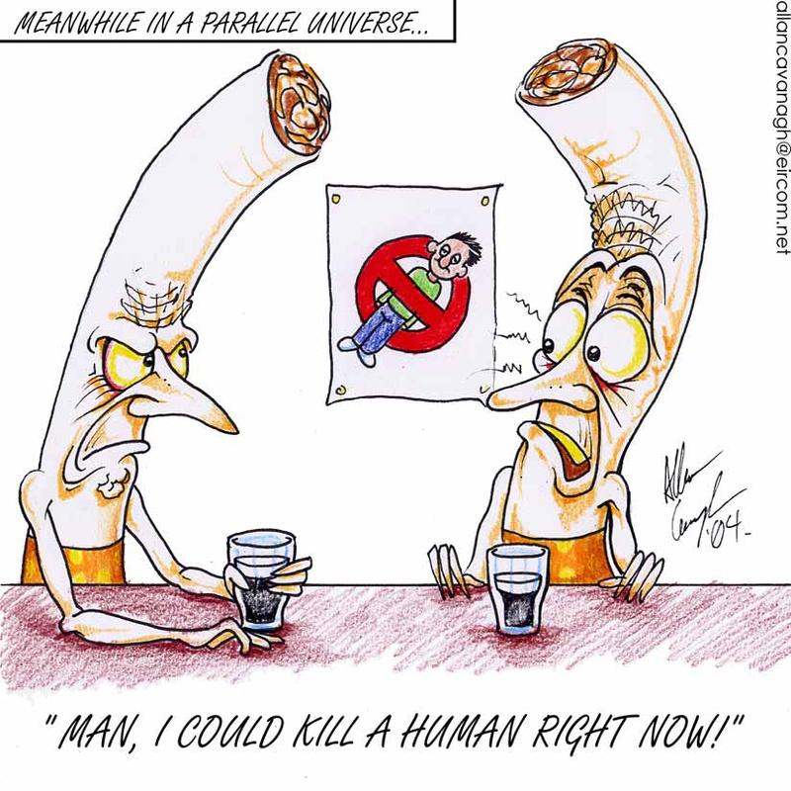
Smoking is by far the most important
preventable cause of cancer in the world
Tobacco is a dirty weed. I like it.
It satisfies no normal need. I like it.
It makes you thin, it makes you lean,
It takes the hair right off your bean.
It's the worst darn stuff I've ever seen.
I like it.

Slide 3
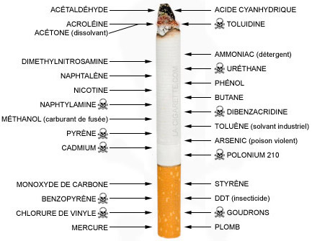

Slide 4
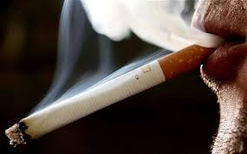
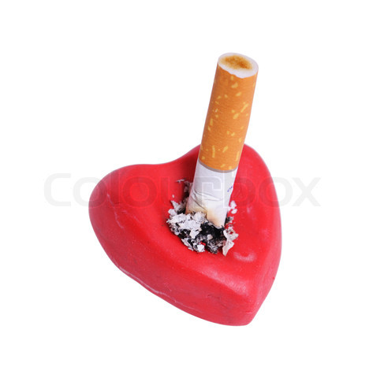
"Cigarette smoking is the most significant public health problem facing our people. More Americans die every year from smoking-related diseases than from AIDS, car accidents, murders, suicides and fires — combined."

Slide 5
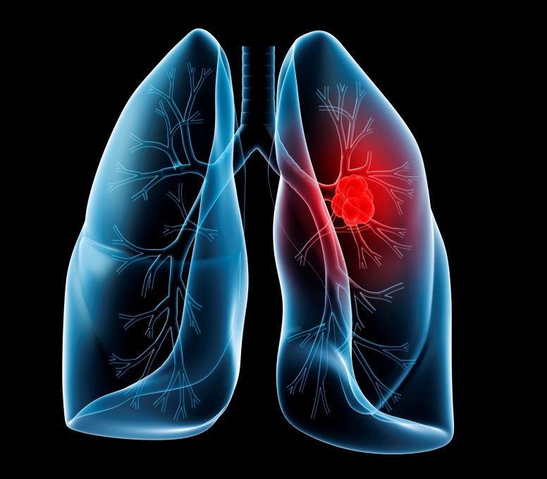
Lung cancer
Smoking & Lung Cancer?
Cigarette smoke inhibits and damages the normal cleaning process by which the lungs get rid of foreign and harmful particles. Smoke destroys an important cleansing layer in the lungs, which in turn causes a build-up of mucus. The result is "smokers' cough," an alternative method that the lungs take in attempting to clean themselves. The harmful cancer-producing particles in cigarette smoke are able to remain lodged in the mucus and develop into cancer tumors.

Slide 6


Slide 7
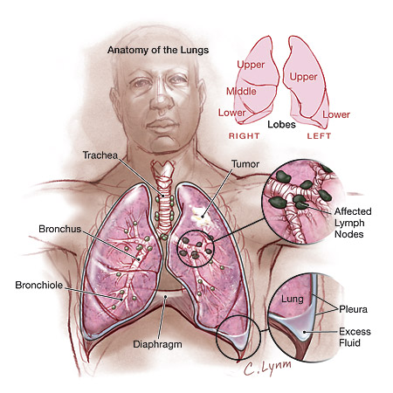
Lung cancer is caused when some of the cells forming the tissues of the lungs grow abnormally and form a malignant tumor. The tumor might start in different parts of the lungs.
There are rarely noticeable symptoms in the early stages of lung cancer, and this is why early detection is difficult. In later stages, symptoms can include:
- A persistent cough that gets worse over time;
- Haemoptysis or increased amounts of mucus;
- Constant chest pain;
- Breathlessness, wheezing or hoarseness;
- Repeated bouts of pneumonia or bronchitis;
- Swelling of the neck and face;
Appetite loss, weight loss and fatigue.

Slide 8
Types and Treatments
Small cell: Chemotherapy and radiotherapy
Non small cell: Surgery, chemotherapy and radiotherapy depending on the stage in which diagnosed

Slide 9
Stages of lung cancer
Stage 0: Treated with surgery to remove a small portion of the lung
Stage 1: Treated with lobectomy
Stage 2: Lobectomy and chemotherapy to decrease chances of cancer coming back
Stage 3: Whole lung may have to be removed
Stage 4: Impossible to cure, but there are treatments that can be used. Chemotherapy to prolong survival time

Slide 10
Non smokers and lung cancer
A possibility
Every year, 3 thousand deaths in America are due to second hand smoke.
“The amount of nicotine absorbed by a non-smoking child whose father smokes is equivalent to the child himself smoking about 30 cigarettes/year; 50 cigarettes/year from a mother who smokes and 80 cigarettes a year if both parents smoke.”
Smoking while pregnant increases chance of miscarriage, premature birth and death of baby within one year
Growth and development of the child is impaired
Brain development is affected. IQ is negatively affected
The child will be more likely to develop behavioural problems

Slide 11
Dangers associated with smoking
Heart disease: 30% of all MIs and cardiovascular deaths
Carbon monoxide and nicotine accelerate the deposition of cholesterol in tunica intima and media of arteries
Increases chance of blood clots
Lack of oxygen to the heart increase the chance of heart attack
Can affect blood flow to legs → blockage and progress to gangrene and amputations
Can affect the elastic tissue and cause wrinkles on the face. Smokers look an average 5 years older

Slide 12
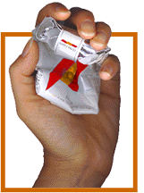
If you smoke, please quit!
Within 48 hours of quitting, blood pressure decreases, heart rate decreases and pulse drops. The ability to smell and taste also increases.

Slide 13
EVIDENCE…

Slide 14
Richard Doll A. Bradford Hill 1950 | Case control study | 20 hospitals in London notified patients with cancer of the lung, stomach and large bowel. Almoners then visited and interviewed each patient. The patients with stomach Ca and large bowel Ca served as comparison. The almoners also interviewed a non-cancer control group chosen so as to be of the same sex and age as the lung Ca patients. 649 men and 60 women were interviewed. | 26% of male and 14.6% of female lung Ca patients who smoked said their most recent smoking habit was 25 or more cigarettes a day. Most cancer patients had a definite history of smoking.

Slide 15
Ernest L. Wynder Evarts A. Graham 1950 | Case control study | 684 cases of bronchogenic carcinoma were enlisted. They were interviewed either personally or via mail. They were asked questions pertaining to their smoking habits for the last 20 years. | The study showed that all cancer patients invariably had a history of smoking. Cigarette smoking proved a higher risk than pipes/cigars. On the basis of the statistical data for both the control study 1 and the combined results, when the non smokers and the total of the high smoking classes of patients with lung cancer are compared with patients who have other diseases, the null hypothesis that smoking has no effect on the lungs is rejected.

Slide 16
A. Parsons, A. Daley, R. Begh, P. Aveyard 2010 | Systematic review with meta-analysis (High level of evidence) | Two researchers independently identified studies for inclusion and extracted data. Estimates were combined by using a random effects model, and the I² statistic was used to examine heterogeneity. Life tables were used to model five year survival for early stage non-small cell lung cancer and limited stage small cell lung cancer, using death rates for continuing smokers and quitters obtained from this review. | Continued smoking was associated with a significantly increased risk of all cause mortality (hazard ratio 2.94, 95% confidence interval 1.15 to 7.54) and recurrence (1.86, 1.01 to 3.41) in early stage non-small cell lung cancer and of all cause mortality (1.86, 1.33 to 2.59), development of a second primary tumour (4.31, 1.09 to 16.98), and recurrence (1.26, 1.06 to 1.50) in limited stage small cell lung cancer. Evidence that smoking cessation after diagnosis of early stage lung cancer improves prognostic outcomes.

Slide 17
References
Doll R., Hill A.B. Smoking and carcinoma of the lung. Br Med J. 1950 September 30; 2(4682): 739–748.
Wynder E.L., Graham E.A. Tobacco smoking as a Possible Etiologic Factor in Bronchogenic Carcinoma. JAMA 1950; 143: 329-336.
Parsons A., Daley A., Begh R., Aveyard P. Influence of smoking cessation after diagnosis of early stage lung cancer on prognosis: Systematic review of observational studies with meta-analysis. BMJ 2010;340:b5569.

Slide 18


Slide 19
Questions
Q 1: Which one of the following sets of components of cigarette smoke is a causal agent of coronary artery disease
  Tar and nicotine
  Nicotine and carbon monoxide and tar
  Carbon monoxide and tar
  Carbon dioxide

Slide 20
Questions
Q 2: Commenest carcinoma in men in tropical countries
  Ca rectum
  Ca oral cavity
  Ca testis
  Ca bladder

Slide 21
Questions
Q 3: Briefly explain effects of smoking on lungs.

Slide 22
Questions
Q 4: Metabolic effects after quitting smoking.

Slide 23
Questions
Q 5: Danger associated with smoking.

