Slide 1
Typhoid Fever
Dr. Grishma Chauhan,
Associate Professor,
Community Medicine dept.

Slide 2
TYPHOID FEVER
Typhoid fever is the result of systemic infection mainly by S. typhi found only in man.
It is an acute generalized infection of the reticulo endothelial system, intestinal lymphoid tissue, and the gall bladder.
The disease is clinically characterized by a typical continuous fever for 3 to 4 weeks, relative bradycardia with involvement of lymphoid tissues and considerable constitutional symptoms.
The term "enteric fever" includes both typhoid and paratyphoid fevers.
May occur sporadically, epidemically or endemically. Found only in human.

Slide 3
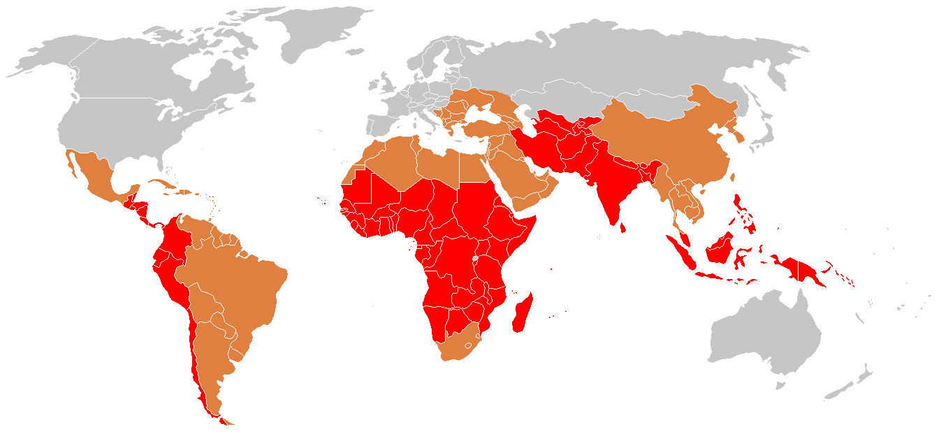
Typhoid fever is prevalent in many regions in the world
  High endemicity (>100 cases per lac per year)
  Medium endemicity (10 cases per lac per year)
  Low endemicity (<10 cases per lac per year)

Slide 4
EPIDEMIOLOGY

Slide 5

WHO Estimate
Infects roughly 21.6 million people each year

Slide 6
WHO Estimate
Kills 216000-600000 people each year

Slide 7
WHO Estimate
62% of these occurring in
Asia and 35% in
Africa

Slide 8
Antibiotic resistance is a challenge for effective treatment of typhoid and is likely to become increasingly problematic with the spread of multi-drug resistant strains.
The situation is further complicated by increased incidence in some countries of S. Paratyphi A as a cause of enteric fever.
This serovar is not prevented by currently available typhoid vaccines and represents an increasing threat to human health.

Slide 9
India
World largest outbreak of typhoid in SANGLI between December 1975 to February 1976 .
This disease is endemic in India
1992 : 3,52,980 cases with 735 deaths
1993 : 3,57,452 cases and 888 deaths
1994 : 2,78,451 cases and 304 deaths
2011 : 1.06million cases & 346 deaths
Prevalence- 88 cases/lac population
Case fatality rate due to typhoid has been varying between 1.1% to 2.5 % in last few years.
In south-East Asia 50% or more of the strains of bacteria has MDR

Slide 10
cont..
Reported data for the year 2015 shows 1.84 million cases and 393 deaths per 1 lac population
Maximum cases were reported from Bihar followed by Andhra Pradesh.
The other states having large number of cases are, Uttar Pradesh, Madhya Pradesh, West Bengal, Maharashtra, Odissa.

Slide 11
AGENT FACTORS
Typhoid Fever mainly caused by the bacterium Salmonella typhi from the family Enterobacteriacea.
S. Para A& B are relatively infrequent.
S. typhi is a gram-negative, facultative aerobic, non spore forming bacteria that is motile due to its peritrichous flagella.
The bacteria grows best at 37°C.
S. typhi survives intracellularly in the tissues of various organs. It is readily killed by drying, pasteurization, and common disinfectants.

Slide 12
Antigenic structure of Salmonella
Two sets of antigens
Detection by serotyping
1. Somatic or 0 Antigens contain long chain polysaccharides ( LPS ) comprises of heat stable polysaccharide commonly.
2. Flagellar or H Antigens are strongly immunogenic and induces antibody formation rapidly and in high titers following infection or immunization. The flagellar antigen is of a dual nature, occurring in one of the two phases.
Phage typing has proved a useful epidemiological tool in tracing the source of epidemics.

Slide 13
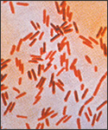
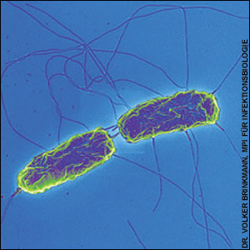
Color pink therefore Gram-negative
With peritrichous flagella

Slide 14
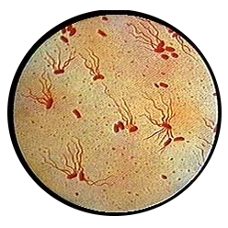

Slide 16
Reservoir of infection
Human is the only reservoir
CASE
A case is infectious as long as bacilli appears in stools or urine.
Case may be missed, mild or severe.
CARRIER
Temporary/Incubatory- excrete bacilli for 6 to 8 weeks
Chronic- excrete bacilli for more than a year,
Organism persist in gall bladder/biliary tract.
e.g. “Typhoid Marry” real name Mary Mallon
1. Cases
2. Carriers

Slide 17
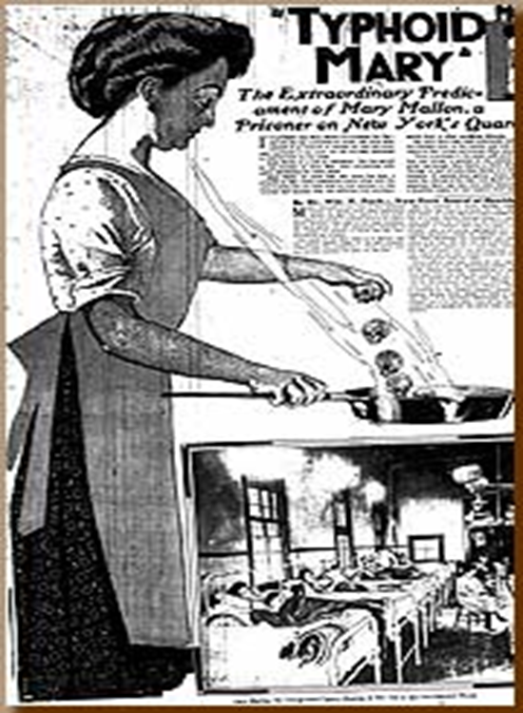
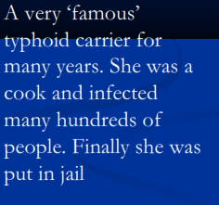
Mary Mallon was a cook in Oyster Bay, New York in early 1900s.
Gave rise to more than 1300 cases in her life time.
She died of pneumonia after 26 years in quarantine.

Slide 19
Source of infection
Faeces & urine of cases and carriers.
Faecal carriers are more frequent than urinary carriers.
Contaminated
      Water
      Food
      Fingers
      Flies
Primary sources
Secondary sources
There is no evidence that typhoid bacilli are excreted in sputum or milk.
Period of communicability: A case is infectious as long as the bacilli appear in stool or urine.

Slide 20
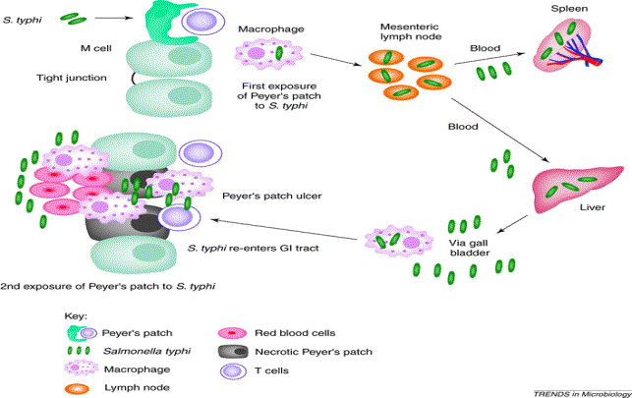
How does the bacteria cause disease ?

Slide 21


Ingestion of contaminated food or water
Salmonella bacteria
Invade small intestine and enter the bloodstream
Carried by white blood cells in the liver, spleen, and bone marrow
Multiply and reenter the bloodstream
Bacteria invade the gallbladder, biliary system, and the lymphatic tissue of the bowel and multiply in high numbers
Then pass into the intestinal tract and can be identified for diagnosis in cultures from the stool tested in the laboratory

Slide 22
Salmonella typhi infecting the body via the Peyer's patches of the small intestine. The bacteria migrates to mesenteric lymph nodes and arrive via the blood in the liver and spleen during the first exposure. After multiple replication in the above locations, the bacteria Migrates back into the Peyer's patches of the small intestine for the secondary exposure and consequently the clinical symptoms are seen. Inflammation in the small intestine leads to ulcers and necrosis.

Slide 23
HOST FACTORS
Age: Typhoid fever may occur at any age. Highest incidence of this disease occurs in the 5-19 years of age group. In a recent study from slums of Delhi, it was found that contrary to popular belief, the disease affects even children aged 1-5 years
Sex: More cases are reported among males than females, probably as a result of increased exposure to infection. But carrier rate is more in females.
Occupation : Certain categories of persons handling the infective material and live cultures of S. typhi are at increased risk of acquiring infection.

Slide 24
Cont..
Nutritional status :Malnutrition may enhance the susceptibility to typhoid fever by altering the intestinal flora or other host defences.
Immunity: All ages are susceptible to infection. Antibody may be stimulated by the infection or by immunization. However, the antibody to the somatic antigen (0) is usually higher in the patient with the disease, and the antibody to the flagellar antigen (H) is usually higher in immunized individuals.
Cell-mediated immunity plays a major role in combating the infection

Slide 25
ENVIRONMENTAL & SOCIAL FACTORS
Typhoid fever regarded as “Index of general sanitation” in any country. It is a disease of Poverty..
Increase incidence in July-September.
Outside human body bacilli found in-
water- 2 to 7 days but not multiply
soil irrigated with sewage- 35 to 70 days
ice & icecream- over a month
food- multiply & survive for sometime
milk- grow rapidly without altering its taste
Vegetables grow in sewage plant.
Pollution of drinking water supplies.
Open area defecation & urination.
Low personal hygiene.
Health ignorance.

Slide 26
Incubation period
Usually 10-14 days. But it may be as short as 3 days or as long as three weeks depending upon the dose of the bacilli ingested.

Slide 27
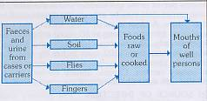
MODE OF TRANSMISSION
The disease is transmitted by “faeco-oral route” or “urine–oral routes” either directly through hands soiled with faeces or urine of cases or carriers or indirectly by ingestion of contaminated water, milk, food, or through flies. Contaminated ice, ice-creams, and milk products are a rich source of infection.
water
Faeces and urine from cases or carriers
Foods raw or cooked
Mouth of well persons
soil
flies
fingers

Slide 28
Cont..
The situation is rendered more complex by the web of social, cultural and economic factors which determine the quality of life of the people.

Slide 29
Clinical Features
The onset is usually insidious but in children may be abrupt, with chills and high fever.
During the Prodromal stage, there is malaise, headache, cough and sore throat, often with abdominal pain and constipation.
The fever ascends in a Step­ladder fashion. After about 7-10 days, the fever reaches a plateau and the patient looks toxic, appearing exhausted and often prostrated.
There may be marked constipation, especially in early stage or "pea soup" diarrhoea. There is marked abdominal distention.

Slide 30
First week: The disease classically presents with step-ladder fashion rise in temperature (40 - 41°C) over 4 to 5 days, accompanied by headache, vague abdominal pain, and constipation.
Second week: Between the 7 th -10 th day of illness, mild hepato-splenomegally occurs in majority of patients. Relative bradycardia may occur and rose-spots may be seen.
Third week: The patient will appear in the "typhoid state" which is a state of prolonged apathy, toxaemia, delirium, disorientation and/or coma. Diarrhoea will then become apparent. If left untreated by this time, there is a high risk (5-10%) of intestinal hemorrhage and perforation.
Rare complications:
Hepatitis, Pneumonia, Thrombophlebitis, Myocarditis,
Cholecystitis, Nephritis, Osteomyelitis, and Psychosis.
2-5% patients may become Gall-bladder carriers

Slide 31
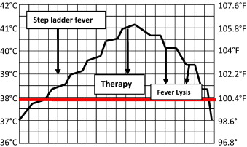

Slide 32
Rose spots
Pink papule 2-3mm on trunk, fade on pressure
Disappears in 3-4 days

Slide 33
DIAGNOSIS

Slide 34
Typhoid should be considered in any patient with prolonged unexplained fever in endemic areas and in those with a history of recent travel to endemic area.
Prolonged fever, rose spots, relative bradycardia and leucopenia make typhoid strongly suggestive.
Widal test measures titres of serum agglutinins against somatic (O) and flagellar (H) antigens which usually begin to appear during the 2nd week. In the absence of recent immunization, a high titre of antibody to O antigen > 1:160 is suggestive but not specific.

Slide 35
Polymerase chain reaction (PCR) can be performed on peripheral mononuclear cells. The test is more sensitive than blood culture alone (92% compared with 50-70%) but requires significant technical expertise
Blood cultures are positive in 70-80% of cases during the 1st week.
Stool and urine cultures are usually positive (45-75%) during the 2nd-3rd week.
Bone marrow aspirate cultures give the best confirmation (85-95%)
The tracing of carriers in cities by sewer – swab technique

Slide 36
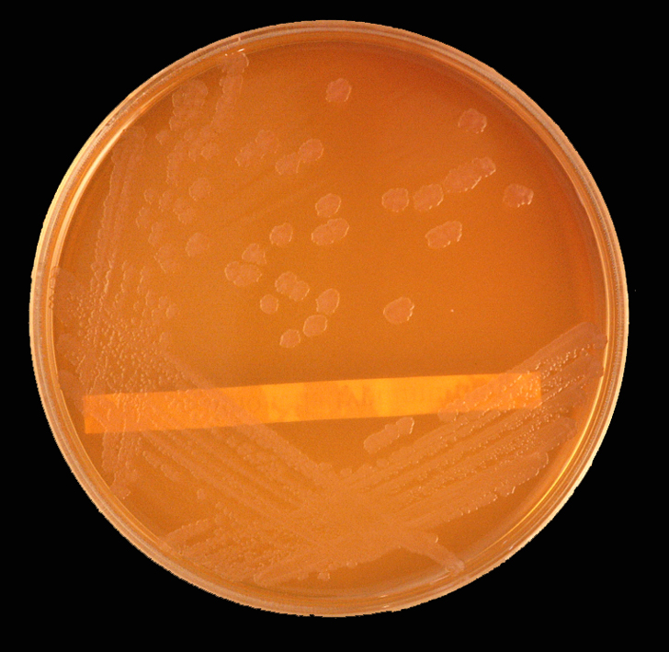
Salmonella on Mac Conkey's agar

Slide 37
Wilson and Blair bismuth sulphite medium jet black colony with a metallic sheen

Slide 38
SEROLOGICAL PROCEDURE
FELIX-WIDAL TEST
Significant Titers helps in Diagnosis
Limitations of Widal test
Classically, a four-fold rise of antibody in paired sera Widal test is considered diagnostic of typhoid fever. However, paired sera are often difficult to obtain and specific chemotherapy has to be instituted on the basis of a single Widal test. Furthermore, in areas where fever due to infectious causes is a common occurrence the possibility exists that false positive reactions may occur as a result of non-typhoid
Serum agglutinins raise abruptly during the 2nd or 3rd week
Following Titers of antibodies against the antigens are significant when single sample is tested
O > 1 in 160
H > 1 in 320
Testing a paired sample (7-10 days) for raise of antibodies carries a greater significance

Slide 39
NEW DIAGNOSTIC TESTS
IDL Tubex detects IgM09 antibodies with in few minutes
Typhidot test that detects presence of IgM and IgG in one hour (sensitivity>95%, Specificity 75%)
Typhidot-M, that detects IgM only (sensitivity 90% and specificity 93%)
Typhidot rapid (sensitivity 85% and Specificity 99%) is a rapid 15 minute immunochromatographic test to detect IgM.
IgM dipstick test

Slide 40
Diagnosis of Carriers
Useful in public health purpose.
Useful in screening food handlers, cooks, to detect carrier state
Typhoid bacilli can be isolated from feces or from bile aspirates
Detection of Vi agglutinins in the Blood can be determinant of carrier state.

Slide 41
Management of typhoid fever:
General: Supportive care includes
Maintenance of adequate hydration.
Antipyretics.
Appropriate nutrition.
Specific: Antimicrobial therapy is the mainstay treatment. Selection of antibiotic should be based on its efficacy, availability and cost.
Chloramphenicol , Ampicillin ,Amoxicillin , Trimethoprim &Sulphamethoxazole ,Fluroquinolones
In case of quinolone resistance – Azithromycin, 3rd generation cephalosporins (ceftriaxone)

Slide 42
Treatment of typhoid fever
Susceptibility | Antibiotic | Daily dose mg/kg | Days | Antibiotic | Daily dose mg/kg | Days
Fully sensitive | Fluoroquinolone Cipro/oflox | 15 | 5-7 | Chloramphenicol Amoxicillin TMP-SMX | 50-75 75-100 8-40 | 14-21 14 14
Multidrug resistance | Fluoroquinolone Or Cefixime | 15 15-20 | 5-7 7-14 | Azithromycin Cefixime | 8-10 15-20 | 7 7-14
Quinolone resistance | Azithromycin Or Ceftriaxone | 8-10 75 | 7 10-14 | Cefixime | 20 | 7-14
OPTIMAL THERAPY
ALTERNATIVE EFFECTIVE DRUGS
K. PARK

Slide 43
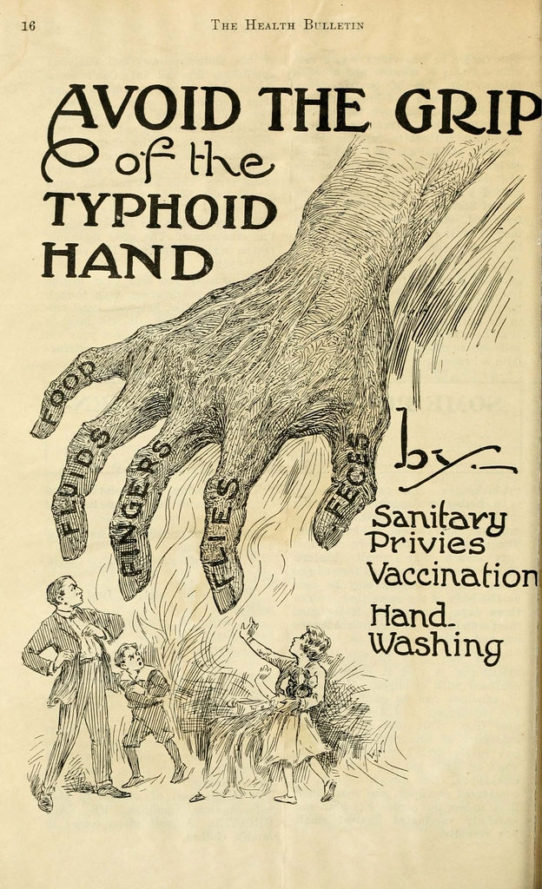
Control of Typhoid fever
1. MEASURES DIRECTED TO RESERVOIR
a) Case detection and treatment
b) Isolation
c)Disinfection of stools and urine
d)Detection & treatment of carriers
2. MEASURES AT ROUTES OF TRANSMISSION
a) Water sanitation
b) Food sanitation
c) Excreta disposal
d) Fly control
3. MEASURES FOR SUSCEPTIBLES
a) Immunoprophylaxis
b)Health education

Slide 44
CONTROL-
1. Control of Reservoir
2. Control of Sanitation
3. Immunization

Slide 45
1. Control of Reservoir
Identification
Treatment
Disinfection
Isolation
Reservoir
Carrier
Case

Slide 46
Control of Cases
(i) Early diagnosis: This is of vital importance as the early symptoms are non-specific. Culture of blood and stools are important investigations in the diagnosis of cases.
(ii) Notification: This should be done where such notification is mandatory
(iii) Isolation: Since typhoid fever is infectious and has a prolonged course, the cases are better transferred to a hospital for proper treatment, as well as to prevent the spread of infection.
(iv) Treatment : The fluoroquinolones are widely regarded as the drug of choice for the treatment of typhoid fever. Patients seriously ill and profoundly toxic may be given an injection of hydrocortisone 100 mg daily for 3 to 4 days.
(v) Disinfection: Stools and urine are the sole sources of infection. They should be received in closed containers and disinfected with 5 per cent cresol for at least 2 hours. All soiled clothes and linen should be soaked in a solution of 2 per cent chlorine and steam­sterilized.
(vi) Follow up : Follow-up examination of stools and urine should be done for S. typhi 3 to 4 months after discharge of the patient, and again after 12 months to prevent the development of the carrier state.

Slide 47
Control of Carrier-
(i) Identification : Carriers are identified by cultural and serological examinations. Duodenal drainage establishes the presence of salmonella in the biliary tract in carriers.
(ii) Treatment : The carrier should be given an intensive course of ampicillin or amoxycillin (4-6 g a day) together with Probenecid (2 g/day) for 6 weeks.
(iii) Surgery : Cholecystectomy with concomitant ampicillin therapy has been regarded as the most successful approach to the treatment of carriers.
(iv) Surveillance: The carriers should be kept under surveillance. They should be prevented from
handling food, milk or water for others.
(v) Health education: Health education regarding washing of hands with soap, after defecation or urination, and before preparing food is an essential element.

Slide 48
2. Control of Saniation
Sanitary Measures to interrupt transmission of typhoid fever are,
Protection and purification of drinking water supplies
Improvement of basic sanitation, and
Promotion of food hygiene
And all these measures should b combined with Health Education.

Slide 49
Best prevention
Best prevention
Scrub of them off your hands
Scrub them off your hands

Slide 50

Simple hand hygiene and washing can reduce several cases of Typhoid

Slide 51
HEALTH PROMOTION
Keep the premises and kitchen utensils clean.
Dispose rubbish properly.
Keep hands clean and fingernails trimmed.
Wash hands properly with soap and water before eating or handling food, and after toilet or changing diapers.
Drinking water should be from the mains and preferably boiled.
Purchase fresh food from reliable sources. Do not patronize illegal hawkers.
Avoid high-risk food like shellfish, raw food or semi-cooked food.
Wear clean washable aprons and caps during food preparation.
Clean and wash food thoroughly.
Scrub and rinse shellfish in clean water. Immerse them in clean water for sometime to allow self-purification.
Remove the viscera if appropriate
Cont………

Slide 52
Store perishable food in refrigerator, well covered.
Handle and store raw and cooked food especially seafood separately (upper compartment of the refrigerator for cooked food and lower compartment for raw food) to avoid cross contamination.
Clean and defrost refrigerator regularly and keep the temperature at or below 4ºc
Cook food thoroughly.
Do not handle cooked food with bare hands; wear gloves if necessary.
Consume food as soon as it is done.
If necessary, refrigerate cooked leftover food and consume as soon as possible. Reheat thoroughly before consumption. Discard any addled food items.
Exclude typhoid carrier from handling food and from providing care to children.

Slide 53
3. Immunization
A complementary approach to prevention is immunization, which is the only specific preventive measure, likely to yield the highest benefit for the money spent.
Immunization against typhoid does not give 100 % protection, but it definitely lowers both the incidence and seriousness of the infection
It can be given at any age upwards of one year.

Slide 54
Indications for Vaccination
Travelers going to endemic areas who will be staying for a prolonged period of time,
Persons with intimate exposure to a documented S. typhi carrier
Immigrants
Military personnel
Household contacts
Those living in endemic areas
Those attending melas and yatras
Groups at risk of infection such as school children and medical and paramedical hospital staff

Slide 55
Typhoid Vaccine
Two safe and effective vaccines are now licensed and available.
One is based on defined subunit antigens, the other on whole-cell live attenuated bacteria.
1. Injectable Typhoid vaccine (TYPHIM –Vi,TYPHIVAX)
2. The live oral vaccine (TYPHORAL)

Slide 56
A.Vi polysaccharide Vaccine
It is composed of purified Vi capsular polysaccharide from the Ty2 S. Typhi strain and elicits a T-cell independent lgG response.
It is given in a single dose subcutaneous or intramuscular.
It is given for individuals aged > 2 years (does not elicit adequate immune responses in children aged < 2 years).
Immunity developed 7 days after injection.
To maintain protection, revaccination is recommended every 3 years.

Slide 57
Cont..
Schedule
Singel dose & Age ≥ 2 years.
Booster dose every 3 years.
The Vi polysaccharide vaccine can be co-administered with other vaccines relevant for international travellers, such as yellow fever
And hepatitis A, and with vaccines of the routine childhood
immunization programmes.
Safety
No serious adverse events and a minimum of local side­
effects.
Contraindications: Previous severe hypersensitivity reaction to vaccine components.
Safe for HIV-infected individuals, the induction of protective
Antibodies is directly correlated to the levels of CD4 positive T-cells.

Slide 58
Injectable Typhim -Vi
This single-dose injectable typhoid vaccine, from the bacterial capsule of S. typhi strain of Ty21a.
This vaccine is recommended for use in children over 2 years of age.
Sub-cutaneous or intramuscular injection
Efficacy : 64% -72%

Slide 59
Vi-CPS— parenteral vaccine

Slide 60
B. Ty21a Vaccine
Orally administered, live­ attenuatedcTy2 strain of S. Typhi in which multiple genes, including the genes responsible for the production of Vi, have been mutated chemically.
The lyophilized vaccine is available as enteric coated capsules.
Protection is markedly influenced by the number of doses and their spacing. There are currently no field trials to document the efficacy of Ty2la vaccine in children aged <3 years.
Ty21a requires storage at 2-8°C; it retains potency for approximately 14 days at
25°C.

Slide 61
Cont.
Schedule :
Age ≥ 5 yrs
Day 1, 3, and 5; a 3-dose regimen is recommended.
Protective immunity is achieved 7 day after the last dose
Repeat this series every 3 years for people living
in endemic areas, and every year for individuals travelling; from non-endemic to endemic countries.
Given simultaneously with other vaccines, including live vaccines against polio, cholera, and yellow fever, or the measles, mumps and rubella (MMR) combination.

Slide 62
Cont..
Safety and precautions
Proguanil and antibacterial drugs should be stopped from 3 days before until 3 days after giving Ty2la, as such drugs may harm live bacterial vaccines.
Ty21a can be administered to HIV-positive, asymptomatic individuals as long as the T-cell count (CD4) is >200/mm3
Ty21a is remarkably well tolerated and has low rates of adverse events.
The vaccine is not recommended in congenital or
acquired immunodeficiency including treatment with immuno-suppressive and antimitotic drugs, acute febrile illness and acute intestinal infection.

Slide 63
Typhoral
This is a live-attenuated-bacteria vaccine manufactured from the Ty21a strain of S. typhi.
The efficacy rate of the oral typhoid vaccine ranges from 50-80%
Not recommended for use in children younger than 6 years of age.
The course consists of one capsule orally, taken an hour before food with a glass of water or milk (1stday,3rd day &5th day)
No antibiotic should be taken during this period
Immunity starts 2-3 weeks after administration and lasts for 3 years
A booster dose after 3 years

Slide 64
SIDE EFFECTS.
Injectable Typhim -Vi
The most common adverse reactions are injection site pain, erythema, and induration, which almost always resolve within 48 hours of vaccination. Occasional fever, flu-like episodes, headache, tremor, abdominal pains, vomiting, diarrhea, and cervical pains have been reported.
Typhoral
Nausea, abdominal pain and cramps, vomiting, fever, headache, and rash or urticaria may occur in some instances but are rare.

Slide 65
Facts of Vaccines for Typhoid
Immunity lasts for 3 years
Need a booster
Vaccines are not effective in prevention of Paratyphoid fevers

Slide 66
Thank You

Slide 67
MCQ Test

Slide 68
Typhoid fever is caused by
S. Typhi
S. Paratyphi A
S. Paratyphi B
S. Paratyphi C

Slide 69
2. India comes in which risk area for typhoid?
Low
High
Medium
Moderate

Slide 70
3. Incubation period for typhoid fever usually is
7-8 days
8-9 days
10-14 days
10-12 days

Slide 71
4. Famous carrier for typhoid is known as
Typhoid Gary
Typhoid Charles
Typhoid David
Typhoid Mary

Slide 72
5. Reservoir for Typhoid is
Animal
Man
Both
None of the above

