Slide 1
HEPATITIS A
Dr.Divyang Patel
Assistant Professor
DEPARTMENT OF COMMUNITY MEDICINE

Slide 2
Topics included
Introduction
Signs and symptoms
Epidemiology
Modes of transmission &
incubation period
Risk factors
Problem statement
Diagnosis
Treatment & prevention
Bibliography

Slide 3
Introduction

Slide 4

World Hepatitis Day 28 July 2013

Slide 5
HEPATITIS
Hepatitis is a general term meaning inflammation of the liver and can be caused by a variety of different agents. Since the development of jaundice is a characteristic feature of liver disease, a correct diagnosis can only be made by testing patient’s sera for the presence of viral antibodies.

Slide 6
TYPES OF HEPATITIS:-
Acute
1. Acute viral hepatitis: -Hepatitis A
-Hepatitis B
-Hepatitis C
-Hepatitis D
-Hepatitis E
2. Toxic and drug induced hepatitis
Chronic
1. Chronic viral hepatitis
2. Drug induced chronic hepatitis
3. Auto immune chronic hepatitis.

Slide 7
HEPATITIS A
Hepatitis A (formerly known as infectious hepatitis) is an acute infectious disease of the liver caused by the hepatitis A virus (HAV), an RNA virus, usually spread through the faeco-oral route; transmitted person-to-person by ingestion of contaminated food or water or through direct contact with an infectious person.
Tens of millions of individuals worldwide are estimated to become infected with Hep A each year.
In developing countries, and in regions with poor hygiene standards, the incidence of infection with this virus is high and the illness is usually contracted in early childhood.
As incomes rise and access to clean water increases, the incidence of HAV decreases.
Hepatitis A infection causes no clinical signs and symptoms in over 90% of infected children and since the infection confers lifelong immunity, the disease is of no special significance to those infected early in life.

Slide 8
HAV infection produces a self-limited disease that does not result in chronic infection or chronic liver disease. However, 10%–15% of patients might experience a relapse of symptoms during the 6 months after acute illness.
Acute liver failure from Hepatitis A is rare (overall case-fatality rate: 0.5%).
The risk for symptomatic infection is directly related to age, with >80% of adults having symptoms compatible with acute viral hepatitis and the majority of children having either asymptomatic or unrecognized infection.
Antibody produced in response to HAV infection persists for life and confers protection against reinfection.
The disease can be prevented by vaccination and hepatitis A vaccine has been proven effective in controlling outbreaks worldwide

Slide 9
Signs and symptoms

Slide 10
SIGNS & SYMPTOMS:-
In hepatitis A infection<6 years, clinically apparent disease increases with age.
In children of age, most infections (70%) are asymptomatic, and if illness does occur, it is usually anicteric.
Among older children and adults, infection is usually symptomatic, with jaundice occurring in 70% of patients. In some cases, HAV causes a second bout of jaundice and cholestasis 6-12 weeks after primary infection. However 15-20%of the patient may have prolonged or relapsing disease.

Slide 11
Prodromal symptoms characterized by:
            Fever
            Chills
            Headache
            malaise
            Anorexia
            Nausea,vomiting and diarrhoea follow.
Steady upper abdominal pain, sometimes severe
Urine is dark with yellowish discoloration of sclera.
With onset of clinical jaundice, constitutional symptoms diminish.
Liver becomes palpable and tender.
Enlarged cervical lymph nodes and splenomegaly.

Slide 12
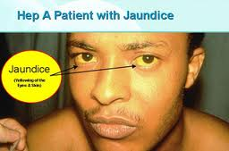

Slide 13
Epidemiology

Slide 14
DEFINITION:
“The study of the distribution and determinants of health-related states or events in specified populations, and the application of this study to the control of health problems.” - John M. Last (1988)
Components of Epidemiology
Disease frequency
Determinants
Distribution

Slide 15
Epidemiological Triad:- shows interaction between-
Environment
Host
Agent

Slide 16
Environmental factors:
In India the disease is most commonly associated with periods of heavy rainfall.
Other factors are:
  Poor standard of hygiene
  Poor sanitation
  Overcrowding
  Unsafe drinking water
  Food giving rise to water borne & food borne epidemics
Agent factors:
  Agent: Hepatitis A virus (HAV), is an enterovirus (type 72) of the picornaviridae family.

Slide 17
  Resistance:
    Virus is fairly resistant to heat & chemicals.
    Survive >10 weeks in well water.
    With stands heating to 60˚C for 1 hour.
    Not affected by Chlorine in doses usually employed for chlorination (minimal recommended concentration of free chlorine is 0.5 mg/l for 1 hour).
  Inactivation of virus:
    Formalin (effective disinfectant)
    UV rays
    Boiling for 5 minutes or autoclave
  Reservoirs of infection:
    Human cases are the only reservoir
    No animal reservoir
    Asymptomatic (anicteric) infections are common in children and these cases play an important role in maintaining the chain of transmissions in the community.

Slide 18
Period of infectivity:
  Risk of transmitting HAV is greatest from 2 week before to 1 week after the onset of jaundice.
  Infectivity falls rapidly with the onset of jaundice.
Infective material:
  Mainly man’s faeces: HAV is excreted in the faeces for about 2 weeks before the onset of jaundice and for up to 2 weeks thereafter.
  Virus also be excreted in urine
  Blood, serum and other fluids

Slide 19
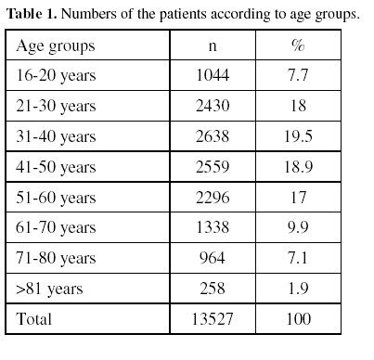
Host factors:
Age:However people from all ages may be infected if susceptible but more frequent among children than in adult.
Clinically severity of disease increase with age.
Ratio of anicteric cases to icteric cases:
In adult about 1:3
In children about 12:1
In India by the age of 10 year 90% of healthy person have serological evidence of HAV infection.

Slide 20
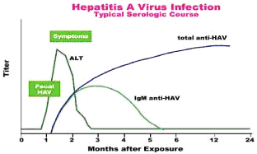
Sex: Males and Females are equally susceptible.
Immunity:
  Immunity after 1st attack probably last for life, but in 5% of patients 2nd attack have been reported.
  IgM antibody appears early in the illness and persist for over 90 days than IgG antibody appears more slowly and persist for many years.

Slide 21
Modes of transmission & incubation period

Slide 22
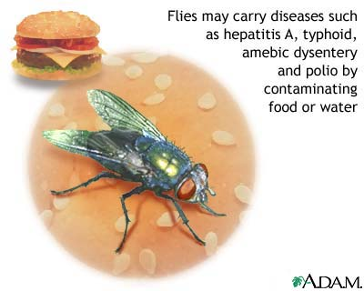
Modes of transmission:
Faeco-oral route:
  Major route of transmission
  May occur by direct contact (person to person) or indirectly by way of contaminated water, food or milk i.e. consumption of raw or inadequately cooked shell fish cultivated in sewage polluted water is associated with epidemic outbreaks of Hepatitis A.
Parenteral route:
  Transmitted by blood & blood products or by skin penetration through contaminated needles.
Sexual transmission:Mainly among homosexual men because of oral anal contact.
Incubation period:
10-50 days (average 28 days),Length of incubation period is proportional to dose of the virus ingested.

Slide 23
Source of Hepatitis A Infection

Slide 24
Risk factors

Slide 25
Risk factors:-
Certain groups can be defined as high risk for containing HAV
  People in household/ Sexual contact with infected person.
  Medical and paramedical personnel in hospital.
  International travelers from developed countries to regions of the world where HAV is endemic.
  Persons living in regions with endemic hepatitis A
  Persons residing in areas where extended community outbreaks exist.
  Preschool children attending day care centers.
  Refugees residing in temporary camps following catastrophe.
  Homosexually active men.
  Injecting drug users using unsterilized injection needles
  Persons with clotting factor disorders.
  Persons with chronic liver disease.
  Food service establishment/food handlers.
Risk factors remain unidentified in as much as 50% of hepatitis A cases.

Slide 26
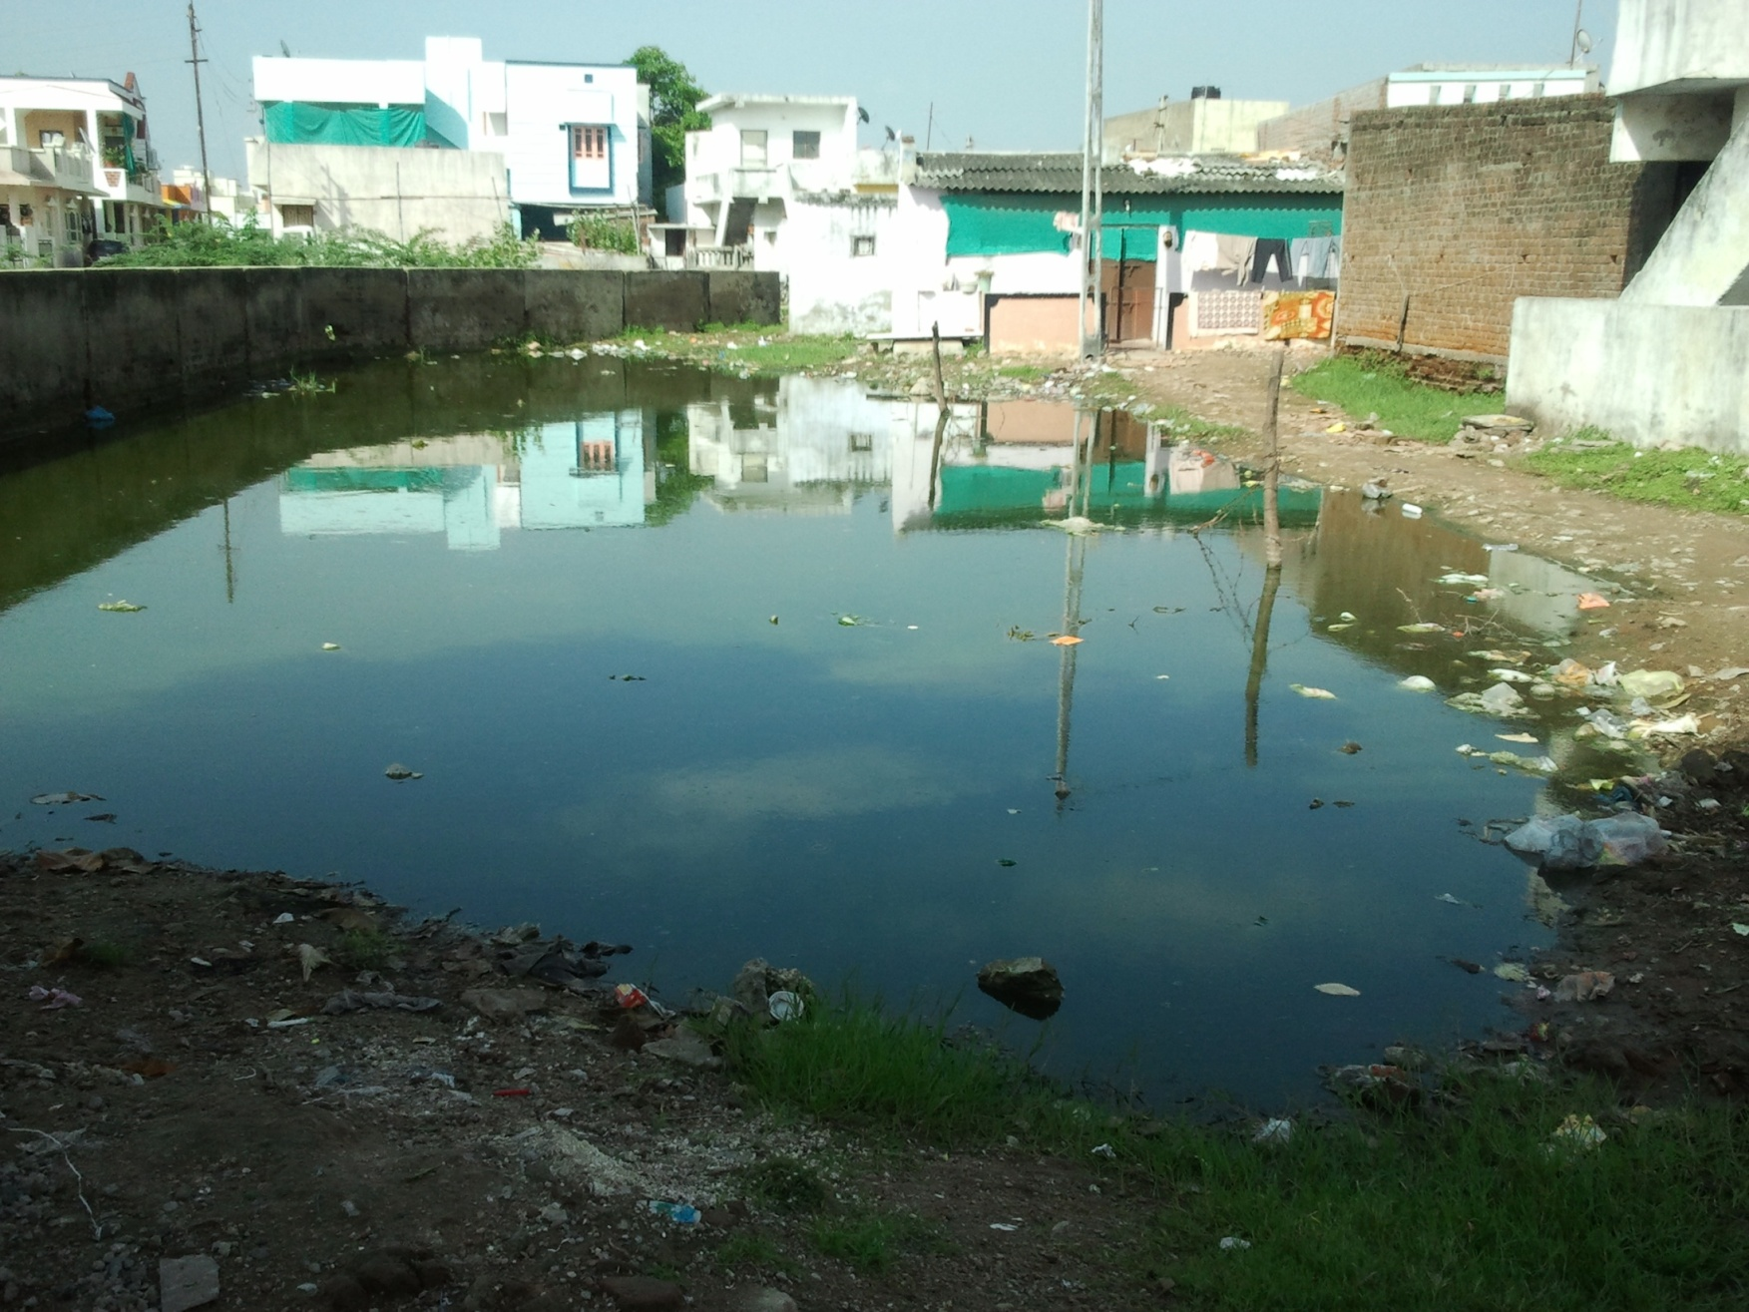
Poor sanitation

Slide 27
Problem statement

Slide 28
Problem statement:
World:In most developing countries Hepatitis A is endemic. According to WHO about 10-15 person per 1 lakh are affected annually.
  In the developed countries, the incidence of Hepatitis A is declined.
  Hepatitis A is very common in all countries of SEAR (South East Asia Region).
SEAR countries:-
      Bangladesh
      Bhutan
      Korea
      India
      Indonesia
      Maldives
      Myanmar
      Nepal
      Srilanka
      Thailand
      Timor-leste

Slide 29
The sero-epidemiological studies carried out in India, Bangladesh, Bhutan & Nepal demonstrated that 85-95% of children have been infected & in this countries demonstrated that HAV infection is responsible for approximately 10-25% of total case of hepatitis in children.
According to endemicity world can be divided into:
High endemicity areas
Intermediate endemicity areas
low endemicity areas
very low endemicity areas
In low endemicity area disease mainly occurs in adolescents and adults.
In intermediate endemicity area disease mainly occurs in late childhood and early adulthood.
In high endemicity area most infection occur in early childhood and here the lifetime risk of infection is >90%.

Slide 30
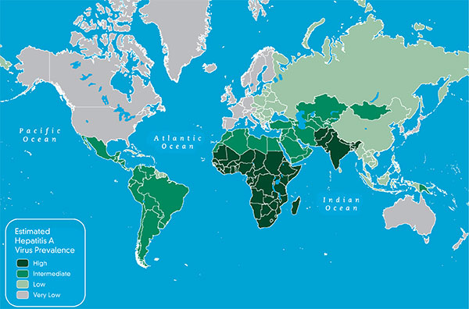

Slide 31
India
The exect incidence of HAV is not known but numerous report of sporadic & epidemic occurence of this disease in various cities, residencial colonies & campuses.
Anti-HAV in rural adults (2006):-
1. Rajasthan-133/143 (93%)
2. Gujarat 173/182 (95.1%)
3. Maharashtra 176/182 (96.7%)
4. Karnataka 146/182 (80.2%)
5. A Pradesh 173/182 (95.1%)
6. Kerala 162/182 (89%)
7. Tamilnadu 173/193 (89.6%)

Slide 32

1
2
3
5
4
6
7

Slide 33
Diagnosis

Slide 34
Test for the abnormal liver function such as:-
Serum alanine
Aminotransferase
Bilirubin
Along with clinical, pathological and epidemiological findings.
Specific laboratory diagnosis of hepatitis A is obtained by:-
Demonstration of HAV particles or specific viral antigens in faeces, bile and blood as HAV is detected in the stool from about 2 weeks prior to onset of jaundice, up to 2 weeks after.
Anti HAV appears in the IgM fraction during acute phase, peaking about 2 weeks after the elevation of liver enzymes.
Anti HAV-IgM usually declines to non-detectable levels within 3-6 months. Thus detection of IgM specific, anti HAV in the blood of an acutely infected person confirms the diagnosis of hepatitis A
Anti HAV-IgG appears soon after the onset of diseases and persists for decades.
Elisa is the method of choice for measuring the HAV antibodies.

Slide 35
Treatment & prevention

Slide 36
Treatment
Tab ciprofloxacin 500 mg
Tab ranitidine 50 mg
Tab multi vitamin B complex
Tab metronidazole 400 mg
Inj. Cefotaxime 1gm I.V. T.D.S.
Glucose powder
Tab. Cyclopalm 1-0-1

Slide 37
Prevention
Control of reservoir :-
Attention should be paid to the usual control measures such as notification, complete bed rest and disinfection of faeces and fomites.
Use of 0.5% sodium hypochlorite has been strongly recommended as an effective disinfectant.
Control of transmission :-
This is successfully prevented by simple measures of personal and community hygiene.
Hand washing before eating and after toilet.
Sanitary disposal of excreta which will prevent the contamination of food and water.
Purification of community, water supplies by flocculation, filtration and adequate chlorination.
Usage of boiling water to drink.
Proper autoclaving of syringes, needles and other equipment.

Slide 38
Infection in community is best prevented by improving Social conditions especially overcrowding and poor sanitation.
Individuals are protected by active immunization by inactivated virus vaccine.
Immediate protection soon after exposure of virus is provided by immune serum globulin.
Immunization is mainly given to people who are in patient’s close contact, elderly people, people with major Diseases, Pregnant women. People Travelling by endemic area.
Once Immunization is done after being diseased it offers lifelong immunity. So, Presence of antibody suggests patient is immunized

Slide 39
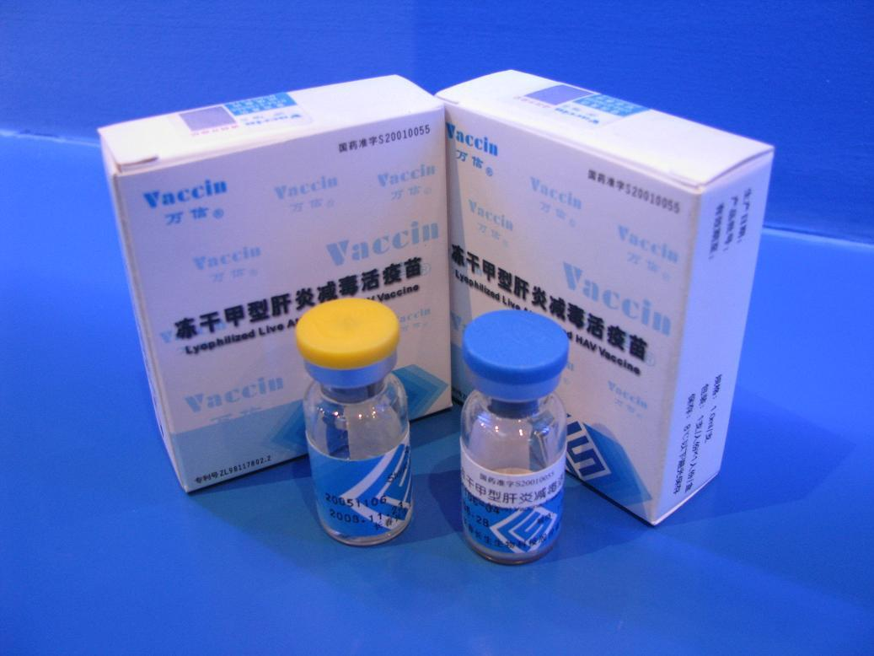
Inactivated Vaccine : given IM, in 2 doses at 6-18 months apart above age of 1 year.
Combination with Hepatitis B , given at 0,1 and 6 months.
Picture of hepatitis A vaccine

Slide 40
Diet: Patient is advised to take balanced adequate diet such as green leafy vegetables, pulses, sugar, jiggery, fruits and juices. Patient is advised not to take fatty diet including ghee, Butter, Oil and Non-veg. Food.
Personal Hygiene: Proper washing of Hands before each meal
Chlorination of water & Boiling of drinking water.
Habit: Patient is advised not to take alcohol, which leads to cirrhosis of liver on prolonged intake.
Immunization: Hepatitis A vaccine.
Regular Health Check up If the Patient or any family members develop similar disease or any other diseases (diabetes, Hypertension, Cardiovascular disease, Malignancy)

Slide 41
Hepatitis A vaccination coverage among adults 18-49 years traveling to a country of high or intermediate endemicity, United States. Lu PJ¹, Byrd KK, Murphy TV. | National Health Interview Survey (NHIS) | determine self-reported HepA vaccination coverage (≥1 dose) and series completion (≥2 dose) among persons 18-49 years who traveled, since 1995, to a country of high or intermediate HAV endemicity. Multivariable logistic regression and predictive marginal analyses were conducted to identify factors independently associated with HepA vaccine receipt. | approximately 36.6% of adults 18-49 years reported traveling to high or intermediate hepatitis A endemic countries; among this group unadjusted HepA vaccination coverage was 26.6% compared to 12.7% among non-travelers (P-values<0.001) and series completion were 16.9% and 7.6%, respectively (P-values<0.001).

Slide 42
Hepatitis A virus infections in the United States: model-based estimates and implications for childhood immunization. Armstrong GL, Bell BP. | Nationwide survey(high level evidence) | The model estimated approximately 270 000 (range: 190 000-360 000) infections annually from 1980 to 1999, 10.4 times the number of hepatitis A cases actually reported during this period. More than half of these infections occurred in children who were younger than 10 years, most of which would have been clinically unrecognizable as hepatitis. | These results suggest a large reservoir of infection in children and that interruption of transmission in children may substantially reduce incidence of hepatitis A overall.

Slide 43
Bibliography

Slide 44
1. Rathi S.K., Public health needs modified strategy health line l(1); 2010:49-52.
2. 9th textbook of preventive and social medicine, 21st edition by K. Park.
3. WHO (1999), health situation in south East Asia region 1994-1997, south east region new Delhi.
4. Indian council of medical research (1980). Viral Hepatitis.
5. Google.
6. Wikipedia.
7. Harrison principle of internal medicine. Section 2, liver and biliary disease,17th edition,. Chp. No. 298-300.4.

Slide 45
Project Questions
Q 1: Hepatitis A is transmitted by
  Feco oral route
  Direct inoculation
  Sexually
  Through blood transfusion

Slide 46
Project Questions
Q 1: Hepatitis A is transmitted by
  Feco oral route
  Direct inoculation
  Sexually
  Through blood transfusion

Slide 47
Project Questions
Q 2: Incubation period for Hepatitis A is _______.

Slide 48
Project Questions
Q 3: Hepatitis A; Mode of transmission.

Slide 49
Project Questions
Q 4: Name few high risk groups for Hepatitis A

Slide 50
Project Questions
Q 5: Basic level of prevention for Hepatitis A.

Slide 51

Thank you for your attention

