Slide 1
Aminoglycosides

Slide 2
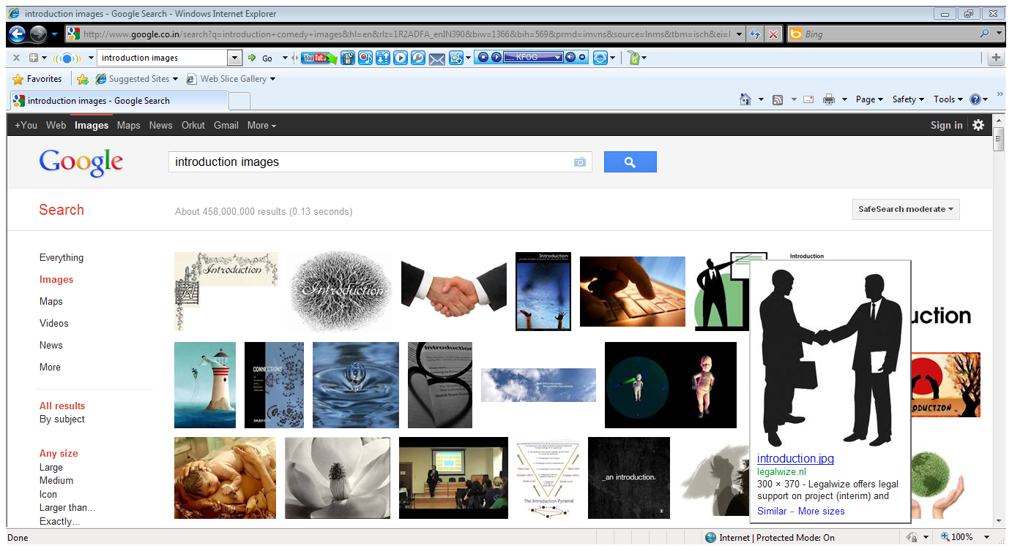
Introduction
Aminoglycoside :- molecule or a portion of a molecule composed of
amino-modified sugars
In use since 1944
Effective antibiotics for treating severe infections

Slide 3
Limited use due to serious adverse effects, especially ototoxicity and nephrotoxicity
Aminoglycosides group includes :
streptomycin,
gentamicin, netilmicin, sisomicin, Isepamicin
neomycin, paromomycin, Framycetin
kanamycin, tobramycin, amikacin.

Slide 4
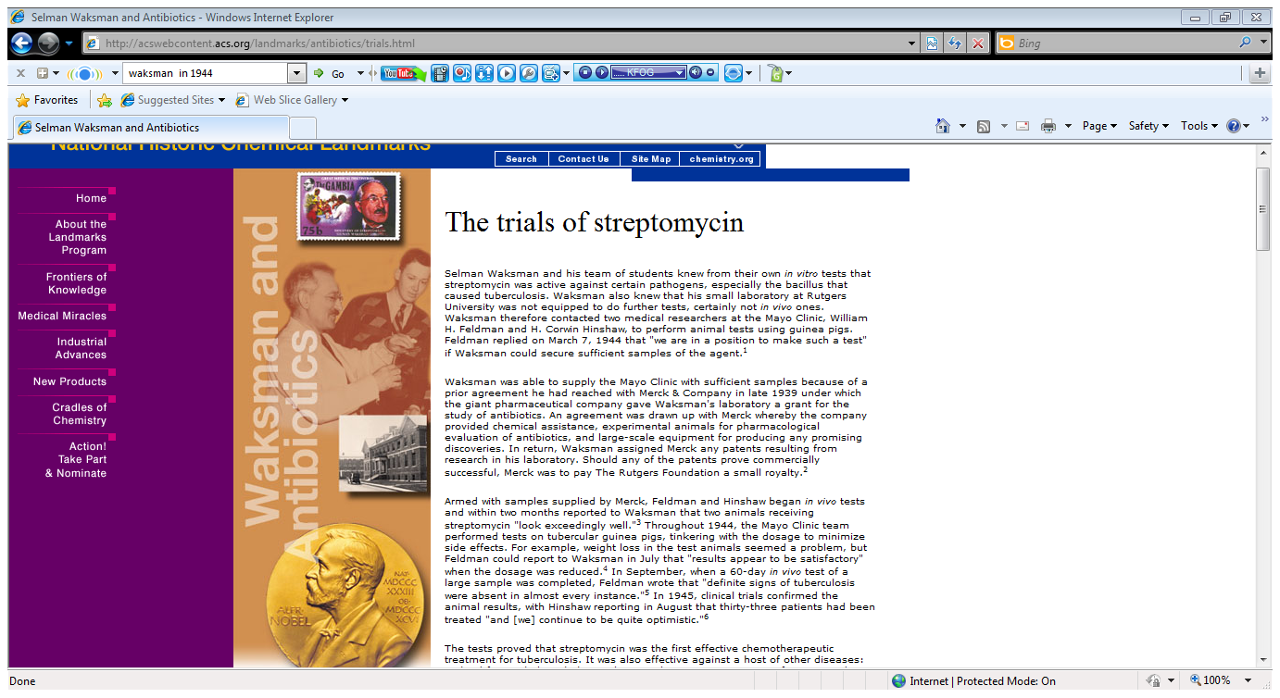
History
1943
1944
1945
First isolated on October 19 by Albert Schatz, a graduate student, in the laboratory of Selman Abraham Waksman at Rutgers University
Waksman contacted two medical researchers at the Mayo Clinic, William H. Feldman and H. Corwin Hinshaw, to perform animal tests using guinea pigs on march 7,1944.
Toxic effects on the
vestibular apparatus were reported by Hinshaw and Feldman

Slide 5
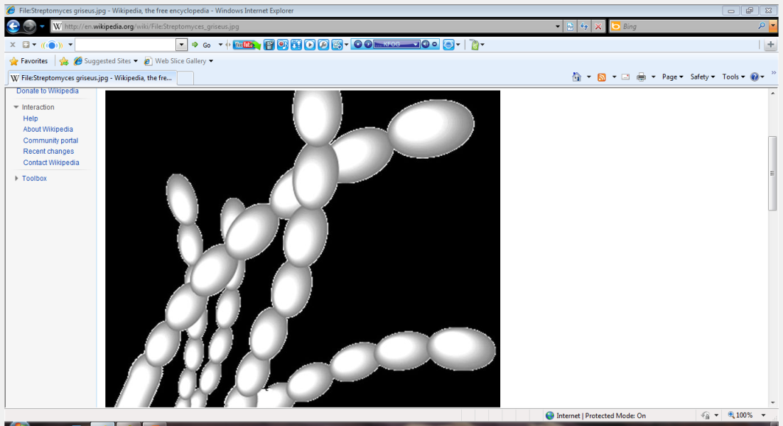
Source
Natural products or semisynthetic
derivatives of compounds
- produced by a variety of soil actinomycetes.
Semisynthetic products- Amikacin, Netilmicin
Bacteria | Suffix | Examples
Streptomyces | -mycin | Streptomyci, Kanamycin
Micromonospora | -micin | Gentamicin, Astromicin
Notes:
actinomycetes are best known for their ability to produce antibiotics
and are gram positive bacteria which comprise a group of
branching unicellular microorganisms.

Slide 6
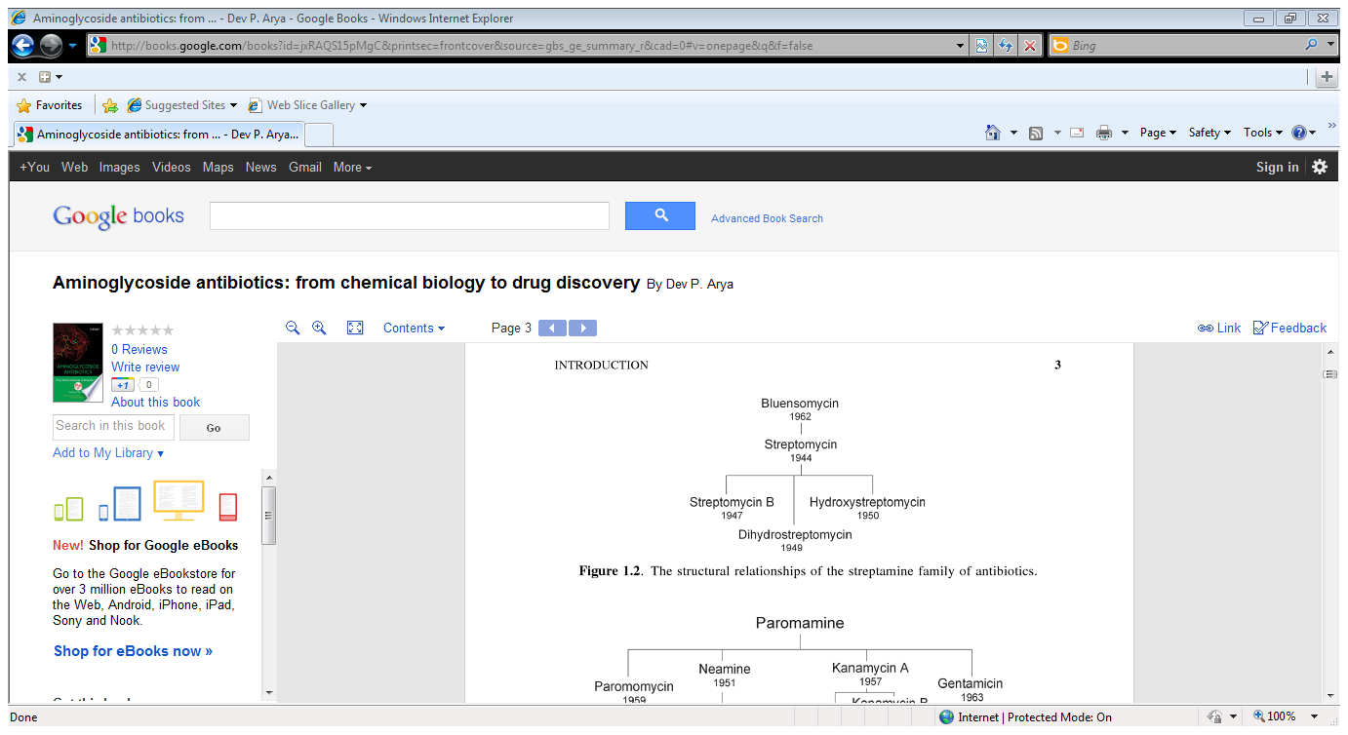

Slide 7
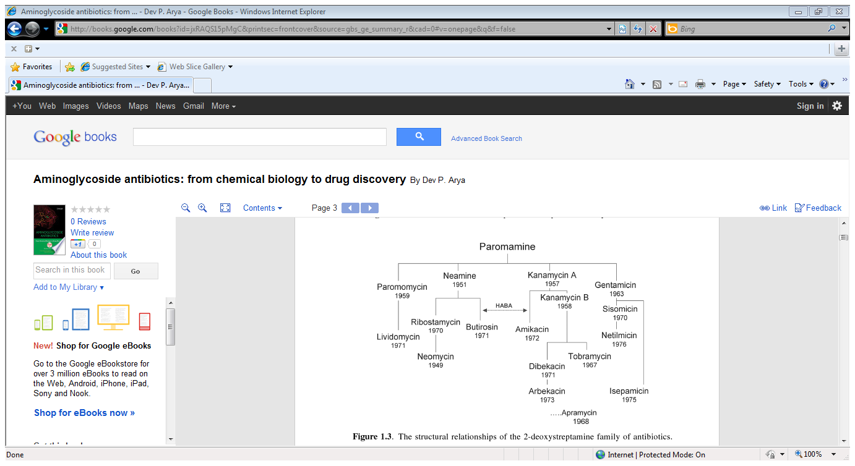

Slide 8
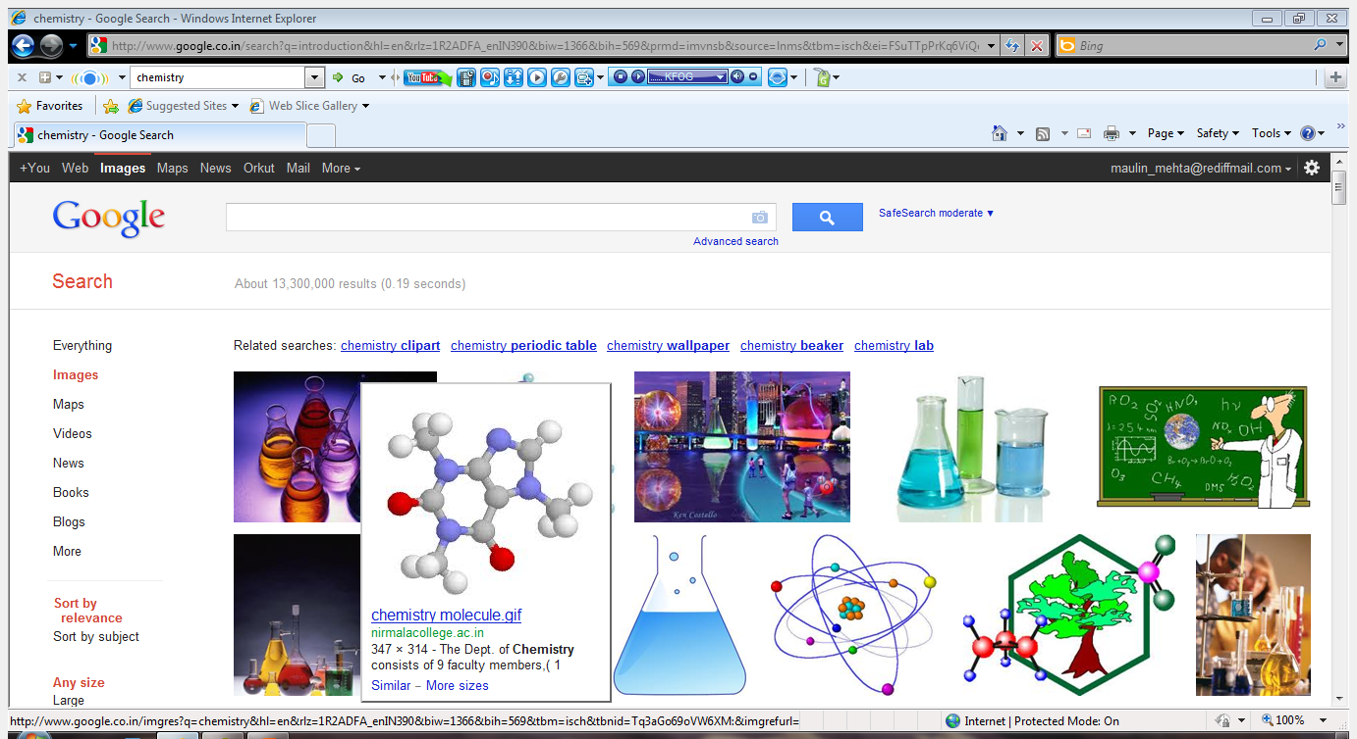
Chemistry
Two or more amino sugars joined in glycosidic linkage to a hexose nucleus
aminoglycosidic aminocyclitols
Hexose (aminocyclitol) | Aminoglycoside
streptidine | Streptomycin
2-deoxystreptamine | All others

Slide 9
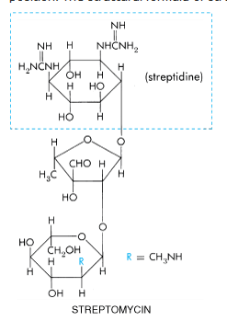
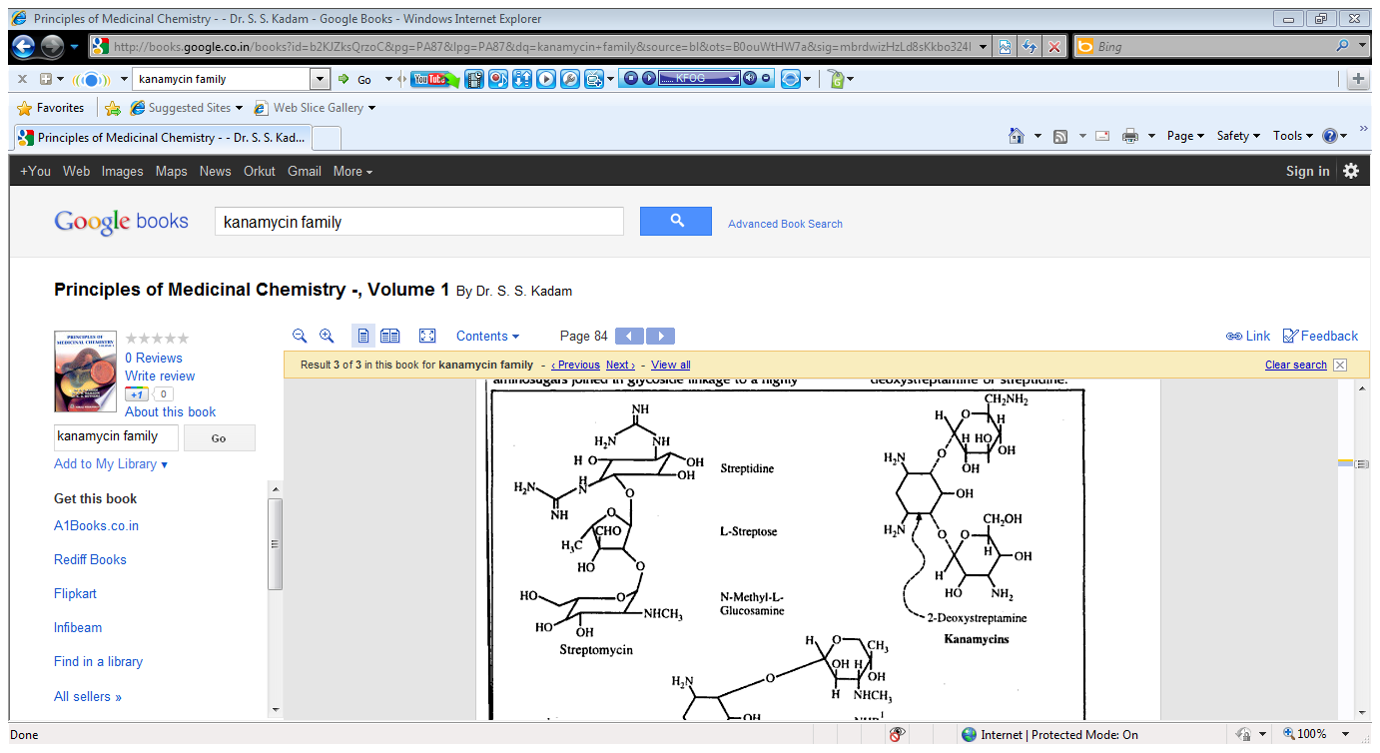

Slide 10
Amino sugars attached to the aminocyclitol distinguished Aminoglycosides families.
Family | Amino sugars
Neomycin | -Three
Gentamycin Kanamycin | -Two

Slide 11
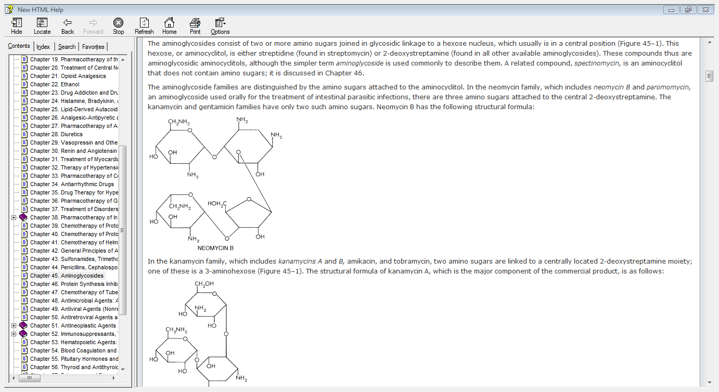
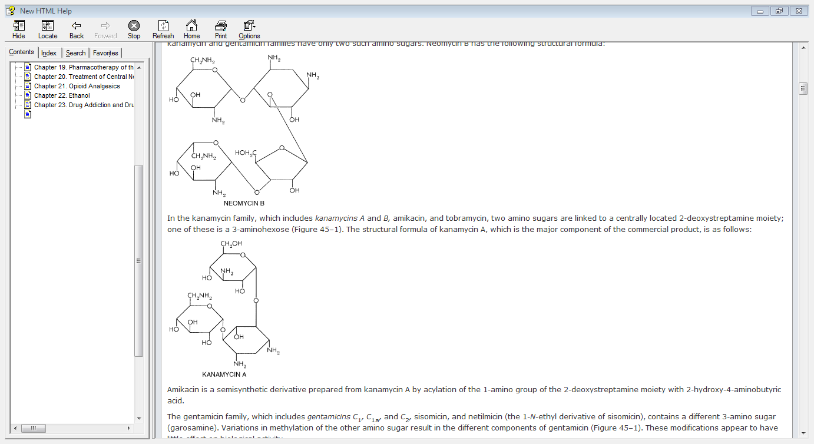

Slide 12
Kanamycin family :
kanamycins A and B,
amikacin, and
tobramycin
two amino sugars and one of these is a
3-aminohexose

Slide 13
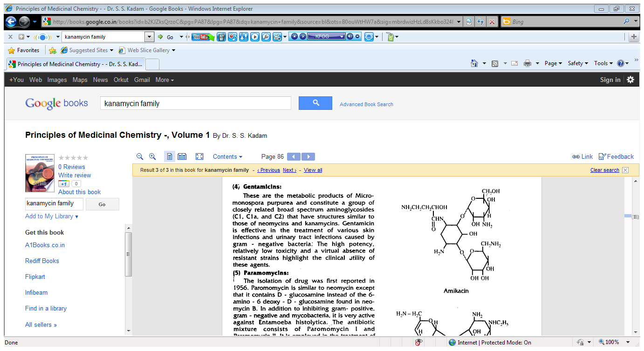
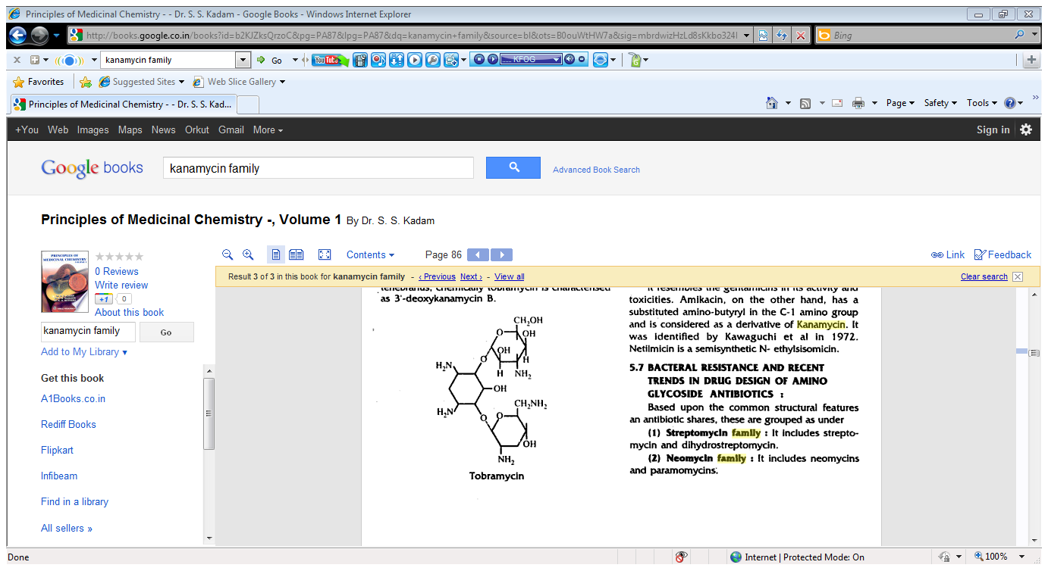

Slide 14
Gentamicin family :-
Gentamicins C1, C1a, C2
Sisomicin and
Netilmicin
different 3-amino sugar named
garosamine
Notes:
3-deoxy-4-C-methyl-3-methylamino-L-arabinopyranose

Slide 15
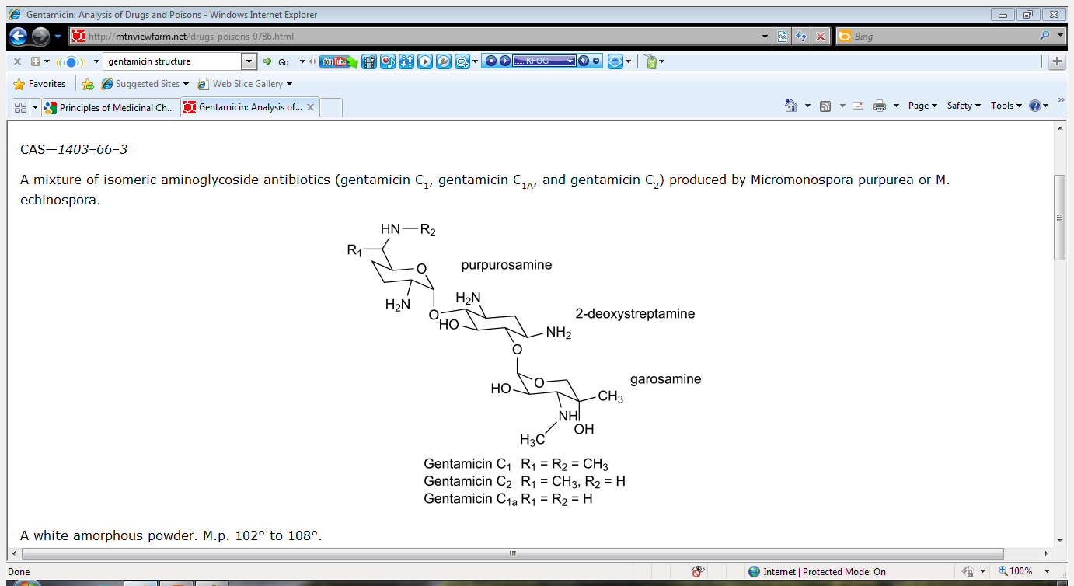

Slide 16
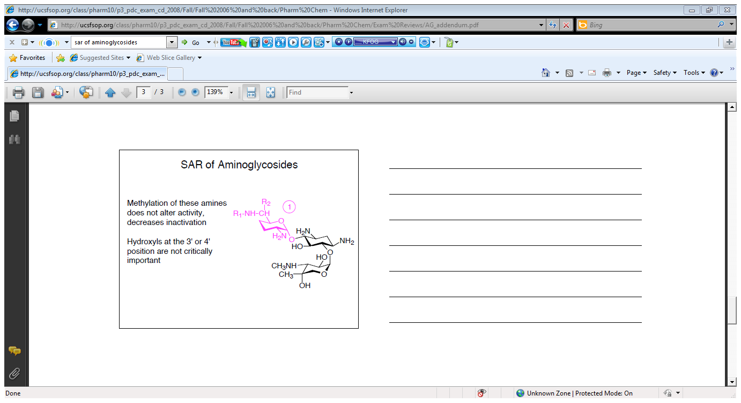
Structure Activity Relationships

Slide 17
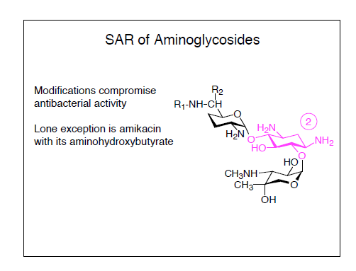

Slide 18
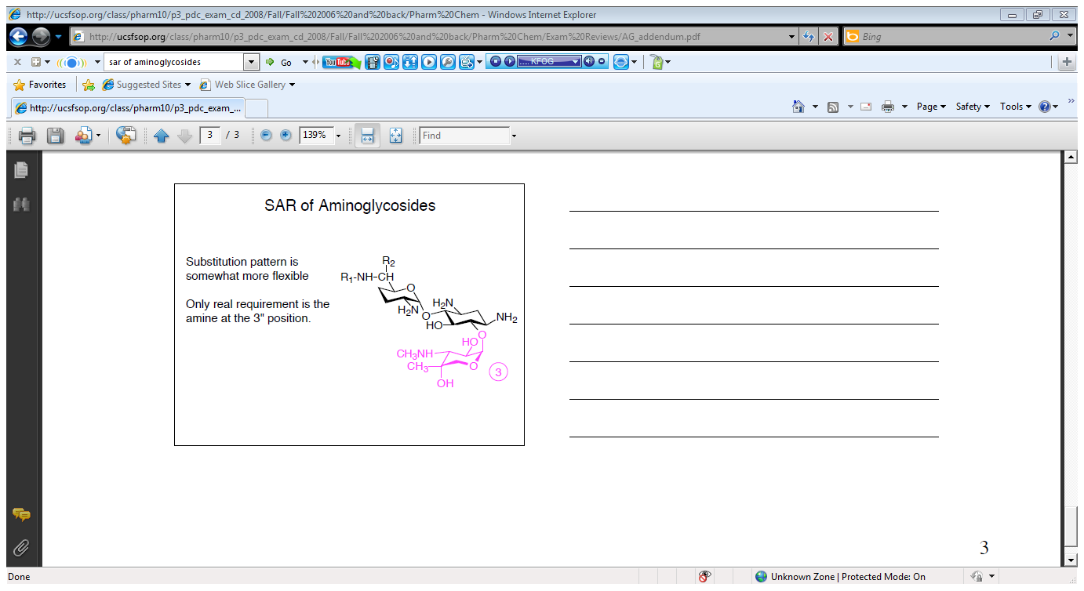

Slide 19
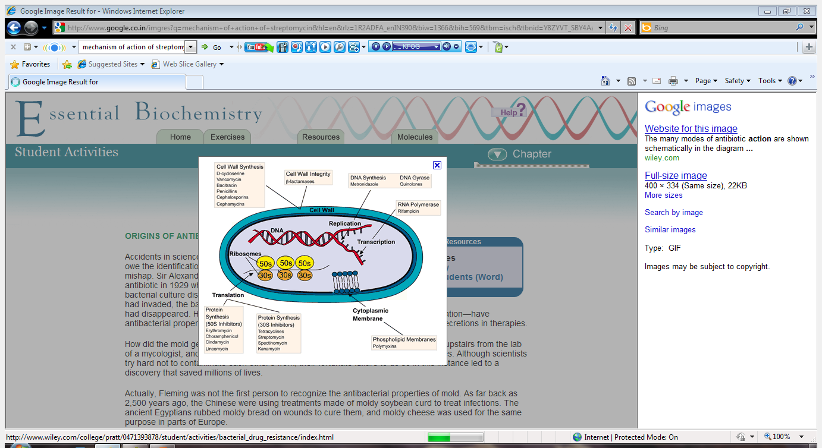
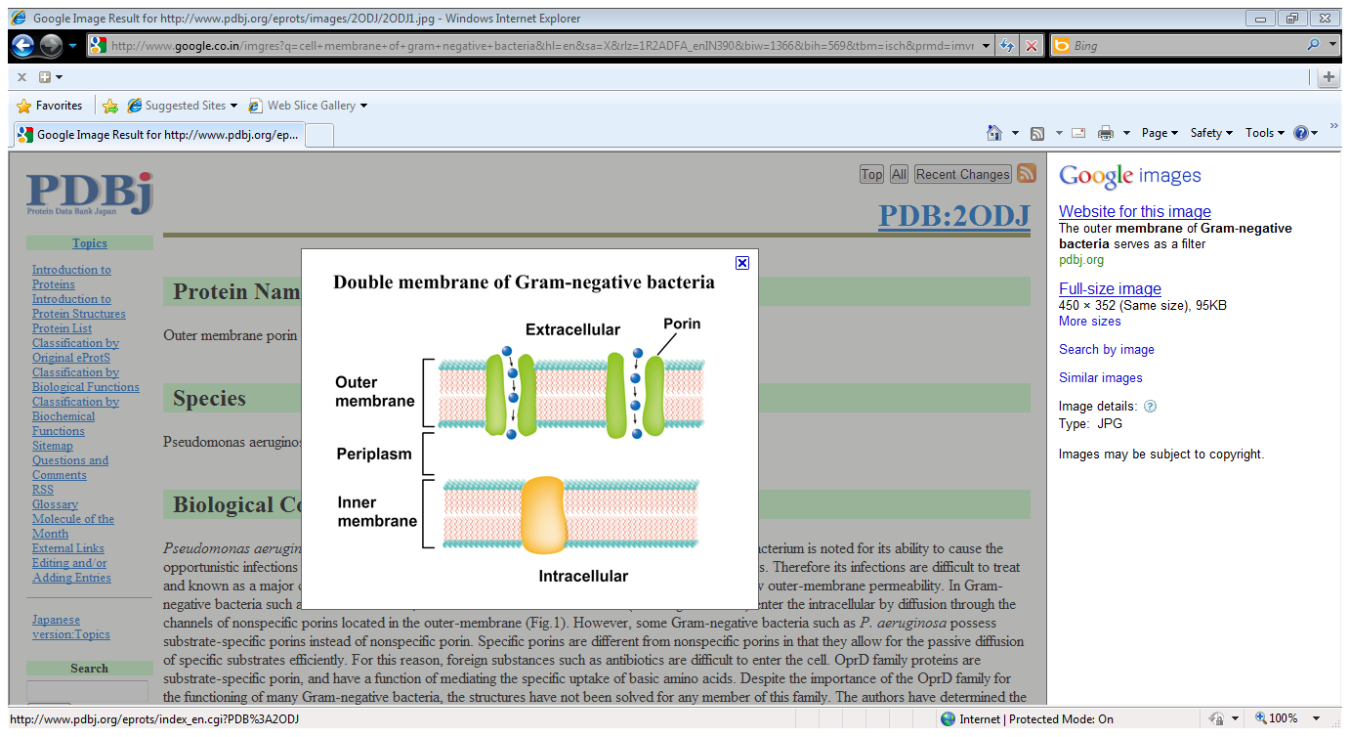
Mechanism of action
Energy-dependent phase I (EDP1) :

Slide 20
Rate-limiting and can be blocked by :
-divalent cations (e.g., Ca2+ and Mg2+),
-hyperosmolarity,
-a reduction in pH (acidic urine)
-anaerobic conditions (abscess)

Slide 21
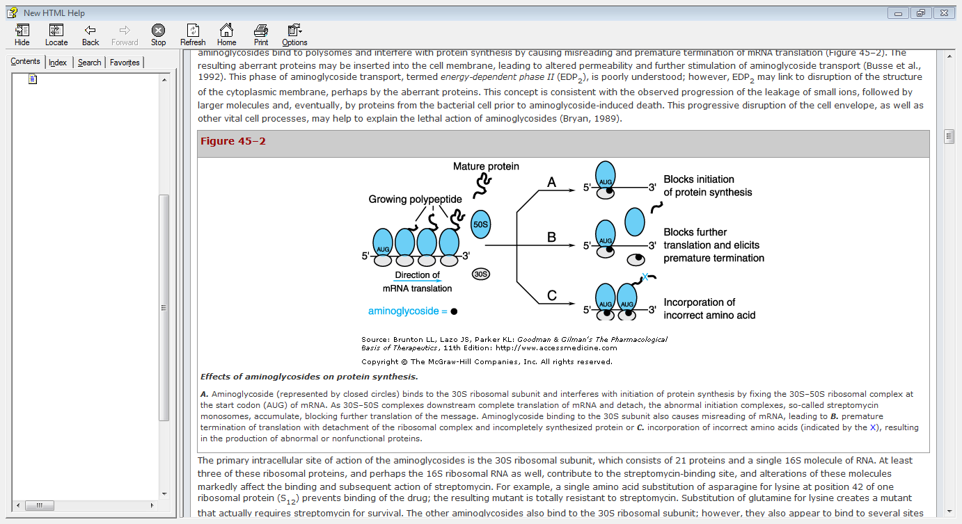

Slide 22
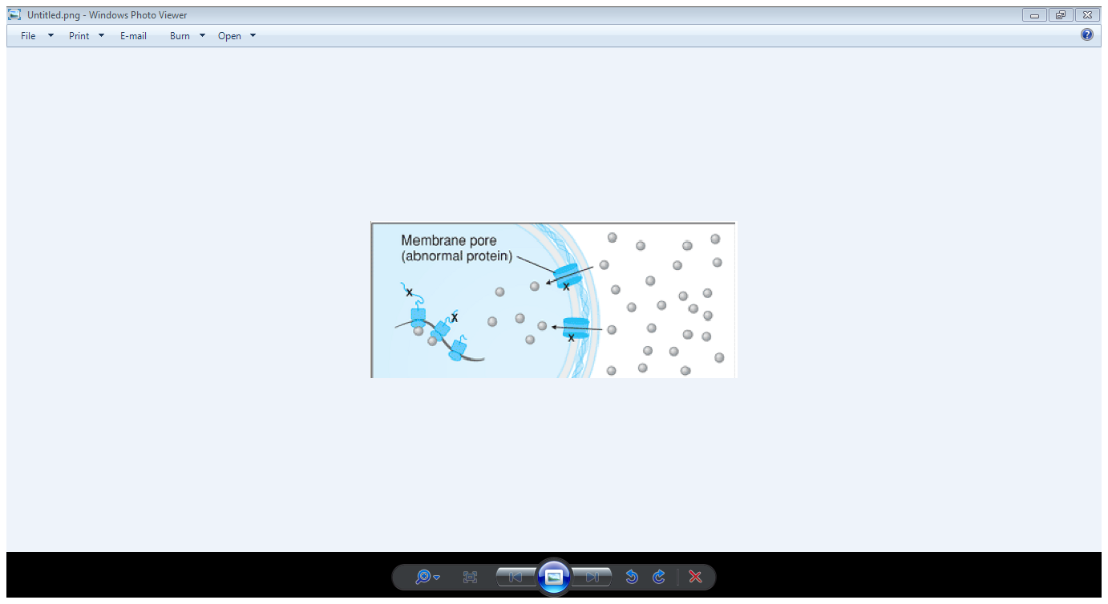
Energy-dependent phase II (EDP2) :
Progression of the leakage of small ions, followed by larger molecules and proteins prior to aminoglycoside-induced death.

Slide 23
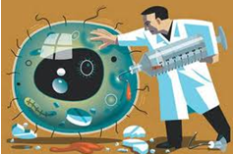
Microbial Resistance
Resistant to aminoglycosides because of :
Failure of the antibiotic to penetrate intracellularly (Natural resistance):-
Pseudomonas aeruginosa, Enterococcus faecalis, E. faecium
Low affinity of the drug for the bacterial ribosome :-
-Escherichia coli,
-5% of strains of P. aeruginosa
-Half the streptomycin-resistant strains of enterococci
It is specific for streptomycin

Slide 24
Inactivation of the drug by microbial enzymes :
Most common mechanism
The genes encoding aminoglycoside-modifying enzymes are acquired primarily by
-Conjugation
-Transfer of resistance plasmids
Amikacin :-
Strains that are resistant to multiple other drugs tend to be susceptible to amikacin.

Slide 25
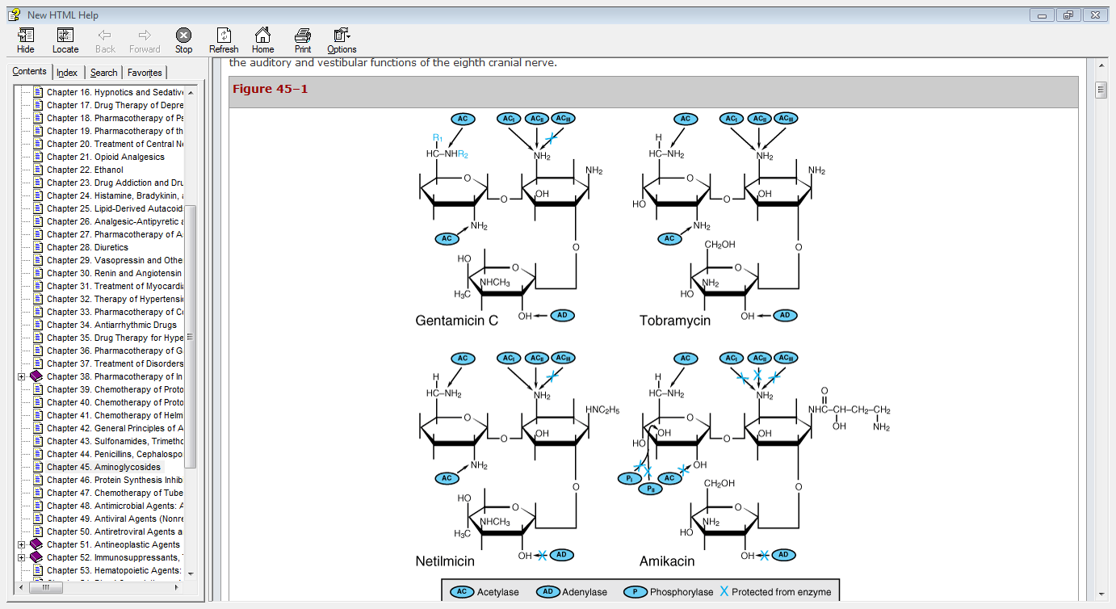

Slide 26
Cross-resistance :-
because the inactivating enzyme is bifunctional
Different chemical structures of streptomycin and other aminoglycosides :-
Gentamicin-resistant strains of enterococci may be susceptible to streptomycin.

Slide 27
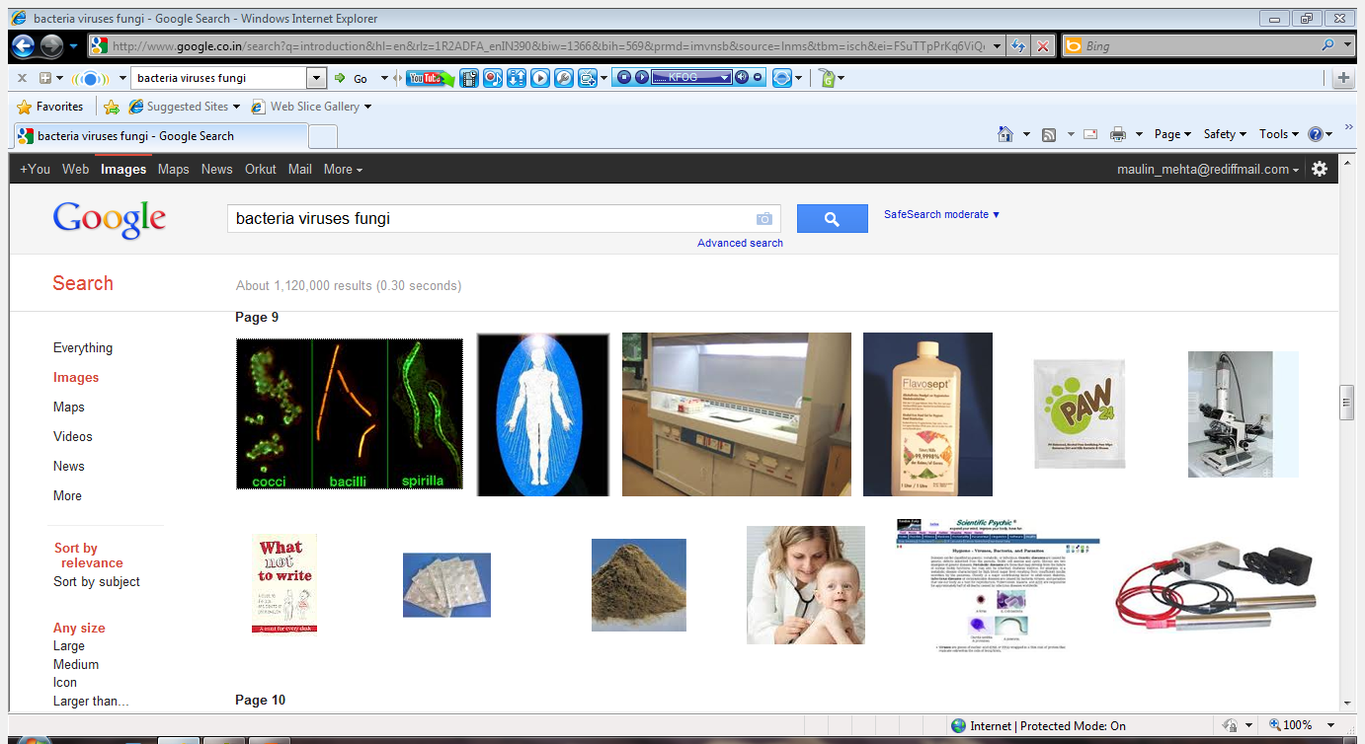
Antibacterial Spectrum
Bactericidal
Bacterial killing is concentration-dependent
A post-antibiotic effect :- the duration of this effect also is concentration dependent.
Primarily against aerobic gram-negative bacilli
Action against most gram-positive bacteria is limited
Streptomycin and Kanamycin :- more limited spectrum compared with other aminoglycosides
Notes:
and they should not be used as single agents to treat infections caused by gram-positive bacteria.

Slide 28
Tobramycin :-
More active against P. aeruginosa and some Proteus spp.
Amikacin :-
Effective against P. aeruginosa.
Also against Klebsiella, Enterobacter, and E. coli that are resistant to gentamicin and tobramycin.
Neomycin :-
Highly sensitive to E. coli, Enterobacter aerogenes, Klebsiella pneumoniae, and Proteus vulgaris.
Gram-positive microorganisms that are inhibited include S. aureus and E. faecalis.
M. tuberculosis also sensitive

Slide 29
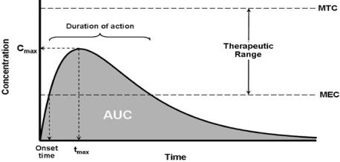
Pharmacokinetics
Highly polar cations (due to hydroxyl and amine groups)
Absorption :-
Very poorly absorbed from the gastrointestinal tract (Less than 1% of a dose)
Long-term oral or rectal administration :-
accumulation to toxic concentrations in patients with renal impairment

Slide 30
Gastrointestinal disease :-
-ulcers or inflammatory bowel disease
-Absorption increase
Intramuscular(IM) injection :-
-absorbed rapidly
Peak concentrations in plasma reach after 30 to 90 minutes of :-
-IM injection
-completion of an intravenous infusion of an
equal dose over a 30-minute period.

Slide 31
Shock :-
-Absorption of drug may be reduced from intramuscular sites because of poor perfusion.
Distribution :–
Do not penetrate into most cells, the central nervous system (CNS) and the eye(polar nature)
The apparent volume of distribution is 25% of lean body weight (approximates the volume of extracellular fluid)

Slide 32
High concentrations :-in the
-Renal cortex
-The endolymph and perilymph of the inner ear
contribute to the nephrotoxicity and ototoxicity
concentrations in CSF :-
-In the absence of inflammation, less than 10% of those in plasma
-25% when there is meningitis

Slide 33
Bacterial endophthalmitis :-
Penetration into ocular fluids is poor that periocular and intraocular injections are required
They should not be used as single agents except for urinary tract infections because of relatively poor tissue penetration and poorer outcomes
Elimination - The aminoglycosides are excreted almost entirely by glomerular filtration

Slide 34
Urine concentrations of 50 to 200 µg/ml are achieved.
A large fraction of dose is excreted unchanged during the first 24 hours
Renal clearance is approximately two-thirds of the creatinine clearance
The half-lives of the aminoglycosides in plasma :-
-vary between 2 and 3 hours in patients with normal renal function.

Slide 35
After a single dose of an aminoglycoside :-
-clearance from the plasma exceeds renal
excretion by 10% to 20%.
After 1 to 2 days of therapy :-
-nearly 100% of subsequent doses are recovered
in the urine.
This lag period represents saturation of binding sites in tissues.

Slide 36
The half-life for tissue-bound aminoglycoside :-
-range from 30 to 700 hours.
Small amounts of aminoglycosides can be detected in the urine for 10 to 20 days after drug administration is discontinued.
Aminoglycoside bound to renal tissue exhibits antibacterial activity

Slide 37
Impaired renal function - critical to reduce the maintenance dosage of these drugs.
Expanded extracellular volume - the volume of distribution is increased and concentration will be reduced.
Cystic fibrosis - clearances are increased and half-lives are reduced
Leukemia - the volume of distribution is increased
Anemia - (hematocrit <25%) concentration in plasma is higher (reduction in the number of binding sites on red blood cells)

Slide 38
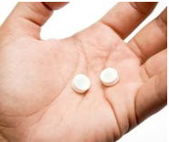
Dosing
Once-daily dosing regimen :–
Higher peak concentration
-bactericidal activity and post-antibiotic effect is
concentration dependent
lower toxicity
-more time concentration remains below
threshold
Costs less
Administered more easily
Notes:
Provides a longer period when concentrations fall below the threshold for toxicity than does a multiple-dose regimen (12 hours versus less than 3 hours total in the example shown) Aminoglycoside bactericidal activity, on the other hand, is related directly to the peak concentration achieved because aminoglycosides cause concentration-dependent killing and a concentration-dependent postantibiotic effect. This enhanced activity at higher concentrations probably accounts for the equivalent efficacy of a once-daily regimen compared with a multiple-dose regimen despite the relatively prolonged periods of time that plasma concentrations are "subtherapeutic,"i.e., below the MIC.

Slide 39
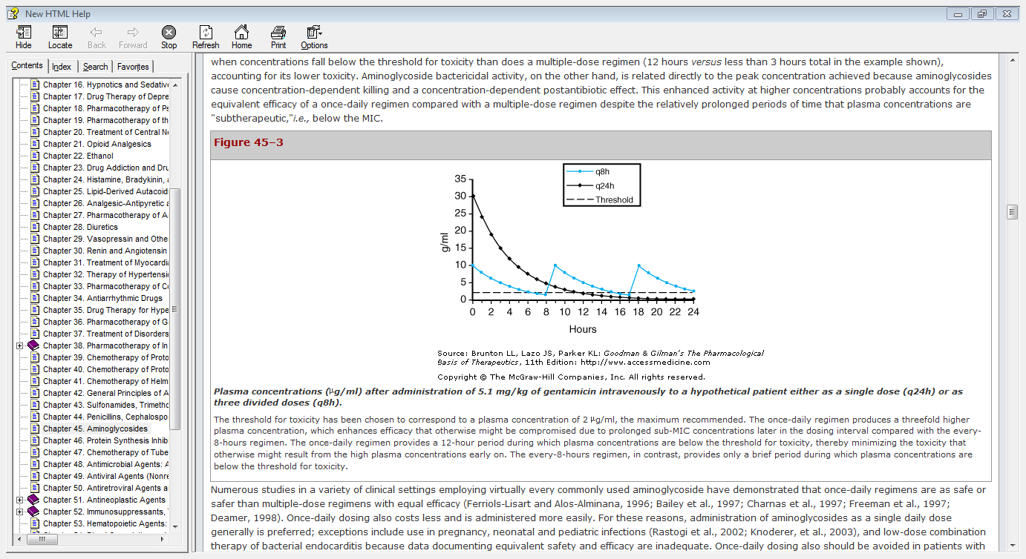

Slide 40
For these reasons, single daily dose generally is preferred.
Exceptions - use in pregnancy,
- neonatal and pediatric infections
- low-dose combination therapy of
bacterial endocarditis
- Creatinine clearance of less than 20 to 25
(ml/min)
Notes:
Half-lives of the drugs may be prolonged in the newborn –
8 to 11 hours in the first week of life in newborns weighing less than 2 kg
5 hours in those weighing more than 2 kg .

Slide 41
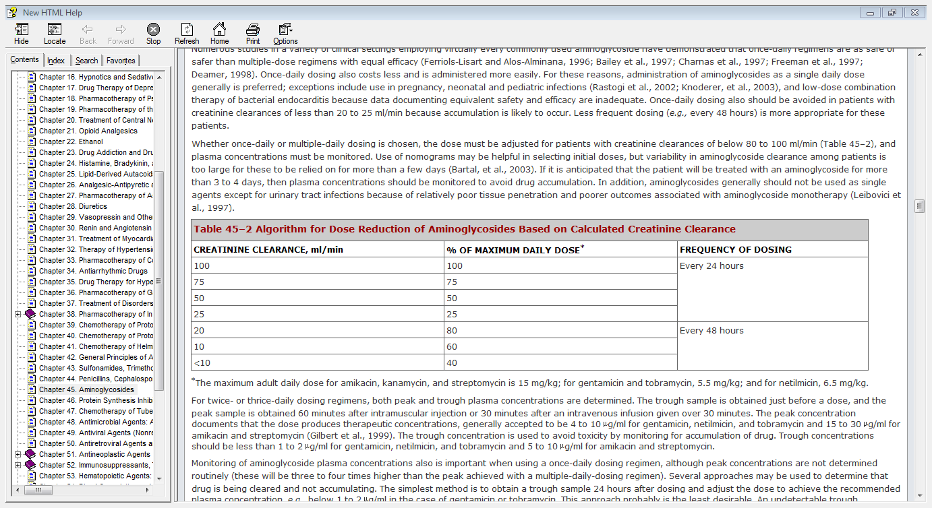

Slide 42
Therapeutic drug monitoring :–
Aminoglycoside for more than 3 to 4 days
Impaired renal function
life-threatening systemic infections
Overdosage

Slide 43
Approaches to monitor plasma concentration :-
Obtain a trough sample 24 hours after dosing and adjust the dose to achieve the recommended plasma concentration, e.g., below 1 to 2 µg/ml in the case of gentamicin or tobramycin.
least desirable.
Nomograms to target a range of concentrations in a sample obtained earlier in the dosing interval
Inaccurate, particularly when conditions that alter aminoglycoside clearance are present .
Measure the concentration in two plasma samples drawn several hours apart (e.g., at 2 and 12 hours after a dose).
Accurate method for monitoring plasma levels for dose adjustment
Notes:
An undetectable trough concentration could reflect grossly inadequate dosing in patients who clear the drug rapidly with prolonged periods (perhaps well over half the dosing interval) during which concentrations are subtherapeutic.
24-hour trough concentration target of 1 to 2 µg/ml actually would increase aminoglycoside exposure compared with a multiple-daily-dosing regimen , which defeats the goal of providing a washout with concentrations of 0 to 1 g/ml between 18 to 24 hours after a dose. . For example, if the plasma concentration from a sample obtained 8 hours after a dose of gentamicin is between 1.5 and 6 µg/ml, then the concentration at 18 hours will be less than 1 µg/ml Target ranges of 1 to 1.5 µg/ml for gentamicin at 18 hours for patients with creatinine clearances above 50 ml/min and 1 to 2.5 µg/ml for those with clearances below 50 ml/min also have been used.

Slide 44
Therapeutic uses-Streptomycin
Bacterial Endocarditis :-
A combination of penicillin G and streptomycin :-
-Treatment of streptococcal endocarditis .
-Treatment of enterococcal endocarditis.
No clinically proven benefit in treatment of staphylococcal mitral or aortic valve endocarditis.
Tularemia :-
Drug of choice
1 g (15 to 25 mg/kg) per day for 7 to 10 days.
Notes:
Bacteriostatic against enterococci(penicillin g)
.

Slide 45
Plague :-
All forms of plague.
2 g/day in two divided doses for 7 to 10 days.
Tuberculosis :-
At least one or two other drugs to which the causative strain is susceptible.
15 mg/kg per day as a single intramuscular injection for 2 to 3 months and then 2 or 3 times a week thereafter.
Streptomycin replaced almost entirely by gentamicin

Slide 46
Gentamicin
Gentamicin, tobramycin, amikacin, and netilmicin can be used interchangeably
The typical recommended dose
For adults :- loading dose of 2 mg/kg and then 3 to 5 mg/kg per day (IM or IV)
For children :- 2 to 2.5 mg/kg every 8 hours

Slide 47
Bacterial Endocarditis :-
Combination with a penicillin or vancomycin for 2 to 4 weeks
Combination therapy has fallen from first-line regimen for treatment of endocarditis.
Urinary Tract Infections :-
Uncomplicated urinary tract infections - single intramuscular dose of gentamicin (5 mg/kg)
Discontinued if microorganism is sensitive to less toxic antibiotics.
Notes:
Because of toxicity and limited clinical benefit,

Slide 48
Pneumonia :-
Combination with a β-lactam antibiotic :-
-Empirical therapy of hospital-acquired pneumonia in which multiple-drug-resistant gram-negative aerobes are likely causative agent.
Ineffective for the treatment of community-acquired pneumonia
There is generally no benefit from adding an aminoglycoside
Notes:
Poor penetration of drug into inflamed tissues and the associated conditions of low oxygen tension and low pH—both of which interfere with aminoglycoside antibacterial activity
anaerobes or S. pneumoniae

Slide 49
Meningitis :-
Third-generation cephalosporins (cefotaxime and ceftriaxone) reduce the need of aminoglycosides, except
Gram-negative organisms that are resistant to β-lactam antibiotics (e.g., species of Pseudomonas and Acinetobacter).
Sepsis :-
Empirical regimen for the febrile patient with granulocytopenia and for infections suspected to be caused by P. aeruginosa.

Slide 50
Topical Applications :-
Absorbed
slowly :- ointment
Rapidly :- cream
Applied to large areas of denuded body surface, in burned patients.
Notes:
Most authorities continue to recommend combination therapy of documented non–urinary tract P. aeruginosa infections, particularly pneumonia with bacteremia.

Slide 51
Tobramycin
Indications :- same as those for gentamicin.
Treatment of serious infections caused by P. aeruginosa

Slide 52
Amikacin
The spectrum of antimicrobial activity is the broadest of the group.
The recommended dose of amikacin :-
15 mg/kg per day
Preferred agent for the initial treatment of serious nosocomial gram-negative bacillary infections
It is active against M. tuberculosis, including streptomycin-resistant strains and atypical mycobacteria.
Treatment of disseminated atypical mycobacterial infection in acquired immunodeficiency syndrome (AIDS) patients.
Notes:
where resistance to gentamicin and tobramycin has become a significant problem.

Slide 53
Netilmicin
Active against bacteria that are resistant to gentamicin
Treatment of serious infections owing to susceptible Enterobacteriaceae and other aerobic gram-negative bacilli.
The recommended dose for
Complicated urinary tract infections :- 1.5 to 2 mg/kg every 12 hours.
Serious systemic infections :- 4 to 7 mg/kg
Notes:
like amikacin, it is not metabolized by the majority of the aminoglycoside-inactivating enzymes,

Slide 54
Kanamycin
Use has declined markedly :-
Spectrum of activity is limited
Most toxic.
Kanamycin has been employed to treat tuberculosis in combination with other effective drugs.

Slide 55
Neomycin
Broad-spectrum antibiotic
Available in creams, ointments and other products :- alone and in combination with polymyxin, bacitracin, other antibiotics and a variety of corticosteroids.
Topical application in a variety of infections of the skin and mucous membranes
Infections associated with burns, wounds, ulcers, and infected dermatoses.
Notes:
There is no evidence that these topical preparations shorten the time required for healing of wounds or that those containing a steroid are more effective.

Slide 56
Irrigation of the bladder :-
Neomycin and polymyxin B
The bladder usually is irrigated at the rate of 1 L every 24 hours.
"preparation" of the bowel for surgery :-
The oral administration of neomycin (usually in combination with erythromycin base)
Hepatic encephalopathy :-
Nephrotoxic, so used rarely for this indication.
Lactulose is a much less toxic agent and is preferred
Notes:
1 ml of a preparation containing 40 mg neomycin and 200,000 units polymyxin B per milliliter is diluted in 1 L of 0.9% sodium chloride solution and is used through appropriate catheter systems.

Slide 57
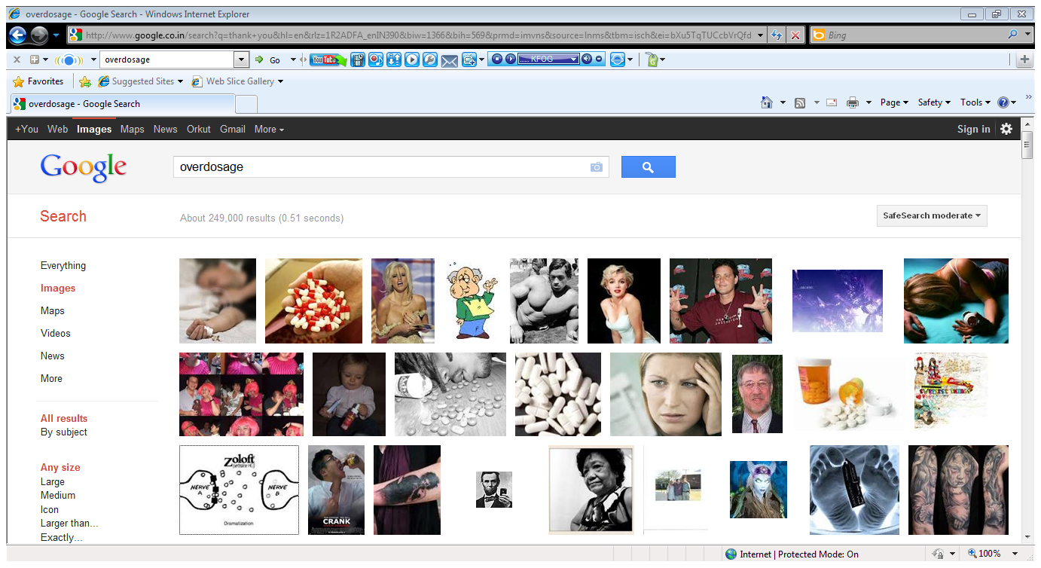
Overdosage
Removed from the body by :-
-hemodialysis or peritoneal dialysis.
Approximately 50% of the dose is removed in 12 hours by hemodialysis
A dose equal to half the loading dose required
Peritoneal dialysis is less effective
Bacterial peritonitis :-
aminoglycosides should be added to the dialysate
Notes:
Continuous arteriovenous hemofiltration (CAVH) and continuous venovenous hemofiltration (CVVH) will result in aminoglycoside clearances approximately equivalent to 15 and 15 to 30 ml/min of creatinine clearance, respectively, depending on the flow rate.
administered after each hemodialysis should maintain the plasma concentration in the desired range. However, a number of variables make this a rough approximation at best.

Slide 58
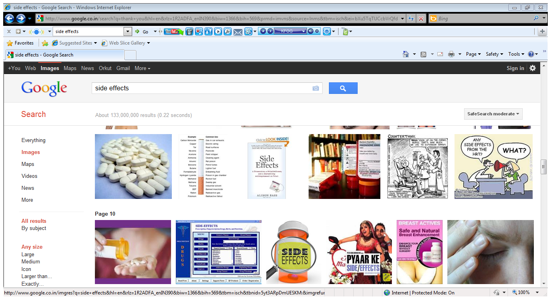
Side effects
Complicate the use and make their administration difficult.
Ototoxicity :-
Accumulation in the perilymph and endolymph of the inner ear when concentrations in plasma are high.
Genetic predisposition :- linked to mutations in a mitochondrial ribosomal RNA gene("A1555G" mitochondrial mutation)

Slide 59
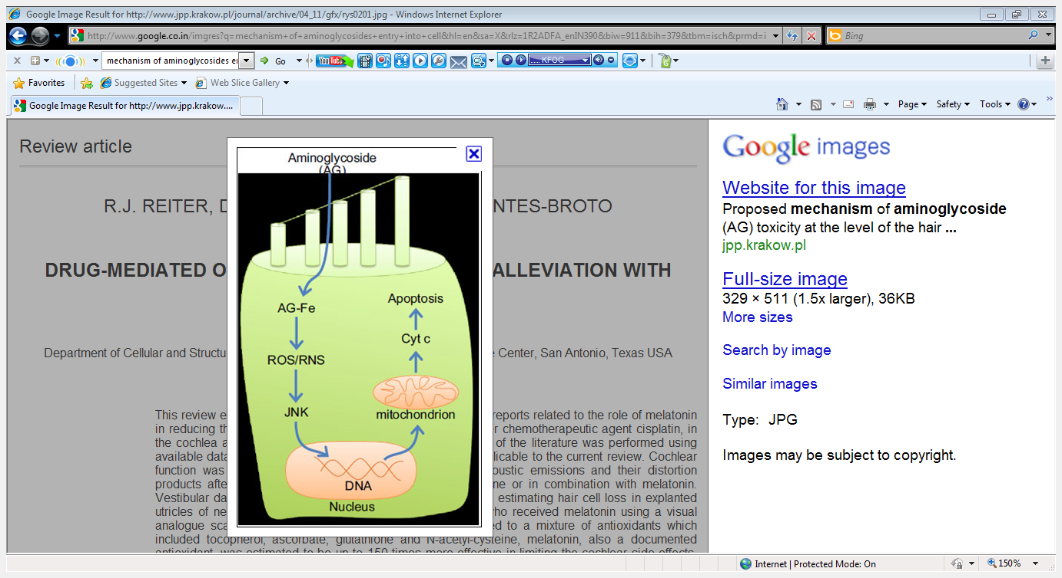
Notes:
Reactive oxygen species/reactive nitrogen species…. c-Jun N-terminal kinase (JNK), one of the signaling pathways activated by aminoglycosides via free radicals, protects the cochlear hair cells from damage due to neomycin treatment

Slide 60
Once sensory cells are lost, regeneration does not occur.
Retrograde degeneration of the auditory nerve, resulting in irreversible hearing loss.
Vestibular effects :- Streptomycin and gentamicin
Cochlear effects :- Amikacin, kanamycin and neomycin
Both :- Tobramycin
Incidence :- may be as high as 25%

Slide 61
Cochlear :-
A high-pitched tinnitus :- the first symptom several days to 2 weeks after therapy
Hearing loss progresses
Vestibular :-
Moderately intense headache lasting 1 or 2 days
Acute stage :-
nausea, vomiting, and difficulty with equilibrium, persist for 1 to 2 weeks.
Prominent symptoms :- vertigo
A positive Romberg test, nystagmus are outstanding signs.

Slide 62
Ends suddenly and followed by
Chronic phase :-
chronic labyrinthitis :- symptomless while in bed, the patient has difficulty when attempting to walk or make sudden movements.
Ataxia is the most prominent feature.
It persists for approximately 2 months.
Gradually superseded by a compensatory stage in which symptoms are latent and appear only when the eyes are closed.

Slide 63
Nephrotoxicity :-
Approximately 8% to 26%
Results from accumulation and retention of aminoglycoside in the proximal tubular cells
Almost always reversible
The glomerular filtration rate is reduced after several additional days
Notes:
regenerate

Slide 64
Neomycin :- highly nephrotoxic, should not be administered systemically.
Streptomycin :- Least nephrotoxic.
Amphotericin B, vancomycin, angiotensin-converting enzyme inhibitors, cisplatin, and cyclosporine, may potentiate aminoglycoside-induced nephrotoxicity
Notes:
concentrates to the greatest degree,

Slide 65
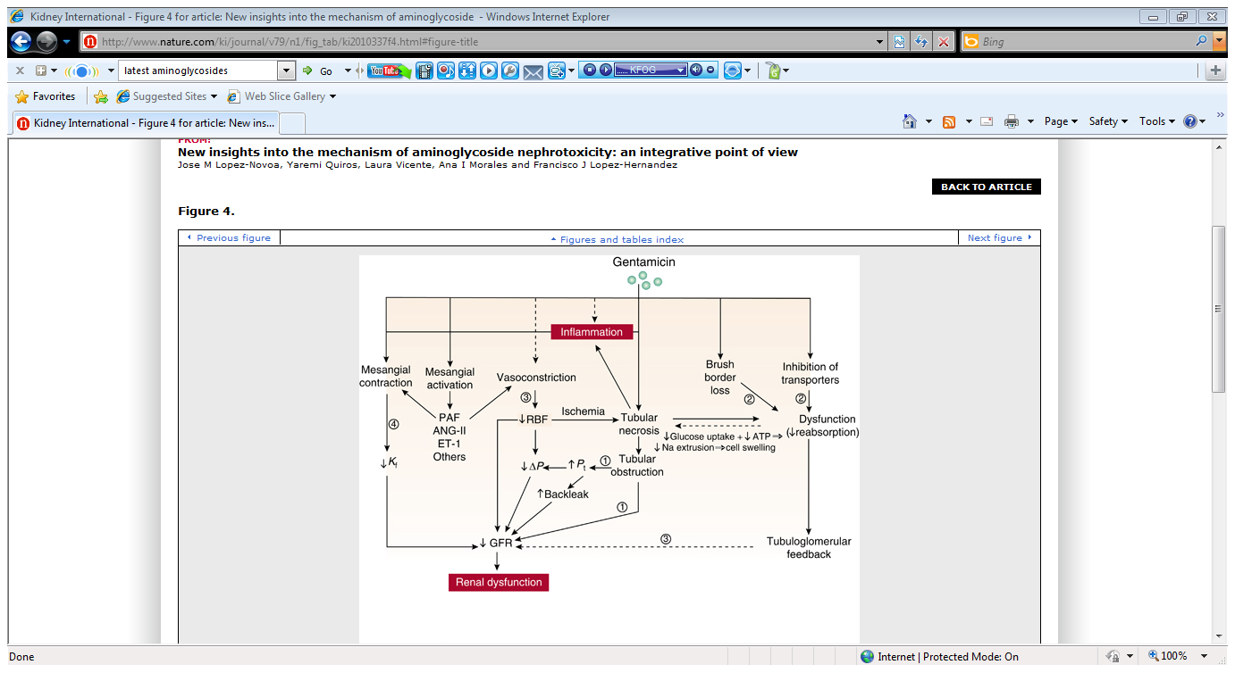

Slide 66
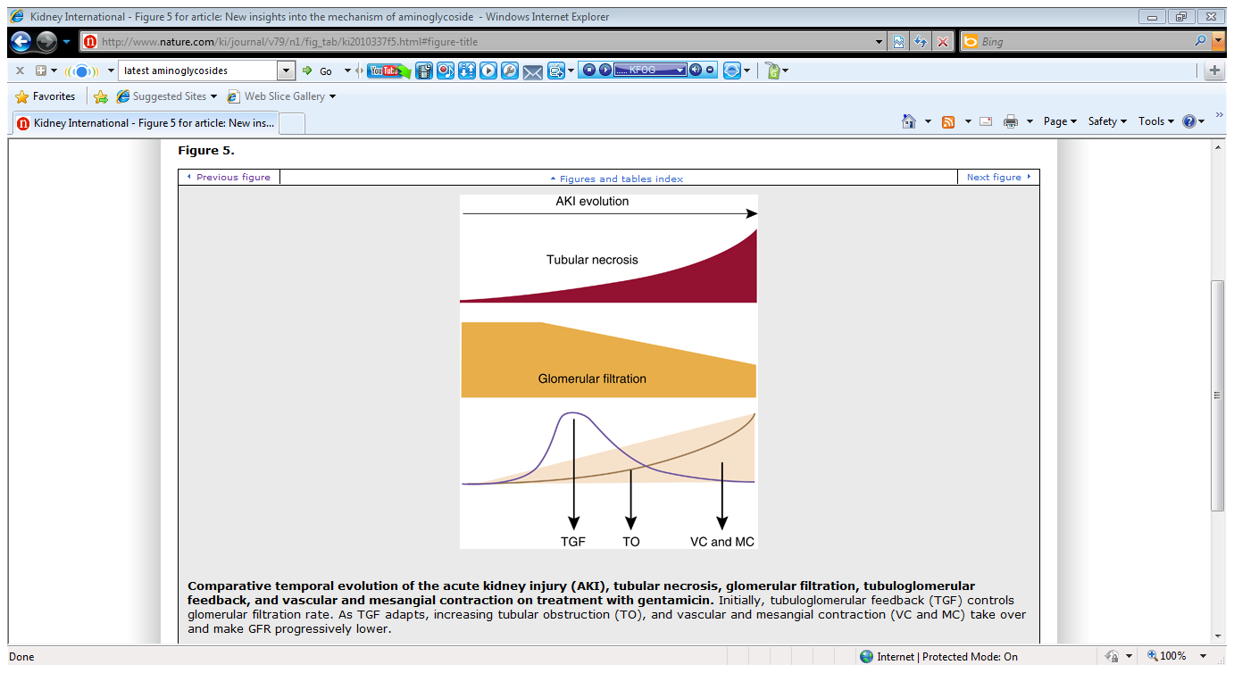

Slide 67
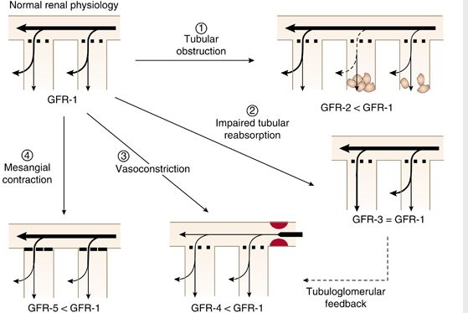

Slide 68
The most important result of this toxicity may be reduced excretion of the drug, which, in turn, predisposes to ototoxicity

Slide 69
Neuromuscular Blockade :-
Acute neuromuscular blockade and apnea
Decreasing potency for blockade :- neomycin, kanamycin, amikacin, gentamicin, and tobramycin.
Patients with myasthenia gravis :-more susceptible
Treatment :-
-The intravenous administration of a calcium salt
-Inhibitors of acetylcholinesterase
Notes:
Aminoglycosides may inhibit prejunctional release of acetylcholine while also reducing postsynaptic sensitivity to the transmitter

Slide 70
Other Effects :-
Dysfunction of the optic nerve, including scotomas,
Peripheral neuritis.
Paresthesia :- most commonly perioral
Allergenic reaction
Pseudomembranous colitis :-
oral preparation(neomycin and kanamycin)
Notes:
This may be due either to accidental injection of a nerve during the course of parenteral therapy or to toxicity involving nerves remote from the site of antibiotic administration.

Slide 71
Factors which increase toxicity
  Duration of treatment >5 days.
  Repeated doses.
  Higher doses ( total amount )
  Elderly
  Hypotension
  Dehydration
  Renal insufficiency
  Concurrent use with loop diuretics, other nephrotoxic drugs (vancomycin, amphotericin B, cisplatin, cyclosporin, some cephalosporins)

Slide 72
Clinical Summary
First-line therapy for very specific, prominent infections, such as plague, tularemia, and tuberculosis.
Because more effective and less toxic alternatives are available, aminoglycosides should be used sparingly and reserved for specific indications
If an aminoglycoside must be used :-
The duration of therapy should be kept to a minimum to avoid toxicity
serum concentrations should be monitored.
Notes:
Gentamicin or amikacin :-
Useful for empirical treatment of nosocomial infections caused by multidrug-resistant gram-negative pathogens such as Pseudomonas or Acinetobacter.
Useful for the treatment of serious urinary tract infections caused by enteric organisms that have acquired resistance to sulfa drugs, penicillins, cephalosporins, and fluoroquinolones.
Combination with vancomycin or a β-lactam :-
To enhance bactericidal effect (i.e., synergism), the clinical benefit of such combinations is unproven for most infections.

Slide 73
Spectinomycin-Introduction
Antibiotic produced by Streptomyces spectabilis.
Bacteriostatic
Voluntarily withdrawn from the market in some regions, as more effective medications are available.
Not the preferred line of treatment
Expensive
Injection as opposed to oral administration

Slide 74
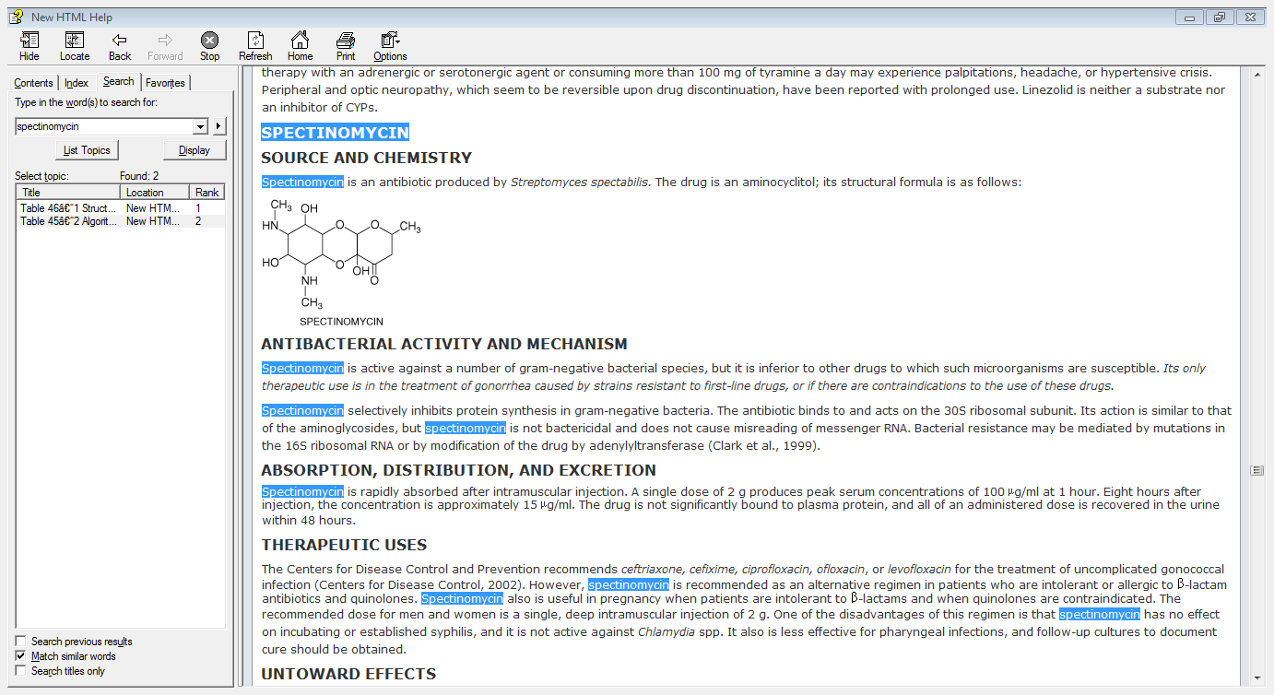
Chemistry
Aminocyclitol that does not contain amino sugars

Slide 75
Mechanism of action
Inhibits protein synthesis in gram-negative bacteria.
Binds to and acts on the 30S ribosomal subunit.
Inhibits translocation of the peptidyl tRNA from the A site to the P site.
Action is similar to that of the aminoglycosides, but does not cause misreading of mRNA.

Slide 76
Microbial resistence
Bacterial resistance may be mediated by :
Low affinity of the drug for the bacterial ribosome - mutations in the 16S ribosomal RNA
Inactivation of the drug by microbial enzymes.

Slide 77
Pharmacokinetics
Rapidly absorbed after intramuscular injection
The drug is not significantly bound to plasma protein
All of an administered dose is recovered in the urine within 48 hours.

Slide 78
Therapeutic uses
Uncomplicated gonococcal infection :-
Recommended as an alternative regimen :-intolerant or allergic to β-lactam antibiotics and quinolones.
Also useful in pregnancy
The recommended dose :- single, deep intramuscular injection of 2 g.
Less effective for pharyngeal infections, and follow-up cultures should be obtained.

Slide 79
Side effects
Serious allergic reaction :-
Difficulty in breathing
Closing of the throat
Swelling of the lips, tongue, or face
Urticaria, chills, and fever
Other side effects :-
nausea
soreness and pain at the injection site
Dizziness and insomnia.

Slide 80

Thank you

