Slide 1
Ant amoebic drugs
Part 2

Slide 2
Chloroquine
Antiamebic drug
Antimalarial drug
Used in combination with metronidazole and luminal amebicide for amebic liver diseases.

Slide 3
Luminal amoebicides
acts on the luminal parasites
used for treatment of asymptomatic amebiasis.
Include
Diloxanide Furoate, nitraxozanide
Iodoquinol, quinidochlor
Antibiotics
  - Paromomycin
  - Tetracyclines
  - Erythromycin

Slide 4
Diloxanide furoate
Chemistry
Ester of diloxanide + furoic acid .
Pharmacokinetics
Given orally.
Split in the intestine, most of diloxanide is absorbed, conjugated to form a glucoronide which is excreted in urine (90%).
The unabsorbed diloxanide is the amoebicidal agent (10%).

Slide 5
Pharmacodynamics:
Unkown mechanism of action
Direct amoebicidal action against luminal forms.
Not active against trophozoites intestinal wall or extraintestinal tissues.
Kill trophozoites responsible for production of cysts

Slide 6
Therapeutic Uses
Drug of choice for asymptomatic intestinal infection.
For eradication of infection given along with all forms of amebiasis.
Dose: 500 mg three times/day for 10 days.

Slide 7
Adverse Effects
Flatulence
Nausea, vomiting, abdominal cramps.
No serious adverse effects
Contraindications:
- Pregnancy
- Children (less than 2 years).

Slide 8
Paromomycin Sulphate
Aminoglycoside, not absorbed.
Effective against luminal forms of ameba
Mechanism of action
Direct amebicidal action (causes leakage by its action on cell membrane of parasite).
Indirect killing of bacterial flora essential for proliferation of pathogenic amoebae.

Slide 9
Kinetics
Orally
Not significantly absorbed from the GIT
Small amount absorbed is excreted unchanged in urine (may accumulate with renal insufficiency).

Slide 10
Adverse effects
Gastrointestinal distress and diarrhea.
Precautions
Severe renal disease
patients with GIT ulceration
500 mg TDS
Resistant kala azar
Giardiasis

Slide 11
Tetracyclines
Very weak direct amoebicidal action.
Mainly act indirectly on bacterial flora.
Used in severe cases of amoebic dysentery not responding to metronidazole combined with dehydroemetine.

Slide 12
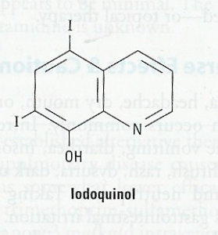
HALOGENATED HYDROXYQUINOLINES
Iodoquinol
Mechanism of action
Unknown
Effective against organisms in GIT only Not intestinal wall or liver.
Pharmacokinetics
Absorption is poor (90%), excreted in feces.
10% enter circulation, excreted as glucouronide in urine.
Half life is 11-14 h

Slide 13
Uses
lumen amoebicide.
For eradication of infection given along with tissue amoebicide (metronidazole).
COST EFFECIVE/GOOD PT.ACCEPTIBILITY

Slide 14
Adverse Effects
Peripheral neuropathy including optic neuritis
GIT: Nausea, vomiting, diarrhoea.
Enlargement of the thyroid gland.
Agranulocytosis.
Iodine sensitivity.
interference with thyroid function tests (increase protein-bound serum iodine, decrease in measured ¹³¹I uptake).
Sub acute myelo neuropathy-in Japan 1970

Slide 15
Contraindications
Optic neuropathy
Thyroid disease
Sensitivity to iodine
Severe liver disease
Severe kidney disease
discontinued if it produces persistent diarrhea or signs of iodine toxicity (dermatitis, urticaria, pruritus, fever)

Slide 16
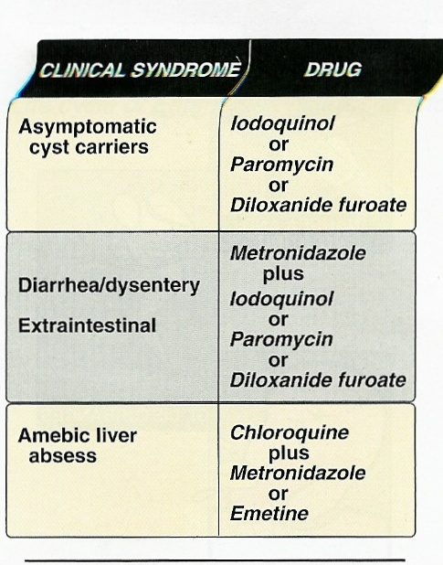
THANK YOU
AND
GOOD DAY!

Slide 17
References
Tripathi KD, Essentials of medical pharmacology, 6th edition, Jaypee publication New Delhi
Lauraence DR, Bennett TN and Brown MJ. Unwanted effects and adverse drug reactions. Clinical Pharmacology 8th edn. Churchill Livingstone 1997

Slide 18
Author | Results | Journal | level
Cecilia Ximénez, Patricia Morán, [...], and Partida Oswaldo | Novelties on Amoebiasis: A Neglected Tropical Disease | Journal of Global Infectious Diseases | Level 1

