Slide 1
RENAL STONES
DR.OHANG CHAUDHARI

Slide 2
Etiology
Idiopathic (calcium stone)
Hypercalcaemic disorders
Renal tubular syndromes
Uric acid lithiasis
Enzyme disorders
Secondary urolithiasis

Slide 3
Idiopathic
Unexplained hypercalciuria with normal serum calcium level
70% of renal stone patients have this type
1 ) renal type- more common in children 2) absorptive type- more common in adult

Slide 4
HYPERCALCAEMIC DISORDERS
Parathyroid adenoma, chief cell hyperplasia
Overproduction of parathormone
Increased reabsorption of calcium from intestine, and renal tubules, &bone resorption
( primary hyperparathyroidism)

Slide 5
Prolonged immobilisation
Lead to bone resorption
Hypercalcaemia, hypercalciuria
As immobility induces osteoclast mediated bone resorption

Slide 6
Milk alkali syndrome
Increased consumption of calcium, vitamine –D lead to hypercalcaemia, alkalosis,
Alkalosis compromise renal excretion of calcium
Other sarcoidosis

Slide 7
RENAL TUBULAR SYNDROME
Renal tubular acidosis
Cystinuria
Uric acid lithiasis

Slide 8
RTA
RTA type 1 associated with renal stone
Due to hypercalciuria & low urinary citrate excretion
Stones composed of calcium phosphate

Slide 9
cystinuria
Autosomal recessive disorder
Defect in amino acid transport in GIT & renal tubules..cystine,lysine, arginine,ornithine
Increased excretion of such amino acid in urine
Cystine stones – multiple,very hard, radio opaque
Family members should be screened for it

Slide 10
Uric acid lithiasis
5-10% of renal stones
Uric acid is end product of purine metabolism
Who take exessive purine content food will excrete more uric acid in urine
Uric acid remains undissociated and insoluble at PH <5.5
Low urine volume contribute to uric acid stone formation

Slide 11
Uric acid stone
Inflammatory bowel disease, ileostomy lead to less urine formation
Uric acid stones are hard , smooth, multiple,multiple faceted
Pure uric acid stones are RADIOLUCENT but they look radio-opaque due to little bit presence of calcium

Slide 12
ENZYME DISORDERS
PRIMARY HYPEROXALURIA
XANTHINURIA
2,8-DIHYDROADENURIA

Slide 13
PRIMARY HYPEROXALURIA
Autosomal recessive disorder
Increased production of OXALATE
Results in nephrocalcinosis
Calcium oxalate stone
Common in children

Slide 14
SECONDARY UROLITHIASIS
SECONDARY HYPEROXALURIA
DIETARY EXCESS- spinach, tea, coco,chocolate, peper increases urinary oxalate
INFECTION- urease producing organism- proteus, pseudomonas,staphylococus,

Slide 15
infection
Bacteria breakdown urea to produce ammonia and co2
Urine becomes alkaline,,,,promote formation of STRUVITE STONE ( magnessium ammonium phoshphate)
Grown to form STAGHORN CALCULI

Slide 16
OTHER
OBSTRUCTION
STASIS
MEDULARY SPONGE KIDNEY
URINARY DIVERSION-(infection acidosis stasis)
DRUGS: acetazolemide,allopurinol,thiazide diuretics
Less water intake
Sedentary life style

Slide 17
TYPES
OXALATE STONES- (75%) also known as mulberry stones, brown in color having sharp projections
PHOSPHATE STONES (15%)-in infected urine, smooth & white in color, in alkaline urine filled in major calyces , taking shape of it. ( STAGHORN CALCULUS), large size, radio opaque
URIC ACID STONES –smooth, hard, yellow,multiple, radilolucent
CYSTINE STONES- cystinuria patient,very hard stone, attains large size

Slide 18
TYPES
XANTHINE STONE
STRUVITE STONE
INDIGO STONE

Slide 19
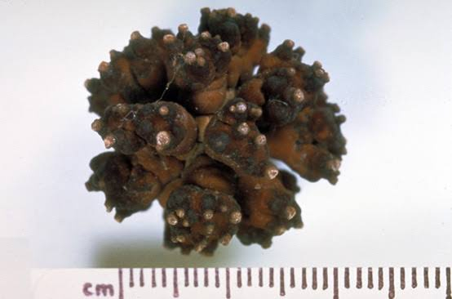
Calcium Oxalate stone

Slide 20
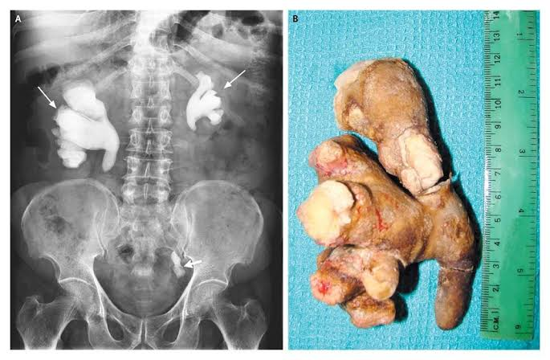
Stag horn stone

Slide 21
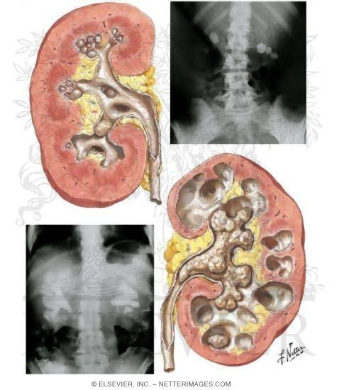
Stag horn

Slide 22
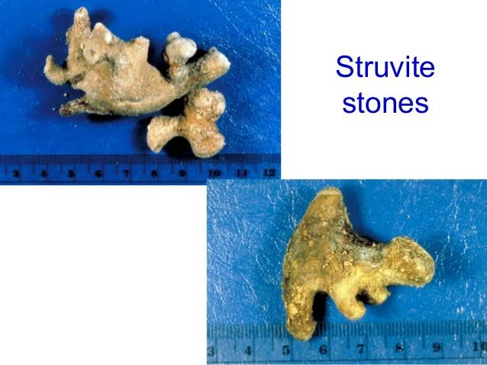
Struvite stone

Slide 23
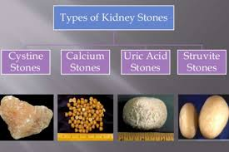
.

Slide 24
CLINICAL FEATURES
PAIN- pain at renal angle, and in lumbar region - radiating to groin and testis -pain worsen on movement
VOMITING- due to pylorospasm
Hematuria
Pyuria
Fever
Burning micturition

Slide 25
Clinical sign
Tenderness in renal angle
Mass in hypochondrium or lumbar due to hydronephrosis which moves with respirations that is bimanually palpable ballotable soft smooth
May present with renal failure due to out flow obstruction

Slide 26
investigations
CBC
RFT
ESR
S.CALCIUM
BLOOD UREA, URIC ACID
PTH LEVEL

Slide 27
INVESTIGATIONS
URINE – CALCIUM,CYSTINE,URIC ACID, MICRO
PLAIN X RAY KUB
IVP
USG
CECT
RENAL SCAN

Slide 28
MANAGEMENT
CONSERVATIVE
SURGICAL

Slide 29
CONSERVATIVE
If stone size < 8mm
Plenty of liquid orally
Intravenous furosemide
Anti spasmodic drugs

Slide 30
surgical
If size > 8mm
PCNL
ESWL
OPEN SURGERIES - PYELOLITHOTOMY -NEPHROLITHOTOMY -PARTIAL NEPHRECTOMY

Slide 31
ESWL
Endoscopic shock wave lithotripsy
Piezo-electric or electromagnetic shock waves passed on stone through water bath or water cushion
Stone location confirmed by C-arm
2 shocks per second
1000-4000 shocks required for each stone
Fragmented stone come out in urine

Slide 32
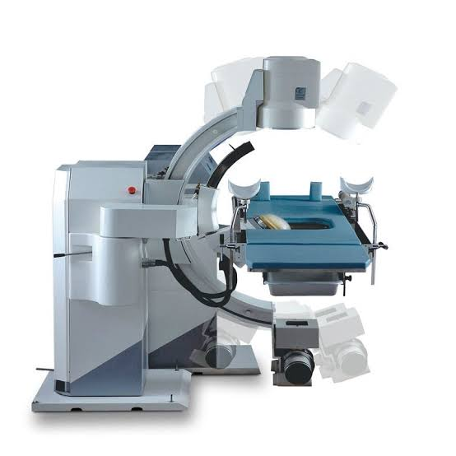
ESWL TABLE

Slide 33
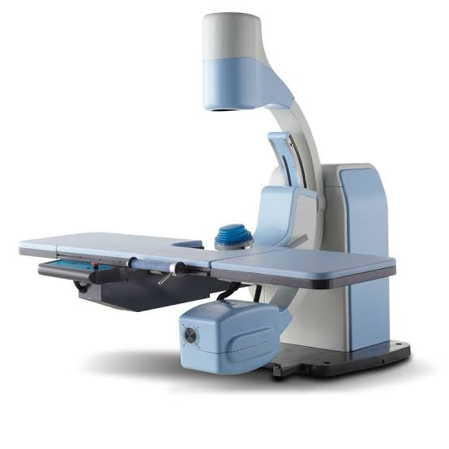
ESWL

Slide 34
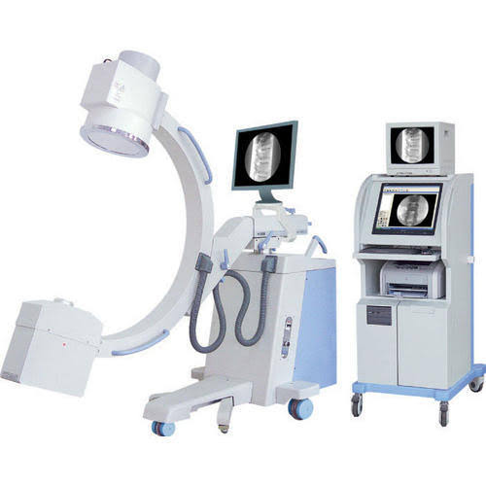
C ARM

Slide 35
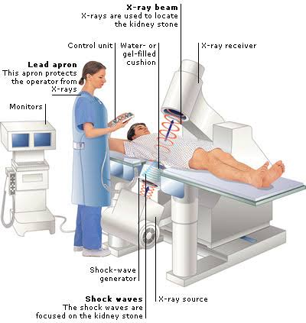
.

Slide 36
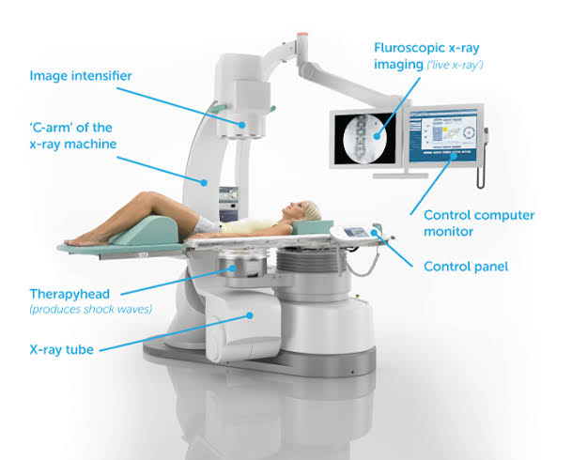
WITH FLUOROSCOPY

Slide 37
ESWL ADVANTAGE
No anesthesia needed
Can be done as OPD procedure
,2.5 cm size stone can break very well
Hard stones can easily eliminated
Can perform multiple times as it is non invasive

Slide 38
COMPLICATIONS
RENAL HEMATOMA
HEMATURIA
FRAGMENTED STONE RETAINED IN URETER

Slide 39
CONTRAINDICATIONS
PREGNANCY
BLEEDING DISORDERS
PATIENTS WITH ABDOMINAL ANEURYSM
SEPSIS & RENAL FAILURE

Slide 40
PCNL
Per cutaneous nephrolithotomy
stones - > 2.5 cm - multiple stones - stones not responding to ESWL
Cystoscopy is done and ureteric stent is placed
Renal pelvicalyceal system identified under C-ARM guidance

Slide 41
PCNL
Through kidney , calyx and pelvis approached
Will pass guide wire after needle puncture
By using Graduated dilator track is widen
NEPHROSCOPE is passed
Will break stone by laser holmium,ultrasonic or electrohydraulic lithotripser
Size- 5mm, 10mm , 15 mm

Slide 42
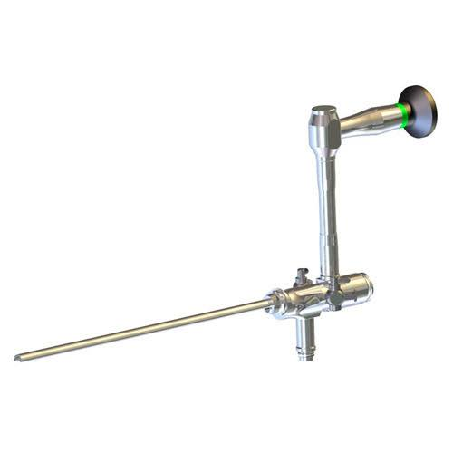
NEPHROSCOPE

Slide 43
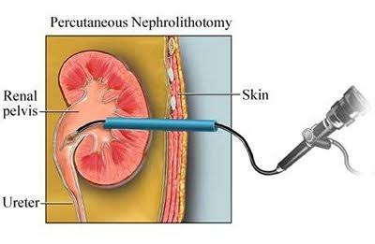
.

Slide 44
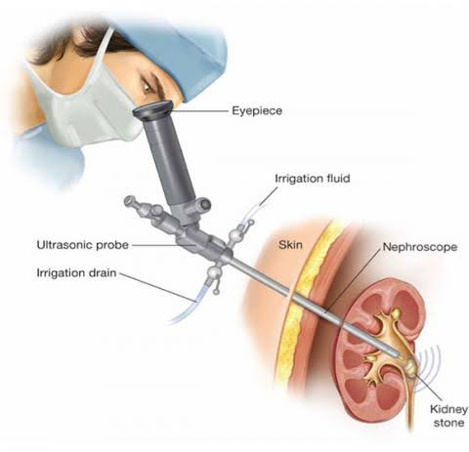
.

Slide 45
COMPLICATIONS
HAEMORRHAGE
PERFORATION OF COLLECTING DUCTS
INJURY TO PLEURA, COLON

Slide 46
PYELOLITHOTOMY
Stone in extra renal pelvis
Posterior subcostal incision
Remove 12th RIB
Open renal pelvis
Remove stone
Put DJ stent
Put drain
closure

Slide 47
EXTENDED PYELOLITHOTOMY
In case of intra renal pelvis
Incision on HILUM between pelvis & kidney over renal sinus

Slide 48
NEPHROLITHOTOMY
INCISION OVER BRODEL”S LINE
ON MOST CONVEX SURFACE OVER POSTERIOR PART
STONE REMOVED

Slide 49
NEPHROPYELOLITHOTOMY
INCISION OVER KIDNEY as well as on PELVIS
In case of STAGHORN STONE

Slide 50
PARTIAL NEPHRECTOMY
Multiple stones occupying in ONE POLE
Usually lower
Damage to that calyx
Remove half kidney
If not removed – can encourage further stone formation later

Slide 51
other
Bench surgery- kidney removed temporarily in ice pack, replaced in RIF
Coagulum pyelolithotomy
Anatrophic pyelolithotomy
Nephrectomy

Slide 52
THANK YOU
.

