Slide 1
Stomach physiology & anatomy
j. b. karia

Slide 2
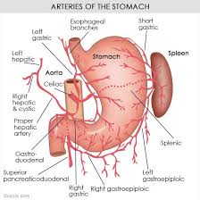

Slide 3
Coeliac axis….three branches
1 : left gastric 2 : splenic 3 : hepatic
Left gastric gives branch .. lower oesophagus via short gastric
Splenic artery gives short gastric branches which anastomose with lower oesophageal
Hepatic artery branch .. Rt. Gastric, gastro duodenal……Rt. Gastro epiploic artery

Slide 4
Lymphatic drainage
Coeliac group
Lt. gastric
Rt. Gastric
Lt. gastroepiploic
Rt. Gastroepiploic
Splenic
Pancreatic
Subpyloric

Slide 5
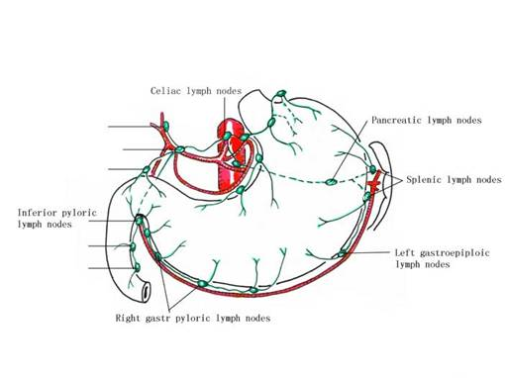

Slide 6
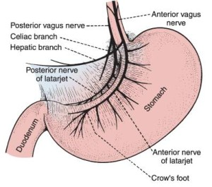
NERVE SUPPLY OF STOMACH

Slide 7
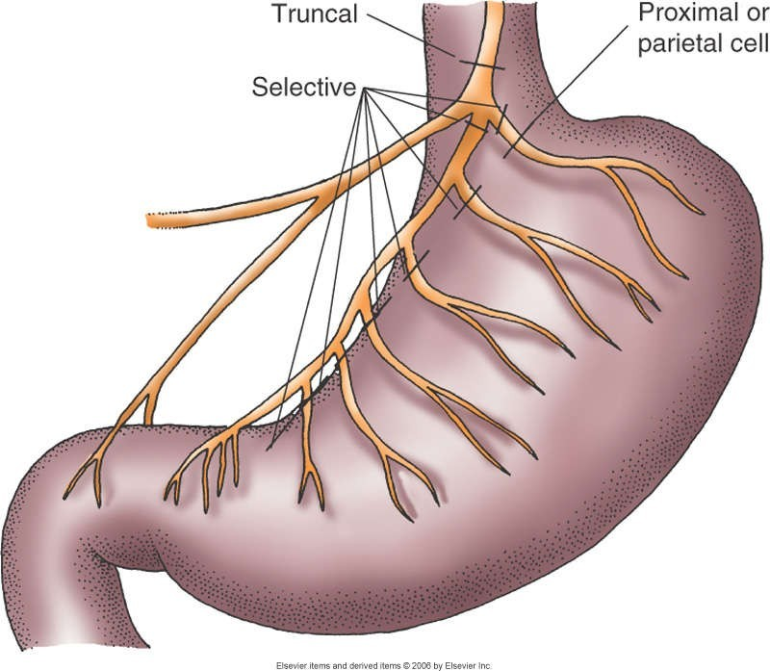
NERVES
■
Vagotomy
■
Cuts vagus nerve
Eliminates acid- secretion stimulus
■

Slide 8
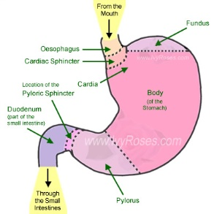
Parts of stomach

Slide 9
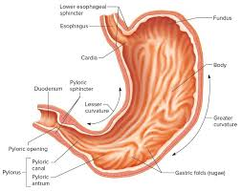
Gastric mucosa & sphincters

Slide 10
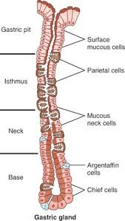
Different cells of gastric mucosa

Slide 11
Secretions of stomach.
Stomach mucosa has many specialised cells with specific secretions.
Body and fundus contains
Chief cells produce pepsinogen….pepsin
Parietal cells in body .. secrets acid.
Antrum contains
Endocrine cells G in antrum …. Gastrin
ECL (enterochromaffin like cells) ….. Histamine which stimulates acid production
D cells …. produce stomatostatin which reduce acid production

Slide 12
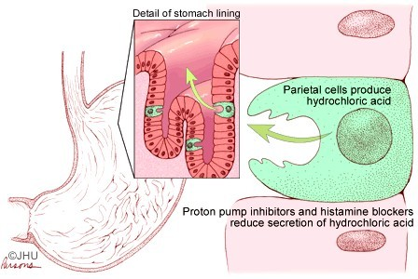

Slide 13
Mucosa of stomach is covered by a thick viscid layer of mucous , which is secreted by mucous secreting cells.
mucous is the main protective layer of mucosa against frictional injuries and pepsin or acid digestion. also contains HCO3 ions to help buffer acid of stomach
Imbalance between mucosa protective factors and damaging factors cause ulcer, gastritis etc.

Slide 14
H2 receptor blocking agents like ranitidine will reduce acid secretion markedly i.e. 90 % so also vagotomy will reduce 90 acid secretion
Proton pump inhibitors abolish acid secretion

Slide 15
Gastric secretions are called messengers which can be
Endocrine that acts via blood on distant organs
Paracrine …. Acts on localised area via interstitial tissue
Neurocrine … acts via neuronal synapses

Slide 16
Messengers that stimulate secretion
Gastrin ….acid more & peptide
Histamine …..acid more
Acetylcholine ….acid more
Gastrin releasing peptides
Cholecystokinin CCK…intestinal phase (10 %)

Slide 17
Messengers that Inhibiting Secretions
Somatostatins……. reduce acid secretion
Secretin …………from duodenum , reduce acid
Prostaglandin….reduce acid
GIP
PYY

Slide 18
Messengers than stimulate motility
Acetylcholine …. Neurone
5HT ….. Neurone
Histamine … From ELC (enterochromaffin cells)..
Substance P ….neurone
Substance K… neurone
Motilin
Gastrin ….increase acid also
Angiotensin

Slide 19
Messengers that inhibit motility
Somatostatins
VIP …… neurone
Nitric oxide …..neurones and smooth muscles
Noradrenaline …neurones
Encephalin .. Neurones
Dopamine …….neurones

Slide 20
Factors affecting the mucosal barrier
Bile reflux, gastric stasis, abnormal gastric acid or pepsin secretion
Smoking, alcohol, NSAID, steroids, H. pylori
Low socioeconomic group
All reduce the barrier capacity of mucosa and makes the mucosa vulnerable to get ulcer or inflammation.

Slide 21
H. pylori
It’s a gram – ve spiral organism with 4-6 flagelets
Most common infection , about 50% of world population is affected
Its importance is well established in last 30 years as causative agent of gastritis, gastric ulcer, duodenal ulcer or Ca. stomach(MALTOMA)……….mucosa associated lymphoid tissue lymphoma
It produces many enzymes and cytotoxins like cagA and vacA which damage mucosal barrier

Slide 22
Marshall and Warren got noble prize for H. pylori in 2005. they ingested the H pylori to prove Koch’s postulate
Organism is fastidious ….multiply only in body
Can not be cultured out side the body
It produces UREASE which can split urea and generate ammonia which is strong alkali. NH3 will stimulate antral G cells by negative feed back to secret GASTRIN which will produce more acid

Slide 23
H. pylori can be detected due to its urea splitting capacity by breath test with a special kit CLO or in biopsy of gastric mucosa
It can infect only gastric mucosa
Also produce enzyme DEHYDROGENASE which converts alcohol to aldehyde and damages mucosa
Its no. 1 carcinogen of stomach

Slide 24
H. Pylori treatment ( kit)
It can be eradicated by combinations like…
1 : amoxicillin 500 mg BD + Tinidazole 600 mg BD or metronidazole 400 mg BD + Omeprazole 20 mg BD for 7-14 days & then omeprazole For 6-12 weeks
2: Clarithromycin 500 MG BD + metrogyl 400 mg BD + Lansoprazole 30 mg BD….7-14 days
3: Tetracycline 500 mg QID or Tab. Bismuth 2 QID + Metronidazole 400 mg TDS + pantoprazole 40 mg BD … for 7-14 days, then pantoprazole for 6 weeks
Reinfection soon by faeco oral route possible

Slide 25
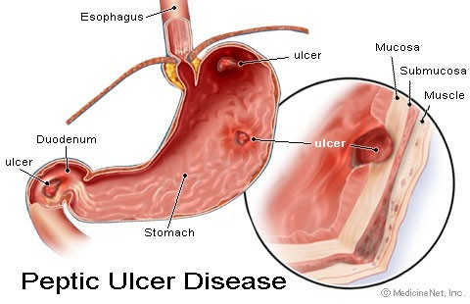

Slide 26
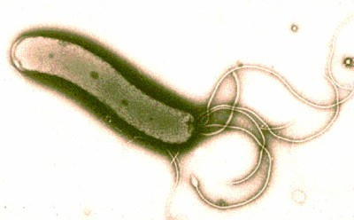
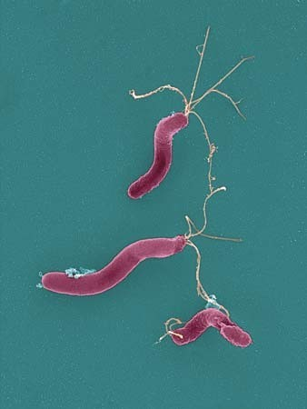
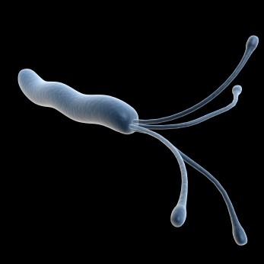
Helicobacter pylori infection

Slide 27
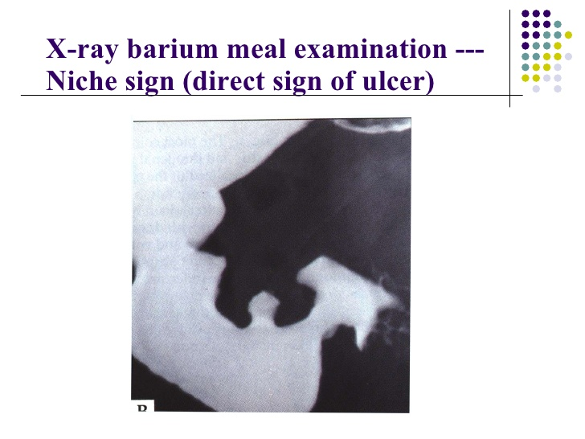

Slide 28
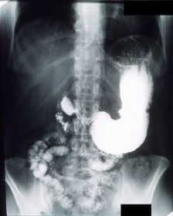

Slide 29

Adenocarcinoma at cardia

Slide 30
MCQ 1
Important entity to prevent gasric ulcer is
A ; home food
B : mucus of stomach
C: gasric acid
D : pepsinogen

Slide 31
MCQ 2
Carcinogen no. 1 for gastric carcinoma is
A : Alcohol
B : Smoking
C : H. pylori
D : hydrochloric acid

Slide 32
Mcq 3
Parietal cells of stomach secrets………
A : pepsinogen
B : acid
C : mucus
D : gastrin

Slide 33
Mcq 4
Enzyme UREASE of H. pylori converts urea into
A ; aldehyde
B: ammonia
C : cytotoxic cagA
d : all of above

Slide 34
Mcq 5
H. pylori infection can be diagnosed by….
A : culture of bacterium
B : gram stain
C : urea breath taking test kit marked CLO
D ; All of above

