Slide 1
ANATOMY OF
SMALL INTESTINE
APPENDIX
ANTERIOR ABDOMINAL WALL
PERITONEUM
DR.OHANG CHAUDHARI
M.S.

Slide 2
SMALL INTESTINE
6-7 meter long
Duodenum----20-30 cm jejunum---2.5 meter ileum--- 3.5 meter

Slide 3
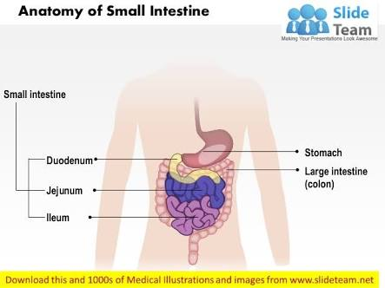
.

Slide 4
function
Digestion
Absorption- calcium,cholesterol,minerals
Secretion
Motility-mixing of food , digestive enzymes propulsion towards large intestine

Slide 5
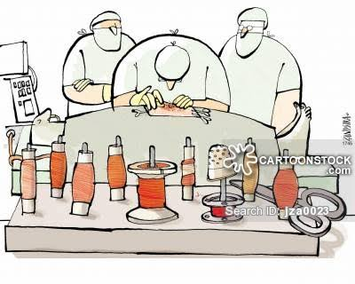
How to identify on table
.

Slide 6
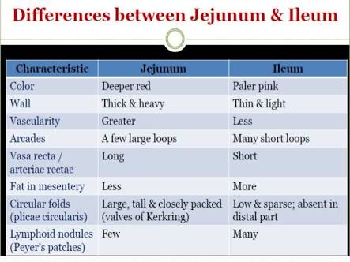
.

Slide 7
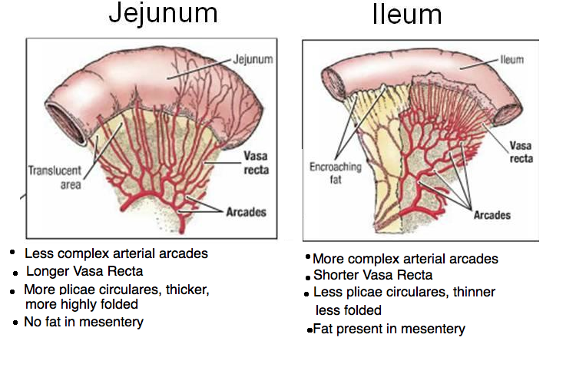
.

Slide 8
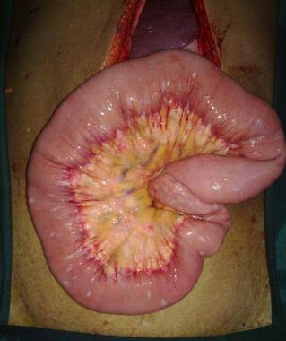
On table view

Slide 9
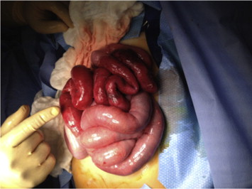
.

Slide 10
Blood supply
Duodenum- gastroduodenal artery - branch of celiac trunk
Jejunum ileum- superior mesenteric artery - branch of abdominal aorta

Slide 11
APPENDIX
9-10 CM LONG
but may range from 2cm to 20 cm
Diameter 7-8 mm
Blind ended tube at ileocaecal junction

Slide 12
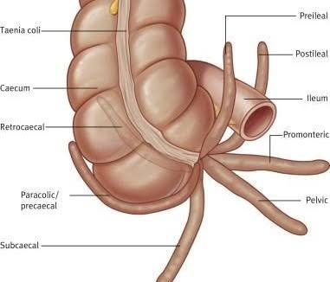
position

Slide 13
.
Most common position-retrocaecal

Slide 14
function
Useless remnant
Some study believes its storehouse for GOOD bacteria which helps to reboot GI tract in diarrheal illness

Slide 15
BLOOD SUPPLY
Appendicular artery terminal branch of ileocolic artery

Slide 16
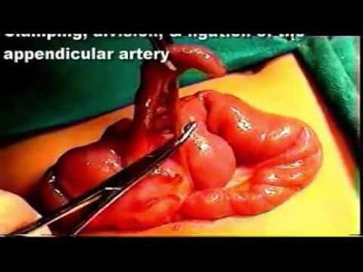
.

Slide 17
peritoneum
Visceral
perietal

Slide 18
.
Covering of abdominal cavity
Serous membrane forms lining of cavity
Gives support to abdominal organs
All blood vessels protected runs in peritoneum

Slide 19
Anerior abdominal wall
Skin
Subcutaneus tissue
Anterior rectus sheath
Rectus muscle
Posterior rectus sheath
peritoneum

Slide 20
disorders
Umbilical hernia
Epigastric hernia
Inguinal hernia

Slide 21
.
Thank you

