Slide 1
RENAL CELL CARCINOMA
DR.OHANG CHAUDHARI

Slide 2
Also known as
HYPERNEOPHROMA
GRAWITZ TUMOUR
CLEAR CELL CARCINOMA
INTERNIST TUMOUR

Slide 3
WHAT IS IT?????
Adenocarcinoma
Arising from RENAL TUBULAR CELLS
Most common site- proximal renal tubule
More common in male, 40 to 60 years of life

Slide 4
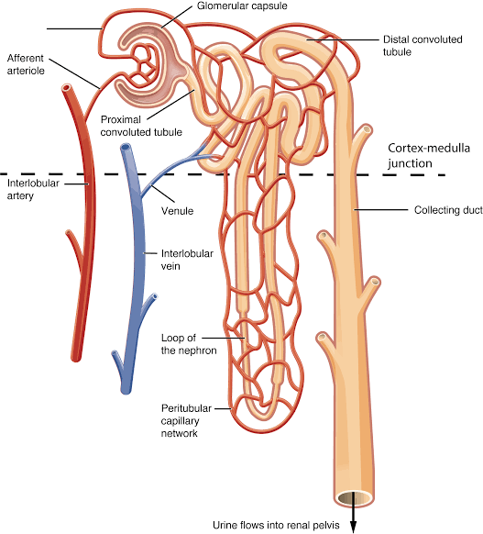
NEPHRON

Slide 5
TYPES
CLEAR CELL ( 75%) -associated with loss of sequence in short arm of chromosome no.3 - sporadic ( 95%) or familial - non papillary
PAPILLARY ( 15%) -multifocal -papillary pattern

Slide 6
TYPES
CHROMOPHOBE RCC (5%) - arise from intercalated cells of collecting duct -having excellent prognosis
COLLECTING DUCT OF BELLINI CARCINOMA (1%) -arise from collecting duct of medulla - tumour with fibrous stroma - also termed as renal medullary carcinoma

Slide 7
Aetiology
Diet high in animal fat
Asbestos, lead, cadmium, tobacco
Smoking
Chromosomal defect
Coffee drinking
Chronic cystic disease
Congenital disease- von hippel-lindau disease

Slide 8
Risk factors
DM
CHRONIC DIALYSIS
LEATHER WORKERS
ANALGESIC ABUSERS

Slide 9
PATHOLOGY
Arise from PROXIMAL RENAL TUBULAR EPITHELIUM
Starts in one of the poles - common in upper pole
Usually ruptures outside the RENAL CAPSULE - normal shape maintained - contrast to wilm’s tumour

Slide 10
pathology
ON CUT SECTION -outer surface is yellow due to deposition of lipids - with areas of haemorrhage & necrosis - non capsulated tumour is HIGHLY VASCULAR
ON MICROSCOPY - alternate clear cells & dark cells

Slide 11
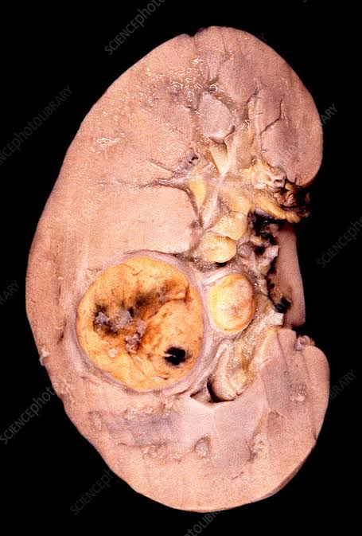
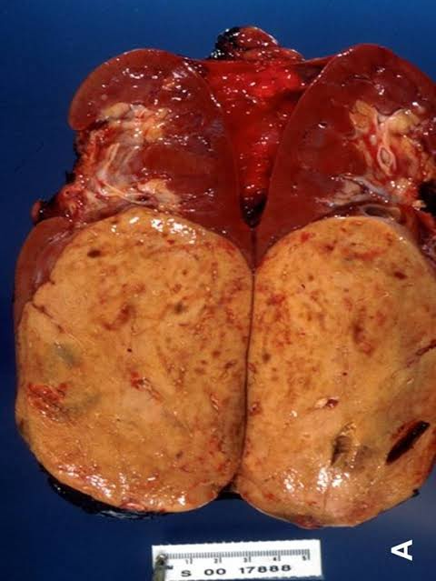
SPECIMEN

Slide 12
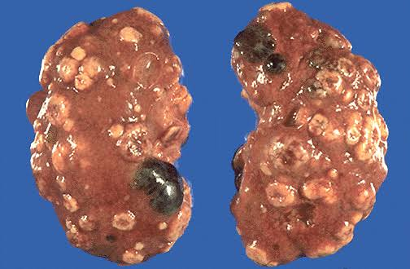
EXTERNAL APPEARANCE

Slide 13
METASTASIS
BLOOD - tumour cells line the blood vessels - RCC enters renal vein as proliferating tumour thrombus and enters IVC and later gets detached and enters in LUNG lead to cannon ball secondaries with calcification - bone, liver,brain, adrenal via blood

Slide 14
Left testicular vein
That drains in left renal vein
May get blocked by PROLIFERATING TUMOUR THROMBUS
lead to irreducible left sided varicocele

Slide 15
Other
LOCAL SPREAD - perinephric fat - renal calyces - renal pelvis
LYMPHATIC SPREAD - Para aortic lymph node - RENAL hilar lymph node

Slide 16
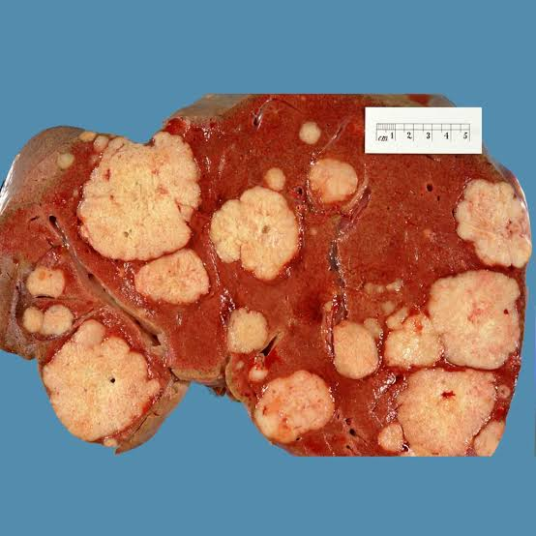
Liver metastasis

Slide 17
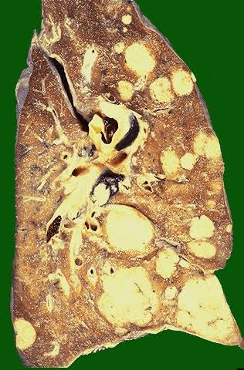
LUNG METASTASIS

Slide 18
TNM STAGING
Tx – primary tumour can not be assessed
T0- N o tumour
T1- < 7 CM, within capsule
T2- > 7 CM within capsule
T3a – Extra capsular within gerota fascia T3b- into adrenal or perinephric fat T3c- into renal vein or IVC
T4- direct invade gerota fascia & extension above diaphragm

Slide 19
TNM STAGING
Nx- nodes can not be assessed
N0- no nodes
N1- Single regional LN
N2-more than one regional LN
M0- no metastasis
M1- distant metastasis

Slide 20
ROBSON”S STAGING
STAGE 1: tumour limited to kidney
STAGE 2: tumour invades perinephric tissue or adrenal gland , but does not extend beyond gerota fascia
STAGE 3 : tumour extend into major vein or lymph node
STAGE 4 : tumour invades beyond gerota fascia or distant metastasis

Slide 21
CLINICAL FEATURES
TRIAD OF RCC 1. PAIN -dragging or intermittent clot colic due to clot blocking ureter 2. INTERMITTENT HAEMATURIA 3. PALPABLE MASS - hard, nodular, ballotable, - bimanually palpable - loin mass moving with respiration

Slide 22
CLINICAL FEATURES
PATHOLOGICAL FRACTURES - femure , humerus - vascular , pulsatile secondaries common in flat bones in scalp, vertebra,rib, sternum - bone pain
ANAEMIA- due to decreased production of erythropoietin

Slide 23
C/F
LOW GRADE FEVER -due to tumour necrosis producing pyrogen - RCC may present as PUO so also termed as internist’s tumour
Hypertension
Liver dysfunction
Nephrotic syndrome

Slide 24
ENDOCRINAL DISTURBANCES
Also termed as paraneoplastic syndrome
Increased ESR- most common
Hypertension- Renin producing tumours
Polycythaemia- due to increased erythropoietin secretion in later stage
Other hormones: -parathormone, ACTH, glucagon, prolactin HCG

Slide 25
Stauffer’s syndrome
Non metastatic liver dysfunction
liver dysfunction gets corrected by NEPHRECTOMY
Carries poor prognosis

Slide 26
INVESTIGATIONS
URINE EXAMINATION - RBC, malignant cells
PLAIN X ray KUB -enlarged kidney shadow
IVP - distortion of calyces - loss of architecture of kidney

Slide 27
Investigations
USG abdomen - enlarged kidney -tumour location, extent -FNAC -thrombus in IVC
CECT ABDOMEN PELVIS

Slide 28
CECT
Mixed density mass lesion
Tumour cell necrosis
Local extent
IVC thrombus
LN status
INVESTIGATION OF CHOICE
CONFIRMATORY

Slide 29
OTHER
RENAL ANGIOGRAM
CHEST X RAY
CHEST CT SCAN
BONE SCAN
PERIPHERAL SMEAR
MRI
Venacavogram

Slide 30
Differential diagnosis
PCKD
SOLITARY CYST OF KIDNEY
ADRENAL TUMOUR
RETROPERITONEAL TUMOUR
CARCINOMA COLON

Slide 31
TREATMENT
SURGERY IS THE TREATMENT OF CHOICE
RADICAL NEPHRECTOMY
NEPHRON SPARING SURGERY
THERAPEUTIC EMBOLISATION,
IMMUNOTHERAPY
PALLIATIVE RADIOTHERAPY

Slide 32
RADICAL NEPHRECTOMY
  Entire kidney with tumour
  Perinephric tissue
  Ipsilateral adrenal gland
  Proximal 2/3 of ureter OR as low as possible
  Lymph node from crus of the diaphragm to aorta bifurcation with renal hilar nodes

Slide 33
APPROACH & technique
Transperitoneal approach often used
Retroperitoneal ( nagamastu) resection of 11th rib
Thoracoabdominal approach
Preoperative renal artery embolisation to decrease vascularity of tumour

Slide 34
Radical nephrectomy with extraction of thrombus
When thrombus in renal vein, IVC , or right atrium
Infradiaphragmatic thrombus can removed with well control of IVC
Supradiaphragmatic thrombus requires CARDIOPULMONARY BYPASS

Slide 35
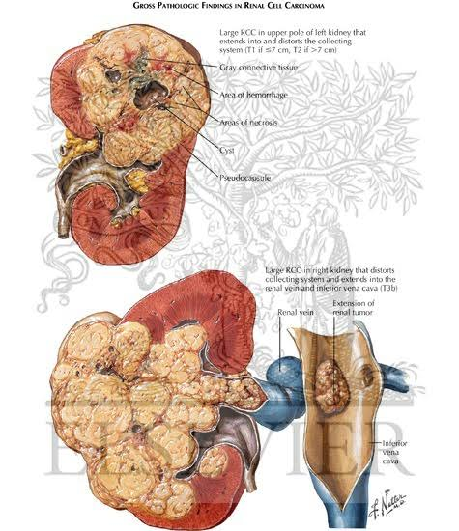
.

Slide 36
NEPHRON SPARING SURGERY
IN CASE OF BILATERAL RCC
LESS THAN 5 CM SIZE TUMOUR

Slide 37
THERAPEUTIC EMBOLISATION
Palliation therapy in advanced carcinoma
Relieve symptoms
Sometimes used to regress the size of large tumour
Catheter placed in renal artery then gel foam,blood clot, crushed muscles injected
They block the lumen of vessels & hence tumour size reduces

Slide 38
chemo radiotherapy
RCC is radio resistant but secondaries in lung bone, brain respond well
Chemotherapy -vinblastine & progesteron - not much helpful but can be used for palliation

Slide 39
immunotherapy
Interferon
Interleukin 2
Found to improve survival rate after surgery

Slide 40
prognosis
Tumour size more than 4 cm poor prognosis
Extension in renal vein
Secondaries
Local spread
Stauffer’s syndrome

Slide 41
MCQ 1
Renal cell carcinoma arise most common from 1. proximal renal tubule 2.collecting duct 3. distal renal tubule 4.glomerulus

Slide 42
MCQ 2
Secondary metastasis from RCC is seen in all EXCEPT 1. LIVER 2. LUNG 3.THYROID 4.BONE

Slide 43
MCQ 3
TRIAD of RCC does not included 1. pain 2. intermittent Haematuria 3.ascitis 4. palpable loin mass

Slide 44
MCQ 4
Which hormone not secreted from RCC?? 1. parathormone 2. ACTH 3. glucagon 4.insulin

Slide 45
MCQ 5
Which of the following is true about RCC?? 1. more common in female 2. it is highly radiosensitive 3. surgery is treatment of choice 4.chemotherapy is treatment of choice

