Slide 1
HYDATID CYST OF LIVER
DR KETUL SHAH
SURGERY DEPARTMENT

Slide 2

 Zoonotic disease
 Causative agents
Echinococcus granulosus ( cystic echinococcus )
Echinococcus multilocularis ( alveolar echinococcus )

Slide 3
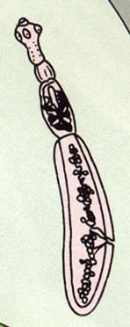

 Only 2-8 mm long
 Usually comprises of-
Scolex: with four suckers and 2 circular rows of hooks
neck
immature proglottid
mature proglottid
gravid proglottid

Slide 4

 Definitive host: dog & other canine
 Intermediate host: sheep, cattle, camel
 Human – accidental host
 Infective stage: egg (gravid proglottid)
 MAN IS A DEAD END HOST

Slide 5
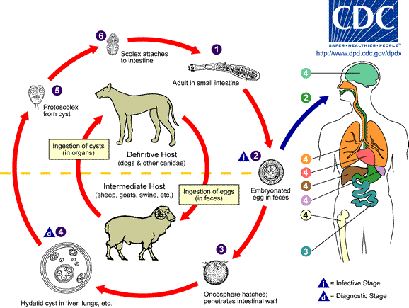

Slide 6
 Gravid segment splits – releases eggs
 When ingested by human – embryo escape from egg- invade intestinal mucosa – enter portal venous circulation – enter into liver , lung
 Larvae develop – fluid filled unilocular cysts
 Daughter cysts(brood capsules) develop from inner germinal layer
 New larvae (protoscolices) develop in large numbers in brood capsule
 Cysts expand slowly over a period of time

Slide 7

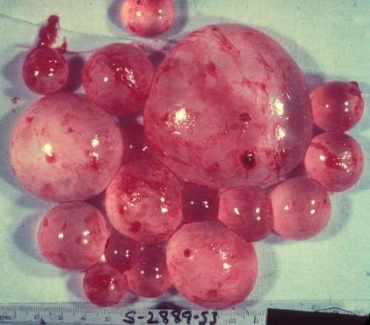
At gross examination, the vesicles resemble a
bunch of grapes
 Sites of hydatid cyst: liver (65%), lungs(25%), muscle, spleen, kidney, heart, bones, brain etc
 Hydatid cysts – slow growing : 2-3cm/yr

Slide 8

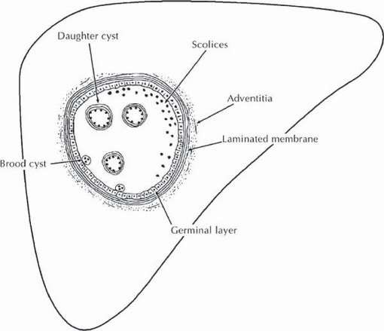

Slide 9
(a) the outer pericyst - composed of modified host
cells that form a dense and fibrous protective zone;
 The hydatid cyst has 3 layers:
the middle laminated membrane - acellular,allows the passage of nutrients
the inner germinal layer, where the scolices (the larval stage of the parasite) and the laminated membrane are produced.

Slide 10

 cysts larger than 5 cm in diameter – pressure symptoms
 Mostly asymptomatic
 Most common symptoms – abd.pain,vomiting,dyspepsia
 Jaundice in 10 % of pts- biliary tract obstruction

Slide 11
 Bacterial infection of cysts – present as pyogenic liver abscess
 Rupture can result in disseminated echinococcosis & anaphylactic reaction
 Most frequent sign is hepatomegaly / palpable mass

Slide 12
 Alveolar echinococcosis :
Asymptomatic incubation period of 5-15yrs
Slow development of tumour like lesion in liver (usually)
Wt loss,abd.pain,general malaise,signs of hepatic failure

Slide 13
 Mostly Incidental finding – small cysts remain asymptomatic
 Mediastinal cysts may erode adjacent structures – causing bone pain / airflow limitation
 Symptoms occur mostly after rupture of the cyst ( spontaneous,trauma,infection )
 Calcification is rare in pulmonary cysts

Slide 14
Symptoms :
sudden onset of cough,fever
If contents are expelled in airway – expectoration of clear salty tasting fluid containing fragments of hydatid membrane and scolices may occur
Sudden collapse – in complicated cysts

Slide 15

 Routine blood inv are nonspecific – 25% esinophilia
 Raised bilirubin
 Indirect hemagglutination test and ELISA are the most widely used methods for detection of anti-Echinococcus IgG antibodies.
 false positive results- schistosomiasis and nematode infestations - not specific for diagnosing hydatidosis.

Slide 16
 Immunoelectrophoresis :
depends on the formation of specific arc of precipitation ( called arc 5 ) which is highly specific and can be used to exclude cross- reactions caused by noncestode parasites
 ELISA is useful in followup to detect recurrence
 Casoni’ s intradermal test

Slide 17

 Plain xray
 Ultrasound
 Ct
 Mri

Slide 18
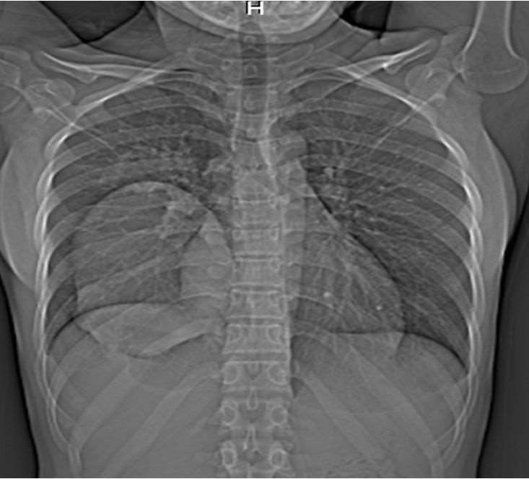
 Plain xray
 Findings are nonspecific
& non revealing
 Thin rim of calcification delineating a cyst is suggestive of echinococcus cyst

Slide 19
 Ultrasound
primary dx & diagnostic accuracy of 90%
 Usual findings :
Solitary cyst – features suggestive include dependant debris (hydatid sand) moving freely with change in position; presence of wall calcification
Water lily sign – separation of membranes due to collapse of germinal layer
Daughter cysts – most charecteristic sign with cyst in a cyst – cart wheel / honeycomb cyst

Slide 20
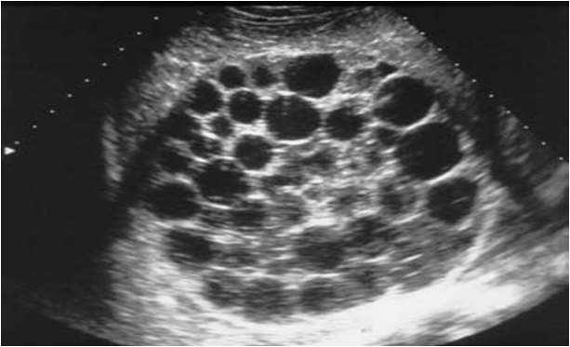
 Ultrasound
 Multiple cysts – multiple cysts with normal intervening parenchyma

Slide 21
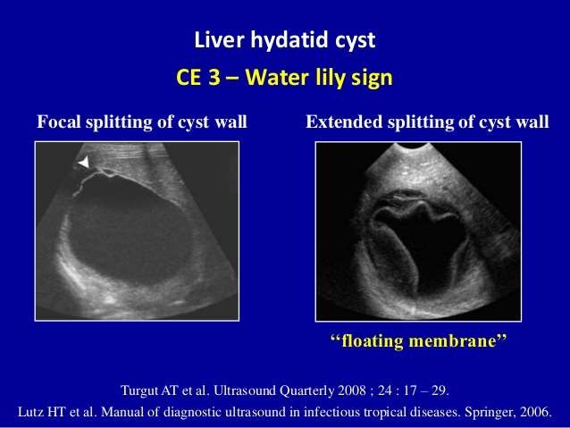
 Ultrasound

Slide 22
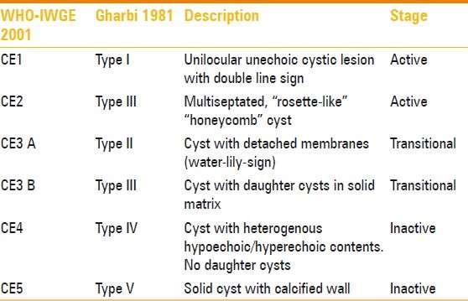
 GHARBI classification

Slide 23
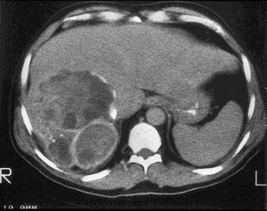
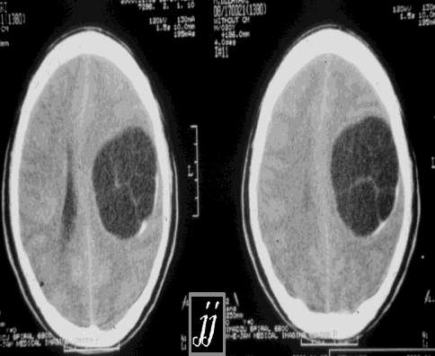
 CT SCAN
 Highest sensitivity of imaging 98%
 Best to detect number,size,location of cysts

Slide 24
 Other imaging techniques
Angiography
Direct cholangiography
Immunoscintigraphy
MRI – no real advantage over CT

Slide 25

 Available options :
Medical
PAIR
Endoscopic
Surgical
 t/t of choice is surgery

Slide 26
 Mebendazole(3-6 months orally in dosages of 40-50 mg/kg/d) &
 albendazole (10-15 mg/kg/d orally 3-6 mnths with intervals of 14 days )
 MEDICAL T/T :
 Praziquantel : most active and rapid scolicidal agent but it has poor effect on germinal layer
so it is of choice for prophylaxis in pre and post operative period in order to prevent secondary implantation of spilled protoscoleces

Slide 27
 Indications: primary liver or lung cysts that are inoperable (because of location or medical condition), and peritoneal cysts.
 MEDICAL :

 Contraindications: Early pregnancy, bone marrow suppression, chronic hepatic disease, large cysts with the risk of rupture, and inactive or calcified cysts

Slide 28
 PAIR (puncture,aspiration,injection,re aspiration)
 Indications:
1. > 5cm (ty 1)
cysts with detachment of membranes , daughter cysts
multiple cysts in segment I, II, and III of the liver
relapse after surgery or chemotherapy
patients refusing surgery

Slide 29
 Contraindications:
Early pregnancy
lung cysts, inaccessible cysts, superficially located cysts (risk of spillage)
type II honeycomb cysts, type IV cysts
cysts communicating with the biliary tree (risk of sclerosing cholangitis from the scolecoidal agent)
Inactive/ calcified cysts

Slide 30
 Complications of PAIR
Hemorrhage
Mechanical damage to other tissue
Infections
Allergic reaction or anaphylactic shock
Persistence of daughter cysts
Sudden intracystic decompression leading to biliary fistulas

Slide 31
 Scolicidal agents :
95 % alcohol
Hypertonic saline
Betadine
4. 3% H2O2

Slide 32
Indications:
 SURGICAL :
Large liver cysts with multiple daughter cysts
superficially located single liver cysts that may rupture (traumatically or spontaneously).
liver cysts with biliary tree communication or pressure effects on vital organs or structures.
infected cysts
cysts in lungs, brain, kidneys, eyes, bones

Slide 33
 Surgical :
 Contraindications :
1. General contraindications to surgical procedures (eg, extremes of age, pregnancy, severe preexisting medical conditions)
multiple cysts in multiple organs
cysts that are difficult to access
dead cysts; calcified cysts; and very small cysts

Slide 34
 Surgical procedures :
 Conservative
Marsupialisation
Capittonage
Partial pericystectomy
 radical
Pericystectomy – cyst and surronding compressed liver tissue
Hepatic resections – lobectomy,partial hepatectomy…only surical therapy in E.multilocularis,as the margins are ill defined

Slide 35
 Laproscopic :
special instrument has been developed perforator - grinder – aspirator apparatus
advantage – it doesn’t get blocked by daughter cysts and laminated membranes

Slide 36
 Complications of surgery
Biliary leakage
Mortality rate is 0.9 – 3.6 %
Recurrence 11 %

