Slide 1
Extrophy of bladder
Ectopia vesicae
DR. OHANG CHAUDHARI

Slide 2
What is it?????
Incomplete development of INFRAUMBILICAL portion of anterior abdominal wall
As well as ANTERIOR WALL of urinary bladder
Embryological origin

Slide 3
Result
Patient will have exposed posterior wall of urinary bladder
Urine come out directly on abdomen
Other malformations... Epispadiasis.. Spina bifida

Slide 4
Embryology behind it.....
Failure of mesoderm to migrate into lower abdominal wall (between umbilicus & genital tubercle)
Ectoderm of anterior abdominal wall & endoderm of the ventral wall if urinary bladder remain unsupported & thin
Their rupture leads to expose of cavity of urinary bladder

Slide 5
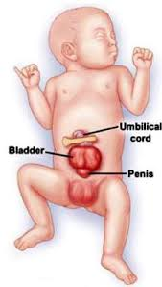

Slide 6
TYPES
COMPLETE- pubic Symphysis is not formed
- complete epispadiasis in male
- bifid clitoris in female
INCOMPLETE- pubic Symphysis, penis or clitoris normal

Slide 7
PRESENTATION
More common in MALE
Posterior bladder wall is seen in lower abdomen
We can see pink red inflamed mucosa
We can see urine efflux from ureteric orifice
Umbilicus is absent
Widely Separated pubic bones
Bilateral inguinal hernia

Slide 8
External Genitalia
MALE-----penis is rudimentary sometimes broad and short ---- normal testis
FEMALE----poorly developed & clitoris is bifid

Slide 9
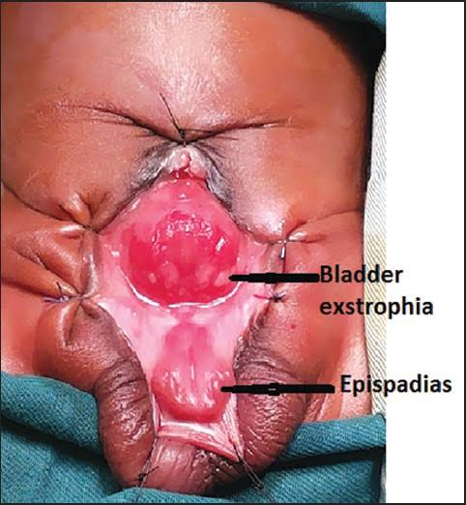

Slide 10
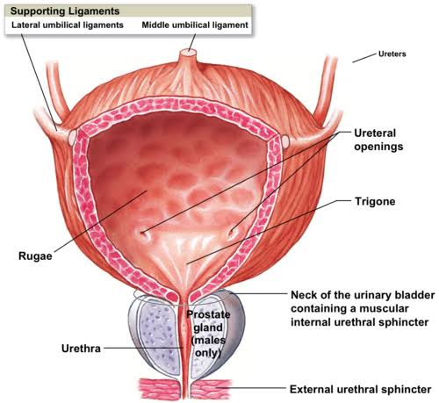

Slide 11
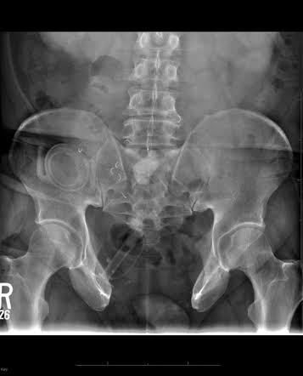

Slide 12
COMPLICATIONS
Constant dribbling of urine from lower abdomen ..... Smell of urine
Recurrent UTI
Pain
Ulcer
Pyelonephritis & Renal failure
Metaplasia in mucosa of bladder lead to malignancy in early age
Dermatitis( ammonia in urine)

Slide 13
TREATMENT
INCOMPLETE TYPE---
-reconstruction of anterior abdominal wall as well as anterior wall of urinary bladder
COMPLETE TYPE----
-total cystectomy f/b urinary diversion
- reconstruction of anterior abdominal wall

Slide 14
Urinary diversions
Total cystectomy
Ureters implanted in sigmoid, colon or ileum
Ureterosigmoidostomy, ureteroileostomy, ileul conduit.. Etc....

Slide 15
Staged procedure
Bladder is closed in first year of life
Osteotomy of both iliac bone just lateral to sacroiliac joint later
Later on more ----reconstruction of bladder neck & sphincters
Results are still less satisfactory and 50% child death due to RENAL FAILURE

Slide 16
Long term complications
Stricture at the Anastomosis with bilateral Hydronephrosis & infection
Hyperchloremic acidosis
Increased risk of adenoma & Adenocarcinoma at the site of Anastomosis

