Slide 1
Acute and Chronic Cholecystitis
DR KETUL SHAH
GENERAL SURGERY DEPARTMENT

Slide 2
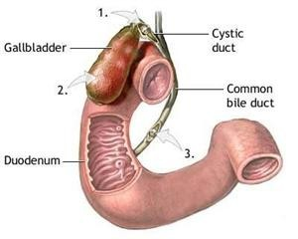

Slide 3
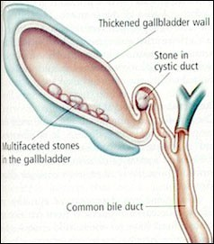
Acute Cholecystitis
Occurs in
Patients with pre existing chronic cholecystitis
As first episode
Most Common Cause
Impacted Gallstone in Hartmann’s Pouch

Slide 4
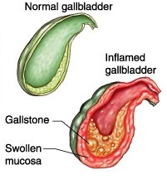
Temporary impaction
  Only Biliary Colic
  No INFLAMMATION
Prolonged impaction
  INFLAMMATION ENSURES
  Edema of GB
  Subserosal Hemorrhage
ACUTE CHOLECYSTITIS

Slide 5
Causitive Organisms:
E Coli (most common)
Klebsiella,Pseudomonas,Proteus
Strep.Faecalis
Salmonella
Clostridium Welchii

Slide 6
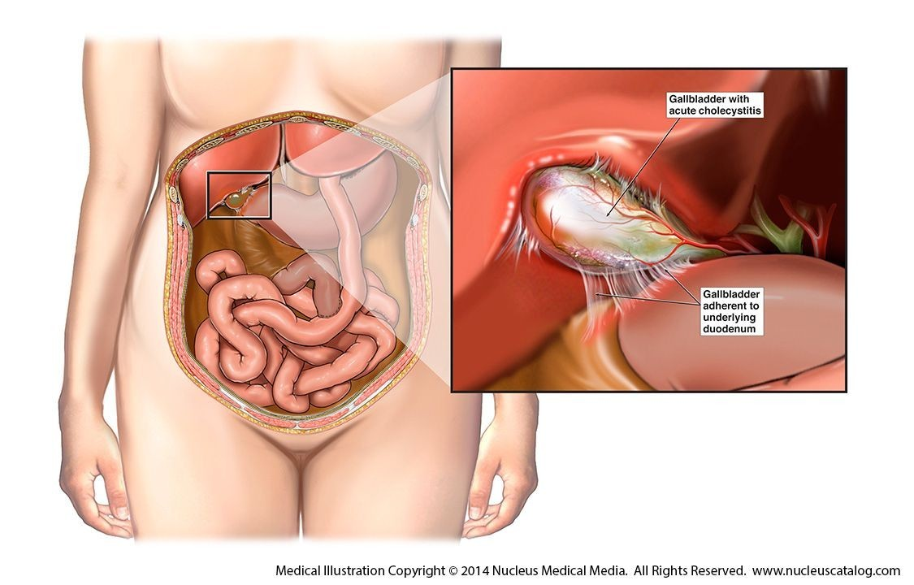
Classification
Acute Calculous Cholecystitis
Acute Acalculous Cholecystitis

Slide 7
Mode of Infection
A. Hematogenous
Hepatic Artery ◊ Cystic Artery
Portal Vein
Through Bile

Slide 8
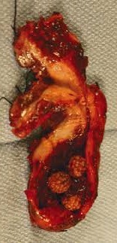
Pathogenesis
•
Stone causes Obstruction at hartmann’s pouch or in cystic duct
•
Obstruction causes Stasis
•
It leads to Edema of the wall
•
Bacterial Infection occurs
•
Leads to Acute Cholecystitis

Slide 9
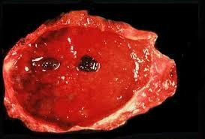
Impacted Stone --◊ mucosal erosion
Thereby Bile Salts will act on Submucosal tissue Bile is toxic to tissues
Leads to Necrosis, Infection and Perforation

Slide 10
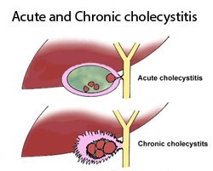

Slide 11
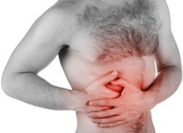
Presentation
SYMPTOMS
θ FEVER
θ RIGHT UPPER QUAD PAIN
θNAUSEA

Slide 12
SIGNS
θ RIGHT UPPER QUAD TENDERNESS
θGUARDING
θRIGIDITY
θMURPHY’S SIGN (arrest of inspiration with gentle pressure under the R costal margin due to tenderness)
θBOAA’s SIGN- Hyperasthesia at 9th to 11th rib posteriorly on R side
θPALPABLE TENDER GALLBLADDER
θTACHYCARDIA

Slide 13
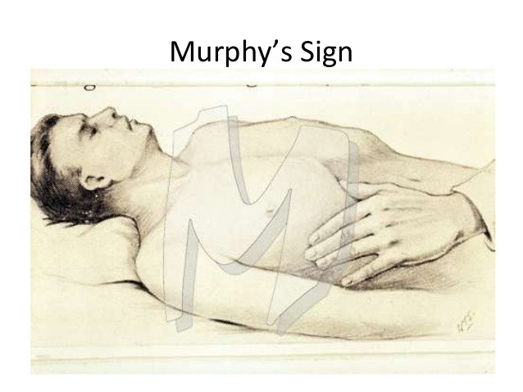

Slide 14
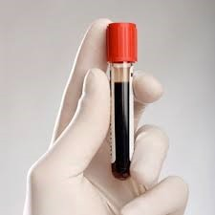
INVESTIGATIONS
LAB STUDIES
  LEUKOCYTOSIS
  Mild elevation of BILIRUBIN , ALP, SGOT/PT
If
Profound Jaundice + Picture of Acute Cholecystitis
Suspect,
CHOLANGITIS with obstruction of CBD MIRIZZI syndrome

Slide 15
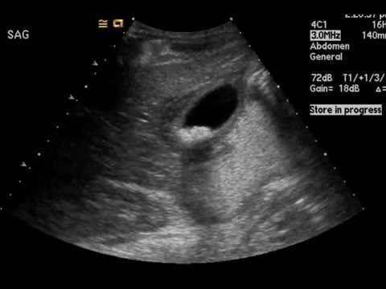
USG
Sensitive
Inexpensive
Reliable
» Sensitivity 85% and Specificity 95%
What will you look in USG? 1.GallStone 2.Pericholecystic fluid 3.GB wall thickening
4.Sonographic murphy’s sign

Slide 16
Accurate History Physical Examination Supportive Lab Studies And an Ultrasound
Needed in most of the cases for Diagnosis Extras
HIDA Scan CT Scan

Slide 17
Remember
CT is less sensitive than USG for the diagnosis of Acute Cholecystitis

Slide 18

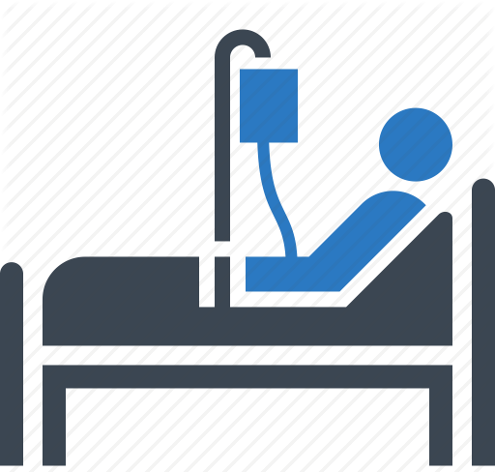



Management of Acute Cholecystitis
NPO
RYLES TUBE ASPIRATE
IV Fluids
BROAD SPECTRUM ANTIBIOTICS
IV ANALGESICS
OBSERVATION

Slide 19
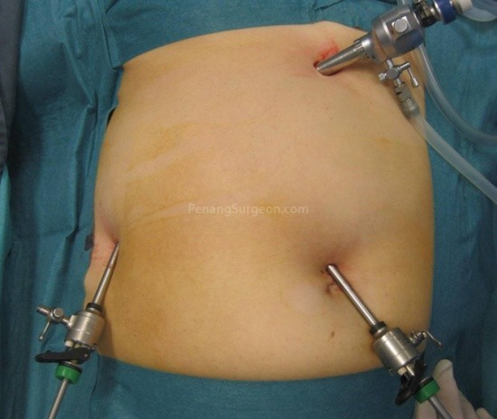
Surgery in a/c Cholecystitis
When presents within 2 to 3 days LAP CHOLECYSTECTOMY
When presents more than 3 days INTERVAL CHOLECYSTECTOMY after 6 weeks
In Pregnancy
CHOLECYSTECTOMY @ T2
Empyema, Persisting and Progressing Symptoms
CHOLECYSTECTOMY
EMERGENCY

Slide 20
Complications
θ PERFORATION
θPERITONITIS
θPERICHOLECYSTIC ABSCESS
θCHOLANGITIS and SEPTICEMIA
θPANCREATITIS
θEMPYEMA GB
θGANGRENOUS GB

Slide 21
Acute Acalculous Cholecystitis
5%
ICU patients, Post OP patients, Burns, Cholecystoses
Gallbladder distension, release of Factor VII
Acute Presentation
Rx – Cholecystectomy

Slide 22
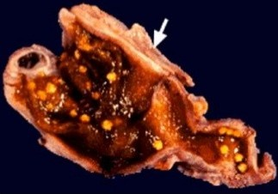
Chronic Cholecystitis
Chronically Inflammed Thickened Gallbladder which is NONFunctioning NONdistending

Slide 23
Causes
GALL STONES
CHOLECYSTOSIS
CHRONIC ACALCULOUS CHOLECYSTITIS
Organisms: Klebsiella Steptococci Salmonella

Slide 24
Pathology
GB is shrunken, contracted,small, nonfunctioning, fibrotic
with thickened GB wall
Mucosa proliferates into Lumen ◊
ROKITANSKY ASHCHOFF SINUSES
Muscular wall replaced by Fibrotic tissue

Slide 25
Clinical Featues
Colicky Pain
Murphy’s Sign
Dyspeptic Symptoms
Intolerance to fatty meal

Slide 26
Complications
CBD Stones
Cholangitis
Pancreatitis
Mirizzi’s Syndrome

Slide 27
Treatment of Chronic Cholecystitis is
CHOLECYSTECTOMY

Slide 28
thankyou

