Slide 1
ANATOMY OF URINARY BLADDER
DR.OHANG CHAUDHARI

Slide 2
ANATOMY
It is a RESERVOIR of urine made up of muscles
Situated in the pelvis
Posterior to the PUBIC bone from which it is separated by RETROPUBIC SPACE

Slide 3
SIZE , SHAPE , POSITION
It depends on amount of urine it contains
Empty bladder is pelvic organ but when full with urine – it can expand up to umbilicus

Slide 4
Relation with peritoneum
MALE - peritoneum is reflected from superior surface of bladder over the superior surface of ductus deference & seminal vesicles
FEMALE -anterior wall of uterus - close to the junction of body of uterus & cervix

Slide 5
DETRUSOR MUSCLES
Smooth muscles
Fibres are intermingled or interlacing

Slide 6
TRIGONE
Triangular area between ureteric orifices & internal urethral orifice
MOST SENSATIVE PART OF THE BLADDER
Irritation of this part lead to frequency of micturition

Slide 7
TRIGONE
URETER opens into posterolateral angles of trigone
Internal urethral orifice opens at inferior angle of trigone

Slide 8
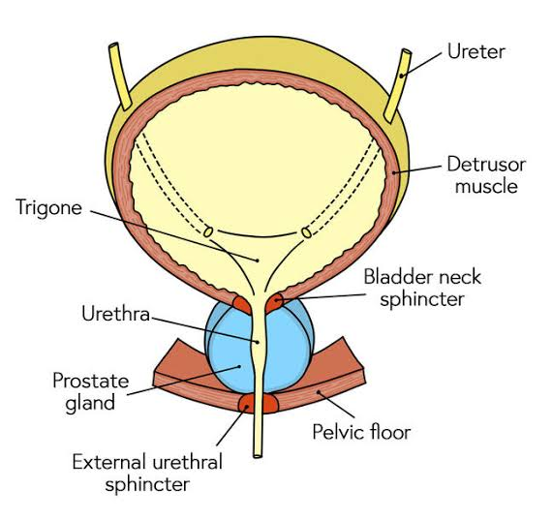
.

Slide 9
NECK
Most fixed part of bladder
3-4 cm behind the pubic symphysis
MALE- it lies on prostate
FEMALE- it rest on anterior vaginal wall

Slide 10
NECK
Smooth muscle which surrounds neck - INTERNAL SPHINCTER
It prevents retrograde ejaculation
When it relaxes – urine comes out
Alpha adrenergic fibers( autonomic NS)

Slide 11
External urethral sphincter
Arise from ischiopubic ramus of each side
They meet around the membranous urethra
Supply by S2-S4 fibres via perineal branch pudendal nerve

Slide 12
histology
Transitional epithelium ( urothelium) that covers LAMINA PROPRIA
Loosely attached and can easily separated from bladder wall except from TRIGONE

Slide 13
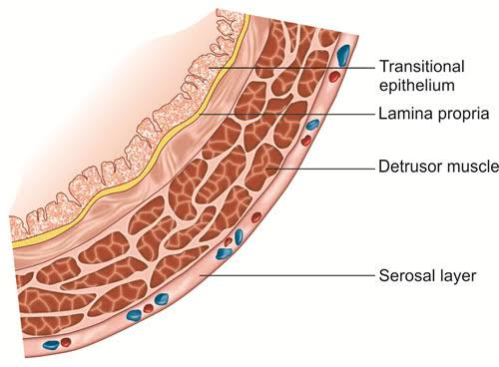
.

Slide 14
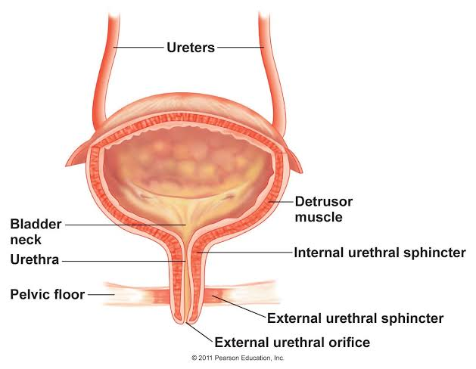
.

Slide 15
BLOOD SUPPLY
SUPERIOR & INFERIOR VESICAL ARTERIES - branches of anterior trunk of internal iliac artery - main source
Other - obturator -inferior gluteal - branches from uterine & vaginal arteries

Slide 16
Venous drainage
Venous plexus on LATERAL & INFERIOR surface of bladder
Vesical plexus continuos with prostatic plexus which drain into INTERNAL ILIAC VEIN

Slide 17
LYMPHATIC DRAINAGE
INTERNAL ILIAC NODES– MAIN
OTHER -OBTURATOR & external iliac nodes

Slide 18
NERVE SUPPLY
PARASYMPATHATIC - anterior division of sacral nerves S2,S3,S4 - through inferior hypogastric plexus - after removal of rectum micturition and sexual function disturbed due to injury to pelvic plexus
SYMPATHATIC - T10 to L2

Slide 19
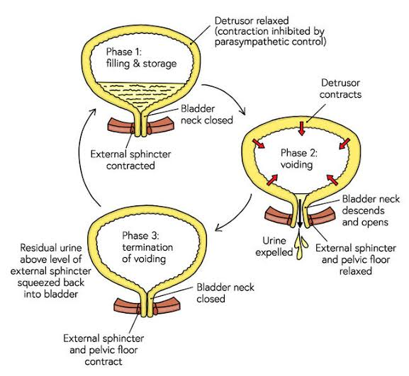
.

Slide 20
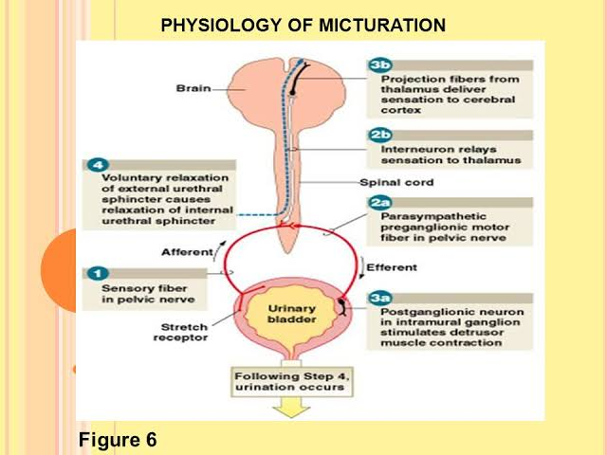
MICTURITION REFLEX

Slide 21
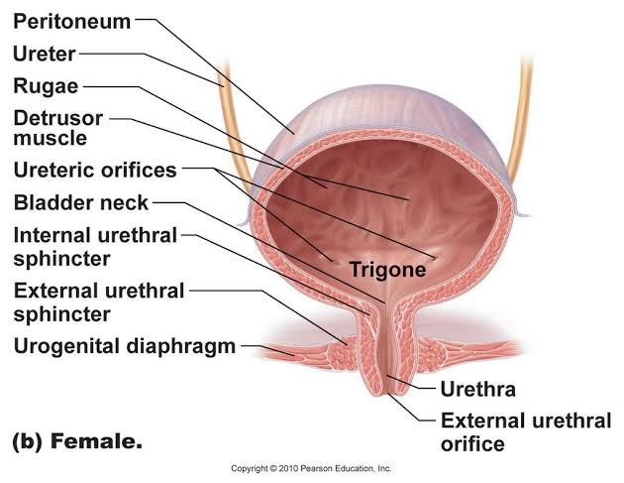
.

Slide 22
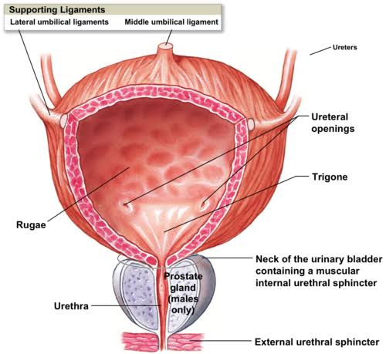
.

Slide 23
.

