Slide 1
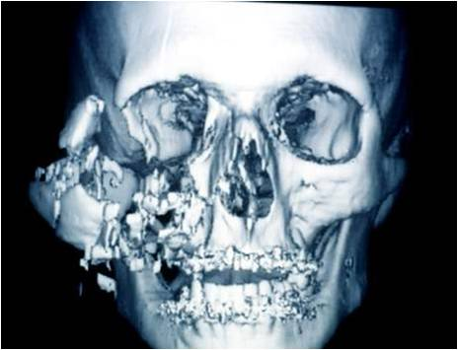
MIDFACE FRACTURES
Dr. Sanjay Vaghani
Assistant Professor
Department of Plastic Surgery SBKSMI & RC

Slide 2
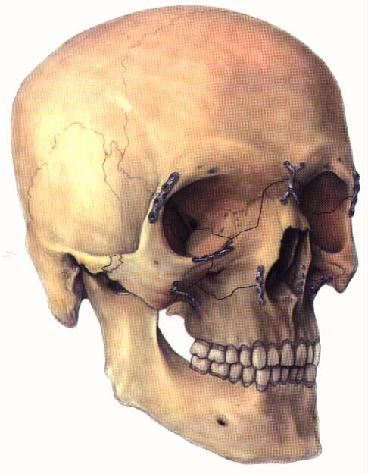
DEFINITION
AN AREA BOUNDED SUPERIORLY BY A LINE DRAWN ACROSS THE SKULL FROM ZYGOMATICOFRONTAL SUTURE OF ONE SIDE, ACROSS THE FRONTONASAL AND FRONTOMAXILLARY SUTURE TO THE ZYGOMATICOFRONTAL SUTURE ON OPPOSITE SIDE, INFERIORLY BY OCCLUSAL PLANE OF UPPER TEETH, POSTERIORLY, THE REGION IS DEMARCATED BY SPHENOETHMOIDAL JUNCTION, BUT INCLUDES THE FREE MARGIN OF THE PTERYGOID LAMINAE OF THE SPHENOID BONE INFERIORLY .

Slide 3
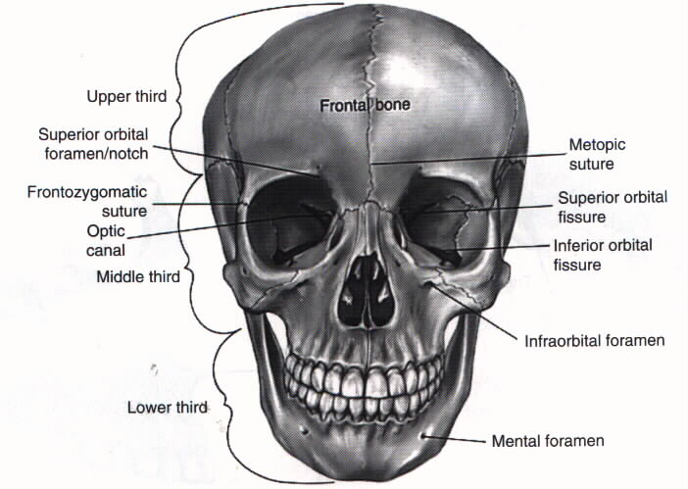
BONES CONSTITUTING MID FACE:
THERE ARE 8 PAIRED BONES AND 2 UNPAIRED BONES THEY ARE:
TWO MAXILLAE
TWO PALATINE BONES
TWO ZYGOMATIC BONES AND THEIR TEMPORAL PROCESSES
TWO NASAL BONES
TWO LACRIMAL BONES
TWO INFERIOR CONCHAE
TWO PTERYGOID PLATES OF SPHENOID
ETHMOID BONE AND ITS ATTACHED CONCHAE-------- UNPAIRED
VOMER--------------------------------------------------------------UNPAIRED

Slide 4
PHYSICAL CHARACTERISTICS OF MIDFACIAL SKELETON:
It is made up of considerable no. Of bones which rarely fracture in isolation
All bones are comparatively fragile and articulate in most complex fashion
Greatest portion of midface is made up of maxilla which is attached to cranium and supported by strong system of buttresses

Slide 5
PHYSICAL CHARACTERISTICS OF MIDFACIAL SKELETON:
Midface acts as cushion for the trauma directed towards cranium from anterior or anteriolateral direction analogous to a “matchbox” sitting below and in front of a hard shell containing the brain.
This type of structure is able to withstand considerable amount of force applied in a vertical manner from below , but the bones can be easily fractured by relatively small impact, if applied from other directions i.e. Anterior , superior or lateral aspects.

Slide 6
PHYSICAL CHARACTERISTICS OF MIDFACIAL SKELETON:
Facial bones have low resistance to impact forces from front and sideways , nasal bones are least resistant followed by zygomatic arch , while maxilla is sensitive to horizontal impacts.

Slide 7
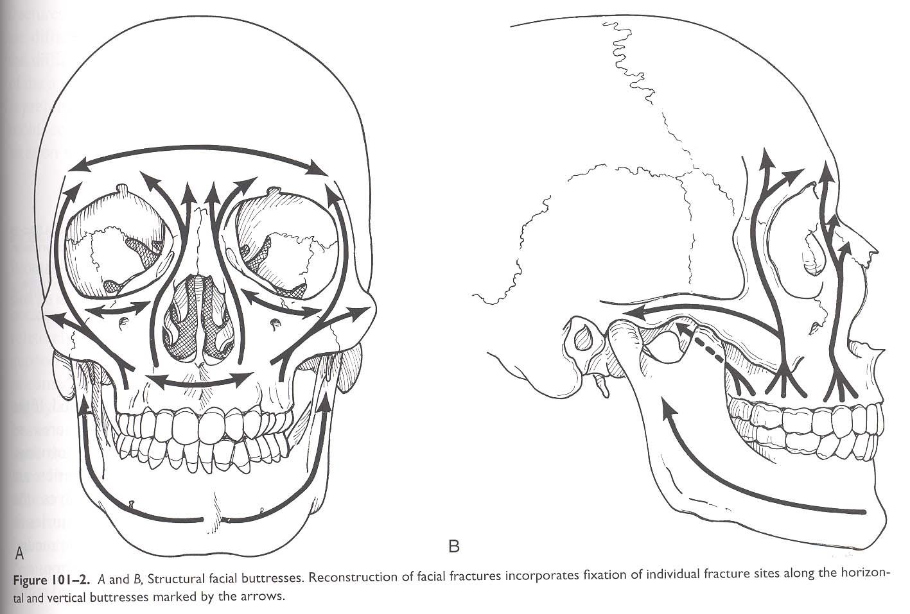
Vertical Buttresses Facial Skeleton
  Nasomaxillary (medial) buttress
  Zymaticomaxillary (lateral) buttress
  Pyterigomaxillary (posterior) buttress
  Mandibular buttress

Slide 8
Horizontal Buttresses
Palate
Inferior orbital rim
superior orbital rim (frontal bar)

Slide 9
Classifications of Mid face fractures
Le Fort Classification
Modified Le Fort Classification
Rowe and Williams Classification

Slide 10
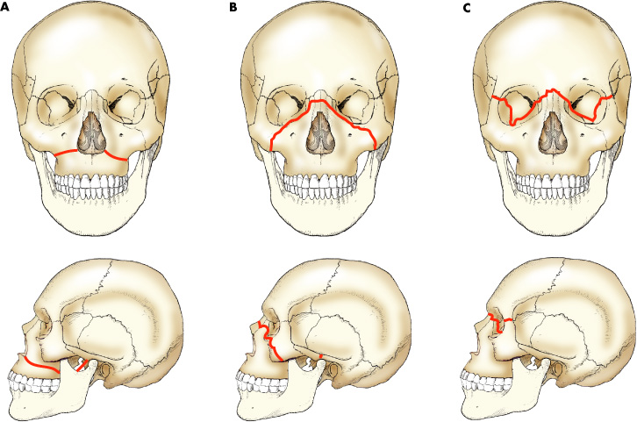
Le Fort I (Guerin’s fracture)
This is a relatively horizontal fracture in the body of the maxilla that results in a maxillary tooth bearing fragment being detached from the middle face.
The fracture line passes above the teeth, below the zygomatic process, through the maxillary sinuses, the tuberosities to the inferior portion of the pterygoid plate; it can be unilateral or bilateral.

Slide 11
Le Fort II (Pyramidal fracture)
In this fracture the maxilla will be separated from the base of the skull by fractures of the nasal bone and the frontal processes of maxillae. The fracture extends laterally through the lacrimal bones, floors of the Orbits, and inferiorly through the zygomaticomaxillary sutures, then passes posteriorly along the lateral wall of the maxilla, across the ptery-gomaxillary fossa and through the pterygoid plates.

Slide 12
Le Fort III (Craniofacial dysjunction)
The fracture line passes the nasal bones and frontal processes of maxillae or nasofrontal and frontomaxilary sutures, across the floors of the orbit through the ethmoid and sphenoid sinuses and the zygomaticofrontal suture. It passes across both pterygoid plates where they arise from the sphenoid bone, so it separates the middle third from the cranium.

Slide 13
Modified Le Fort classification
Le Fort I ...................Low maxillary fracture
Le Fort I a .................Low maxillary fracture/multiple segments
Le Fort II...................Pyramidal fracture
Le Fort II a.................Pyramidal and nasal fracture
Le Fort II b.................Pyramidal and NOE fracture
Le Fort III..................Craniofacial dysjunction
Le Fort III a................Craniofacial dysjunction and nasal fracture
Le Fort III b................Craniofacial dysjunction and NOE fracture

Slide 14
Le Fort IV
Le Fort IV ....................Le fort II or III and cranial base fracture
Le Fort IV a..................Supraorbital rim fracture
Le Fort IV b..................Anterior cranial fossa and supraorbital rim fracture
Le Fort IV c.................. Anterior cranial fossa and orbital wall fracture

Slide 15
Rowe and William classification
A-Fractures not involving the occlusion
  1- Central region
    a- Fracture of the nasal bones and/or nasal septum
      Lateral nasal injuries
      Anterior nasal injuries
    b Fractures of the frontal process of the maxilla
  c Fractures of type (a) and (b) which extend into the frontal bone
2- Lateral region
    Fractures involving the zygomatic bone, arch and ,maxilla (zygomatic Complex) excluding the dento-alveolar component

Slide 16
Rowe and William classification
B-Fractures involving the occlusion
  1- Dento-alveolar
  2- Subzygomatic
    a- Le fort I
    b- Le fort II
  3- Suprazygomatic (Le fort III)

Slide 17
Aetiology
1- Assaults
2- Falls
3- Road traffic accidents
4- Industrial injuries
5- Sports injuries
6- War injuries

Slide 18
Signs and symptoms
Intra-oral
  Ecchymosis in buccal sulcus in zygomatic buttress region
  Laceration in labial mucosa
  Anterior open bite
  Posterior gagging of occlusion
  Tenderness over zygomatic buttress and nasal aperture.
  Mobility of the Maxilla felt at the anterior nasal spine.
  Percussion of upper teeth gives a dull “cracked pot sound”
LEFORT I
Extraoral –
  Swelling of upper lip+/- laceration
  Increase in Vertical dimension of face
  Epistaxis
  Pain during speech and mastication

Slide 19
LEFORT – II
Extraoral
  Gross facial edema, giving `moon face appearance`.
  Increased vertical dimension with dish face deformity.
  Bilateral circumorbital ecchymosis (`raccoons eye`) and edema.
  Subconjunctival haemorrhage .
  Widening of the intercanthal distance
  Depression in the nasal region
  Epistaxis
  CSF rhinorrhoea may be present
  Infraorbital nerve parasthesia .
  Surgical emphysema from air of maxillary sinus

Slide 20
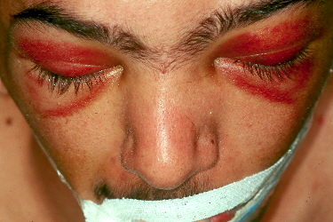
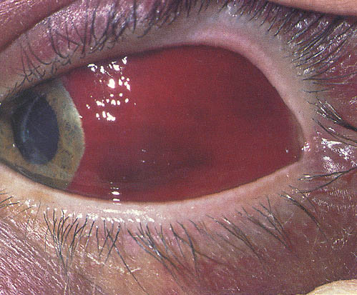
Racoon eyes
Subconjuctival haemorrhage

Slide 21
LEFORT - II
Intra-oral
  Retropositioning of the maxilla
  Laceration of the hard and soft palate seen if there is fracture in midpalatine region.
  Echymosis in buccal vestibule
  Percussion gives cracked pot sound
  Mobility elicited at infraorbital ridge.

Slide 22
LEFORT - III
Symptoms and signs of Le fort II in addition to the following
  Tenderness and seperation of F-Z sutures producing lengthening of the face and lowering of the occular level.
  Enopthalmos , diplopia or impairment of vision, temproray blindness.
  Flattening and widening, deviation of nasal bridge

Slide 23
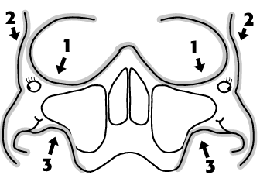
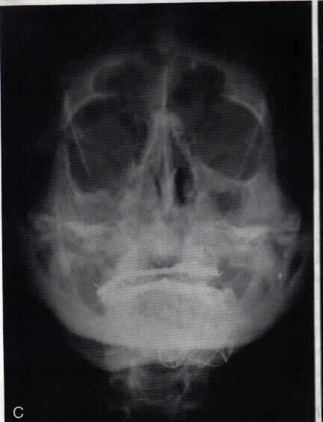
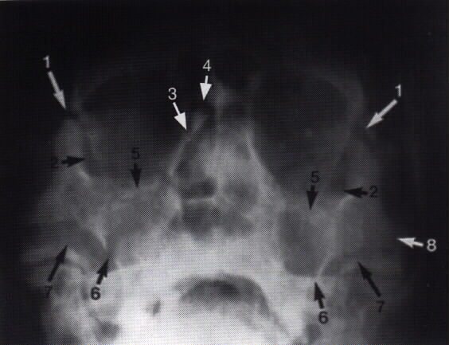
Radiodiagnosis
Plain radiograph
Occipitomental
(10 or 30 degree)
Water’s view
Suitable for isolated orbital fracture

Slide 24
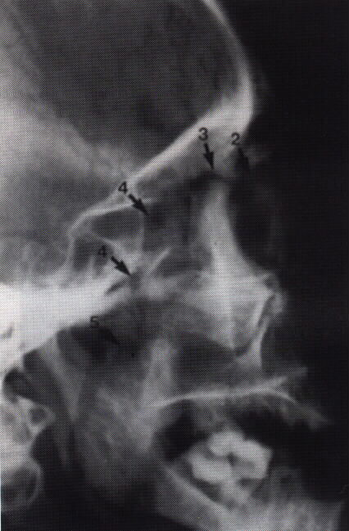
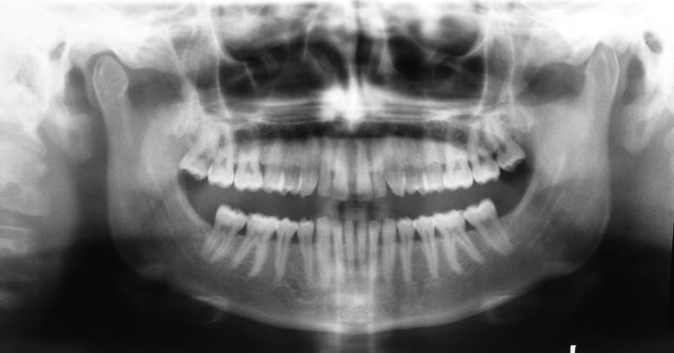
Radiodiagnosis
Lateral skull view
OPG
Occlusal view of the maxilla

Slide 25
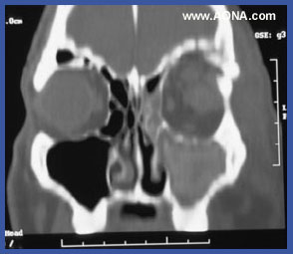
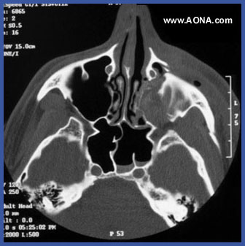
Radiographical examination
CT scan
3-D CT imaging
      Coronal sections
      Axial sections
Whenever intracranial damage and frontal sinus are suspected
Extensive fracture that involves nasoethmoid complex or orbital region
Orbital trauma to evaluate the degree of orbital injury and enophthalmos

Slide 26
Stages of Treatment
1. Emergency care and stabilization
2. Definitive treatment

Slide 27
Emergency Care and Stabilization
Immediate care of the injured patient has to be done to restore and maintain the upper airway.
Oral cavity cleared of blood, debris, fractured teeth, dentures etc.
Emergency cricothyrotomy / tracheostomy may be rarely required. Patient is placed in lateral decubitus or mild trendelenberg position to fecilitate drainage.

Slide 28
The control of nasal or oral bleeding can be gained with anterior / posterior nasal packs and oral suturing
Also by inflating Folley’s catheter bulb in the nasopharynx and tying it under traction.
But single most effective method to stop the bleeding is to insert an arch bar and give IMF

Slide 29
After airway is controlled patient’s blood volume is ascertained. Vital’s are monitored and in case patient is hypovolaemic ,
2 IV lines are established one in upper extremity and one in lower and Normal saline or RL should be infused to maintain Blood pressure and later after blood grouping is done, crossmatched blood should be transfused according to the requirement

Slide 30
Definitive treatment
Goals of treatment of maxillary fractures:
  Precise anatomical reduction to the cranial base above and to the mandible below
  Stable fixation of the reduced fragments
  Preservation of blood supply to the fractured site
  Restoration function
  Restore the dental occlusion
  Restore jaw movement at the earliest possible stage

Slide 31
The optimum time for reduction of midface fractures is usually between the fifth to eighth post injury day . They can be satisfactorily reduced after this time but with each succeding day disimpaction becomes more difficult

Slide 32
Principle of treatment for Mid face fractures
OPERATIVE/SURGICAL REDUCTION AND FIXATION
Restoration of occlusion is must for correct reduction
Fixation is maintained by external/internal skeletal fixation until consolidation is achieved.
Immobilization for 6-8 weeks to stabilize segments
IMF for 3-4 weeks

Slide 33
Indications for Closed Reduction
1. Non displaced fracture
2. Grossly comminuted fractures
3. Fractures exposed by significant loss of over­lying soft tissues
4. Edentulous maxillary fractures
5. In children with developing dentition.

Slide 34
Indications for open reduction
1. Displaced fractures
2. Multiple fractures of the facial bones
3. Fractures of the edentulous maxilla with severe displacement
4. Edentulous maxillary fracture opposing an edentulous mandibular fracture
5. Delay of treatment and interposition of soft tissues between non-contacting displaced fracture segments
6. Specific systemic conditions contraindicating IMF.

Slide 35
Reduction of the Maxilla
Manual reduction
Reduction with wires
Reduction using disimpaction forceps.
Reduction by means of traction(elastics)

Slide 36
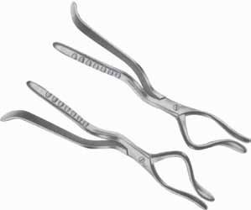
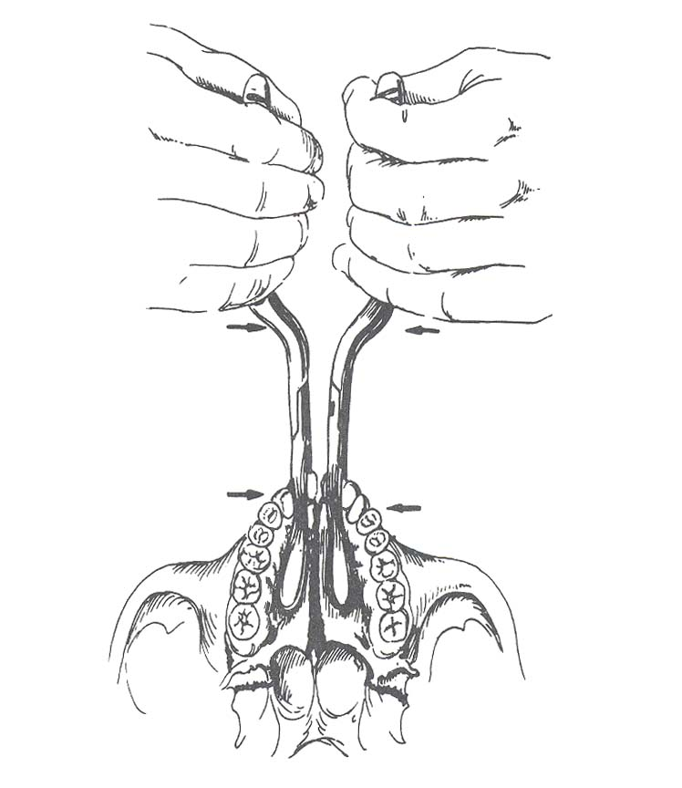
ROWE`S MAXILLARY DISIMPACTION FORCEPS
Direction of disimpaction is downwards and forwards

Slide 37
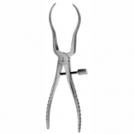
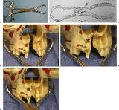
HAYTON WILLIAMS FORCEPS

Slide 38
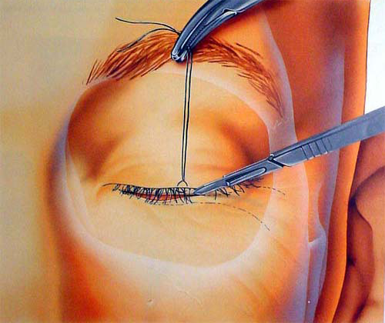
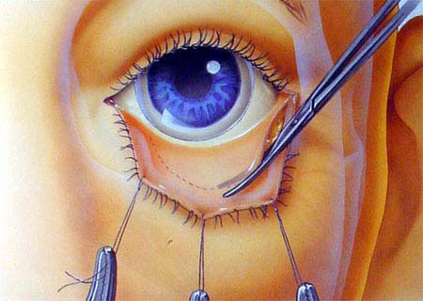
Approaches to the mid face skeleton
For the Exposure of
  orbital floor and
  infra orbital margin
Subcilliary approach
Transconjunctival approach

Slide 39
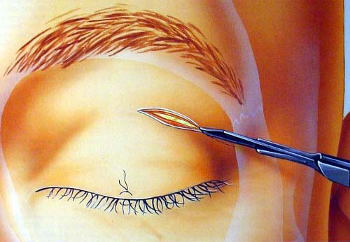
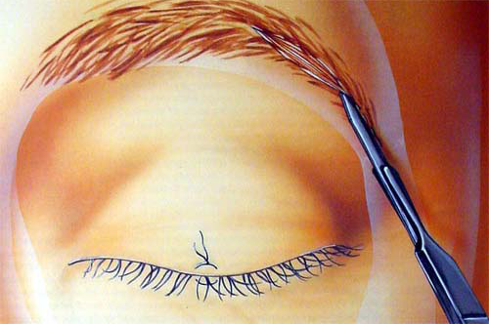
For exposure of
  Lateral orbital rim and
  Zygomatico frontal suture
Supratarsal upper eyelid crease approach
Lateral brow incision

Slide 40
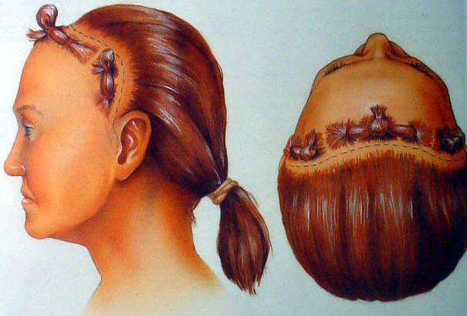
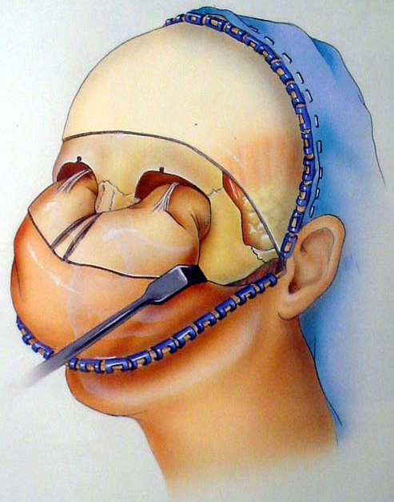
Coronal approach
Exposure of
  Frontal bone
  Nasal bone
  Zygoma body and arch
  Z-F
  Supraorbital margin

Slide 41
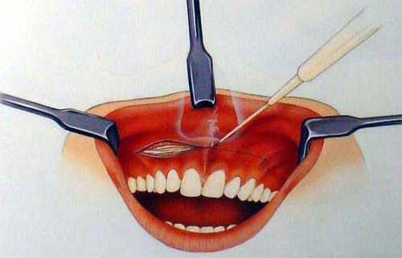
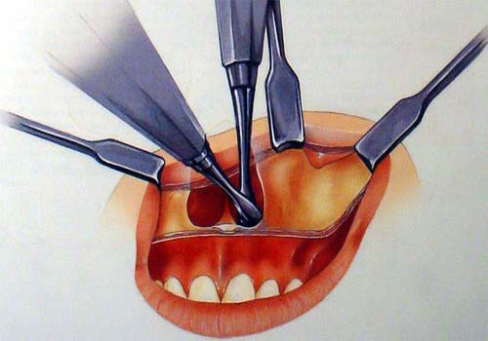
Maxillary Vestibular approach
Exposure of
  Naso-maxillary buttress
  Zygomaxillary buttress
  Infraorbital margin
  Pyriform fossa

Slide 42
Classification of Methods of Maxillary Fracture Fixation
A. Internal Fixation (Immobilization within the tissues)
  1. Direct Osteosynthesis (preferred methods of treatment)
  a.Transosseous wiring at fracture sites
    b.Miniplates and screws
    c.Transifixation with Kirchner wire (or) steinmann pin
    2. Suspension wires
    B . External Fixation devices.

Slide 43
Mini Plates and Screws
Since Michelet first introduced miniplate stabilization of facial fractures in 1972, plating of midface fractures has become the universal standard for patient's with these injuries.
Selection of appropriate plates should be based on patient’s actual injuries and knowledge of midfacial biomechanics

Slide 44
Mini Plates and Screws
Monocortical semirigd fixation provides 3 dimensional stability
They eliminate movement and allow the primary healing to occur
At least 2 screws should be placed on either side of the fracture line to prevent anteroposterior and rotatory movement
Increasing width provides more stabilization towards rotational forces.

Slide 45
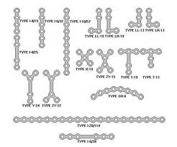
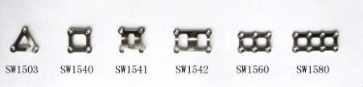
Various designs are available in market which includes X, H, L, T, and Y types. Mesh and ladder shaped three dimensional plates also use this principle to augment rotational stability over fracture sites.

Slide 46
Resorbable bone plates and screws
Composed of combinations of different biodegradable polymers ( polylactide - polgalactide ).
Advantages
  Self resorbable so no need to remove over prominent areas.
  Thermoplastic so can be well contoured
  Theoretically if resorbable plates are placed over sutures they donot restrict the growth at that site and instead it promotes fracture remodelling under functional loads in absence of stress shielding.

Slide 47
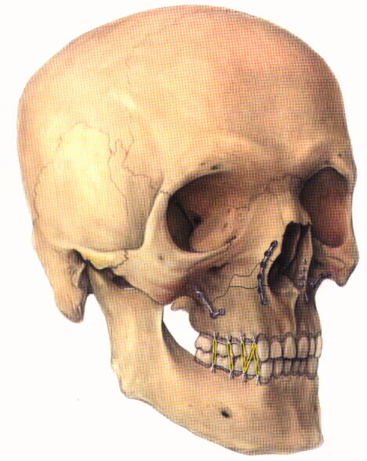
Location of fixation
Le fort 1 fracture
  stabilized with “L” plates placed at zygomatic buttress as well as curved plated placed at pyriform aperture.

Slide 48
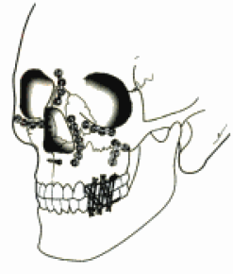
Le fort II
Stabilised with either a linear or a Y configuration plate at F-N junction, curved plates at infraorbital rims and L shaped plates at buttress.

Slide 49

Le fort III
In addition to fixation of le fort II fractures Zygomatico frontal suture is also to be fixed

Slide 50
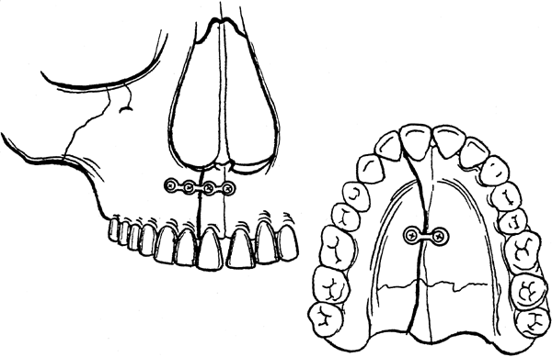
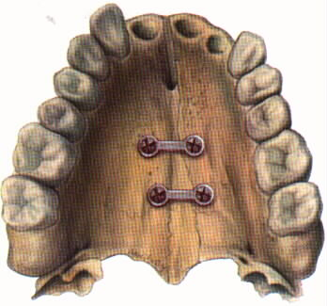
Palatal fractures
In most cases lateral and medial stabilization of maxilla with arch bars in combination with a palatal splint is sufficent
However if internal fixation is required it may be applied at anterior maxillary surface below the nasal spine and posterior junction of hard palate through small mucosal incision.

Slide 51
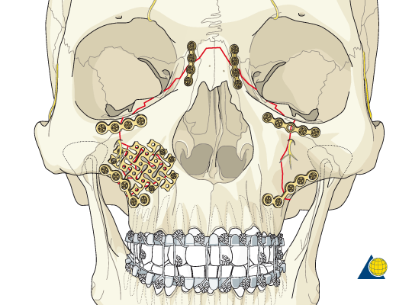
Mesh fixation
Mesh fixation is used for retention and alignment of small fragments or bone grafts. Anterior and lateral walls of maxilla and anterior table of frontal bone are common sites for these application

Slide 52
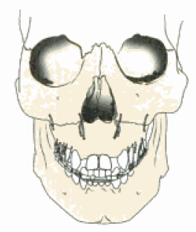
Trans osseous wiring
Semirigid type of fixation
Disadvantage
  Does not provide 3 D fixation
  Micromovement interferes with the fracture healing
Sites
  Frontozygomatic
  Frontonasal
  Orbital rim
  zygomatic buttress
  alveolar
  mid palate

Slide 53
Suspension Wiring
Described by Adams in 1943
Lower jaw arch bar is connected by soft stainless steel wires of 0.5 mm diameter to areas of facial skeleton above the fracture line, thus sandwitching fracture portion between mandible and unfractured portion of facial skeleton
Advantage
  Require only minimum armamentarium

Slide 54
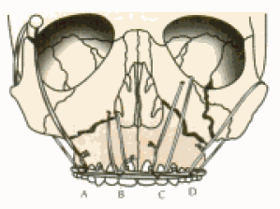
suspension wires
    Sites
    a. Frontal - central / laterally placed.
    b. Piriform aperture
    c. Infra -orbital
    d. Circumzygomatic
    Use – only for fixation of arch bar in uncoperative (head injury) patients

Slide 55
External fixation devices
Not used now a days but is still advocated in some cases of markedly depressed, posteriorly displaced midface fractures of the maxillae
Principle-sandwiching the midface between the base of the skull and mandible following disimpaction and closed manipulation

Slide 56
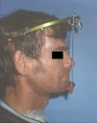
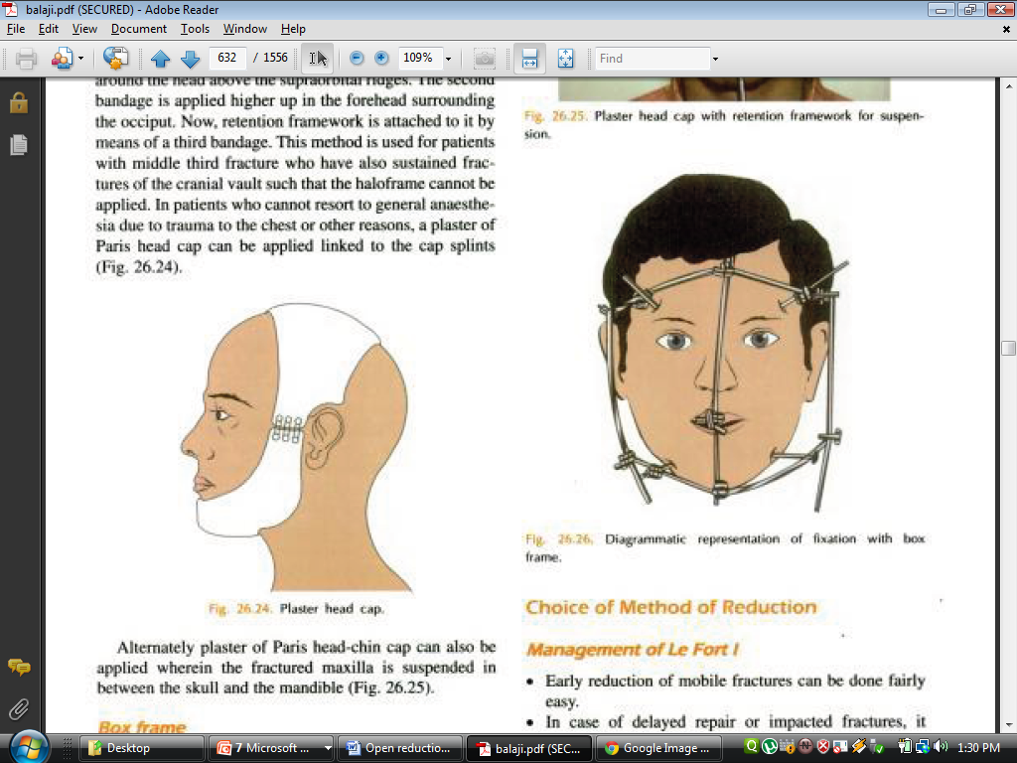
EXTERNAL FIXATION
1. Craniomandibular
  a.Box -frame
  b.Halo -frame
  c.Plaster of Paris headcap .
Halo Frame
POP Head cap
Box frame

Slide 57
  2. Craniomaxillary
  a.Supra -orbital pins
  b.Zygomatic pins
  c.Levant frame

Slide 58
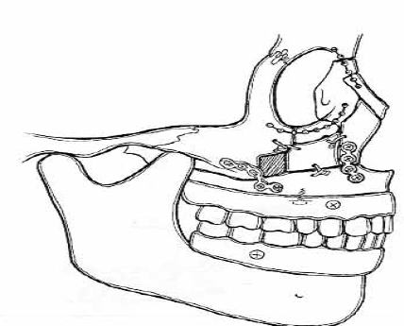
Fractures of edentulous maxilla
No displacement – conservative management with soft diet for 3-8 weeks followed by construction of a new denture.
Mobile and displaced –
  open reduction and internal fixation with screw & plates
  Denture or the splint is fixed with a screw to the alveolus of the maxilla

Slide 59
Complications
Early complications
  Haemorrhage
  Airway obstruction
  Infection
  Lacrimal duct obstruction
  CSF rhinorrhoea
  Blindness

Slide 60
Late Complications
Non union
Mal union – disimpaction / osteotomies
Plate exposure
Infraorbital and lip hypoaesthesia
Devitalisation of teeth
Malocclusion

Slide 61
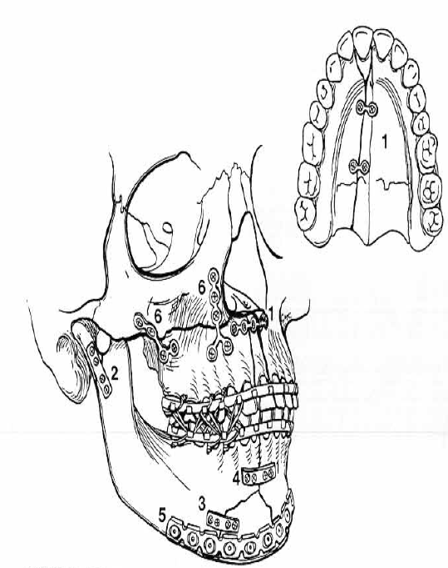
Reconstruction sequence in lower facial unit fractures

Slide 62
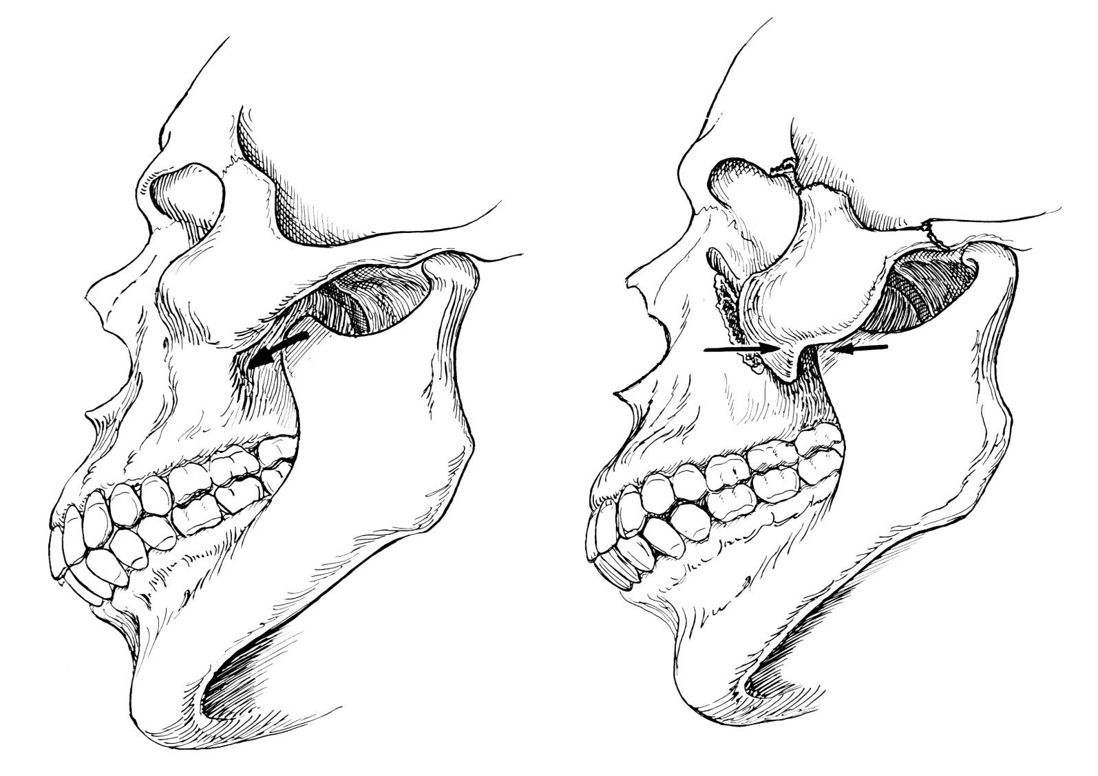
Management of the Zygomatic complex fractures
Physical Exam

Slide 63
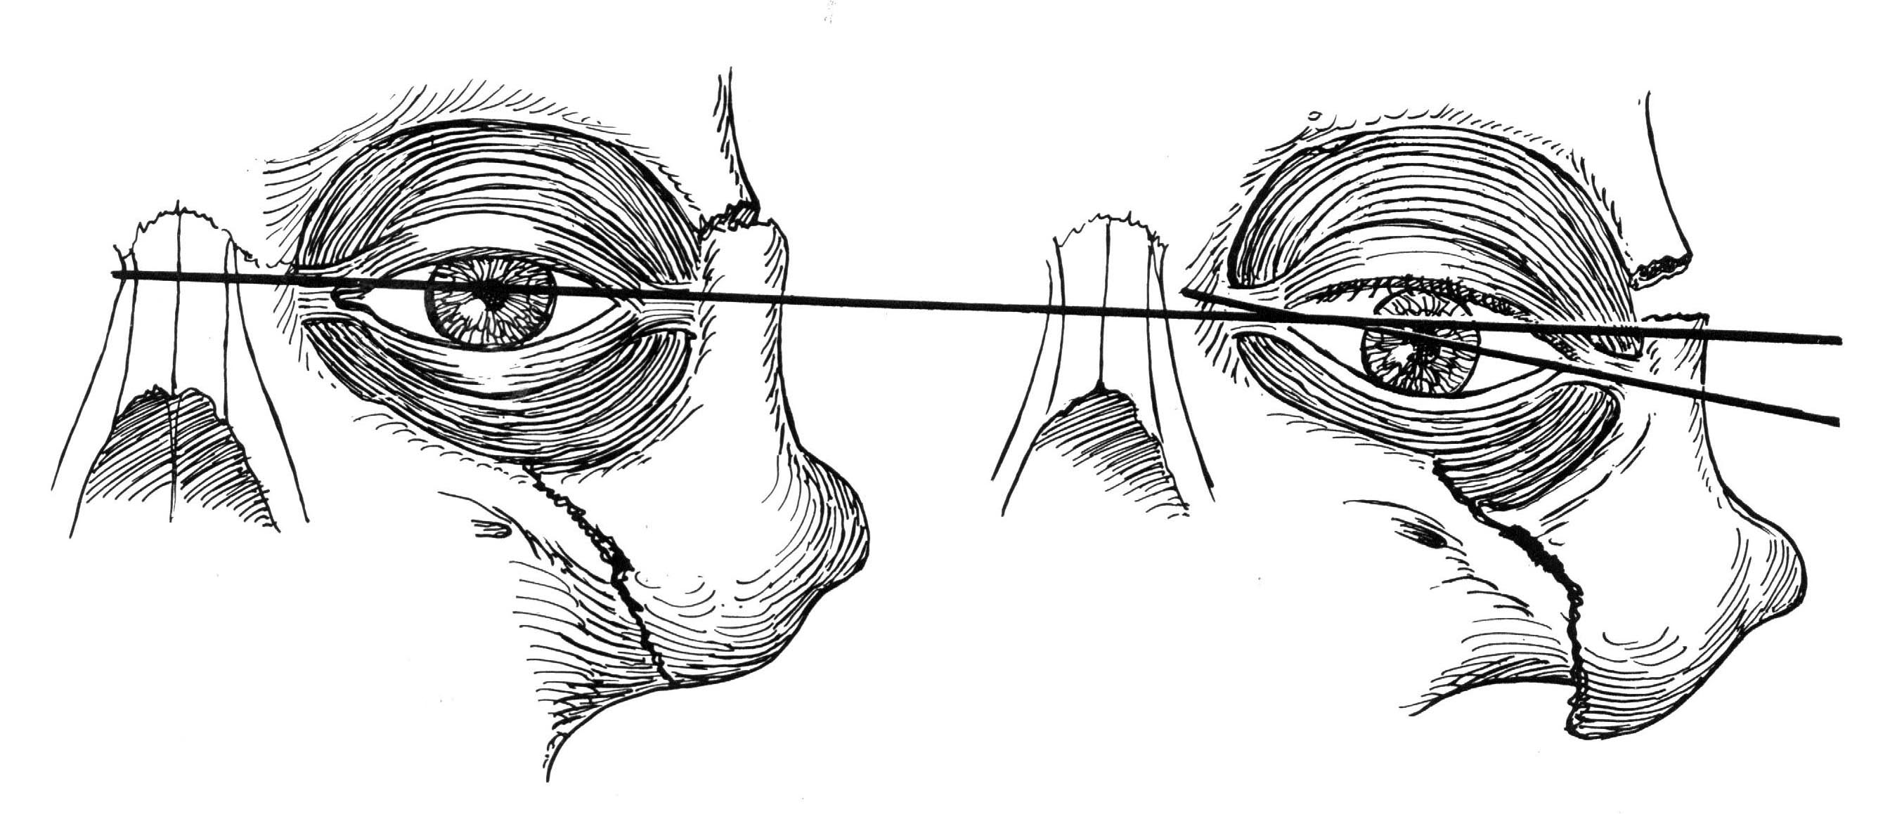
Antimongoloid slant of palpebral fissure

Slide 64
Knight and North classification
Group I: No significant displacement
Group II: Arch fractures which involve Inward buckling of the arch
Group III: Unrotated body fractures, downward inward displacement, but no rotation
Group IV: Medially rotated body fractures with downward, backward and inward displacement
Group V: Laterally rotated body fractures with downward, backward and medial displacement
Group VI: Complex fractures (presence of additional fracture lines across the main fragment)

Slide 65
compare the distance between the lateral orbital rim and anterior corneal surface of each globe using Hertel exophthalmometer. If the difference between the eyes is more than 3 mm, it is considered significant.
When the lateral orbital rim cannot be used as a reference because of a displaced zygoma fracture, enophthalmos becomes more of a clinical finding

Slide 66
Visual examination
Diplopia
enophthalmos
Abnormal nerve sensibility
    Restricted Eye movement

Slide 67
Zygoma
Radiology
X-Ray
  Water’s View Most Useful
CT Scan
  Coronal Cuts For Orbital Anatomy

Slide 68
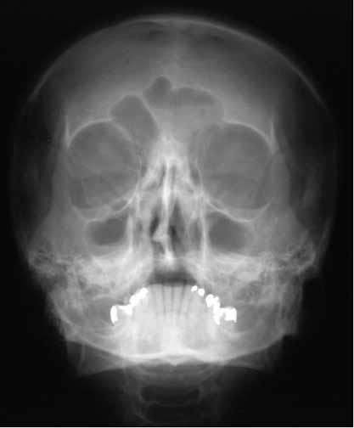
Occipitomental view
(Posterioanterior oblique)
(water’s view)

Slide 69
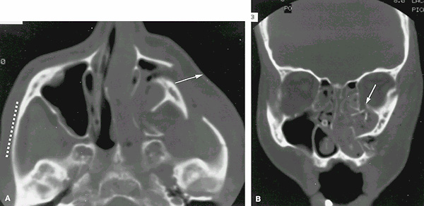
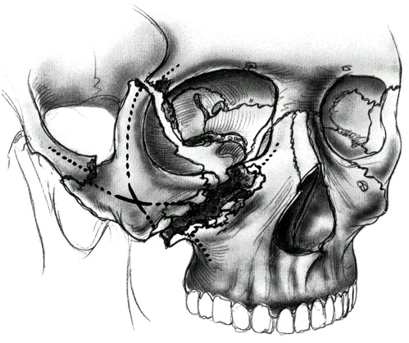
CT scan
Coronal sections
Axial sections

Slide 70
Treatment
Timing:
As early as possible unless there are ophthalmic, cranial or medical complications
Periorbital edema and ecchymosis obscure the fine details of the fracture, intervention can be postponed but not more than a week
Indications:
Diplopia
Restriction of mandibular movement
Restoration of normal contour
Restoration of normal skeletal protection for the eye

Slide 71
Methods of reduction
Temporal approach
Iift the depressed malar forwards, upwards and outwards
Suitable for isolated
zygomatic fracture with
good stability afterwards

Slide 72
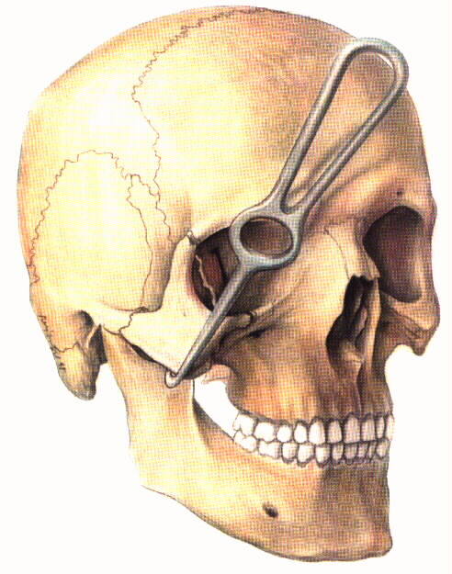
Methods of reduction
Percutaneous approach (malar hook, Carroll-Girard bone screw)
Suitable for displaced zygomatic
fracture with high
Stability after reduction

Slide 73
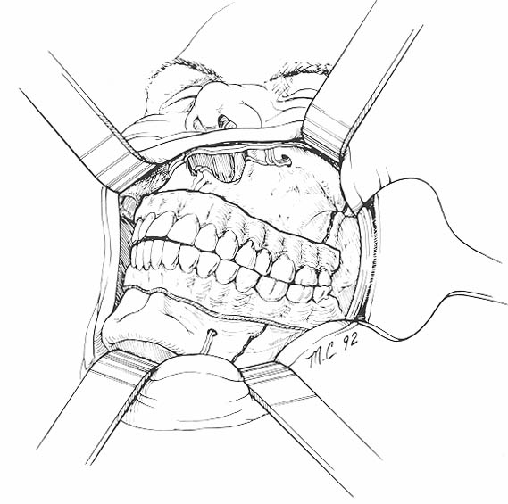
Methods of reduction
Buccal sulcus approach (Keen 1909)
Elevation from eyebrow approach
(the same principle of Gillies approach)

Slide 74
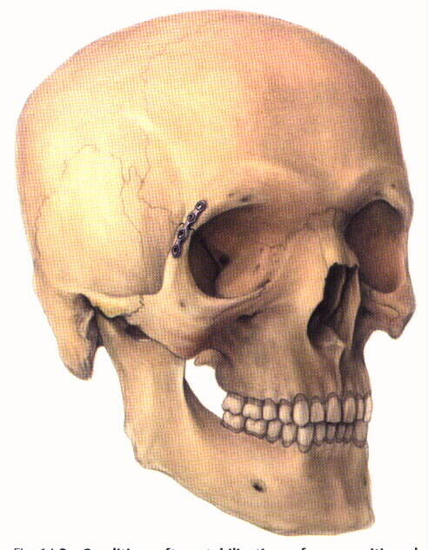
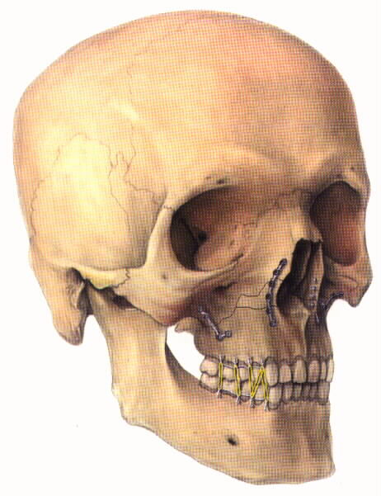
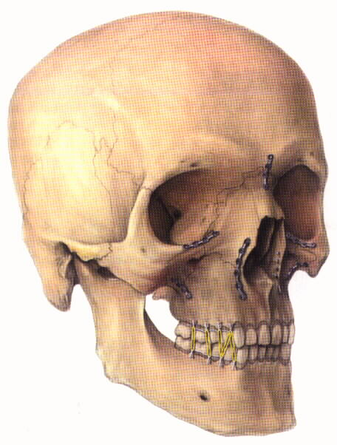
Points of fixation:
Lateral orbital rim
Buttress of zygoma
Infraorbital rim and buttress

Slide 75
Zygoma
Management
Undisplaced
  Nonoperative
Displaced
  Isolated Zygomatic Arch - Gilles Elevation
  Orbitozygomatic Fractures - Open reduction and Stabilization

Slide 76
Orbital Blowout Fractures
Pure Blowout - only orbital floor or medial wall injured
Impure Blowout - associated orbital rim fractures

Slide 77
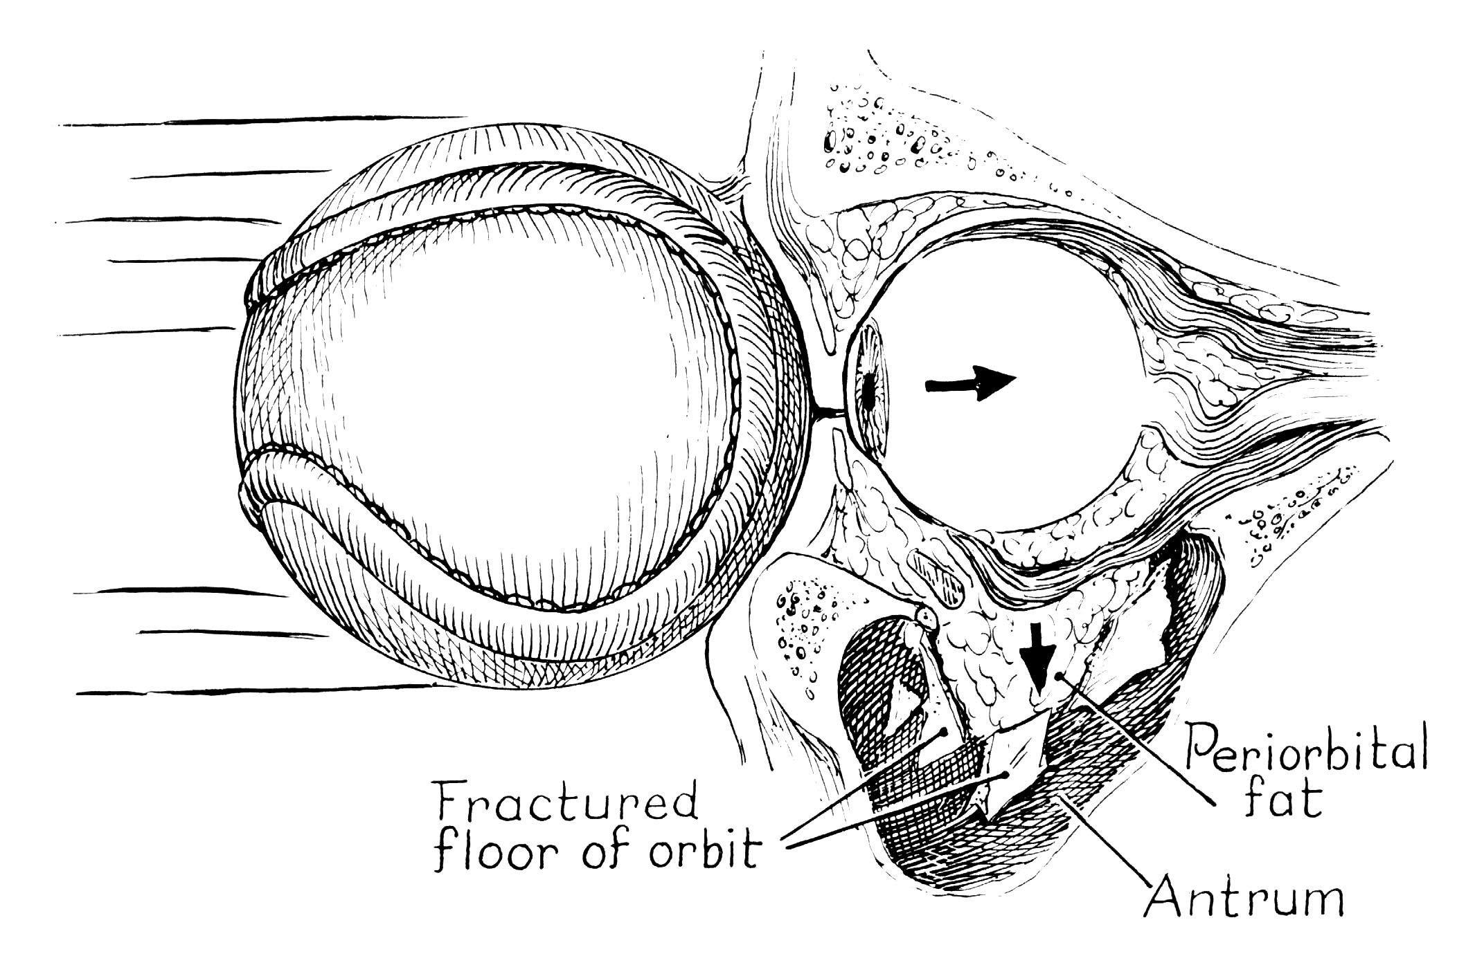
Orbital Fractures
Blowout Fractures

Slide 78
Orbital Fractures
Physical Exam
Diplopia
Enophthalmos
Inferior Displacement Palpebral Fissure
Anesthesia of Infraorbital Nerve
Orbital Emphysema

Slide 79
Orbital Fractures
Physical Exam
Diplopia
  Commonly on Upward Gaze
  Primary (Central Gaze) or Secondary (Perpheral)
  Mechanical (incarceration of infraorbital tissue) or Nonmechanical (paresis)

Slide 80

Orbital Fractures
Forced Duction Test
Grasp the inferior rectus muscle about 7-10 mm from the limbus
Differentiates inferior rectus incarceration from muscle weakness, paralysis and contusion

Slide 81
Orbital Fractures
Physical Exam
Enophthalmos
  Inferior and Posterior Displacement of Globe and Intraorbital Soft Tissue
  Etiology
    Enlargement of the Bony Orbital Cavity
    Escape of Orbital Fat or Fat Necrosis
    Muscle Entrapment in Fracture Line
    Soft Tissue Scarring and Contracture

Slide 82

Orbital Fractures
Enophthalmos

Slide 83
Orbital Fractures
Physical Exam
No Diplopia + No Enophthalmos
    ?Significant Fracture
Diplopia + No Enophthalmos
    Incarceration Only
No Diplopia + Enophthalmos
    Volume Discrepancy Only
Diplopia + Enophthalmos
    Incarceration + Volume Discrepancy

Slide 84
Orbital Fractures
Indications For Exploration
Symptomatic Diplopia With Positive Forced Duction Test
Xray evidence of Extraocular Muscle Entrapment
Early Enophthalmos (>3mm)
Large Orbital Floor Defect
Abnormally Low Vertical Globe Level
Associated Orbital Rim or Other Craniofacial Fractures

Slide 85
Contraindications to surgery
Hyphema
Retinal detachment
Globe perforation
Only seeing eye
Medically unstable patient

Slide 86
Orbital Fractures
Management
Grafts
  Autologous Bone (cranial, rib, iliac)
  Cartilage
  Fascia lata
Alloplastic Implants
  Teflon
  PDS
  Silastic
  Titanium Mesh

Slide 87

Nasal Bone fractures
Anatomy
Upper Vault
  nasal bones, ethmoid, superior edge of septum, vomer
Middle Vault
  upper lateral cartilages, most of septum, maxilla
Lower Vault
  alar cartilages, inferior edge of septum

Slide 88
Physical Exam
Edema
Crepitus
Periorbital Ecchymosis
Epistaxis
Internal And External Lacerations
Widened Nasal Bridge
Septal Hematoma

Slide 89

Classification
Stranc and Robertson
Lateral Impact Injuries
  Unilateral vs. Bilateral
Frontal Impact Injuries
  Plane I
  Plane II
  Plane III

Slide 90
Treatment
Lateral Impact Injuries
Closed Reduction
Drainage of Septal Hematoma
Simple Repositioning of Deviated Nasal Bones and Septum
  Completion Of The Fracture
Internal Packing and External Splint

Slide 91
Closed Reduction
Delayed for 5-7 days to wait till reduction of edema
Not to wait > 2 weeks to prevent partial healing which makes fracture reduction difficult
Principle is to complete the nasal bone and septum fracture and then mould it with fingers in right position
Then apply internal nasal pack and external splint.

Slide 92


Walsham’s Forceps

Slide 93



Asch’s forceps

Slide 94

Treatment
Frontal Impact Injuries
Plane I
  Fracture of both nasal bones
  possible septal distortion
  closed reduction with internal support
  possibly may require secondary septorhinoplasty

Slide 95

Treatment
Frontal Impact Injuries
Plane II
  Fracture of both nasal bones and fracture of the septum leading to saddling
  Usually bilateral
  May Require Delayed Septal Reconstruction With Grafts

Slide 96



Treatment of Plane II fractures
Percutaneous compression using two 30G wires passed trans nasaly and compression plates using 18 G spinal needle.

Slide 97

Treatment
Frontal Impact Injuries
Plane III
  Extend Into Pyriform Aperture And Medial Orbital Rim
    ie. Naso-Orbital-Ethmoidal Fractures
  Open Reduction an Internal Fixation of Frontal Process of Maxilla
  Transnasal Reduction of Medial Canthal Ligaments

Slide 98
Complications
Occur In Up To 70%
  Deviated Nasal Pyramid
  Nasal “Hump”
  Septal Deformity With Respiratory Obstruction

Slide 99
Naso-Orbital-Ethmoidal Fractures
Anatomy
Interorbital “Space”
  two ethmoidal labyrinths
  superior and middle turbinates
  perpendicular plate of ethmoid
Medial Orbital Wall
  anteriorly - lacrimal bone and lamina papyracea
  posteriorly - body of sphenoid

Slide 100
Naso-Orbital-Ethmoidal Fractures
Physical Exam
Flat nose
Swollen medial canthal area
Telecanthus (12-20%)
Lack of skeletal support on palpation of nose
CSF leak

Slide 101
Naso-Orbital-Ethmoidal Fractures
Telecanthus
Normal intercanthal distance (Stranc)
  males: 33-34mm
  Females: 32-33mm
Consider >35mm abnormal (Manson)

Slide 102
Naso-Orbital-Ethmoidal Fractures
Classification - Markowitz
Type I - Single central segment
Type II - Comminuted central segment
Type III - Avulsed medial canthal tendon

Slide 103

Naso-Orbital-Ethmoidal Fractures
Classification

Slide 104
Naso-Orbital-Ethmoidal Fractures
Management
Early open reduction
Four Objectives:
  correct epicanthal folds
  restore bony contour
  reestablish lacrimal system continuity
  medial canthoplasty / canthopexy

Slide 105
Naso-Orbital-Ethmoidal Fractures
Management
Wide Exposure
  coronal incision
  “open sky” - transverse across root of nose
  vertical midline nasal
  subciliary
  buccal sulcus
  extend existing lacerations

Slide 106
Naso-Orbital-Ethmoidal Fractures
Management
Correct nasofrontal separation
  Elevate nasal bones
Reduce comminuted nasal bones
Bone graft where needed
Explore septum
Stabilize nasomaxillary buttresses

Slide 107

Reconstruction sequence in upper facial unit fractures

Slide 108
THANK YOU

