Slide 1
ULNAR NERVE INJURY
Dr. Piyush Doshi
Associate Professor
Department of Plastic Surgery, SBKSMI & RC

Slide 2
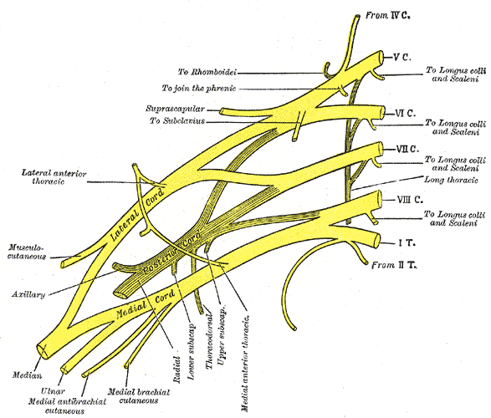
ANATOMY
Two roots from the lateral (C5, 6, 7) and medial (C8, T1) cords, which embrace the third part of the axillary artery, and unite anterior or lateral to it

Slide 3
ULNAR NERVE
It is continuation of the medial cord of the brachial plexus.

Slide 4
Course
ARM –It runs through the axilla medial to axillary artery and between it and vein, continuing distally medial to the brachial artery. It enters posterior compartment of the upper arm midway by piercing medial intermusculer septum, inclines medially as it descends anterior to the medial head of triceps and passes behind behind the medial epicondyle of humerus to enter the forearm.

Slide 5
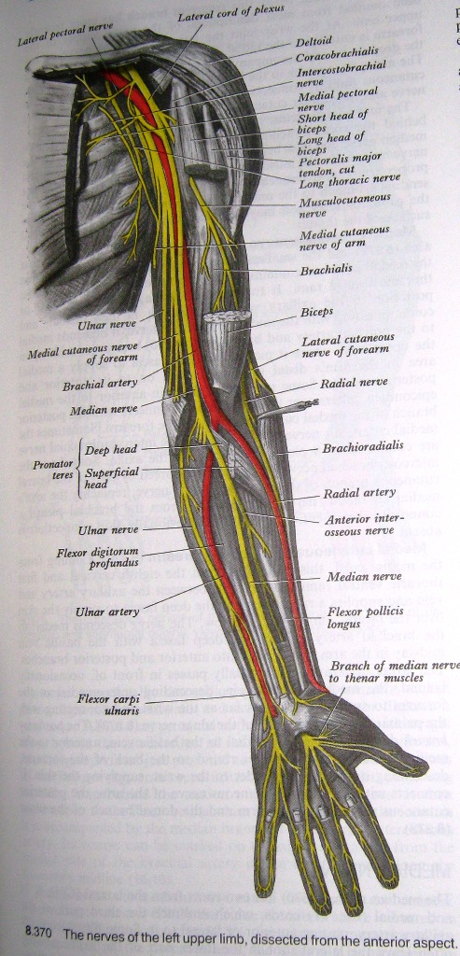

Slide 6
FOREARM- descends on medial side of forearm, lying on FDP. Proximally , it is covered by FCU; its distal half lies lateral to the muscle and is covered only by skin and fascia.
In the upper 1/3rd , nerve is distant from ulnar artery but distally, it comes to lie close to medial side of artery.
About 5 cm proximal to the wrist, it gives off a dorsal branch which continues distally into the hand, anterior to flexor retinaculum on the lateral side of pisiform and posteromedial to the ulnar artery.

Slide 7
Ulnar nerve then passes deep to the superficial part of retinaculum (in Guyon’s canal) with the artery and divides into superficial and deep terminal branches.

Slide 8
BRANCHES
ARM- No branches in the arm.
FOREARM-
Muscular Branches- Usually 2 muscular branches. They begin near elbow & supply FCU and ,medial half of FDP(Little and Ring Finger).
Palmar Cutaneous Branch- It arises about mid-forearm. Descends on ulnar artery, which it supplies, and then perforates deep fascia to end in the palmar skin, after communicating with the palmar branch of median nerve.

Slide 9
BRANCHES IN HAND-
DORSAL BRANCH- It arises 5 cm proximal to the wrist. Passes distally and dorsally, deep to FCU, perforates the deep fascia, descends along the medial side of the back of wrist and hand and then divides into 2 or 3, dorsal digital nerves.
1st supplies the medial side of little finger.
2nd supplies adjoining sides of ring & little finger.
3rd when present supplies adjoining sides of ring & middle finger.

Slide 10
In little finger, dorsal nerves extend only to the base of distal phalnx, and in ring finger, extend to the base of middle phalnx .
Most distal part of the little finger and ulnar side of ring finger are supplied by dorsal branches of proper palmar digital branches of the ulnar nerve.
The most distal part of the lateral side of ring finger are supplied by dorsal branches of proper palmar digital branches of the median nerve.

Slide 11
SUPERFICIAL TERMINAL BRANCH- It supplies palmaris brevis and medial palmar skin.
Divides into two palmar digital nerves, which can be palpated against the hook of hamate bone.
One supplies the medial side of little finger
Other sends a twig to the median nerve and divides into two proper digital nerves to supply adjoining sides of little and ring fingers.

Slide 12
DEEP TERMINAL BRANCH- It accompanies deep branch of ulnar artery as it passes between abductor digiti minimi and flexor digiti minimi and then perforates the opponens digiti minimi.
At its origin, it supplies three short muscles of the little finger.
As it crosses the hand, it supplies the interossei and 3rd and 4th lumbricals.
It ends by supplying adductor pollicis, 1st palmar interossei and usually FPB.

Slide 13
Medial half of FDP is supplied by ulnar nerve. It also supplies 3rd & 4th lumbricals which are connected with the tendons of this part of muscle.
It also give branches to some intercarpal, carpometacarpal, and intermetacarpal joints.

Slide 14
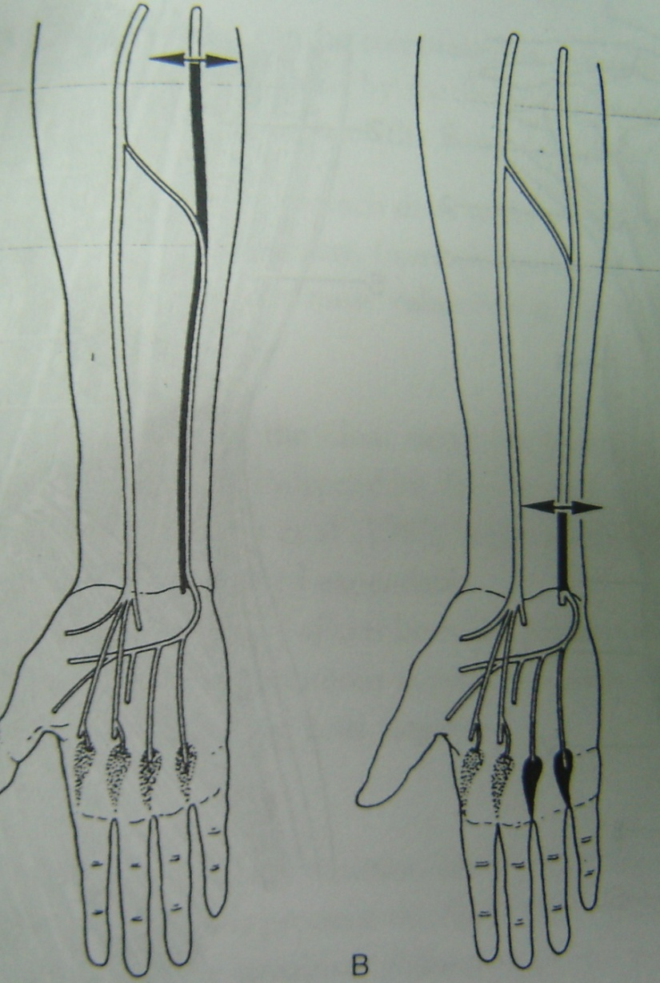
ANAMALOUS NEURAL PATTERN
Martin-Gruber anast.
Found in 15%
Between ulnar & median nerve adjacent to ulnar artery in proximal forearm

Slide 15
ETIOLOGY
      . Trauma
      . Iatrogenic
      . Compression neuropathy

Slide 16
CLASSIFICATION
HIGH- Occur above the origin of the motor branches to FCU and ring and little finger FDP.
LOW- Occur distal to origins of the motor branches to FCU and ring and little finger FDP.

Slide 17
LOW NERVE INJURY
Strength of extrinsic hand muscles is unaffected, but sensation is lost on the ulnar border of the hand & in ring and little fingers, and ulnar-innervated intrinsic muscles are paralysed.
Results in weakness of thumb pinch, claw deformity, loss of normal pattern of finger flexion and significant loss of hand dextrity and strength.

Slide 18
HIGH NERVE INJURY
Loss of active ring and little finger DIP joint flexion and wrist flexion compound the aforementioned findings.
Paradoxically,the claw deformity tends to be less severe.

Slide 19
PATTERN OF PARALYSIS
Laceration of nerve in palm of hand after giving branches to hypothenar muscles
Paralysis of the adductor pollicis muscle and interossei for index, middle & ring finger.
Hypothenar muscles retain normal function.
Sensation in ring & little finger is preserved.

Slide 20
Damage or compression of nerve in distal portion of Guyon’s canal
Sensation in ring & little finger is normal
Loss of function in all ulnar innervated intrinsic muscles and hypothenar muscles.

Slide 21
Damage or compression of nerve in proximal portion of Guyon’s canal
Loss of Sensation in ring & little finger & on palmar aspects of the hypothenar eminence.
Loss of function in all ulnar innervated intrinsic muscles and hypothenar muscles.
Sensation is preserved on the dorsal ulnar aspect of the hand

Slide 22
Ulnar nerve injury in or above Cubital tunnel
Loss of function in FCU and ring & little finger FDP muscles.

Slide 23
Characteristic deformity of ulnar nerve palsy is clawing of two ulnar digits(as there lumbricals and interossei muscles are innervated by ulnar nerve)
Lumbricals of index and middle finger are innervated by median nerve.
Low ulnar nerve palsy show more severe clawing of the ring and little finger than a high palsy because of unopposed IP flexion of the FDP.

Slide 24
FUNCTIONAL LOSS
MOTOR:
1.Loss of MP joint flexion of ring&little finger
Duchenne’s sign (1867):
Bouvier’s sign (1851):

Slide 25
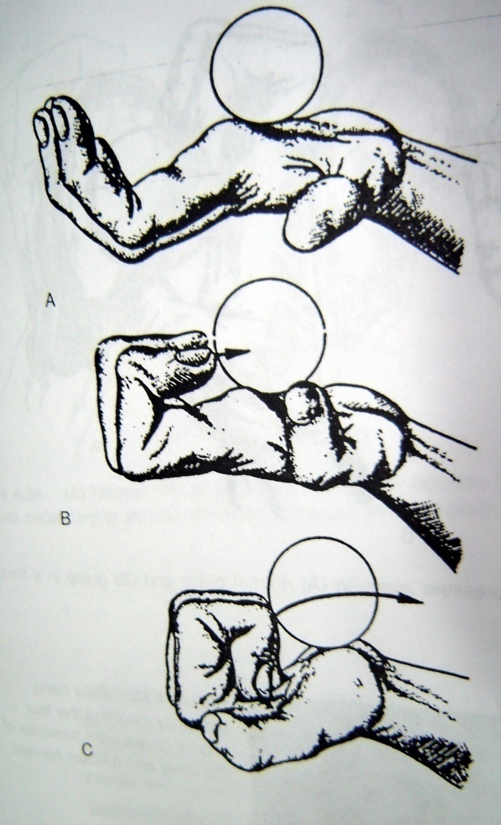
  Loss of integration of MP &IP joint flexion:

Slide 26
3.Flattening of MC arch & loss of hypothenar eminence:
Masse’s sign(1916):
4.Loss of extrinsic power of ulnar innervated portion of FDP:
Pollock’s sign (1919):
5.Partial loss of wrist flexion:

Slide 27
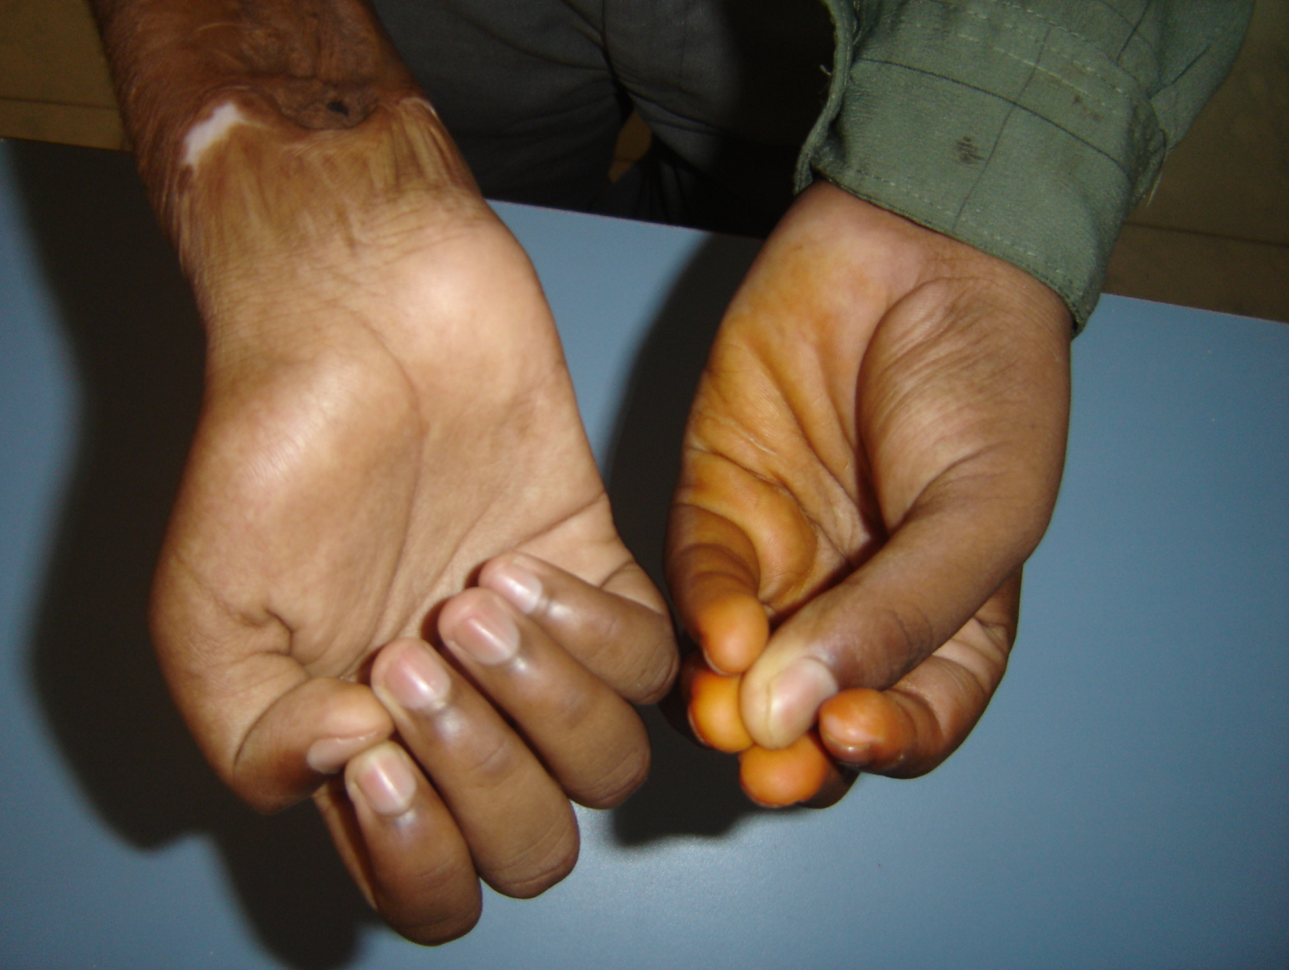
6.Impairment of precision grip:
Pitre-Testut’sign(1925):

Slide 28
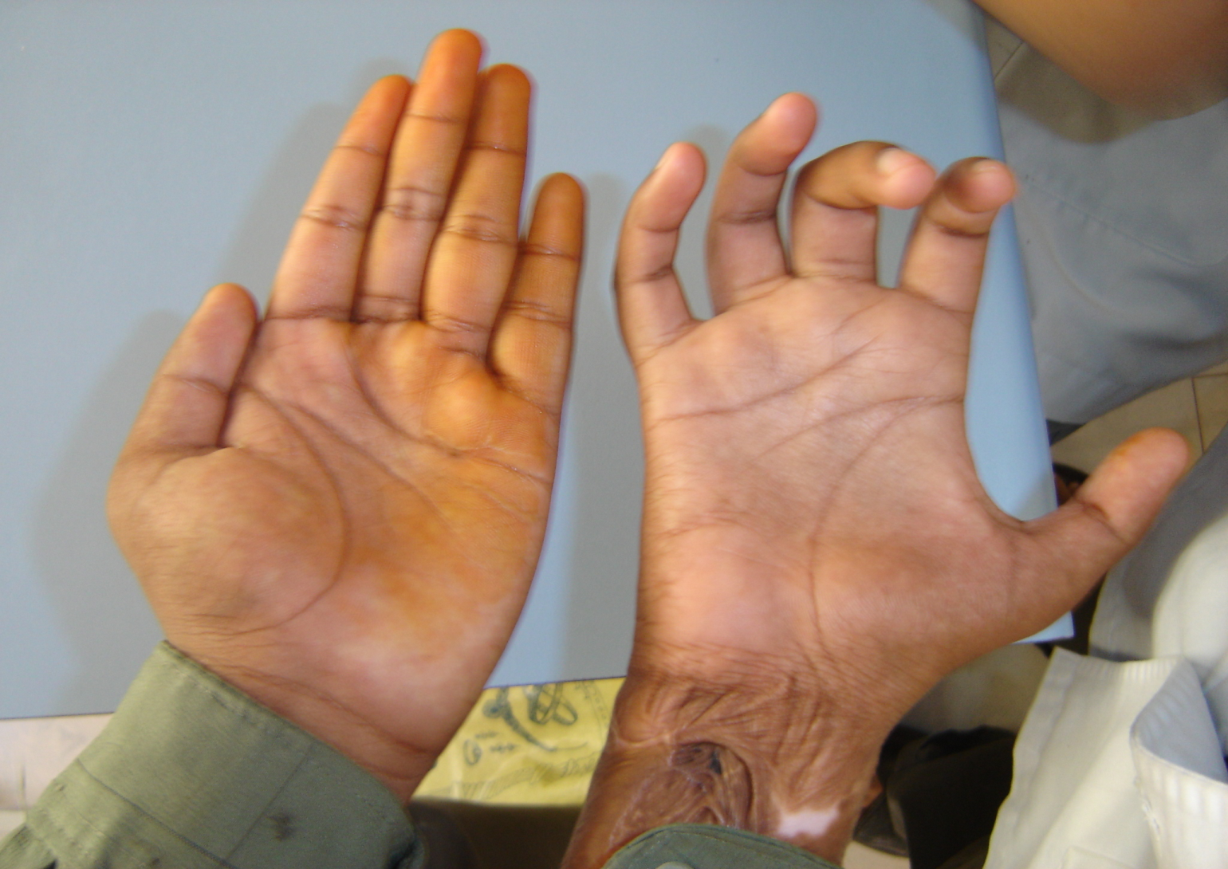
Wartenberg’s sign:

Slide 29
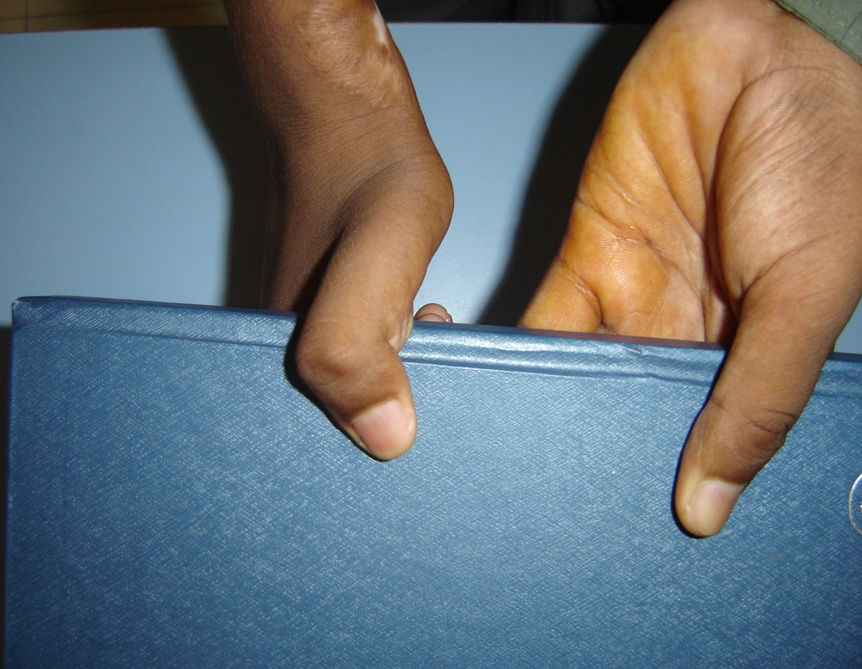
7.Loss of distal stability &rotation for tip pinch b/w thumb & index finger:
Froment’s sign(1915):

Slide 30
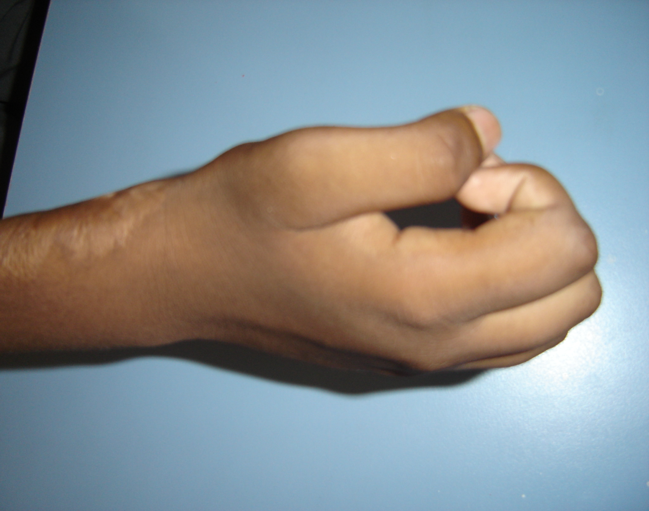
Bunnel’s “O” sign:

Slide 31
SENSORY:
Volar side of little finger &ulnar aspect of volar side of ring finger
Dorso-ulnar aspect of palm & dorsal side of little finger

Slide 32
MANAGEMENT
NERVE REPAIR & NERVE GRAFTING:
- conservative
- early exploration
- late exploration

Slide 33
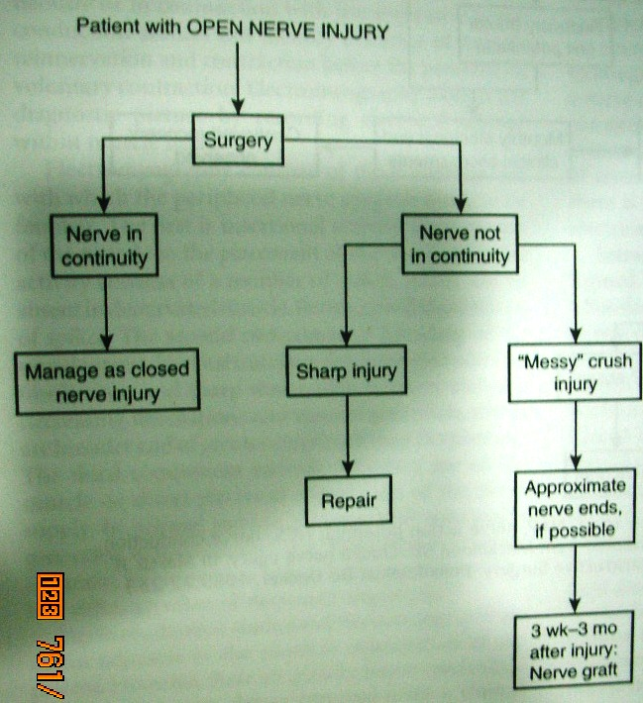
Plan for open nerve injury

Slide 34
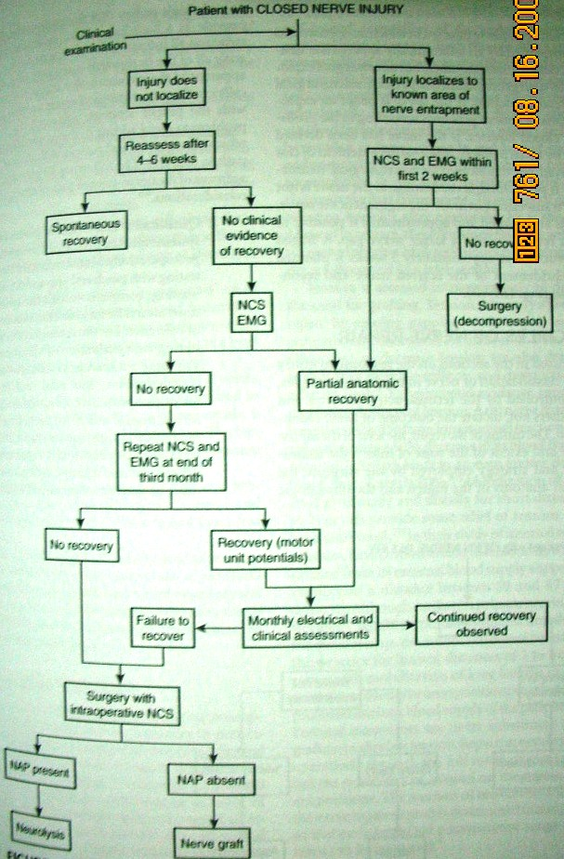

Slide 35
Consideration before surgical intervention
Lifesaving or limb saving measures come first
In late cases, indolent wounds & infection must be cleared
Deep scar offer hostile bed to nerve graft
Static or dynamic splinting is helpful to patients by diminishing their disability, by giving an indication of what is hoped to be achieved

Slide 36
Principles of nerve repair
Ten principles of nerve repair :
  Quantitative assessment of motor & sensory system both preop & postop
  Microsurgical tech including proper magnification, instrumentation & microsutures must be employed
  Tension free repair
  Primary repair is performed when feasible
  Nerve graft if nerve gap > 2 – 2.5 cms

Slide 37
Principles of nerve repair
Ten principles of nerve repair ( contd ) :
  Postural maneuvers cannot substitute for a tension- free repair
  Group fascicular repair preferred
  Repair is delayed for minimum of 3 wks when zone of injury is poorly defined in the acute evaluation
  Postoperative early movement within protected range allows gliding of nerve & prevents secondary traction injury from scar tissue
  Preop physical theraphy maintains range of motion & avoids contracture of joints & muscle- tendon units

Slide 38
Principles of nerve repair
Aim is tension free nerve to nerve or nerve to graft approximation
Tension leads to increased fibrotic reaction & deranged attempts of regeneration at the repair site due to ischemia
8% elongation cause decreased blood flow
10-15% occlude all blood flow
Total ischemic time >8hrs – axonal loss & necrosis

Slide 39
Treatment options
Direct suturing :
used when interleison distance is short
Primary suture = within 5 days
Delayed primary = upto 3wks
Secondary suture = after 3wks
Advantage : use only injured nerve
must use non irritative suture & no tension on nerve on suture line

Slide 40
Treatment options
Epineural vs Fascicular repair :
The internal organisation of nerves is different in the proximal extremity compared to the distal aspect
Nerves in proximal extremity are monofasicular & each fasicle contains motor & sensory fibres
As nerve progress distally --- polyfascicular & fascicular further differentiated into motor & sensory components

Slide 41
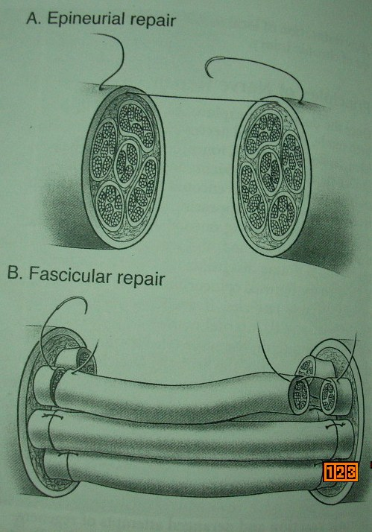
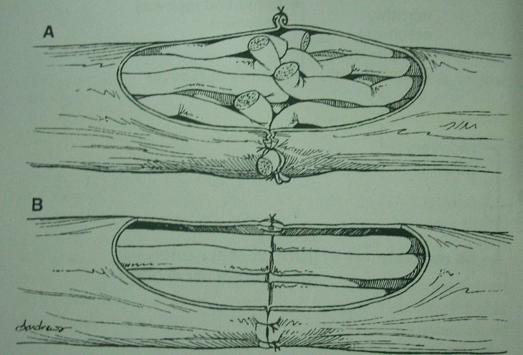
Epineural repair
Dia.g&s 80

Slide 42
TENDON TRANSFERS
1. Indications
- Late cases
- Expected poor outcome of nerve repair
- Irreparable nerve lesion

Slide 43
EARLY TENDON TRANSFER
Improves function more in dominant hand
As few tendon transfer are required to maintain dynamic positions for functional co-ordination & sensibility reeducation

Slide 44
INTERNAL SPLINTAGE
Thumb adduction for key pinch
Proximal phalanx flexion of ring & little finger
MC transverse arch & adduction for little finger
Thumb index tip pinch
Radial half of ring FDS to adductor tubercle
Ulnar half of ring FDS with split insertion to A2 pulley or rad lat band of dorsal extensor apparatus
“Y” insertion of two half of ring FDS
Arthrodesis of thumb MP joint at 15* flexion

Slide 45
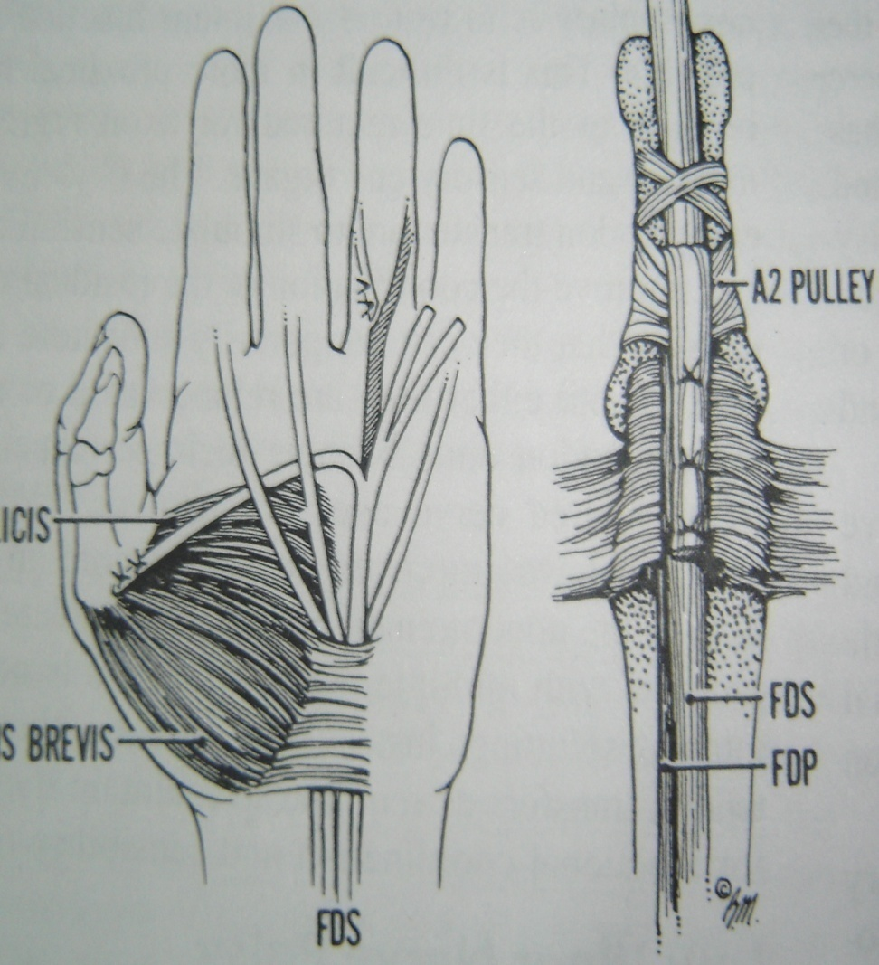
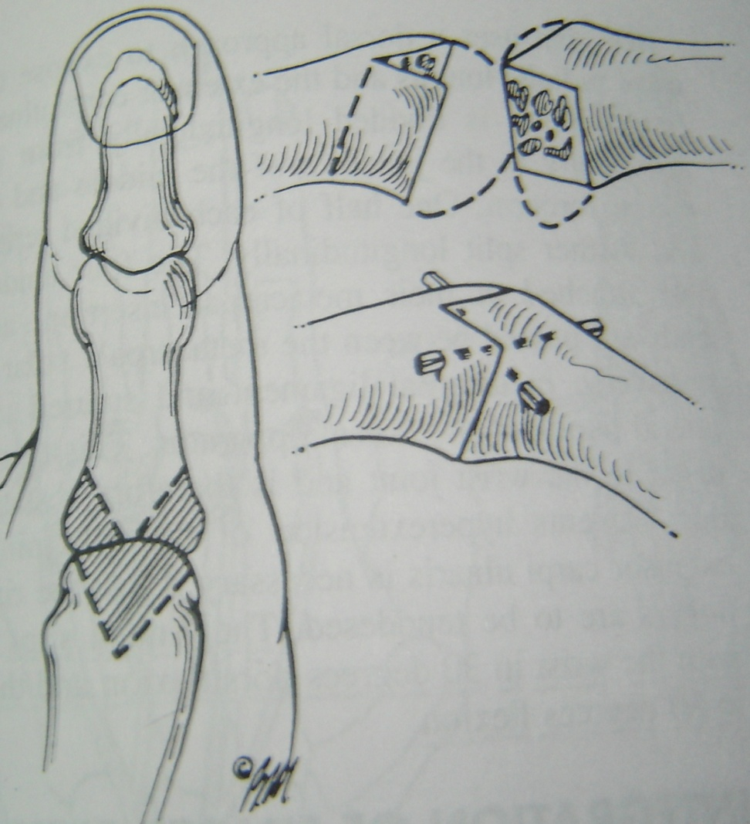
DIAGRAMS

Slide 46
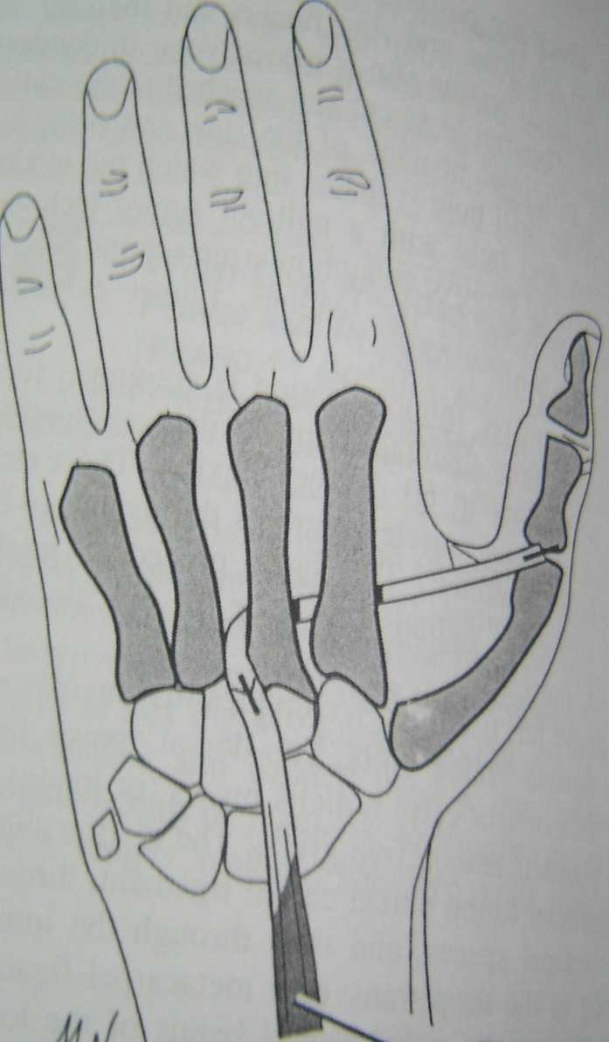
LATE TENDON TRANSFER Low ulnar nerve palsy
THUMB ADDUCTION FOR KEY PINCH:
ECRB with free tendon graft b/w 3rd &4th MC to adductor tubercle of thumb
FDS to abductor tubercle of thumb with palmar fascia as pulley

Slide 47
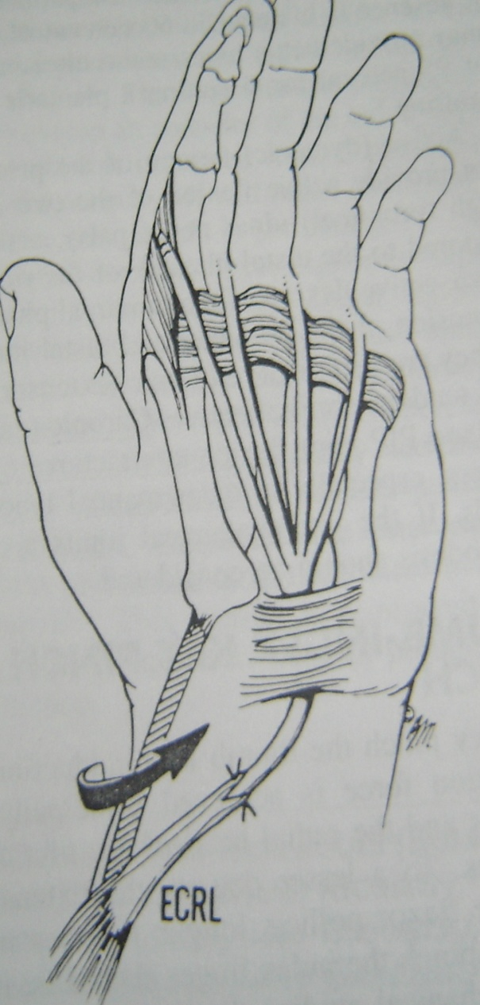
Proximal phalanx power flexion & integration of MP &IP Motion
ECRL with four tailed free tendon graft passed volar to deep transverse MC lig. to A2 pulley or radial band of dorsal apparatus

Slide 48
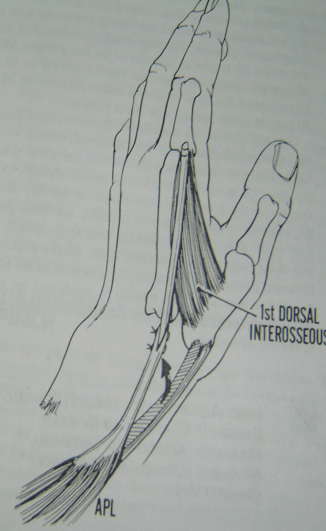
Thumb index tip pinch
Accessory slip of APL to 1st dorsal inteross tendon,arthrodesis of MP joint of thumb
EPL to 1st dorsal interosseous tendon(if thumb MP joint artherodesed

Slide 49
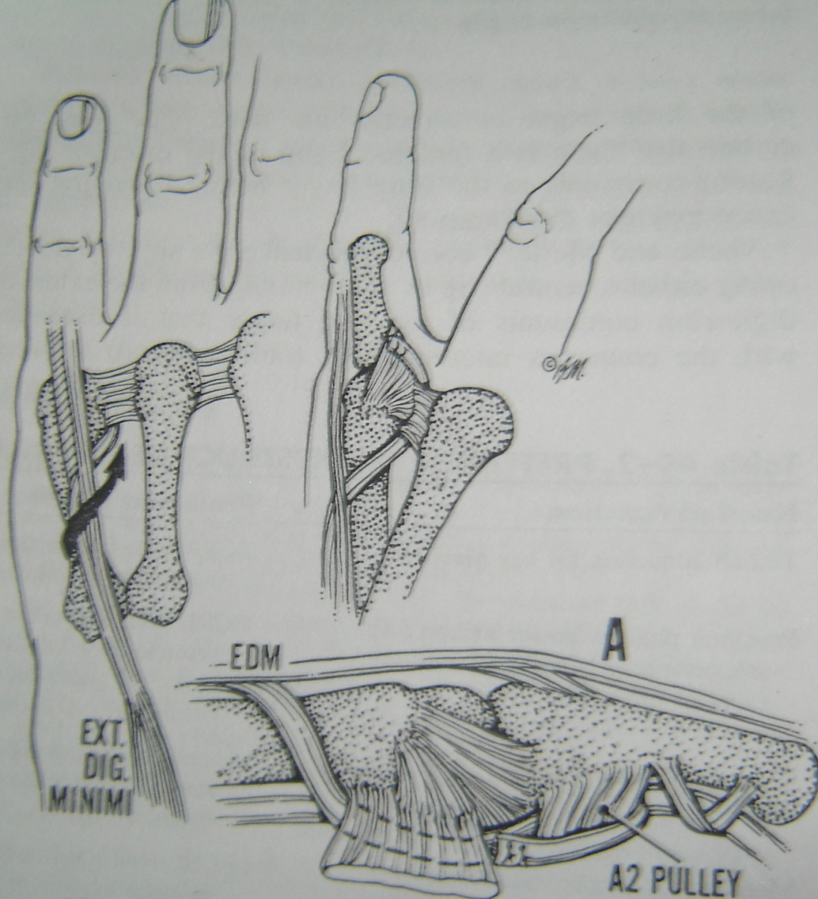
MC transverse arch & adduction for little finger
EDM tendon split & ulnar half transferred volar to deep transverse MC lig to redial collateral lig of proximal phalanx
If little finger clawed as well as abducted insert ulnar half of EDM to A2 pulley

Slide 50
CLAW HAND
Due to combined paralysis of interossei of all fingers and lumbricals of ring and little fingers.
Intrinsic muscle flex MP and extend PIP & DIP joints of the fingers, and loss of their resting tone results in the ‘intrinsic-minus’ posture of hyperextension at MP joint and flexion at IP joints.
Clawing due to isolated ulnar nerve disease- Most marked in ring and little finger.
In addition to static deformity, loss of intrinsic muscle function may affect normal dynamics of finger movement.

Slide 51
REPAIR OF CLAW HAND
STATIC TECHNIQUES- Prevent hyperextension of MP joints by either shortening their palmar capsules or creating ‘check rein’ ligament or tenodeses.
Corrects clawing of fingers only if passive flexion of MP joints causes extension of their PIP joints (Bouvier’s Maneuver)
Significant fixed flexion deformities of IP joints need to be corrected with therapy, splinting or release.
Avoid tendon transfers- spares potential motors for other transfer.
Do not restore normal pattern of finger flexion

Slide 52
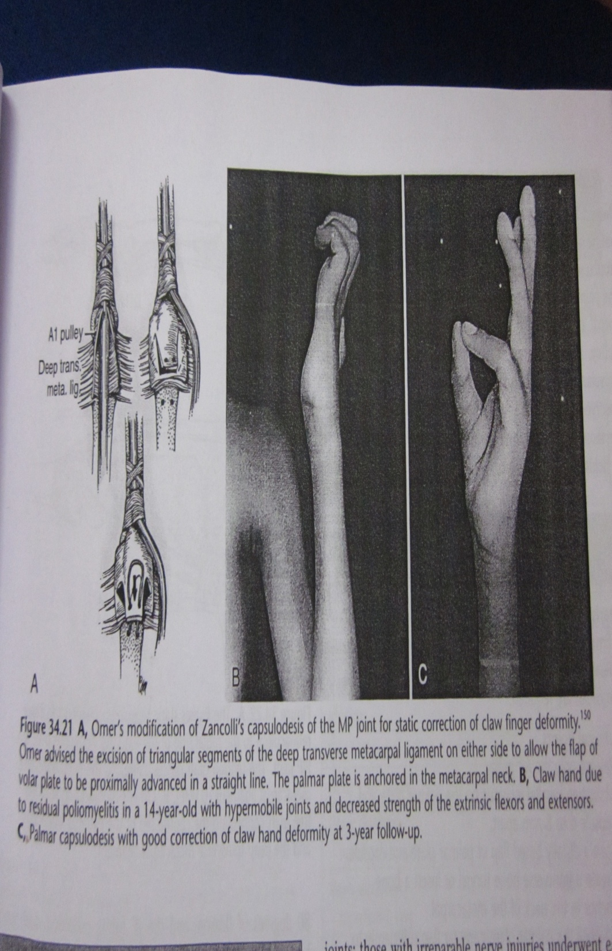
Palmar Capsulodesis of Metacarpophalangeal joint(Zancolli’s Technique)
Omer_ modified Zancolli's technique by cutting away a triangular portion of the deep transverse metacarpal ligament on each side of the palmar plate flap

Slide 53
DYNAMIC TENDON TRANSFER
Whichever muscle is selected as motor for transfer
Pass palmar to axis of rotation of finger MP joint to achieve MP joint flexion
Done by passing transfer palmar to trnsverse metacarpal ligament.

Slide 54
Various Methods-
FDS tendon transfer
Extensor Indicis Proprius & EDM Transfer
ECRL Transfer

Slide 55
Superficialis Tendon Transfer Technique & modifications
Stilles first described dynamic tendon transfer . Transferred one slip of each superficialis tendon into the corresponding extensor digitorum tendon over the proximal phalanx.
Bunnell modified their transfer by rerouting both slips of all the superficialis tendons through the lumbrical canals and anchoring them to both the radial and ulnar lateral bands of the extensor mechanism (Stiles-Bunnell procedure). Aim was to correct the claw deformity and restore MP abduction and adduction

Slide 56
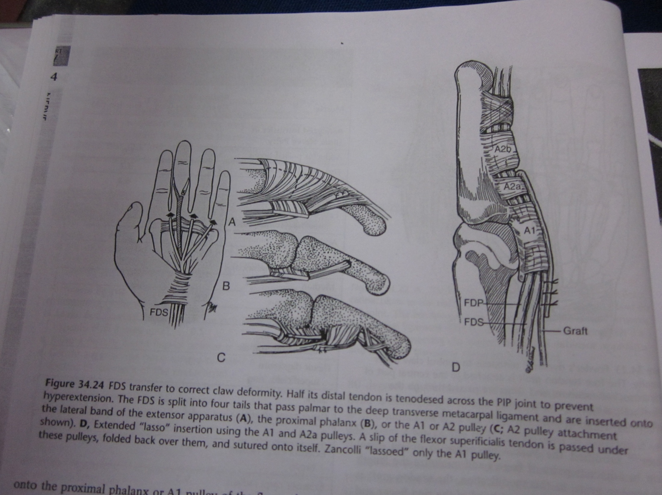

Slide 57
Littler_ modified the Stiles-Bunnell procedure by using only one superficialis tendon (usually the middle finger. The FDS of the middle finger is detached through an incision on the lateral side of the middle finger PIP joint, and its distal end is brought into a palmar incision and split lengthwise into four equal slips. One slip is passed through the lumbrical canal of each finger, palmar to the deep transverse metacarpal ligament, and is sutured onto the radial lateral band of the extensor apparatus

Slide 58
Burkhalter_ Inserted the superficialis slips onto the proximal phalanx in patients with traumatic ulnar nerve palsy to avoid the risk of PIP joint hyperextension, which may occur when the transfer is attached to the lateral band of the extensor apparatus
Riordan_ Recommended attaching the tendon slips to the A1 pulley if the PIP joints are lax and hyperextended
Zancolli_ looped the tendon slips beneath the entire A1 pulleys (lasso technique).

Slide 59
Omer_ Preferred the A2 pulley over the A1 pulley as the insertion site to increase the force of MP flexion.
Anderson and Oberlin_ Performed “extended pulley insertions,” looping a slip of the superficialis tendon around both the A1 and the proximal portion of the A2 (A2a) pulleys in each finger
Shah_ Modified the superficialis transfer and addressed only clawing of the ring and little fingers

Slide 60
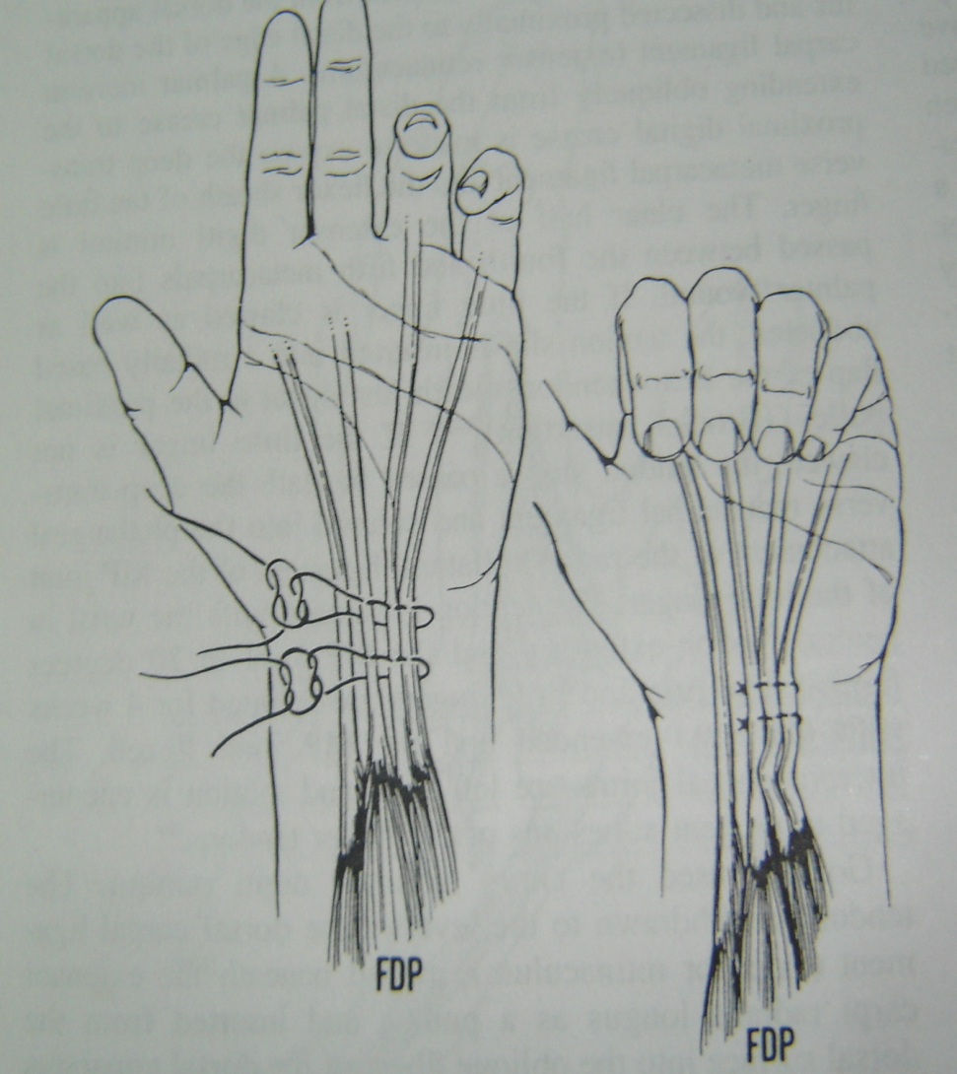
HIGH ULNAR NERVE PALSY
DISTAL FINGER FLEXION RING & LITTLE FINGER
FDP (long) tenodesed to FDP of ring &little finger with tenodeses of distal IP joints in ring &little finger

Slide 61
HIGH ULNAR NERVE PALSY (CONT.)
WRIST FLEXION - ULNAR SIDE:
FCR to insertion of FCU or
PL to insertion of FCU
VOLAR SENSIBILITY FOR FINGERS:
proximal median digital nerve translocated to distal ulnar nerve
free/vascularized nerve graft

