Slide 1
Etiopathology of otosclerosis

Slide 2
Levels of Evidence
Grade A – Systemic reviews, Meta analyses, RCT
Grade B – Non-randomised studies
Grade C – Observational studies
Grade D – Case Series, Expert opinion

Slide 3
Evidence scoring
**** systematic reviews, Meta analysis of RCT
*** Non –randomised studies
** Observational studies
* Expert opinion

Slide 4
Definition
“ it is a localised hereditary disorder affecting endochondral bone of otic capsule characterised by disordered resorption and deposition of bone.”

Slide 5
Clinical otosclerosis-
Stapedial otosclerosis –
Histological otosclerosis-
Cochlear otosclerosis-

Slide 6
Clinical otosclerosis—
“ a lesion involving stapes bone or stapedovestibular joint”
Clinically – CHL

Slide 7
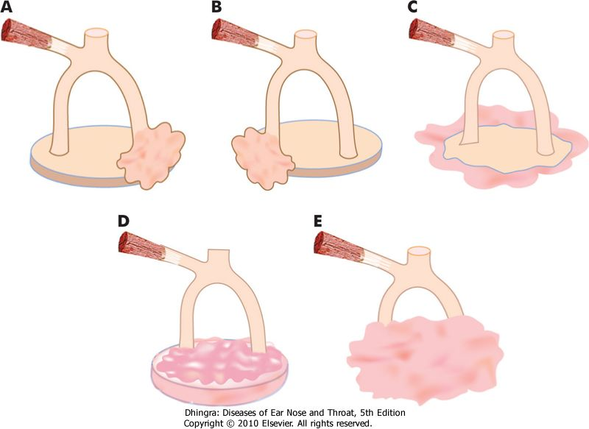
Anterior focus
Posterior focus
Circumferential
Biscuit type
Obliterative type

Slide 8
Histologic otosclerosis-
a lesion that does not involve the stapes bone, stapedovestibular joint or cochlear endosteum.
It is asymptomatic
Diagnosed only on PM studies.

Slide 9
Cochlear otosclerosis:
Occurrence of pure sensori neural hearing impairment due to otosclerosis.
There is no conductive component to cause hearing impairment(stapes fixation).

Slide 10
PATHOLOGY

Slide 11
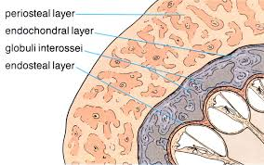
Bone of otic capsule is unique.
It undergoes very little remodelling and contains small regions of immature cartilagenous tissue called (****/***) ‘globuli interossei’.

Slide 12
(***/**) evidence suggest that otosclerosis is simply the process of bone modelling and remodelling within otic capsule.
It appears distinct within the otic capsule on histological sections, as otic capsule undergoes minimal remodelling normally.

Slide 13
An otosclerotic lesion consists of areas of
Bone resorption, new bone formation, vascular proliferation and connective tissue stroma.

Slide 14
‘ Blue Mantle’–
Earliest histological change.
Areas of otic capsule that stain more basophilic than normal.

Slide 15
There is resorption of enchondral bone , increase in perivascular spaces , deposition of immature(woven) bone .
With time remodelling occurs with mature (lamellar) bone.

Slide 16
Process of resorption is mediated by osteoclasts .
Process of deposition is mediated by osteoblasts.
Proliferation of blood vessels is seen in active otosclerosis.

Slide 17
Other features
Connective tissue stroma of histocytes and fibroblasts.
Absence of acute inflammatory cells or polymorphonuclear cells.
Other cells like osteocytes and bone lining cells may contribute to calcium flux.

Slide 18
Factors affecting remodelling
Growth factors
Cytokines
Ecosanoids
Enzymes
Free radicles
Failure of regulation of one or more factors.

Slide 19
Aetiological agents
Genetic mutation
Measels virus infection
Auto immunity
Biochemical changes
may be responsible for triggering failure of regulation

Slide 20
Distribution of otosclerotic lesion
Area anterior to oval window 80-90%(****)
Round window niche -30%
Apical medial wall of labyrinth -15%
Stapes foot plate -12%
Posterior to oval window-5-10% (contd…

Slide 21
Other sites involved ….
In decreasing frequency…
Walls of Internal auditory canal
Around vestibular and cochlear aqueducts
Around semicircular canals ,malleus, incus

Slide 22
Otosclerosis is not seen in bones outside temporal bones(***)
Usually bilateral
Single or multiple foci
Multiple foci unite to form extensive lesion
Lumen of Facial canal ,lumen of internal auditory canal – never invaded

Slide 23
Pathology of CHL
Stapes involvement can lead to a CHL ranging from 5-60 dB.
Foci anterior to oval window – fibrous fixation of stapes—30 dB HL
Localised bony fixation of stapes- 30-40 dB HL
Diffuse bony ankylosis involving entire circumference of annular ligament > 40dB

Slide 24
Schwartze’s sign—
Due to cytokines, angiogenic factors , chemical mediators .
Excessive vascularity within the mucosa over promontory & oval window causes a red vascular blush visible on otoscopy.

Slide 25
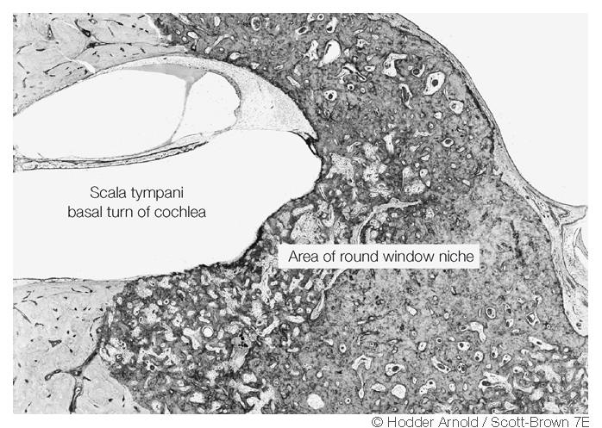
Otosclerotic lesion can invade oval window niche .(****)
Complete obliteration of round window, (means stapes surgery will not help).
It can be diagnosed by HRCT temporal bone

Slide 26
Pathology of sensorineural HL
SN loss occurs when the lesion reaches the endosteum of cochlea.
Hyalinization of spiral ligament
Fibrocytes in spiral ligament form channels for flow of ions and metabolites and maintain ionic haemostasis of cochlea.
Otosclerotic lesion --> diffuse cytokine --> disrupt ion hemostasis--> SN Loss

Slide 27
Pathology of vestibular symptoms
Non specific dizziness or unsteadiness
Recurrent attack of vertigo
(***/**) study by Saim & Nadol ⁽¹⁾ 118 otosclerotic patients–
Scarpa’s ganglion cell count were less.
Degeneration could be due to soluble toxic substance released by otosclerotic bone or change in inner ear fluid.

Slide 28
Aetiology

Slide 29
Genetic predisposition
More common among whites
Less among asians
Rare among blacks
Familial cases – monozygotic twins
Spordiac cases , later birth order
Defect in expression of COL 1A1 gene

Slide 30
COL 1A1
Reduced expression of COL1A1 gene .
Association increases from 3 prime to 5 prime
Similar to osteogenesis imperfecta type 1

Slide 31
measels
Ultra structure and immunohistochemistry evidence .
Measels like structure and antigenecity in active otosclerotic lesion.
Measels RNA in fresh footplate species.
Elevated level of anti-measels antibody in perilymph .

Slide 32
Autoimmune disease
Humoral autoimmunity to type II collagen
Elevated levels of Circulating antibodies to type II collagen.
Immunohistochemistry of stapes foot plate shows tissue bound Ig-G inactive lesions.

Slide 33
Biochemistry
Changes in mucopolysaccharide composition in fragments of stapes foot plate .
Bone cells synthesise lesser amount of glycosaaminoglycans.
….. may be due to active remodelling process and an intrinsic factor for dev. of otosclerosis.

Slide 34
NAME OF STUDY | NAME OF AUTHOR | REFERENCE DETAILS | RESULT | CONCLUSION
A fifth locus for otosclerosis, OTSC5, maps to chromosome 3q22–24 | K Van Den Bogaert¹, E M R De Leenheer²,³, W Chen⁴, Y Lee⁵, P Nürnberg⁵, R J E Pennings², K Vanderstraeten¹, M Thys¹, C W R J Cremers², R J H Smith⁴, G Van Camp¹ | J Med Genet 2004;41:450-453 doi:10.1136/jmg.2004.018671 | Identification of new otosclerosis loci will increase the possibility of detecting the first otosclerosis-causing gene in the near future | Characterisation of these genes will give us increased knowledge regarding the underlying molecular pathway of otosclerosis and of the otic capsule in general.

Slide 35
Q-1The part most commonly involved in otosclerosis is:
A) oval window
B) Round Window
C) tympanic membrane
D) Malleus

Slide 36
Q-2In majority of cases with otosclerosis the tympanic membrane is:
A) steroids
B) antibiotics
C) fluorides
D) vitamins

Slide 37
Q-3 Schwartz sign is seen in:
A) glomus jugulare
B) otosclerosis
C) meniere’s disease
D) acoustic neuroma

Slide 38
Q-4 Most common site of initiation of otosclerosis
A) foot plate of stapes
B) margins of stapes
C) fissula antefenestrum
D) fissula post fenestrum

Slide 39
Q-5 In majority of cases with otosclerosis the tympanic membrane is:
A)Normal
B) Flamingo Pink
C) blue
D) yellow

Slide 40
Thank you

