Slide 1
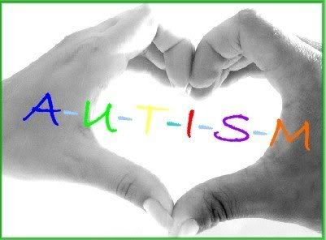
Autistic spectrum disorders
Faculty : Dr. C. Rathore

Slide 2
Scheme of presentation
Introduction
Historical aspects
Epidemiology
Etiology
Clinical features
Specific disorders
Diagnosis
Management
Summary

Slide 3
Introduction
Autism spectrum disorders (ASD) are severe, neuropsychiatric disorders characterized by impairments in social interaction, deviances in communication, and restricted or stereotyped patterns of behavior and interests .
    The terms ‘autistic’ and ‘autism’ are derived from the Greek word ‘autos’, which means self .

Slide 4
Introduction
Autism the third most common developmental disorder
1 child in every 150 newborns has an autistic spectrum disorder.
1 in 88 children had an ASD , based on children who were 8 years old in 2008 .
Autism is as common in India as it is elsewhere in the world.
The majority of children with autism in India have not received a diagnosis or any intervention.

Slide 5
Introduction
Initially used to designate only the most severe cases
Now include children with a range of different levels of functioning,
From individuals with profound mental retardation and little or no speech or communication,
To more verbal, functionally able children, many of whom are being educated in mainstream environments.

Slide 6
Uneven skill development is the hallmark of autism.
In some areas the child may show age-appropriate skills,
In some areas the skills may be below the developmental level .
Strengths are seen in non-verbal abilities and weaknesses in verbally mediated tasks.
Isolated savant skills may be present, such as musical or drawing abilities or date calculations

Slide 7
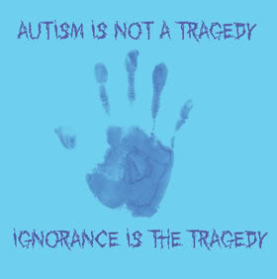
Many myths and misconceptions about autism still prevail.
In many countries of the world, most of the public—as well as many professionals—are still unaware of
how it affects people,
how to best work with individuals with autism.
Including those in the medical, educational, and vocational fields.

Slide 8
History of autism
The disorder was first described in 1943 by Leo Kanner Johns Hopkins Hospital in Baltimore, USA.
He described a pattern of behaviour , he called ‘early infantile autism’.
Landmark paper ‘‘Autistic disturbances of affective content,’’ Leo Kanner presented medical histories for 11 physically normal- looking children: eight boys and three girls.

Slide 9
In 1944 Asperger wrote his first paper on a different, but related, behavior pattern in boys with a similar but milder form of the disorder .
He called ‘autistic psychopathy’ now referred to as Asperger’s syndrome.

Slide 10
HISTORY
Initial history of autism was heavily influenced by psychoanalytical theory.
Etiology blamed were
Parents’ attitudes to their children, Their personalities and Child rearing methods
Attributed to ‘‘refrigerator parents’’ who were unable to relate appropriately to their children
Was regarded as an emotional disorder without any neurological basis.

Slide 11
Concept Changed in the 1960s for two main reasons -
1. Groups of parents in the USA and the UK, firmly rejected the idea that they were to blame for their children’s problems, came together to form voluntary associations.
2.The development of scientific research into autism.
Autism is now seen as a disorder of the developing brain, mainly genetic in origin and part of a wider spectrum of disorders.

Slide 12
The current triad (social, communication, behaviour impairments) concept was launched by Lorna Wing .

Slide 13
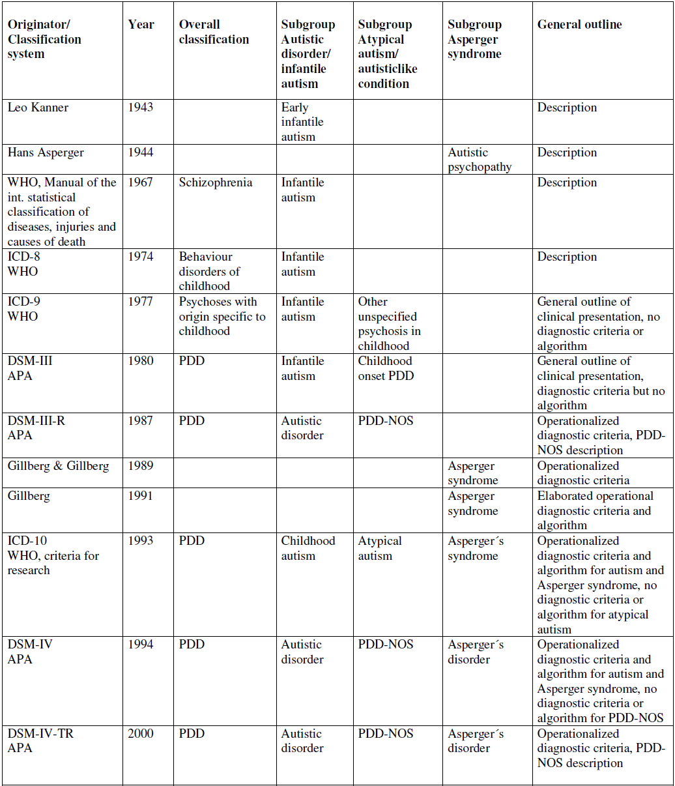

Slide 14
DSM-IV and ICD 10 – Pervasive Developmental Disorders(PDD) --- umbrella term that refers to a group of conditions
Autistic Disorder,
Rett’s Disorder,
Childhood Disintegrative Disorder,
Asperger’s Disorder,
Pervasive Developmental Disorder- Not Otherwise Specified (PDD-NOS)

Slide 15
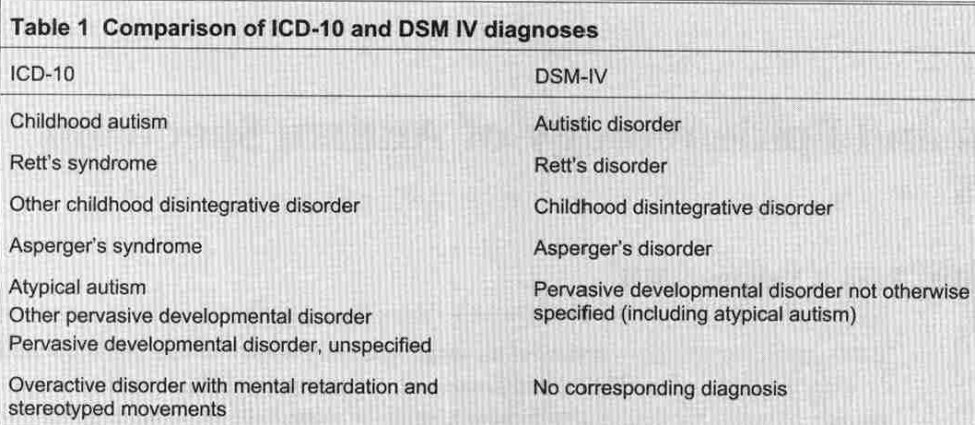

Slide 17
The phrase ‘‘autistic spectrum disorder’’ (ASD) first surfaced in 1983 as part of the workshop ‘summary on the diagnosis of autism and related disorders’ .
Collective term for the set of disorders regarded as PDD
Called as spectrum because the presentation and outcome can vary from an independent, almost normal- looking and high functioning child to a totally dependent child with multiple disabilities.

Slide 18
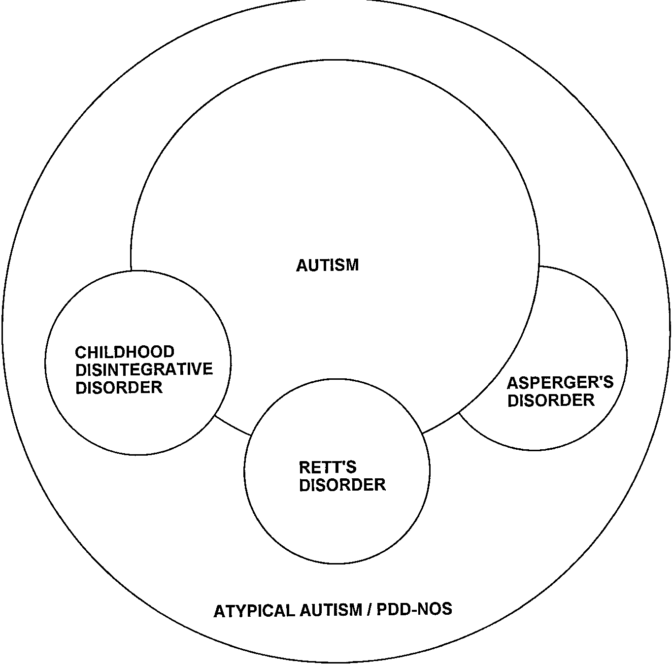

Slide 19
Delay in developmental milestones is the characteristic of mental retardation, deviation is the characteristic of autism.

Slide 20
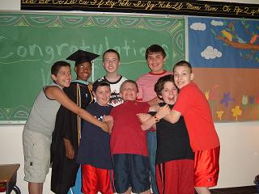
EPIDEMIOLOGY

Slide 21
The prevalence of autism is approximately four times higher in males than in females
Higher ratio in milder forms of ASD.

Slide 22
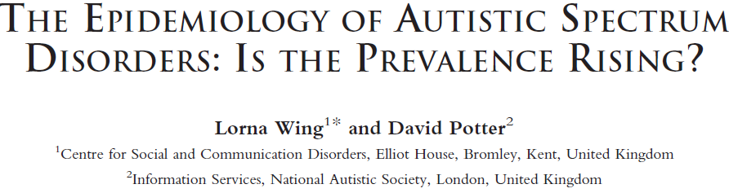
For decades after Kanner’s original paper in 1943, considered to be a rare condition with a prevalence of around 2–4 per 10,000 children .
In the late 1990s and the present century reported annual rises in incidence of autism .
Prevalence rates of up to 60 per 10,000 for autism and even more for the whole autistic spectrum disorders

Slide 23
Possible reason for increase in prevalence
Changes in diagnostic criteria,
Development of the concept of the wide autistic spectrum,
Different methods of diagnosis used in studies,
Growing awareness and knowledge among parents and professional workers
Development of specialist services,
The possibility of a true increase in numbers .

Slide 24
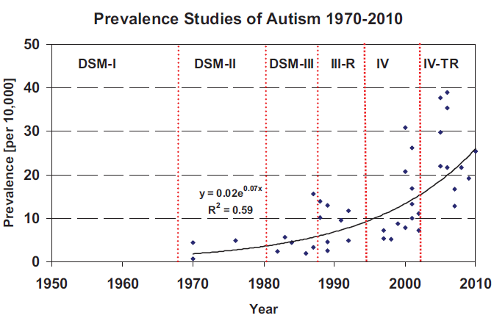
Nosology and Epidemiology in Autism:Classification Counts ;GENE S. FISCH; American Journal of Medical Genetics Part C (Seminars in Medical Genetics) 160C:91–103 (2012)

Slide 25
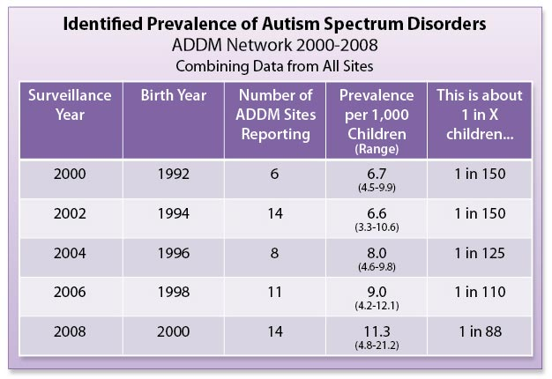
Centers for Disease Control and Prevention (CDC),U.S. Department of Health and Human Services

Slide 26
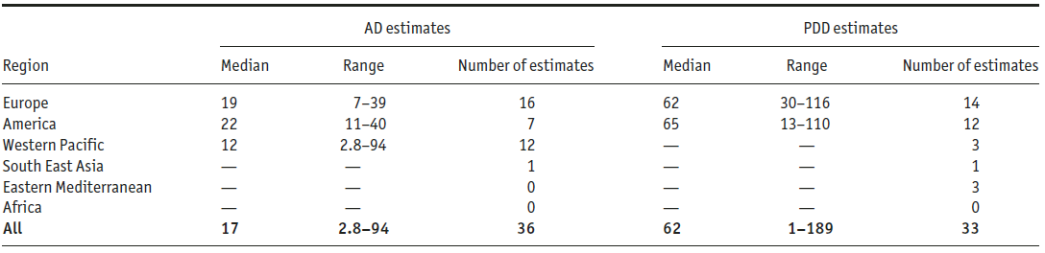
Prevalence Estimates of AD and PDD Across World Regions Since the Year 2000
Autism Res 2012, 5: 160–179. © 2012 International Society for Autism Research

Slide 27

Community Report From the Autism and Developmental Disabilities Monitoring (ADDM) Network-
Autism Spectrum Disorder (ASD) Prevalence, 2008
Number of 8-year-old children identified with ASDs: 3,820
Overall prevalence of ASDs: 11.3 per 1,000 (or 1 in 88)
Range of prevalence estimates across sites: 4.8 to 21.2 per 1,000
Boys: 18.4 per 1,000 (or 1 in 54)
Girls: 4.0 per 1,000 (or 1 in 252)
U.S. Department of Health and Human Services

Slide 28
Recurrence Rate
One child with autism in family: 20%
More than one child with autism: 37%

Slide 29
ETIOLOGY
Syndromic autism
~ 20% of cases with recognizable genetic syndrome
Non-syndromic or idiopathic autism
cases without a recognizable syndrome

Slide 30
Neurocognitive theories
Psychological models of autism—
1. Deficits in executive functioning skills, related to specific cortical mechanisms. This theory accounts for some of the difficulties in perseveration and set-shifting (Limitations: problems in this area not specific to autism ).
2. Weak central coherence- Difficulties integrating information into meaningful wholes. Many autistic individuals have fragmented learning style and difficulties in this area. (Supportive data are lacking )
THE LANCET • Vol 362 • October 4, 2003; Autism .The neurobiology of autism: Theoretical applications; Jessica H. Schroeder ; Research in Autism Spectrum Disorders 4 (2010) 555–564

Slide 31
3. Theory of mind
Characteristic problems in social interaction arise because of the difficulty in understanding phenomena in other people and oneself—ie, in intersubjectivity .
Unable to think about the intentions, desires, feelings, and beliefs of other people, and, therefore, have difficulties in social interaction .
Limitations include the strong relation of theory-of-mind abilities to language (many highfunctioning individuals with autism can complete usual theory of mind tasks and yet have striking social difficulties).

Slide 32
4.Mirror neuron system model
The ability to understand the intentions and actions of others depends upon an intact mirror neuron system(MNS), which is compromised in ASD.
The MNS functions as a sort of “neural Wi-Fi,” which allows an observer to understand the actions of another by activating the same regions of their brain as if they were performing the actions themselves through a process called simulation .
IFG (pars opercularis), the parietal lobe, STS, amygdala, striate cortex, and the cerebellum
Ramachandran and Oberman et al . 2007

Slide 33
Theory of Brain mechanisms
Clinical features strongly suggest brain involvement in autism
Seizures (various types, about 25% of cases),
Persistent primitive reflexes, delayed hand dominance
High rate of associated cognitive disability (about 75% exhibit mental retardation)
Neurochemistry
High peripheral serotonin concentrations (about a third of cases)

Slide 34
Theory of Brain mechanisms
Neuroanatomic
Fewer neurons and reduced dendritic arborisation in certain brain areas: amygdala, hippocampus, septum, anterior cingulate, and cerebellum
In animals, lesions in amygdala, hippocampus, or both produce some features of autism
Overall brain size in autism is increased by 2–10%

Slide 35
Neurophysiological
Failure to activate fusiform gyrus in response to faces
Abnormal ventral temporal cortical activity during face discrimination among individuals with autism and Asperger syndrome.
Arch Gen Psychiatry 2000; 57: 331–40

Slide 36
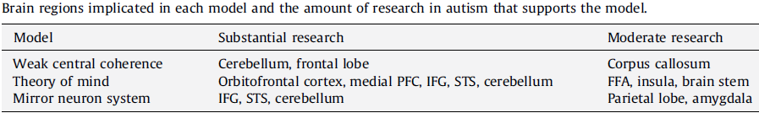

Slide 37
Genetic factors
Genetic basis of autism is well established, but the mode of genetic transmission is unknown
The clinical heterogeneity of ASD probably reflects the complexity of its genetic profile, involving multiple genes, genetic ⁄ locus heterogeneity, genetic imprinting, uniparental disomy, epistasis, and gene– environment interactions .

Slide 38
Autism Genome Project (AGP) --new genome-wide scan National Alliance for Autism Research and the National Institutes of Health,
single nucleotide polymorphisms (SNPs) arrays
microsatellite technologies

Slide 39
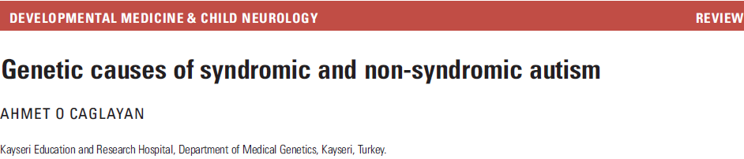
INHERITED AUTISTIC DISORDERS
variety of genetic mechanisms—single gene disorders, copy-number variations, and polygenic mechanisms .
monozygotic twin concordance rate (73–95%)
The highest heritability (90%, as estimated by twin studies),
Sizeable risk of occurrence in siblings (5 –6 ⁄ 100 in the case of non-syndromic autism).
Presence of mild autistic traits in the first-degree relatives of individuals with autism points to a strong genetic component

Slide 40
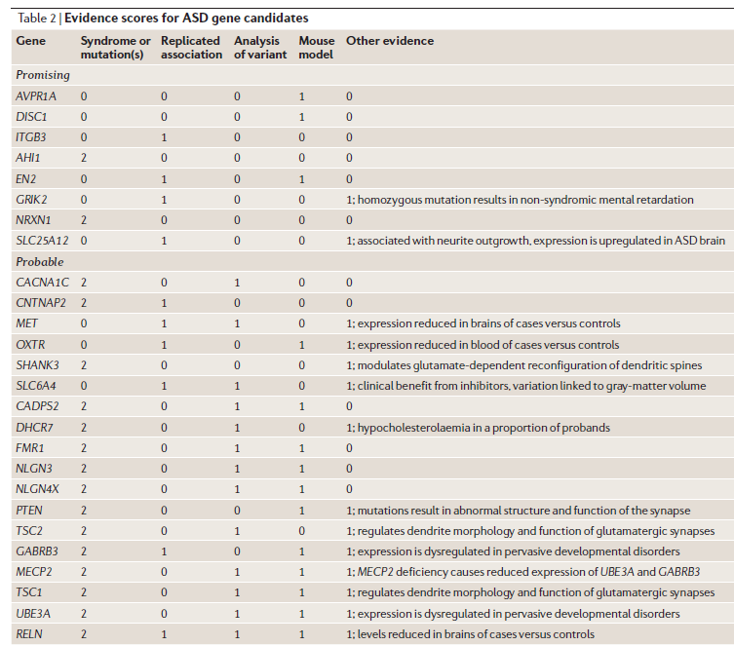

Slide 41
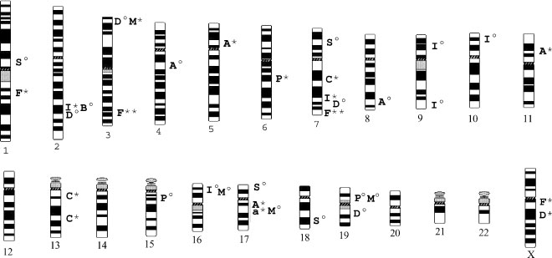
Nearly every chromosome has been found to contain a region of interest with quantitative trait loci(QTLs) for autism.
Is Autism a Polygenic Disorder?Gene S. Fisch;Am J Med Genet Part A 146A:2203–2212

Slide 42
Autism Candidate Genes
1.Genes whose products affect axonal targeting and pathfinding --- Cadherins and leucine-rich repeat proteins
2. Those that affect synaptic functioning -- Neurexins and neuroligins
3.Those that appear to affect dendritic function -- SHANK family of synaptic proteins

Slide 43
candidate genes analysis
Reelin (RELN)-- 7q22 , encodes a protein involved in neuronal migration during brain development.
Two neuroligin genes >NLGN3, Xq13, >NLGN4, Xp22.33 postsynaptic cell-adhesion proteins with an important role in mediating synaptogenesis and synapse remodeling.
CNTNAP2, a member of the neurexin family , SNP polymorphism
SHANK3 gene in the region 22q13 ,forms a network at glutamatergic synapses.
Serotonin transporter gene (SLC6A4), elevated whole blood and/or urine serotonin levels in autistic individuals and the responsiveness of autistic symptoms to treatment with serotonin transporter inhibitors

Slide 44
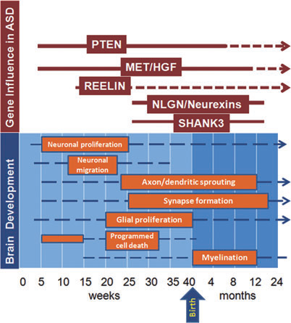

Slide 45
No genetic variants have been conclusively shown to contribute to autism susceptibility.

Slide 46
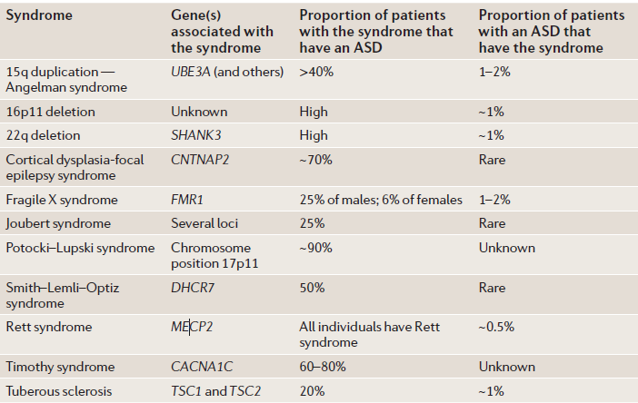
Syndromic autism

Slide 47
AUTISM IN GENETIC SYNDROMES
Fragile X syndrome - 90% of male children with FXS show one or more features of autism
prevalence of autism within the male FXS population is reported to range from 1.5 ⁄ 100 to 3.3 ⁄ 100
FXS is diagnosed in almost 5 ⁄ 100 of individuals with autism.
Screening for FXS in autistic boys

Slide 48
AUTISM IN GENETIC SYNDROMES
Rett syndrome--X-linked dominantly inherited postnatal neurodevelopmental disorder
mutations in the gene encoding methyl-CpGbinding protein 2 (MeCP2).
severe cognitive impairment , by age of 15 years -1 in 8000 females
develop normally up to the age of 6 to 18 months (stage I )
In stage II (age 1–4y), individuals display a developmental arrest --social withdrawal and loss of language , irritability and self abusive behaviour and other autistic features also manifest

Slide 49
AUTISM IN GENETIC SYNDROMES
Prader–Willi syndrome
Individuals with PWS exhibit repetitive behaviour and social deficits
ASDs diagnosed in up to 25 ⁄ 100 of affected individuals, risk of autistic symptomatology is greater in maternal uniparental disomy .
Angelman syndrome--virtual absence of speech, impaired use of non-verbal communicative behaviours (such as facial expression), attention deficits, hyperactivity,feeding and sleeping problems, and delay in motor development.
Autistic features are considered as a comorbidity

Slide 50
AUTISM IN GENETIC SYNDROMES
Tuberous sclerosis complex
An autosomal dominant inherited
mutations in one of the tumour suppressor genes TSC1 or TSC2
1 in 6000 births
Prevalence of TSC in the ASD population is 1-4 ⁄ 100
Autism present in 25 ⁄ 100 to 5 ⁄ 10 of individuals with TSC
incidence of autism does not differ between the sexes

Slide 51
Tuberous sclerosis complex
Likelihood of autism is greater if the child experiences early-onset West syndrome that are difficult to control, especially if there is an epileptic focus in a temporal lobe.
Very strong association between temporal lobe tubers and autism.

Slide 52
AUTISM IN GENETIC SYNDROMES
Turner syndrome --increased risk of autism.
Among affected females, the risk of ASDs is substantially higher .
200 times greater than among females with intelligence in the normal range .
Up to 10 times higher than in males .

Slide 53
AUTISM IN GENETIC SYNDROMES
Klinefelter syndrome--increased levels of autistic features across all dimensions of the autism phenotype
XYY syndrome language and motor development delay and an increased risk of autism
22q13.3 deletion syndrome severe neonatal hypotonia ,global developmental delay ,normal to accelerated growth , absent to severely delayed speech , autistic-like with poor eye contact, stereotypic movements,and self-stimulation.

Slide 54
Smith–Lemli–Opitz syndrome (SLOS), AR, multiple malformation syndrome , 7-dehydrocholesterol reductase (DHCR7) gene located on chromosome 11q12 to 13.
75%of children with SLOS met the criteria for some variants of ASD
It is a rare cause of ASD, accounting for no more than 1 ⁄ 100 of cases, and routine screening is not indicated

Slide 55
AUTISM IN GENETIC SYNDROMES
15q region is inv dup(15) or idic(15) syndrome. early central hypotonia, developmental delay and intellectual disability, epilepsy, and autistic behaviour with no facial dysmorphic features
Down syndrome-Autism is 10 times more common , manifests as a distinct behavioural phenomenon in Down syndrome as anxious behaviour and complex and unusual stereotypies .
Macrocephaly and overgrowth syndromes - Sotos syndrome, Simpson–Golabi–Behmel syndrome , Perlman syndrome and Beckwith-Wiedemann syndrome

Slide 56
AUTISM IN GENETIC SYNDROMES
Phenylketonuria- autism frequency ranging from 2.7 to 5.6 ⁄ 100 in individuals with phenylketonuria.
Adenylosuccinate lyase deficiency– clinical features ranging from fatal neonatal encephalopathy with hypokinesia to mild learning disability, with autistic features in about one-third of patients .
Duchenne muscular dystrophy--- 3.1 ⁄ 100 had ASD (Hendriksen and Vles et al , using a questionnaire-based study)
BMD-- frequency of autism was 8.3 ⁄ 100 ( Young et al. Prospective cohort study )

Slide 57
AUTISM IN GENETIC SYNDROMES
Mitochondrial cytopathies
Mitochondrial disease might be one of the most common medical conditions associated with autism . Correia et al
7 ⁄ 100 of children with ASD exhibited a mitochondrial respiratory chain disorder . Oliveira et al

Slide 58
Cerebral creatine deficiency syndromes (CCDS)
1.Two creatine biosynthesis disorders, *guanidinoacetate methyltransferase (GAMT) deficiency
* L-arginine:glycine amidinotransferase (AGAT or GATM) deficiency, 2. Creatine transporter (SLC6A8) deficiency.
Clinical presentation
Intellectual disability and seizures
Behavior disorder >> autistic behaviors and self- mutilation
Pyramidal/extrapyramidal findings .

Slide 59
Diagnosis of CCDS
Measurement of guanidinoacetate (GAA), creatine, and creatinine in urine and plasma
Molecular genetic testing of the three genes involved, GAMT, GATM, or SLC6A8.
If molecular genetic test results are inconclusive,
GAMT enzyme activity (in cultured fibroblast or lymphoblasts),
GATM enzyme activity (in lymphoblasts),
Creatine uptake in cultured fibroblasts

Slide 60
NEUROIMMUNITY, ENVIRONMENT AND
NON-GENETIC FACTORS IN ASD
Environmental factors -- maternal influences and exposure to neurotoxins and potential environmental pollutants
Epigenetic factors
Astroglial activation secondary to injury or in response to neuronal dysfunction, produce several factors that may modulate inflammatory responses
Increases in pro-inflammatory cytokines --MCP-1, IL-6 and TGFb1 --- in serum and brain .
Different factors eg, genetic susceptibility, maternal factors, prenatal environmental exposures >>> trigger neuroglial reactions

Slide 61
ENVIRONMENTAL FACTORS
Oxidative stress- decreased levels of antioxidants such as superoxide dismutase, transferrin and ceruloplasmin in the blood or serum of patients with ASD .
Advanced glycation end products have also been reported to be elevated in both the brain tissue and serum .
Maternal factors-- maternal autoimmune factors, transfer of maternal antibodies during early development could interact with fetal CNS proteins .

Slide 62
Autoimmunity in ASD
30–70% of autistic patients have circulating anti-brain autoantibodies
Antibodies to neruon-axon filament proteins (NAFP), cerebellar neurofillaments , myelin basic protein (MBP) , caudate nucleus ,serotonin receptor , brain endothelial cells , brain tissue (unknown antigens) .
Family history of autoimmune disorders is more common among children with autism than healthy control children .
Autoimmune enteropathies with specific antibodies targeted to gut epithelial cells in ASD .
Is autism an autoimmune disease?Paul Ashwood, Judy Van de Water, Autoimmunity Reviews Volume 3, Issues 7–8, November 2004, Pages 557–562

Slide 63
The role of xenobiotics in autism
Direct or indirect effects on the immune system and/or the developing CNS
Vaccines (mercury-containing Thimerosal --proved unassociated
Heavy metals --- lead and mercury

Slide 64
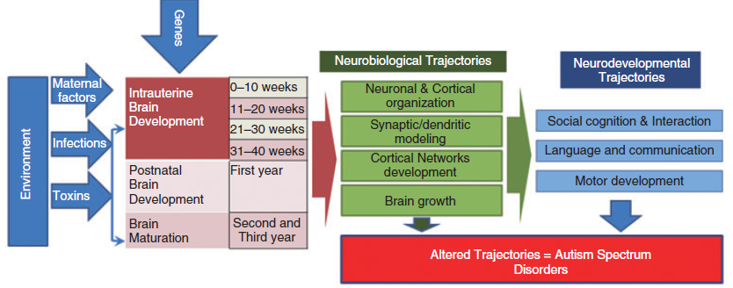

Slide 65
From DNA to Behavior: A Connected Sequence of Mechanisms
Abnormalities in Genetic Code for Brain Development
Mechanisms of Brain Development
Structural and Functional Abnormalities of Brain
Cognitive & Neurological Abnormalities
Behavioral Syndrome

Slide 66
The clinical onset of autism appears to be preceded by two phases of brain growth abnormalities:
Reduced head size at birth,
Sudden and excessive increase between 1–2 months and 6–14 months of age
Brain overgrowth --frontal lobe, cerebellum and limbic structures between 2 and 4 years of age,
Followed by abnormal slowness in brain growth

Slide 67
NEUROPATHOLOGY
Cytoarchitectural organizational abnormalities
unusual laminar cytoarchitecture with packed small neurons
3 different types of pathological abnormalities
(i) a curtailment of the normal development of neurons in the forebrain limbic system,
(ii) an apparent decrease in the cerebellar Purkinje cell population,
(iii) age-related changes in neuronal size and number in the nucleus of the diagonal band of Broca, the cerebellar nuclei and the inferior olive.

Slide 68
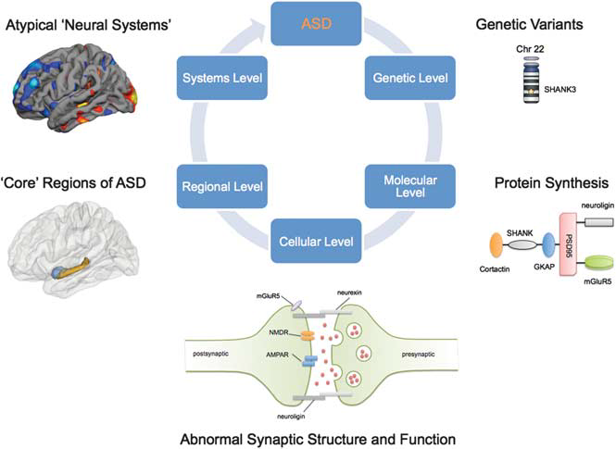
‘Neural systems’ condition , abnormalities in spatially distributed, large-scale cortical networks .
‘developmental disconnection syndrome.

Slide 69
Increased total GM brain volume is predictive of greater ASD severity .
GM thinning in mirror neuron system (pre-post central gyri, inferior frontal gyrus, medial frontal gyrus, middle temporal gyrus) has been correlated with social and communication deficits .
HFA patients have significantly smaller GM volumes in the subcortical, posterior cingulate and precuneus regions .

Slide 70

CLINICAL FEATURES

Slide 71
Features and sample behaviours required for diagnosis of autism
Qualitative impairment in social interaction
Impaired eye gaze
Lack of social reciprocity
Poor or absent joint attention
Limited or absent peer relationships
Qualitative impairments in communication
No language (no alternative compensatory means used to communicate)
If language spoken, involves echolalia, difficulties in pragmatic language
Lack of appropriate imaginative play

Slide 72
Features and sample behaviours required for diagnosis of autism
Restricted patterns of behaviour, interests
Abnormal preoccupations, interests, and activities
Difficulties with change
Stereotyped mannerisms
Onset before age 3 years
Problems in social interaction, communication or play

Slide 73
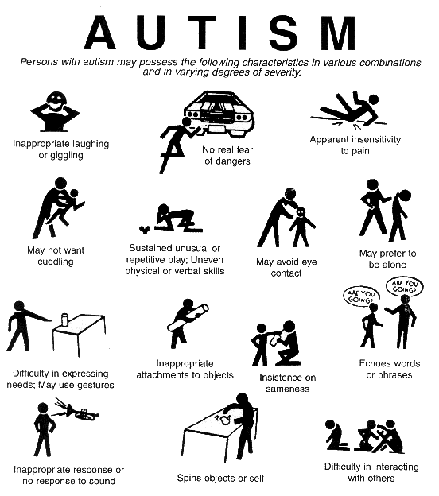

Slide 74
CLINICAL FEATURES
The clinical picture is affected by the individual’s level of ability, and the number and type of additional features or other disorders.
Age, sex, personality, and temperament
Social and physical environment,
Educational, psychological, and medical interventions

Slide 75
Very early indicators that require evaluation
No babbling or pointing by age 1
No single words by 16 months or two-word phrases by age 2
No response to name
Loss of language or social skills
Poor eye contact
Excessive lining up of toys or objects
No smiling or social responsiveness.

Slide 76
Later indicators
Impaired ability to make friends with peers
Impaired ability to initiate or sustain a conversation with others
Absence or impairment of imaginative and social play
Stereotyped, repetitive, or unusual use of language
Restricted patterns of interest that are abnormal in intensity or focus
Preoccupation with certain objects or subjects
Inflexible adherence to specific routines or rituals.

Slide 77
LANGUAGE
Delays in the development of language are the most common presenting complaint .
Many children with autism never speak at all .
Expressive language disorder--no speech or absence of communicative speech ,nonverbal communication at a higher level than verbal , pulling others by the hand and leading to what wants
limited reciprocal conversational speech , self-directed verbalizations, or speaking on topics of interest to self
Unusual intonation, screeching, odd noises, repetitive vocalizations, echolalia, idiosyncratic jargon , and pronoun reversal .

Slide 78
Stereotyped movements - more prominent after age 3 years
Hand flapping or finger flicking, body tensing ,body rocking, teeth grinding or clenching ,hand or finger movements, facial grimacing, repetitive running, twirling, or jumping
Stereotyped and repetitive play (e.g., spinning, flicking, throwing, lining up, sorting, opening and closing)
pacing, playing with saliva, picking at skin, hyperventilating
Unusual perceptual interests, such as examining objects out of the corner of the eye .

Slide 79
Mood Disturbance
Overreactivity, irritability, agitation, tantrums, aggression, self-injurious behaviour
Emotional lability with mood changes sometimes internally triggered (e.g., laughing or becoming upset for no apparent reason)
Flat affect, unresponsive in some situations
Unusual fears (e.g., elevators, steps, toilets)
ADHD-- 29% of group with autism had ADHD and 41% of children with ADHD met criteria for autism.

Slide 80
Sleep disorders– difficulty in sleep onset and waking times, frequent night waking, and fragmented sleep patterns, irregular sleep–wake cycle
Attachments to unusual objects, such as, string, metal toys
Preoccupied by non-functional features of play materials, such as taste or smell, or may involve them in stereotyped activities
Difficulties in development of symbolic-imaginative play

Slide 81
Disordered sensory perceptions
  >>unusually sensitive to loud noises.
  >>Ordinary sights, smells, tastes and touches - painful.
  >>Hearing may be hypersensitive .
  >>Sense of smell may be highly sensitive
  >>Hate to be cuddled or touched or hugged.
  >>under react to pain

Slide 82
Splinter skills
Specific abilities significantly above the child's mental age
(1) Rote memory (e.g., identification of numbers, letters, shapes, logos, and colours; singing or humming tunes; memorizing car routes; counting; saying the alphabet; reading; spelling; reciting segments from videos or books),
(2) Visual, manipulative, or mechanical skills (e.g., completing puzzles, matching shapes, using a computer or VCR), or
(3) Gross motor skills

Slide 83
Savant syndrome
Savant syndrome (SS) is ‘‘characterized by remarkable islands of mental ability in otherwise handicapped persons”.
Pitch discrimination ,Calendar calculation , superior visual abilities
Mechanisms
Existing or dormant cognitive functions, such as memory
Paradoxical functional facilitation
Enhanced local connectivity

Slide 84
The autistic spectrum; Lorna Wing; The Centre for Social and Communication Disorders, Elliot House, UK; Lancet 1997; 350: 1761–66;
Simple system of subgrouping based solely on a description of the type of social impairment
Aloof group
Passive group
Active but odd group
Loners

Slide 85
1.Aloof group
Most easily recognised variant--appear aloof and indifferent to others, especially their age peers
Profoundly disabled and have little or no speech and no skills in any area apart from gross motor function
Moderate or mild learning disabilities, with higher levels of skill in specific areas, especially visuospatial tasks or rote memory .
May have no speech or speech is delayed in onset and shows characteristic abnormalities including immediate echolalia (parrot-like copying of other people’s utterances) or delayed echolalia (repetition of words or phrases in a stereotyped way).

Slide 86
1.Aloof group
Eye contact is inappropriate for the social situation. Play is absent or limited
Repetitive routines, such as putting objects into long straight lines or patterns, insisting on following the same routes for journeys, and demanding a lengthy, unchanging bedtime routine .
Routines can come to dominate family life because the child has terrifying temper tantrums if any change is introduced .

Slide 87
1. Aloof group
Other features include:
Unusual responses to sensory stimuli, especially over sensitivity to some sounds;
Disturbance of sleep pattern;
Refusal to eat all but a few items of food;
Odd posture; odd gait, such as tiptoe walking;
Motor stereotypies,such as hand and arm flapping or twisting;
Poor attention span in general but with the ability to attend intensely to one or a few activities

Slide 88
2.Passive group
Do not socially interact spontaneously but passively accept approaches from others.
They have the impairments of communication and imagination and additional features similar to the aloof group, but usually in less florid form
Amenable in behaviour and less obviously upset at interference with their repetitive routines .
Some have ability in the average or high range and manage to survive mainstream school, at least in the primary years.
Problems with learning and with social interaction with age peers begin to emerge in secondary school.

Slide 89
3.Active but odd group
Children who make active social approaches that are naive, odd , inappropriate, and one-sided .
Speech is often fluent with good grammar and vocabulary but repetitive and not used for reciprocal conversation .
Play is concerned only with one or a few themes and usually not shared with other children.
Some like to watch particular videos and act out the same scenes over and over again.

Slide 90
3.Active but odd group
The repetitive routines take the form of fascination with and talking about particular topics .
Some become intensely interested in a particular person, real or fictional.
Any topic can become a special interest and the focus may change from time to time.
Tend to fantasise about their special interests,
Telling muddled stories about events that never occurred.
They seem to have difficulty distinguishing these inventions from reality.

Slide 91
3.Active but odd group
Poor gross motor coordination, most noticeable when attempting to play team games,
Odd responses to sensory stimuli and motor stereotypies -→ less common
Behaviour difficulties, including temper tantrums and physical and verbal aggression, arise from the egocentricity and stubborn resistance to doing anything other than their own preferred activities .
Larger proportion have average or superior intelligence as measured on standardised tests.

Slide 92
4.Loners
Most subtle form of the triad
Average, high, or outstanding ability, including fluent speech .
Tend to prefer to be alone
Lack empathy
Concerned with their own interests regardless of peer-group pressures

Slide 93
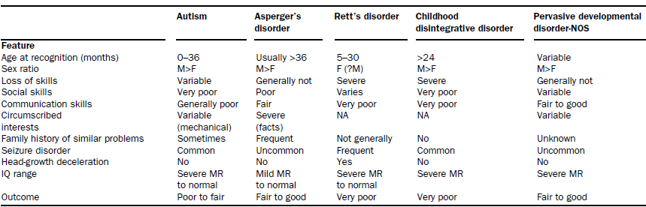
Clinical features

Slide 94
DSM-IV Diagnostic Criteria for 299.00 Autistic Disorder
A. A total of at least six items from (1), (2), and (3), with at least two from (1), and one each from (2) and (3):
(1) Qualitative impairment in social interaction, as manifested by at least two of the following:
(a) marked impairment in the use of multiple nonverbal behaviours such as eye-to-eye gaze, facial expression, body postures, and gestures to regulate social interaction
(b) failure to develop peer relationships appropriate to developmental level
(c) a lack of spontaneous seeking to share enjoyment, interests, or achievements with other people (e.g., by a lack of showing, bringing, or pointing out objects of interest)
(d) lack of social or emotional reciprocity

Slide 95
DSM-IV Diagnostic Criteria for 299.00 Autistic Disorder
(2) Qualitative impairments in communication as manifested by at least one of the following:
(a) delay in, or total lack of, the development of spoken language (not accompanied by an attempt to compensate through alternative modes of communication such as gesture or mime)
(b) in individuals with adequate speech, marked impairment in the ability to initiate or sustain a conversation with others
(c) stereotyped and repetitive use of language or idiosyncratic language
(d) lack of varied, spontaneous make-believe play or social imitative play appropriate to developmental level

Slide 96
DSM-IV Diagnostic Criteria for 299.00 Autistic Disorder
(3) Restricted repetitive and stereotyped patterns of behaviour, interests, and activities, as manifested by at least one of the following:
(a) encompassing preoccupation with one or more stereotyped and restricted patterns of interest that is abnormal either in intensity or focus
(b) apparently inflexible adherence to specific, nonfunctional routines or rituals
(c) stereotyped and repetitive motor mannerisms (e.g., hand or finger flapping or twisting, or complex whole body movements)
(d) persistent preoccupation with parts of objects

Slide 97
DSM-IV Diagnostic Criteria for 299.00 Autistic Disorder
B. Delays or abnormal functioning in at least one of the following areas, with onset prior to age 3 years: (1) social interaction, (2) language as used in social communication, or (3) symbolic or imaginative play.
C. The disturbance is not better accounted for by Rett’s Disorder or Childhood Disintegrative Disorder.

Slide 98
DSM-IV Diagnostic Criteria for 299.80 Asperger's Disorder
A. Qualitative impairment in social interaction, as manifested by at least two of the following:
(1) marked impairment in the use of multiple nonverbal behaviours such as eye-to-eye gaze, facial expression, body postures, and gestures to regulate social interaction
(2) failure to develop peer relationships appropriate to developmental level
(3) a lack of spontaneous seeking to share enjoyment, interests, or achievements with other people (e.g., by a lack of showing, bringing, or pointing out objects of interest)
(4) lack of social or emotional reciprocity

Slide 99
DSM-IV Diagnostic Criteria for 299.80 Asperger's Disorder
B. Restricted repetitive and stereotyped patterns of behaviour, interests, and activities, as manifested by at least one of the following:
(1) encompassing preoccupation with one or more stereotyped and restricted patterns of interest that is abnormal either in intensity or focus
(2) apparently inflexible adherence to specific, nonfunctional routines or rituals
(3) stereotyped and repetitive motor mannerisms (e.g., hand or finger flapping or twisting, or complex whole body movements)
(4) persistent preoccupation with parts of objects

Slide 100
DSM-IV Diagnostic Criteria for 299.80 Asperger's Disorder
C. The disturbance causes clinically significant impairments in social, occupational, or other important areas of functioning .
D. There is no clinically significant general delay in language (e.g., single words used by age 2 years, communicative phrases used by age 3 years) .
E. There is no clinically significant delay in cognitive development or in the development of age-appropriate self-help skills, adaptive behaviour (other than social interaction), and curiosity about the environment in childhood .
F. Criteria are not met for another specific Pervasive Developmental Disorder or Schizophrenia

Slide 101
Most distinguishing symptom of AS is a child’s obsessive interest in a single object or topic to the exclusion of any other

Slide 102
DSM-IV Diagnostic Criteria for 299.80 ---Pervasive Developmental Disorder Not Otherwise Specified (Including Atypical Autism)
Severe and pervasive impairment in the development of reciprocal social interaction or verbal and nonverbal communication skills, or stereotyped behaviour, interests, and activities .
Includes atypical autism --- presentations that do not meet the criteria for Autistic Disorder because of late age of onset, atypical symptomatology, or subthreshold symptomatology, or all of these.
The criteria are not met for a specific Pervasive Developmental Disorder, Schizophrenia, Schizotypal Personality Disorder, or Avoidant Personality Disorder.

Slide 103
Rett’s syndrome (RS)
Severe neurodevelopmental disorder
severe intellectual disability in females, incidence of 1 in 10,000 .
Mutations in MECP2 in the majority of cases,
Atypical cases mutations in CDKL5,
Nonsymptomatic phase for the first 6–18 months of age followed by apraxia, deceleration of head growth, gait abnormalities, stereotypic hand movements, and mental retardation.
Male - MECP2 mutation --fatal neonatal encephalopathy , Rett syndrome like features, and familial X-linked mental retardation

Slide 104
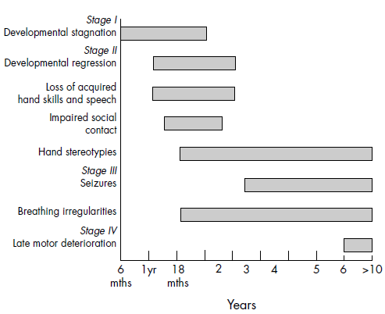

Slide 105
Revised Diagnostic Criteria
Supportive criteria
Main criteria
1. Breathing disturbances when awake
2. Bruxism when awake
3. Impaired sleep pattern
4. Abnormal muscle tone
5. Peripheral vasomotor disturbances
6. Scoliosis/kyphosis
7. Growth retardation
8. Small cold hands and feet
9. Inappropriate laughing/screaming spells
10. Diminished response to pain
11. Intense eye communication - ‘‘eye pointing’’
1. Partial or complete loss of acquired purposeful hand skills.
2. Partial or complete loss of acquired spoken language
3. Gait abnormalities: Impaired (dyspraxic) or absence of ability.
4. Stereotypic hand movements such as hand wringing/squeezing, clapping/tapping,mouthing and washing/rubbing automatisms

Slide 106
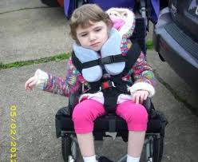
Exclusion criteria for typical RTT
1. Brain injury secondary to trauma (peri- or postnatally), neurometabolic disease, or severe infection that causes neurological problems
2. Grossly abnormal psychomotor development in first 6 months of life

Slide 107
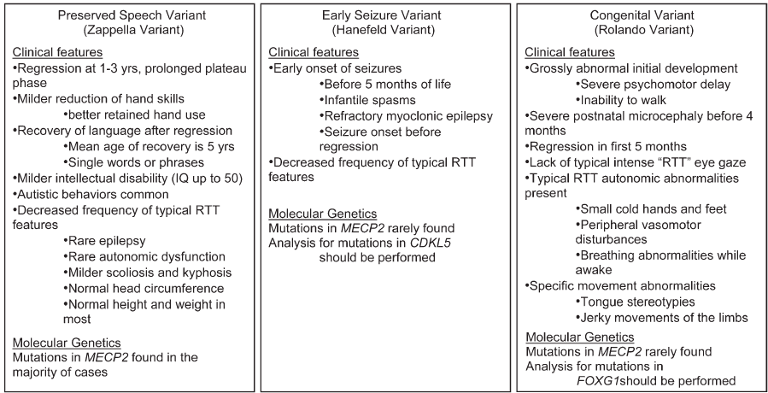
Variant Forms of Atypical RTT

Slide 108
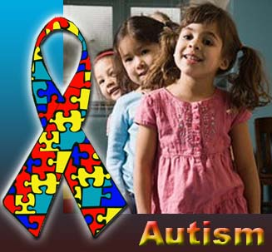
EVALUATION AND DIAGNOSIS
The comprehensive evaluation of a child with a suspected ASD may include
Speech, language, and communication assessments,
Cognitive testing, behavioral assessments,
Academic assessments,
Medical evaluation

Slide 109
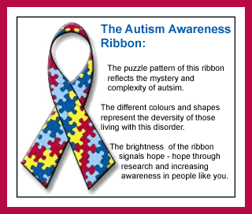
Team including general pediatricians, developmental/behavioral pediatricians, neurologists, child psychiatrists, and geneticists .
(a) complete medical and family history,
(b) physical examination,
(c) formal audiological evaluation,
(d) selected medical/laboratory tests on an individual basis (e.g., serum lead levels, brain MRI, EEG),
(e) clinical genetic assessments

Slide 110
Genetic Work-Up.
Autism Research and Treatment Volume 2012, Article ID 242537
Three-tier approach
First --initial screening to identify known syndromes & targeted screen-- viral titers (e.g., rubella), metabolic screening (urine for organic acids and mucopolysaccharides, plasma lactate, and aminoacid levels), and DNA testing for fragile X syndrome .
Second tier -- DNA analysis for Rett syndrome in females and males, chromosomal microarrays, and PTEN gene mutation screening if head size of the patient is >2 SD
Third tier -- brain MRI, serum and urine uric acid levels, and assays for adenylate succinase deficiency , mitochondrial function

Slide 111
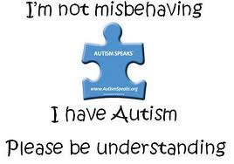
EVALUATION OF AUTISTIC CHILD
Screening tools :
  Checklist for Autism in Toddlers (CHAT)- most commonly used.
  Modified Checklist for Autism in Toddlers (M-CHAT).
  Social Communication Questionnaire (SCQ)
  Asperger Syndrome Diagnostic Scale (ASDS)
Diagnostic tools:
  1.Childhood Autism Rating Scale (CARS2)- most commonly used.
  2.Autism Diagnostic Interview Revised (ADI-R)- age above 2 years
  3.Autism Diagnostic Observation Schedule, 2nd (ADOS-2) -provides a highly accurate picture of current symptoms ,anyone – from one-year-olds with no speech to adults who are verbally fluent
  Trivandrum Autism Behavior Check list (TABC).

Slide 112
Importance of early diagnosis
Correct and early diagnosis of autism is so crucial
children who receive intensive intervention in a highly structured program by the age of 18-36 months have a greatly improved prognosis .
(a) needing fewer special education and other habilitative services later in life;
(b) being retained in grade less often;
(c) in some cases being indistinguishable from (non autistic) classmates years after intervention.

Slide 113
Comorbid Medical Conditions
Mental retardation --IQs of less than 70 occur in 50%–70% of children and 10% have a high IQ
Sensorimotor impairments
Seizure disorders-- 20%–30% with autism , 80% with Rett’s Disorder .
Gastrointestinal problems -- diarrhea, gastroesophageal reflux, increased pancreatic secretion, and altered gut permeability
Immune dysfunction -- otitis media, food allergies, and GI disorders

Slide 114
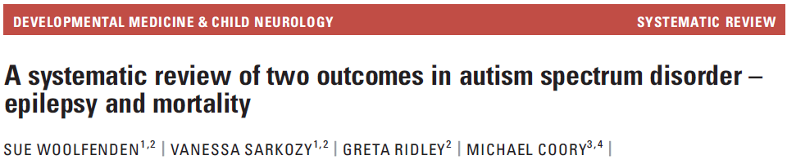
Incidence and prevalence of epilepsy dependent on
coexistent intellectual disability,
family history,
severe language delay,
underlying genetic conditions ⁄ syndromes,
the age and sex of the participants in the study,
severity of autistic features.

Slide 115
Patients with intellectual disability and age >12 years epilepsy →23.7%,
Without intellectual disability and the age at follow-up under 12 years →1.8%
Standardized mortality ratio was ->2.8 %
Epilepsy was responsible for 7%to 30%of deaths in ASD
Male:female ratio with epilepsy -> 2:1
Epilepsy and epileptiform patterns are more frequent in regressed children

Slide 116
IMAGING IN AUTISM
Cerebral creatine deficiency in cranial MR spectroscopy (MRS) is the characteristic hallmark of all CCDS.
Functional MRI ---Long distance under-connectivity and local over-connectivity of the frontal cortex
Reduced long-range cortical functional connectivity in frontal regions by fMRI in executive functioning, working memory for faces, and facial affect processing .

Slide 117
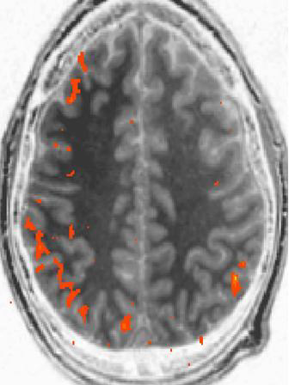
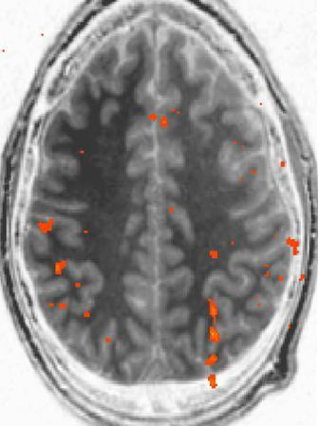
fMRI Activation During a Spatial Working Memory Task

Slide 118
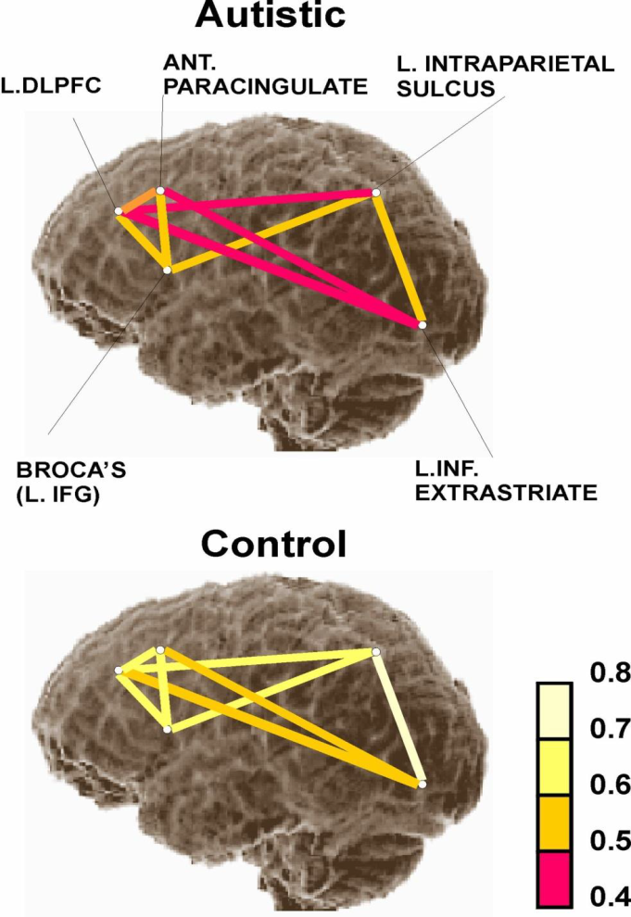
Reliably lower functional connectivity for autism participants between pairs of key areas during sentence comprehension (red end of scale denotes lower connectivity)

Slide 119
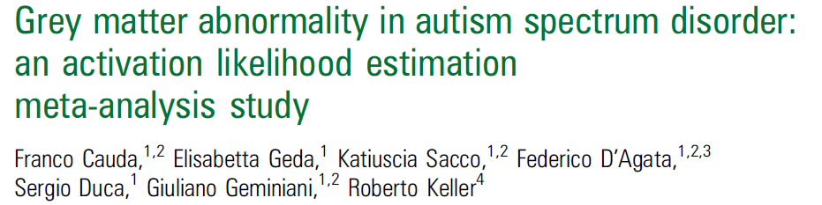
Voxel based morphometry (VBM),a technique that gives a probabilistic measure of local grey matter (GM) and white matter concentration
GM increases were observed bilaterally in the cerebellum, in the middle temporal gyrus, in the right anterior cingulate cortex,caudate head, insula, fusiform gyrus, precuneus and posterior cingulate cortex, and in the left lingual gyrus
GM decreases -bilaterally in the cerebellar tonsil and inferior parietal lobule , right hemisphere in the amygdala,insula, middle temporal gyrus, caudate tail and precuneus

Slide 120
GM thinning in autism in regions associated with the mirror neuron system has been correlated with social and communication deficits
Increased total GM brain volume is predictive of greater ASD severity
caudate nucleus volume correlates with repetitive and stereotyped behaviour and social communication
HFA patients have significantly smaller GM volumes in the subcortical, posterior cingulated and precuneus
J Neurol Neurosurg Psychiatry 2011;82:1304e1313.

Slide 121
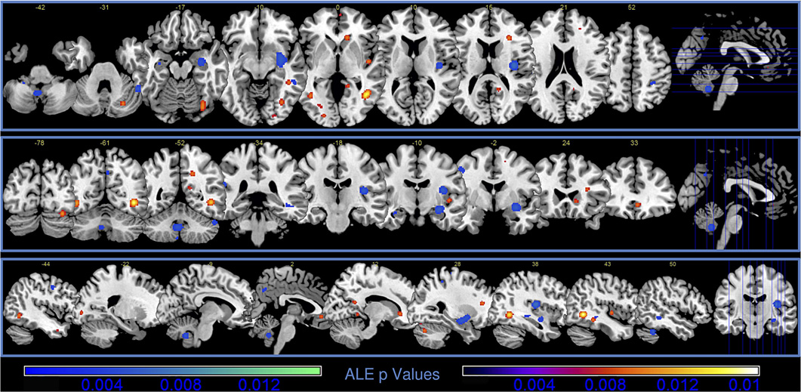
Grey matter (GM) activation likelihood estimation (ALE) results. Colours from red to yellow show GM increases, colours from blue to green show GM decreases

Slide 122
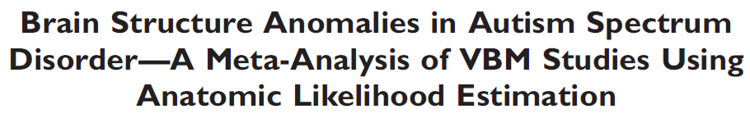
Disturbances in the brain structure of ASD patients, include the lateral occipital lobe, the pericentral region, the medial temporal lobe, the basal ganglia, and proximate to the right parietal operculum.

Slide 123
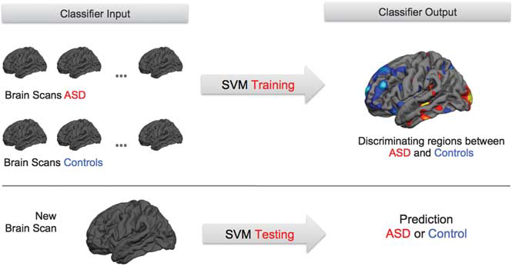
Pattern classification using support vector machine based on structural magnetic resonance images in Autism Spectrum Disorders

Slide 124

TREATMENT

Slide 125
Most effective treatment
An appropriate educational training program that is tailored to the child’s specific needs.
Based on the principles of behaviour analysis; >antecedents of behaviour
>consequences of behaviour.
For lower-functioning and younger children --developing basic learning-to-learn skills and fostering communication.
As the child acquires more symbolic abilities -- more conceptual learning

Slide 126
Behavioural therapy
Speech & language therapy
Sensory Integration therapy
Physical therapy
Occupational therapy
Auditory Interventions
Most children with Autism, benefit from a combination of treatment

Slide 127
Developmental interventions treatments
Applied Behaviour Analysis (ABA),
Verbal Behaviour Analysis (VB),
Lovaas , Pivotal Response Training
TEACCH (Treatment and Education of Autistic and related Communication-handicapped children)
Augmentative and Alternative Communication (AAC)
Discrete Trial Training (DTT) is a technique or treatment approach within the framework of applied behavior analysis (ABA).
Parent-mediated communication-focused treatment in children with autism (PACT)
Picture Exchange Communication System (PECS)

Slide 128
Applied Behavior Analysis Verbal Behavior (ABA VB) approach and music incorporated with ABA VB method ---successfull to enhance the functional verbal production .
Computer-assisted technology (CAT)—properly designed CAT program can encourage performance of a variety of new social and communication skills .

Slide 129
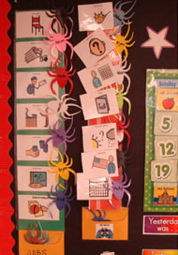
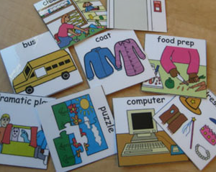
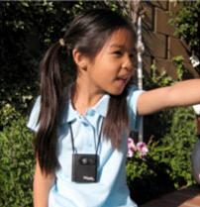
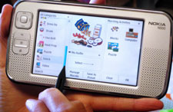
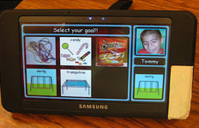
Interactive visual supports for children with autism
Paper-based visual supports.
Mocotos: mobile communication tools
vSked: interactive and intelligent visual schedules
SenseCam: automatic recording of everyday images
enable children with ASD to communicate and to learn more easily .

Slide 130
Teaching Young Nonverbal Children with Autism Useful Speech: Denver Model and PROMPT Interventions
PROMPT --Prompts for Restructuring Oral Muscular Phonetic Targets
Denver Model
Both are useful for developing speech in nonverbal preschoolers with autism

Slide 131
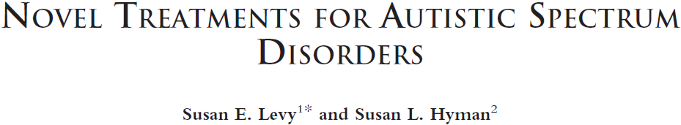
Biological treatments--- none found effective
Complementary and alternative medical therapies (CAM) ---immune modulation, gastrointestinal, supplements that affect neurotransmitter function, Nonbiologic intervention .Eg Secretin, Vitamins, minerals, and dietary interventions
Conventional therapies focus on educational or developmental interventions designed to address skill acquisition associated with core deficits of ASD, including communication, social interaction, and play.

Slide 132
TRIALS
Therapeutic procedures --low-frequency repetitive transcranial magnetic stimulation
Increase the surround inhibition of minicolumns. Improvement was based on ERPs and induced gamma activity, and behavioral improvement is reported

Slide 133
Resperidone and Aripiprazole ,olanzapine and Quetiapine— Used for irritability; treat aggression, self-injury and temper tantrums
SSRIs –used for depression, obsessive-compulsive disorder, and/or anxiety. fluoxetine ,fluvoxamine , sertraline , and paroxetine
Evid.-Based Child Health 6: 1044–1078 (2011); Katrina Williams ET AL

Slide 134
Cerebral creatine deficiency syndromes
GAMT deficiency and AGAT deficiency ---Oral creatine monohydrate to increase cerebral creatine levels.
GAMT deficiency --supplementation of ornithine and dietary restriction of arginine.
SLC6A8 deficiency --creatine supplementation does not improve clinical outcome and does not result in increased cerebral creatine levels;

Slide 135
Principles of treatment selection
“ Do no harm,”
“Start low and go slow with any medications,”
“Individualize patient care.”

Slide 136
Focus and build on what the child can do rather than what he can’t do.
Look for his strengths.
Provide a well structured environment for him.
Avoid distractions in his training sessions.
Find the right way to do most things.
Identify what triggers his melt downs – prevent it.
Love him unconditionally.

Slide 137
Screening for Autism Spectrum Disorders in Preterm Infants at 18 months follow up is worth in early identification and interventions .

Slide 138
With effective treatment,
Most of them learn to cope with their disabilities,
May still find social situations and personal relationships challenging.
Many adults with ASD are able to work successfully in mainstream jobs, although they may continue to need encouragement and moral support to maintain an independent life.

Slide 139
Famous people with Autism
Daniel Tammet -1in 100 geniuses of world
Temple Grandin, animal and autistic advocate
U.S. autistic jazz prodigy Matt Savage
Satoshi Tajiri, the creator of Pokémon
Donna Williams, bestselling author and autistic
John Elder Robinson author and autistic
HFA/SAVANTS
Alexander Graham Bell
Beethoven
Da Vinci
Edison
Einstein
Emily Dickinson
Isaac Newton
Michael Angelo
Mark Twain

Slide 140
The most basic, yet most essential step to being able to more effectively help those afflicted with ASD is to educate ourselves as well as the world around us.

Slide 141
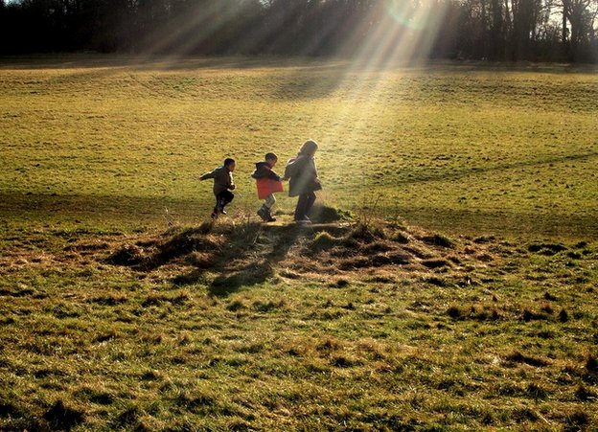
THANK YOU

Slide 142
REFERENCE S
Autism ;Fred R Volkmar, David Pauls;Lancet 2003; 362: 1133–41
American Psychiatric Association. (1994). Diagnostic and statistical manual of mental disorders (4th ed.).
World Health Organisation. (1992). International classification of diseases and health related problems (10th ed.).
The autistic spectrum; Lancet 1997; 350: 1761–66
Autistic Spectrum Disorders;A Guide for Paediatricians in India; Merry Barua ,Tamara C. Daley
Nosology and Epidemiology in Autism:Classification Counts ;GENE S. FISCH; American Journal of Medical Genetics Part C (Seminars in Medical Genetics) 160C:91–103 (2012)
Oberman, L. M., & Ramachandran, V. S. (2007). The simulating social mind: The role of the mirror neuron system and simulation in the social and communicative deficits of autism spectrum disorders. Psychological Bulletin, 133, 310–327.
THE LANCET • Vol 362 • October 4, 2003; Autism .The neurobiology of autism: Theoretical applications; Jessica H. Schroeder ; Research in Autism Spectrum Disorders 4 (2010) 555–564

Slide 143
REFERENCE S
J Autism Dev Disord; Use of Computer-Assisted Technologies (CAT) to Enhance Social,Communicative, and Language Development in Childrenwith Autism Spectum Disorders;Bertram O. Ploog et al
Interactive visual supports for children with autism Gillian R. Hayes Pers Ubiquit Comput (2010)
Teaching Young Nonverbal Children with Autism Useful Speech: A Pilot Study of the Denver Model and PROMPT Interventions ;Sally J. Rogers; J Autism Dev Disord (2006) 36:1007–1024
Autism and Developmental Disabilities Monitoring Network. Prevalence of autism spectrum disorders. MMWR 2007;56:SS–1
EARLY COMMUNICATION DEVELOPMENT AND INTERVENTION FOR CHILDREN WITH AUTISM Rebecca Landa; MENTAL RETARDATION AND DEVELOPMENTAL DISABILITIES RESEARCH REVIEWS 13: 16 – 25 (2007)
The Neurobiology of Autism;Carlos A. Pardo ; Brain Pathol 2007
NOVEL TREATMENTS FOR AUTISTIC SPECTRUM DISORDERS ;Susan E. Levy; MENTAL RETARDATION AND DEVELOPMENTAL DISABILITIES RESEARCH REVIEWS
Translational approaches to the biology of Autism: false dawn or a new era? C Ecker; Molecular Psychiatry (2012

Slide 144
Gene affected in Rett ‘s syndrome
1.PTEN
2.SHANK3
3.CDKL5
4.REELIN

Slide 145
Latest theory of autism supported by f MRI evidence
1. Theory of mind
2. Theory of mirror neuron system
3.Weak central coherance

Slide 146
Very early indicators requiring evaluation for ASD
1.No babbling or pointing by age 1
2.No single words by 10 months or two-word phrases by 15 months
3.No response to name
4.Loss of language or social skills

Slide 147

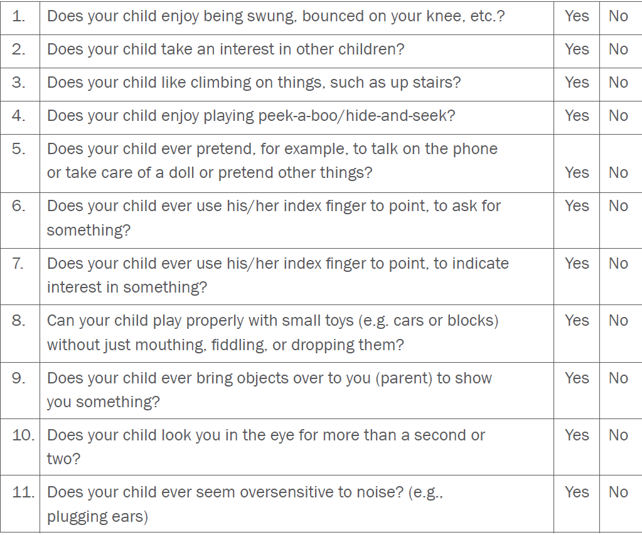

Slide 148
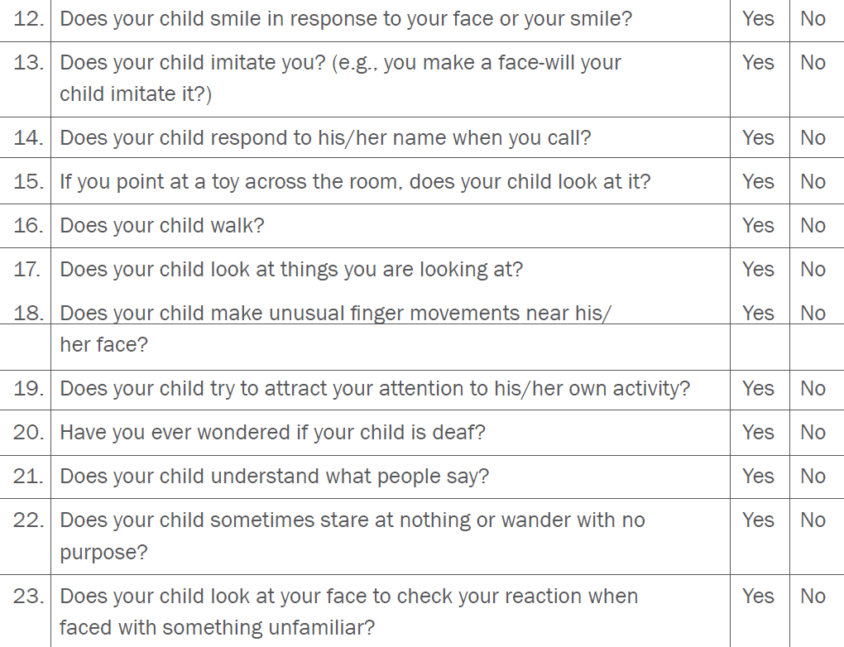

Slide 149
Autism Organizations in India
Action For Autism (AFA)
The National Centre for Autism
Assam Autism Foundation
Autism Society of Hyderabad
Autism Society of India
Forum For Autism
Institute for Remedial Intervention Services
Parents Network for Autism
Parents Association for Autistic Children (PAAC)

