Slide 1
DIAGNOSTIC CRITERIA FOR
MULTIPLE SCLEROSIS
Dr. C. Rathore

Slide 2
Multiple sclerosis
Immune-mediated inflammatory disease in which
the myelin sheaths around the axons of the brain
and spinal cord are damaged, leading to
demyelination.
Disease onset usually occurs in young adults, and
It is more common in women

Slide 3
1996 the United States National Multiple Sclerosis Society standardized four subtype definitions
Relapsing remitting,
Secondary progressive,
Primary progressive, and
Progressive relapsing

Slide 4
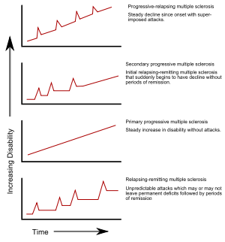

Slide 5
Diagnostic Definitions in MS
CIS: Clinically Isolated Syndrome
  Occurrence of one neurological event consistent with demyelination
  Example: Visual changes with MRI showing evidence of Gd+ enhancement in optic tract
CDMS: Clinically Definite MS
  Occurrence of ≥ 2 neurological events consistent with demyelination that are separated in time and space (occur at clearly different anatomical locations)
  Example: visual changes followed by leg weakness 6 months later

Slide 6
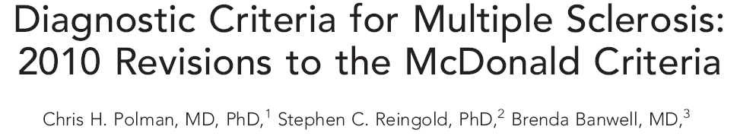
In May 2010 in Dublin, Ireland, the International Panel on Diagnosis of MS (the Panel) met for a third time to examine requirements for demonstrating DIS and DIT and to focus on application of the McDonald Criteria in pediatric, Asian, and Latin American populations

Slide 7
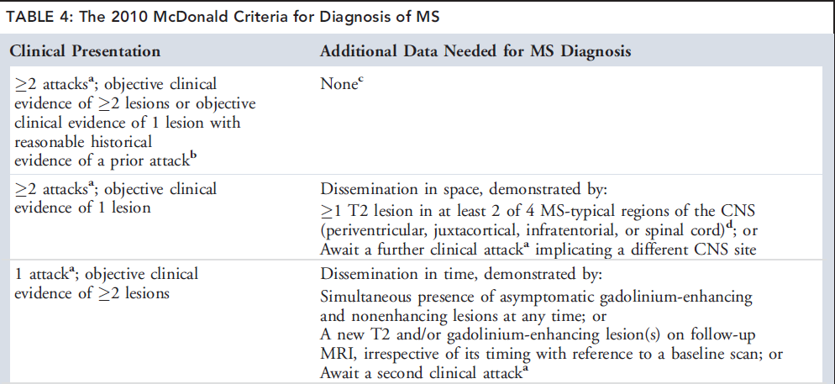

Slide 8
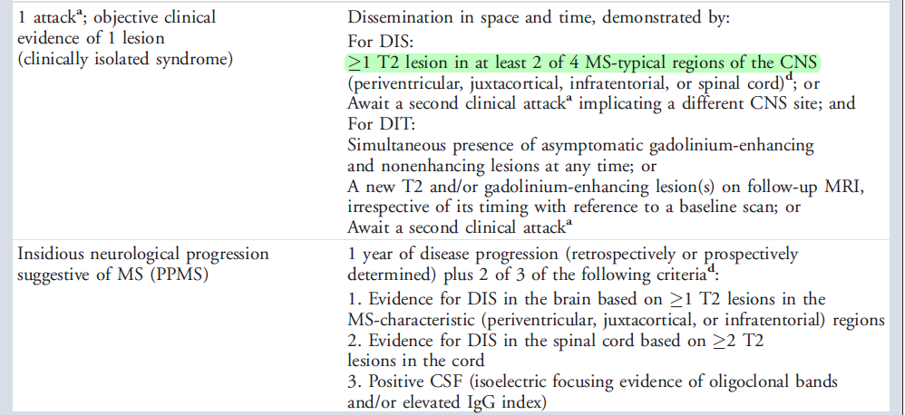

Slide 9
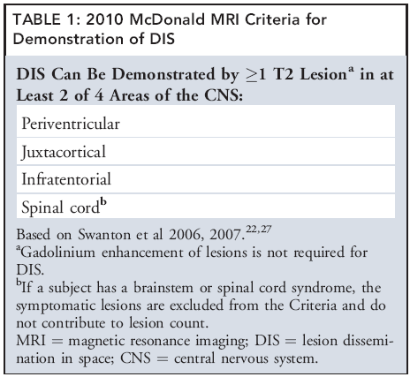
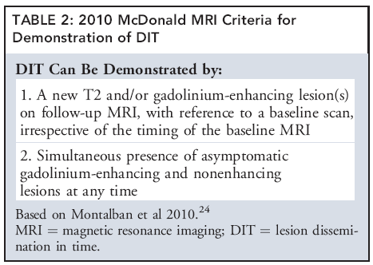
2010 McDonald’s Criteria

Slide 10
An attack (relapse, exacerbation) patient-reported
symptoms or objectively observed signs typical of an
acute inflammatory demyelinating event in the CNS.
Duration of at least 24 hours, in the absence of fever
or infection.

Slide 11
Before a definite diagnosis of MS can be made, at
least 1 attack must be corroborated by findings on
neurological examination,VEP in patients reporting prior
visual disturbance, or MRI consistent with demyelination
in the area of the CNS implicated in the historical report
of neurological symptoms

Slide 12
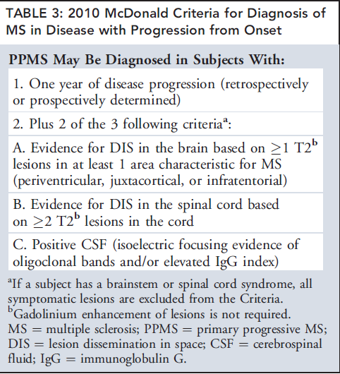

Slide 13
Pediatric MS
About 80% of pediatric cases, and nearly all
adolescent onset cases, present with attacks typical for
adult CIS, with a similar or greater total T2 lesion
burden.
In children younger than 11 years,lesions are larger
and more ill-defined than in teenagers.

Slide 14
15 to 20% of pediatric MS patients, most aged <11
years, present with encephalopathy and multifocal
neurological deficits difficult to distinguish from
acute disseminated encephalomyelitis

Slide 15
MRI scans of children with monophasic ADEM
typically demonstrate multiple variably enhancing
lesions (often >2) typically located in the
juxtacortical white matter, infratentorial space, and
spinal cord.
Application of the revised criteria for DIS and DIT on
initial MRI would be inappropriate for such patients,
and serial clinical and MRI observations are required
to confirm a diagnosis of MS

Slide 16
Clinically isolated syndromes

Slide 17
Clinically isolated syndrome (CIS) is a term that
describes a first clinical episode with features
suggestive of multiple sclerosis (MS).
It usually occurs in young adults and affects optic
nerves, the brainstem, or the spinal cord

Slide 18
To be termed CIS, the episode should last for at
least 24 h and occur in the absence of fever or
infection, with no clinical features of encephalopathy

Slide 19
A CIS is, by definition, always isolated in time (ie,
monophasic).
Clinically, it is usually also isolated in space (ie,
monofocal) with signs indicating a lesion in the optic
nerve (a common presentation in many reported CIS
studies), spinal cord, brainstem or cerebellum, or
(rarely) a cerebral hemisphere.

Slide 20
Some patients with a CIS have clinical evidence for
dissemination in space (ie, multifocal)
Clinically multifocal CIS presentations
eg Optic neuritis with an extensor plantar response
Optic neuritis and internuclear ophthalmoplegia
These are less common than mono focal
presentations

Slide 21
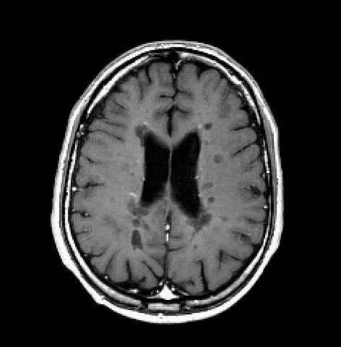
CIS (Monofocal) presentations: Relation to MS
Presentation
% of patients converting to MS
Optic neuritis
10 -85%^{1-3, 6}
CIS
Spinal cord
41 - 61%³⁻⁵
brainstem
53 - 60%^{4,5}
Compston A, ed. McAlpine’s Multiple Sclerosis, 4th edn. Edinburgh: Churchill Livingstone, 2005.
Optic Neuritis Study Group. Arch Neurol 2008; 65: 727–32.
Fisniku LK, Brex PA, Altmann DR, et al. Brain 2008; 131: 808–17.
Tintore M, Rovira A, Arrambide G, et al. Neurology 2010; 75: 1933–38.
Young J, Quinn S, Hurrell M, Taylor B. Mult Scler 2009; 15: 1295–302.
Swanton JK, Fernando K, Dalton CM, et al. J Neurol Neurosurg Psychiatry 2006; 77: 1070–72.

Slide 22
The long-term risk for clinically definite MS is
60 -- 80% when lesions are present and about 20%
When scanning is normal apart from the
Symptomatic lesion

Slide 23
Patients who have at least one lesion in the
infratentorial regions at onset of CIS have increased
risk of conversion, the risk being slightly higher in
those with a lesion in the brainstem than it is in those
with a lesion in the cerebellum.

Slide 24
CSF
Although CSF oligoclonal bands (OCBs) increase the risk
of CIS developing to MS, they add little to MRI-assigned
Risk
Conversion to MS in 59% of all patients with CIS with
more than 10 brain lesions and in 64% who had more
than 10 brain lesions and CSF OCBs.
Neurology 2008; 70: 1079–83.

Slide 25
CSF examination helps to predict conversion to MS in
patients with negative MRI or with an MRI showing few
lesions (ie, MRI that does not meet the McDonaldcriteria
for dissemination in space).
In patients with negative MRI, the presence of OCBs
Increased the risk for developing MS from 4% to 23%.
The development of MS is unlikely in patients with a CIS
showing few or no MRI lesions and no CSF OCBs.

Slide 26
Thank you

