Slide 1
BASAL GANGLIA CIRCUITS
Faculty : Dr. C.RATHORE

Slide 2
SCHEME OF PRESENTATION
ANATOMY
HISTOLOGY
PATHWAYS
NEUROTRANSMITTERS
CIRCUITS
DISORDERS

Slide 3
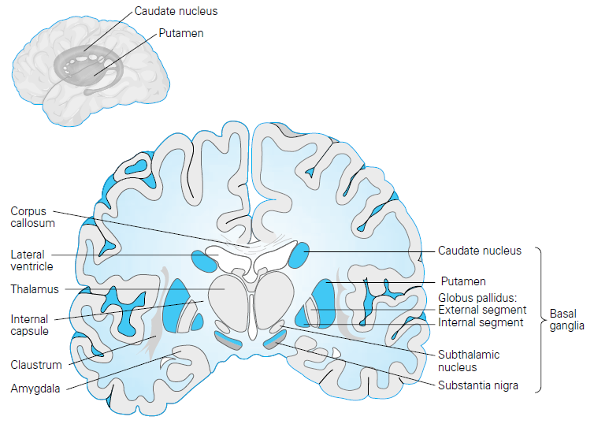
The basal ganglia play a major role in the control of posture and movement and are responsible for the automatic execution of learned motor plans.

Slide 4
HISTORY
First anatomical identification of distinct subcortical structures -Thomas Willis in 1664
In the mid 1950s Arvid Carlson showed that 80% of the brain's dopamine is in the basal ganglia.
Oleh Horynekiewicz found that the brains of patients with Parkinson disease are deficient in dopamine, in the striatum, most severely in the putamen.
1960s Parkinson disease was shown to result largely from the degeneration of dopaminergic neurons in the substantia nigra pars compacta.

Slide 5
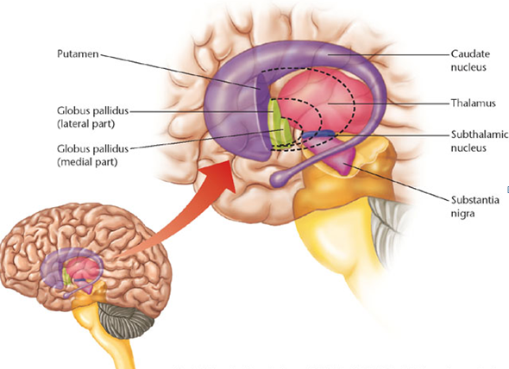
ANATOMY OF THE BASAL GANGLIA

Slide 6
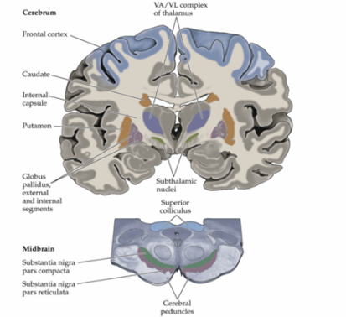
THE BASAL GANGLIA
NEOSTRIATUM / STRIATUM PROPER
Caudate Nucleus Putamen
PALEOSTRIATUM/ PALLIDUM
Globus Pallidus
Subthalamic Nucleus of Luys.
Substantia nigra
Ventral striatum
Nucleus accumbens
Pedunculo pontine nucleus
Ventral pallidum Substantia innominata

Slide 7
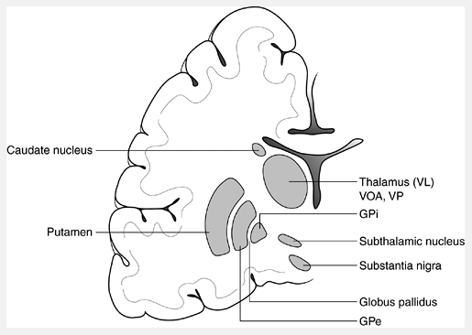
THE BASAL GANGLIA
Notes:
Anteriolaterally- internal capsule and globus pallidus.
Posteromedially - adjacent to red nucleus.
Ventrally - cerebral peduncle and SN
Dorsally - fasciculus lenticularis and zona incerta.

Slide 8
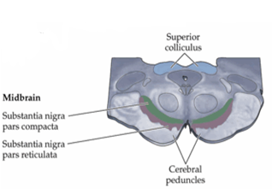
SUBSTANTIA NIGRA
Pars compacta
dorsal part
Pars reticularis-
ventral part
Notes:
Latin for "black substance.
dorsal part-contains dopaminergic neurons contain melanin.
input to the basal ganglia circuit, supplying the striatum with dopamine.
Pars reticularis-
ventral part -contains gamma-aminobutyric acid (GABA)–ergic neurons
functions as an output nucleus

Slide 9
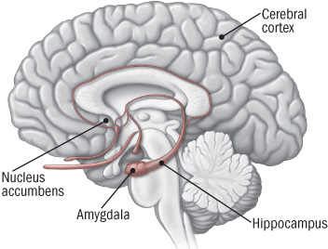
VENTRAL STRIATUM
Ventral Striatum/Limbic Striatum
Nucleus Accumbens and Olfactory tubercle
Notes:
located where the head of the caudate and the anterior portion of the putamen meet, just lateral to the septum pellucidum.

Slide 10
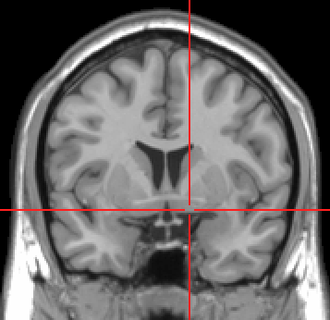
VENTRAL PALLIDUM
Substantia innominata of Meynert
lies below the anterior part of the thalamus and lentiform nucleus . The gross anatomical structure -anterior perforated substance

Slide 11
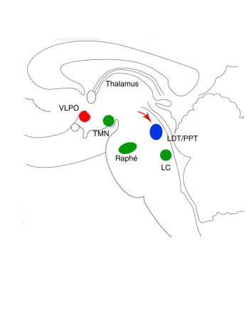
PEDUNCULO PONTINE NUCLEUS
Caudal pontomesencephalic tegmentum.
Forms part of the Mesencephalic Locomotor Region (MLR) along with the Cuneiform nucleus
Pars compacta (PPNc)
Pars dissipata (PPNd)
Notes:
Located in the caudal pontomesencephalic tegmentum.
Two territories based on cell density and neurochemical characteristics- Pars compacta (PPNc) has clustered cholinergic neurons.
Pars dissipata (PPNd) has cholinergic and non cholinergic neurons mostly glutamatergic.

Slide 12
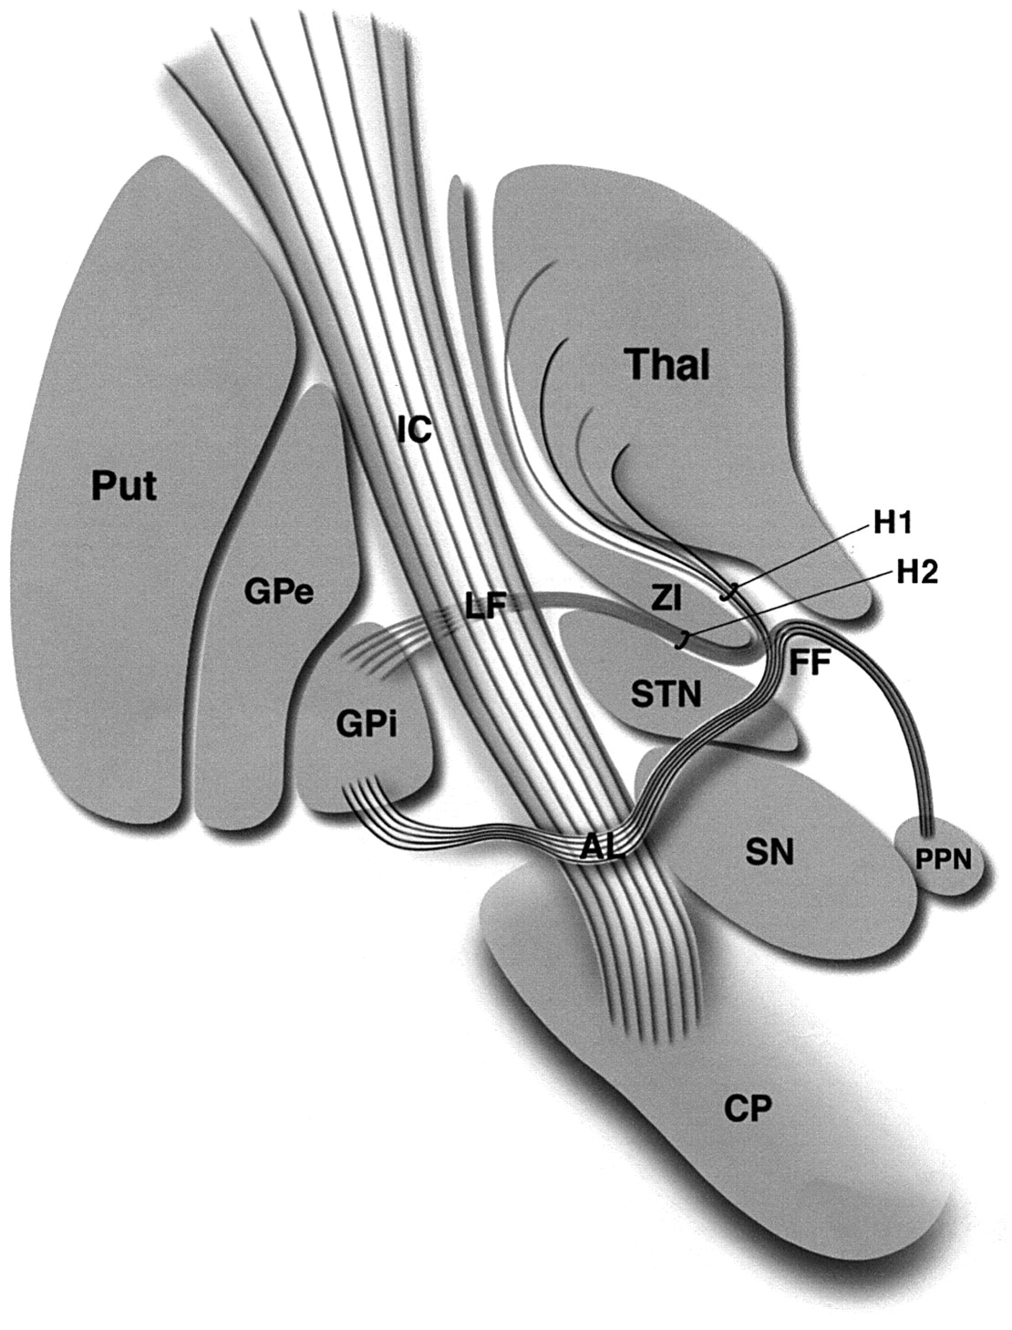
FIELDS OF FOREL
White matter areas located below the thalamus
"H fields" (for Haubenfelder)
H1 -thalamic fasciculus- the pallidothalamic,mesothalamic, rubrothalamic, and dentatothalamic fibres.
H2 - lenticular fasciculus is made up of projections from the pallidum to the thalamus, traverses the internal capsule in a number of small fascicles.
H3 - prerubral field, is a large zone of mixed gray and white matter located just rostral to the red nucleus.

Slide 13
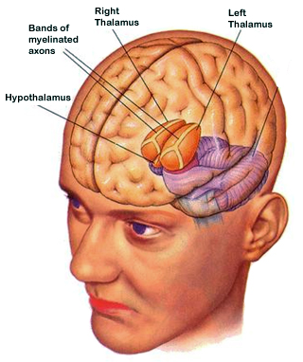
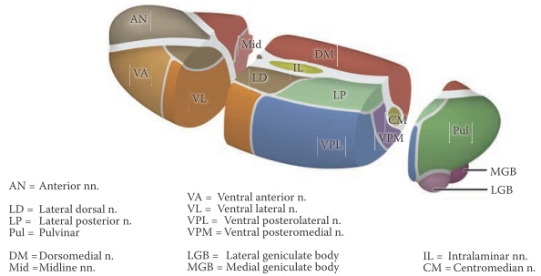
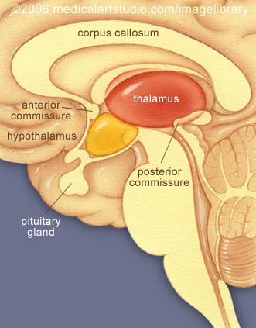
THALAMUS - FUNCTIONALLY A PART OF BASAL GANGLIA

Slide 14
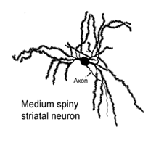
HISTOLOGY
2 types of neurons in Neostriatum:
SPINY NEURONS / PROJECTION NEURONS
ASPINY NEURONS/ INTERNEURONS
Large and small sized neurons. Large neurons contains acetylcholine and the small contains GABA.
90% of neostriatal neurons. They contain GABA, taurine and a number of neuropeptides.

Slide 15
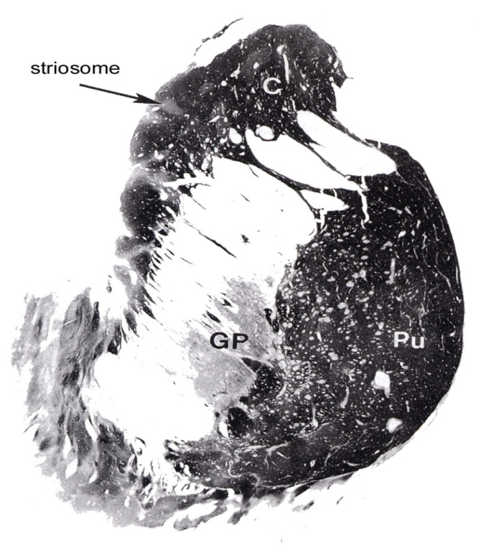
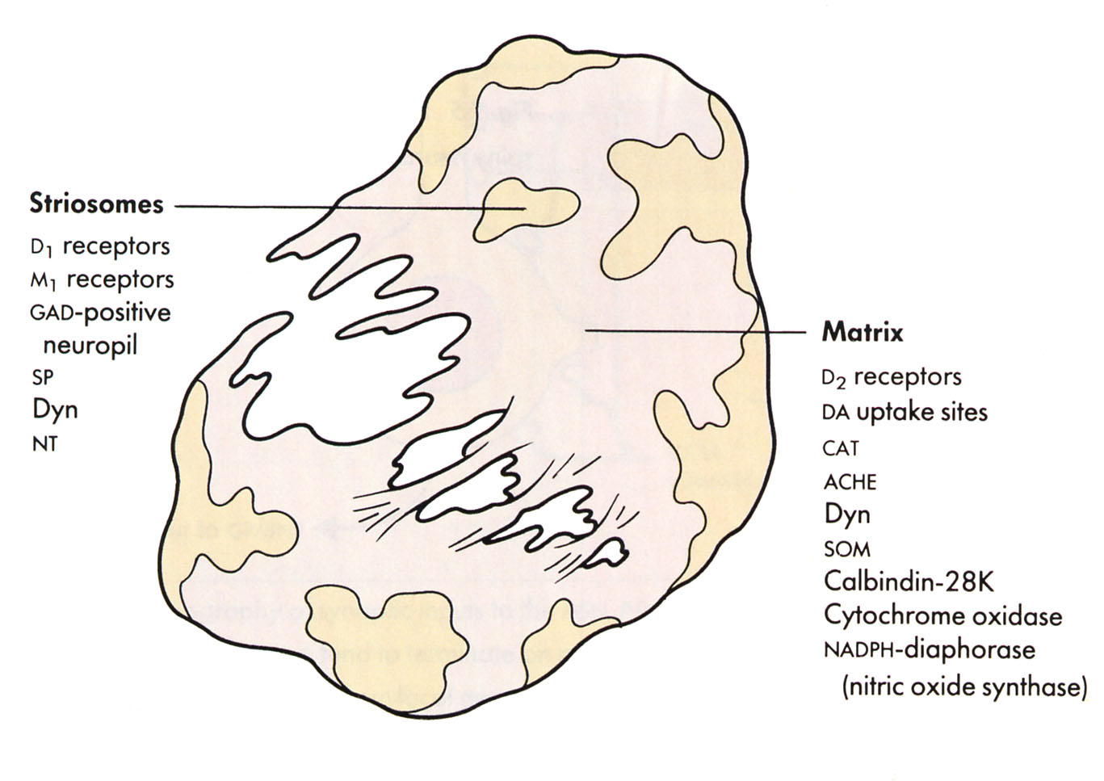
Based on Acetylcholinesterase reactivity of neurons neostriatum is compartmentalized into weakly reactive patches (striosomes) interspersed between strongly reactive patches (matrix).

Slide 16
PATHWAYS
AFFERENT
EFFERENT
INTERCONNECTIONS

Slide 17
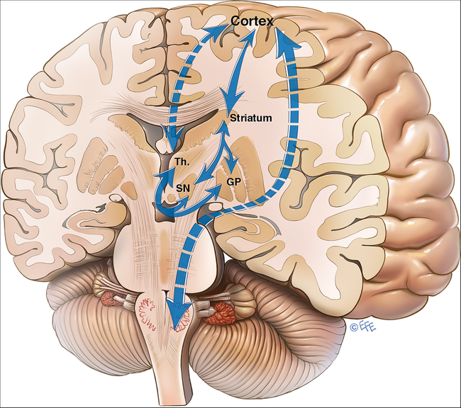
CONNECTIONS OF NEOSTRIATUM
AFFERENT
Cortico striate projections
Thalamo striatal projections
Nigrostriatal projections (pars compacta)
Brain stem / Raphe nucleus- striatal projections
EFFERENT
Striato pallidal fibres
Striato nigral fibres (pars reticularis)

Slide 18
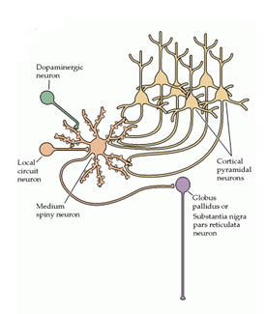
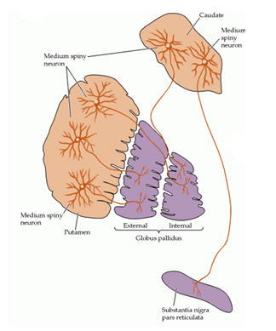

Slide 19
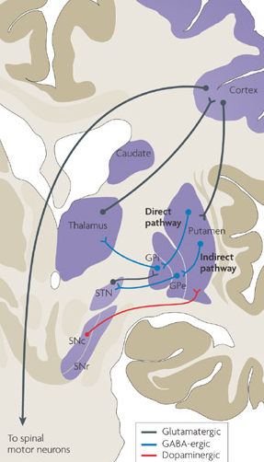
CONNECTIONS OF GLOBUS PALLIDUS
AFFERENTS
Striato pallidal fibres
Subthalamo pallidal fibres
Nigro pallidal fibres
EFFERENTS TO
Thalamic nuclei-VA ,VL,CM
Subthalamic nucleus
Substantia nigra
PPN
Brain stem- Reticular formation, Red nucleus, Inferior olivary nucleus
Notes:
Globus pallidus is the major output nucleus of BG. Gpe with SNr= output

Slide 20
CONNECTIONS OF SUBSTANTIA NIGRA
PARS RETICULARIS
EFFERENTS
Thalamus- VA,VL,DM
Reticular formation
Superior Colliculus
AFFERENTS
Cerebral cortex
Striatum
Globus pallidus
Subthalamic Nucleus
PARS COMPACTA
EFFERENTS
Striatum

Slide 21
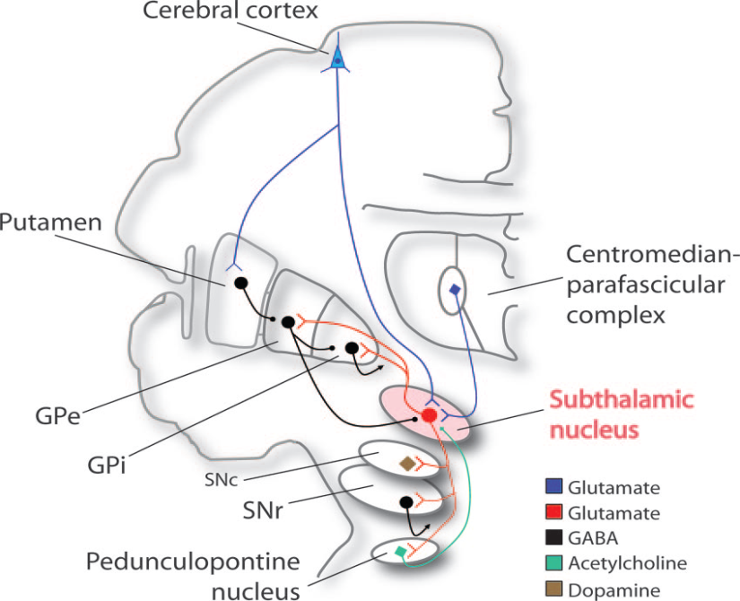
CONNECTIONS OF SUBTHALAMIC NUCLEUS
AFFERENTS
Cerebral cortex
Thalamus
Globus pallidus externa
Brain stem
EFFERENTS
Globus pallidus – Subthalamo pallidal (ONLY EXCITATORY INTRINSIC CONNECTION IN THE BASAL GANGLIA)
Substantia nigra
Striatum
PPN
Ventral Tegmentum

Slide 22
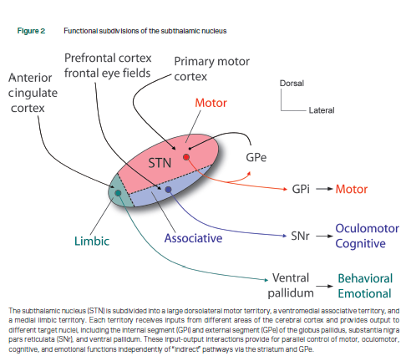

Slide 23
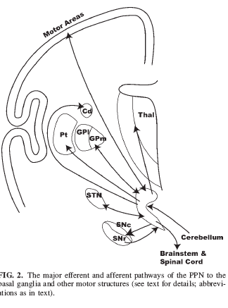
PEDUNCULOPONTINE NUCLEUS
EFFERENTS
DESCENDING PROJECTIONS
Reticular formation
Deep cerebellar nuclei
Raphe nuclei
Locus coeruleus
Spinal cord
AFFERENTS
Gpi-pallido tegmental tract
SN r
EFFERENTS
ASCENDING PROJECTIONS
Thalamus
STN
SN c
Globus pallidus

Slide 24
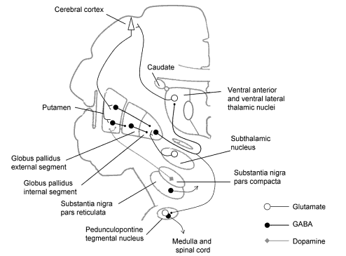
NEUROTRANSMITTERS IN THE BASAL GANGLIA
Glutamate-containing neurons
  project from the cerebral cortex to the striatum.
  project from the cerebral cortex to the Subthalamic nucleus
  project from the subthalamic nucleus to the globus pallidus.
  project from thalamic nuclei to cortex
  excite striatal GABA-ergic and cholinergic neurons.

Slide 25
GABA-containing neurons
  the predominant neurons of the striatal system.
  found in the striatum, globus pallidus, and substantia nigra (pars reticularis).
  give rise to the following GABA-ergic projections: striatopallidal, striatonigral, pallidosubthalamic, pallidothalamic, and nigrothalamic projections.
  degenerate in Huntington’s disease.

Slide 26
Dopamine-containing neurons
found in the pars compacta of the substantia nigra.
  give rise to the dopaminergic nigrostriatal projection.
  degenerate in Parkinson’s disease.

Slide 27
Neurons containing acetylcholine (ACh)
local circuit neurons found in the striatum.
Serotonin containing neurons
In the raphe nucleus
Project to the neostriatum and substantia nigra
Norepinephrine containing neurons
In the locus coeruleus
Project to the neostriatum and substantia nigra

Slide 28
NEUROTRANSMITTERS
EXTRINSIC CONNECTIONS
Cerebral cortex → Striatum
Cerebral cortex → STN
Globus pallidus to thalamus
SN r to thalamus
Glutamate
Glutamate
GABA
GABA

Slide 29
INTRINSIC CONNECTIONS
Striatal interneurons
Striatum to Globus Pallidus
Striatum to SN r
Globus pallidus to STN
STN to Globus Pallidus
Ach, GABA
Glutamate
GABA
GABA
GABA

Slide 30
DOPAMINE RECEPTORS
D3
Nucleus accumbens
D4
Frontal cortex and Limbic structures
D5
Hippocampus
D1 and D2
Striatum
Notes:
The five types of dopamine receptors are found in differing concentration throughout various parts of the brain

Slide 31
Dopamine effect in a synapse is determined by the local receptor.
D1 receptors- EXCITATORY-predominate on the small spiny neurons in putamen -direct striatopallidal output .
D2 receptors- INHIBITORY- indirect striatopallidal output.
Notes:
Excitatory D1 receptors predominate on the small spiny neurons in putamen - the origin of the direct striatopallidal output pathway
D2 receptors mediate the inhibitory influence of dopamine on the indirect striatopallidal output.

Slide 32
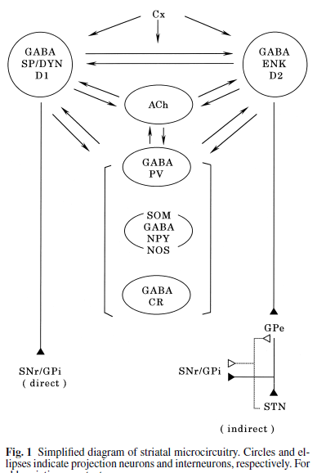
MICROCIRCUITS OF THE STRIATUM

Slide 33
BASAL GANGLIA CIRCUITS

Slide 34
CORTICO-BASAL GANGLIA- THALAMO CORTICAL CIRCUITS- 5 CLOSED LOOPS
MOTOR
OCULOMOTOR
ASSOCIATIVE
ORBITOFRONTAL
LIMBIC
Notes:
At least five circuits have been described, each projecting to a different portion of the frontal lobe:
(1) the motor circuit, converging on the premotor cortex;
(2) the oculomotor circuit, on the frontal eye fields;
two prefrontal circuits,
(3) one on the dorsolateral prefrontal and
(4) another on the lateral orbitofrontal cortex; and
(5) a limbic circuit that projects to the anterior cingulate and medial orbitofrontal cortex.
thalamic output of each circuit is directed back to the portions of the cortex from which the circuit originates.

Slide 35
3 OPEN LOOPS
MOTOR
ASSOCIATIVE
LIMBIC

Slide 36
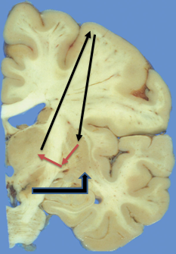
DIRECT PATHWAY
CORTEX
STRIATUM
GPi
SNr
THALAMUS VL
SNc
GLUTAMATE +
GLUTAMATE +
DOPAMINE +
GABA -
GABA -
GPe STN
Notes:
Stimulation of the direct pathway disinhibits the thalamus leading to cortical excitation

Slide 37
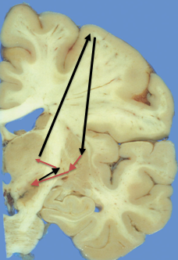
INDIRECT PATHWAY
CORTEX
STRIATUM
GPe
STN
THALAMUS VL
GPi
SNc
GLUTAMATE +
GLUTAMATE +
DOPAMINE -
GABA -
GABA -
GLUTAMATE +
GABA -
Notes:
Stimulation of indirect pathway inhibits VL nucleus of thalamus and leads to cortical inhibition

Slide 38
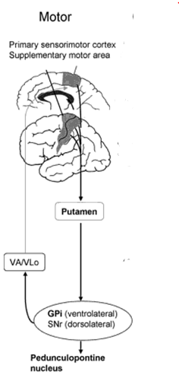

MOTOR CIRCUIT
PREMOTOR &MOTOR CORTEX
DORSOLATERAL PUTAMEN
DORSOLATERAL SNr
VENTROLATERAL GPi
THALAMUS
VA, VL PARS ORALIS
PPN

Slide 39
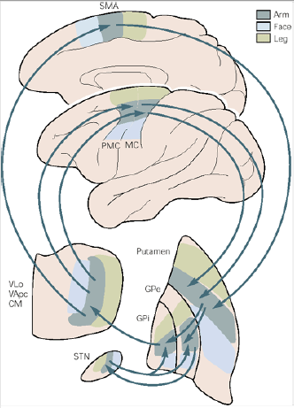

Slide 40
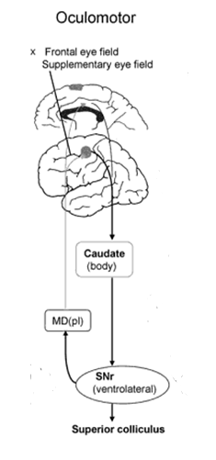

OCULOMOTOR CIRCUIT
FRONTAL EYE FIELD, SUPPLEMENTARY EYE FIELD
BODY OF CAUDATE NUCLEUS
VENTROLATERAL SNr
THALAMUS
VA mc,MD pl
Notes:
Control of saccadic eye movements. Inhibition of tonic activity in the substantia nigra pars reticulata
disinhibits output neurons in the deep layers of the superior colliculus whose activity is
associated with saccades. Inactivation of neurons in the pars reticulata results in
involuntary saccades to the contralateral side. These observations provided the critical clue that
the skeletomotor circuit might similarly disinhibit thalamocortical neurons phasically
during movement, thus facilitating the intended movement.

Slide 41
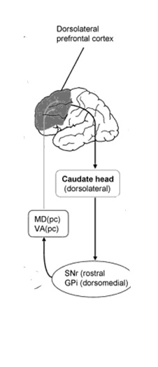
ASSOCIATIVE CIRCUIT
DORSOLATERAL PREFRONTAL
DORSOLATERAL PREFRONTAL CORTEX – 9, 46
DORSOLATERAL CAUDATE HEAD
ROSTRAL SNr
DORSOMEDIAL GPi
THALAMUS
MD pc, VA pc
Notes:
Executive function

Slide 42
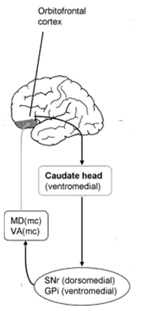
ORBITOFRONTAL CIRCUIT
ORBITOFRONTAL CORTEX- 10 , 11
VENTROMEDIAL CAUDATE HEAD
DORSOMEDIAL SNr
VENTROMEDIAL Gpi
THALAMUS
MD mc , VA mc
Notes:
Regulation of emotion and social behaviour

Slide 43
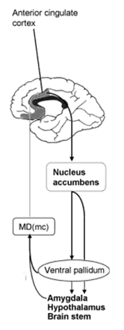

LIMBIC CIRCUIT
ANTERIOR CINGULATE CORTEX- 24, 25
LIMBIC STRIATUM
VENTRAL PALLIDUM
THALAMUS MD mc
Notes:
Regulating motivated behaviours

Slide 44
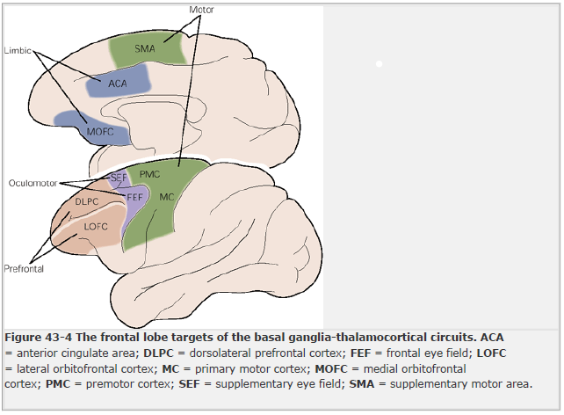

Slide 45
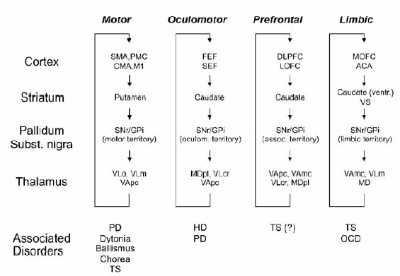

Slide 46
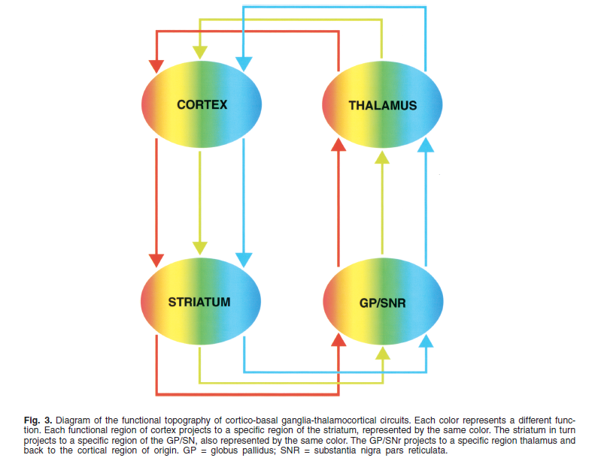
FUNCTIONAL TOPOGRAPHY OF BG-THALAMOCORTICAL CIRCUITS

Slide 47
3 OPEN LOOPS
MOTOR
ASSOCIATIVE
LIMBIC

Slide 48
CLOSED LOOP
OPEN LOOP
MOTOR CORTEX
ASSOCIATION CORTEX
MOTOR STRIATUM
GPi
SNr
THALAMUS
VA
THALAMUS
DM

Slide 49
OPEN LOOP
CLOSED LOOP
MOTOR CORTEX
ASSOCIATION CORTEX
ASSOCIATION
STRIATUM
GPi
SNr
THALAMUS
VA
THALAMUS
DM

Slide 50
OPEN LOOP
CLOSED LOOP
ASSOCIATION CORTEX
LIMBIC CORTEX
LIMBIC
STRIATUM
LIMBIC PALLIDUM
SNr
THALAMUS
DM
THALAMUS
DM

Slide 51
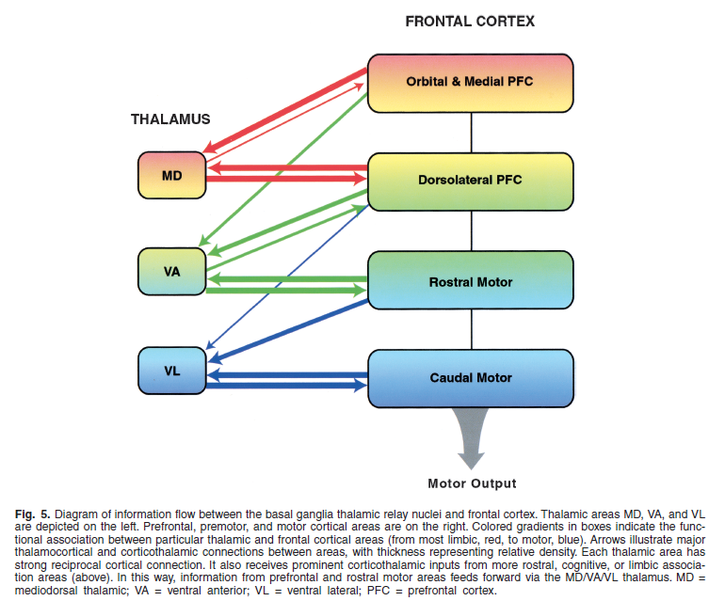

Slide 52
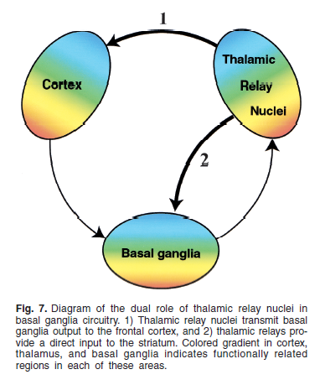

Slide 53
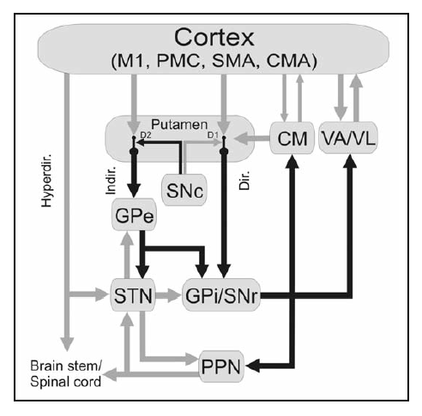
MOTOR CIRCUIT

Slide 54
NEW MODEL OF BG CIRCUITS
Traditionally considered to be a “go-through” system.
NEWER MODELS-
Parallel interactions between corticostriatal and corticosubthalamic afferents on the one hand, and internal feedback circuits modulating basal ganglia output through the GPi and SNr on the other hand.
Notes:
The basal ganglia has traditionally been considered to be a “go-through” system, where cortical afferent activity is modulated by the basal ganglia and is then sent back to the cortex to modify motor activity .

Slide 55
INPUT OUTPUT
Cortical innervation to the basal ganlia -corticostriatal and corticosubthalamic projections.
The primary basal ganglia projections back to the cortex originate in the GPi(and SNr) and pass through the ventral nuclei of the thalamus (VL-VA).

Slide 56
INTERNAL / HORIZONTAL CIRCUITS
Substantia nigra pars compacta (SNc) dopaminergic projections to the striatum and other basal ganglia nuclei
Reciprocal connections between the globus pallidus pars externa (GPe) and the STN and striatum.
Centromedian-parafascicular (CM/Pf) thalamic projections to the striatum and subthalamic nucleus (STN)
Notes:
Several “internal” or “horizontal” circuits control basal ganglia excitability.
In this model, the GPe appears to be strategically placed to modulate basal ganglia output

Slide 57
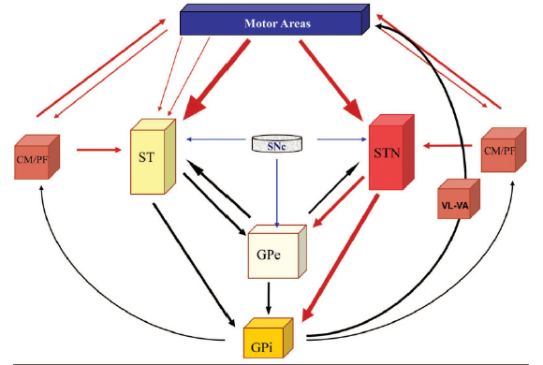
NEW MODEL OF BG CIRCUITS
Notes:
Current emphasis is placed on the parallel interactions between corticostriatal and
corticosubthalamic afferents on the one hand, and internal feedback circuits modulating BG output through the globus pallidus
pars interna and substantia nigra pars reticulata on the other.
Standard
pharmacological treatments do not mimic the normal physiology of the dopaminergic system and, therefore, fail to restore
a functional balance between corticostriatal afferents in the so-called direct and indirect pathways, leading to the development of
motor complications. This review emphasizes the concept that the BG can no longer be understood as a “go-through” station
in the control of movement, behavior, and emotions.

Slide 58
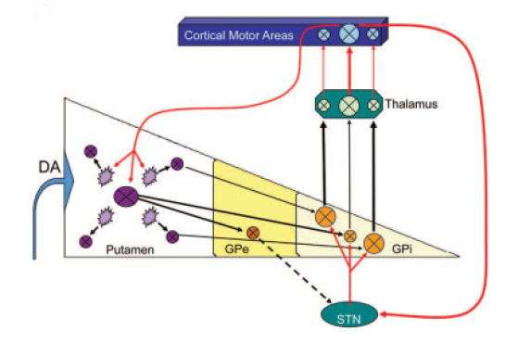
DIRECT AND HYPERDIRECT PATHWAYS
DIRECT PATHWAY
Movement related corticostriatal signal
HYPERDIRECT PATHWAY
Facilitation of desired action
Inhibition of unwanted movements
Notes:
The “direct” and
“hyperdirect” pathways. In the normal state, a movementrelated
corticostriatal signal excites a pool of medium spiny
GABAergic neurons (MSNs) (large circle) in the target area
of the motor striatum. At the same time, there is a parallel
inhibition of surrounding MSNs (small circles) that are unrelated
to the desired action mediated by dopamine and interneurons
(small rough circles). Transmission in activated neurons
in the “direct” pathway subsequently inhibits the
concomitant pool of globus pallidus pars interna (GPi) neurons,
resulting in facilitation of thalamocortical activity underlying
the desired action. The cortical volley also activates neurons
in the subthalamic nucleus (STN; “hyperdirect” pathway),
which increases excitation of surrounding neuronal pools in the
GPi, thereby inhibiting the corresponding region of the thalamus
and the selection of unwanted movements. This combination
of effects allows for specific activation of thalamocortical
fibers subserving a given motor action coupled with inhibition
of surrounding neurons that promote undesired movements.

Slide 59
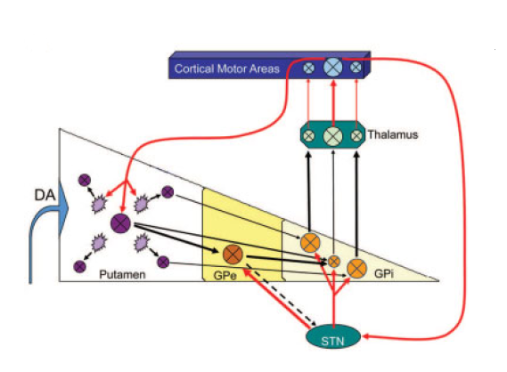
GPe – STN – GPi CIRCUIT
DIRECT PATHWAY
HYPERDIRECT PATHWAY
Notes:
Globus pallidus pars externa (GPe)-STN-GPi circuit.
STN activation leads to excitation of the GPe, which in the
normal state leads to further inhibition of the GPi neuronal
pool associated with the desired movement, thereby facilitating
the effect of the “direct” pathway and the selection of the appropriate
motor activity.

Slide 60
BASAL GANGLIA CIRCUIT DISORDERS

Slide 61
PARKINSON’S DISEASE
Parkinson's description of PD:
“…involuntary tremulous motion, with lessened muscular power, in parts not in action and even when supported, with a propensity to bend the trunk forwards, and to pass from a walking to a running pace, the senses and intellects being uninjured.”

Slide 62
Due to decreased dopaminergic tone in the motor portions of the putamen.
Non motor symptoms-depression, anxiety,autonomic dysfunction,sleep disorders, cognitive impairment
Due to dopamine deficiency in the nonmotor portions of the striatum and more widespread progressive pathologic changes in the brainstem, thalamus, and eventually the cerebral cortex.

Slide 63
PARKINSON’S DISEASE-DIRECT PATHWAY
CORTEX
STRIATUM
GPi
SNr
THALAMUS VL
SNc
GLUTAMATE +
GLUTAMATE +
DOPAMINE +
GABA -
GABA -
GPe STN
Notes:
No dopamine, inhibits striatum,no gaba, disinhibits output nuclei, release GABA, inhibits thalamus and cortex

Slide 64
PARKINSON’S DISEASE – INDIRECT PATHWAY
CORTEX
STRIATUM
GPe
STN
THALAMUS VL
GPi
SNc
GLUTAMATE +
GLUTAMATE +
DOPAMINE -
GABA -
GABA -
GLUTAMATE +
GABA -
Notes:
SNc – no dopamine, disinhibition of striatum, ihhibits Gpe, no gaba, STN disinhibited, release glutamate, stimulates Gpi, inhibits thalamus, inhibits cortex

Slide 65
HUNTINGTON’S CHOREA
CORTEX
STRIATUM
GPe
STN
THALAMUS VL
GPi
SNc
GLUTAMATE +
GLUTAMATE +
DOPAMINE -
GABA -
GABA -
GLUTAMATE +
GABA -
Notes:
Degeneration of intrastriatal cholinergic and gaba ergic neurons, disinhibits the globus pallidus

Slide 66
HEMIBALLISMUS
CORTEX
STRIATUM
GPe
STN
THALAMUS VL
GPi
SNc
GLUTAMATE +
GLUTAMATE +
DOPAMINE -
GABA -
GABA -
GLUTAMATE +
GABA -
Notes:
Lesion in the sub thalamic nucleus- inhibits the inhibitory effect of globus pallidus interna– excitation of thalamus and cortex

Slide 67
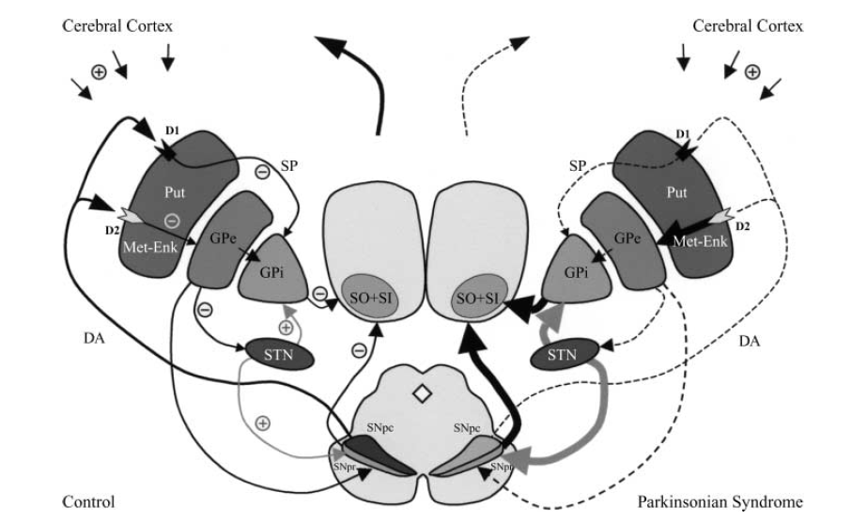
BG CIRCUITS - NORMAL vs PD

Slide 68
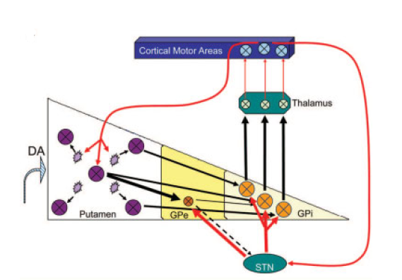
PARKINSONIAN STATE- DIFFICULTY IN THE SELECTION AND EXECUTION OF THE DESIRED MOVEMENT
DIRECT PATHWAY
HYPERDIRECT PATHWAY
Movement related corticostriatal signal
Notes:
In the parkinsonian state, there
is impaired capacity to filter cortical inputs and to specifically
activate MSN pools responsible for a desired motor activity. In
addition, the STN-GPi pathway is hyperactive and responds
excessively to input signals, which reduces the signal-to-noise
ratio in the GPi. Altogether, these changes make precise movement
selection and execution difficult

Slide 69
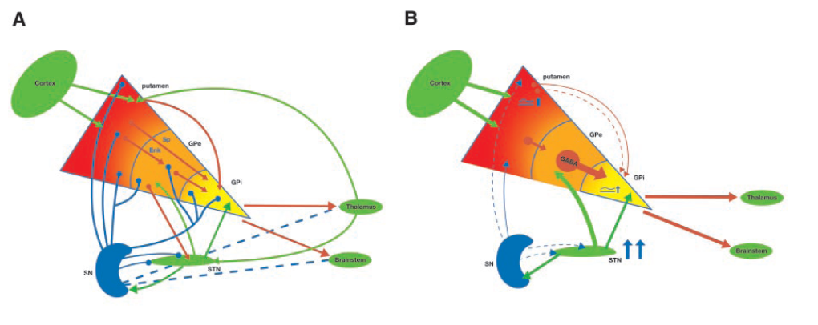
NORMAL
EARLY PD
Modifications induced by dopamine depletion in early PD. Hyperactivity of the STN precedes significant dopamine depletion. Therefore, the GPe is still functionally operative and overstimulated by the STN. This leads to increased inhibition from the GPe to the GPi, disnhibition in the “direct” pathway
Notes:
PATHWAYS OF THE BASAL GANGLIA IN DIFFERENT FUNCTIONAL STATES
Normal basal ganglia, highlighting that dopaminergic innervation is not limited to the striatum and the various “internal” loops. (B) Modifications induced by dopamine depletion in early PD. Hyperactivity of the STN precedes significant dopamine putaminal depletion. Therefore, the GPe is still functionally operative and overstimulated by the STN. This leads to increased inhibition from the GPe to the GPi, which partially compensates for the augmented excitation from the STN and reduced inhibition in the “direct” pathway

Slide 70
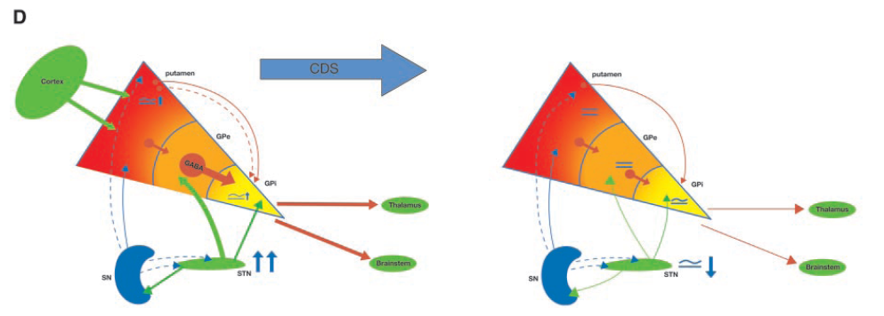
EARLY PD
(D) Effects of stable dopaminergic delivery in early PD. Hyperactivity of both the STN and putamino-GPe projections is normalized, restoring the homeostatic mechanisms of the basal ganglia and output activity. This should reduce the probability of developing motor complications.

Slide 71
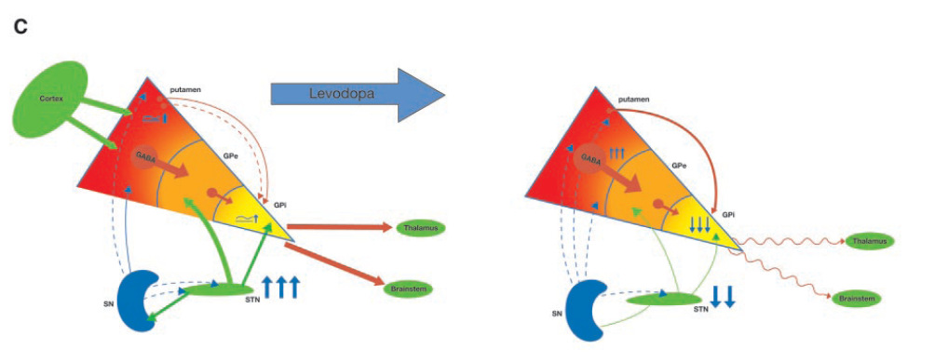
ADVANCED PD
(C) Changes associated with advanced PD and the effects of levodopa. At this stage, striatal depletion has progressed and both striatopallidal projections are altered. There is increased inhibition from the GABA/enkephalin projection to the GPe, which is hypoactive and no longer compensates for STN hyperactivity. This results in overactivity of GPi output and abnormal inhibition of motor areas. In this state, levodopa does not restore the normal physiology of the basal ganglia.

Slide 72
THEORIES IN PARKINSON’S DISEASE
GPi RATE THEORY
BURSTING NEURONS THEORY
SYNCHRONISATION THEORY
PROKINETIC ANTIKINETIC OSCILLATORS THEORY
SYSTEMS OSCILLATORS THEORY

Slide 73
GPi RATE THEORY IN PD
This explains the pathophysiology of Parkinson’s Disease based on the increased rate of neuronal discharges of the globus pallidus internal segment (GPi)
Its strengths were its consistency with anatomy, neurochemistry, some experimental evidence and simplicity.

Slide 74
GPi RATE THEORY
MAIN FEATURES
Overactivity of GPi suppressing activity of Thalamo cortical circuit
FACTORS IN FAVOUR
Increased neuronal activity in GPi and STN in MPTP treated models
Effectiveness of Pallidotomy

Slide 75
GPi RATE THEORY
FACTORS AGAINST
No change in neuronal activity in GP, STN, Cortex in some MPTP treated models of PD
FACTORS AGAINST
FACTORS AGAINST
No change in Gpi in Non MPTP models of PD
No differences in GPI and STN neuronal activity in PD compared to other neurological conditions
FACTORS AGAINST
Therapeutically effective Gpi DBS drives Gpi output

Slide 76
BURSTING NEURONS THEORY
MAIN FEATURES
Change in pattern of neuronal activity with increased bursting in GPi
FACTORS IN FAVOUR
Demonstration of increased neuronal bursting activity in Gpi in some MPTP treated models
FACTORS AGAINST
Unclear account of pathophysiology
Levodopa treatment in animal models does not affect bursting.

Slide 77
SYNCHRONISATION THEORY
Main Features
Increased synchronisation of neuronal activities within the basal ganglia
Factors in favour
Demonstration of increased synchronisation in animal models

Slide 78
SYNCHRONISATION THEORY
FACTORS AGAINST
Synchronisation seen in the normal initiation of movement
Therapeutically effective STN ,Gpi DBS increase synchronisation of neuronal activities
FACTORS AGAINST

Slide 79
There is a variety of oscillatory phenomena that occur in the basal ganglia and in associated regions of the thalamus and cortex.
The most significant finding is that in Parkinson’s disease synchronized oscillatory activity in the 10- to 35-Hz band (often termed “β-band”) is prevalent in the basal ganglia–thalamocortical circuits, and that such activity can be reduced by dopaminergic treatments.

Slide 80
PROKINETIC/ ANTIKINETIC OSCILLATORS THEORY
MAIN FEATURES
PD associated with increase in the antikinetic 20Hz oscillator and decrease in the prokinetic 70 Hz oscillator
FACTORS IN FAVOUR
Empirical demonstration of differences in the anti and prokinetic oscillators recordings in local field potentials in PD and effective treatment of PD

Slide 81
PROKINETIC/ ANTIKINETIC OSCILLATORS THEORY
FACTORS AGAINST
Unclear mechanistic account of pathophysiology
FACTORS AGAINST
FACTORS AGAINST
70 Hz prokinetic oscillator too slow to account for the rapid dynamics of neuronal activity.
Inconsistent with the therapeutic effectiveness of low frequency DBS for gait and speech in PD
FACTORS AGAINST
Evidence of oscillators in all nuclei of BG-TH-CTX system with coherence across multiple nuclei
Unclear whether causal or epiphenomenal

Slide 82
SYSTEMS OSCILLATORS THEORY
MAIN FEATURES
Basal Ganglia- Thalamo Cortical system comprised of dynamically coupled, non linear , re entrant, polysynaptic oscillators representing wide range frequencies.
The main oscillator is the very high frequency (140 Hz) thalamo cortical circuit whose activity is modulated by lower frequency oscillators comprising the basal ganglia nuclei.

Slide 83
Physiology and pathophysiology represented in the BG- TH- CTX systems rather than specific nuclei.

Slide 84
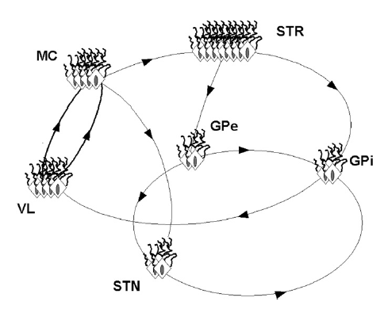
SYSTEMS OSCILLATORS THEORY
BG–TH–CTX system has many sets of nested or interconnected reentrant oscillators or loops.
Each oscillator is made up of nodes and connections between nodes. Nodes represent subsets of neurons within the individual anatomical nuclei.

Slide 85
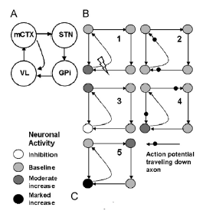
SYSTEMS OSCILLATORS THEORY
The model consists of a four-node oscillator (loop) made up of mCTX, STN, GPi, and VL.
There is a two node-oscillator made up of the VL and mCTX nested within the fournode oscillator.

Slide 86
SYSTEMS OSCILLATORS THEORY
1. The DBS pulse orthodromically activates the axon from Gpi to VL and antidromically activates the VL axon projecting to the motor cortex.
2. The activity in VL is orthodromically transmitted to the motor cortex while activity of Gpi is transmitted to VL
Notes:
Each numbered step in (B) shows the subsequent activations

Slide 87
SYSTEMS OSCILLATORS THEORY
3. The orthodromic activation of VL axons result in excitation of motor cortex while orthodromic activation of GPi axons results in inhibition of VL.
4. MCTX activity is transmitted back to VL at the same time there is a post inhibitory rebound increase in activity in VL.
5 The combination of these two results in a marked increase in activity of the thalamus.

Slide 88
SYSTEMS OSCILLATORS THEORY
FACTORS IN FAVOUR
Demonstration of multiple and high frequencies in the neuronal spike trains of BG nuclei
Demonstration of Resonance amplification of high frequency oscillations by DBS.
Evidence of direct activation of motor cortex with STN, Gpi and VL DBS consistent with the VL-CTX as the primary oscillator

Slide 89
Consistent with nearly simultaneous activities within multiple nuclei in the BG- TH- CTX system.
Accounts for the similar efficacy of brain stimulation across multiple structures of the BG- TH- CTX system.
Accounts for the production of Parkinsonism by lesion of multiple different structures such as the Gpe and SMA.

Slide 90
Accounts for simultaneous hypo and hyper kinesia of HD and LDD.
Accounts for the therapeutic efficacy of anticholinergic agents

Slide 91
Recently, the systems oscillators theory has been refined since the demonstration that high rate DBS can worsen speech while low rate DBS improves it . Similarly, low rate DBS of the pedunculopontine nucleus may help gait .
The refined theory holds that the VL–mCTX circuit is the main oscillator driving bulbar and spinal motor neuron recruitment

Slide 92
REFERENCES
The basal ganglia in Parkinson's disease: Current concepts and unexplained observations⁻Front Neuroanat. 2011; 5: 39
The Basal Ganglia in Parkinson’s Disease: Current Concepts and Unexplained Observations – Obeso et al-Ann Neurol 2008;64 (suppl):S30–S46
Pathophysiology of the basal ganglia in Parkinson's disease-Obeso et al-Trends Neurosci. 2000 Oct;23(10 Suppl):S8-19.
Subthalamic nucleus and its connections-Anatomic substrate for the network effects of deep brain stimulation-Eduardo E. Benarroch. Neurology 70 May 20, 2008

Slide 93
REFERENCES
Basic Neurosciences with Clinical Applications by Eduardo E. Benarroch
Theory of the Basal Ganglia and Their Disorders by Robert Miller
Essential Neuroscience by Allan Siegel
Circuits and Circuit Disorders of the Basal Ganglia- DeLong et al- ARCH NEUROL/VOL 64, JAN 2007
CLINICAL EEG and NEUROSCIENCE ©2010 VOL. 41 NO. 261-Changing Views of Basal Ganglia Circuits and Circuit Disorders- DeLong et al

Slide 94
REFERENCES
The Place of the Thalamus in Frontal Cortical-Basal Ganglia Circuits-Neuroscientist 2001 7: 315- Haber et al
Atlas of Regional Anatomy of the Brain Using MRI: With Functional Correlations

Slide 95
WHICH AMONG THE FOLLOWING STRUCTURES CONTAIN PREDOMINANT D3 DOPAMINE RECEPTORS
1. STRIATUM
2. HIPPOCAMPUS
3. NUCLEUS ACCUMBENS
4. LIMBIC STRUCTURES

Slide 96
WHICH AMONG THE FOLLOWING STRUCTURES CONTAIN PREDOMINANT D3 DOPAMINE RECEPTORS
1. STRIATUM- D1, D2
2. HIPPOCAMPUS- D5
3. NUCLEUS ACCUMBENS- D3
4. LIMBIC STRUCTURES- D4

Slide 97
WHICH AMONG THE FOLLOWING CONSTITUTES THE ANTERIOR PERFORATED SUBSTANCE
1. NUCLEUS ACCUMBENS
2. SUBSTANTIA INNOMINATA
3. ZONA INCERTA
4. PEDUNCULOPONTINE NUCLEUS

Slide 98
WHICH AMONG THE FOLLOWING CONSTITUTES THE ANTERIOR PERFORATED SUBSTANCE
1. NUCLEUS ACCUMBENS
2. SUBSTANTIA INNOMINATA
3. ZONA INCERTA
4. PEDUNCULOPONTINE NUCLEUS

Slide 99
WHICH AMONG THE FOLLOWING BASAL GANGLIA CIRCUITS IS CONCERNED WITH THE REGULATION OF EMOTION AND SOCIAL BEHAVIOUR
ASSOCIATIVE CIRCUIT
LIMBIC CIRCUIT
ORBITOFRONTAL CIRCUIT

Slide 100
WHICH AMONG THE FOLLOWING BASAL GANGLIA CIRCUITS IS CONCERNED WITH THE REGULATION OF EMOTION AND SOCIAL BEHAVIOUR
ASSOCIATIVE CIRCUIT- Executive function
LIMBIC CIRCUIT- Regulating motivated behaviours
3. ORBITOFRONTAL CIRCUIT- Regulation of emotion and social behaviour

Slide 101

THANKYOU

