Slide 1
MEASUREMENT OF THE NASAL AIRWAY

Slide 2
Levels of Evidence
Grade A – Systemic reviews, Meta analyses, RCT
Grade B – Non-randomized studies
Grade C – Observational studies
Grade D – Case Series, Expert opinion

Slide 3
Levels of Evidence
**** ~ Systematic reviews, meta analysis of randomized control studies
*** ~ Non randomised studies
** ~ Observational or non experimental studies
* ~ Expert opinion

Slide 4
NASAL AIRWAY
Rhinomanometry provides a functional measure of the nasal airway resistance or conductance
Acoustic rhinometry provides an anatomical measurement of cross-sectional area or nasal volume

Slide 5
RHINOMANOMETRY
Dynamic test of nasal function that calculates nasal airway resistance (NAR)
Measures⁽¹⁾
  Transnasal pressure
  Nasal airflow
Laminar airflow versus turbulent airflow
Three methods-active and passive.
Active rhinomanometry
  Active anterior rhinomanometry
  Passive anterior rhinomanometry

Slide 6
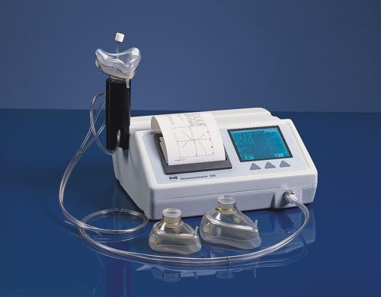
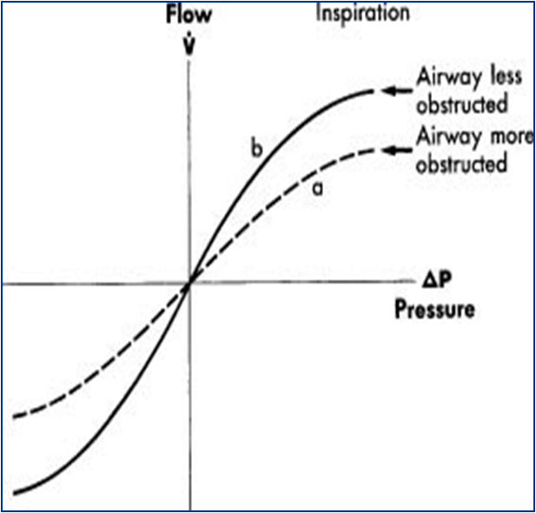
RHINOMANOMETRY

Slide 7
RHINOMANOMETRY
UNILATERAL NASAL AIRFLOW Measured at sample pressure point of 150 Pa and bilateral nasal airflow measured at 75 Pa are recommended as universal standard.
Total nasal resistance to airflow can be either determined directly using the posterior method of rhino manometry or it can be calculated by combining the two separate values of nasal resistance for the two nasal passages.
1/R (total) = 1/r (left) + 1/r (right)
The reciprocal of total resistance is equal to the sum of the reciprocals of left and right resistance.

Slide 8
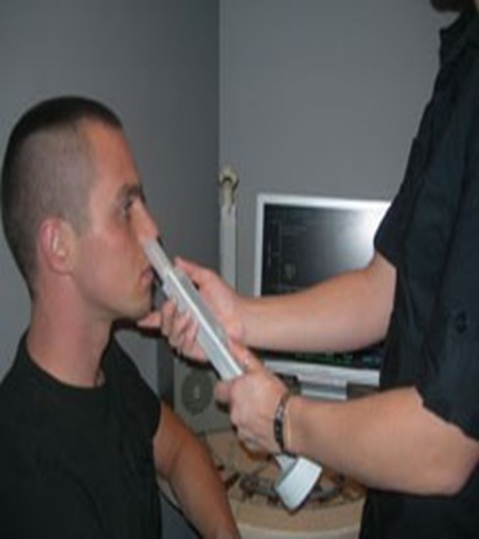
ACOUSTIC RHINOMETRY
Based on the analysis of sound waves reflected from the nasal cavity.
Two -dimensional picture of the nasal cavity.
Normal value – 0.7 cm2

Slide 9
OTHER METHODS
Peak nasal inspiratory flow rate
Nasalance
  Measured by pair of directional microphones mounted on either side of hard palate
  Ratio of nasality of sound output from nose vs mouth
  Inversely proportional to nasal airway resistance
Rhinostereometry
  Plotting of changes of inf turbinate by binocular microscope
  Patient head fixed by biting into tailor made tooth splint fixed on microscope

Slide 10
NAME OF STUDY | NAME OF AUTHOR | REFERENCE DETAILS | SAMPLE SIZE | RESULT | P VALUE | CONCLUSION
Objective measurement of nasal airway dimensions using acoustic rhinometry: methodological and clinical aspects | Hilberg O. | Allergy. 2002;57 Suppl 70:5-39. | 30 | Acoustic rhinometry showed reasonable correlation with CT in a cadaver and in 10 subjects in comparison with MRI for the first 6 cm of the nasal cavity. Models based on MRI scannings of subjects also showed good correlation for the first 6 cm of the nasal cavity. Posteriorly in the nasal cavity and the epipharynx, differences were found mainly due to 'sound loss' to the paranasal sinuses. Sound loss due to viscous loss or friction at increasing surface/area ratio (the complex geometry in the nose) and loss due to nonrigidity the nasal mucosa were also examined. Neither these factors affected the area-distance function significantly. | Less then 0.05 | A decade after its introduction acoustic rhinometry is a well-established method for evaluation of nasal patency, but further improvement can be obtained by continued validation and adjustments of the technique.

Slide 11
QUESTIONS
WHAT IS RHINOMANOMETRY?
Dynamic test of nasal function that calculates nasal airway resistance (NAR)
anatomical measurement of cross-sectional area or nasal volume
All of the above
None of the above

Slide 12
WHAT IS ACOUSTIC RHINOMETRY?
Dynamic test of nasal function that calculates nasal airway resistance (NAR)
anatomical measurement of cross-sectional area or nasal volume
All of the above
None of the above

Slide 13
WHAT DOES RHINOMANOMETRY MEASURE?
A.Transnasal pressure
B.Nasal airflow
C.Cross sectional area
D.A and B

Slide 14
WHAT IS THE VOLUME OF NASAL CAVITY?
0.7
0.
0.6
0.9

Slide 15
WHAT ARE THE OTHER METHODS USED?
Peak nasal inspiratory flow rate
Nasalance
All of the above
None of the above

Slide 16
THANK YOU

