Slide 1
BRACHIAL PLEXOPATHY
Faculty : Dr. C.Rathore

Slide 2
SCHEME
Anatomy
Nerve conduction study
Individual conditions
Etiology
Cases
journal

Slide 3
INTRODUCTION
The brachial plexus is a complicated anatomic structure formed by the ventral rami of the lower cervical and upper thoracic nerve roots.
Different fascicles from those roots intermix widely within the plexus to ultimately form all the nerves of the upper extremity

Slide 4
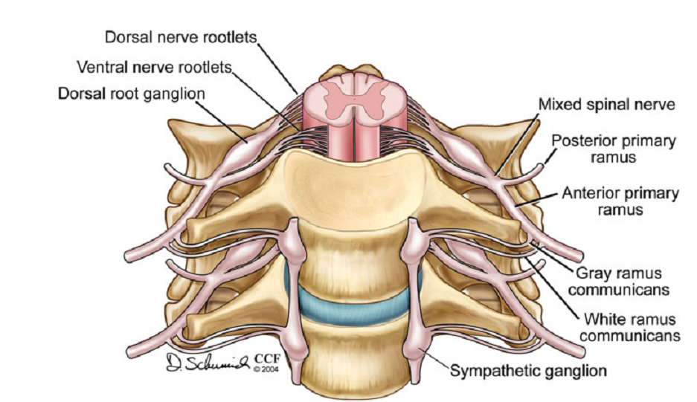

Slide 5
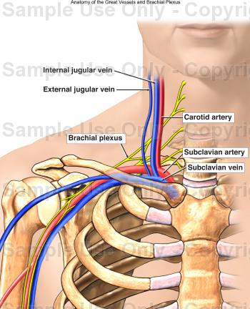
Anatomy
Average extraforaminal length – 15.3 cm
Composed of connective tissue and neural tissue in a ratio of 2 : 1

Slide 6
Elements of brachial plexus
1) Five roots – C5 to T1
2) Three trunks – Upper, middle, lower.
3) Six divisions – 3 anterior + 3 posterior
4) Three cords – Lateral, Posterior and Medial
5) Terminal nerves -
strictly speaking, the roots and peripheral nerves are not considered part of the plexus proper.

Slide 7
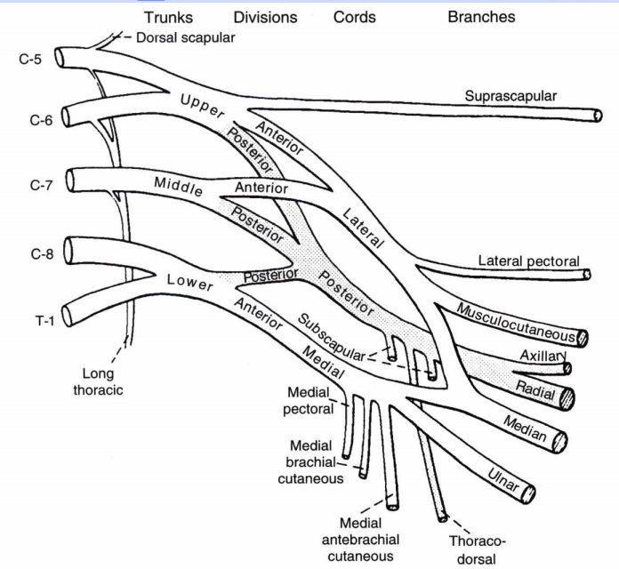
Notes:
Each trunk then divides into an anterior and posterior
division. From these six divisions, the cords are formed,
located below the level of the clavicle.

Slide 8
ANOMALIES
Prefixed- the brachial plexus is formed predominantly from the C4-C7 roots
post fixed- innervation from the C6-T2 roots.

Slide 9
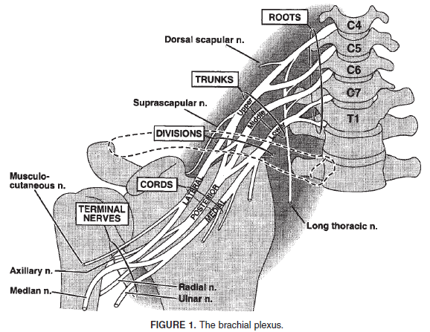

Slide 10
Branches from roots
1) Scalene and longus colli (C5 - C8)
2) Long thoracic nerve (C5 - C7) – Serratus anterior
3) Dorsal scapular nerve (C5) - Rhomboids, Levator scapulae
4) Phrenic nerve (C5) - Diaphragm

Slide 11
Trunks
Located in the posterior cervical triangle.
Behind the clavicle and sternomastoid
Upper Trunk – C5 and C6
Middle trunk – C7
Lower trunk – C8 and T1

Slide 12
Branches from Trunk
Only from Upper trunk-
-Suprascapular nerve: to
SS and IS (C5)
- Nerve to the Subclavius
muscle(C5)
Lower trunk- close relation to subclavian artery and lung apex.

Slide 13
Divisions
Retroclavicular
No direct branches.

Slide 14
Cords
Infraclavicular part of plexus.
In the proximal axilla.
Named according to relation to second part of axillary artery.

Slide 15
Posterior cord
Union of posterior divisions.
C5, C6, C7 -sensory
C5–C8: motor.
Branches-
Upper subscapular
Lower subscapular
Nerve to latissimus dorsi
Axillary nerve
Radial nerve

Slide 16
Lateral cord
Union of anterior division of upper and middle trunk -- C5, C6 , C7
-----Branches-----
Lateral pectoral nerve
Musculocutaneous
Lateral part of median nerve.
(LML)
No C5 sensory fibres pass through lateral cord (C5 sensory – posterior cord).

Slide 17
Medial cord
Anterior division of lower trunk.
C8, T1 motor and sensory.
-----Branches-----
Medial brachial cutaneous nerve.
Medial antebrachial cutaneous nerve.
Medial pectoral nerve.
Medial part of median nerve.
Ulnar nerve.

Slide 18
Classification of Brachial plexopathies
1)Supraclavicular (root & trunk):
can be assigned into one of the 5 categories:
1) upper trunk alone
(2) upper and middle trunk
(3) middle and lower trunk
(4) lower trunk alone
(5) diffuse or panplexus
2)Retroclavicular(divisions):rare
3)Infraclavicular (cords and nerves)

Slide 19
Evaluation of Brachial plexus
History and Clinical examination
Electrophysiological tests
Imaging and other ancillary tests – angiogram, MRI, etc

Slide 20
Clinical assessment of various plexus
components individually.
Supracla - vicular | Sensory | Motor | Reflex
Upper trunk C5,6 | Lateral arm & forearm, lateral hand & thumb (dorsal & palmar) | Deltoid, supra-infraspinatus, biceps, brachioradialis | Biceps Brachioradialis
Middle trunk C7 | Middle & index fingers, posterior forearm | Triceps, PT, FCR | Triceps
Lower trunk C8, T1 | Medial arm & forearm, medial hand, 4th & 5th digits | FDI, APB, FPL, FDP, EIP | None

Slide 21
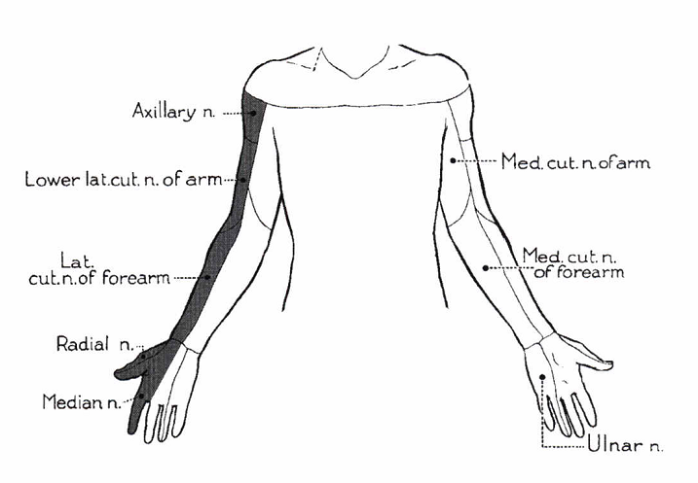
Upper trunk

Slide 22
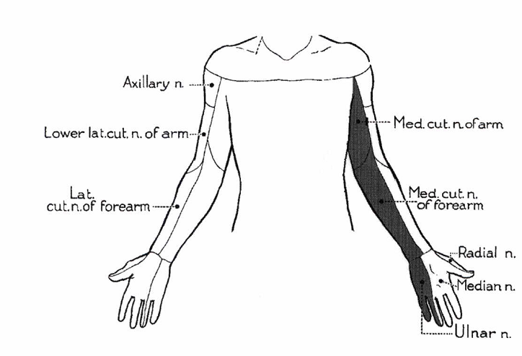
Lower trunk

Slide 23
Clinical assessment of various plexus
components individually.
Infraclavicular | Sensory | Motor | Reflex
Posterior Cord | Lateral arm, posterior arm & forearm, radial dorsal hand | Deltoid, LD, all radial innervated ms | Triceps, brachioradialis
Lateral cord | Lateral forearm & hand, lateral 3 fingers | Biceps, PT, FCR | Biceps
Medial cord | Medial arm & forearm, medial hand, 4th & 5th digits | FDI, APB, FPL, FDP | None

Slide 24
Panplexus
A complete brachial plexopathy results in weakness, sensory loss, and decreased or absent reflexes in the entire arm.
the serratus anterior and rhomboids usually are the only muscles spared

Slide 25
Localization in brachial plexus
C5-C6 roots Vs upper trunk Vs lateral cord
C5-C6 roots (rami) Vs upper trunk
  Sparing of rhomboids and serratus anterior in upper trunk
Upper trunk Vs lateral cord
  Sparing of deltoid & brachioradialis in lateral cord
  Sensory affection of middle finger in lateral cord

Slide 26
C7 root Vs middle trunk Vs posterior cord
C7-root Vs middle trunk
  Cannot differentiate
Middle trunk Vs posterior cord
  Sparing of deltoid & brachioradialis in middle trunk lesions
  Sensory affection in index & middle finger in middle trunk, never in posterior cord

Slide 27
C8- T1 roots Vs lower trunk Vs medial cord
C8-T1 roots Vs Lower trunk
  Horner’s
Lower trunk Vs medial cord
  Sparing of Extensor indicis proprius and extensor pollicis brevis in medial cord
Notes:
27

Slide 28
Electrodiagnostic assessment
Advantages over clinical
1) Better localisation and characterisation
2) Subtle involvement in clinically normal muscle
3) To prove continuity in myotomal pattern of involvement.
4) Clinically inaccessible muscles.
5) Estimate lesion severity for current and future comparisons.
6) etiology

Slide 29
Recommended NCS protocol for BP
Sensory NCS play a central role in assessment of possible brachial plexopathy
Sensory NCS
        Median nerve: rec from thumb & index finger
        Ulnar nerve
        Radial nerve
        LABC
        MABC
Compare with unaffected side, esp if potentials are near lower limit of normal.
50% diff in SNAP from side to side- abnormal
Notes:
In the arm, the lateral ante-brachial cutaneous, radial, median, ulnar, and medial
antebrachial cutaneous sensory conduction studies are all
easily performed. In brachial plexopathy, one or more of
these SNAPs usually are abnormal, depending on the
location and etiology of the lesion

Slide 30
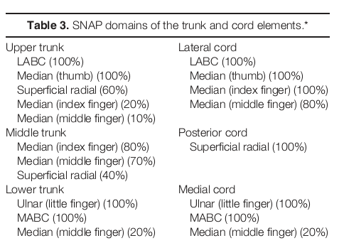

Slide 31
Motor NCS
Median nerve - four point (wrist, elbow, axilla and Erb’s point)
        Ulnar nerve - four point
        Radial nerve - four point
        Axillary nerve
        Musculocutaneous nerve
        Suprascapular nerve
F responses- median & ulnar

Slide 32
Pitfalls in Motor conduction study
Motor studies are less useful in the assessment of brachial plexopathy.
Their usefulness lies primarily in excluding multiple entrapment neuropathies that can mimic a brachial plexus lesion.

Slide 33
The routine median, ulnar, and radial motor studies all record from distal C8—T1-innervated muscles.
are useful only in assessing medial cord or lower trunk lesions.
radial motor studies are useful only in assessing posterior cord or lower trunk lesions.
Lesions of the lateral cord or of the upper or middle trunks do not result in any abnormalities on routine motor studies

Slide 34
Technical EDX diff in BP
it may be diff to obtain supramaximal stimulation at proximal sites, esp, Erb’s point.
Submaximal stimulation, if not recognized, may give mistaken impression of conduction block (CB).
Co-stimulation of adjacent nerves at axilla & Erb’s point.
Collision study should be performed, otherwise focal slowing & CB may be missed.

Slide 35
EMG approach
An extensive EMG study of many muscles must be performed to tease out the correct pattern.
Ideally, enough muscles to represent all the trunks, cords, and nerves should be studied.

Slide 36
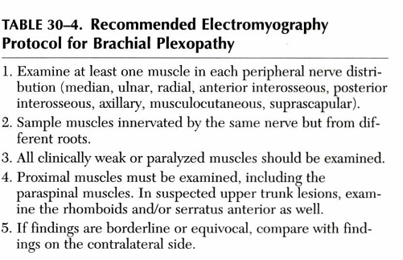

Slide 37
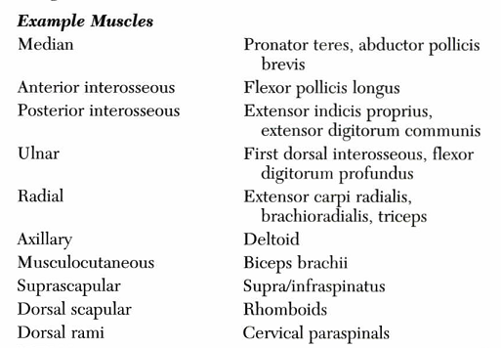

Slide 38
COMMON Electrophysiological
PATTERNS OF BRACHIAL PLEXOPATHY

Slide 39
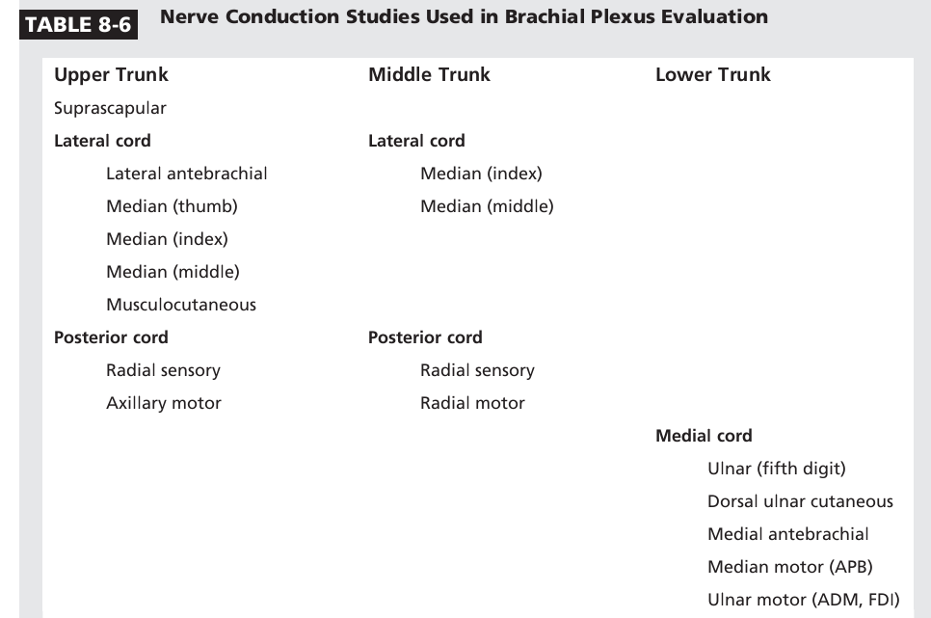

Slide 40
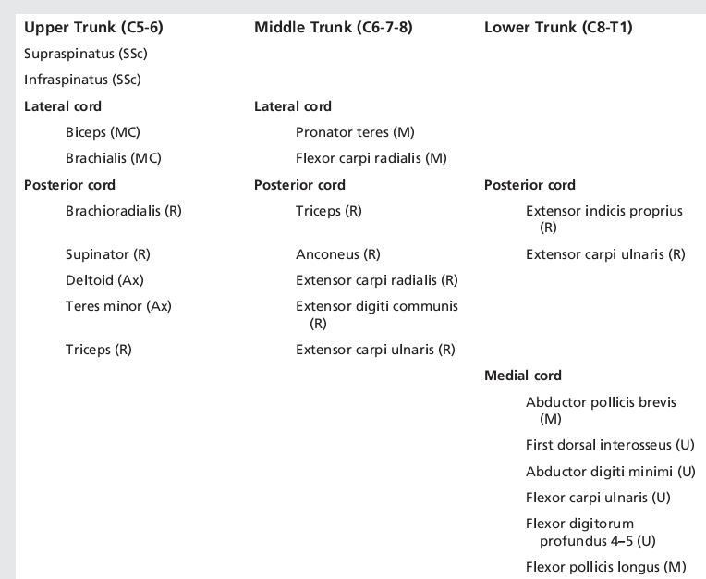

Slide 41
Information from EDx study
Pathophysiology
Axonal
↓amp of CMAP & SNAP
Spontaneous denervation
Reduced recruitment
Most common pathology
Eg; Avulsions & neoplasm
Prognosis poor
Demyelinating
↓CV, ↑DL, CB
↓recruitment with CB
Eg; Traumatic, Rucksack,
Radiation
Prognosis better except in
radiation

Slide 42
Timing in axonal loss
If this temporal pattern is ignored, localisation can go wrong.
↓ CMAP amplitude | Day 3
↓ SNAP amplitude | Day 6
Spontaneous activity | Day 10- 2 weeks
Large, long, polyphasic MUAPs | > 2-3 months

Slide 43
localisation of proximal extent
CMAP – abnormal and SNAP normal – lesion is preganglionic – provided the test is done after 11 days.
In all cases of suspected upper trunk lesions, EMG of paraspinals, serratus & rhomboids to be done to differentiate from radiculopathies.

Slide 44
Prognostication
CMAP- proportional to amount of axonal loss
Denervation- If profuse suggest severe lesions
MUAPs- No activation despite good effort is ominous sign

Slide 45
Prognositcation & outcome
Good | Dismal | Variable
Rucksack paralysis | Avulsion | Post op paralysis
Burner syndrome | Metastasis | Traumatic
True TOS | Radiation plexopathy | Primary neoplasm
Post sternotomy | Disputed TOS | Obstetric palsy

Slide 46
ETIOLOGY

Slide 47
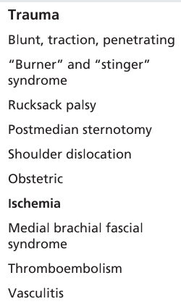
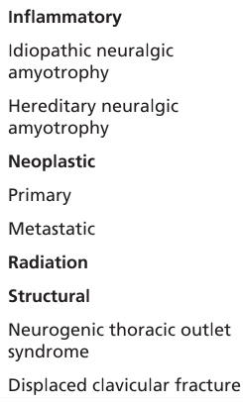

Slide 48
CASE 1
Miss S 26/F
H/o atrophy of thenar muscles( R hand) , neck pain and shoulder pain since 4 years
O/E wasting of Rt thenar, FDI, lumbricals
decreased sensation of medial aspect of forearm
No Horner’s
DTR Normal

Slide 49
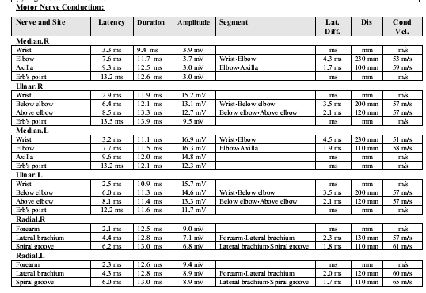

Slide 50
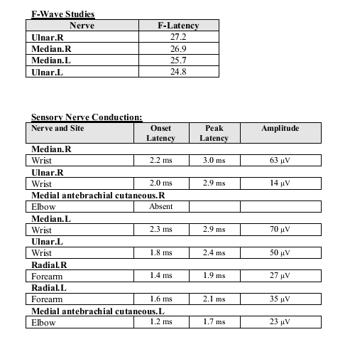

Slide 51
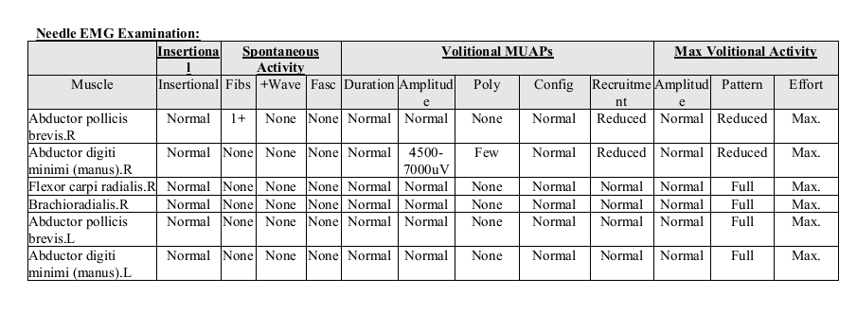

Slide 52
Right TOS
B/L cervical rib
MRI - normal

Slide 53
Thoracic Outlet Syndrome
fibrous band that runs from a rudimentary cervical rib to the first thoracic rib, entrapping the lower trunk of the brachial plexus
the fibrous band most often preferentially affects the T1 fibers
prominent wasting and weakness of the thenar and, less prominently, the hypothenar muscles
Notes:
it may be that the thenar muscles are
more Tl innervated, whereas the hypothenar muscles
receive more C8 innervation

Slide 54
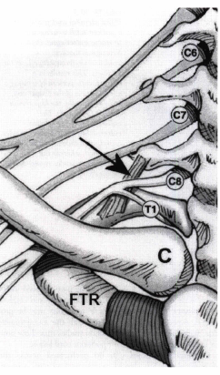
Most cases of true NTOS are
caused by a fibrous band that
runs from a rudimentary cervical rib
to the first thoracic rib (arrow),
entrapping the lower trunk of
the brachial plexus.

Slide 55
TOS has to be differentiated from C8T1 radiculopathy and Ulnar neuropathy
In neurogenic TOS, thumb abduction not only is involved but often preferentially affected.
In a C8-T1 radiculopathy, thumb abduction may be weak but is not out of proportion to weakness of the other C8- T1-innervated muscles.

Slide 56
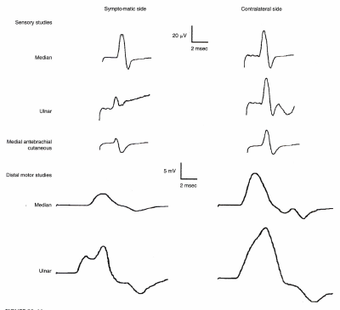
Distinct SNC & MNC pattern in TOS
Low ulnar & MABC SNAPs with Normal Median nerve SNAP
Median innv thenar muscles more affectec than ulnar-hypothenar
Reflects greater T1 innervation of thenar muscles as compared to hypothenar

Slide 57
CASE
Mr P 49/M
Rt shoulder & upper scapular pain- no radiation / no neck pain
Next day weakness of Rt UL- lifting hand above shoulder and flexing at elbow
Paresthesia of post arm
Thinning of arm and shoulder
No DM

Slide 58
O/E
Hypotonia of Rt UL
Wasting of Rt SS, IS, deltoid, triceps, biceps, LD
Weakness of deltoid,SS,IS,biceps,brachioradialis
UL DTR- absent
LL DTR- 3+/3+
Plantar b/l flexor
Decreased sensn of right lateral arm

Slide 59
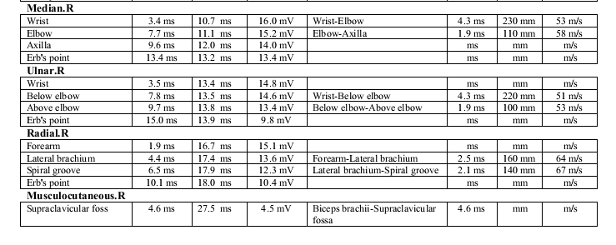

Slide 60
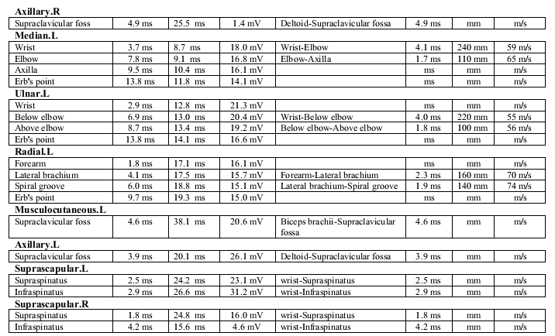

Slide 61
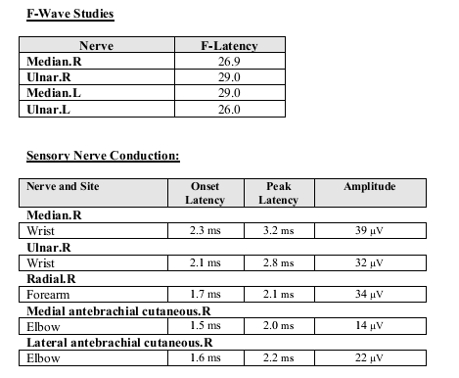

Slide 62
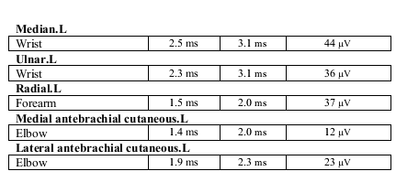

Slide 63
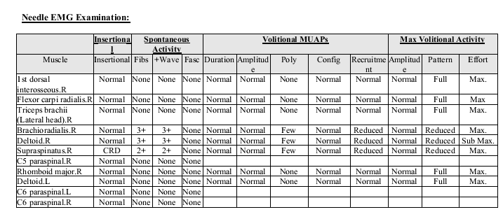

Slide 64
CASE
Mr N 35/M
h/o pain in Lt arm- nocturnal since Dec 2010
Weakness ( proximal)and wasting of left arm and shoulder since Aug 2011
Pain in rt arm- Aug 2011
No radicular pain/ sensory symptoms

Slide 65
O/E
Wasting of left deltoid, SS ,IS
Hypotonia of Lt UL
Weakness of Lt SS, IS, deltoid ( 3) triceps ( 4)
DTR N/N
Decreased sensn of lateral aspect of arm

Slide 66
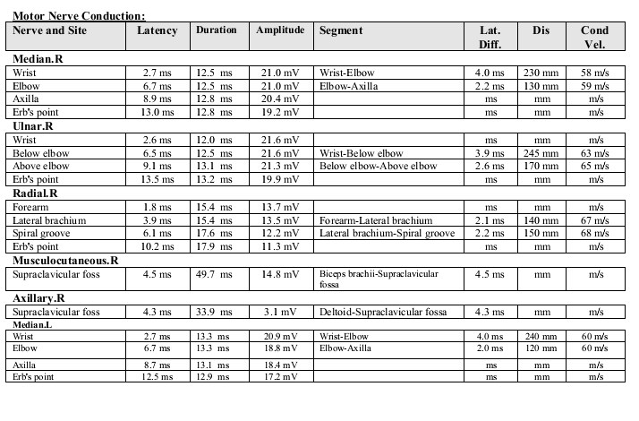

Slide 67
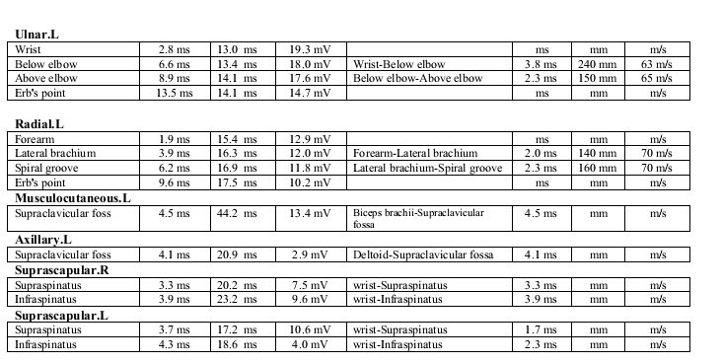

Slide 68
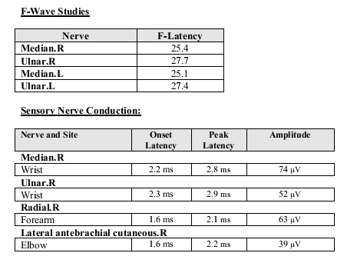

Slide 69
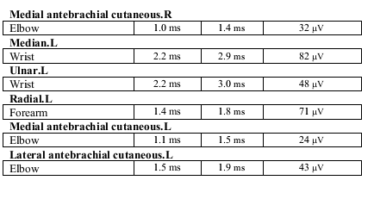

Slide 70
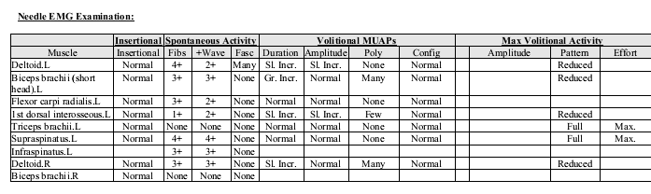

Slide 71
Neuralgic Amyotrophy (Brachial Plexitis)
frequently affects individual upper extremity nerves or the brachial plexus.
In many but not all cases, the syndrome is preceded by an antecedent event that triggers the immune system, usually a viral illness or immunization or, occasionally, surgery.

Slide 72
Neuralgic amyotrophy (Parsonage Turner syn)
Predilection for motor and more proximal nerves – long thoracic, suprascapular and axillary nerves.
Within the brachial plexus, upper trunk is most commonly involved.

Slide 73
The pain is severe, often awakening the patient from sleep.
Muscle atrophy and weakness
paresthesias and sensory- may be present

Slide 74
CASE
Mr KK 40/m
h/o RTA 08/04/2012- foll which he developed left UL weakness- unable to lift arm above shoulder
Pain in left shoulder and arm
Numbness of lateral aspect of arm

Slide 75
O/E hypotonia of Left UL
Wasting of left deltoid
Weakness of deltoid, SS, biceps (0-2)
Sensory loss along the outer aspect of left arm and forearm
Left BJ, SJ are absent
Other DTR normal

Slide 76
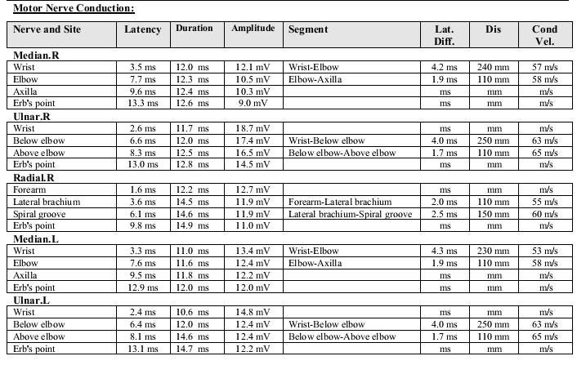

Slide 77
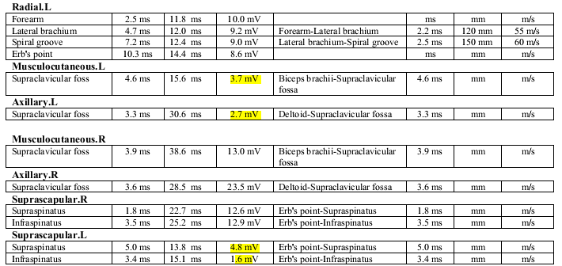

Slide 78
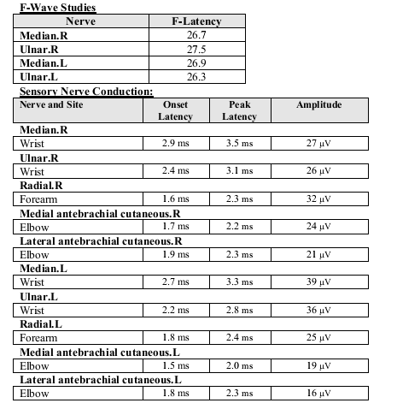

Slide 79
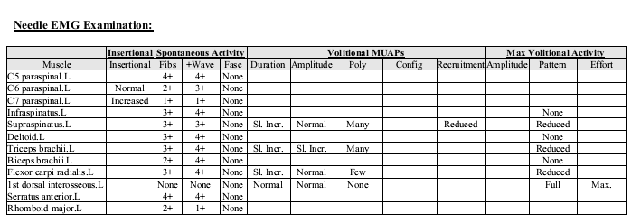

Slide 80
Traumatic Brachial Plexopathy
most common cause of brachial plexopathies.
CAUSES
automobile, motorcycle, or bicycle accidents.
Penetrating knife or gunshot
may occur in newborns, usually as a result of traction during delivery.

Slide 81
Vulnerability to trauma
Large size
Superficial location
Position between two highly mobile structures (neck & upper extremity).
Proximity to other structures - blood vessels, apex of lung, bones.

Slide 82
ERB’S PALSY C56
weakness of shoulder abduction, elbow flexion, and arm supination,
most common type of brachial plexopathy seen in newborns, presumably as a result of the head being delivered down, away from the shoulder.

Slide 83
KLUMPKE’S PARALYSIS
If the arm and shoulder are pulled up - result in lower plexopathies, affecting the C8-Tl fibers.
Severe hand weakness with preservation of upper arm and shoulder girdle muscles.

Slide 84
Avulsions
Most serious complication of traction injury.
C8 – T1 roots are more likely to avulse.
Upper roots more commonly rupture extraforaminally (due to their oblique course).

Slide 85
Features suggestive of avulsion
Concomitant bony injury – fracture of transverse process.
Long tract signs (asso SC injury).
Severe burning pain, with shooting pain in an anaesthetic hand.
Horner’s syndrome.
Complete avulsion - Entire upper extremity is paralyzed, including long thoracic, dorsal scapular, thoracodorsal & pectoral nerve innervated muscles.

Slide 86
Postoperative Brachial Plexopathy
coronary artery bypass and other chest surgery.
result from stretch injury following chest wall retraction or occur secondary to compression from hematomas associated with internal jugular catheters.
involve principally the lower trunk or medial cord of the plexus.

Slide 87
Obstetric brachial plexopathy
5 patterns:
C5-C6- Erb’s palsy (50%)
C5-C7- Erb’s plus palsy/ Waiter’s tip position (35%)
C5-T1 with some finger flexion sparing
C5-T1 with flail arm & horner’s syndrome
C8-T1 – Klumpke’s palsy with paralysis of hand & horner’s syndrome

Slide 88
Neoplasms and Other Mass lesions
Pancoast tumors
Lymphomas
breast cancer
lung cancer
Rare- primary nerve sheath tumors (e.g., schwannomas, neurofibromas, or neurofi-brosarcomas)
Hematomas and vascular anomalies (e.g., aneurysm, arteriovenous malformation)

Slide 89
Delayed Radiation Injury
typically presenting years after the radiation exposure.
the differential diagnosis usually rests between radiation-induced brachial plexopathy and direct invasion from recurrent tumor

Slide 90
Neoplastic vs radiation plexopathy
Feature | Neoplasm | Radiation
Location | Supra/ infra | Usually Infra
Pain | Present | Absent
Horner’s syndrome | Present | Absent
Early & prominent sensory symptoms | Absent | Present
Slow progression | Absent | Present
Myokymia & fasciculations | Absent | Present
Paraspinal muscle involvement | Absent | Present
Conduction block | Absent | Present

Slide 91
REFERENCES
Electromyography & neuromuscular disorders, Preston & Shapiro, 2nd ed.
Ferranate et al . Brachial plexopathies: Classification, causes and consequences. Muscle and nerve,June 2004
Ferrante M A. Electrodiagnostic approach to the patient with suspected brachial plexopathy. Neurologic clinics, May 2002
DISEASES OF THE PLEXUS Devon I. Rubin Continuum 2008

Slide 92
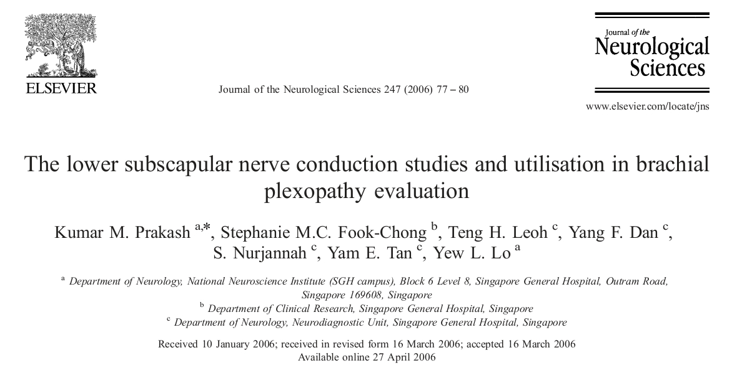

Slide 93
Introduction
The sub scapular nerves are motor nerves which originate from the fifth, sixth (and occasionally seventh) cervical roots.
The nerve fibers subsequently travel through the upper trunk of brachial plexus into the posterior cord.

Slide 94
The upper subscapular nerve supplies the upper part of subscapularis, which is a deep muscle.
The lower subscapular nerve (also known as inferior subscapular nerve) supplies the lower part of subscapularis and ends in teres major muscle

Slide 95
Why this study is done……..
Lesions at or proximal to its origin from the posterior cord may affect the lower subscapular nerve.
there are no published reports of this nerve abnormality in patients with brachial plexopathy.
there are no publications on methods and normal values of lower subscapular nerve conduction studies

Slide 96
This study was conducted to establish the optimal technique and normal values of lower subscapular nerve conduction studies.
These normal values were subsequently used as reference in evaluation of patients with brachial plexopathy

Slide 97
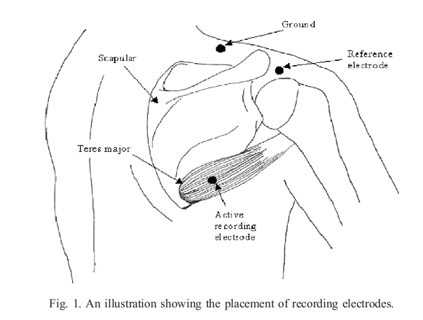
NCS of lower subscapular N

Slide 98
The active recording electrode was placed over teres major muscle belly that is localized immediately lateral to the lower one-third of the lateral scapular border
The reference electrode was placed on the shoulder over the surface marking of lateral third of the scapula spinous process

Slide 99
Materials and methods
Thirty healthy adults (8 males) with a mean age of 45.2+_16.5 (range, 21–75) years, were recruited with informed consent in this study.
A total of sixty nerves were studied.
The subjects were asymptomatic and had no risk factors for neuropathy.

Slide 100
Surface stimulation was performed at the Erb’s point in the supraclavicular fossa, just posterior to the sternocleidomastoid muscle with the shoulder in relaxed, abducted position and elbow flexed supported on a pillow.

Slide 101
The stimulation pulse was set between 0.1 and 0.3 ms, and supramaximal stimulation was employed to record the compound muscle action potential (CMAP) on the recording electrodes

Slide 102
The distal latencies
base-to-peak amplitudes
inter-side ratios of amplitudes
(smaller amplitude/larger amplitude) were calculated.

Slide 103
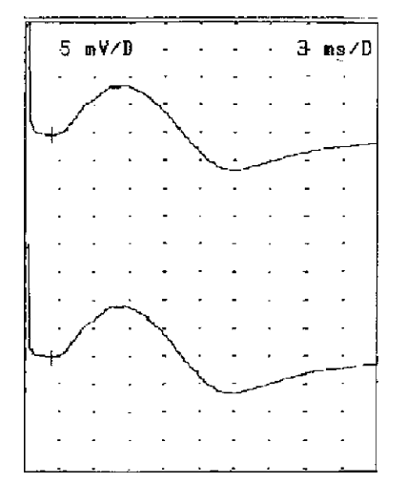
The lower subscapular nerve recordings on the right and left upper limbs

Slide 104
Statistical methods
All data are presented as mean ±2standard deviation(SD).
A paired Student’ t-test was used to test for side-to-side or gender differences.
Pearson’s correlation test was used to determine the correlation of the distal latencies as well as amplitudes with age.
A p value of less than 0.05 was considered significant.
A value of 2SD beyond the mean value was used as the normal limits for study parameters

Slide 105
studied 6 consecutive patients (2 female) suspected having brachial plexus lesions resulting from trauma.
These patients were involved in road traffic accident between 6 and 14 weeks prior to electro-diagnostic evaluation.

Slide 106
They underwent routine electrodiagnostic study protocol for brachial plexopathy evaluation and lower subscapular nerve conduction studies

Slide 107
Results
The mean±2SD (maximum, minimum values)
  distal latencies 2.38±0.52 (1.80, 2.90) ms,
  base-to-peak amplitudes 13.10 ± 5.10 (8.70, 21.10) mV
  inter-side amplitude ratio were 0.93 ± 0.12 (0.67, 1.00)

Slide 108
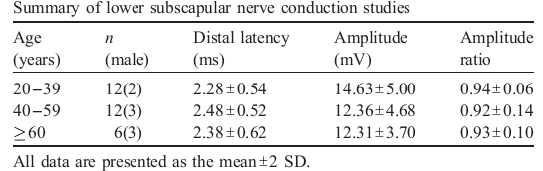
There was a significant correlation between the subject age and the base-to-peak amplitudes (r=0.335, p<0.0001).
there was no significant correlation between the subject age and distal latencies.
No significant differences between male and female or left and right side parameters.

Slide 109
The 6 patients who had routine electrodiagnostic evaluation showed normal median and ulnar studies.
They had reduced or absent radial and lateral antebrachial cutaneous sensory nerve action potential (SNAP) amplitudes on the affected side

Slide 110
The needle electromyographic study showed neurogenic abnormalities in the C5 and/or C6 innervated muscles (which include the biceps, deltoid, brachioradialis, supraspinatus and infraspinatus) sparing the serratus anterior, rhomboids and upper cervical paraspinal muscles.
Thus showing electrophysiologic evidence of upper trunk brachial plexopathy on the affected side

Slide 111
The lower subscapular nerve conduction studies were also abnormal on the affected side in all 6 patients and showed significantly reduced CMAP amplitudes as well as inter-side amplitude ratio of less than 0.67 which is the lower limit of healthy subjects

Slide 112


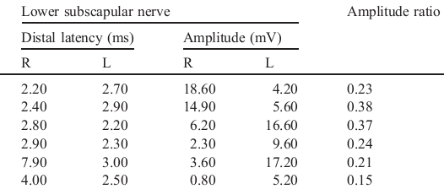

Slide 113
Discussion
Evaluation of brachial plexus lesions apart from nerve conduction studies (NCS) relies significantly on extensive needle electromyographic (EMG) evaluation.
However, as it is an invasive investigation, some patients may not tolerate it well and studies may be incomplete.

Slide 114
Overall the lower subscapular nerve conduction studies were not difficult to perform.
with advancing age there was a gradual decrement of the CMAP amplitudes,

Slide 115
In summary, this is the first paper, to study about the normal values of lower subscapular nerve conduction studies according to different age groups.
This NCS method is non-invasive and may be helpful in evaluation of brachial plexopathies, especially, when needle electromyographic studies are limited or not tolerable

Slide 116
THANK YOU

Slide 117
ANATOMY
The brachial plexus is located between the lower neck and axilla
running behind the scalene muscles, clavicle and the pectoral muscles

Slide 118
Terminal nerves
Formed in the distal axilla
Mainly 3 – Median, Ulnar and Radial
Only median arises from more than one cord.

Slide 119
Pathophysiology of BP Lesions
Neurapraxia
Myelin destruction
Conduction block
Recovery faster
Prognosis good
Eg; minor trauma
Neurotmesis
Wallerian degeneration
Endoneurium destroyed
No/poor regeneration
Poor prognosis
Eg; complete avulsion
Axonotmesis
Wallerian degeneration
Endoneurium preserved
Slow regeneration
Intermediate prognosis
Eg; Parsonage Turner
syn

Slide 120
Clinical evaluation
History
Initial and subsequent symptoms – esp pain
Circumstances
Trauma – sports, injections, accident, obstetrical,
Rucksack, Post operative
H/o malignancy or radiation

Slide 121
Clinical evaluation
If traumatic - what was the arm position on impact?
Arm by side of body – C5, C6
Arm parallel to ground – C7
Arm above shoulder – C8 T1
Past medical history
Family history

Slide 122
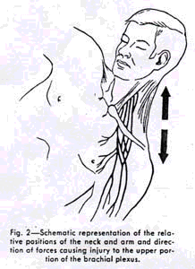
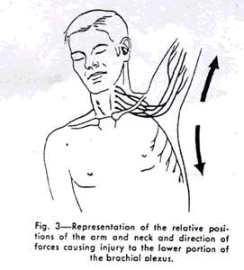

Slide 123
Examination
Look for wasting with weakness – axonopathy vs demyelinating.
Look for pattern of deficits
    Supraclavicular – segmental i.e dermatomal & myotomal
    Infraclavicular – more in territory of multiple
    peripheral nerves of diff
    segments.

Slide 124
Look for proximal extent –
        Horner’s syndrome
        Check Rhomboids and Serratus anterior
Vascular assessment –
        Carotid and radial pulse.
        Any expanding mass, bruit or thrill near injury site.
Concomitant injuries – fractures of bones.
Examine breast, lungs, clubbing & lymphnodes.

Slide 125
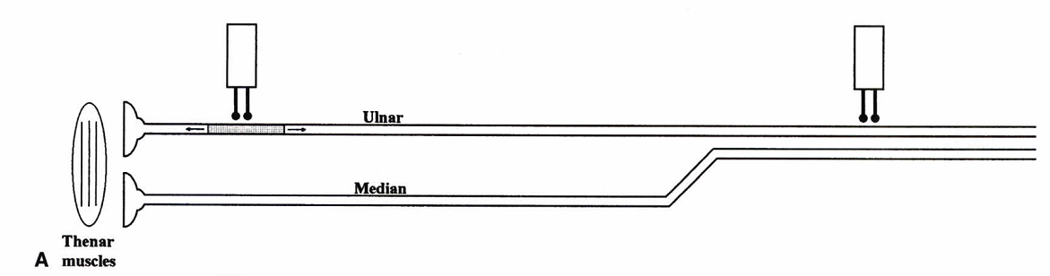
COLLISSION STUDY
The basic idea of a collision study is to collide out the ulnar fiber contribution from proximal stimulation by also stimulating the ulnar fibers distally
The first stimulus depolarizes the ulnar nerve and travels both distally and proximally.

Slide 126
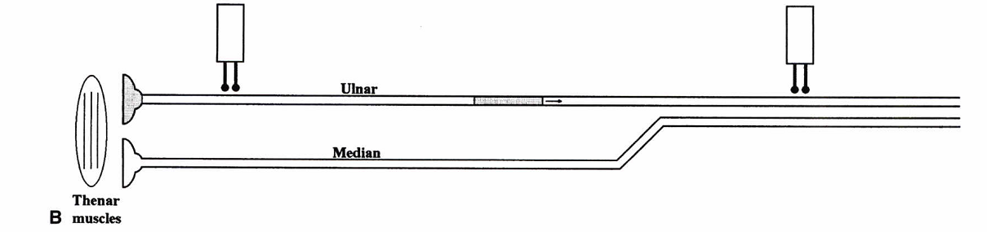
The distal pulse results in an ulnar compound muscle action potential (CMAP) from the ulnar-innervated thenar muscles.

Slide 127
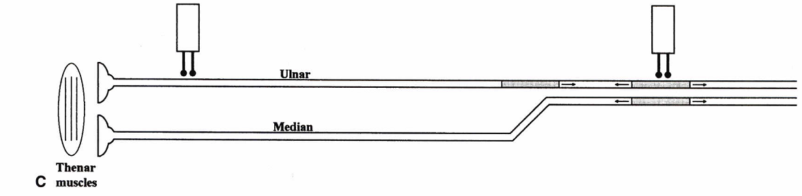
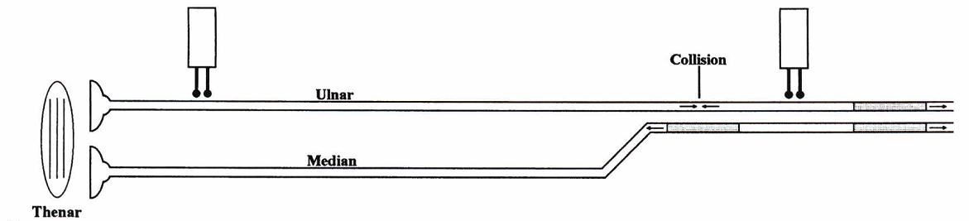
The second stimulus at Erb's point is given at a time before the first stimulus antidromically passes the proximal stimulation site.
The depolarization in the ulnar fibers collides with the antidromic impulse from the first stimulus, resulting in elimination of the impulse.

Slide 128
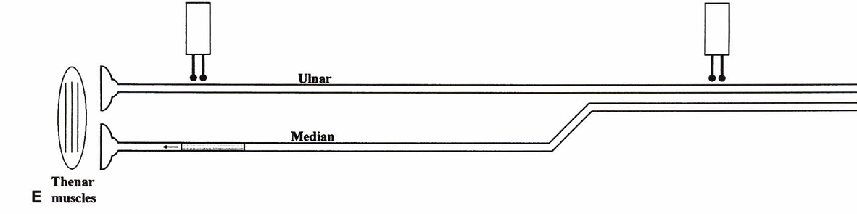
If collision studies are not performed for proximal median studies across the plexus, conduction block and focal slowing may be missed

Slide 129
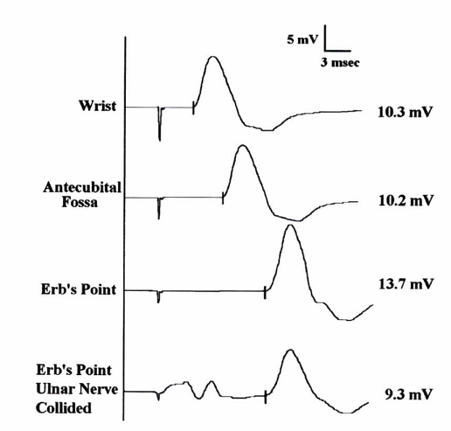
COLLISSION STUDY
Notes:
Note the higher amplitude at Erb's
point from co-stimulation and co-recording of ulnar muscles in
the thenar eminence. In the collision study (bottom trace),
a supramaximal stimulus is given over the ulnar nerve at the
wrist 4 ms before the stimulation at Erb's point. An initial
thenar ulnar compound muscle action potential (CMAP) is seen
from the first stimulus, followed by the one from the collided
Erb's point stimulus, which represents the true proximal medi(Ln
CMA

Slide 130
Co- stimulation
Co-stimulation often occurs at the axilla and always occurs at Erb's point.
When routine ulnar motor conduction studies are performed, stimulating at the axilla or at Erb's point results in depolarization of both ulnar and median C8—T1-innervated muscles.
This is not a major problem when the abductor digiti minimi (ADM) is used for recording

Slide 131
When routine median motor nerve conduction studies are performed recording the APB
both median-and ulnar-innervated muscles are present in the thenar eminence.
With co-stimulation, the median CMAP will be contaminated by the contribution from ulnar fibers.

Slide 132
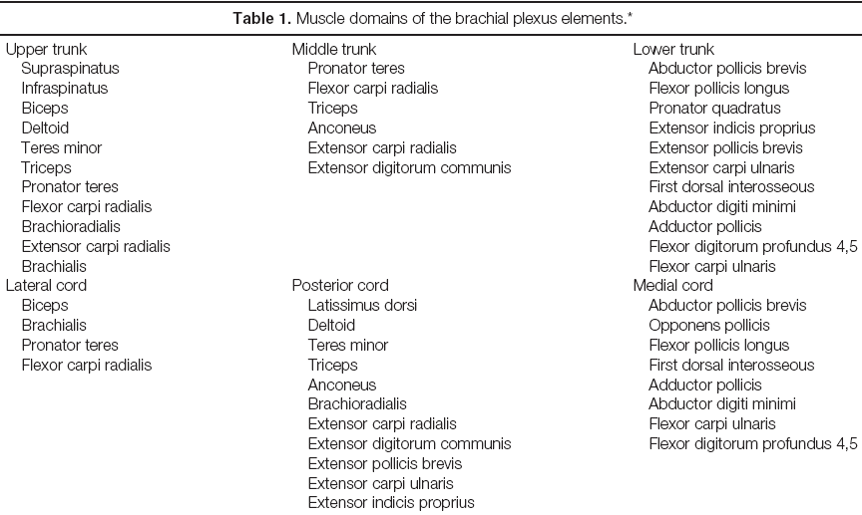

Slide 133
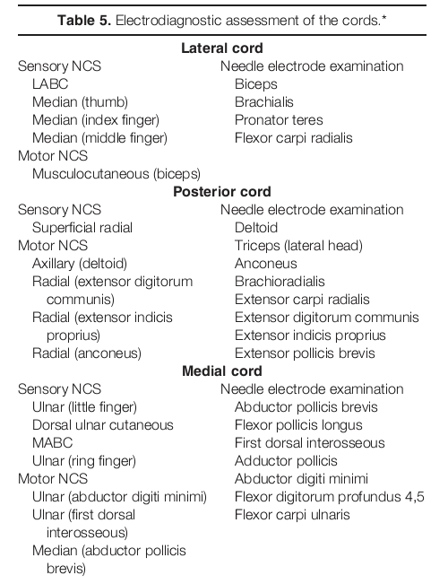

Slide 134
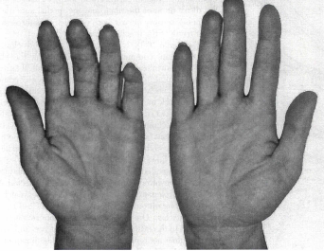
The classic finding in a person with neurogenic thoracic outlet syndrome is the Gilliatt-Sumner hand.
This physical examination finding includes atrophy of the abductor pollicis brevis with lesser involvement of the interossei and hypothenar muscles.

Slide 135
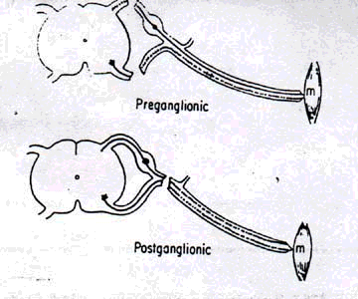

Slide 136
The teres major is a relatively superficial muscle and is localized immediately lateral to the lower one-third of the lateral scapula borders
This makes surface electrode recording of the muscle during NCS feasible.

Slide 137
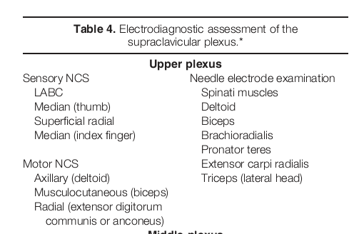

Slide 138


Slide 139


Slide 140
Upper Trunk Plexopathy
SNAPs – LABC, radial & median SNAPS are abnormal
CMAP-median and ulnar are normal
axillary, musculocutaneous, suprascapular may be abnormal
Needle EMG- deltoid, biceps, brachioradialis, supraspinatus and infraspinatus muscles.
  triceps, pronator teres, and flexor carpi radialis may be partially involved.
the rhomboids, serratus anterior, and cervical paraspinal muscles are spared.

Slide 141
Middle Trunk Plexopathy
SNAP- median and radial may be abnormal
Motor condn –normal
EMG- involvement of triceps, pronator teres, flexor carpi radialis, with sparing of the paraspinal muscles.

Slide 142
lower Trunk Plexopathy
Sensory condn - the ulnar, dorsal ulnar, and
MABC---- abnormal.
Median & ulnar CMAPs may be abnormal
EMG- intrinsic hand muscles, EIP & FPL

Slide 143
Posterior Cord Plexopathy
abnormal radial SNAPs.
Routine median and ulnar motor conduction studies and F responses are normal.
EMG - may show abnormalities radial innervated muscles (e.g., extensor indicis proprius, extensor carpi radialis, brachioradialis, triceps).
abnormalities may be seen in the deltoid, teres minor, and latissimus dorsi.

Slide 144
lateral Cord Plexopathy
LABC and the median SNAPs are abnormal
Median and ulnar motor conduction studies & F responses are normal.
Needle EMG may show abnormalities in the biceps and proximal median forearm muscles (pronator teres, flexor carpi radialis).
Distal median-innervated muscles in the forearm and hand, including the flexor pollicis longus and APB are normal.

Slide 145
Medial Cord Plexopathy
Medial cord lesions are identical to lower trunk plexopathies, except that radial-innervated C8 muscles are normal on EMG.
may affect the ulnar, dorsal ulnar, and MABC SNAPs.
median- and ulnar motor studies and F responses may be abnormal.
Needle EMG abnormalities are limited C8 T1 innervated hand muscles (median and ulnar)

