Slide 1
Management of Myasthenia Gravis
Dr C. Rathore

Slide 2
Schema of presentation
Intoduction
Conventional management of MG
Management in special situations

Slide 3
Introduction
A number of therapeutic options are available
Treatment must be individualized according to
a The extent (ocular versus generalized)
b Severity (mild to severe) of disease
c Presence or absence of concomitant disease (including
autoimmune diseases and thymoma).

Slide 4
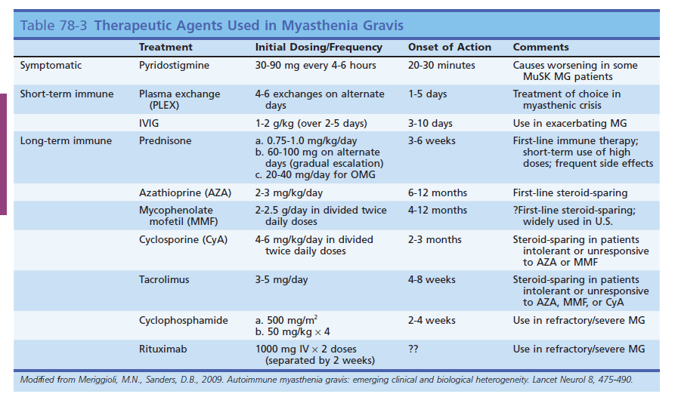

Slide 5
ANTICHOLINESTERASE DRUGS

Slide 6
Acetylcholinesterase inhibitors are typically the first line
treatment of MG.
These medications boost the amount of acetylcholine
available for neuromuscular transmission

Slide 7
Pyridostigmine bromide and neostigmine bromide
are the most commonly used ChEIs.
Pyridostigmine is generally preferred because it has
a lower frequency of gastrointestinal side effects and
longer duration of action

Slide 8
The initial oral dose in adults is 30 to 60 mg every 4 to 8 hours.
The equivalent dose of neostigmine is 7.5 to 15 mg.
In infants and children, the initial oral dose of pyridostigmine
is 1 mg/kg, and of neostigmine is 0.3 mg/kg .
Pyridostigmine is available as syrup (60 mg/5 mL)
The effects of pyridostigmine may be noticed 15 to 30 minutes
after taking a dose. Beneficial effects last for 4 hours.

Slide 9
Many patients can be well controlled on 60 mg three to
four times a day.
Pyridostigmine can be safely dosed at 120 mg four times a
day.
If at a dose of 90 mg four times a day a patient has
significant weakness, then the MG is not under good
control and an immunomodulating treatment should be
added

Slide 10
The drug schedule should be titrated to produce an
optimal response in muscles causing the greatest
disability
Patients who do have severe weakness upon awakening, a
bedtime dose of sustained release pyridostigmine can be
helpful.
Patients with oropharyngeal weakness may require doses
timed to provide optimal strength during meals.

Slide 11
At high doses, pyridostigmine can cause muscle weakness
through effects on nicotinic acetylcholine receptors.
In the current era of MG management, in which
immunomodulating therapies are often utilized, the doses
of pyridostigmine used are not high enough to cause
weakness.

Slide 12
At standard doses of pyridostigmine, rather than weakness,
patients may experience fasciculations.
Other common adverse effects of pyridostigmine are from
muscarinic effects and include abdominal cramps and
diarrhea.

Slide 13
Pyridostigmine can be given intravenously if oral
medications cannot be taken.
This usually is only during hospitalization for myasthenic
crisis.
The intravenous dose is one-thirtieth the oral dose and
dosing frequency is the same.

Slide 14
IMMUNOMODULATING THERAPIES

Slide 15
Corticosteroids
Prednisone has been shown to reduce acetylcholine receptor
antibody levels and this decrease often correlates with clinical
improvement

Slide 16
The ideal prednisone dose has not been established, but
Initial doses are usually 60 to 100 mg per day.
The dose can be calculated at 1 to 1.5 mg/kg.

Slide 17
After beginning corticosteroid therapy at moderate to high
doses, improvement is typically seen within 2 to 3 weeks.
A problem with starting treatment at high doses is that as
many as 50% of patients experience a transient deterioration.
The exact cause of this is unknown but may involve
prednisone-induced worsening of neuromuscular junction
function

Slide 18
This worsening can be serious almost 10% of patients who
experienced deterioration required intubation.
If MG patient has significant weakness, high-dose prednisone
therapy should only be initiated in the hospital where
respiratory and bulbar function can be closely monitored

Slide 19
Deterioration can occur for as long as a week after initiation
of corticosteroids
For patients with milder baseline weakness, corticosteroids
can be started at low doses and then built up slowly.
Therapy can be initiated with 20 mg per day and Increased by
5 mg every 5 days.
While this will minimize the risks of deterioration, the onset
Of improvement will be significantly prolonged

Slide 20
After 4 weeks, change to a dose of 60 -100 mg every
Other day.
Patients can be maintained on 100 mg every other
day for 3 months before tapering.
Patients with diabetes are better treated with the same
prednisone dose each day to avoid fluctuations in blood
sugar.

Slide 21
After improvement is achieved, the prednisone dose
should be decreased.
It is important not to taper prednisone too quickly,as
with dose, there are no established guidelines for this.

Slide 22
Taper by only 5 mg per day every 2 weeks. When the
Prednisone dose is decreased to 20 mg every other day, taper
even more slowly
It may take a week or two for deterioration to occur following
a decrease in corticosteroid dose
Many patients will need to be maintained on low doses (5 to
10 mg every other day) for years or indefinitely.

Slide 23
If any weakness returns during dose reduction, the
dose should be increased or another immunosuppressant
should be added to prevent further worsening.
Stopping the drug almost invariably leads to return of
weakness, but a very low dose (5-10 mg every other day) may
be sufficient to maintain good improvement in many patients

Slide 24
In the treatment of 116 patients with prednisone, a marked
Improvement was seen in 52% ( no functional limitations), no
improvement in 5%.
The mean time to maximum prednisone benefit was 5.5 months
(range: 2 weeks to 6 years).
This study also pointed out that only 14% of patients were able to be
completely taken off of prednisone.
Long-term corticosteroid treatment of myasthenia gravis: report of 116 patients.
Ann Neurol 1984;15:291–298

Slide 25
Azathioprine
Azathioprine is an antimetabolite that blocks cell
proliferation.
Inhibition of T lymphocytes is the presumed mechanism for
benefit.
Acetylcholine receptor antibody levels are decreased with
Azathioprine treatment

Slide 26
Azathioprine is used most often in patients who have
relapsed while on prednisone or as a steroid-sparing
agent in patients who have been taking prednisone for
long periods of time

Slide 27
The response is slow, ranging from 3 to 12 months.
Double-blind study comparing the use of oral prednisolone
versus prednisolone plus azathioprine, patients receiving both
medications had fewer relapses, a higher incidence of
remission, and could be managed on a lower steroid dose.
A randomized doubleblind trial of prednisolone alone or with azathioprine In myasthenia gravis. Myasthenia
Gravis Study Group. Neurology 1998;50:1778–1783

Slide 28
On the basis of this data, corticosteroids and azathioprine
may be combined in the initial treatment of patients with
MG.
In general many still uses prednisone monotherapy,
especially in patients without risk factors for steroid-induced
morbidity (e.g., obesity, diabetes, hypertension, osteopenia).

Slide 29
Azathioprine is started at 50 mg per day. If, after 1 week,
there are no systemic side effects, the dose is increased to 2
to 3 mg/kg per day.
Most MG patients are placed on 150 to 200 mg per day

Slide 30
Azathioprine is usually well tolerated,there are a few limiting
adverse effects.
Within the first several weeks of treatment, 10% of patients
will have an idiosyncratic reaction consisting of fever,
anorexia, nausea (flu like reaction )
These symptoms resolve quickly after the drug is stopped or
tapered

Slide 31
Leukopenia and hepatotoxicity are important adverse effects.
White blood cell counts and liver function tests should be
monitored monthly. If the white blood cell count falls below
3000 cells/mm3, azathioprine should be stopped.
Medication should also be held if liver enzymes become
significantly increased.
In these circumstances, patients can be rechallenged with
azathioprine, although in many patients, recurring toxicity will
require discontinuation of this drug.

Slide 32
Following long-term use of azathioprine, patients are
at increased risk of developing malignancies.
Azathioprine is supposed to be teratogenic.

Slide 33
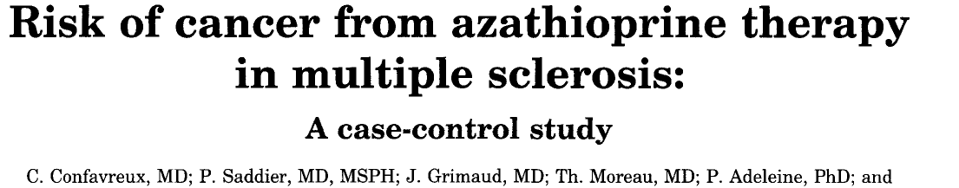
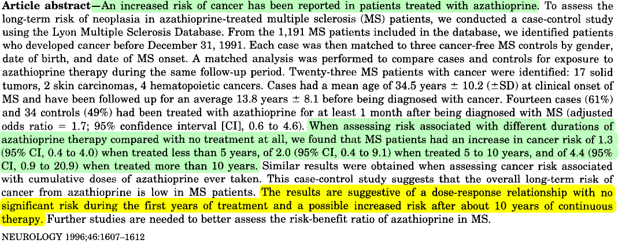

Slide 34

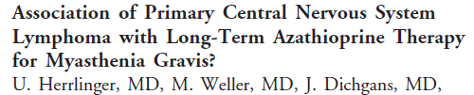
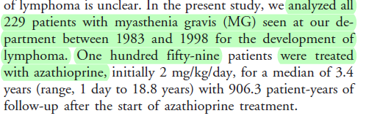
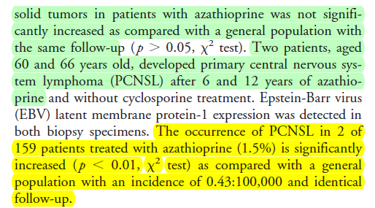
Ann Neurol 2000; 47:682–683

Slide 35
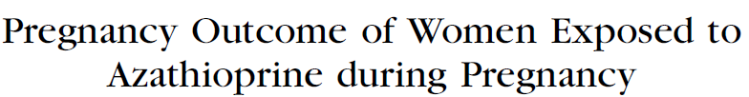
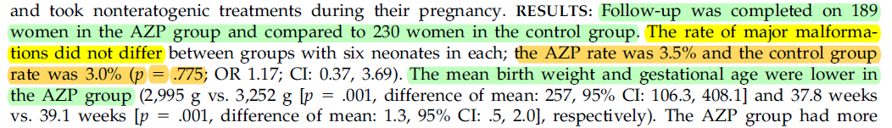

Slide 36
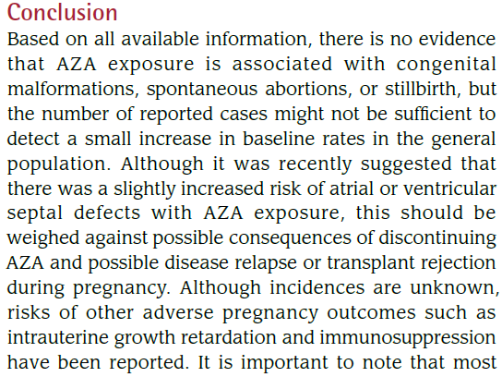

Slide 37
Cyclosporine
Cyclosporine a drug designed to prevent rejection in
organ transplantation patients, became popular for
the treatment of myasthenia gravis in the 1990s

Slide 38
Clinical benefit can be seen 1 to 2 months after
Starting cyclosporine.
The time to effect is slower than that seen with
prednisone but faster that seen with azathioprine.
The dose of cyclosporine is 4 to 6 mg/kg per day in
two divided doses.

Slide 39
Side effects include hirsutism, tremor, gum hyperplasia,
paresthesias, anemia, and hepatotoxicity.
Hypertension and nephrotoxicity are the main
treatment limiting adverse effects of this therapy

Slide 40
Mycophenolate Mofetil
MyM is another immunosuppressive agent used in
organ transplantation.
Selectively blocks purine synthesis and suppresses
both T- and B-cell proliferation

Slide 41
MyM is an effective adjunct therapy for MG. It
improves function and allow for decreased doses of
prednisone and pyridostigmine.
Benefit is similar to cyclosporine

Slide 42
Standard doses are 2000 to 3000 mg per day in
two divided doses.
Patients can be started on 500 mg twice a day and
after 1 to 2 weeks, increased to 1000 mg
twice a day.
MyM is well tolerated in most patients.

Slide 43
The main adverse effects are gastrointestinal,
primarily diarrhea.
In transplant patients, myelosuppression is common,
But in MG patients taking lower MyM doses, this is
not a frequent problem.
Check blood counts monthly.

Slide 44
In contrast to azathioprine and cyclosporine, MyM
may not increase the risk of malignancy.
MyM appears to have efficacy similar to cyclosporine
but with much less toxicity

Slide 45
Cyclophosphamide
Cyclophosphamide is a nitrogen mustard alkylating
agent that blocks cell proliferation, affecting both T
and B cells.
Cyclophosphamide is a potent immunosuppressive
medication,but due to significant potential adverse
effects, it is not typically used in MG.
Cyclophosphamide may be of benefit in MG patients
refractory to other treatments

Slide 46
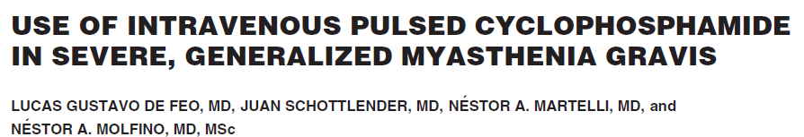
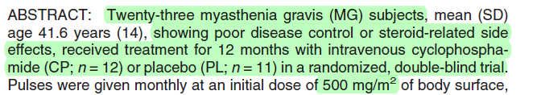
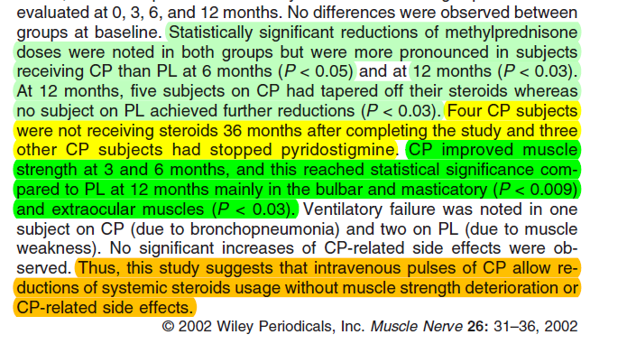

Slide 47
The best approach to treating refractory MG patients is
uncertain.
Further studies are needed to compare chronic
conventional immunosuppressive medications, repeated
pulse-dose cyclophosphamide, and one-time high-dose
cyclophosphamide.
The long-term benefits and risks of these therapies need
to be determined.

Slide 48
In a review of 1000 MG patients who received
Immunosuppressants for at least 1 year. All forms of
MG benefited from Immunosuppression
The rate of remission or minimal manifestations
ranged from 85% in OMG to 47% in thymoma
associated disease

Slide 49
Prednisone was used in the great majority of these
patients, and AZA was the first-choice nonsteroidal
Immunosuppressant.
MMF and CYA were used as second-choice agents.
Treatment was ultimately discontinued in nearly 20% of
anti-AChR Ab-positive MG patients, but in only 7% of
thymoma cases

Slide 50
Use the minimal maintenance dose of
immunosuppressant
medications required to keep the MG in control.

Slide 51
Rituximab
Rituximab is a genetically engineered anti-CD20
Monoclonal antibody that binds with high affinity to cells
expressing CD20 and induces B-lymphocytes depletion.
Originally used as a therapy for B cell malignancies
Rituximab has recently been considered a therapeutic
option for autoimmune diseases where B cells are
thought to play a prominent

Slide 52
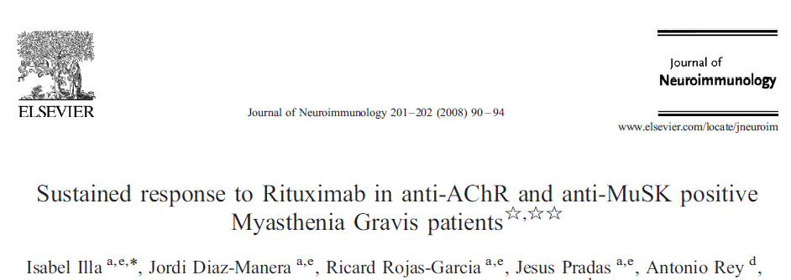
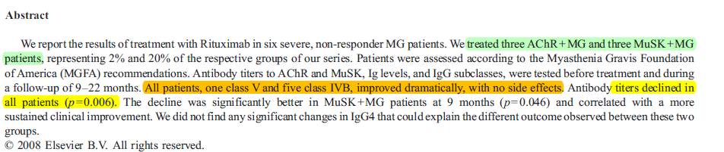

Slide 53

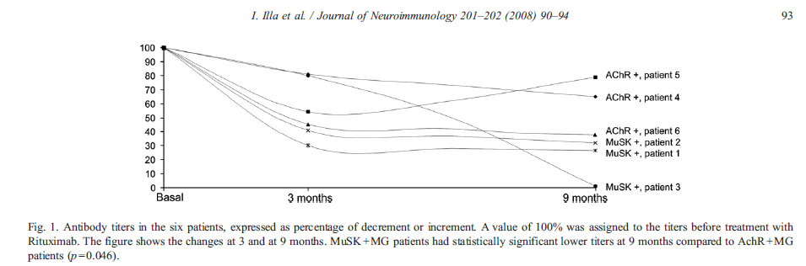

Slide 54
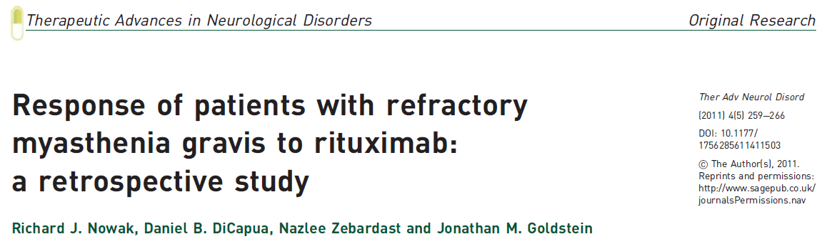
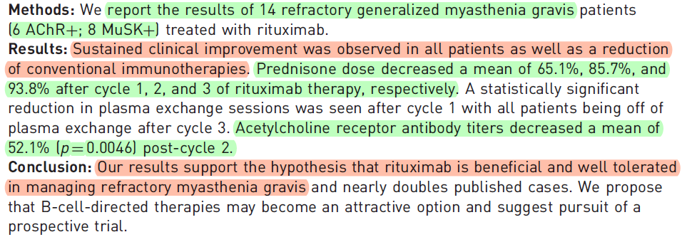

Slide 55
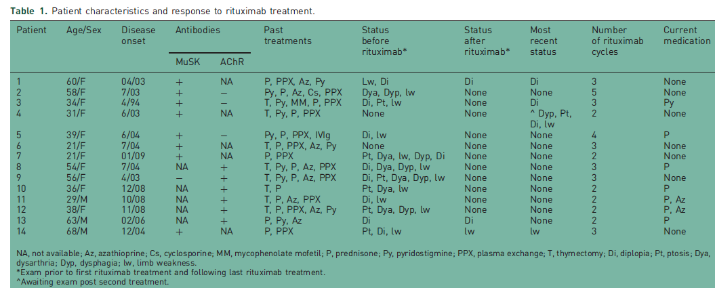

Slide 56
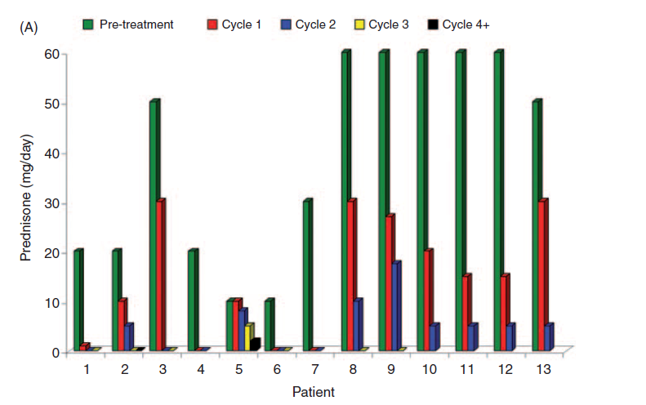

Slide 57
Plasmapheresis

Slide 58
Plasmapheresis, a procedure that removes
AchR antibodies from the circulation, is an effective
treatment for MG.
Controlled trial of plasmapheresis in MG has never
been performed

Slide 59
Improvement following plasmapheresis occurs within a
Few days, much faster than for other immunomodulating
therapies.
Plasmapheresis is an established therapy for patients in
myasthenic crisis.
It is also often used to improve strength (if necessary) in
Patients prior to undergoing thymectomy.

Slide 60
A course of plasmapheresis usually consists of four to
six exchanges, removing 3 to 5 L of plasma each
Treatment.
The effects of a course of plasmapheresis last only
several weeks

Slide 61
IV Ig

Slide 62
Improvement in MG occurs in 50% to 100% of MG
patients after infusion of high-dose IVIG
2 g/kg given over 2 to 5 days.
Improvement usually begins within 1 week and lasts
for several weeks or months
Class I evidence supports the use of IVIG to treat
patients with refractory exacerbations of MG

Slide 63
RCTs comparing IVIg to plasmapheresis in 87 MG
patients with exacerbations found the two therapies
to be equally effective
IVIg had fewer side effects

Slide 64
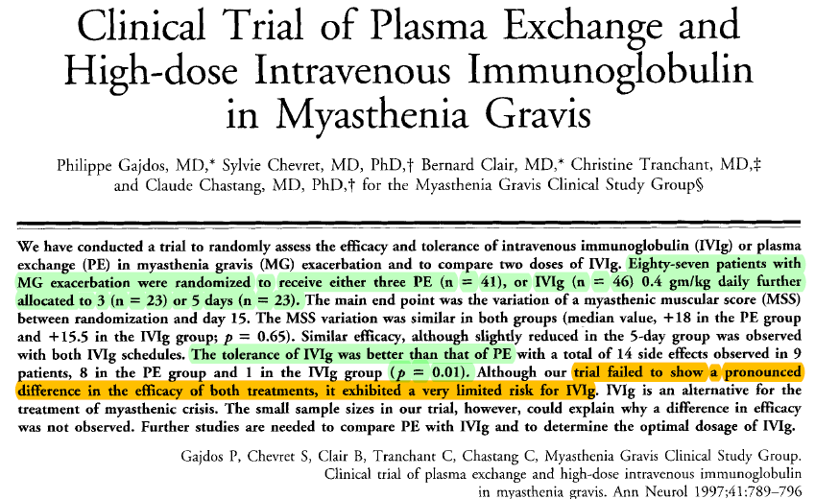

Slide 65
A retrospective series found plasmapheresis
to be superior to IVIg in patients in myasthenic crisis.
Myasthenic crisis: response to plasmapheresis following failure of intravenous gamma
globulin. Arch Neurol 1993;50:837–840

Slide 66
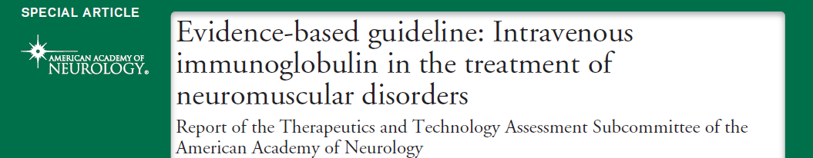
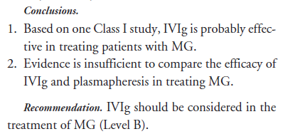

Slide 67
Most adverse effects are related to the rate of
Infusion and include headache, light-headedness, and
chills.
Although uncommon, significant thrombotic events,
including myocardial infarction and stroke, may occur

Slide 68
Thymectomy

Slide 69
In 1939, Blalock and colleagues reported the
Remission of generalized MG in a 21-year-old woman
Following the removal of a thymoma.
Since then, thymectomy, with or without the
presence of thymoma, has gained widespread
acceptance as a form of treatment for MG.

Slide 70
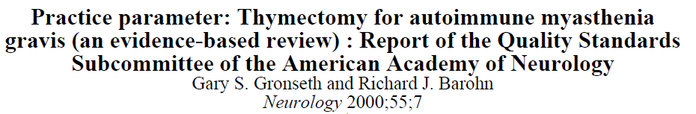
Patients who underwent thymectomy were more
likely to achieve medication-free remission, become
Asymptomatic and show clinical Improvement
compared with patients who did nothave thymectomy
(median relative rates: 2.1, 1.6, and 1.7,
respectively)

Slide 72
Among the patients undergoing thymectomy, the
median rate of remission, asymptomatic state, or
improvement were only 25, 39, and 70%, respectively.
The majority of patients having this surgery will not
experience remission or become completely
asymptomatic

Slide 73
Even in the most favorable reports, the response
to thymectomy was not immediate.
Among patients who obtained remission, only 25%
achieved remission in the first year, 40% the
second year, and 55% in the third year.

Slide 74
Thymectomies can be done in children but probably
should be avoided during the first few years of life.
Whether or not ocular MG patients should have
thymectomies is controversial.
Generally thymectomy is not advised for these
patients,but they also improve after thymectomy

Slide 75
Thymectomy is probably less effective in the elderly
due to atrophy of the thymus.
Age limit for thymectomy has not been established

Slide 76
The presence of a thymoma is an absolute indication for
thymectomy.
All newly diagnosed MG patients should have a CT scan or
MRI of the chest to look for a thymoma.
Chest X-rays are not sensitive enough to exclude
thymoma

Slide 77
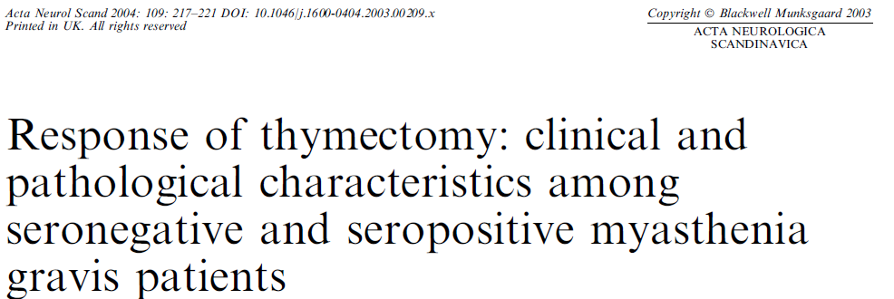
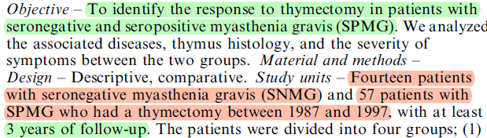


Slide 78
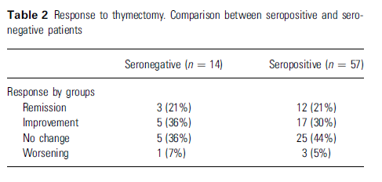

Slide 79
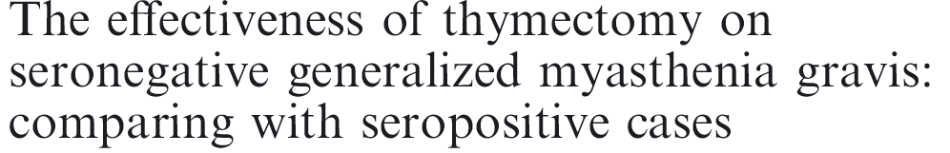
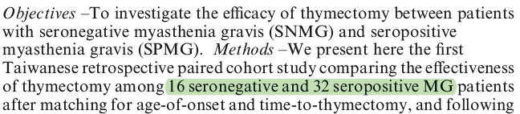
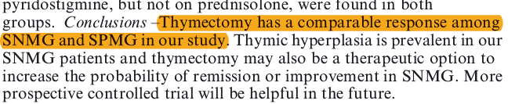

Slide 80
consider repeat thymectomy when relapse follows
a good response to the initial surgery or if there is
concern that thymic tissue removal had been
incomplete.
MRI with appropriate cardiac gating may be useful in
identifying residual thymus tissue.
Many authors believe that the clinical suspicion
should be the basis upon which repeat surgery is
considered

Slide 81
Myasthenic Crisis

Slide 82
Myasthenic crisis is respiratory failure from
myasthenic weakness.
An identifiable precipitating event such as infection,
aspiration, surgery or medication change precedes
most episodes of crisis

Slide 83
In MG patients with progressive respiratory symptoms,
approach is to admit the patient to an ICU and observe
closely.
Respiratory assistance is needed if
NIF is less than −20 cm H2O
Tidal volume is less than 5 mL/ kg body weight
When the forced vital capacity is less than 15 mL/kg
body weight

Slide 84
Noninvasive mechanical ventilation using bilevel
positive-pressure ventilation (BiPAP) may avoid the
need for intubation in patients in crisis without
hypercapnia .
In patients with Pco2 greater than 50 mm Hg, tracheal
intubation should be done.

Slide 85
Many case series report short-term benefit from PLEX
and IVIG in myasthenic crisis.
Retrospective studies suggest that both are equally
effective in disease stabilization

Slide 86
Ocular Myasthenia Gravis

Slide 87
Treatment of OMG requires an accurate assessment
of the patient’s functional impairment and its effects
on daily life.
ChEIs control symptoms adequately in some
patients, but the benefit is often partial and not long
lived
Prednisone is often quite effective.

Slide 88
The decision to initiate steroid therapy will depend
upon the risk/benefit assessment.
For purely cosmetic reasons versus those in whom
diplopia has a profound bearing on their livelihood
(pilots, surgeons, etc.).

Slide 89
In OMG, use a maintenance dosage of corticosteroids
that does not significantly suppress the immune
system and causes few major systemic adverse effects.
Consider a steroid-sparing agent only when absolutely
indicated
OMG is not an indication for thymectomy, but this may
be effective in some patients

Slide 90
Management of Juvenile Myasthenia Gravis

Slide 91
The onset of immune-mediated MG before age 18 is
referred to as juvenile myasthenia gravis (JMG).
20% of JMG and almost 50% of those with onset
before puberty are seronegative

Slide 92
For patients who remain symptomatic despite optimal
dosing of ChEIs, prednisone is efficacious and cost
effective.
Chronic side effects potentially have a long-term impact
in children (growth stunting, weight gain, mood
alteration, hyperglycemia, hypertension).
A suggested starting dose is 0.5 mg/kg/day, with a
Maximum starting dose in older children of 30 mg/day.

Slide 93
Use steroid-sparing immunosuppressive drugs in
more severe or refractory cases, as in adult MG.
PLEX and IVIG are effective short-term therapies in
JMG.

Slide 94
The maximum oral dose of pyridostigmine for children
Is 7 mg/kg/day
The indications for thymectomy are less clear for
prepubertal children.

Slide 95
There are concerns that thymectomy performed at a
young age may lead to premature immunosenescence
Longer-term studies (with 14-17 years of follow-up) have
not reported any deleterious effects.
Very long-term studies are not available.

Slide 96
Compared with older children and adolescents, prepubertal
children demonstrate a higher rate of spontaneous
remission.
After compiling the data from a number of studies, it was
observed that 35% of prepubertal children will achieve
remission without undergoing thymectomy.
The remission rate after thymectomy in prepubertal children
was 27%.

Slide 97
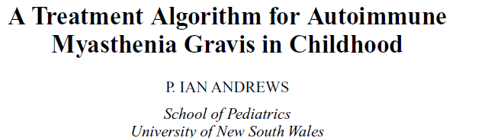
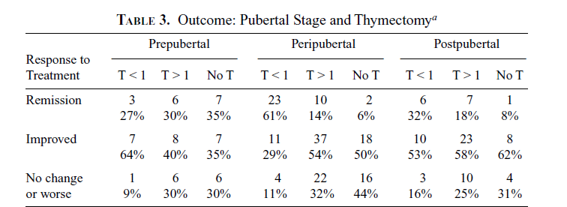

Slide 98
The role of thymectomy in prepubertal children remains
poorly defined.
Nonetheless, thymectomy constitutes an important option in
this group if medical treatment proves unsatisfactory
No reported adverse effects on the immune system by
removing the thymus at an early age exist

Slide 99
ANTI-MuSK ANTIBODY MYASTHENIA GRAVIS

Slide 100
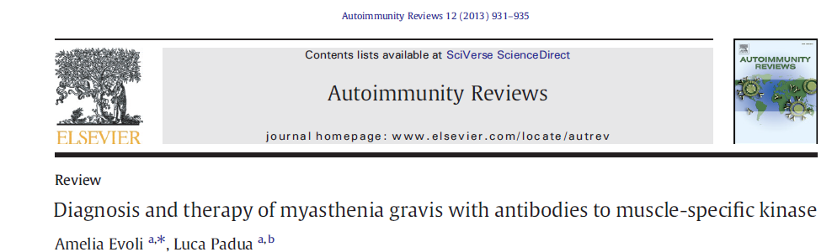
MuSK-MG patients, for the most part, do not improve on
pyridostigmine.
Proportion of patients ranging from 13% to 32% in different series
show both responsiveness and good tolerance and keep on taking
pyridostigmine as long-term treatment
In most patients standard doses very frequently induce marked
nicotinic side effects, evident clinically as diffuse fasciculations
and cramps.

Slide 101
Thymectomy
Thymus alterations appear to be definitely
uncommon in MuSK-MG, supporting the view that
the thymus does not play a pathogenic role in this
form of MG.

Slide 102
The clinical outcome after thymectomy in MuSK-MG has been
investigated retrospectively and in small patient series.
These studies failed to show any obvious benefit from
Thymectomy , as remission was reported in very few cases, and
most patients remained dependent on immunosuppressive
therapy after Surgery
Muscle specific receptor tyrosine kinase antibody positive myasthenia
gravis current status. J Clin Neurol 2009;5:53–64.

Slide 103
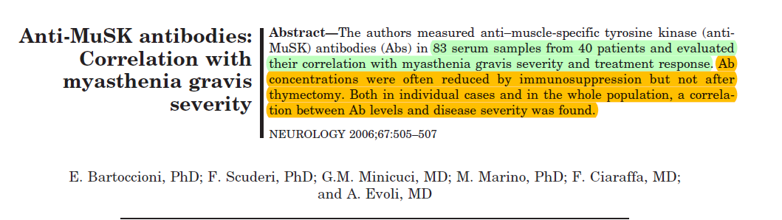

Slide 104
Currently, on the basis of pathological and clinical data,
thymectomy is not recommended for MuSK MG.
Two patients with small nodular thymomas have been
Reported, a radiological study of the mediastinum
by CT scan is indicated in these as performed in other
MG patients

Slide 105
Immunosuppressive and immunomodulating treatment
The great majority of MuSK-MG patients need
Immunosuppression with rates varying from 95% to
100% in different series
In addition, these subjects often require early and
aggressive treatment owing to progressive disease
course and symptom severity

Slide 106
MuSK-MG responds well to steroids and dramatically to
plasma-exchange.
The association of high-dose prednisone and plasma
exchange is the treatment of choice in patients with
respiratory crisis or severe bulbar weakness, as in other
forms of MG

Slide 107
During steroid dosage tapering, MuSK-MG patients frequently
complain of disease relapses, and tend to remain dependent
On prednisone, in spite of concomitant treatment with
Steroid sparing agents.
Good response to mycophenolate has been reported
Azathioprine and cyclosporine, as a whole, seem to be less
effective than in AChR-MG.

Slide 108
Disease relapses are frequent, especially in the first
Years from the onset, and often require
hospitalization for emergency treatment.
IVIg appears to be less effective than in AChR-MG
patients, with a rate of positive response ranging
from 11% to 45%
It represents a reasonable alternative only when
Plasma exchange is contraindicated or not available.

Slide 109
In MuSK-MG patients, the long-term outcome is generally
Considered less satisfactory than in AChR-MG, on account
of lower rate of complete stable remission and higher
frequency of refractory disease.
Permanent bulbar weakness with muscle atrophy is
responsible for significant disability and partially accounts
for a less satisfactory outcome in these patients

Slide 110
Many case reports have convincingly shown that muscle
wasting can be effectively treated with aggressive
Immunosuppression.
High-dose prednisone should be performed as early as
possible in patients with recent-onset facial and oro
pharyngeal weakness, in order to prevent (or treat)
muscle atrophy.

Slide 111
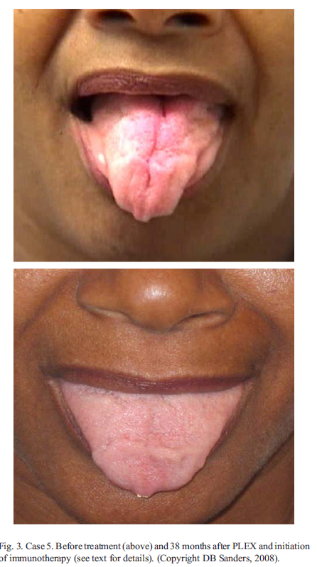
Journal of Neuroimmunology 201–202 (2008) 85–89

Slide 112
Refractory MuSK-MG
Both cyclophosphamide and rituximab proved
effective in the management of these cases.

Slide 113
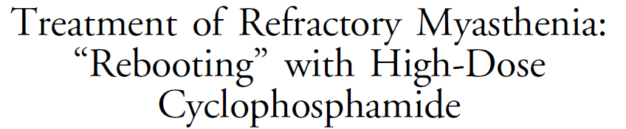
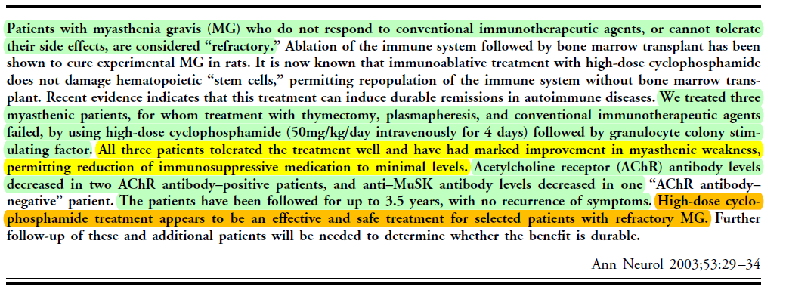

Slide 114
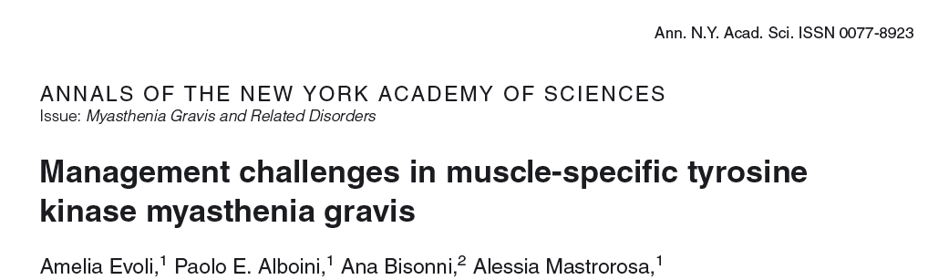
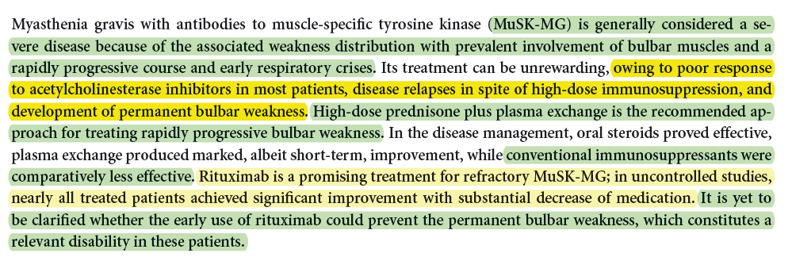

Slide 115
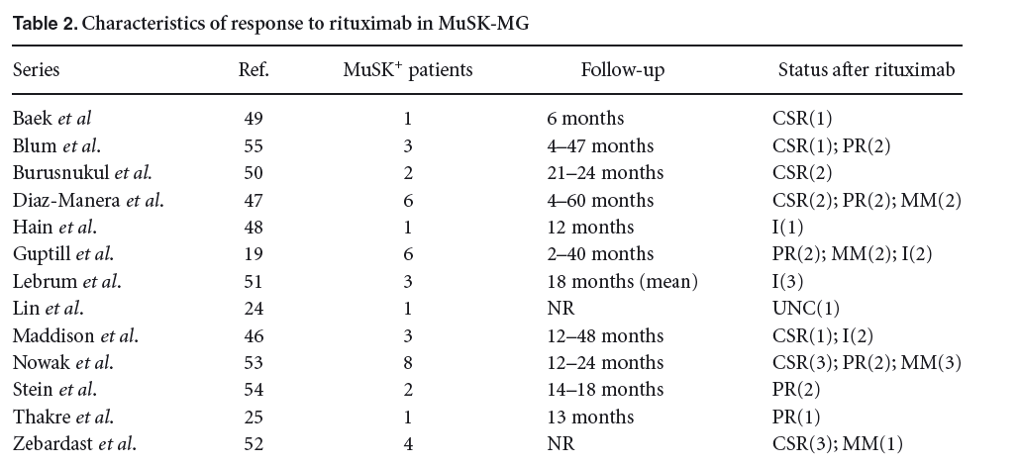
Treatment was performed with four to six infusions of 375 mg/m2 weekly in most
cases,with two infusions of 1,000 mg fourweeks apart in a single patient

Slide 116
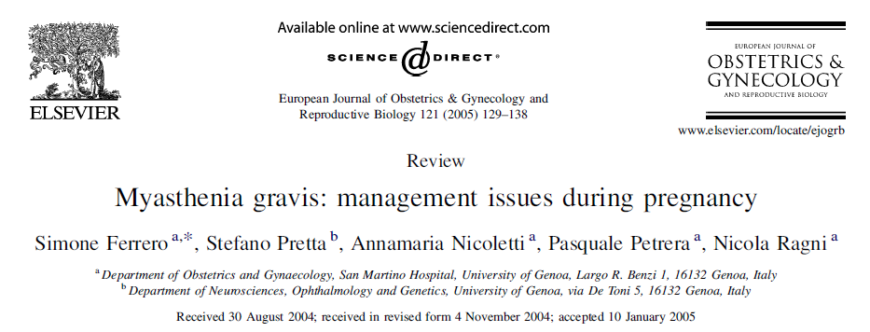

Slide 117
Worsening of symptoms occurs in about one-third of
pregnant women
Though possible at any time during pregnancy, worsening
is more likely during the first trimester and the first
month postpartum
The clinical course of MG during the first pregnancy does
not predict the course during the subsequent pregnancies

Slide 118
Puerperal complications, especially infections (endometritis,
cystitis, mastitis), increase the risk for exacerbation of MG
Symptoms and should be promptly recognized and treated

Slide 119
Thymectomy is a primary disease-controlling modality
and it is generally performed prior to pregnancy
Thymectomized patients have fewer clinical exacerbations
during pregnancy

Slide 120
No study has proved an increase in the risk of preeclampsia
among women with MG.
Magnesium sulfate is contraindicated in myasthenic patients.
Hypermagnesemia inhibits the release of acetylcholine at the
myoneural junction and can worsen MG muscle weakness.
Maternal deaths have been reported in myasthenic women who
have received magnesium sulphate for preeclampsia

Slide 121
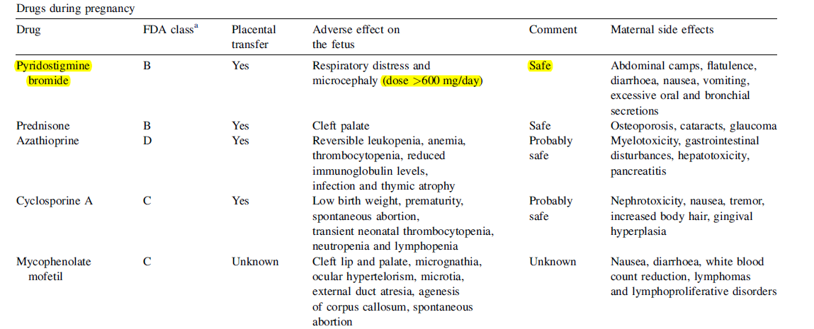

Slide 122
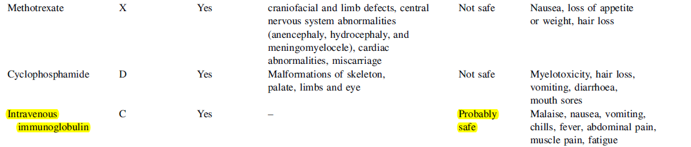

Slide 123
Azathioprine crosses the placenta, but the fetal liver lacks
the enzyme that converts the drug to its active metabolites
This fetal enzyme deficiency protect the fetus from any
teratogenic effect of azathioprine early in pregnancy.
Infants exposed to azathioprine might develop reversible
leukopenia, anemia, thrombocytopenia, reduced
immunoglobulin levels, infections

Slide 124
Plasmapheresis has been safely carried out in
Myasthenic crisis during pregnancy .
Plasmapheresis is a very effective treatment when
short-term benefit is critical and can safely be
administered during pregnancy if needed.

Slide 125
Plasmapheresis can result in premature delivery because
of the removal of hormones crucial to the integrity of
The pregnancy .
Other complications can occur due to hypovolemic
Reactions.
During the exchanges, hypotension must be carefully
monitored and corrected

Slide 126
Intravenous immunoglobulins
The safety of intravenous immunoglobulin therapy during
pregnancy has not been established but has proved to be
effective and safe for deteriorating MG in pregnancy.
The common adverse effects of intravenous
Immunoglobulins are related to the rate of infusion and
include headache, chills and fever.
Hyperviscosity and volume overload may be of greater
Significance during pregnancy.

Slide 127
Concerning the mode of delivery, most labours can safely
be completed vaginally .
The uterus is not affected by autoantibodies; therefore,
the first stage of labour is not compromised.
The second stage of labour involves striated muscles so
Forceps delivery and vacuum extraction may be needed

Slide 128
Cholinesterase inhibitor medications should be
administered parenterally during labour owing to
unpredictable gastric absorption.
Prednisone should be continued during labour and an
extra-dose of 50–100 mg can be administered
Intramuscularly in the first stage of labour

Slide 129
Breastfeeding

Slide 130
Breastfeeding is not contraindicated in women with
MG.
AChR antibodies may pass to the infant through
breast Milk and may potentially enhance neonatal
MG
Pyridostigmine is compatible with breastfeeding.

Slide 131
Corticosteroids are poorly excreted in breast milk
and the amount received by the infant is minimal.
Breastfeeding is contraindicated in mothers taking
azathioprine

Slide 132
Newborns of women with MG

Slide 133
Ten to twenty percent of infants born to myasthenic
women show signs of neonatal MG produced by
AChR antibodies crossing the placenta.
Every newborn of myasthenic mothers should be
Carefully monitored for signs of muscle weakness and
Impaired respiratory and bulbar function.

Slide 134
The neuromuscular symptoms usually develop within
the first few days of life, most in the first few hours
after birth (12– 48 h)
The severity of symptoms varies from child to child

Slide 135
The severity of symptoms in the newborn does not
correlate with the severity of symptoms in the mother.
The maternal antibody level correlates with the
frequency and severity of transient neonatal
myasthenia gravis (TNMG).
TNMG occurs only rarely in infants of seronegative
mothers.

Slide 136
Symptoms usually last less than 2 weeks but may
continue for as long as 12 weeks, which correlates
with the half-life of neonatal antibodies.
It is not clear why some newborns develop weakness and
others with equally high antibody concentrations do not.
Some mothers with antibodies directed specifically
against fetal AChR might themselves be asymptomatic,
which makes diagnosis of TNMG more difficult.

Slide 137
Weakness may manifest in utero, particularly when
maternal antibodies are directed against the fetal
AChR and may lead to arthrogryposis multiplex
congenita .
Decreased fetal movement may be considered as a
possible indication for PLEX or IVIG.

Slide 138
Affected newborns require symptomatic treatment
with ChEIs if swallowing or breathing is impaired.
Consider exchange transfusion if respiratory weakness
is severe.

Slide 139
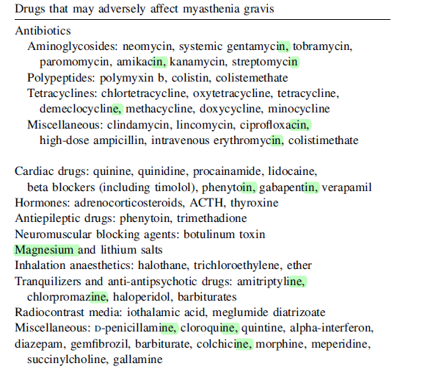

Slide 140
Thank you

Slide 141
Bibliography
Management of Myasthenia Gravis SEMINARS IN NEUROLOGY VOLUME 24, NUMBER 1 2004
Management of Myasthenia Gravis Practical Neurology, 2005
Diagnosis and therapy of myasthenia gravis Autoimmunity Reviews 12 (2013) 931–935

Slide 142
1
Starting dose of pyridostigmine in children
A 1 mg/kg/dose
B 3 mg/kg/dose
C 5 mg/kg/dose
D 7 mg/kg/dose

Slide 143
2
Which of the following has nephrotoxicity as
dose limiting side effect
A Azathioprine
B Cyclosporine
C MyM
D IV Ig

Slide 144
3
Chance of spontaneous remission is maximum in
which MG
A Prepubertal
B Peripubertal
C Post pubertal
D Adult

Slide 145
4
True about MUSK MG when compared AchR MG
A Better response to azathioprine
B Better response to pyridostigmine
C Overall fair outcome
D More chance of bulbar atrophy

