Slide 1
PARANEOPLASTIC NEUROLOGICAL SYNDROMES
Dr. C. Rathore

Slide 2
Scheme of presentation
Introduction
Classification
Mechanisms of pathogenesis
Specific syndromes
Treatment
Approach to diagnosis of paraneoplastic disorders
Summary

Slide 3
PARANEOPLASTIC SYNDROMES (PNS)
“Paraneoplastic syndromes” refers to symptoms or signs resulting from damage to organs or tissues that are remote from the site of a malignant neoplasm or its metastases
Excludes other cancer complications such as metabolic and nutritional deficits, infections, coagulopathy, and side effects of cancer treatment.

Slide 4
History
The first description of PNS was in the 19th century by a French physician M Auche’ who described the peripheral nervous system involvement in cancer patients in 1890
Brierley and colleagues first described PNS involving cerebral hemispheres in 1960
The first antibody described was PCA-1 (Purkinje Cell Antibody 1), by Greenlee and Brashear in 1983

Slide 5
Demography
About one per 10, 000 patients with cancer develop PND
Higher prevalence
  3–5% of patients with small-cell lung cancer
  15–20% with thymomas
  3–10% with B-cell or plasma-cell neoplasms
In 60% patients, neurological disorder precedes cancer diagnosis

Slide 6
Age
Comonly occurs in older population
Median age of onset is 66 years (range 30–77 years)
        Graus, Dalmau et al, 1997
PNS in young people seen with Hogkin’s lymphoma (cerebellar degeneration), testicular cancer (brainstem and limbic encephalitis), breast carcinoma
In children, neuroblastoma produces opsoclonus-myoclonus syndrome

Slide 7
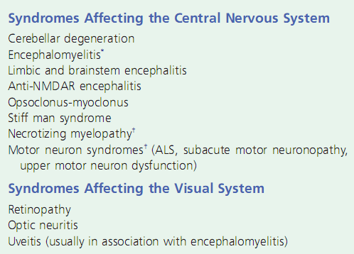
PARANEOPLASTIC SYNDROMES

Slide 8
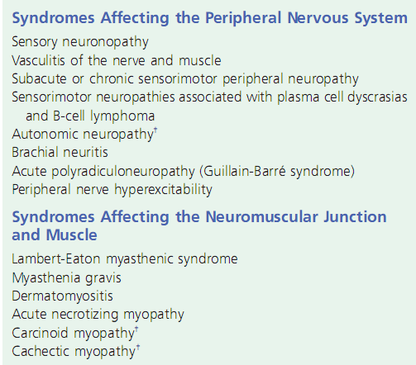

Slide 9
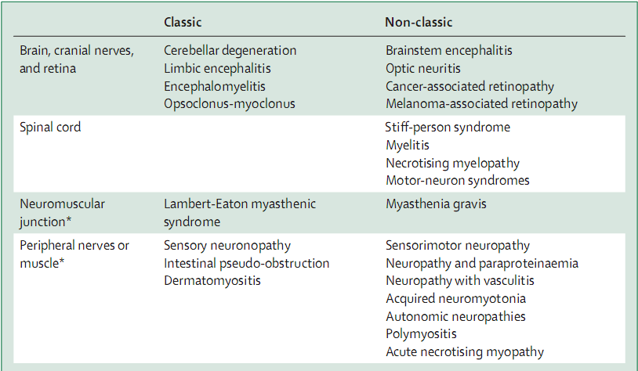
Classic and non-classic syndromes

Slide 10
PATHOGENESIS

Slide 11
Immune hypothesis
Most of the paraneoplastic syndromes occur because the tumor secretes substances that mimic normal hormones or that interfere with circulating proteins
Most or all PNS are immune-mediated.
May involve a single area (e.g., limbic encephalitis) or a single cell type or multiple levels of the nervous system

Slide 12
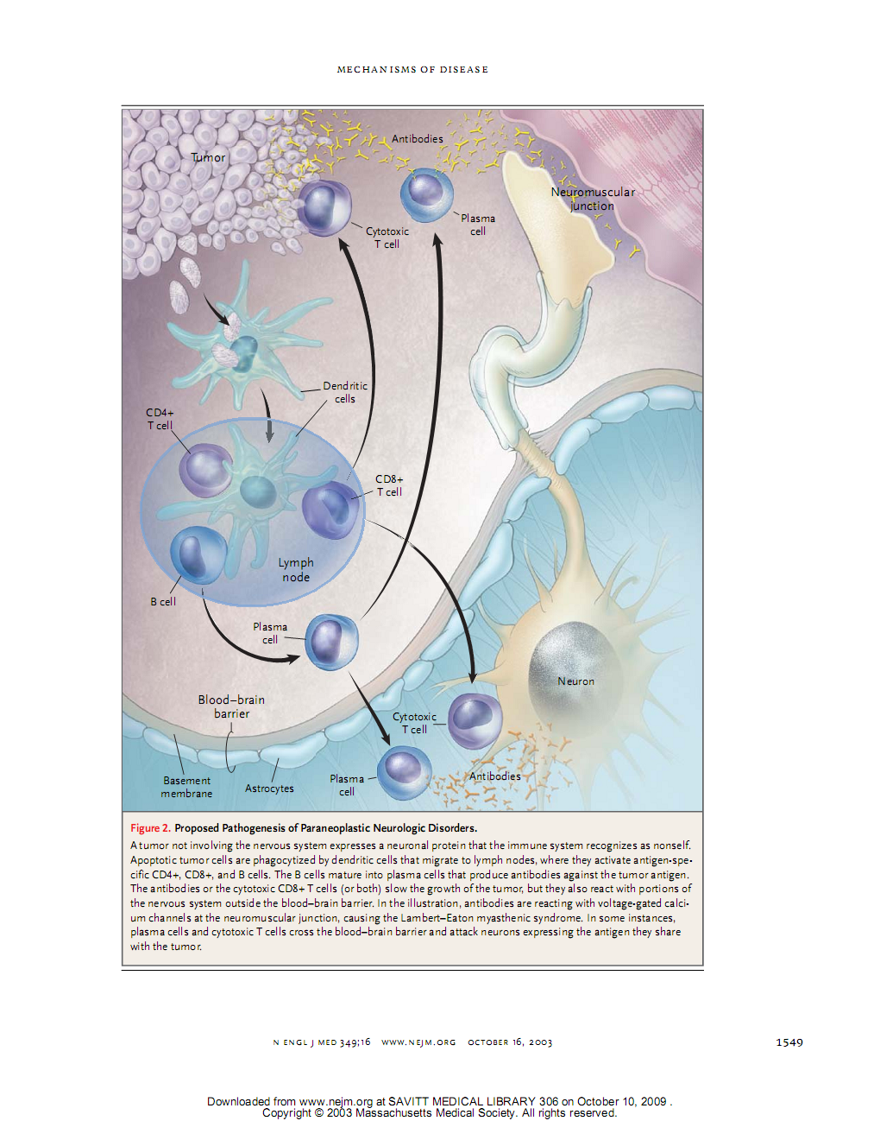

Slide 13
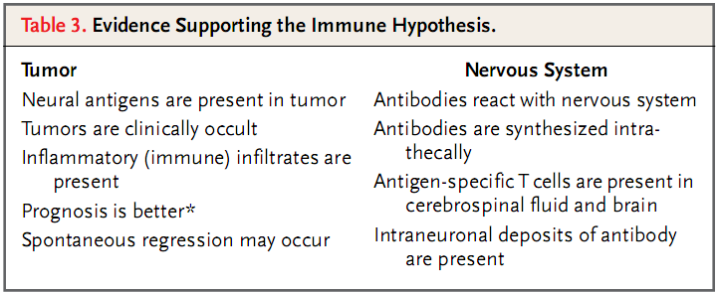

Slide 14
Onconeural antibodies
Antibodies in the serum and CSF that react with both the nervous system and the underlying cancer
Each of these antibodies is associated with a narrow spectrum of clinical syndromes and a restricted sub-group of cancers
Highly specific for identifying a patient with neurologic disability who has a paraneoplastic syndrome.
These antibodies also suggest the site of the underlying cancer.

Slide 15
Onconeural antibodies
Antibodies to Intracellular antigens
Antibodies to
Cell surface antigens
Anti-NMDA,
Anti –VGKC,
Anti-AMPA, Anti-GABA
Anti VGCC
Anti Hu, Anti Ri,
Anti Yo, Anti Ma2,
AntiCv2/CRMP5,
Anti amphiphysin
CRMP 5- collapsin response mediator protein

Slide 16
Antibodies to intracellullar antigens
More commonly paraneoplastic
T cell mediated
Cell surface antibodies
Non-paraneoplatic commonly
Antibodies are pathogenic
Antibodies are not pathogenic

Slide 17
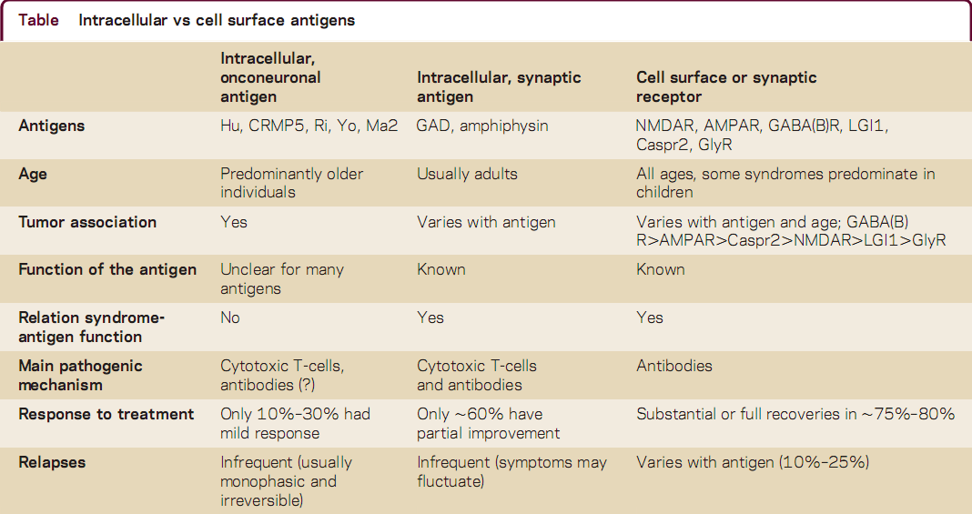

Slide 18
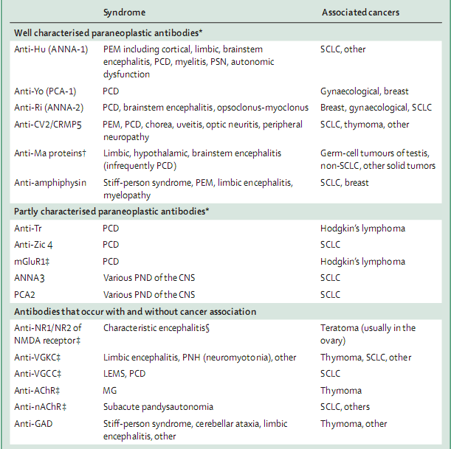

Slide 19
Antigens
In most cases, the antigen has been identified and the gene coding for the antigen has been cloned and sequenced.
Tumours of a particular histologic type may express the antigens whether or not an immune response is mounted
Failure to find the antigen in the cancer of a patient with paraneoplastic antibodies should prompt a search for a second cancer.

Slide 20
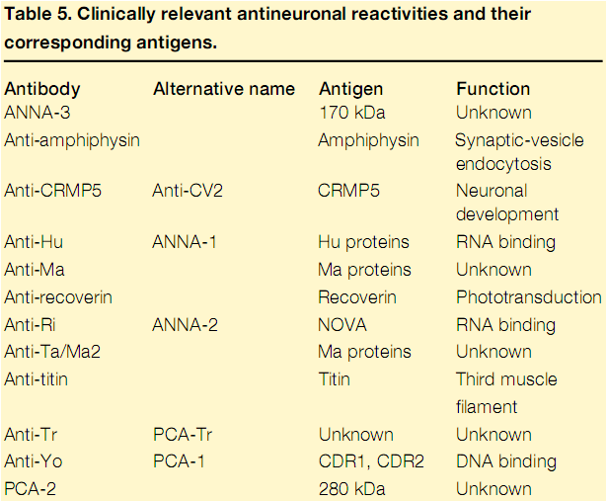

Slide 21
Onconeural antigens are present in the tumor in all patients with antibody-positive paraneoplastic neurologic disorders and in many patients without such disorders
Genes of these antigens are not mutated
Hence, the reason for only some exhibiting PNS not clear

Slide 22
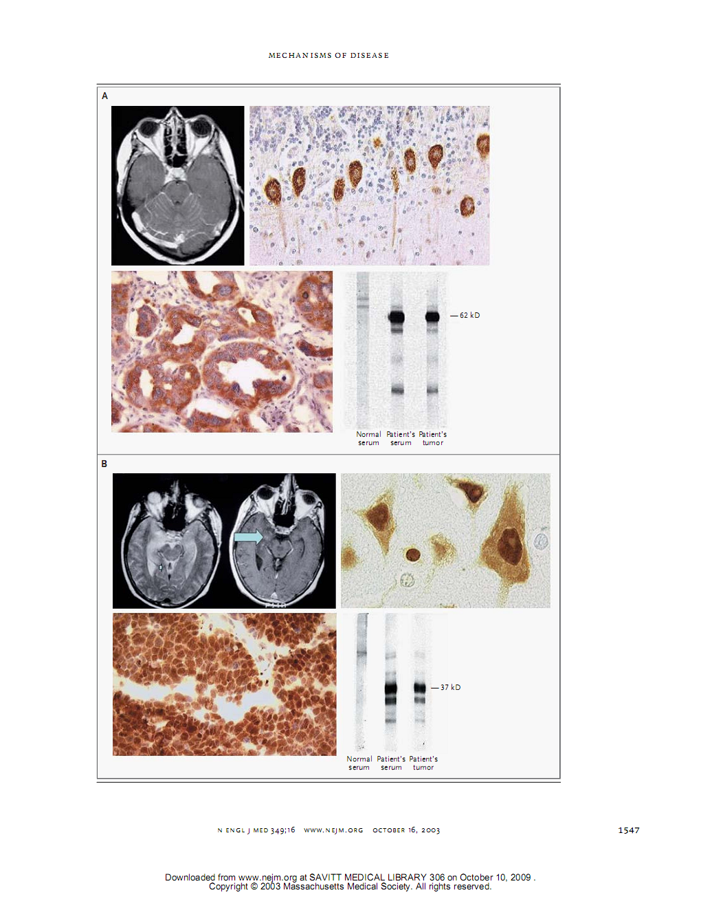

Slide 23
The autoimmune model of pathogenesis
Ectopic expression by a tumor of an antigen that normally is expressed exclusively in the nervous system
The tumor antigen is identical to the neural antigen, but is identified as foreign
The immune attack controls the growth of the cancer and may in a few instances obliterate it

Slide 24
Characteristics of tumours with PNS
Histological features of the tumour similar, except for heavy infiltration with inflammatory cells
Better prognosis
  Earlier diagnosis
  Immune mechanisms

Slide 25
Specificity of the antibodies
Low titres of some of the antibodies may be noted in normal patients; high titres specific
Absence of antibodies does not rule out a PNS (low titres, non-detectable type)
Search for other causes/ second tumour
  Detected Ab not associated with the neurological syndrome
  Histological type does not correlate
  Tumour cells do not express the corresponding antigen

Slide 26
SPECIFIC PARANEOPLASTIC SYNDROMES

Slide 27
PNS INVOLVING BRAIN
Limbic encephalitis
Paraneoplastic encephalomyelitis
Paraneoplastic cerebellar degeneration
Brainstem encephalitis
Opsoclonus myoclonus syndrome
Anti-NMDA receptor associated encephalitis
Anti VGKC associated encephalitis

Slide 28
LIMBIC ENCEPHALITIS – history
Corsellis and colleagues’ [Coresellis et al. 1968] described history of two men aged between 50 and 60, who seemed to suffer from depression and irritability for some weeks.
This was followed by a striking impairment of recent memory
Memory of past events was not impaired and judgement and reason were intact.
Both underwent autopsy, brain metastasis was ruled out ; but were detected to have lung cancer.
Neuropathology showed lymphocytic perivascular cuffing and infiltration in many parts of the brain, with severe affection of mesial-temporobasal lobes.

Slide 29
Limbic encephalitis
Limbic encephalitis is an inflammatory process highly confined to structures of the limbic system.
Key clinical feature is acute or subacute onset, progressive recent memory loss associated with seizures and psychiatric symptoms
Not always paraneoplastic
The tumours more frequently involved are small-cell lung cancer, testicular germ-cell neoplasms, thymoma, Hodgkin’s lymphoma, or teratoma.

Slide 30
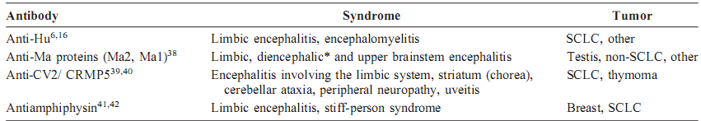
Antibodies in limbic encephalitis
Antibodies directed against two groups of antigens
  Intracellular or classic paraneoplastic antigens – Hu, CV2/CRMP5, Ma 2, amphiphysin
  Cell membrane antigens- VGKC, NMDA, antibodies against neuropil of hippocampus and cerebellum

Slide 31
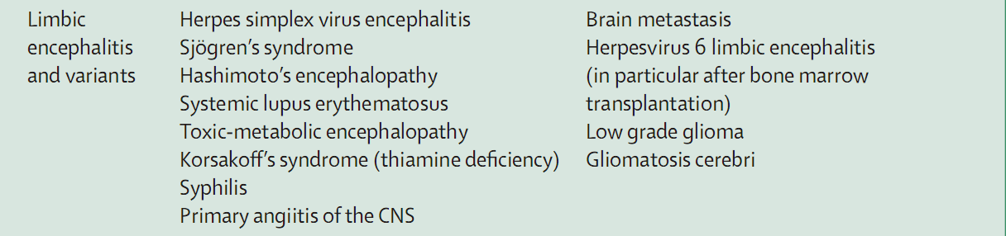
Differential diagnosis

Slide 32
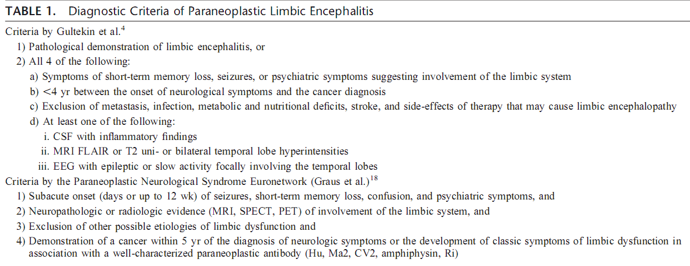

Slide 33
Investigations
Electroencephalography usually reveals foci of epileptic activity in one or both temporal lobes or focal or generalized slow activity.
CSF shows pleocytosis (< 100/cc)and raised protein (<150 mg/dl) with normal glucose
FDG-PET can show hypermetabolism in one or both temporal lobes (earliest manifestation)

Slide 34
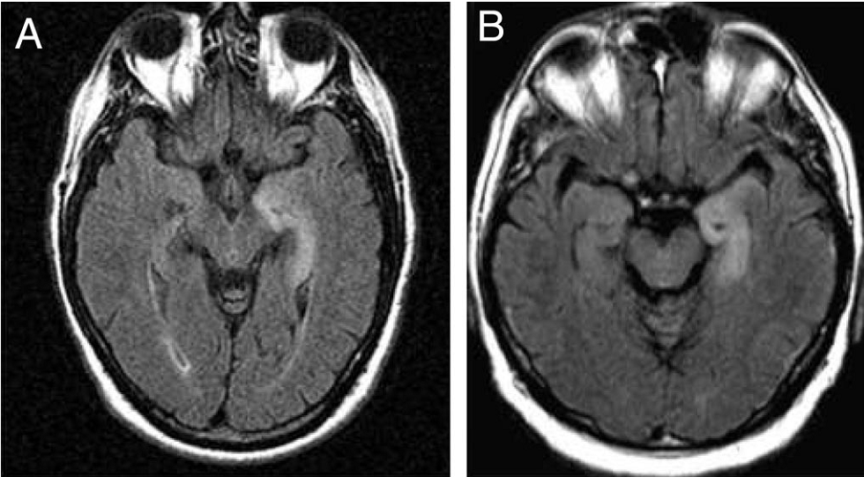
MRI brain
In 70–80% of patients, MRI FLAIR or T2 sequences show hyperintense signals in the medial portion of one or both temporal lobes.

Slide 35
Treatment
Removal of the tumor is critical for neurologic improvement or stabilization of symptoms
Most limbic encephalitides related to intra-cellular antigens do not improve after tumor removal and immunotherapy.
Those related to antibodies to surface antigens have excellent response to immunotherapy.

Slide 36
PARANEOPLASTIC ENCEPHALOMYELITIS
Multifocal inflammatory disorder of the central nervous system
Frequently associated with subacute sensory neuronopathy
Anti Hu antibody is commonly associated
Other PEM antibodies include anti-CV2, anti-Yo, anti-Ma1, anti-Tr or anti-Ma2, anti-LGI1
80% cases are related to lung cancer

Slide 37
PARANEOPLASTIC CEREBELLAR DEGENERATION
Rapidly or subacutely evolving pancerebellar syndrome
Common tumours
  Small-cell lung cancer
  Gynaecological and breast tumours
  Hodgkin’s lymphoma
Hallmark is an extensive loss of Purkinje cells that might be associated with inflammatory infiltrates in the cerebellar cortex, deep cerebellar nuclei, and inferior olivary nuclei

Slide 38
Antibodies
Antibody | Tumour
Anti-Yo (PCA-1) | Gynaecological or breast cancer
Anti-Tr | Hodgkin’s lymphoma
VGCC, Anti Hu CRMP or CV2, amphiphysin, Purkinje cell cytoplasmic antibody type 2 (PCA2), and antineuronal nuclear antibody 3 (ANNA3) | Small cell lung cancer

Slide 39
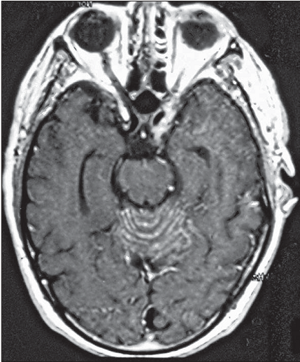
Investigations
MRI brain
  Normal
  Diffuse cerebellar enlargement
  Leptomeningeal enhancement
  Later – cerebellar atrophy
  FDG PET - Hypometabolism

Slide 40
Treatment and prognosis
Treatment of the tumour is needed for stabilisation or symptom improvement with or without immunotherapy.
More severe neurological deficits are more resistant to treatment
Survival from time of diagnosis is significantly worse in patients with anti-Yo (median 13 months) or anti-Hu (median 7 months)

Slide 41
OPSOCLONUS – MYOCLONUS SYNDROME
Opsoclonus comprises involuntary, arrhythmic, chaotic, multi directional saccades
Associated with myoclonic jerks in the limbs and trunk, cerebellar ataxia, tremor, and encephalopathy
Classically thought to be related to damage of the omnipause cells in the nucleus raphe interpositus of the pons
Recent pathological and functional MRI studies suggest that disinhibition of the fastigial nucleus of the cerebellum is involved

Slide 42
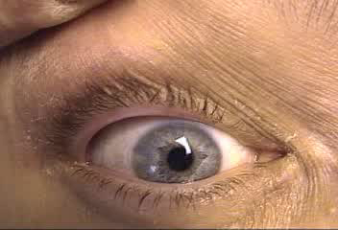
Opsoclonus

Slide 43
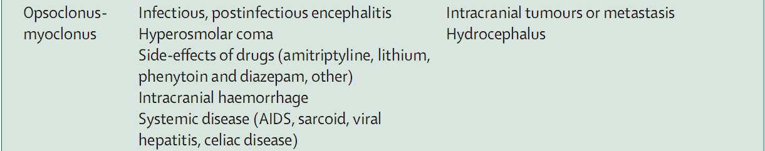
Differential diagnosis

Slide 44
The etiology is likely to be paraneoplastic if opsoclonus is seen in a child than in an adult
In children, the disorder is related to the presence of a neuroblastoma in about 50% of cases.
In adults, the tumours most commonly involved include small-cell lung cancer and cancer of the breast and ovary.
Most patients (both children and adults) are antibody negative

Slide 45
Immunological finding in opsoclonus-myoclonus is the progressive demonstration of antibodies against postsynaptic or cell-surface antigens
Humoral immune mechanisms have an important pathogenic role in opsoclonus-myoclonus and that there are multiple autoantigens.

Slide 46
Prognosis and response to treatment
Children respond better to immunotherapy than adults
Residual motor, speech, behavioural and sleep problems common

Slide 47
ANTI NMDA RECEPTOR ASSOCIATED ENCEPHALITIS
Antibody to NR1 and NR 2 subunits of NMDA receptor
9 – 56% associated with cancer
Ovarian teratoma is the commonly associated tumour
80-90% are females

Slide 48
Clinical stages
Prodromal phase – flu like
Psychiatric symptoms, mutism
Seizures, dysautonomia
Hyperkinestic phase - dyskinesias
Recovery phase

Slide 49
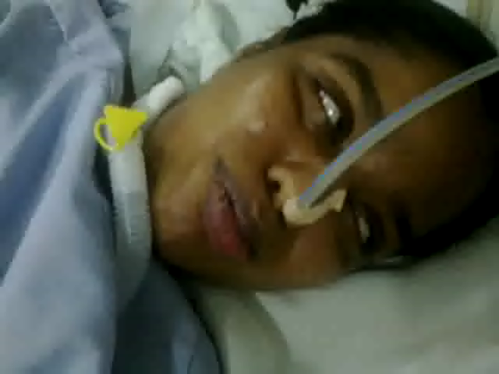
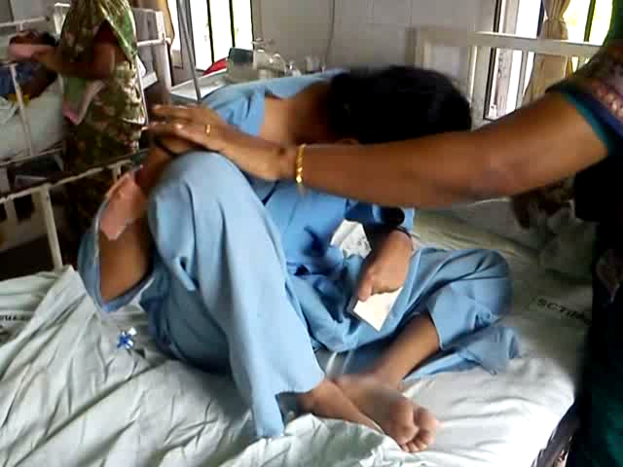

Slide 50
Investigations and treatment
MRI brain
  Normal in 50%
  T2 or FLAIR hyperintensities in the mesial temporal lobe, cerebral cortex (esp frontobasal), cerebellum, basal ganglia
EEG
  Extreme delta brush in 30%
Treatment
  Good resposne to immunotherapy
  IV Ig

Slide 51
Anti VGKC associated encephalitis
Anti LGl1(leucine rich glioma inactivated protein 1)
Anti CASPR 2 (contactin associated protein 2)
Limbic encephalitis
Morvan’s syndrome
Psychiatric, autonomic, peripheral nerve hyperexcitability
Short term memory loss, psychiatric, faciobrachial dystonic seizures, hyponatremia
SCLC, renal, thyroid, ovarian carcinoma
Thymoma
VGKC encephalitis is related to proteins which co-precipitate with VGKC
Only 11-30% related to tumours
Notes:
LC,

Slide 52
PARANEOPLASTIC SYNDROMES OF SPINAL CORD

Slide 53
MOTOR NEURON DISEASE
Occurrence as PNS rare
4.6% incidence of cancer in their ALS patients did not differ significantly from normal population
Most cases with typical ALS and co-existing cancer did not show improvement with treatment of the tumour
May occur as a fragment of paraneoplastic encephalomyelitis or sensory neuronopathy (Anti Hu, purkinje cell antibody)

Slide 54
Lymphoma with MND noted to have good outcome
  Pure LMN presentation
  Asymmetric
  Lower limb affected more than upper limbs
  Improves with treatment of lymphoma
Primary lateral sclerosis
  Association noted with breast cancer

Slide 55
Suspect paraneoplastic syndrome in MND
Atypical MND (fragment of other PNS)
  Ataxia
  Sensory findings
  Autonomic instability
Predominant LMN (Lymphoma)
  Raised CSF protein
  Paraproteinemia
Females with PLS – should have mammogram

Slide 56
ACUTE NECROTIZING MYELOPATHY
Subacute ascending flaccid areflexic paraplegia with sphincter paralysis, and segmental loss of all sensory modalities
May have UMN signs initially
CSF shows moderate pleocytosis and elevated protein levels.
MRI may show enlargement of the spinal cord, T2- weighted abnormalities, and sometimes mild contrast enhancement
Not associated with any specific malignancy

Slide 57
STIFF-PERSON SYNDROME
Rare disorder characterized by
  progressive rigidity of the truncal muscles
  super-imposed spasms
  an exquisite sensitivity to external stimuli
Hallmarks are co-contractions of agonist and antagonist muscles and continuous involuntary firing of motor units at rest
Pathogenesis – Impaired synaptic GABAergic inhibition resulting from autoantibodies against various presynaptic and synaptic proteins in the inhibitory neurons of the brain and spinal cord

Slide 58
Antibodies in stiff person syndrome
Anti glutamic acid decarboxylase (GAD) antibody
Autoimmune
Unrelated to neoplasms usually
Commonest (80%)
Very high titres
Association with IDDM
Anti amphiphysin antibody
Paraneoplastic
Breast, ovarian, small cell lung carcinoma
Occurs in < 5% cases of SPS
Rare antibodies – Antibodies against gephyrin, GABA receptor associated protein

Slide 59
Diagnosis
Paraneoplastic
  Absent reflexes, sphincter disturbances
EMG
  Demonstration of firing of MUAP from muscles at rest
  Failure of reciprocal inhibition from antagonistic muscles
MRI brain and spinal cord – normal
MRI spectroscopy – Decreased GABA in motor cortex

Slide 60
Treatment
Symptomatic treatment
  Diazepam, clonazepam, or baclofen,
Steroids
Treatment of the tumor

Slide 61
PARANEOPLASTIC SENSORY NEURONOPATHY
Paraesthesias, pain and progressive sensory loss involving lower or upper extremities, trunk, and face.
Vibration and joint position sense preferentially affected
Pseudoathetosis, ataxia, lost DTR
Frequently occurs along with encephalomyelitis and autonomic dysfunction

Slide 62
Tumour associations
Common tumours are lung and breast carcinoma
The specificity of the anti-Hu antibodies for PSN was found to be 99.8%, and sensitivity was 82%
CT chest mandatory if anti-Hu positive
PET may show neoplastic adenopathies several months before they are detected by CT or MRI

Slide 63
Investigations
CSF may show increased protein levels and a pleocytosis.
NCS
  Small amplitude or absent sensory nerve action potentials.
  Motor nerve and F-wave studies are usually normal
  Abnormal blink reflex was most likely to occur in association with the non-paraneoplastic neuropathies (Auger et al, 1995)
Mononuclear (T cells and plasma cells) infiltrate of DRG

Slide 64
Treatment
Poor response to IVIg, plama exchange and immunosuppresants
Early identification and removal of tumour stabilizes the disease

Slide 65
PARANEOPLASTIC SYNDROMES OF
PERIPHERAL NERVES

Slide 66
Guillain–Barre ´ Syndrome
Hodgkin’s lymphoma most common association
4 out of 40 patients with GBS had cancer in one study from Olmstead County, Minnesota.
Neurologic prognosis worse compared to noncancer patients
  Progressed over a longer period of time
  Poor neurological recovery
  Death due to cancer

Slide 67
Paraneoplstic polyneuropathy
5% patients have neuropathy clinically, electrically 30-40% have neuropathy
Subacute progression
May or may not be associated with onconeural antibodies

Slide 68
Peripheral neuropathies with onconeural antibodies
Subacute sensory neuropathy or neuronopathy
(Anti Hu)
Sensory neurons in DRG and peripheral sensory nerves, rarely motor and autonomic
Rarely vasculitis or demyelinating neuropathy alone
Sensory or sensorimotor peripheral neuropathy (Anti CV2)
Predominantly axonal or mixed neuropathy
Lower limb predominant
SCLC (70-80%), Hodgkin’s disease
SCLC, thymoma
Other Ab – anti Yo, anti Ma2, anti amphiphysin

Slide 69
Peripheral neuropathies without onconeural antibodies
Peripheral neuropathies with monoclonal gammopathies
Related to IgA/G (myeloma, POEMS) or IgM (Waldenstorm’s, B cell lymphomas/ leukemias)
Upto 45% MAG associated, Axonal or demyelinating
Peripheral neuropathies without onconeural antibodies
After ruling out other causes
Paraneoplastic vasculitis
Painful, symmetric or asymmetric neuropathy, mononeuritis multiplex
SCLC, lymphoma
Some may have low titres of ant-ganglioside antibodies
Axonal neuropathy

Slide 70
PARANEOPLASTIC AUTONOMIC SYNDROMES
Can occur in isolation or as a part of other PNS (PEM, PSN, LEMS)
Tumours are small cell lung carcinoma, carcinoma pancreas, testicular carcinoma, lymphoma, and carcinoid tumours
Commonly anti Hu antibody associated; anti Yo, anti CV2 less common
T cell response against neurons in autonomic ganglia

Slide 71
Common syndromes
Chronic intestinal pseudo-obstruction
  Involvement of extrinsic nerves of the gut, the myenteric plexus and the intestinal pacemaker cells of Cajal
  SCLC and thymoma are the commonest underlying tumours
Orthostatic hypotension
Pandysautonomia
Parasympathetic system failure
  Part of LEMS
  VGCC associated
  Dry mouth, impotence, constipation

Slide 72
LAMBERT – EATON MYASTHENIC SYNDROME
Presynaptic neuromuscular junction disorder
Weakness of limb muscles, less frequently ocular
Improvement with brief exercise, fatigues with long duration exercise
Autonomic symptoms and signs very frequent
  Absent reflexes, sluggish pupillary reaction, Adie’s pupil

Slide 73
Associated with cancer in 50-70%
Commonly associated with SCLC
Antibodies to P/Q type voltage gated calcium channel
(VGCC) in presynaptic terminal in 90% cases (both tumourala nd non-tumoural)
SOX 1 (antiglial nuclear antibody) antibodies are noted in LEMS with SCLC (47%)
Can occur along with other paraneoplastic syndromes

Slide 74
Diagnosis and treatment
NCV/ EMG
  Low CMAP at baseline
  Fast RNS/ brief exercise – at least 100% facilitation
Chest CT and bronchoscopy fo 2-5 years (longer in smokers)
Treatment
  3,4 diaminopyridine with pyridostigmine
  Immunotherapy
  Treatment of tumour

Slide 75
MYASTHENIA GRAVIS AND THYMOMA
A thymoma is found in about 10% of patients with MG; one-third of patients with thymoma develop MG
Rare association with other malignancies
All are anti-acetyl choline receptor antibody positive
Antititin antibodies may help predict the presence of thymoma
Thymoma does not alter survival

Slide 76
Dermatomyositis
9% of patients with polymyositis and 15% of patients with dermatomyositis had cancer.
Interval between the diagnosis of the neurologic disorder and cancer short for DM, many years for PM.
Cancer was the cause of death in 14% of patients with PM and 40% of those with DM
Relationship between polymyositis and cancer is questionable, could be related to increased surveillance

Slide 77
Clinical presentation
Common tumors are ovarian and breast cancer in women and lung and gastrointestinal cancer in men.
Necrotic skin ulcerations and pruritus are predictive factors for the development of cancer.
Childhood DM not associated with cancer
Pathology : Antibody mediated intramuscular angiopathy, leading to ischemia, muscle fiber necrosis, and perifascicular atrophy.

Slide 78
Treatment
The treatment of patients with cancer and dermatomyositis should be directed primarily to the tumor.
No studies comparing the effects of immunosuppressants in these patients and patients without cancer
Reasonable to use the same strategies (steroids, azathioprine, IVIg).

Slide 79
Paraneoplastic visual syndromes
Cancer associated retinopathy
Commonly with SCLC, antibodies to recoverin
Treatment of tumour, IVIg, PLEX, alemtuzumab
Optic neuropathy
Painless bilateral visual loss, vitritis
Trt of tumour, Systemic corticosteroids and intravitreal corticosteroids
Bilateral diffuse uveal melanocytic proliferation
Associated with Ca of genital tract in women, lung and pancreas in men
May worsen with steriods
Melanoma associated retinopathy, Ab to bipolar cells
Ab to CV2/CRMP-5

Slide 80
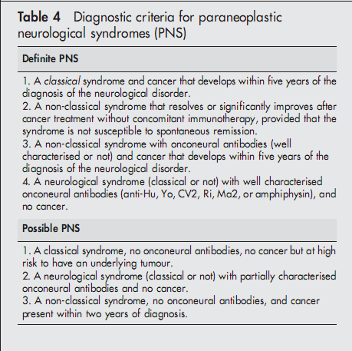
Graus et al, 2004

Slide 81
MANAGEMENT

Slide 82
Diagnosis of the underlying tumour
Early diagnosis of tumour gives the best treatment outcome
Onconeural antibody identified will give a clue to the neoplasm
Radiological diagnostic modalities – HRCT chest, ultrasound abdomen
Whole-body positron-emission tomography may be the best screening method for locating the occult cancer
Repeated examinations may be required – follow up every 4 to 6 months

Slide 83
Approach to treatment
Treatment of the tumour
Stabilizes the neurological condition
Suppression of autoimmune effectors
More effective in syndromes associated with neuronal surface antibodies
May not reverse the damage if morphological changes have already occurred

Slide 84
Immunomodulatory therapy
AIDP and CIDP – as per established guidelines
LEMS – IVIg, PLEX
Dermatomyositis - Combinations of steroids, azathioprine, or IVIg
Others poorly responsive

Slide 85
Empirical therapy suggested
IV methyl prednisolone 500 mg x 5 days
1-2 weeks
IV immunoglobulin 2 g/kg
1-2 weeks
PLEX/ Cyclophosphalmide
Raymond Voltz, Lancet Neurology 2002; 1: 294–305

Slide 86
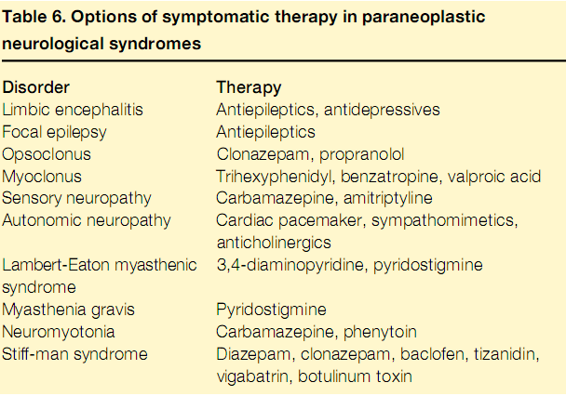
Symptomatic therapy

Slide 87
Treatment response
Poor response to immunotherapy seen with PEM, PCD, PSN
Limbic encephalitis may show good response to treatment of tumour
Children with opsoclonus-myoclonus sydrome respond well to immunotherapy; adults have poor response
LEMS has the best outcome with treatment – combination of IVIg/ PLEX with steriods and tumour therapy

Slide 88
APPROACH TO DIAGNOSIS OF PNS

Slide 89
Approach
Patient with known cancer
Rule out metastasis, metabolic,problems opportunistic infections, drug toxicity
Patient presenting with neurological syndrome
? Paraneoplastic

Slide 90
Pointers to PNS
History
  Personal or family history of cancer, smoking, age > 50 years
Clinical evidence of underlying cancer
  Weight loss, raised ESR, other clinical examination findings
Subacute onset
Classical syndromes, multifocal involvement
CSF – pleocytosis, increased protein, OCBs
EEG – usually nonspecific

Slide 91
MRI brain
May be normal or non-specific
Positive in limbic encephalitis, PEM and PCD
  Abnormal T2 HI in mesial temporal structures (PLE)
  Extensive signal changes involving thalamus, hypothalamus, brainstem
  Bilateral cerebellar enhancement in PCD

Slide 92
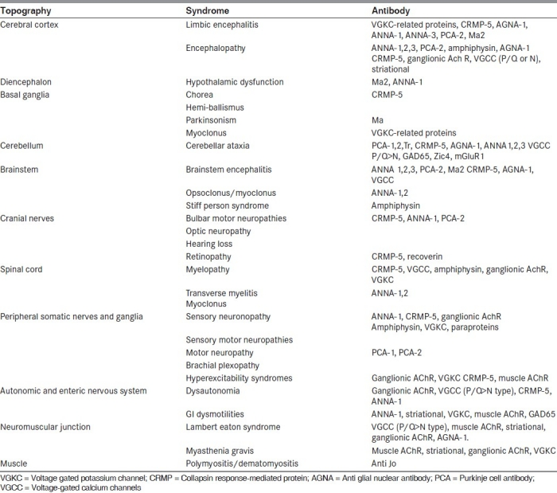

Slide 93
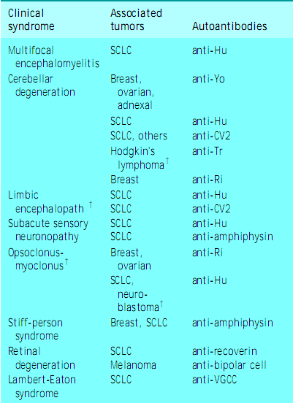

Slide 94
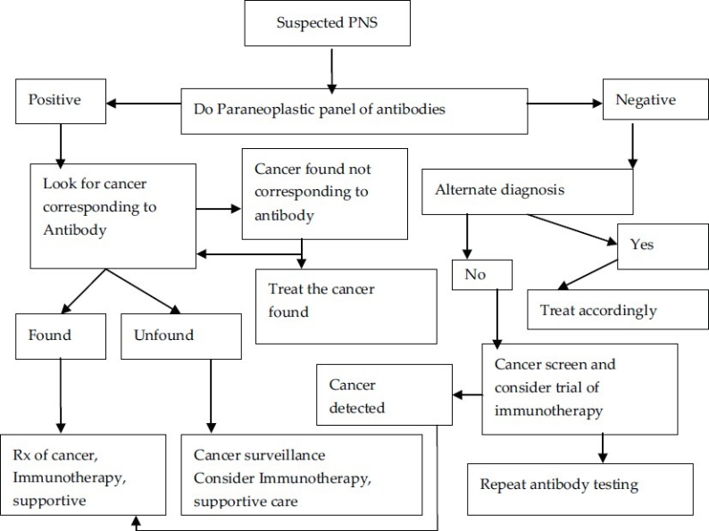
Algorithm

Slide 95
SCTIMST data
40 cases of confirmed/ suspected paraneoplastic syndrome in the last 13 years (since 2000)
18 cases had definite tumour association
Neuropathy commonest (8/18), followed by myopathy (4/18) and encephalitis (4/18)
Common tumours
  Lung carcinoma – 4/18
  Lymphoma – 3/18
  Renal cell carcinoma – 3/18
  Thymoma – 3/18

Slide 96
Summary
Majority have an occult neoplasm
  May not be able to identify the neoplasm in the initial screening
  Follow up examinations necessary
Patients presenting with classical syndromes and no other obvious cause
  CAREFUL CLINICAL EXAMINATION –lymph nodes, chest, abdomen, breast, testis, thyroid
  Paraneoplastic antibody profile
  Whole body PET should be considered if strong suspicion exists

Slide 97

THANK YOU

Slide 98
References
Josep Dalmau, Myrna R Rosenfeld. Paraneoplastic syndromes of the CNS. Lancet Neurol 2008; 7: 327–40
Darnell RB, Posner JB. Paraneoplastic syndromes involving the nervous system. N Engl J Med 2003; 349: 1543–54.
Rudnicki SA, Dalmau J. Paraneoplastic syndromes of the spinal cord, nerve, and muscle. Muscle Nerve 2000; 23: 1800–18.
Voltz R., Paraneoplastic neurological syndromes: an update on diagnosis, pathogenesis, and therapy. Lancet Neurology 2002; 1: 294–305

Slide 99
MCQ
Which of the following syndromes is less common with anti Hu antibody?
Limbic encephalitis
Stiff person syndrome
Autonomic neuropathy
Paraneoplastic sensory neuronopathy

Slide 100
MCQ
Which of the following syndromes is less common with anti Hu antibody?
Limbic encephalitis
Stiff person syndrome
Autonomic neuropathy
Paraneoplastic sensory neuronopathy

Slide 101
2. Which of the following does not show any morphological changes in brain in autopsy?
Limbic encephalitis
Paraneoplastic cerebellar degeneration
Opsoclonus myoclonus syndrome
Braisntem encephalitis

Slide 102
2. Which of the following does not show any morphological changes in brain in autopsy?
Limbic encephalitis
Paraneoplastic cerebellar degeneration
Opsoclonus myoclonus syndrome
Braisntem encephalitis

Slide 103
3. Which among the following is the false statement?
Anti-amphiphysin antibodies are the commonest antibodies in paraneoplastic stiff man syndrome
Morvan’s syndrome is characterized by anti LGI1 antibody
Autonomic neuropathy can be a component of LEMS
MRI changes are common with limbic encephalitis

Slide 104
3. Which among the following is the false statement?
Anti-amphiphysin antibodies are the commonest antibodies in paraneoplastic stiff man syndrome
Morvan’s syndrome is characterized by anti LGI1 antibody
Autonomic neuropathy can be a component of LEMS
MRI changes are common with limbic encephalitis

