Slide 1
PHYSIOLOGY OF PHONATION

Slide 2
Levels of Evidence
Grade A – Systemic reviews, Meta analyses, RCT
Grade B – Non-randomised studies
Grade C – Observational studies
Grade D – Case Series, Expert opinion

Slide 3
Levels of Evidence
**** ~ Systematic reviews, meta analysis of randomized control studies
*** ~ Non randomised studies
** ~ Observational or non experimental studies
* ~ Expert opinion

Slide 4
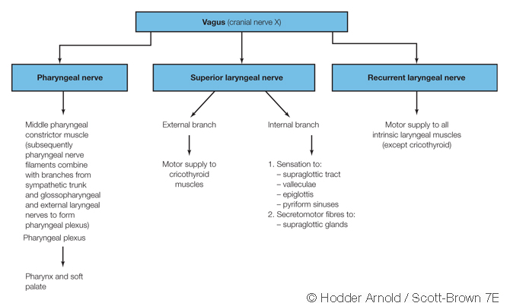
LARYNGEAL INNERVATION

Slide 5
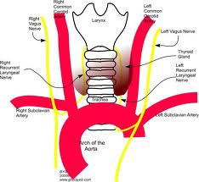
LARYNGEAL INNERVATION

Slide 6
NEUROANATOMY OF PHONATION
Periaqueductal grey matter (PAG)
Nucleus retroambigualis (NRA)

Slide 7
INITIATION OF VOICE
Prephonatory inspiratory phase
Vocal fold oscillation
Phonation threshold pressure

Slide 8
THE VIBRATORY CYCLE
Adduction
Aerodynamic separation
Recoil

Slide 9
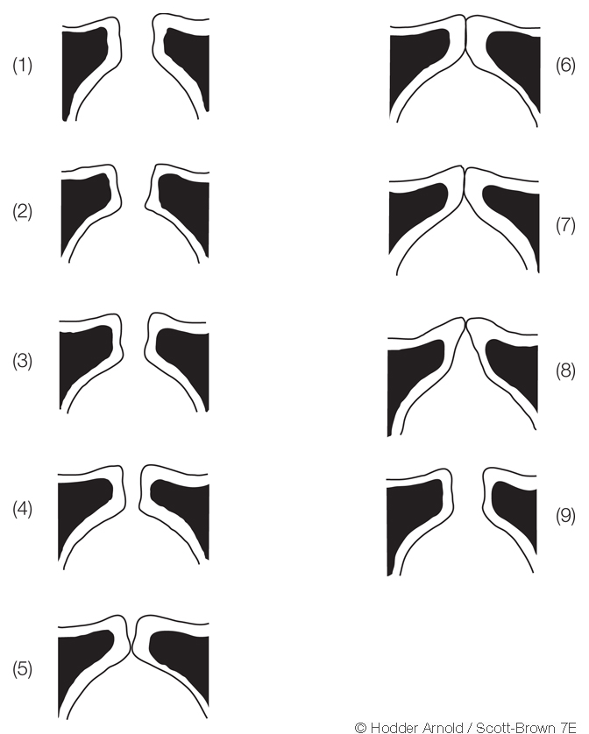
VOCAL CORD VIBRATORY CYCLE

Slide 10
VOCAL REGISTERS
REGISTER | EQUIVALENT TERM | VOCAL FOLDS | RANGE (Hz)
Loft | Falsetto | Thin,tense,lengthened.minimal vibration | 275-1100
Modal | Chest,head,middle,heavy voice | Complete adduction | 100-300
Pulse | Vocal fry,glottal fry,creaky voice | Long closed phase | 20-60

Slide 11
GLOTTAL SIGNALS
Quality of the sound
Frequency of glottal signal
Amplitude

Slide 12
VOCAL RESONANCE
Oral
Nasal

Slide 13
NAME OF STUDY | NAME OF AUTHOR | REFERENCE DETAILS | SAMPLE SIZE | RESULT | P VALUE | CONCLUSION
Diagnostic Accuracy of History, Laryngoscopy, and Stroboscopy | Benjamin C. Paul, MD; Si Chen, BS; Shaum Sridharan, MD; Yixin Fang, PhD; Milan R. Amin, MD; Ryan C. Branski, PhD | Laryngoscope, 123:215–219, 2013 | 58 | When compared to diagnoses obtained during direct laryngoscopy, the percent agreement for HPE, flexible laryngoscopy, and stroboscopy were 5%, 68.3%, and 68.3%, respectively | 0.0001 | These findings confirm the value of laryngeal visualization in dysphonic patients.

Slide 14
Q-1 All are supplied by recurrent laryngeal nerve except
Posterior cricoarytenoid
Thyroarytenoid
Cricothyroid
vocalis

Slide 15
Q-2 All are abductors of larynx except
Thyroarytenoid
Interarytenoid
Lateral cricoarytenoid
Posterior cricoarytenoid

Slide 16
Q-3 All are unpaired cartilages of larynx except
Arytenoid
Thyroid
Cricoid
Epiglottis

Slide 17
Q-4 cartilage of larynx having signet ring shape
Thyroid
Criocoid
Arytenoid
Cuneiform

Slide 18
Q-5 Narrowest part of infant larynx
Supraglottis
Glottis
Subglottis
None of the above

Slide 19
THANK YOU…

