Slide 1
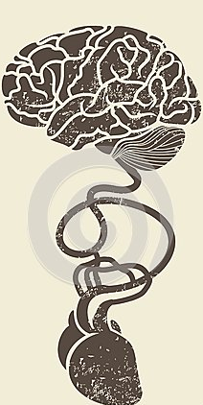
Prevention & Treatment of Cardioembolic Stroke
Faculty : Dr. Sanjay Prakash

Slide 2
Scheme
Features of Cardioembolic Stroke
Workup for Cardioembolic source
Important Embolic conditions & Prevention of Stroke
Treatment
Thrombolysis
Anticoagulation
Specific Issues
AHA Guidelines

Slide 3
Introduction
Embolism of cardiac origin accounts for about one fifth (20%) of ischemic strokes
Associated with substantial morbidity and mortality.
Enormous preventive potential- Underutilized

Slide 4
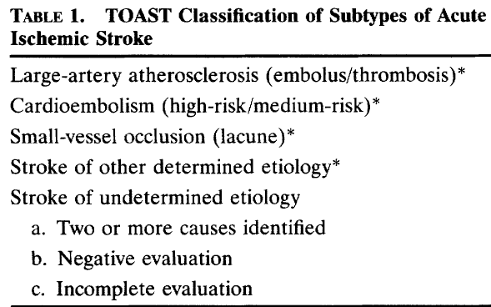
TOAST

Slide 5
Importance of Cardioembolic Stroke
Generally severe and prone to early recurrence
Risk of long term recurrence and mortality high after a cardioembolic stroke
Early confirmation of a diagnosis of cardioembolic infarction extremely important to initiate anticoagulation for an adequate secondary prevention

Slide 6
Pathophysiology of Cardioembolic Stroke
Valves- Valvular heart disease, IE
Atria- ASA, LA thrombus, LA myxoma
Ventricles- coronary artery disease, dilated cardiomyopathies, LV thrombus/Tumor
Shunts- Paradoxical Embolism
Arrhythmia

Slide 7
Pathophysiology of Cardioembolic Stroke
Cardiac Embolism results from three mechanisms:
Blood stasis and thrombus formation in an enlarged (or affected by another structure alteration) left cardiac chamber (e.g., left ventricular aneurysm);
Release of material from an abnormal valvular surface (e.g., calcific degeneration, IE);
Abnormal passage from the venous to the arterial circulation (paradoxical embolism)

Slide 8
Pathophysiology of Cardioembolic Stroke- Arrhythmia
Atrial Fibrillation- Mechanism
AF leads to Inadequate contraction of, and leads to stasis that is most marked in the left atrial appendage.
Stasis associated with increased concentrations of fibrinogen, D-dimer, and von Willebrand factor, which are indicative of a prothrombotic state, predisposing to thrombus formation with consequent increased rate of cerebral embolization

Slide 9
Sites Involved
Approximately four out of every five emboli that arise from the heart go into the anterior circulation, equally divided between the two sides.
The remaining one fifth of emboli go into the posterior circulation- a rate about equal to the proportion of the blood supply

Slide 10
Sites Involved- Anterior Circulation
Emboli often pass into the superior and inferior divisions of the MCA and their cortical branches.
Cause massive superficial, single large striatocapsular or multiple infarcts in the middle cerebral artery.
Clinical syndromes such as Wernicke’s aphasia or global aphasia without hemiparesis common
Seldom go into the MCA penetrating artery (lenticulostriate arteries) branches because these arteries originate at a nearly 90-degree angle from the parent arteries

Slide 11
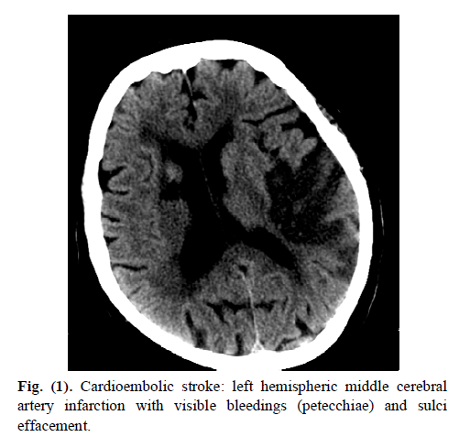

Slide 12
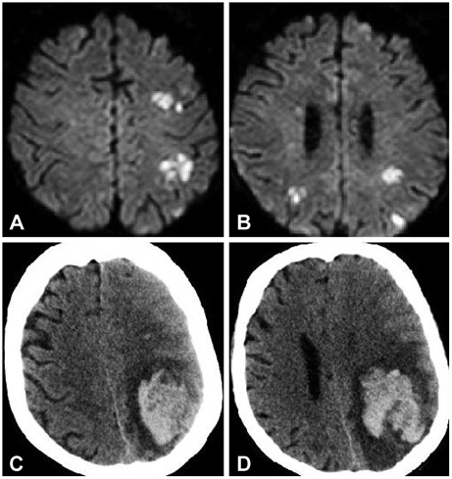
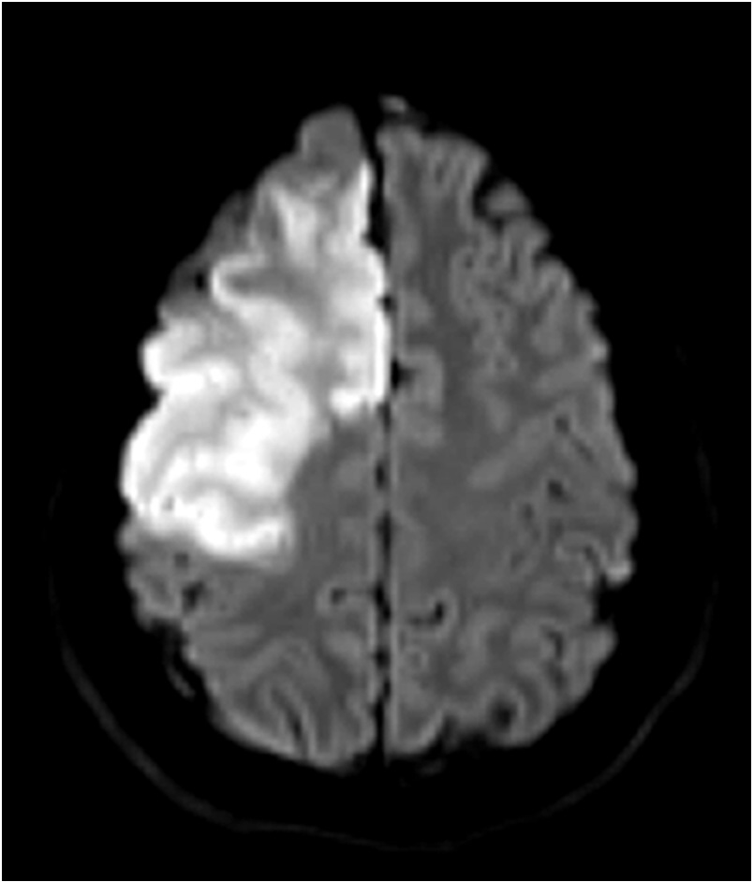

Slide 13
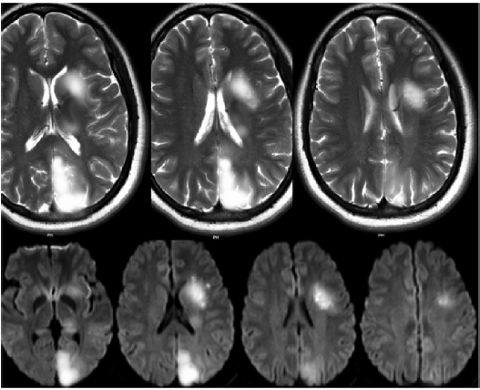

Slide 14
Sites Involved- Posterior Circulation
Posterior inferior portion of the cerebellum in the territory of the posterior inferior cerebellar artery branch of the ICVA
Superior surface of the cerebellum in the territory of the SCA
Thalamic and hemispheric territories of the PCAs.

Slide 15
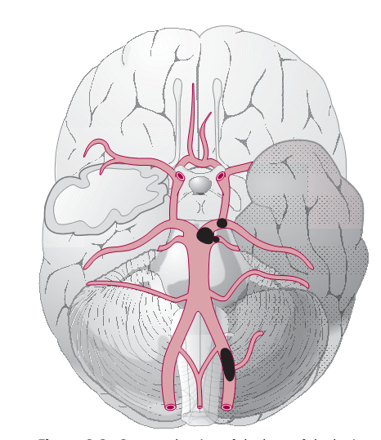
Sites Involved- Posterior Circulation

Slide 16
How to Suspect
Decreased consciousness at onset
Rapid regression of symptoms (the spectacular shrinking syndrome)
Sudden onset to maximal deficit (<5 min)

Slide 17
How to Suspect
Simultaneous or sequential strokes in different arterial territories
Visual-field abnormalities, neglect, and aphasia are more common in cardioembolic stroke
Headache or seizures at onset

Slide 18
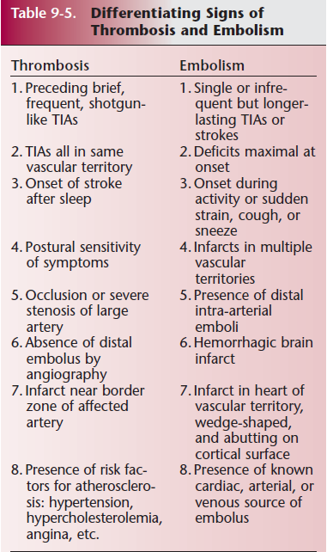

Slide 19
How to Suspect -Imaging
Bihemispheric or combined anterior and posterior, bilateral, or multilevel posterior circulation infarcts
Haemorrhagic transformation of an ischaemic infarct
Early recanalisation of an occluded intracranial vessel

Slide 20
Uncommon in Cardioembolic Stroke
Pure Hemiparesis
Lacunar syndromes
Multiple lacunar infarcts

Slide 21
Identification of Cardioembolic source
At the site of Effect
On the way
At the site of Origin

Slide 22
At the site of Effect- MRI
MRI can provide evidence for cardioembolism by showing lesions not visible on CT
Can reveal cortical involvement in strokes that seem to be subcortical & multiple lesions in strokes that seem to be single lesions on CT
Sensitivity of MRI to hemorrhagic transformation is higher than that of CT.

Slide 23
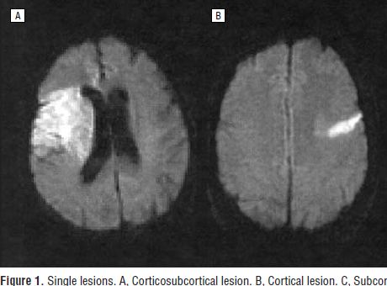
MRI

Slide 24
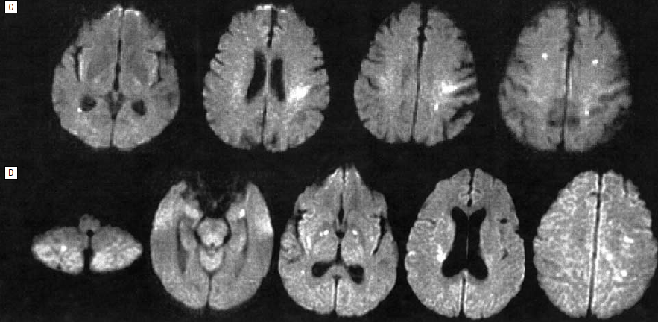
MRI- Multiple Lesions

Slide 25
Cardioembolic Stroke- Clues to Etiology on MRI
Arterial Emboli cause smaller infracts in distal locations than Cardiac Emboli
PFO-strokes were more likely to present as a single cortical lesion or multiple small scattered lesions, more often located in the vertebrobasilar circulation.
Occlusion of the corresponding artery was less frequent, and the recanalization rate was lower in PFO than in AF-stroke
Imaging Characteristics of Ischemic Strokes Related to Patent Foramen Ovale
Bum Joon Kim, MD; Stroke. 2013

Slide 26
AF vs PFO- MRI
PFOs may work as filters, allowing only smaller emboli to pass through the shunt- Predilection for small cortical embolic infarctions or multiple small scattered lesions
Excess flow to vertebrobasilar circulation after the Valsalva maneuver in patients with PFO- Predilection for Posterior circulation stroke
Imaging Characteristics of Ischemic Strokes Related to Patent Foramen Ovale
Bum Joon Kim, MD; Stroke. 2013

Slide 27
Hemorrhagic Transformation
20–40% of all patients with stroke- hemorrhagic transformation within the first week of symptom onset
HT in Up to 71% of cardioembolic strokes.

Slide 28
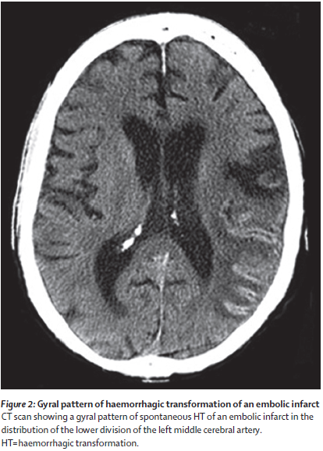

Slide 29
Hemorrhagic Transfomation- Mechanism
Infarct caused by blockage of a large artery by the thrombus
Blockage causes local vascular spasm
Release of this local spasm and fragmentation of the thrombus
Exposes ischaemic tissues, damaged vessel walls and capillaries to Reperfusion

Slide 30
Predictors of hemorrhagic transformation in Acute cardioembolic stroke
Decreased alertness
Total circulation infarcts, severe strokes (NIHSS>14)
Proximal occlusion
Hypodensity in more than one third of the middle-cerebral artery territory
Delayed recanalisation (>6 h after stroke onset)

Slide 31
Identification of Cardioembolic source
At the site of Effect
On the way
At the site of Origin

Slide 32
On the way- CTA or TCD
Occlusion of the MCA Mainstem
Ultrasonography can detect emboli as oscillating, homogeneous, elastic-mass echos
Suspicion of cardioembolism increases if angiography or TCD show that artery in the territory of the infarct is patent, or if they show Early recanalisation of a previously occluded vessel.

Slide 33
TCD
Helpful for the diagnosis of Right to Left shunting by detecting bubble signals passing the MCA less than 20 s after agitated saline is injected in an antecubital vein
TCD can also show high intensity transient signs (HITS) that indicate microembolism in several emboligenic cardiac conditions

Slide 34
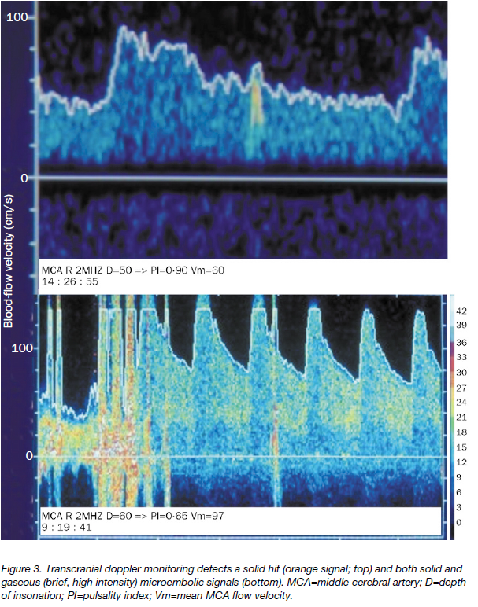

Slide 35
Identification of Cardioembolic source
At the site of Effect
On the way
At the site of Origin

Slide 36
At the site of Origin
History, physical examination, and ECG can help make the diagnosis of a cardiac emboligenic condition in certain cases
ECHO
Holter Monitoring
Newer techniques for detection of AF

Slide 37
ECHO-TTE
Can disclose mitral stenosis, Dilated cardiomyopathies and other structural ventricular diseases.
Intraventricular thrombus, vegetation, or tumors
Enables the measurement of left atrial size and of left ventricular systolic function.
Transthoracic echocardiogram provides little additional information to history, physical examination, and ECG

Slide 38
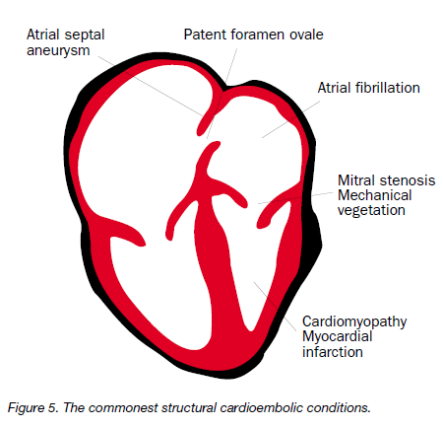

Slide 39
TEE
To study the aortic arch and ascending aorta, left atrium and left atrial appendages, inter-atrial septum, pulmonary veins, and valve vegetation
Useful in diagnosing PFO with ASA & Rt to Left shunt
Better sensitivity to pickup infective or non-infective vegetation in endocarditis

Slide 40
TEE-Importance
Can influence secondary prevention significantly toward Oral anticoagluation in one third of patients with stroke of undetermined etiology after routine diagnostics
High-risk sources identified by TEE are aortic thrombi or plaques >4 mm, thrombi in left atrial cavity/left atrial appendage, spontaneous echo contrast, and Left atrial flow velocity <30 cm/s
Potential sources in TEE were PFO, atrial septal aneurysm, and aortic plaques< 4 mm.
Therapeutic Strategies After Examination by Transesophageal Echocardiography in 503 Patients With Ischemic Stroke; Andreas Harloff, Stroke. 2006

Slide 41
Holter
Single 24-hr holter monitoring has low yield in detecting Occult AF
Seven-day Holter ECG (7-d ECG) increases the detection rate of AF to a maximum of 10% to 15%

Slide 42
Significant AF on Holter
Definition of AF in Holter varied in different studies
Most common duration used in various studies and commonly applied clinically is AF for a duration of 30 sec during monitoring

Slide 43
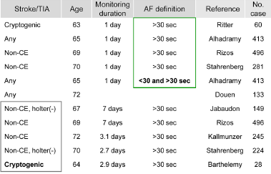
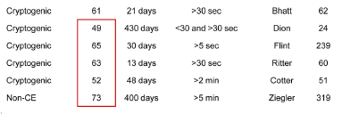

Slide 44
Techniques for AF detection
7-Day Holter monitoring
In- hospital and outpatient Tele-monitoring
Insertable cardiac monitor (Loop Recorder)

Slide 45
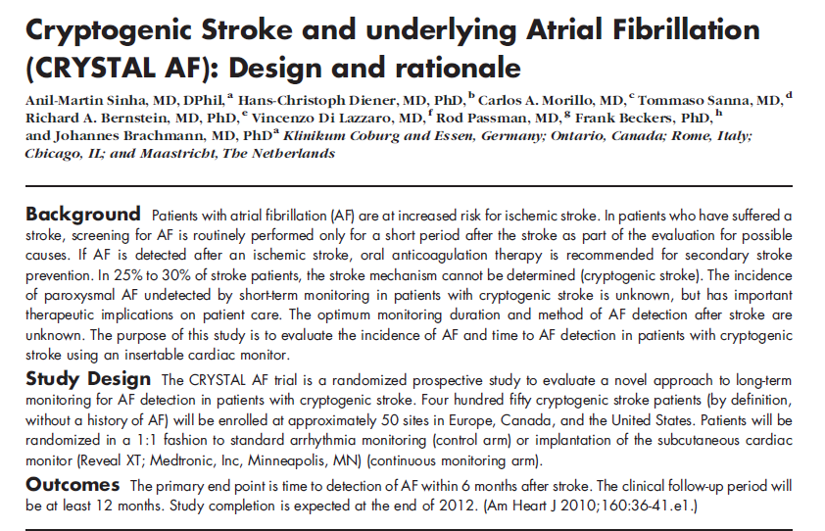

Slide 46
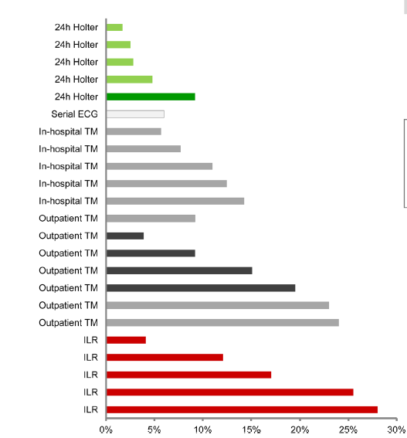
Evaluation of Cryptogenic Stroke With Advanced Diagnostic Techniques
Oh Young Bang, MD; Stroke. 2014;45:1186-1194.

Slide 47
Important Emboligenic Conditions & Stroke Prevention

Slide 48
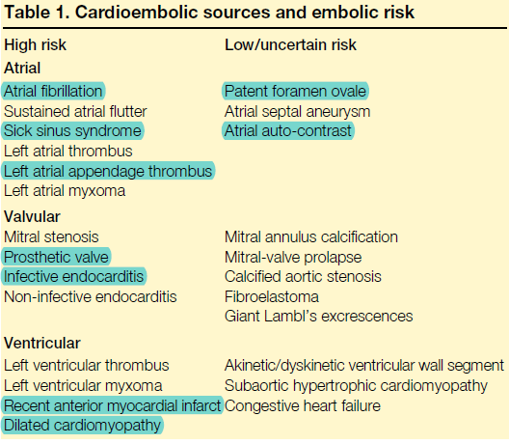

Slide 49
Non valvular Atrial Fibrillation
The prevalence of AF increases from less than 1% in patients younger than 60 years to almost 10% in patients over the age of 80 years
Approximately, 16% (11% to 29%) of all ischemic strokes are associated with AF
Among patients over 70 years old with ischemic stroke, more than one-third suffer from AF

Slide 50
Non valvular Atrial Fibrillation
The risk of stroke is at least six times higher in patients with atrial fibrillation than in healthy controls
Loss of atrial contraction in AF leads to blood stasis, particularly, in the left atrial appendage which is a known pro-thrombotic condition

Slide 51
AF
The major risk factors for stroke in AF:
Previous stroke or TIA
(Relative risk [RR] 2.5, 95% CI 1.9–3.3)
Advancing age (RR 1.4, 1.3–1.6 per decade)
History of Hypertension (RR 1.9, 1.5–2.4)
Systolic blood pressure >160 mm Hg(RR 1.4, 1.2–1.6)
Diabetes (RR 1.7, 1.5–2.1).

Slide 52
AF
Factors associated with a particular high embolic risk:
Spontaneous echo contrast
Left atrial thrombus
Aortic plaque detected by transesophageal echocardiogram

Slide 53
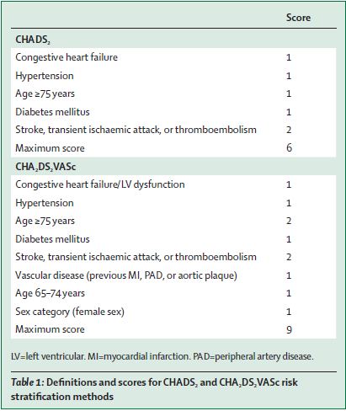
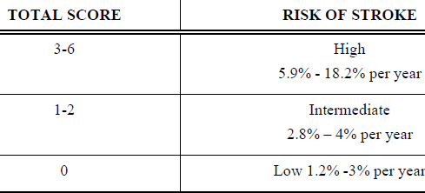
Risk Stratification

Slide 54
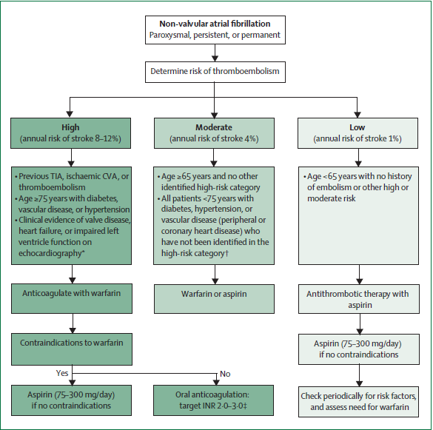
Atrial fibrillation and stroke prevention. Gregory YH Lip; Lancet Neurol 2007

Slide 55
Evidence for thromboprophylaxis in AF
Warfarin versus aspirin- BAFTA Trial
Adjusted-dose warfarin significantly more effective than aspirin for prevention of first-ever stroke (RR 0.62, 95% CI 0.48–0.82) and recurrent stroke (HR 0.38, 0.23–0.64) in AF
Birmingham Atrial Fibrillation Treatment of the Aged (BAFTA) trial, selected patients aged 75 years or older, reported no significant difference in the yearly risk of extracranial haemorrhage (1.4% with warfarin vs 1.6% with aspirin; RR 0.87, 95% CI 0.43–1.73)

Slide 56
Evidence for thromboprophylaxis in AF
Warfarin versus aspirin and clopidogrel: ACTIVE- W Trial
Adjusted-dose warfarin (target INR 2.0–3.0) is significantly more effective than the combination of clopidogrel (75 mg daily) and aspirin (75–100 mg daily) in patients with AF for prevention of stroke (1.4% per year with warfarin vs 2.39% with clopidogrel plus aspirin; RR 0.58, 95% CI 0.42–0.81)
Does not cause more major bleeding (2.21% vs 2.42% per year; RR 0.91, 0.69–1.20)

Slide 57
Evidence for thromboprophylaxis in AF
Aspirin versus control
Aspirin associated with a non-significant reduction in the relative risk of stroke by about a fifth compared with placebo (5.2% per year with aspirin vs 6.3% with placebo; RR 0.81, 95% CI 0.65–1.01) without any significant excess of intracranial haemorrhage (0.16% vs 0.13% per year)
Fixed low-dose warfarin associated with more thromboembolic events without reducing the risk of bleeding complications when compared with adjusted-dose warfarin

Slide 58
Evidence for thromboprophylaxis in AF
Aspirin and clopidogrel versus aspirin- ACTIVE Trial
Aspirin plus clopidogrel 75 mg daily reduces the risk of stroke by a quarter compared with aspirin alone in AF (2.4% per year with aspirin plus clopidogrel vs 3.3% with aspirin; RR 0・72, 95% CI 0.62–0.83).
Despite an increase in major bleeding (2.0% vs 1.3% per year; RR 1.57, 1.29–1.92), the addition of clopidogrel to aspirin leads to a slight net benefit in patients for whom warfarin is unsuitable.

Slide 59

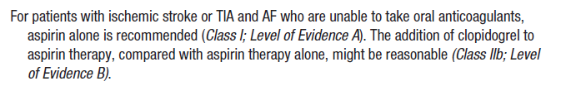
Prevention of Stroke in AF-
When Anticoagulation is Contraindicated

Slide 60

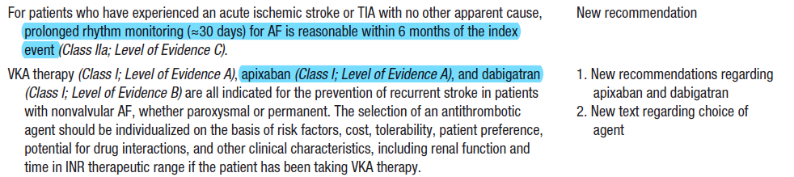
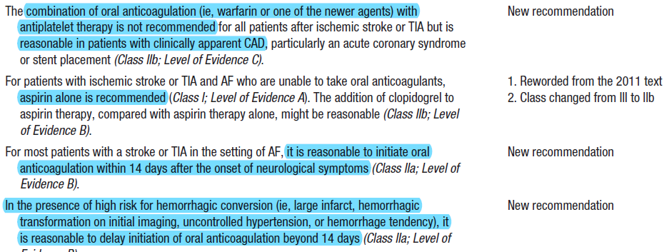

Slide 61
AF & LA Appendage
In AF, the majority of left atrial (LA) thrombi involve the LA appendage (LAA).
Surface ECG may not always reflect underlying LAA mechanical function- Mechanical Discordance between body of LA and LAA
Detected by Pulse wave Doppler on TEE

Slide 62

Non Pharmacological Management of AF
Percutaneous, Left atrial appendage occluders- on the assumption that most thrombi that embolise originate in the left atrial appendage
WATCHMAN, LAPTONI

Slide 63
Acute Myocardial Infarction
Approximately 2.5% of patients with acute myocardial infarction experience a stroke within 2 to 4 weeks of the infarction
8% of men and 11% of women will have an ischemic stroke within the next 6 years.
Stroke occurred especially in those with anterior AMI, in whom the risk of ischemic stroke raises to 12%

Slide 64
Acute MI- Factors Enhancing risk of stroke
Severe left ventricular dysfunction with low cardiac output
Left ventricular aneurysm or thrombus
Associated arrhythmias such as atrial fibrillation.
Patients with an EF< 28% had a relative risk of stroke of 1.86 compared with patients with an EF>35%.
The incidence of early embolism possibly up to 22% in the presence of a mural thrombus- when the thrombus is mobile or protrudes into the ventricle

Slide 65
AMI- Stroke Prevention
Randomized trials showed that heparin followed by low-intensity oral anticoagulation (INR 1.6 to 2.5) reduced stroke by about 70% in the weeks following Acute MI
Stroke rate three months after AMI being so low, long-term anticoagulation beyond three months is not justified unless other major cardiac embolic risk factors, such as mural thrombosis coexist
Antiplatelet therapy adequate after 3months

Slide 66
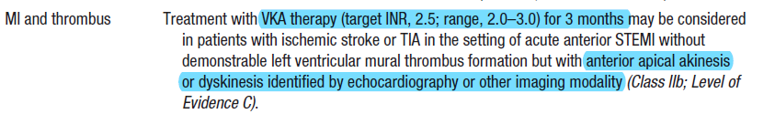


Slide 67
Prosthetic Heart Valves
In patients with prosthetic heart valves, thromboembolic events occur at a rate of 7 to 34% per year without anticoagulant therapy and at a rate of 1 to 5% per year with oral anticoagulation
Both mechanical and bioprosthetic valves are at increased risk of stroke
Risk: First 3 months after bioprosthetic valve
Long-lasting after mechanical valve

Slide 68
Prosthetic Heart Valves
Thromboembolic risk related to the site of valve replacement- higher for mitral valve than for aortic Valve
Kind of mechanical valve used- lower for the bileaflet ones than for monoleaflet and caged ball ones
Stroke may occur from either inadequate anticoagulation or because thrombogenic factors are inadequately suppressed despite adequate anticoagulation therapy.

Slide 69
Stroke Prevention in PHV
Bioprosthetic valves: Anticoagulant therapy for the first 3 months after implantation followed by anti-platelet therapy.
Mechanical valves: Lifelong Anticoagulation
INR range of 2 to 3 for bileaflet mechanical aortic valves
INR range of 2.5 to 3.5 for mechanical mitral valves and for monoleaflet valves

Slide 70
PFO
Present in a third of all patients with stroke & up to 40% of patients with ischemic stroke who are younger than 55 years of age
between 2–8 mm in diameter
Can cause stroke through paradoxical embolism, an event that is difficult to prove because it requires the thrombus to be shown at the PFO by Echo or autopsy.

Slide 71
PFO
Paradoxical embolism is a possible diagnosis if there is an arterial embolism with:
No source found in the pulmonary veins, left cardiac cavities and valves, ascending aorta and aortic arch, cervical extracranial arteries, and in the large basal intracranial arteries;
A Right-to-left shunt;
Coexisting DVT or PE
cough or other Valsalva maneuver immediately preceding the onset of stroke symptoms.

Slide 72
PFO-ASA
Atrial septal aneurysms are detected in 0·2–4·0% of patients examined with TEE.
Criteria for the diagnosis of ASA:
Minimum of 10 mm phasic movement
Diameter of at least 15 mm

Slide 73
PFO
Paradoxical embolism, supraventricular arrhythmia, and thrombus from a coexistent ASA are the more likely mechanisms of stroke in PFO
ASA can cause stroke by paradoxical embolism of a thrombus originating in the aneurysm or by inducing supraventricular arrhythmia

Slide 74
PFO on TEE
PFO defined as TEE evidence of infused microbubbles in the LA within three cardiac cycles after their appearance in RA, at rest or during Valsalva release.
Shunt size Grading:
Grade 0 indicating no microbubbles
Grade 1, 1 to 9 microbubbles;
Grade 2, 10 to 20 microbubbles;
Grade 3, more than 20 microbubbles.

Slide 75
Management- Prevention of Stroke in PFO
Factors that increase the risk for recurrent stroke in patients with PFO:
Younger age
Association with ASA
Presence of a right-to-left shunt at rest,
Size of the PFO

Slide 76
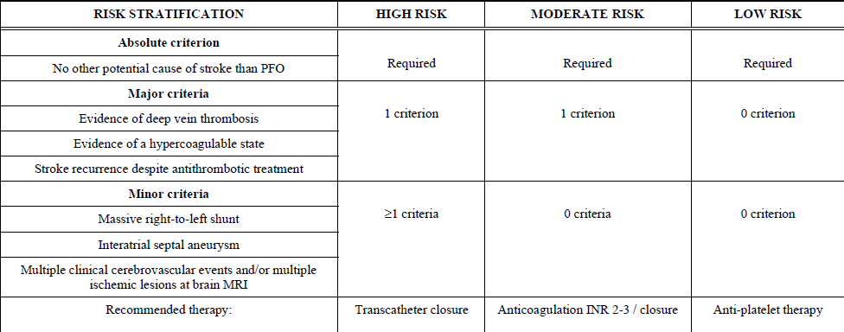
PFO-Risk Stratification
Prevention Strategies for Cardioembolic Stroke: Present and Future Perspectives
Giacomo Giacalone; The Open Neurology Journal, 2010

Slide 77
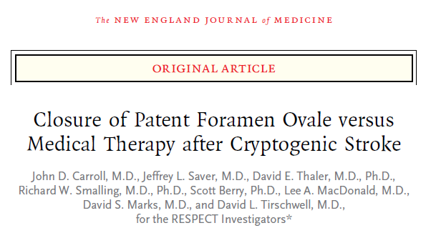
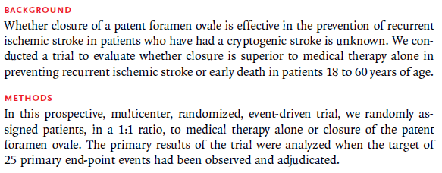
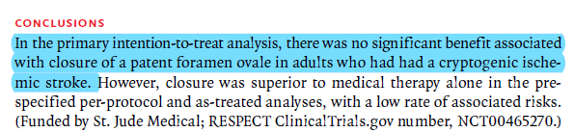
‘’

Slide 78
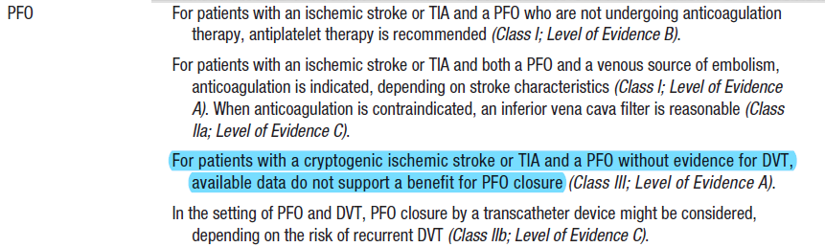

Slide 79
Endocarditis
Non Infective:
Systemic cancer, Lupus, and the APLA
Owing to their high embolic risk, patients with stroke and non-infective endocarditis should receive heparin followed by oral anticoagulants

Slide 80
Infective Endocarditis
Complicated by stroke in about 10% of cases
Most stroke happens early in the course of the disease and before or during the first 2 weeks of appropriate antimicrobial therapy.
Multiple Emboli- Infection of prosthetic valves and in Staphylococcus aureus Endocarditis

Slide 81
Infective Endocarditis
TEE- confirms valve vegetation more reliably, should be initial diagnostic procedure for all patients with moderate to high clinical suspicion of infective endocarditis
Emboli are fragments of vegetation- best antithrombotic regimen is appropriate antibiotic or antifungal treatment

Slide 82
IE
Use of anticoagulants associated with increased mortality in patients with native valves who are being treated with antithrombotic drugs
Indications for Surgery:
Persistent vegetation in anterior mitral leaflet (particularly if >10 mm)
one or more embolic events during the first 2 weeks of antimicrobial treatment
Two or more embolic events later in treatment

Slide 83
Aortic Atheroma
Thickness over 4 mm
Ulcerated, noncalcified plaques
Plaques with mobile components
Associated with an increased risk of stroke recurrence
Dual antiplatelets are preferred over anticoagulation (ARCH trial)

Slide 84
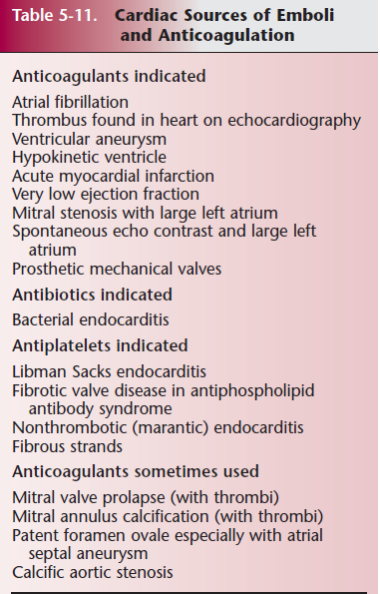

Slide 85
Treatment of Cardioembolic stroke

Slide 86
Thrombolysis in Acute Cardioembolic Stroke
Stroke outcome after intravenous thrombolysis with rtPA is not influenced by the stroke etiology
3months functional outcome and the mortality risk same for a certain baseline NIHSS score regardless of the stroke etiology

Slide 87
Thrombolysis in Acute Cardioembolic Stroke
Cardioembolic stroke - more uniform fibrin-rich clots in which rtPA penetrates and distributes homogeneously, leading to entire and rapid clot dissolution.
Early recanalization was more frequent, faster and more complete in cardioembolic stroke

Slide 88
Thrombolysis in Acute Cardioembolic Stroke- Contraindications
Recent myocardial infarction (MI) within 3 months relative contraindication for IV stroke thrombolysis
Beyond guidelines, risk for cardiac rupture can be stratified and IV stroke thrombolysis may be considered for younger patients without transmural involvement After 7 weeks of MI

Slide 89
Thrombolysis of patients on Anticoagulation for secondary prevention
AHA/ASA Guidelines(2013)
Within 3hours of onset, Current use of anticoagulant with INR >1.7 is contraindication for IV tPA
3- 4.5 hrs of onset, use of oral anticoagulants is contraindication regardless of INR
Use of intravenous rtPA in patients taking direct thrombin or direct factor Xa inhibitors not recommended unless sensitive laboratory tests ECT, TT, or appropriate direct factor Xa activity assays are normal, or the patient has not received a dose for >2 days

Slide 90
Thrombolysis in Cardioembolic Stroke- Concerns
Increased risk of SICH in patients with acute ischaemic stroke and prior warfarin therapy with a subtherapeutic INR after treatment with intravenous and/or intra-arterial thrombolysis.
Risk of SICH was more than two times higher in patients on warfarin therapy
No effect on outcome or mortality
Thrombolytic therapy for ischaemic stroke in patients using warfarin: a systematic review and meta-analysis. J Neurol Neurosurg Psychiatry 2012

Slide 91
Thrombolysis in Cardioembolic Stroke- Concerns
Higher chance of Hemorrhagic Transformation
Double-Hit
Increased recanalisation after IV tPA by the effect of warfarin results in increased rate of HT

Slide 92
Anticogulation in Newly diagnosed Cardioembolic stroke

Slide 93
When to start Anticoagulants after Acute Cardioembolic Stroke?
Current guidelines and usual practice recommend that anticoagulation should be started as soon as possible in patients with AF after brain imaging for a TIA
Anticoagulation should be delayed in ischemic stroke, according to ischemic lesion extension, clinical severity and cardiologic comorbidity, stroke in favour of anti-platelet therapy by up to 2 weeks
Prevention Strategies for Cardioembolic Stroke: Present and Future Perspectives
Giacomo Giacalone; The Open Neurology Journal, 2010

Slide 94
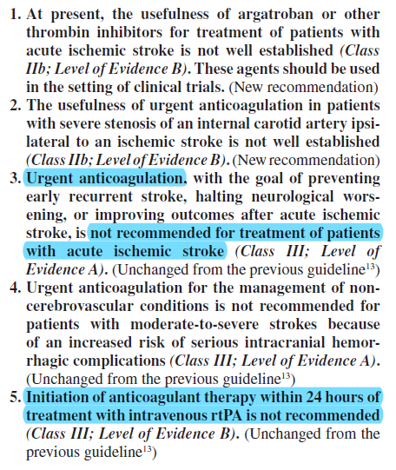

Slide 95
When to start Anticoagulation for secondary prevention after Cardioembolic Stroke?
Start immediately in:
TIA
Minor strokes with a high-risk source of cardioembolism
Nonhaemorrhagic infarcts
Delay it for 2weeks in:
Disabling strokes
Large or haemorrhagic infarcts.

Slide 96
Early Initiation of Antocoagulation
Left Atrial Thrombus
Prosthetic Heart Valve
Left ventricular thrombus
Decision to be individualized balancing risk of Hemorrhagic Transformation and risk of recurrent cardioembolism

Slide 97
Newer Anticoagulants
Dabigatran- Direct Thrombin Inhibitor
Only approved indication is Non valvular AF
RELY trial
Disadvantages- Expensive, no antidote
Rivoroxaban- Factor Xa inhibitor
Apixaban- Factor Xa inhibitor

Slide 98
Management of acute ischaemic stroke in patients taking new oral anticoagulants
Guidelines recommend against using IV alteplase in anticoagulated patients with an acute ischemic stroke because of a presumed higher risk of hemorrhagic transformation of any infarcted brain
Reversal of any coagulopathy (eg, with prothrombin complex concentrates) before initiation of thrombolytic therapy untested and might produce prothrombotic risks

Slide 99
Restarting Anticoagulants after ICH
Selection of patients eligible for reinitiating of anticoagulation after ICH is contingent on weighing the risks of thrombosis against the risks of bleeding
Patients that are high thrombotic risk with indications for long-term warfarin may be considered for reinitiating in-hospital
In patients with a very high risk of thromboembolism, warfarin may be restarted 7 to 10 days after ICH onset

Slide 100
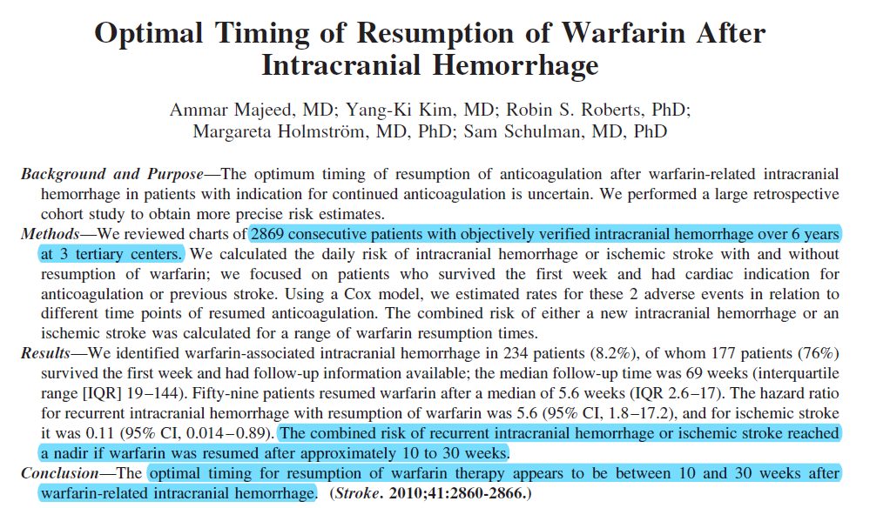
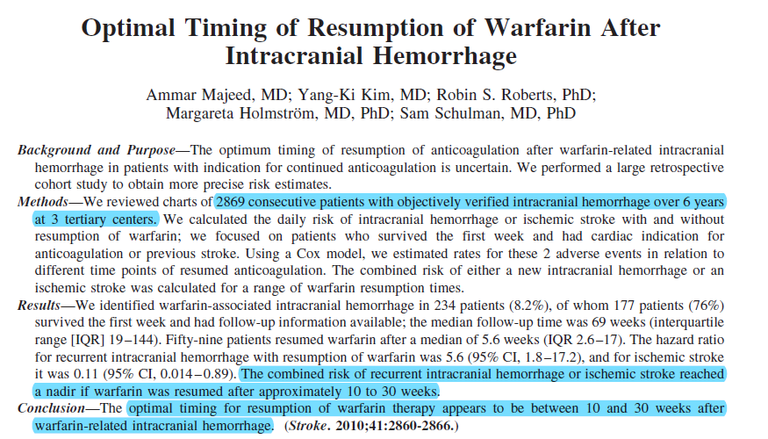

Slide 101
Summary
Significant proportion of so-called Cryptogenic Strokes have cardioembolic etiology, most common being lone AF
High index of suspicion needed in Young stroke, recurrent cryptogenic stroke and Multiple territory involvement
Newer diagnostic techniques increasing detection rate- DWI MRI, Holter, Loop Recorders, TEE
Prompt initiation of anticoagulation and maintaining therapeutic INR can prevent recurrence

Slide 102
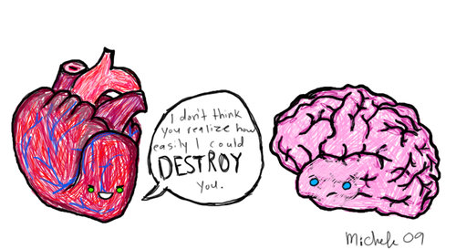
Thank You

Slide 103
Reference
Cardioembolic stroke: an update. José M Ferro; THE LANCET Neurology Vol 2 March 2003
The search for paroxysmal atrial fibrillation in cryptogenic stroke- Leave no stone unturned. Neurology 2013;80:1542–1543
Prevention Strategies for Cardioembolic Stroke: Present and Future Perspectives Giacomo Giacalone; The Open Neurology Journal, 2010
Thrombolytic therapy for ischaemic stroke in patients using warfarin: a systematic review and meta-analysis. J Neurol Neurosurg Psychiatry 2012

Slide 104
Reference
Detection of Atrial Fibrillation After Ischemic Stroke or Transient Ischemic Attack- A Systematic Review and Meta-Analysis; Stroke. 2014;45:520-526.
Caplan’s Stroke- A clinical Approach, 4th Edition.
Efficacy and Safety of Anticoagulant Treatment in Acute Cardioembolic Stroke: A Meta-Analysis of Randomized Controlled Trials; Stroke. 2007
Guidelines for the Prevention of Stroke in Patients With Stroke and Transient Ischemic Attack: A Guideline for Healthcare Professionals From the American Heart Association/American Stroke Association; Stroke. 2014

Slide 105
Q & A
1) A 55 year old male, chronic smoker presented with acute onset right hemiparesis and right UMN facial palsy which improved within 12 hours. He was seen in stroke unit 1 day later. CT brain was normal. ECG on admission was suggestive of Atrial fibrillation. What would be the ideal management?
Dual antiplatelet therapy
Start immediately on aspirin monotherapy and consider anticaogulation after a month
Start immediately on anticoagulation with warfarin
Start LMWH

Slide 106
Q & A
2) A 33 year old lady, post MVR, on therapeutic anticoagulation with warfarin presented with acute onset left hemiparesis and left UMN facial palsy. She presented to stroke unit within 3 ½ hours of symptom onset. NIHSS was 8. CT head and CTA were normal. INR was 1.6. What would be the Recommended management?
IV thrombolysis with rtPA
Intra arterial thrombolysis
Defer thrombolysis and continue anticoagulation

Slide 107
Q& A
3) Which of the following is NOT a high risk condition for cardioembolism:
Atrial Fibrillation
Sick sinus syndrome
Atrial Septal Aneurysm
Infective Endocarditis

