Slide 1
Risk stratification & management of asymptomatic carotid stenosis
Faculty : Dr. Sanjay Prakash

Slide 2
Introduction
CAS is defined as atherosclerotic narrowing of the proximal ICA exceeding 70% in severe cases and 50% in moderate cases
Symptomatic CAS is transient or permanent focal neurologic symptoms related to ipsilateral retina or cerebral hemisphere
Notes:
diagram

Slide 3
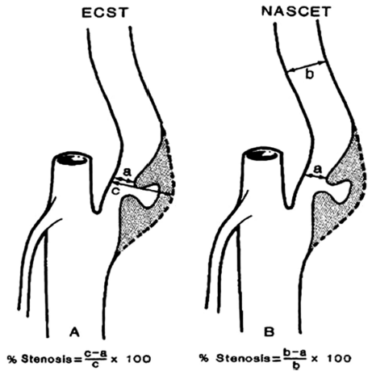
Measuring carotid artery stenosis

Slide 4
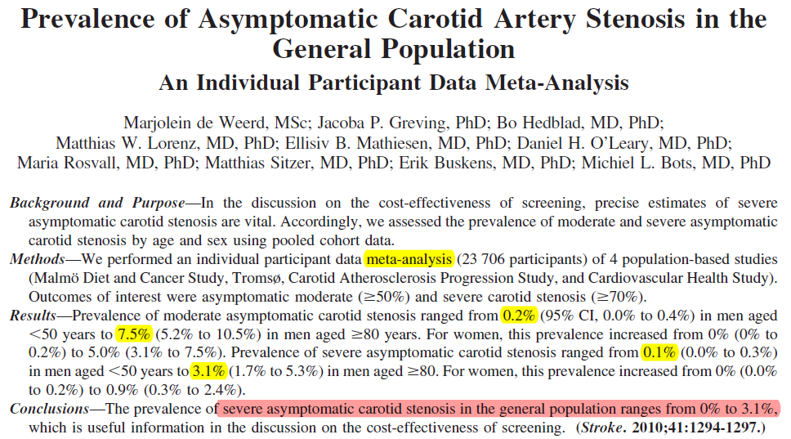
Notes:
A recent Western European populn study placed the prevalence of moderate asymptomatic stenosis at 4.2% and severe stenosis at 1.7%.
The prevalence was found to increase with age and be higher in males, with 12.5% of men being diagnosed with moderate stenosis.

Slide 5
Introduction
Risk of stroke in ACS is 0.1% to 1.6% per year for 75% to 80% stenosis (NASCET) method and 2.0% to 3.3% per year with greater degrees of stenosis
Notes:
Studies performed in the 1980s and 1990s1-10 have
indicated that the

Slide 6
Introduction
CEA is a surgical procedure of removing the plaque from the carotid artery, thus reducing the risk of stroke by enlarging the lumen and by removing a possible embolic nidus
NASCET & ECST showed that in symptomatic patients > 70% stenosis, CEA plus BMT, when compared to BMT alone, reduces stroke incidence by 50%

Slide 7
Introduction
CEA is effective in preventing future ipsilateral ischemic events, provided that the perioperative combined risk of stroke and death is not higher than 6%.
Thus, NASCET and ECST studies have provided the evidence in support of CEA
Notes:
NNT 8,nnt 20

Slide 8
Introduction
Because of impressive results in symptomatic disease, studies on the effect of CEA for ACS as primary prevention considered
However, therapeutic recommendations for asymptomatic patients are still uncertain and controversial
Notes:
To prevent stroke in this group before symptoms occur

Slide 9
Introduction
Two RCTs, ACAS and the ACST concluded that CEA conferred a 50% RR reduction( 2% to 1% per year & 5 yr risk of stroke from ~ 12% down to 6%)
However, despite level I (Grade A) evidence management of patients with ACS continues to be controversial

Slide 10
Why?
BMT used in these trials has significantly improved in the past decade
Average annual risk of ipsilateral stroke in ACS receiving medical intervention alone has fallen to approximately 1%
While risk of surgery has not(2-3%)

Slide 11
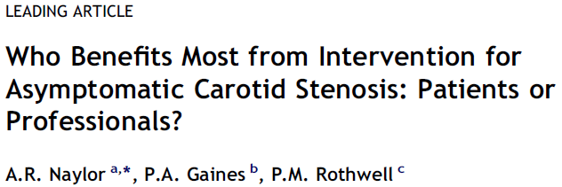
Opinion remains polarised
Continued inability to identify ‘high risk for stroke’ patients in whom to target therapies
Growing evidence that improvements in BMT has significantly reduced the risk of stroke compared to that observed in ACAS and ACST
Notes:
to $21 billion is being spent each year on ultimately ‘unnecessary’ interventions

Slide 12
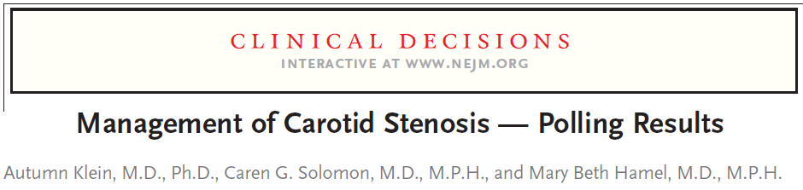
The lack of consensus was illustrated by a 2008 poll undertaken by the NEJM
Out of the >5000 respondents to the survey, ~ 50% voted to treat the patient conservatively, a pattern replicated across every continent
Notes:
A case scenario was given (67 yr old non-smoking male with HTN, DLP and a 70-80% asymptomatic carotid stenosis)

Slide 13
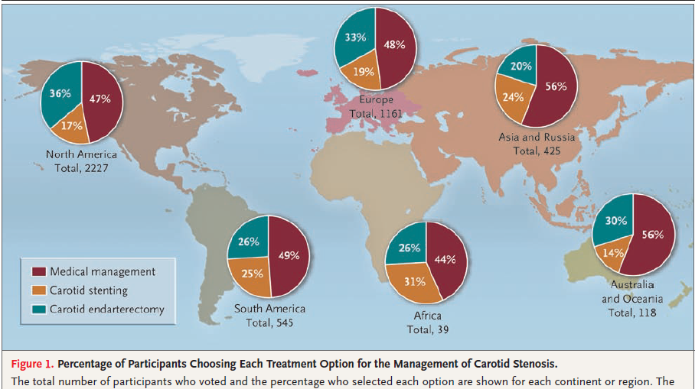

Slide 14


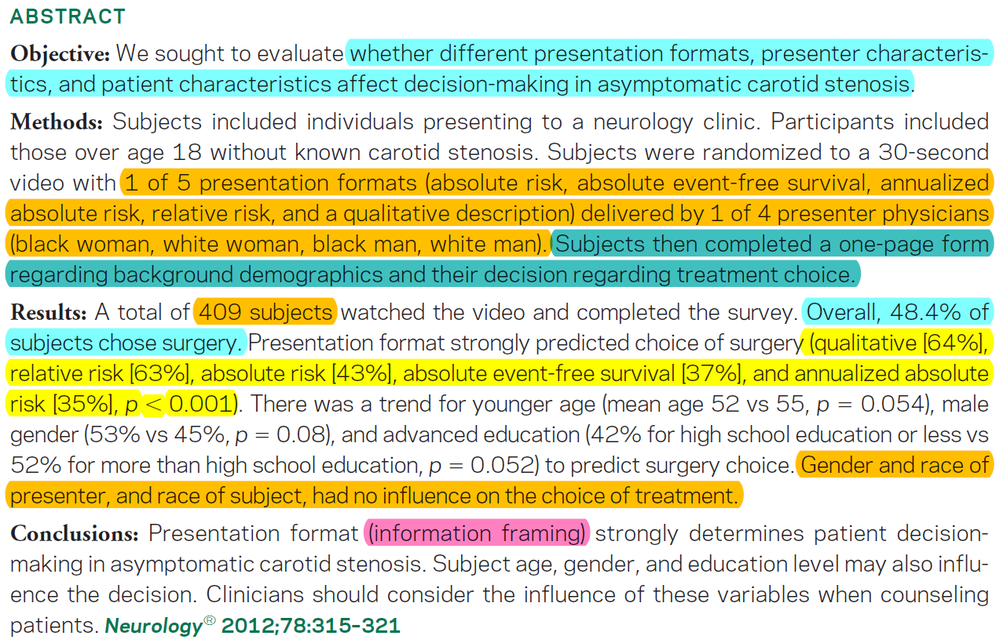

Slide 15
What is the evidence in favour of CEA in ACS?
What is the evidence in favour of BMT?
Risk stratification in ACS
Current guidelines
CEA vs Stenting; existing data
Future trends

Slide 16
Rise of CEA in acs

Slide 17
Rationale of CEA in ACS
Because of impressive results in symptomatic disease, studies on the effect of CEA for ACAS as primary prevention was considered

Slide 18
Rise of CEA in asymptomatic CS
Three Class I studies are available:
Veterans Affairs Study
Asymptomatic Carotid Atherosclerosis Study (ACAS),
Asymptomatic Carotid Surgery Trial (ACST)
Two other studies were either completed/planned but these were either stopped prematurely (Mayo Clinic trial) or poorly designed (Carotid Artery Stenosis with Asymptomatic Narrowing: Operation Vs Aspirin CASANOVA study).

Slide 19
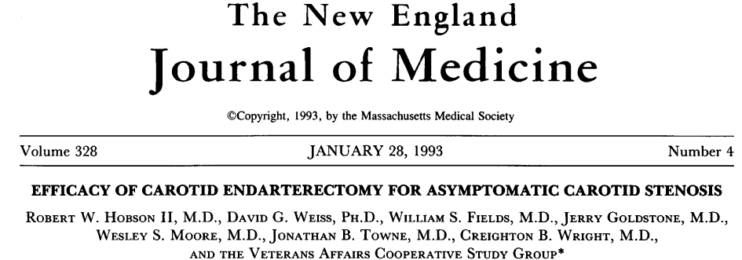
The first prospective RCT comparing CEA with medical Rx was multi-institutional VA study; > 50% stenosis
The incidence of death, ipsilat TIA, and ipsilat stroke in the surgical group was 8% compared with 20.6% in the group treated with medical Rx alone (P < 0.002)

Slide 20
VA study
Pts randomly assigned to ‘optimal medical management’ plus CEA and medical management alone(211 vs 233)
Results: combined incidence of neurological events was 8.0 vs 20.6 (p<0.001); RR- 0.38(CI 0.22-0.67)
Rate of stroke or death at 30 days was 4.7%(including arteriography) in surgical group vs 1.3% in medical group
No significant difference in all strokes or death

Slide 21
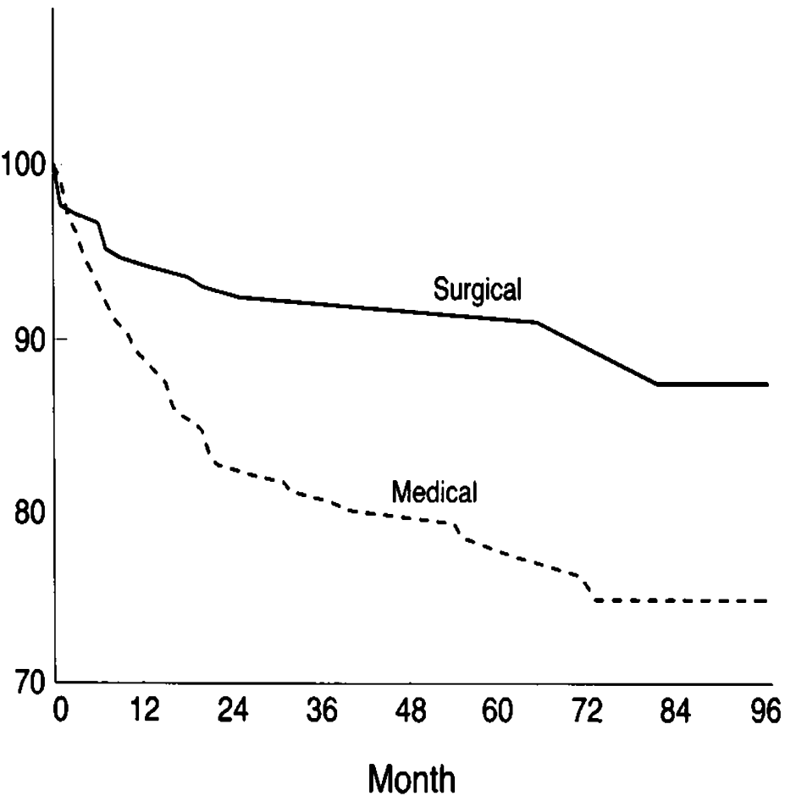
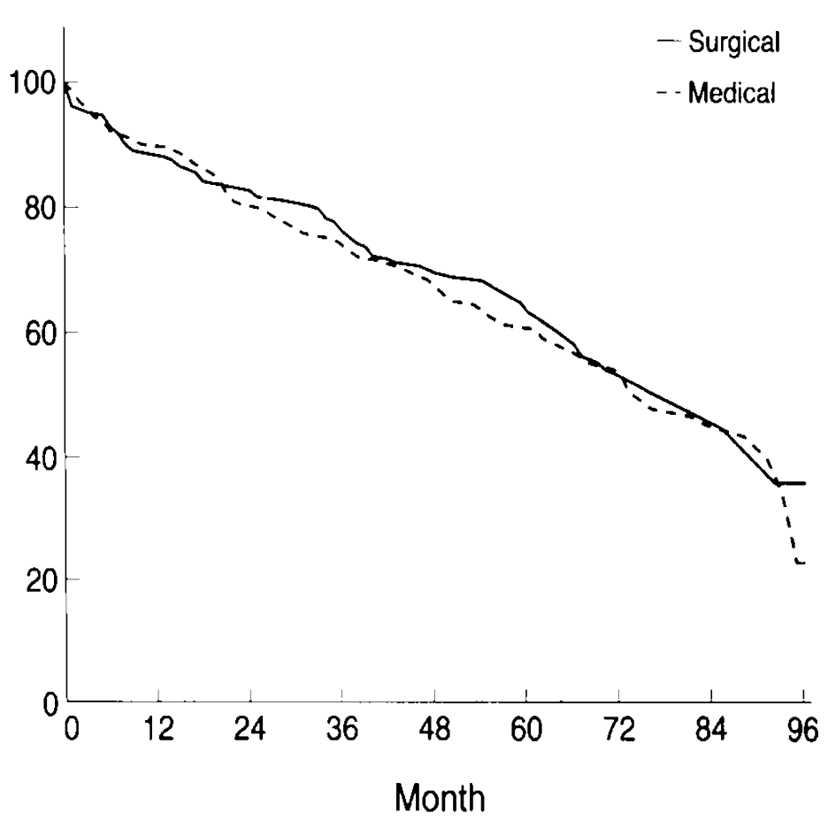

VA study

Slide 22
Conclusion
CEA can reduce ipsilateral neurological outcome in ACS > 50% compared to ‘optimal medical management’
Notes:
But for stroke alone it was not significant

Slide 23
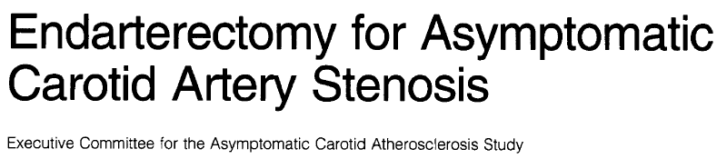
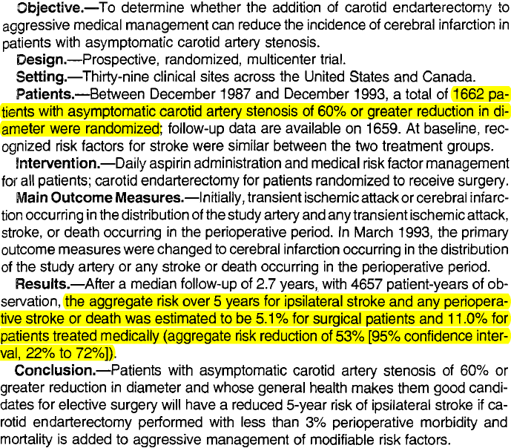

Slide 24
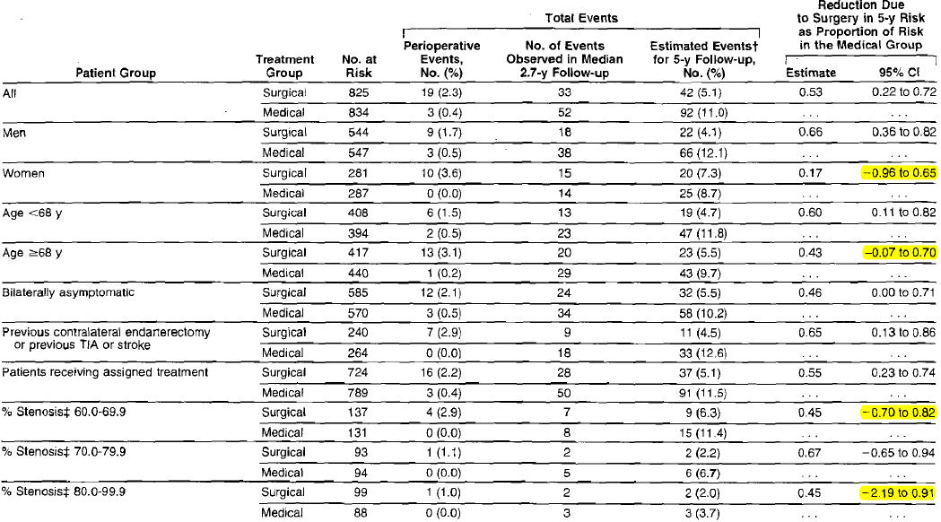
Reduction Due to Surgery in 5-Year Risk

Slide 25
ACAS- Implications
The results led to major increases in rates of CEA in ACS
Of the approximate 1,50 000 endarterectomies performed in US each year, at least half are done for ACS
Had little effect in UK- benefit (40 operations were needed to prevent 1 disabling/fatal stroke after 5 years) did not justify the cost.

Slide 26
ACAS- Implication
Annual absolute risk reduction was 1.2% only
CEA was not beneficial for women, who had more surgical complications
30-day morbidity and mortality of ACAS patients, 2.7%(including arteriography), could not be matched in routine clinical practice
ACAS only accepted surgeons with an excellent safety record,.
Notes:
Discussio regarding DM, HTN, DLP,Smoking alcohol

Slide 27
Implications
The annual stroke rate in the medical limb of both the V A and ACAS studies was 2%
In the surgical limb after successful CEA it was 1 % in both studies
Stroke as an endpoint alone was not quite statistically significant in the VA study (p=0.056) but in the ACAS it was (p=0.006)
Thus, the ACAS study has provided the first scientific evidence that CEA can reduce the incidence of stroke in patients with ACS
Notes:
What accounted for the difference in number of patients randomised (VA: n=444; ACAS: n=1662) and the perioperative combined stroke and death rates (V A: 4.7%; ACAS 2.3%).

Slide 28
MACE & CASANOVA study
The (MACE) study was prematurely stopped after only 71 patients due to a high rate of myocardial infarction (22%) in the surgical group.
This was likely due to the trial policy of withholding aspirin from the surgical group
CASANOVA trial which randomized 410 pts for CEA vs BMT with stenosis between 60%-90% found no significant benefit
Both trials criticized because of study design
Notes:
Mayo Asymptomatic Carotid Endarterectomy

Slide 29
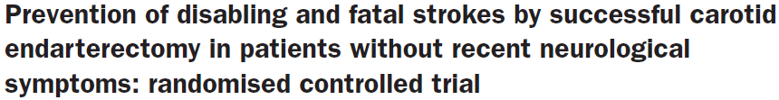
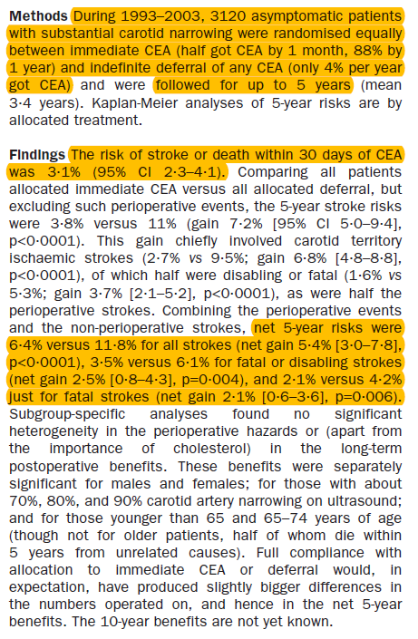

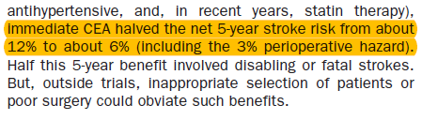

Slide 30
ACST trial
ACST was carried out in the UK and included 3120 pts with asympt CS of ≥ 70% as measured by DUS.
Subjects were randomized to immediate CEA versus indefinite deferral of the operation
The trial used different end points than were used in ACAS (perioperative stroke, MI or death and nonperioperative stroke).
The net 5-year risks were 6.4% versus 11.8% for any stroke or perioperative death (net gain, 5.4%; 95% CI, 3.0% to 7.8%; P < 0.0001).

Slide 31
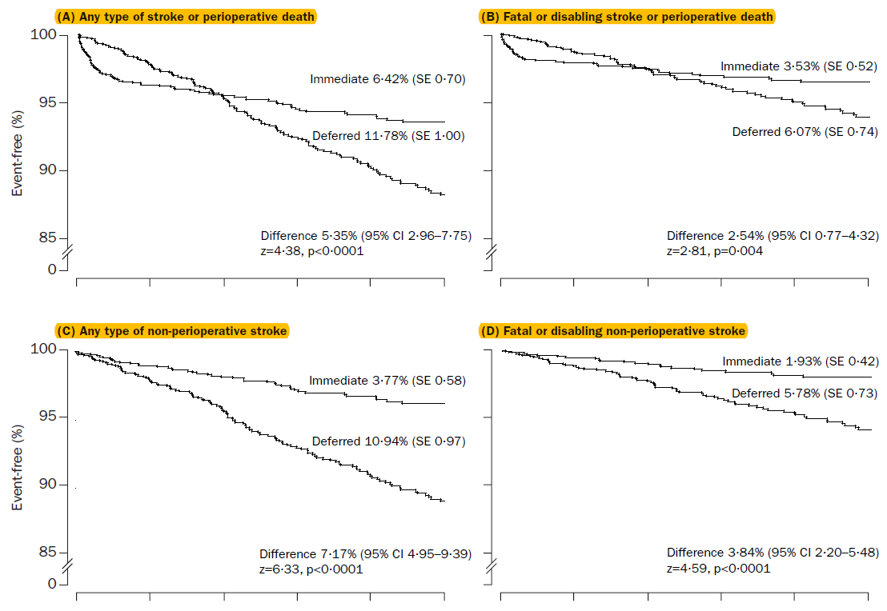

Slide 32
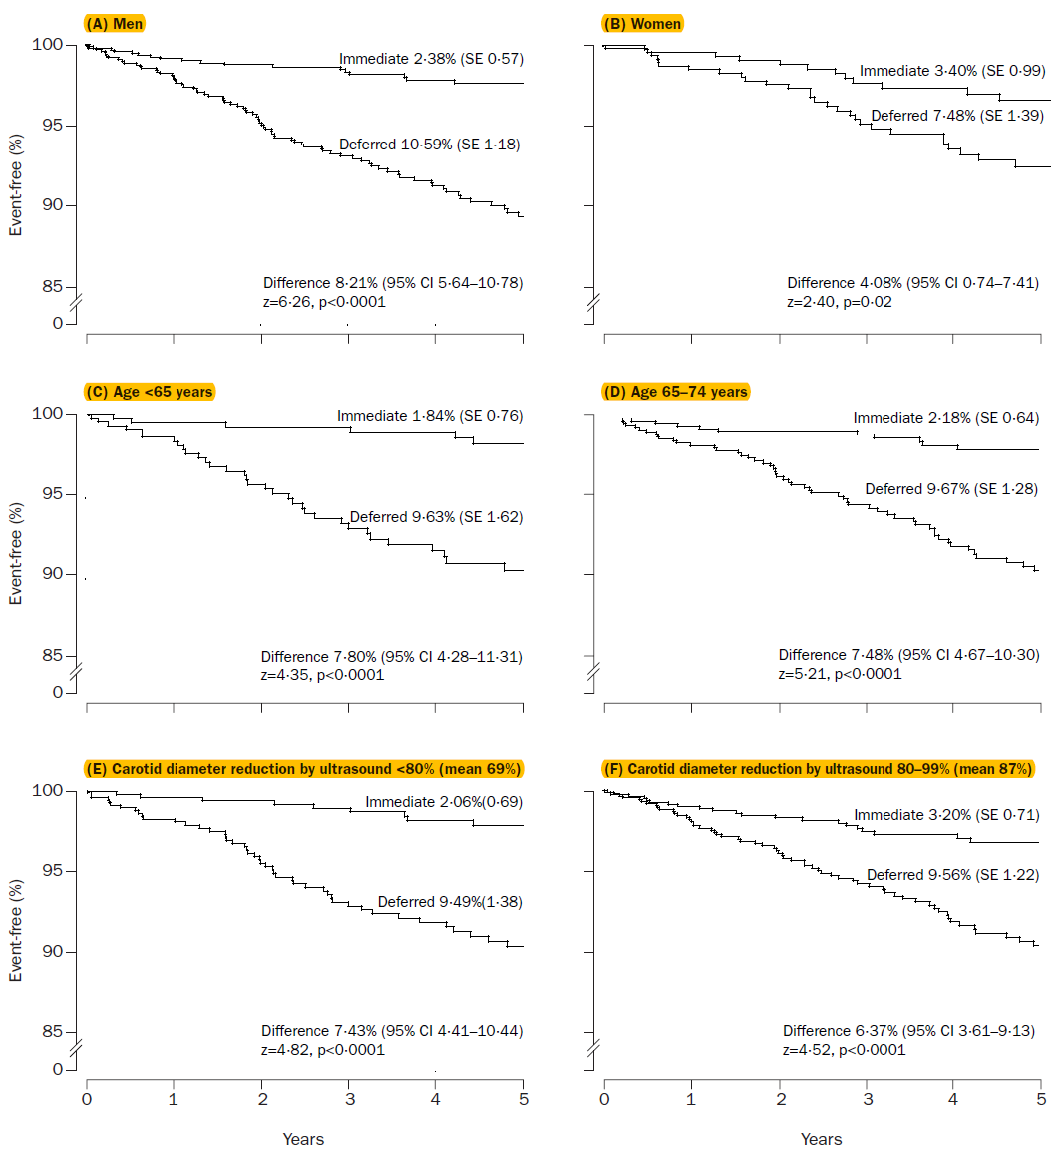

Slide 33
Conclusion
The authors concluded that in asympt pts ≤75 yrs of age with ≥ 70% stenosis as measured by DUS, immediate CEA reduced stroke risk by half

Slide 34
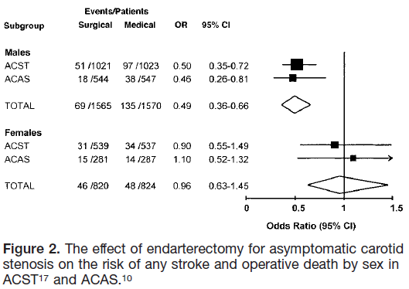

Slide 35
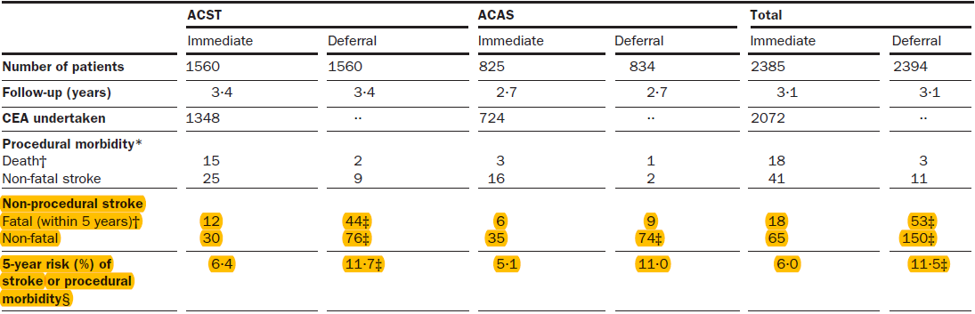
A significant difference of ACAS and ACST was the primary endpoint.
ACAS utilized ipsilat stroke as the primary endpoint whereas ACST included all strokes, including contralat events and vertebrobasilar strokes.
If the ACST analysis was limited to ipsilat stroke only, the absolute benefit would be reduced.

Slide 36
NNT
The number of patients that must be treated by CEA to prevent one additional ipsilat stroke in the 2 yr period after the procedure, compared to medical Rx, is known as NNT.
NASCET established that the NNT to prevent one stroke was 19 for symptomatic patients with moderate stenosis and 6 for those with severe stenosis.
In contrast, due to the low risk faced by the asympt pts, the NNT to prevent one additional stroke in 2 yrs was 83.
Based on the ACAS results it has been calculated that in order to prevent one stroke in 5 years, approximately over 20 operations have to be performed or 100 operations to prevent one stroke in 1 year.

Slide 37
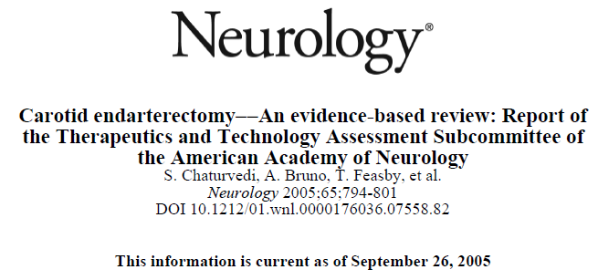
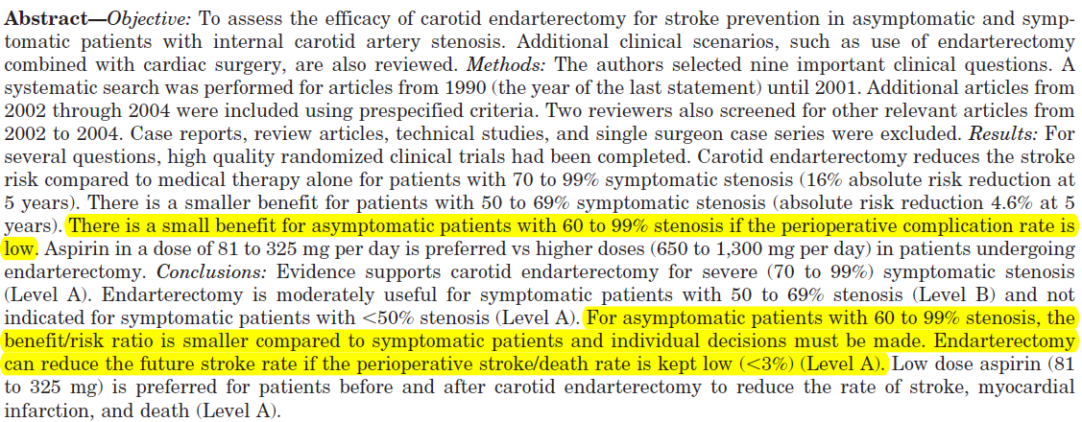

Slide 38
Role of bmt

Slide 39
Data in favour of BMT
Definition of best medical therapy has dramatically changed since 1980s & 90s
In VA & ACAS, BMT consisted of 325 mg of aspirin daily, modification of risk factors by ‘discussion of diastolic and systolic hypertension, diabetes mellitus, abnormal lipid levels, excessive consumption of ethanol, and tobacco use’

Slide 40
In favour of medical treatment
Annual rates of stroke in medically treated patients with ACS have fallen from 2% - 2.5% to 1% in recent years with the advent of modern medical therapy
Mainly due to major improvements of medical therapy, particularly the use of statins and blood pressure–lowering medication
In ACST, the proportion of patients on lipid-lowering therapy rose from less than 10% in 1993 to more than 80% when follow-up ended in 2006–08.
Conversely, stroke risk after carotid revascularization remained unchanged over the last 2 decades
Notes:
BMT has changed dramatically since the time of the RCTs

Slide 41
Role of BMT
During 1997-98, nearly 3/4th of CEAs were performed on asympt pts.
Enthusiasm was highest amongst those surgeons, radiologists and cardiologists who promote their procedures and lowest amongst neurologists & stroke physicians.
1997- a consortium of Canadian stroke neurologists campaigned against screening & intervention in asympt pts.(Perry JR Arch Neurol 1997)
By 2003, some called for the RCTs to be repeated (Chaturvedi S Arch Neurol 2003)

Slide 42
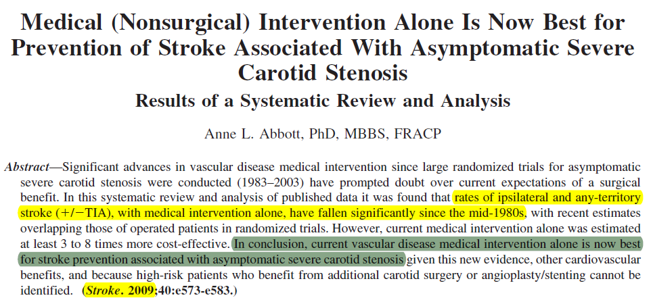
Data against intervention

Slide 43
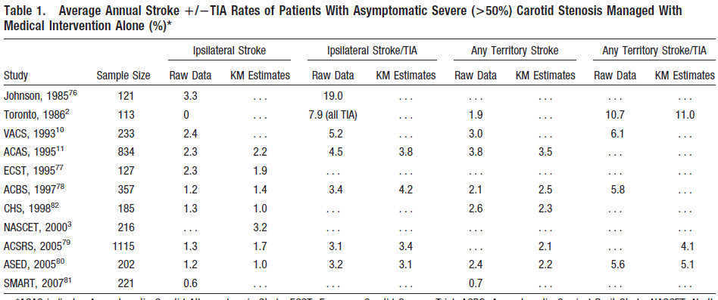

Slide 44
Medical management
The key findings included significant falls in annual rates of ipsilateral & any-territory stroke with isolated medical intervention for asymptomatic severe proximal ICA stenosis since the mid-1980s
This 25-year falls consistent with falls in incidence of heart attack and sudden death- improving efficacy of vascular disease medical intervention

Slide 45
Medical management
Medical intervention is 3 to 8 times cheaper in preventing stroke/TIA
Further, vascular disease medical intervention can be more easily administered in the wider community

Slide 46
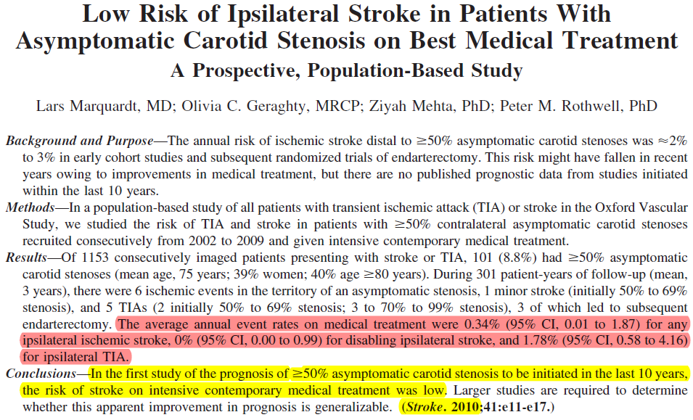

Slide 47
Conclusion
The average annual risk of ipsilateral stroke and/or TIA in patients with asymptomatic 50% carotid stenosis on intensive contemporary medical intervention was very low, albeit with relatively wide CIs

Slide 48
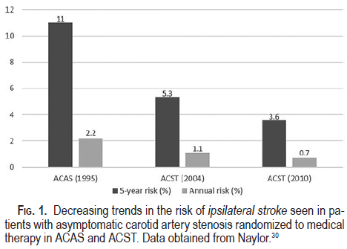
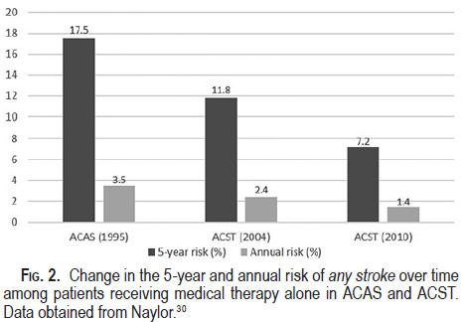
Risk reduction on BMT

Slide 49
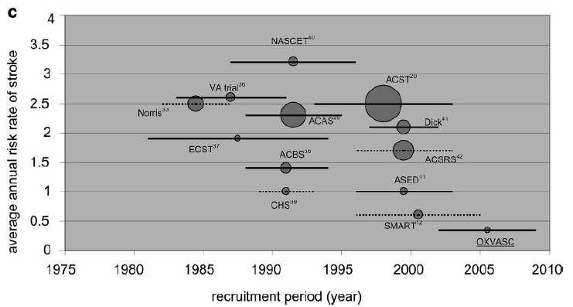
Avg annual risk rates of stroke in patients with at least 50% asymptomatic carotid stenosis in published studies that reported data.
-The size of each bubble reflects the relative no. of patients in the study,
-Risk of ipsilateral (to asympt CS) stroke displayed by recruitment period (horizontal bar; dashed line indicates estimated recruitment period)

Slide 50
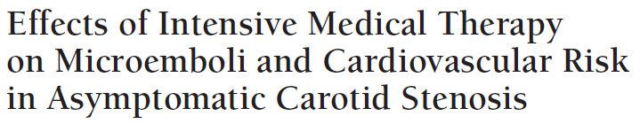
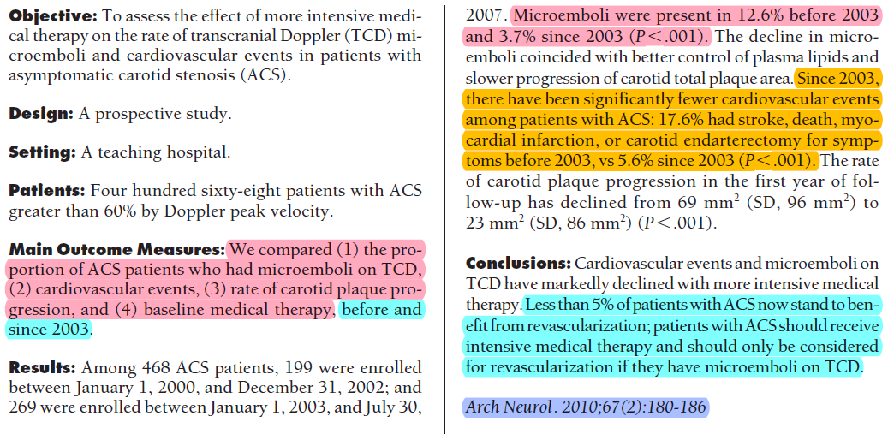

Slide 51
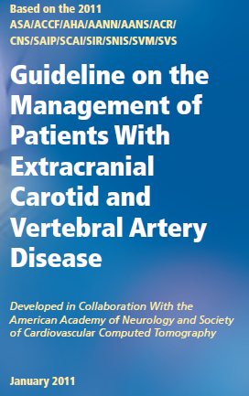
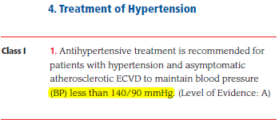
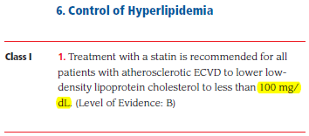
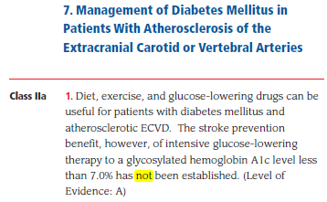
Notes:
Smoking cessation is imperative,
and any necessary counseling and medical therapies for
smoking cessation should be use, ASA 75 TO 325MG

Slide 52
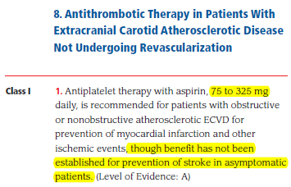
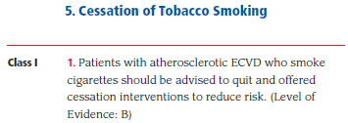

Slide 53
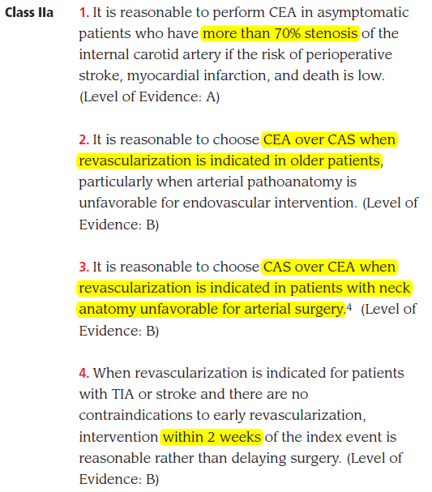

Slide 54
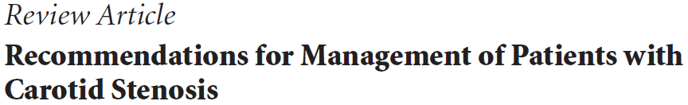

Medical management is the most appropriate option for most asymptomatic subjects
Only centres with a perioperative complication rate of 3% or less should contemplate surgery
Patients with a high risk of stroke (men with stenosis of more than 80% and a life expectancy of more than 5 years) may derive some benefit from surgery in appropriate centers
Notes:
Trials have concluded that although surgery reduces the incidence of ipsilateral stroke (RR 0.47–0.54) and any stroke, the absolute benefit is small (approximately 1% per annum) whereas the perioperative stroke or death rate is 3%

Slide 55
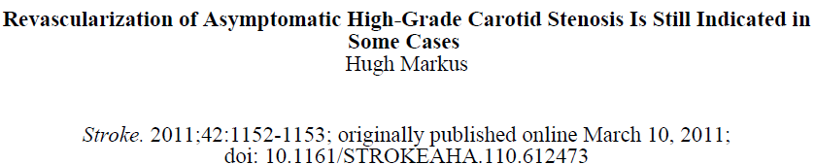
Plaque morphology and the presence of emboli in TCD
TCD is a simple, noninvasive technique but further work required to confirm less intense signals seen in ACS
Presence of CT infarction, degree of stenosis, plaque morphology on ultrasound or MRI also points in favour of CEA

Slide 56
Risk Stratification

Slide 57
Need for stratification
Stroke rates in ACS have fallen over the last decade with medical intervention alone & cost-effectiveness of CEA in has been questioned
Identification of the group of ACS patients at higher risk, to whom intervention could be limited would improve cost-benefit
Notes:
Nevertheless, ACS accounts for a large burden of stroke, and the
majority of ipsilateral strokes are unheralded.7

Slide 58
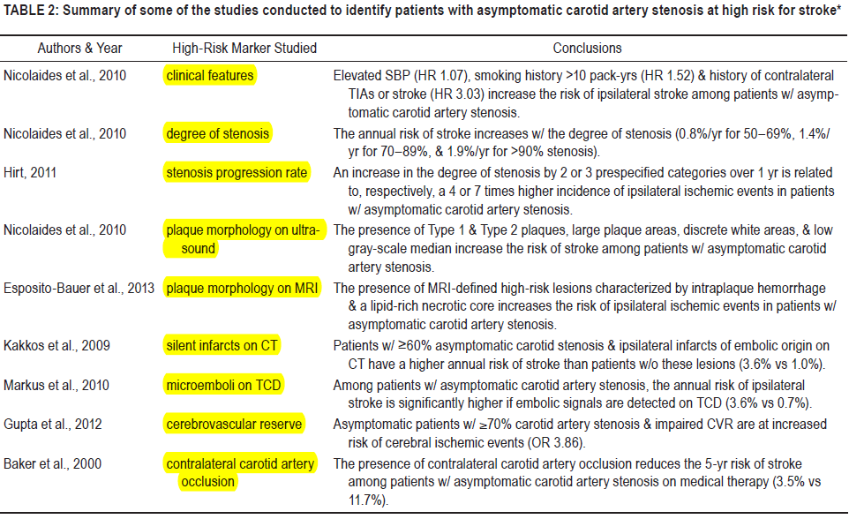

Slide 59
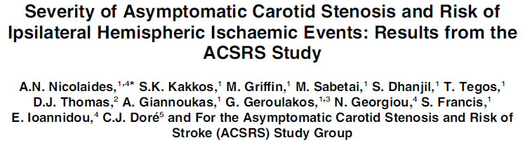
1115 pts with ACS > 50% up for a mean period of 37.1 months
Stenosis was graded using duplex, and clinical and biochemical risk factors were recorded
Three factors: severity of ipsilateral stenosis ECST, h/o contralateral hemispheric TIAs and creatinine were independent predictors of risk
Notes:
In a Cox regression analysis all

Slide 60
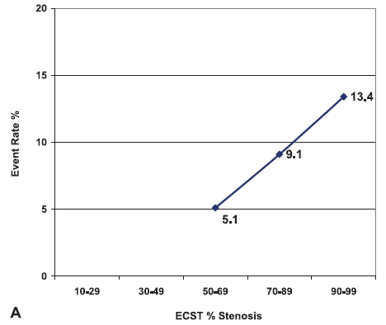
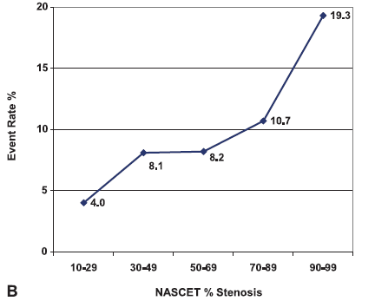
ACSRS study
Relationship between ICA stenosis and event rate is linear when stenosis is expressed by the ECST method

Slide 61
ACSRS study
Paradoxically, patients with ICAs severely narrowed or nearly collapsed have a relatively lower risk of stroke on best medical treatment alone (HR = 0.49; CI 0.19–1.24) compared to vessels with moderate degree of stenosis
Notes:
due to markedly reduced poststenotic blood flow pseudoocclusion, near occlusion)

Slide 62
Degree of stenosis alone?
Shortcoming is that not all plaques that generate a vessel stenosis are unstable enough to prompt distal embolization
Spence et al., investigating 319 ACS pts with >60% stenosis, demonstrated that <1% of them developed stroke if there were no HITS on TCD
Notes:
degree of stenosis alone may no longer reflect or predict the group of patients who will have a stroke and may benefit from carotid artery intervention

Slide 63
Embolic signals
Spence following a cohort of 319 for a two-year period, reported incidence of 10% of patients with ACAD with positive embolic signals
Those patients with negative TCD for embolic signals had lower risk of stroke during the first year of follow-up (15.6% vs.1%)

Slide 65
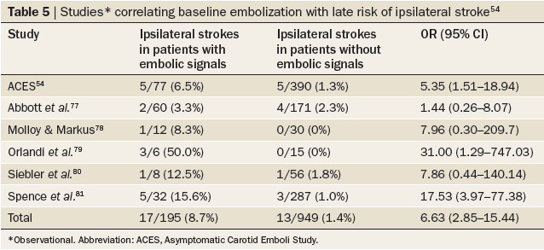
Detection of emboli on ultrasonography
One of the unique advantages of TCD is that it is the only method available for diagnosing spontaneous embolization
The predictive role of emboli detected by TCD in pts with asympt stenosis has been evaluated in several studies

Slide 66
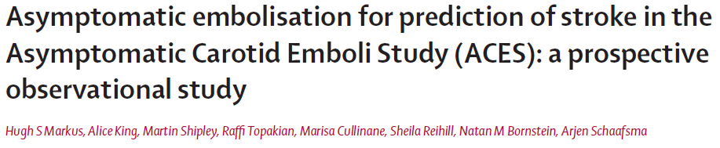

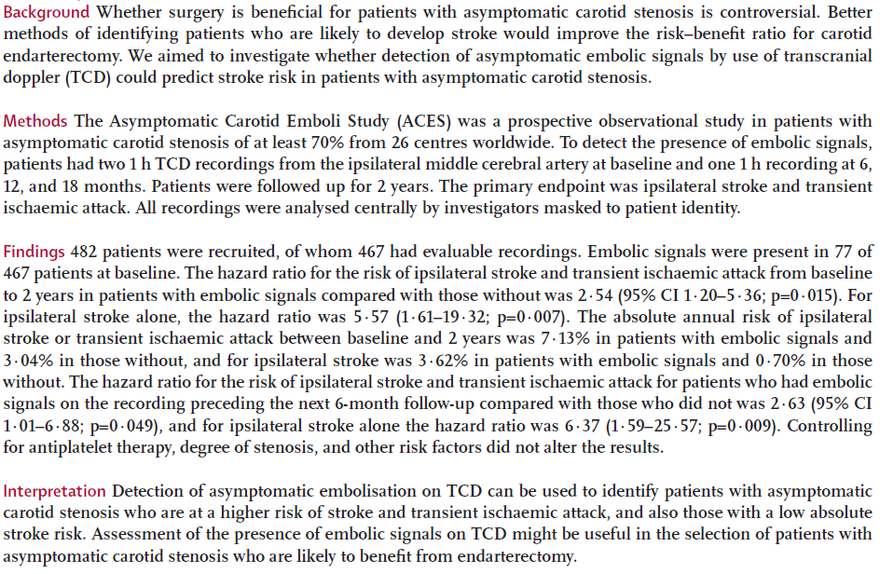

Slide 67
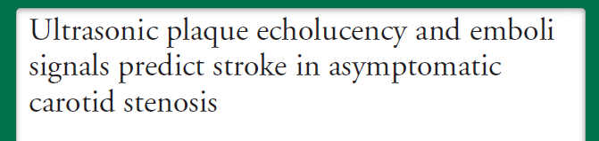
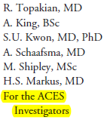
ACES study also prospectively collected data on ultrasonic plaque morphology
A total of 435 subjects with ACS 70% & baseline ultrasound images and TCD data followed up for 2years
Plaque echolucency at baseline was associated with an increased risk of ipsilateral stroke (HR 6.43, 95&CI 1.36–30.44, p 0.019).
A combined variable of plaque echolucency and ES positivity at baseline was associated with a markedly increased risk of ipsilateral stroke (HR 10.61, 95% CI 2.98–37.82, p 0.0003).
Notes:
This association remained significant after controlling
for risk factors, degree of carotid stenosis, and antiplatelet medication

Slide 68
Implication
The combination of ES and plaque morphology allows a greater prediction than either measure alone and identifies a high-risk group with an annual stroke risk of 8%, and a low-risk group with a risk of 1% per annum

Slide 69
Plaque morphology
Surface characteristics
Echogenicity
Distribution of plaque content, volume, and plaque kinetics
These have been studied by several methods such as DU, MRI, CT and histology

Slide 70
Plaque morphology
Plaque surface: Defined by the lining that covers the plaque contents- smooth, irregular or ulcerated
The risk of stroke in patients with carotid stenosis and ulcerated plaque was doubled among patients with >70% stenosis compared to those without plaque ulceration
Eliasziw M NASCET. Stroke. 1994

Slide 71
Plaque morphology
Asymptomatic carotid artery plaques that are ulcerated or have surface thrombi were found to be associated with higher cerebral embolization rate up to 53%
Bassiouny HS,morphologic and chemical similarity between symptomatic and asymptomatic plaques. J Vasc Surg. 1989;9(2):202-12.
Sitzer M, Plaque ulceration and lumen thrombus are the main sources of cerebral microemboli in high-grade internal carotid artery stenosis. Stroke. 1995;26

Slide 72
Plaque morphology
Plaque cap thickness has been correlated with plaque vulnerability
A greater number of plaques with cap thickness defined as <200 μm was found to be associated with cerebrovascular events (p=0.01)
Faggioli GL, Pini R, Mauro R, et al. Identification of carotid ‘vulnerable plaque’ by contrast-enhanced ultrasonography: correlation with plaque histology, symptoms and cerebral computed tomography. Eur J Vasc Endovasc Surg. 2011

Slide 73
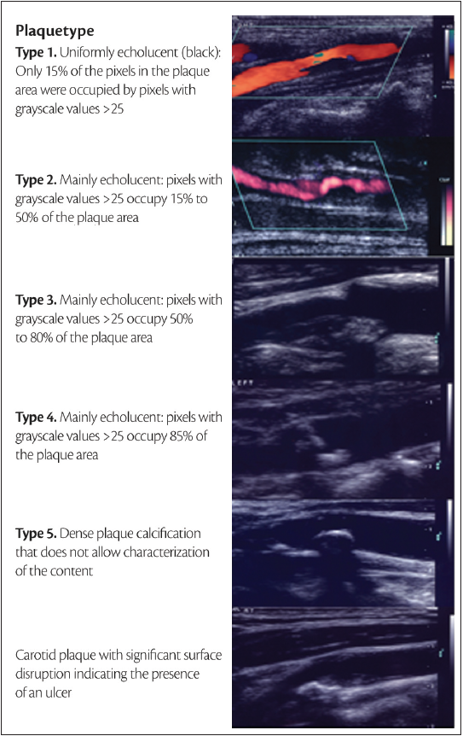
Plaque morphology
Distinct nomenclature is used to characterize the plaque morphology (i.e., echolucent vs. Echogenic
Plaques have been classified into 4-5 types based on their echogenicity

Slide 74


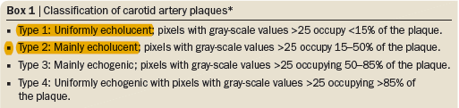
ACSRS Study: US Plaque characteristics
Atherosclerosis deposition in the ICA begins as wall thickening; when the intima-media complex exceeds 1 mm the term plaque is used
76% of all late strokes in the ACSRS study
population were observed in the 38% of
patients (426 of 1,121) who had type 1 or
type 2 plaques.

Slide 75
Plaque content, volume and kinetics
Lipid-rich plaque core is seen in the DU as echolucent, and fibrotic components as echogenic
Plaque heterogeneity is the most important predictor of intra-plaque hemorrhage
Notes:
and symptoms related to cerebrovascular events

Slide 76
Plaque content, volume and kinetics
3D ultrasound measurement of plaque volume and its changes related to medical treatment has been described
Plaque volume reduction in the Statin Group
These initial findings signalize to a potential tool for treatment monitoring and surveillance in asymptomatic patients.

Slide 77
Plaque content, volume and kinetics
Plaque kinetics: plaque and vessel wall move in the opposite direction of the blood flow
Hypothesized to be a potential cause of external plaque layer disruption
Higher in symptomatic patients

Slide 78
Plaque kinetics
Asymptomatic patients were found to have more homogenous orientation and magnitude of velocity vectors
Clinical association of plaque motion was assessed in a study of 242 stroke and 336 TIA patients showing that the presence of longitudinal plaque motion tripled the risk (p 0.02)*
*Ultrasonographic correlates of carotid atherosclerosis in transient ischemic attack and stroke. Stroke. 1995

Slide 79
Contralateral infarcts
ACS pts with c/l ischemic events secondary to carotid plaque were found to have more ipsilateral strokes
Pts with ACS who had a history of contralateral TIAs/stroke had an increased risk of ipsilateral ischemic events (HR=2.35; 95%CI 1.60–3.43)*
The embolic activity of carotid plaque can be indirectly stated in the by finding a silent brain infarct
*ACST

Slide 80
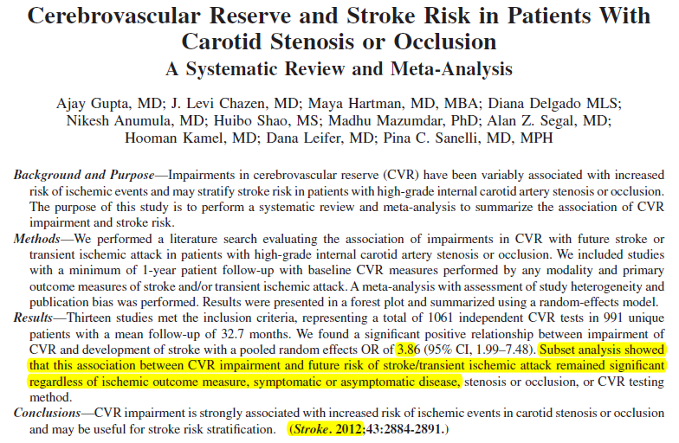

Slide 81


Slide 82
Role of cas

Slide 83
Endovascular treatment (CAS) in ACS
In the last decade, CAS emerged as a valuable alternative to CEA and is the Rx of choice for selected pts.
Carotid stenting gained acceptance & popularity mainly due to the perceived advantages of a less invasive treatment for carotid occlusive disease
The SAPPHIRE trial & CREST trial, are class I studies that attempted to compare carotid stenting with carotid CEA in patients with asymptomatic carotid stenosis.
Carotid Revascularization Using Endarterectomy or Stenting Systems (CaRESS) phase I clinical trial: 1-year results. J Vasc Surg. 2005

Slide 84


The SAPPHIRE study was a randomized non-inferiority trial involving 29 institutions throughout the US and included 334 high risk patients considered ideal candidates for either stenting or surgery.
Patients had to have either symptomatic stenosis of 50% or asymptomatic stenosis of 80% on ultrasound.
Of the 334 patients 238 (71%) were asymptomatic.
Patients were then randomized to stenting or surgery

Slide 85
The SAPPHIRE Trial
Primary endpoint comparison at one yr post-Rx revealed a risk of 12.2% in the stenting group compared to 20.1% in the surgery group.
This difference was significant (P = 0.05) to prove non-inferiority of stenting versus carotid CEA at one yr post-Rx.
The overall incidence of stroke within one year of treatment was 6.2% in the stenting group and 7.9% in the surgery group, a difference that was not significant (P = 0.60).
The trend towards stenting leading to reduced stroke incidence compared with surgery lent support to the non-inferiority of stenting versus carotid CEA at one year follow-up.
Notes:
Death, stroke, or myocardial infarction within 30 days after
the procedure or death or ipsilateral stroke between
31 days and 1 year

Slide 86
Symptomatic stenosis of 50% or asymptomatic stenosis of 80% on ultrasound randomized to CAS or CEA(2502pts)
Primary end point was composite of any stroke, MI or death during the periprocedural period & ipsilateral stroke thereafter, up to 4 years
No significant difference in the rates of the primary end point between CAS and CEA

Slide 87
Outcomes were slightly better after CAS for patients aged < 70 years and better after CEA for patients aged > 70 years
Also there was a lower incidence of MI immediately after CAS and a lower incidence of stroke immediately after CEA (stroke 4.1% versus 2.3%, P-0.012; MI 1.1% versus 2.3%, P-0.032).
Notes:
Periprocedural end point did not differ
for CAS and CEA, but

Slide 88
Outcome With CAS in High-Surgical Risk Patients
There is no evidence that ACS > 80yrs are better treated with CAS than with medical therapy
SAPPHIRE had no BMT group
These patients were clearly at high risk for surgery, but they may not have been at high risk for stroke on BMT

Slide 89

Comparison of 30 day perioperative stroke/death/MI & subsequent ipsilateral stroke. Outcome in SAPPHIRE CAS versus ACST 80% to 99% stenosis medical and CEA groups.
The outcome in the SAPPHIRE CAS group was worse than either ACST medical or CEA groups in terms of both perioperative and subsequent event rates

Slide 90

Cea vs stenting

Slide 91

1. Pts with ACS should be screened for other treatable RFs for stroke with appropriate lifestyle changes & medical therapy (Class I; Level of Evidence C)
2. Selection of ACS for CEA should be guided by an comorbid conditions & life expectancy & other individual factors, and should include a thorough discussion of the risks & benefits of the procedure with an understanding of pt preferences (Class I; Level of Evidence C).

Slide 92
Guidelines..
3. The use of aspirin with CEA is recommended unless C/I because aspirin was used in all of the cited trials of CEA as an antiplatelet drug (Class I; Level of Evidence C).
4. Prophylactic CEA performed with <3% morbidity & mortality can be useful in highly selected pts with ACS(min 60% by angiography, 70% by DUS) (Class IIa; Level of Evidence A).
It should be noted that the benefit of surgery may now be lower than anticipated based on RCT results, and the cited 3% threshold for complication rates may be high because of interim advances in medical therapy.

Slide 93
Guidelines..
5. Prophylactic CAS might be considered in highly selected pts with an asympt CS (>60% on angiography, >70% on DUS, or >80% on CTA/MRA if the stenosis on DUS was 50% to 69%).
The advantage of CAS over current medical therapy alone is not well established (Class IIb; Level of Evidence B).
6. The usefulness of CAS as an alternative to CEA in asympt pts at high risk for the surgical procedure is uncertain (Class IIb; Level of Evidence C).
7. Population screening for asympt CS is not recommended (Class III; Level of Evidence B).

Slide 94

At present, there are no clearly defined indications
Recommendations:
In Pts with asympt CS (< 50%) planned to undergo general surgery, available data do not support performing CEA prior to surgical intervention.
In Pts with unilateral asympt CS (> 60%) planned to undergo CABG, synchronous CEA+CABG is an acceptable option but has not yet been proven.

Slide 95
Asymptomatic carotid artery stenosis in the surgical patient
In Pts with bilateral ICA stenosis (>75%) planned to undergo CABG, synchronous CEA (on the side of the more severe stenosis) + CABG is an acceptable option but has not been proven to date
In Pts with ICA stenosis (> 60%) and contralateral occlusion planned to undergo CABG, available data do not support performing CEA prior to surgical intervention.
In these patients planned to undergo CABG, carotid stenting could be a therapeutic alternative but no study has examined this issue.

Slide 96
Future trend
Evidence base for treatment of ACS may no longer apply for decision making today
Most of the patients enrolled in the 1990s
Outcomes following CEA, CAS, and BMT have all improved in the past 2 decades
Therefore, the time has come to test whether contemporary intensive medical therapy is an acceptable

Slide 97

Ongoing trials

Slide 98

Figure 1. CREST-2 parallel study design. Endpoint = stroke and death in first 30 days and ipsilateral stroke thereafter up to
4 years. S, screening; R, randomization

Slide 99
Conclusion
Intervention in ACS has been shown to be beneficial in select high risk population
BMT continues to be the most preferred treatment option world wide
RCTs that compare BMT, CEA and CAS are underway
Until results are obtained, best to continue existing guidelines

Slide 100
Thank you
..The best intervention is prevention and the best
prevention is noninvasive..

Slide 101
References
Time to rethink management strategies in asymptomatic carotid artery disease Naylor, A. R. Nat. Rev. Cardiol. 9, 116–124 (2012)
Chambers BR, Donnan G. Carotid endarterectomy for asymptomatic carotid stenosis. Cochrane Database of Systematic Reviews 2005, Issue 4.
Severity of asymptomatic carotid stenosis and risk of ipsilateral hemispheric ischaemic events: results from the ACSRS study. Nicolaides et al.: EJVES 2005; 30: 275-284.

Slide 102
Chaturvedi, S. et al. Carotid endarterectomy—an evidence-based review: report of the Therapeutics and Technology Assessment Subcommittee of the American Academy of Neurology. Neurology 65, 794–801 (2005).
Naylor, A R Who benefits most from intervention for asymptomatic carotid stenosis: patients or professionals? Eur. J. Vasc. Endovasc. Surg. 37, 625–632 (2009).
Spence, J. D. et al. Effects of intensive medical therapy on microemboli and cardiovascular risk in asymptomatic carotid stenosis. Arch. Neurol. 67, 180–186 (2010).

Slide 103
Questions
Which of the following trials showed favourable outcome for CEA in ACS?
NASCET
MACE
SAPHIRE
ACST

Slide 104
Questions
Which of the following trials showed favourable outcome for CEA in ACS?
NASCET
MACE
SAPHIRE
ACST

Slide 105
Question 2
Which of the following predicts high risk for TIA/Stroke in ACS?
Uniformly echolucent plaque with gray scale value > 15 in <15%
Uniformly echogenic plaque with gray scale value > 15 in >85%
Absent microembolic in TCD
Total occlusion of vessel

Slide 106
Question 2
Which of the following predicts high risk for TIA/Stroke in ACS?
Uniformly echolucent plaque with gray scale value > 15 in <15%
Uniformly echogenic plaque with gray scale value > 15 in >85%
Absent microembolic in TCD
Total occlusion of vessel

Slide 107
Question 3
Which of the following is true of carotid artery stenting?
Preferred intervention in elderly as compared to CEA
Better than BMT in ACS > 70%
Preferred when vessel is totally occluded
Preferred over CEA when neck anatomy is unfavourable for CEA

Slide 108
Question 3
Which of the following is true of carotid artery stenting?
Preferred intervention in elderly as compared to CEA
Better than BMT in ACS > 70%
Preferred when vessel is totally occluded
Preferred over CEA when neck anatomy is unfavourable for CEA

Slide 109
Recommendation for screening
In asymptomatic patients with known or suspected carotid stenosis, DUS, performed by a qualified technologist is recommended as the initial diagnostic test to detect hemodynamically significant carotid stenosis. (Level of Evidence C)

Slide 110
Recommendation for screening
It is reasonable to perform DUS to detect hemodynamically significant carotid stenosis in asymptomatic patients with carotid bruit. (Level of Evidence: C)

Slide 111
Recommendation for screening
DUS may be considered in asymptomatic patients peripheral arterial disease (PAD), CAD, or atherosclerotic aortic aneurysm, 2 > of hyperlipidemia, smoking, a family history in a first-degree relative < 60 yrs, or a family history of ischemic stroke.

Slide 112


Slide 113


