Slide 1
CLEFT LIP AND PALATE
BY DR JAGDISH B. KARIA

Slide 2
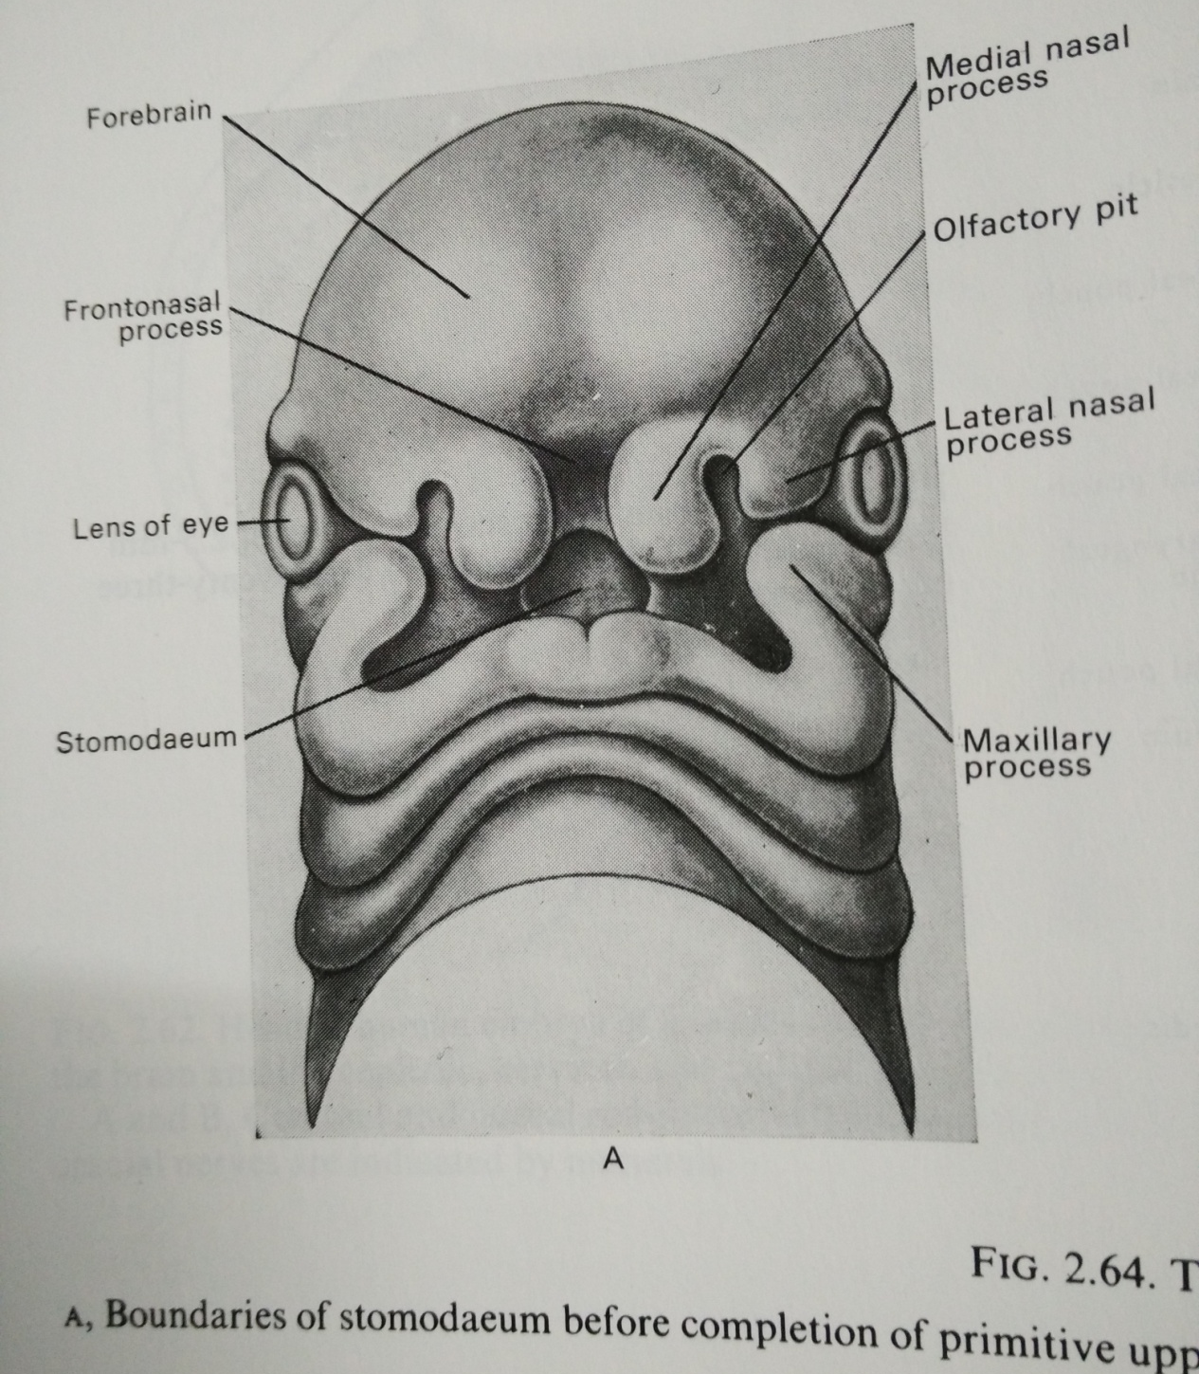

Slide 3
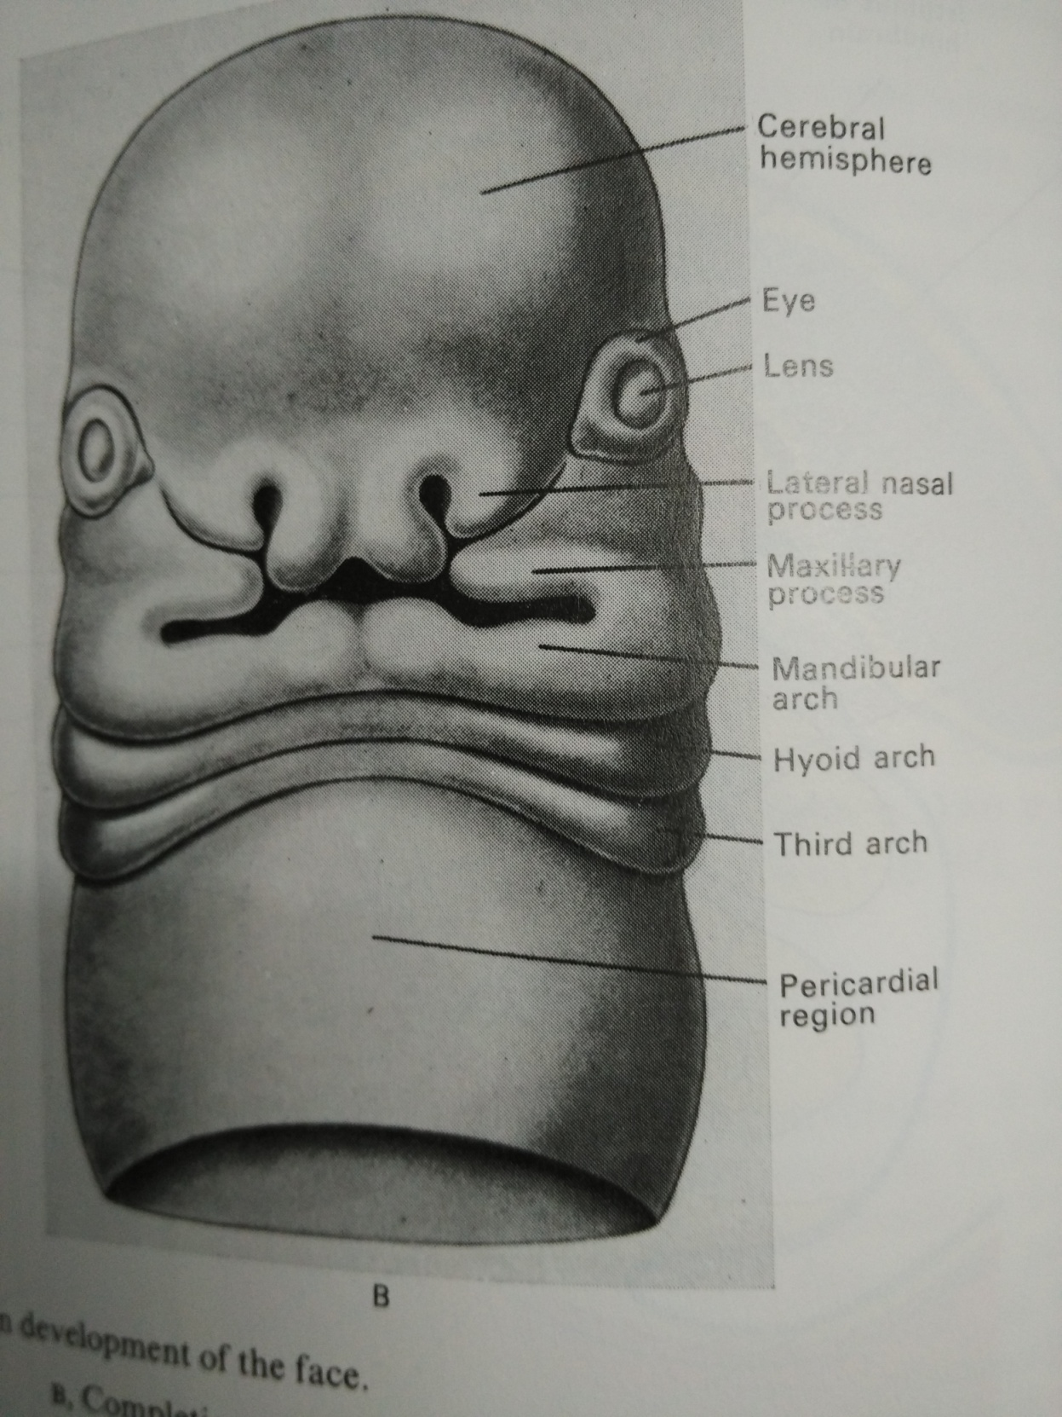

Slide 4
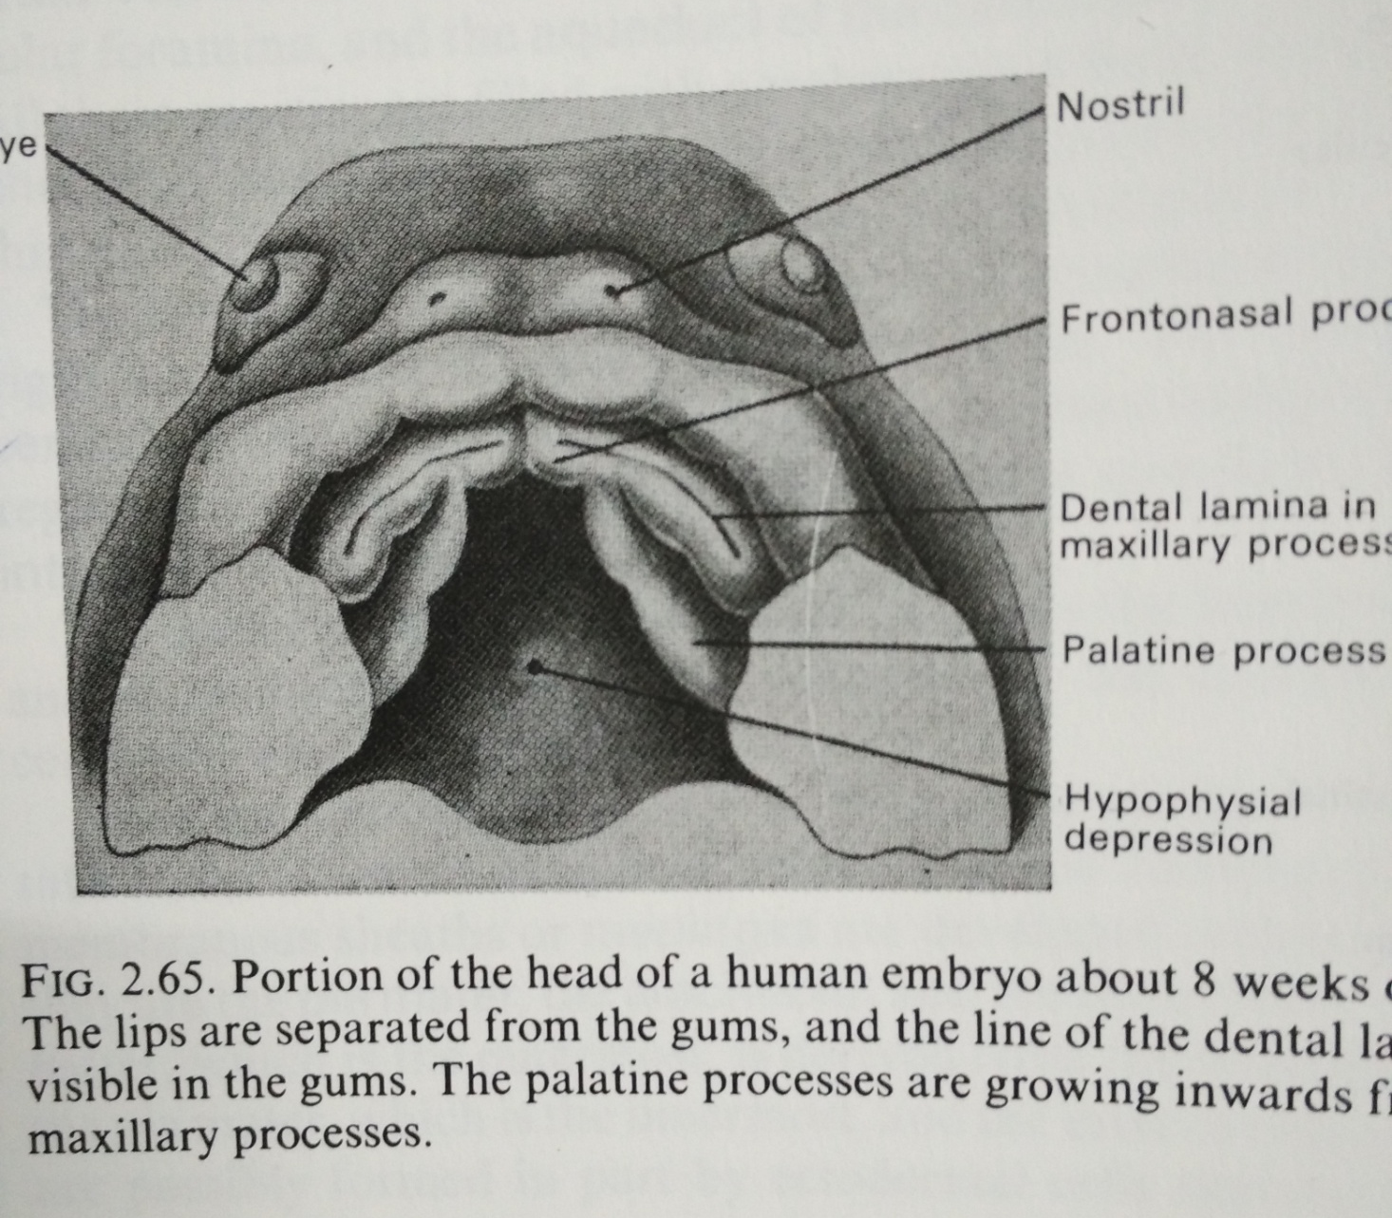

Slide 5
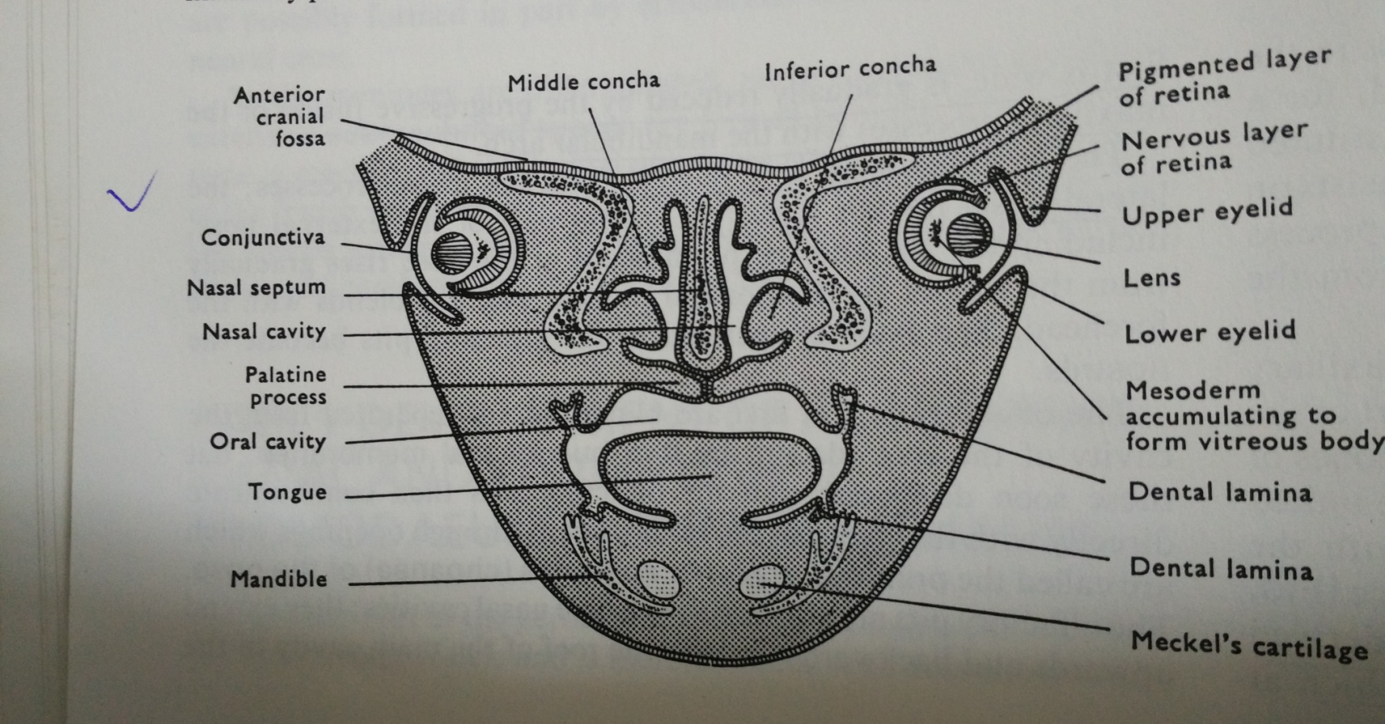

Slide 6
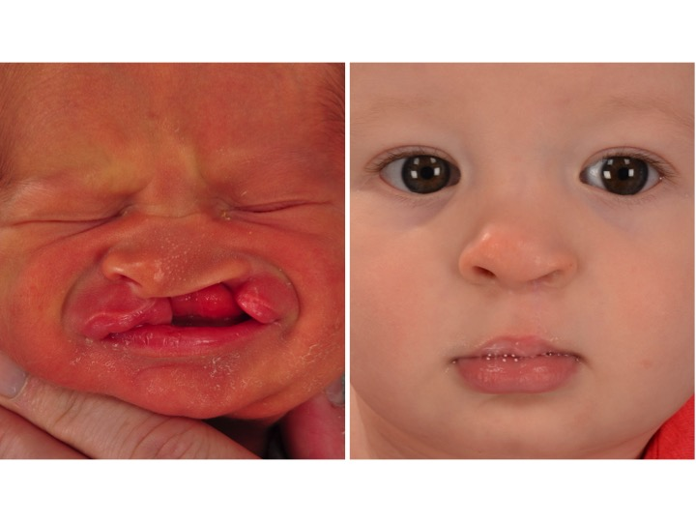
Lt. Lateral cleft lip with palate

Slide 7
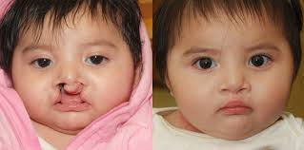
Bilateral cleft lip

Slide 8
CLEFT LIP
It’s the gap in the lip , mostly congenital but can be acquired due to trauma.
Congenital cleft lip: usually affects upper lip
Classification:
Central cleft lip: cleft exactly central in position
very rare
due to failure of fusion of two globular process, derived from median nasal process

Slide 9
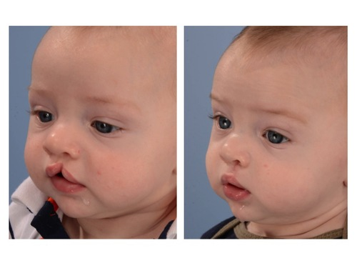
Central cleft lip

Slide 10
Lateral cleft: this is common type
cleft between the philtrum and the lateral part of lip. There is failure of fusion of median nasal process and the maxillary process.
Lateral cleft can be 1: Unilateral
2: Bilateral
can be partial if not extending in nostril
and complete if cleft extending in nostril
its compound if associated with cleft alveolus
and simple if alveolus is intact with cleft lip

Slide 11
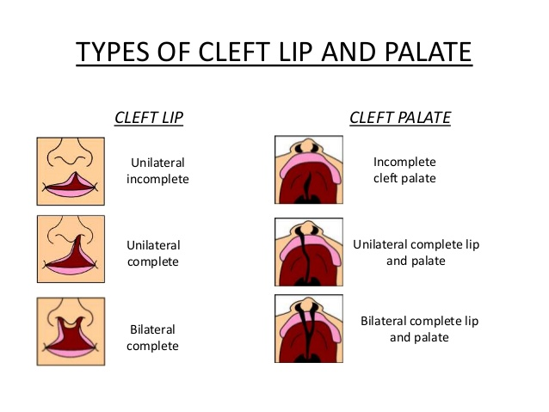

Slide 12
Lateral cleft:
Complicated:- if associated with cleft palate also
Uncomplicated :- if not associated with cleft palate

Slide 13
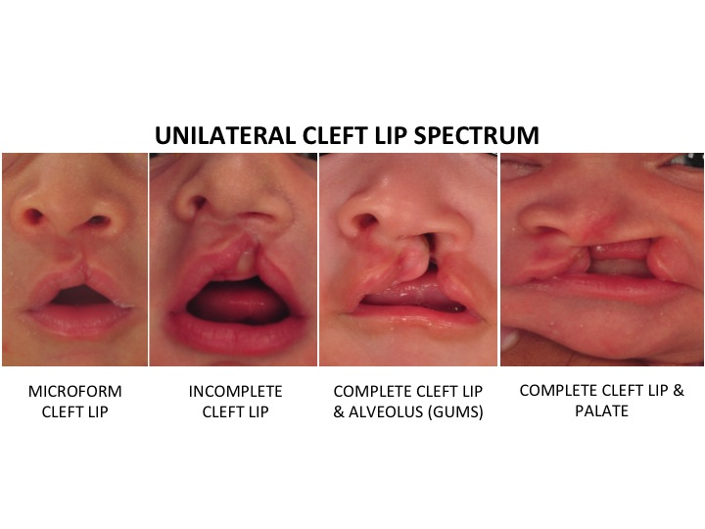

Slide 14
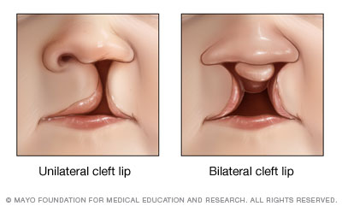

Slide 15
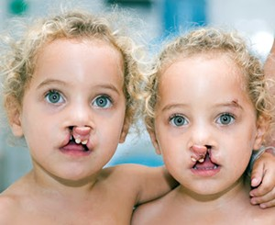

Slide 16
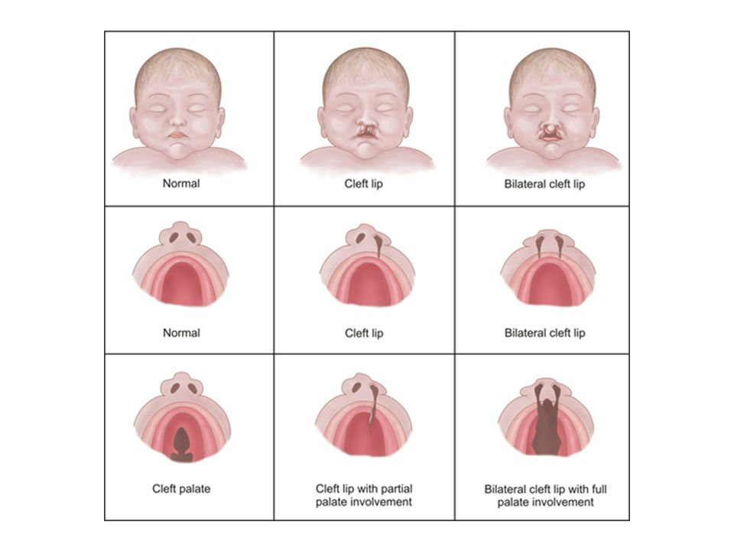
Cleft lip, cleft palate & lip with palate

Slide 17
Lateral cleft lip incomplete

Slide 18
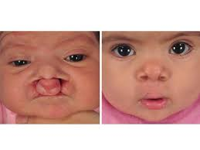
Bilateral complete cleft lip

Slide 19
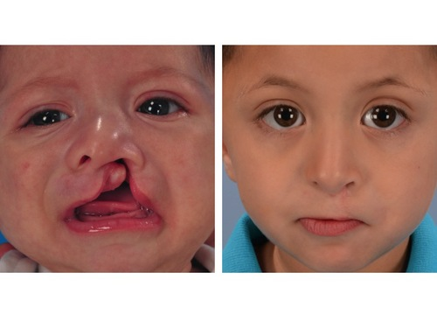
left lateral cleft lip compound

Slide 20
CLEFT PALATE
Its the gap in palate. Usually congenital
Classification: ( foramen caecum)
Incomplete :
1: bifid uvula: cleft in uvula only
2: cleft of soft palate along its entire length
3: cleft of the whole length of soft palate with cleft of posterior part of hard palate

Slide 21
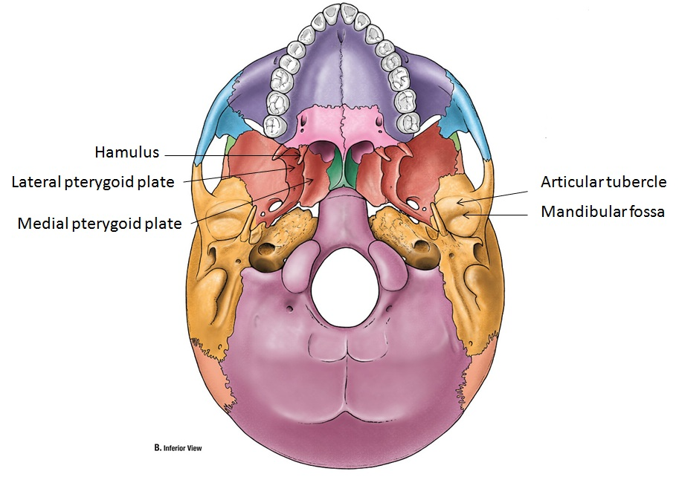

Slide 22
Complete cleft palate:
Here there is cleft on the soft palate and whole length of hard palate , so that the mouth and nose are one cavity.
Its due to failure of fusion of the palatine process and the pre-maxilla
i

Slide 23
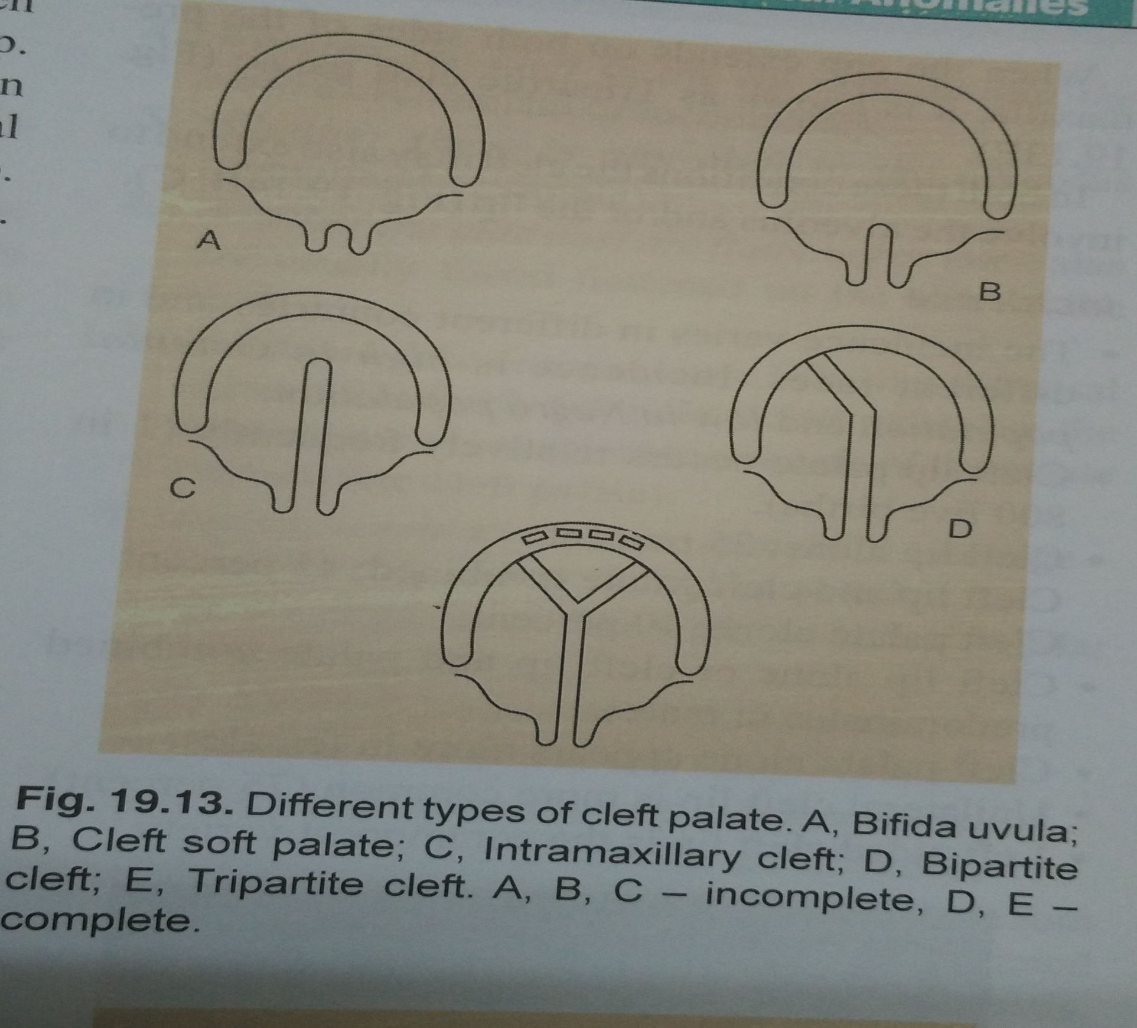

Slide 24
Bipartite cleft palate: cleft palate extends on one side of the pre-maxilla
Tripartite cleft palate: when the gap extend on both sides of the pre-maxilla

Slide 25
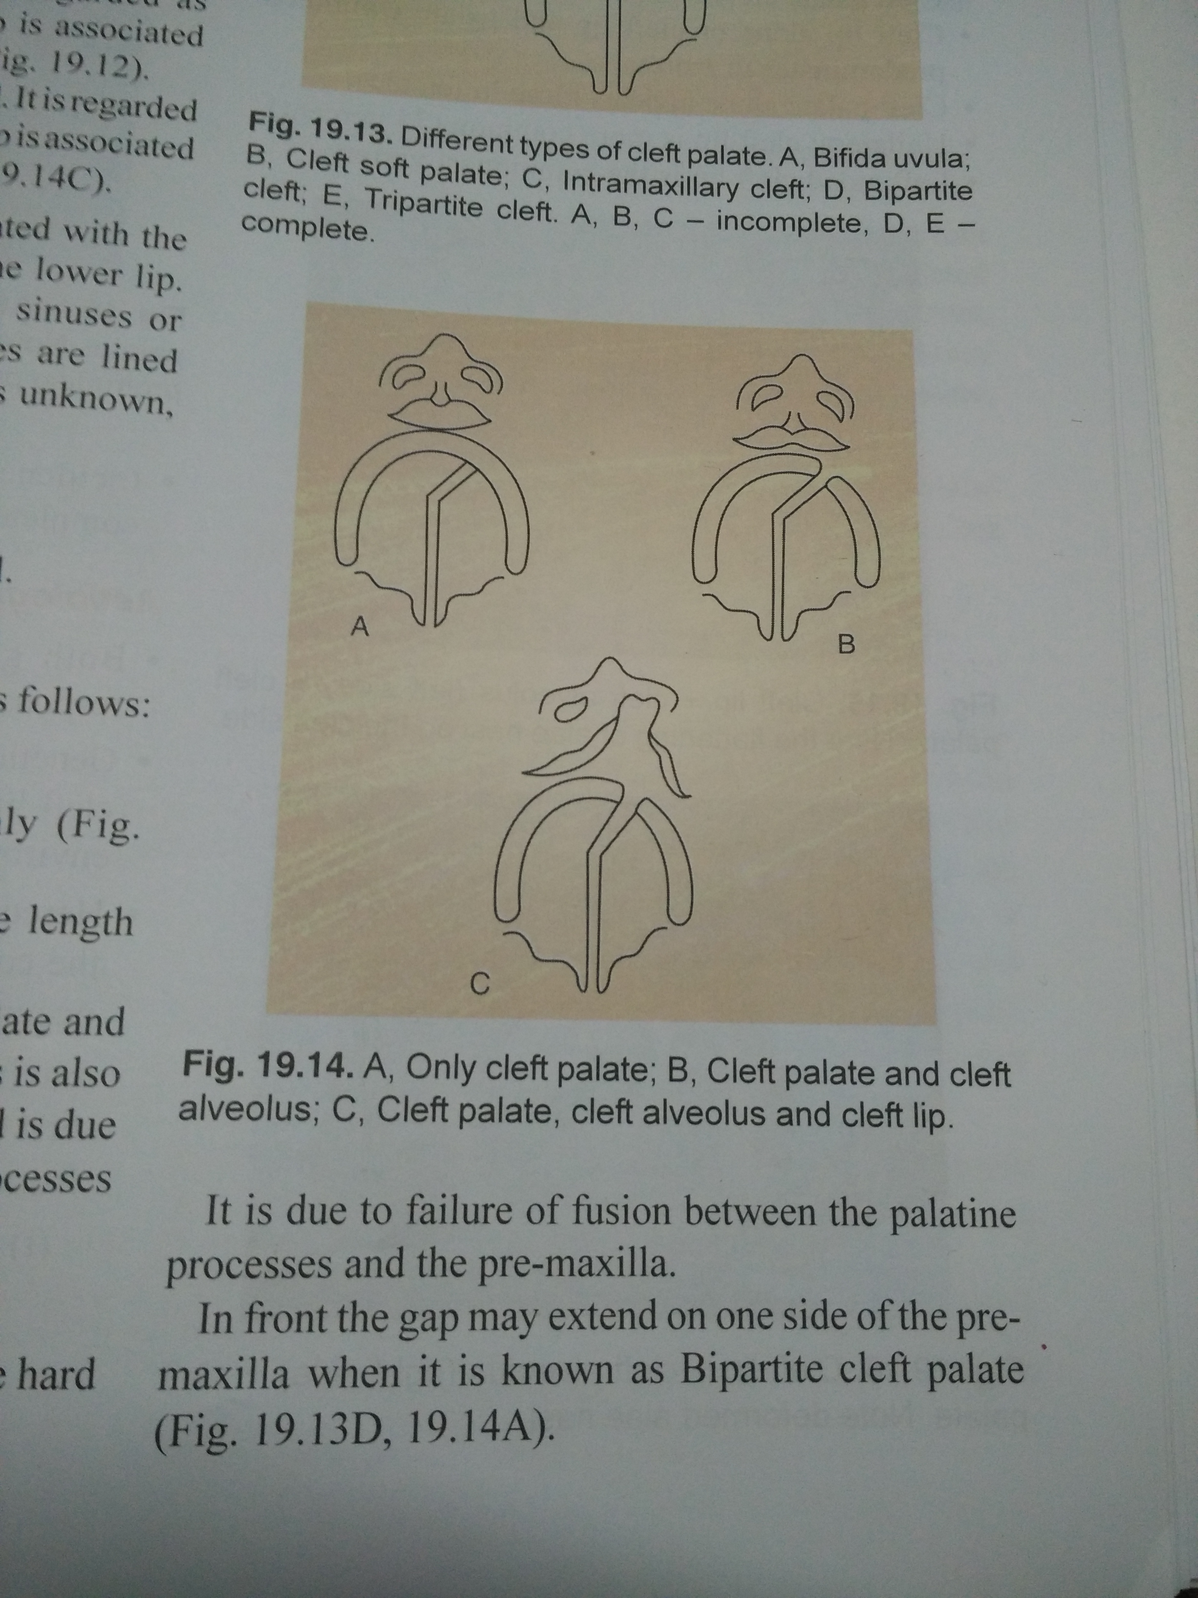

Slide 26
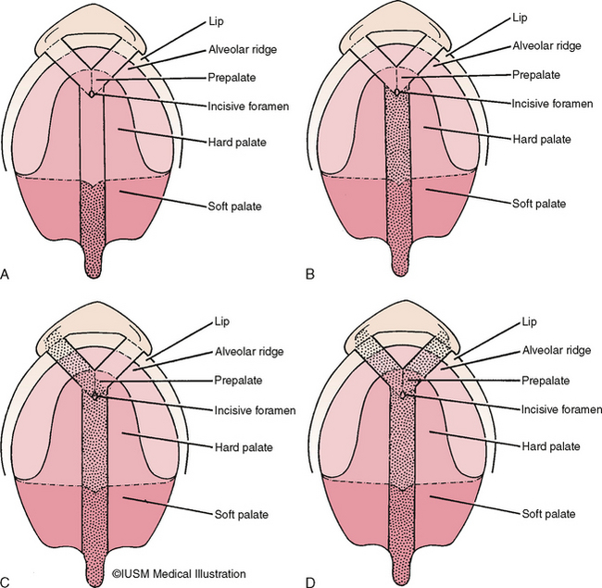

Slide 28
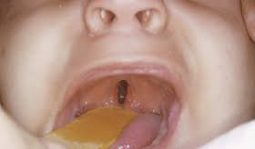
Cleft soft palate only

Slide 29
Incidence : 1:800 live births, more in oriental people . Rare in negroes
Cleft lip alone 25%
Cleft lip and cleft palate combined 45%
Cleft palate alone 20%
cleft lip and palate more common in males
Alone cleft palate more common in female

Slide 30
Etiology of cleft lip/ palate
Genetic factor: 15% cases have familial history +
Environmental factor: specially when mother suffers any of the following conditions during 1st trimester of pregnancy:
Nutritional deficiency:
1: Vitamin B and vitamin A deficiency. Antenatal folic acid supplement helps to prevent this
2: Endocrine disorder
3: Infection by RUBELA virus
4: Drugs excess like steroids, diazepam, phenytoin.

Slide 31
Cortisone inhibits the synthesis of certain amino acids and also vitamin B6 and folic acid which are necessary for synthesis of RNA , DNA
4: Anoxia: as in threatened abortion, it can cause deformity
5: Exposure to radiation – teratogenic
6: Stress: by producing excess endogenous
steroids

Slide 32
Maternal age: late age pregnancy has risk of child deformity
Diabetes : mothers with diabetes has more chances of deformed child
Consanguineous marriages: more chances
Other syndromes may be associated with cleft lip/ palate e.g. down’s

Slide 33
Diagnosis : clinically apparent deformity.
See for : palate, alveolus, nasal septum, alae nasi, spines, urethra, speech defect, age of patient on arrival, teeth alignment, difficulty in swallowing or drinking, talipes equinovarus
Now a days cleft lip ( but not palate) can be diagnosed antenatal by USG examination at 18 weeks of gestation

Slide 34
Problems with cleft lip:
Cosmetics looks bad
Sucking problem
Defective dentition. Tooth protrudes out via gap
Defective speech with labial words like B,F,M,P,V,W,

Slide 35
Problems with cleft palate :
Defective suction
Defective speech
Defective smell : due to constant irritation of nasal mucosa
Defective hearing: internal ear infection due edema of internal auditory meatus-due to constant infection of pharynx
Recurrent respiratory infection, aspiration pneumonia

Slide 36
Defective dentition due to alveolar anomaly
Cosmetically ugly look

Slide 37
Surgical anatomy of nasopharyngeal isthmus
It’s the site of communication between oral cavity and nasal part of pharynx
Boundaries of isthmus
Free Margin of soft palate
Both sides laterally palatopharyngeal arches
Posteriorly palatopharyngeus sphincter muscle
The isthmus is closed during deglutition, blowing air via mouth, uttering several words during speech (except N, M)

Slide 38
Cleft lip management
Treatment : closure of cleft for cosmetics as well as functional recovery.
Surgery time: before 6 months of age i.e. before dentition
Rule of 10 should be fulfilled by baby
Age 10 weeks or more
Weight of baby should be 10 lbs
Hb. 10 gms.

Slide 39
Thus ideal age of operation is 2.5 months to 3 months
Principles : cupid bow remain intact, vermilion border remain intact, integrity of muscle orbicularis oris be maintained , nostril deformity corrected
For this suture lip in three layers
Mucosa to mucosa by catgut
Muscle by vicryl
Skin by prolene/ vicryl

Slide 40
Adequate mobilization of flaps from underlying maxilla on both sides of cleft is required
Gain adequate vertical length from nostril to vermilion border to match precisely with opposite lip. To achieve this various types of Z plasties are there .
Paring of edges of cleft for good healing
Achieve accurate apposition of margins of both sides

Slide 41
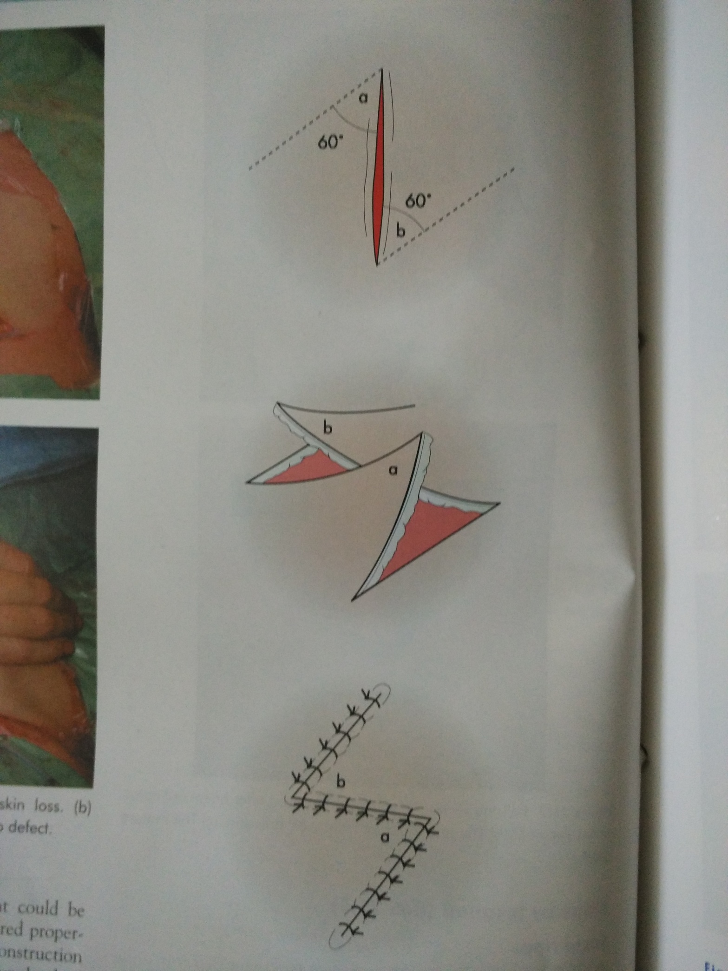

Slide 42
Treatment of cleft palate
Palatoplsasty : aim is to gets
(1) adequate speech
(2) prevent regurgitation of food in nose
Ideal time for repair is
14-18 months before child starts speaking
Now a days many prefers to do at 9 to 12 months as child start efforts to utter understandable sounds at 1 year of age

Slide 43
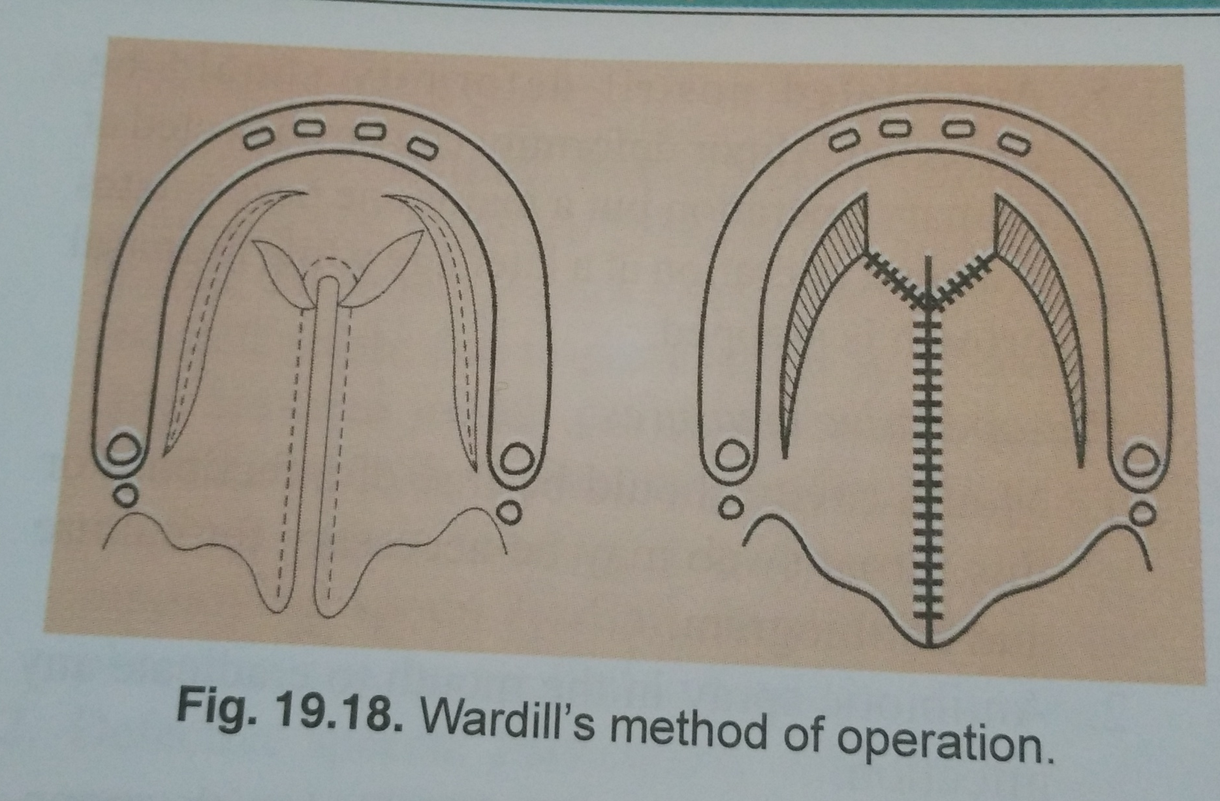

Slide 44
M.C.Q.1
CONGENITAL CLEFT LIP ……….. VARIETY IS VERY RARE
A: CENTRAL.
B: LATERAL
C: BILATERAL
D: ALL OF ABOVE

Slide 45
2
COMPLETE CLEFT LIP MEANS……
A: CLEFT REACHING UP TO PALATE
B: CLEFT REACHING UPTO NOSTRIL
C: CLEFT INVOLVING THE ALVEOLUS
D: NONE OF ABOVE

Slide 46
3
ONLY CLEFT PALATE IS MORE SEEN IN …….
A: MALES
B; FEMALES
C: BOTH MALE AND FEMALE
D: ALL OF ABOVE

Slide 47
4
CLEFT LIP REPAIR IS DONE WHEN CHILD GETS ……….WEIGHT
A: 10 LBS
B: 20 LBS
C 5 LBS
D 15 KGS

Slide 48
5
CLEFT PALATE REPAIR IS DONE USUALLY WHEN CHILD IS ………..OLD
A: 1 YEAR
B; 2 YERS
C: 3 YEARS
D: 5 YEARS

Slide 49
Key to mcq
MCQ CORRECT ANSWER
1 A
2 B
3 B
4 A
5 A

