Slide 1
Periodic Lateralized
Epileptiform Discharges (PLEDs)
Dr C Rathore
21/6/2011

Slide 2
Scheme of Presentation
Introduction & Definition
Characteristics
Classification
Etiology and pathophysiology
Illustrative examples
Variants
Journal article

Slide 3
Introduction
Term ‘PLEDs” first coined by Chatrian et al. in 1964
Distinct but uncommon EEG pattern with an incidence range of 0.4% - 1 %.
Incidence of this short-lived phenomenon increases when EEGs are performed earlier in the course of the disease process.
Although more commonly described in an older patient population, PLEDs may also occur in children and even infants.
Chatrian, Shaw and Leffman. Electroenceph clin Neurophysiol 1964;17:177–193.

Slide 4
Definition
First defined in 1964 by Chatrian et al as periodic and lateralized complexes, usually recurring every 1-2 seconds and consisting of spike or sharp wave often followed by a slow wave.
Kuroiwa and Celesia (1980) defined PLEDs as
complexes which occur at approximately regular intervals and which persist for greater than 10 min or are continuous in a specific behavioral state.
Kuroiwa Y, Celesia GG. Clinical significance of periodic EEG patterns. Arch Neurol 1980

Slide 5
Characteristics
Usually PLEDs are surface -ve bi-, tri- & polyphasic spikes and sharp waves, and are maximal ipsilat to the structural involvement.
Duration- between 100-300 msec
Amplitude range of 100-300 uV and usually greater than BGA.
Morphology may be heterogenous.
Hallmark feature is a conserved recurrence pattern or ‘periodicity’.
Recurrence frequency – once in every 0.5 to 4 sec (usually recur atleast every 2 sec)

Slide 6
Case # 1
52/F
Case of Rt ACA aneurysm, clipped in December
3 weeks later presented with Status epilepticus
EEG showed..

Slide 7
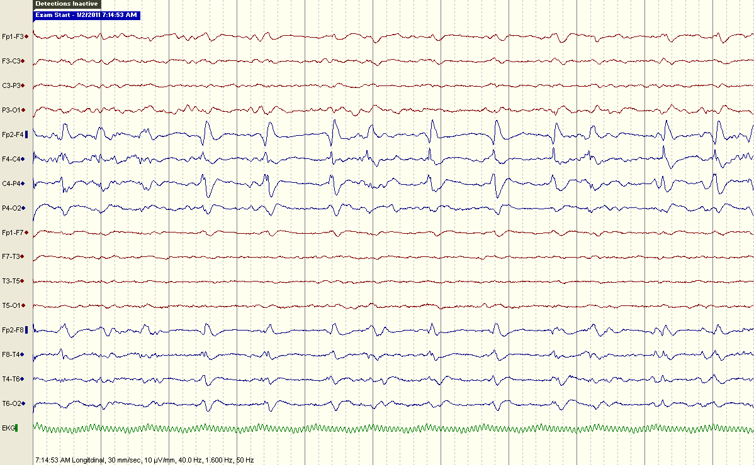
LF1.6Hz/HF50Hz/10μV
Notes:
Bipolar montage, sens of 10 uV, 7-8 Hz BGA, better on left, Rt F-T discharges at freq of 1 per sec reversing at F4
In Avg montage…

Slide 8
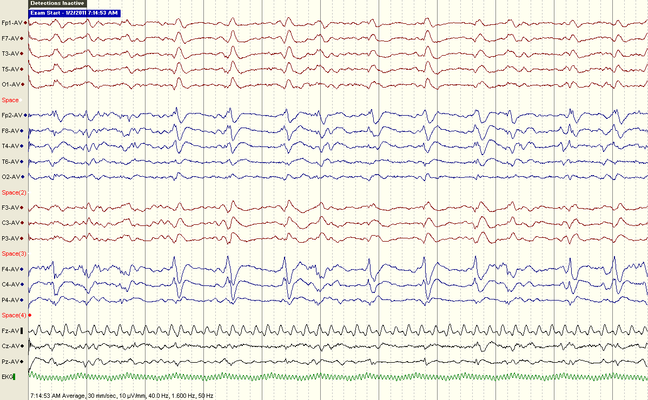
LF1.6Hz/HF50Hz/10μV
Notes:
Avg Montage, same sens

Slide 9
Characteristics: Periodicity
The term "periodic" defines activity of waves/complexes occurring at an ‘approximately’ regular rate which, for a given patient, varies less than 20%. (Daly and Pedley, 1990).
Daly coined the term Pseudoperiodic
Pseudoperiodic refers to-
  1. Greater variation in interdischarge interval
  2. Greater variation in wave morphology during recurrences

Slide 10
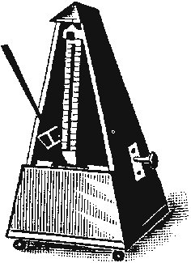
Characteristics
Metronomic periodicity - the recurrence of discharges at constant intervals
Stating periodicity as metronomic or relative bears no relation to any particular etiology

Slide 11
Characteristics
Reactivity to hyperventilation, photic stimulation, and noxious stimuli is either diminished or absent.
Persist during both REM and NREM sleep and sometimes recur during drowsiness after disappearance in wakefulness (Terzano et al., 1986)
Painful stimuli can result in an increase in the interval between the complexes . (Young et al.,1988)

Slide 12
Case # 2
9/F
c/o Rt infantile hemiplegia
CT Brain s/o left F-P encephalomalacia
Rec sec gen Seizures

Slide 13
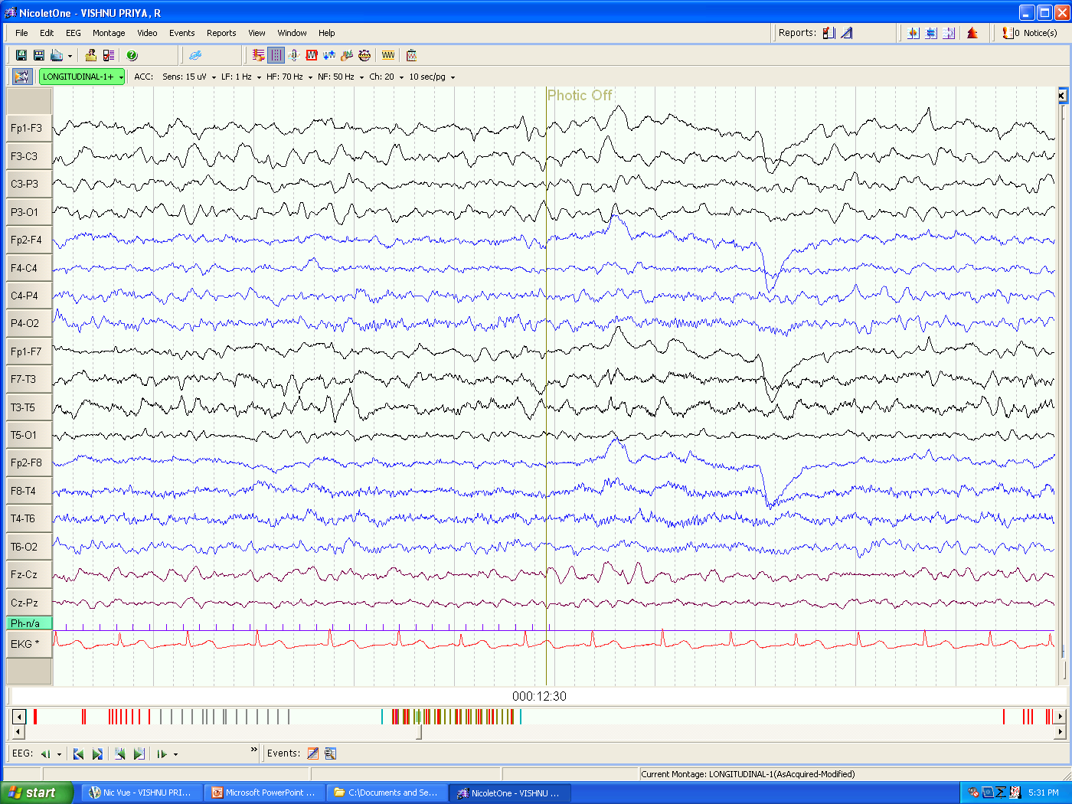
LFF1Hz/HFF70Hz/15μV
Notes:
Recording in an awake state,bipolar montage 15 uV, BGA ~ 8 Hz on rt side with int fast beta activity. Left slowing present. Few suspicious sharp disch seen at T3. In sleep…

Slide 14
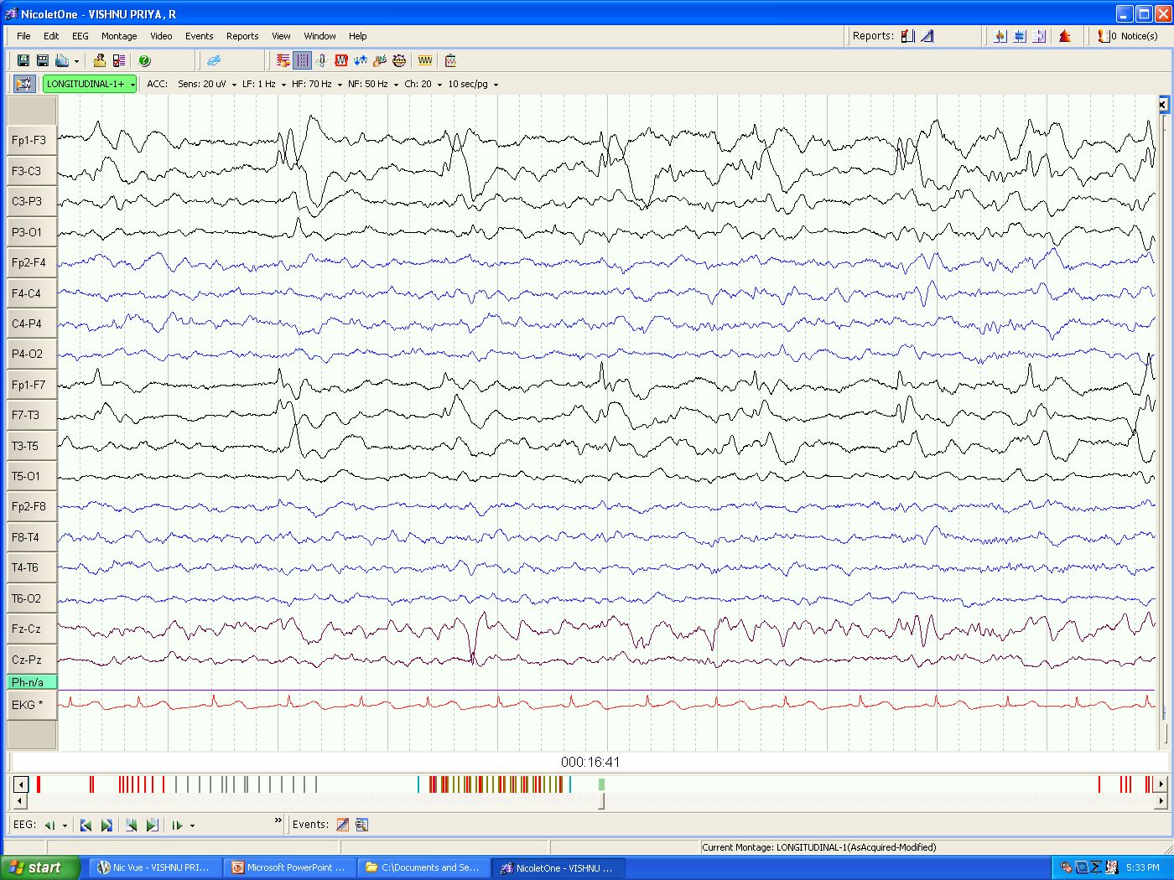
LFF1Hz/HFF70Hz/20μV
Notes:
In sleep activation of periodic disch on left side with reversal at F3. few rudimen V waves seen.
In avg montage

Slide 15

LFF1Hz/HFF70Hz/20μV
Notes:
Avg Montage

Slide 16
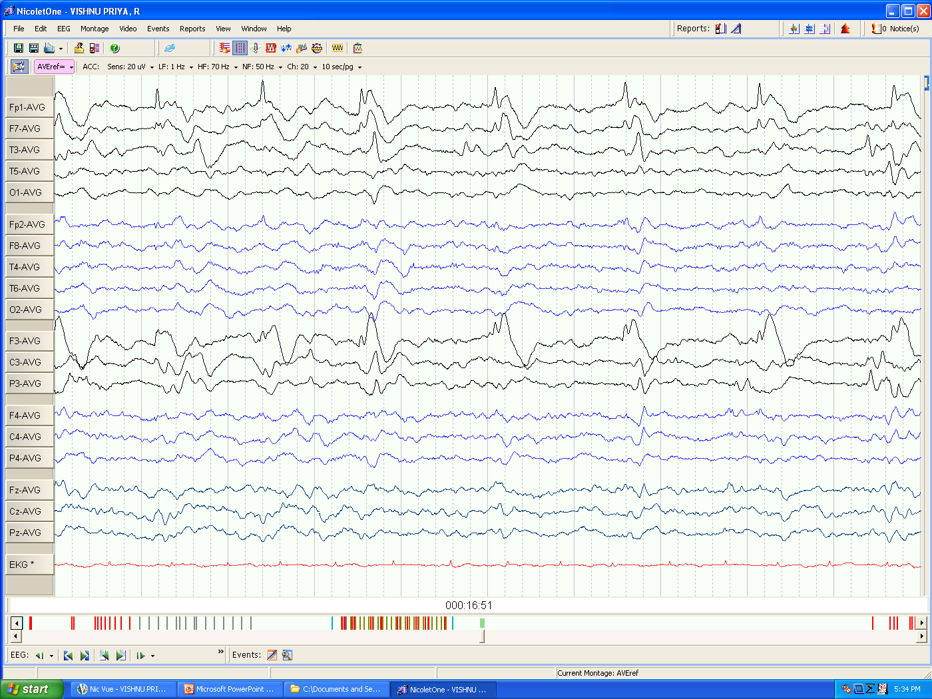
LFF1Hz/HFF70Hz/20μV

Slide 17
Case # 3
10/M,
Case of congenital CMV infection, comm hydrocephalus with Rt P-O porencephalic cyst
Remote symptomatic epilepsy
EEG showed…

Slide 18
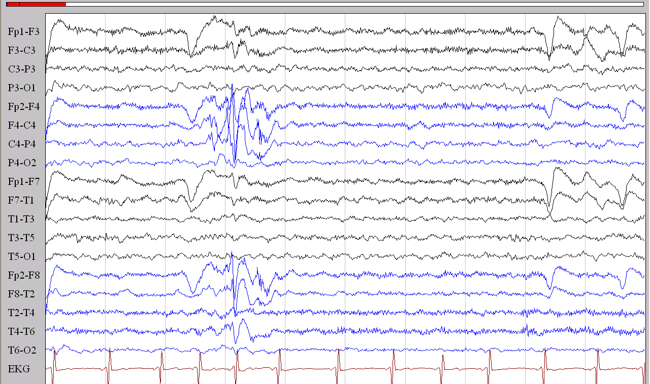
LF1Hz/HF70Hz/14μV
Notes:
Bipolar montage, sens of 14, awake state, bga of ~ 6-7 Hz, right F-C spike &wave discharge

Slide 19
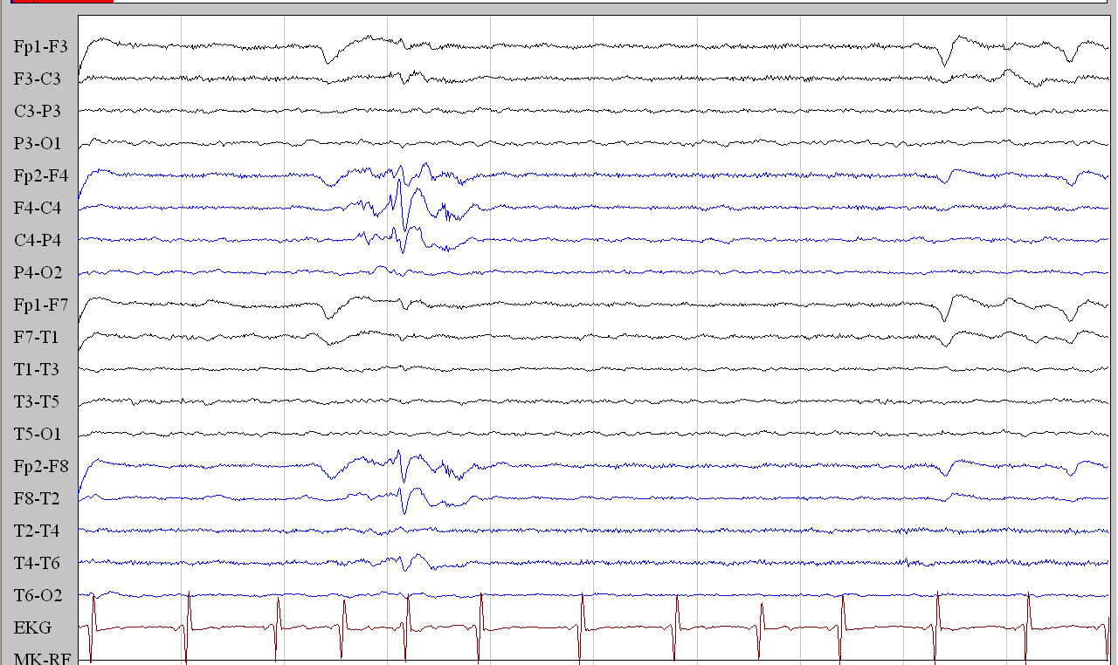
At sensitivity of 35

Slide 20
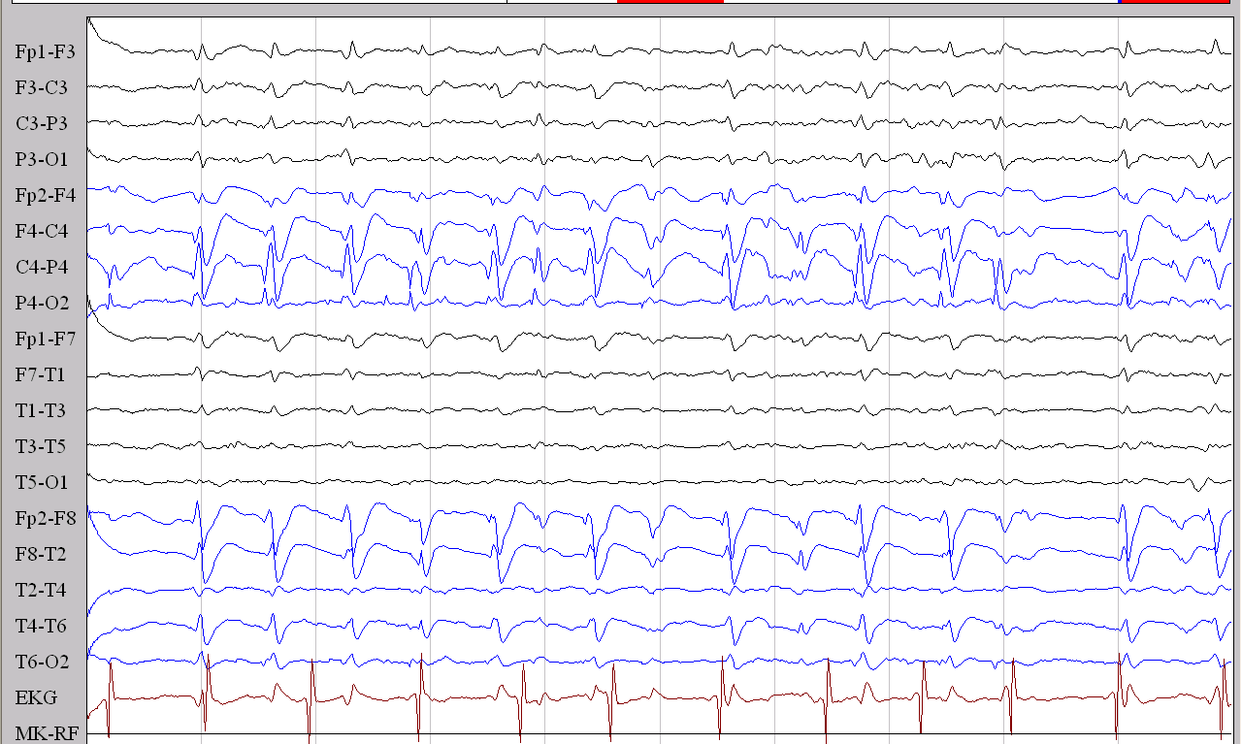
LF1Hz/HF70Hz/50μV
Notes:
During sleep there is marked activation of Rt F-P PLEDS with reversal at P4

Slide 21
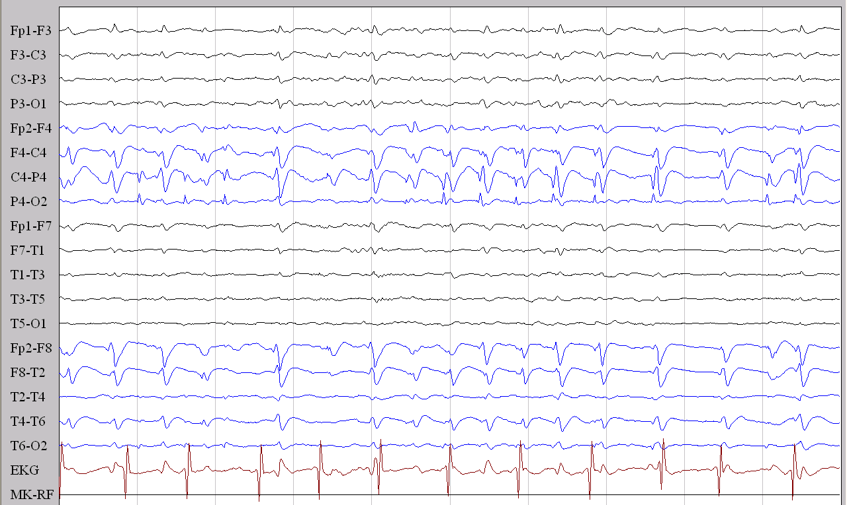
Phase reversal at P4
LF1Hz/HF70Hz/70μV

Slide 22
Ephemeral nature of PLEDs
90% of the diagnosed PLEDs disappear within 4 weeks. (Schwartz et al. 1973)
Chronic PLEDs described from 18 months to 20 years (Westmoreland et al 1986)
Recurrent PLEDs also described in patients with TIAs and symptomatic epilepsy.

Slide 23
Etiological Associations

Slide 24
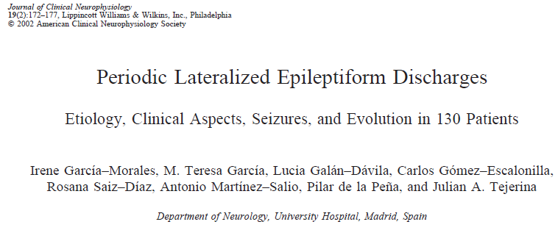
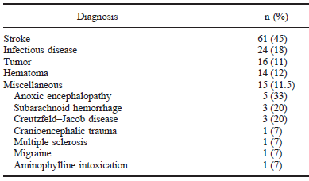

Slide 25
Etiological associations
Infectious disease (18%)
  HSV encephalitis/ Focal Encephalitis
  TBM
  Early stages of CJD
  Abscess
  AIDS,
  Neurosyphilis
  Metabolic Conditions
Other rare assocations
Neurobehcets
Fat Embolsim
Alcoholic encephalopathy
Porencephalic cysts
Sickle cell disease
Mitochondrial

Slide 26
Metabolic Causes
In the setting of structural lesions mild to moderate metabolic abnormalities may precipitate PLEDs.
Hypoxia, NKHS, hypoglycemia, alcohol withdrawal, aminophylline intoxication, Hyponatremia, Hepatic encephalopathy, CO poisoning.
Fever & sepsis.

Slide 27
PLEDs are most commonly found in the ICU !
General agreement that PLEDs are usually a response to an acute process.
Stroke, infections, tumors, metabolic conditions –majority of causes.
Stroke:
- Embolism >> thrombosis
- watershed infarcts >> single vessel strokes
- Post CEA hyperperfusion $ also a known
cause. (Reigel et al. 1987)

Slide 28
Case # 4
28/F
Case of RHD, with DVR on Warf
Admitted with right sided hemiparesis and focal seizures. INR- 1.2
MRI Brain showed left ACA-MCA territory embolic infarcts.
EEG showed…

Slide 29
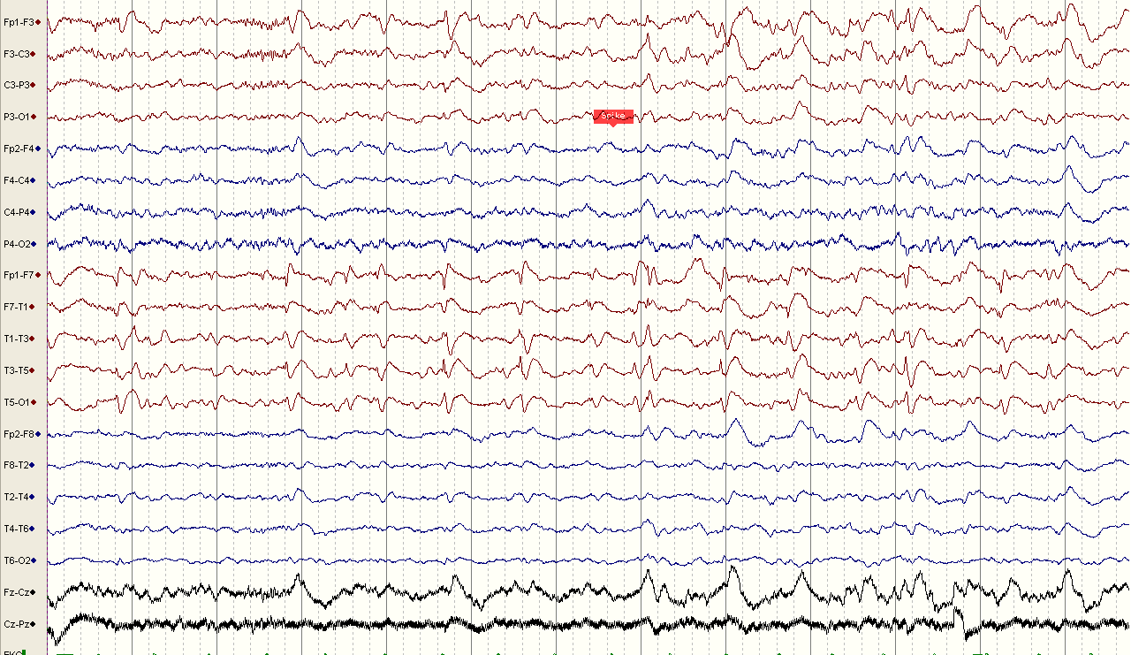
LFF1Hz/HFF70Hz/10μV
Notes:
Bipolar montage, sens 10 uV/mm, eeg shows BGA 8 Hz, symmetric, 1- 2 Hz discharges, not very periodic, reversing at T1 seen continuously thru the record. On Avg montage…

Slide 30
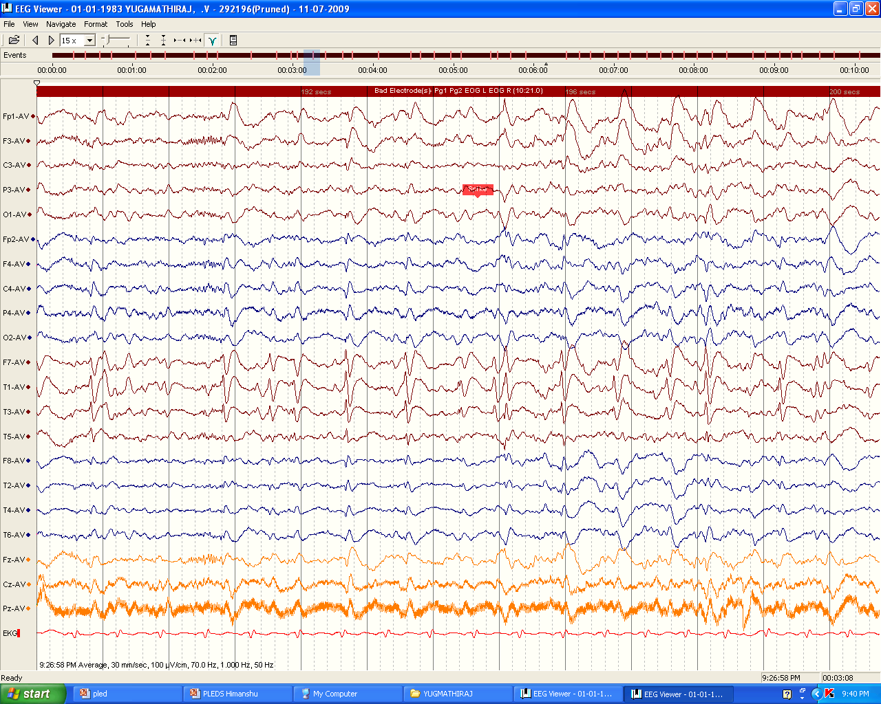
avg

Slide 31
Pathophysiology of PLEDs
-cannot be explained by a common unifying pathophysiology
-an EEG signature of a dynamic patho-physiological state in which unstable neurobiological processes create an ictal-interictal continuum. (Pohlmann et al 1996)
“Cortical isolation hypothesis”: periodicity occurs when the cortex is disconnected from subcortical influences by damage to the white matter. (Cobb & Hill 1950)

Slide 32
Pathophysiology
? Nonspecific response of acute partial and transient functional denervation of cortical neurons
Local factors such as edema , infarction and h’rage → blocking of inhibitory influences on the neuron
Abnormal interaction between deranged cortex & deeper triggering structures → ↑ed local cortical irritability

Slide 33
Classification

Slide 34
Reihers Classification of PLEDs
PLEDs proper (without RDs)
  Class I - aperiodic; throughout
  Class II - metronomic, intermittent
  Class III - metronomic, throughout
PLEDs plus (with RDs)
  Class IV - brief RDs < 1 sec
  Class V - prolonged RDs
  RD- high freq, low voltage polyspike rhythms
Reiher J etal .Electroencephalography & clinical Neurophysiology.1991;78:12-17

Slide 35
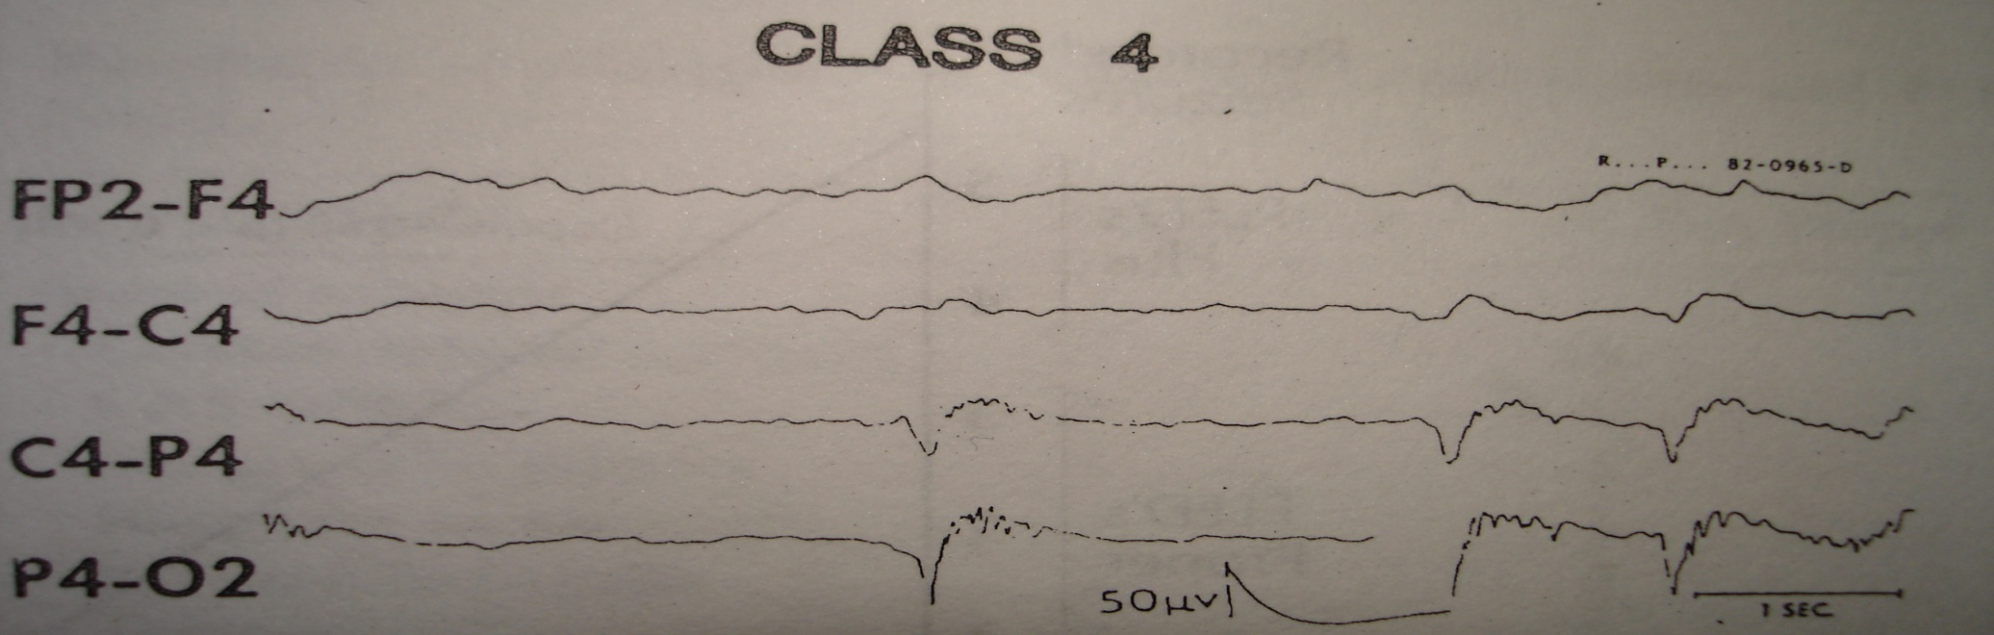
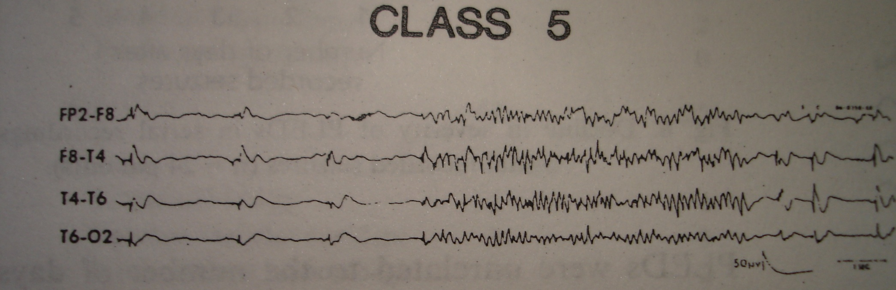
PLEDs Plus
PLEDs Plus
Class 4 : PLEDs with brief RDs (of 1 second or less)
Class 5 : PLEDs with more prolonged RDs

Slide 36
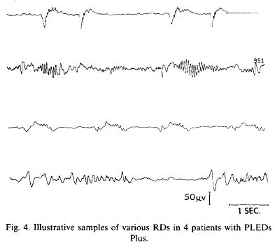

Slide 37
PLEDs PLUS
Incidence of seizures is higher in PLED Plus than PLEDs proper / NPED
With time PLED Plus evolve into periodic PLEDs (class 2 and 3) & then into aperiodic PLEDs ( class 1)
This transformation is also accompanied by a decreasing frequency of clinical seizures
Hirsch et al. J of Clinical Neurophysiology 2005;22(2):128-135.

Slide 38
Evolution of PLEDs
PLEDS may change to
  Seizure
  Isolated high voltage slow waves with delta/theta activity
  Sporadic spikes or sharp waves
  Hypsarrhythmia in infants
May persists as chronic PLEDs
Recurrence of PLEDS – Recurring pathology e.g. TIA

Slide 39
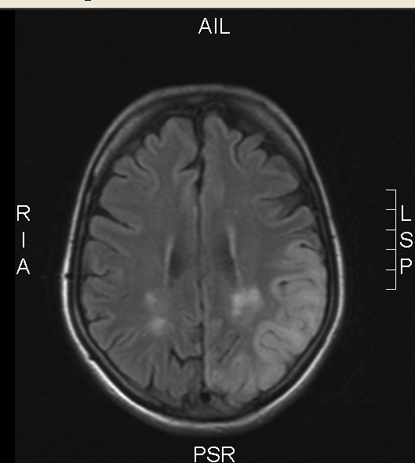
Case # 5
38/F
k/c/o CPS- ET, left hemisphere since 1984
Admitted in status epilepticus (? Drug default)
GCS- E3M4V4 on admsn
MRI- ? Post ictal changes
EEG showed…

Slide 40
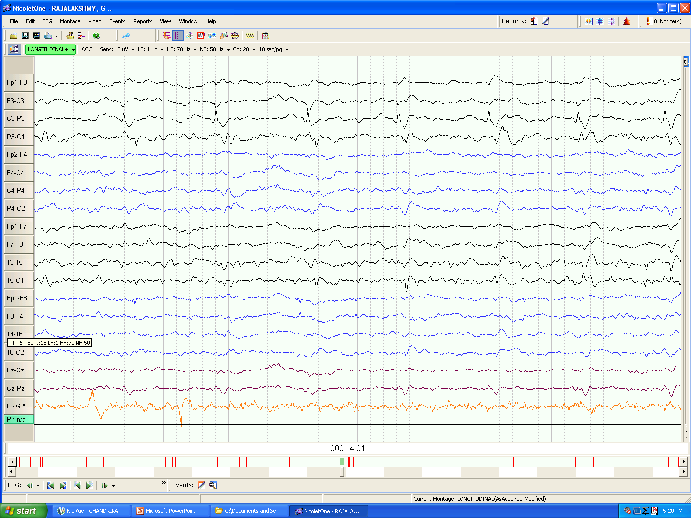
LFF1Hz/HFF70Hz/15μV
Notes:
Bipolar montage, sens of 15 uV, periodic discharges form left hemis, some reversing at C3 and some at T5- left PHR pleds

Slide 41
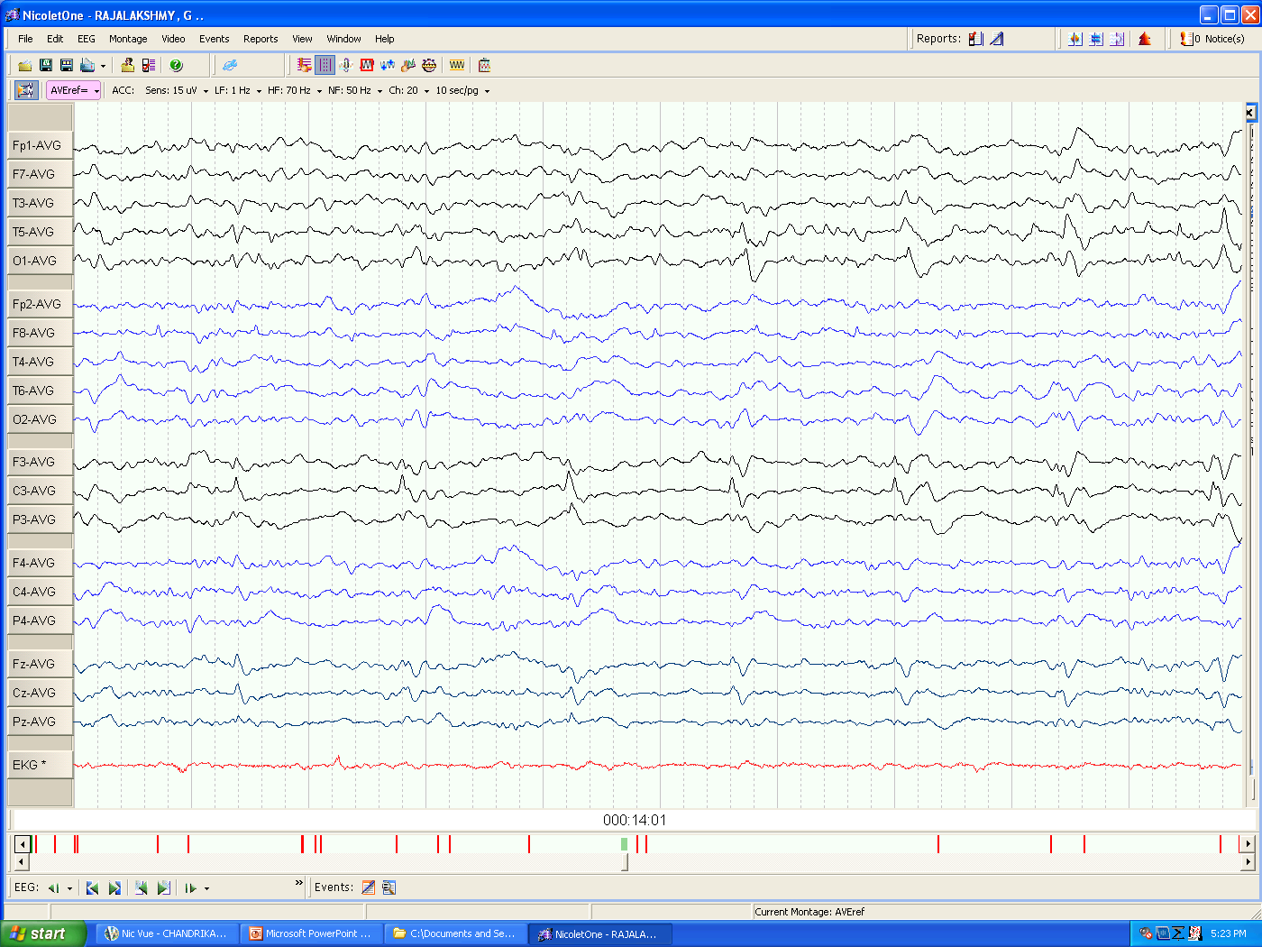
Avg
LFF1Hz/HFF70Hz/15μV
Notes:
In avg montage

Slide 42
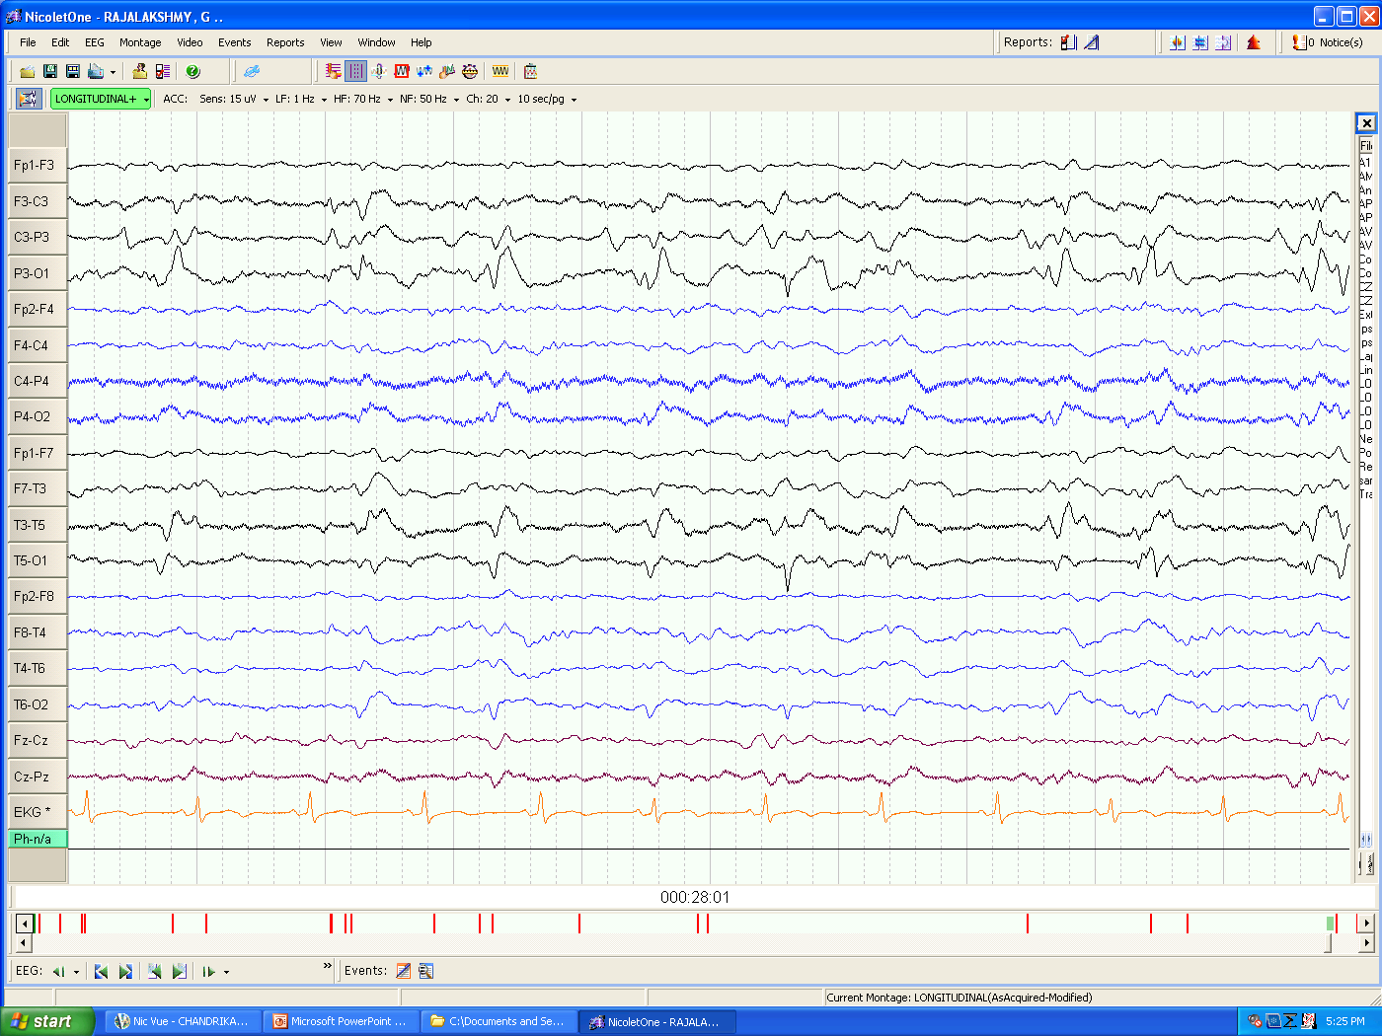
LFF1Hz/HFF70Hz/15μV
Notes:
Few RDs seen in p3-o1- evolution in a seizure

Slide 43
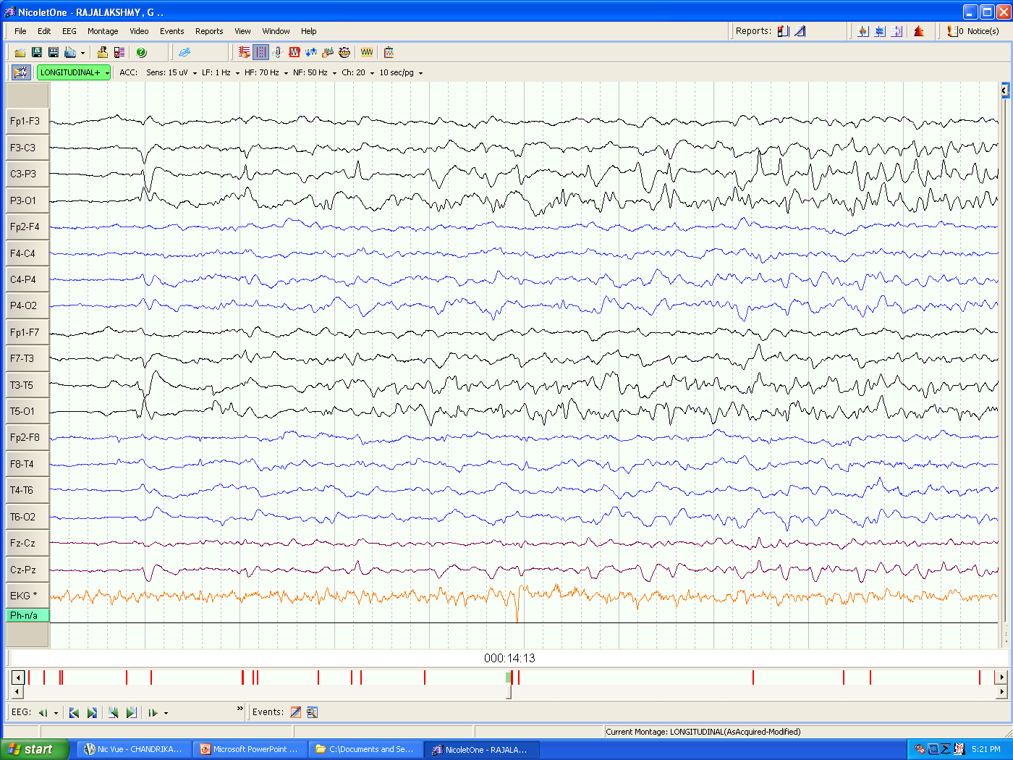
LFF1Hz/HFF70Hz/15μV
Notes:
Polymorphic low voltage spikes evolving in a seizure

Slide 44
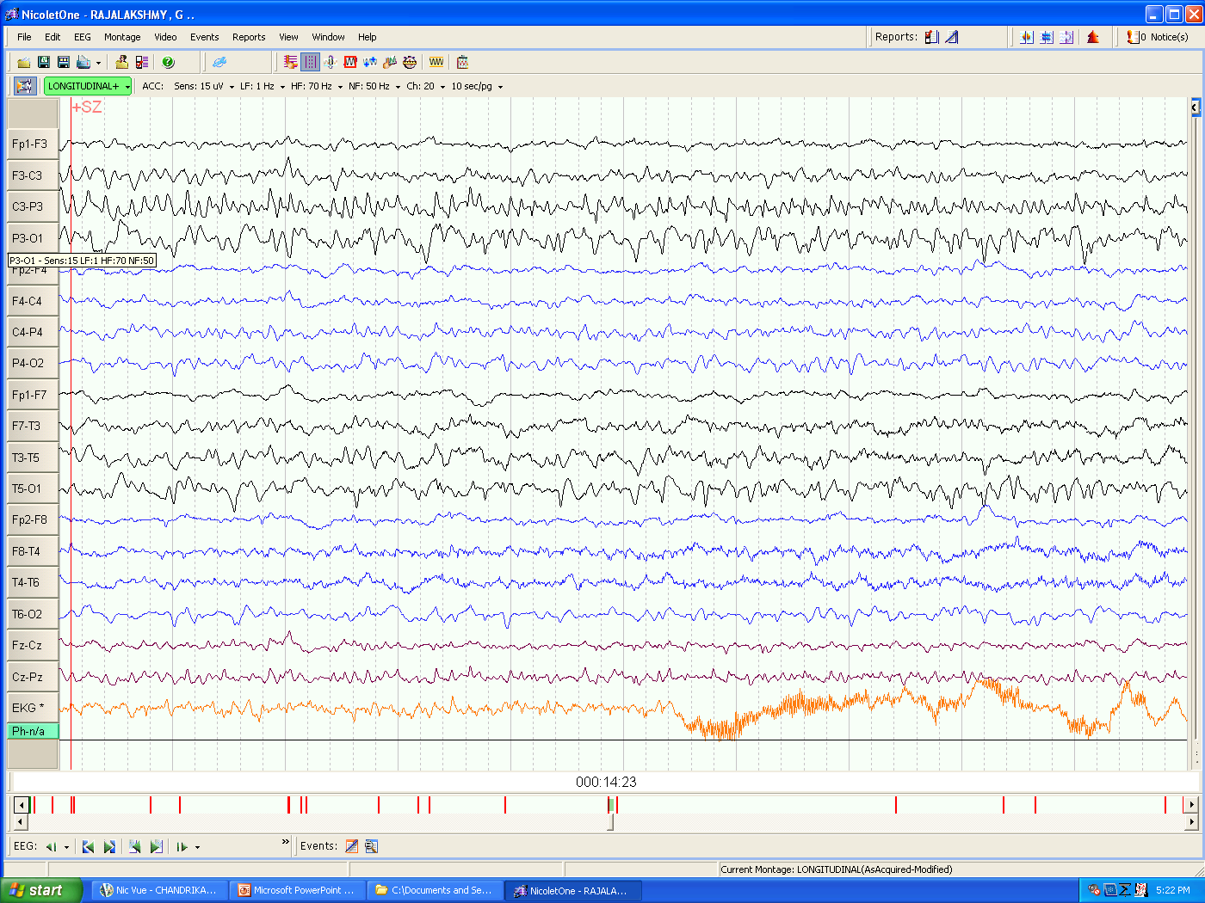
LFF1Hz/HFF70Hz/15μV

Slide 45
Case # 6
70-year-old lady
Recurrent left hemispheric stroke with symptomatic seizures (clustering)
Admitted in altered sensorium
GCS - E4 V1 M3 on ventilator

Slide 46
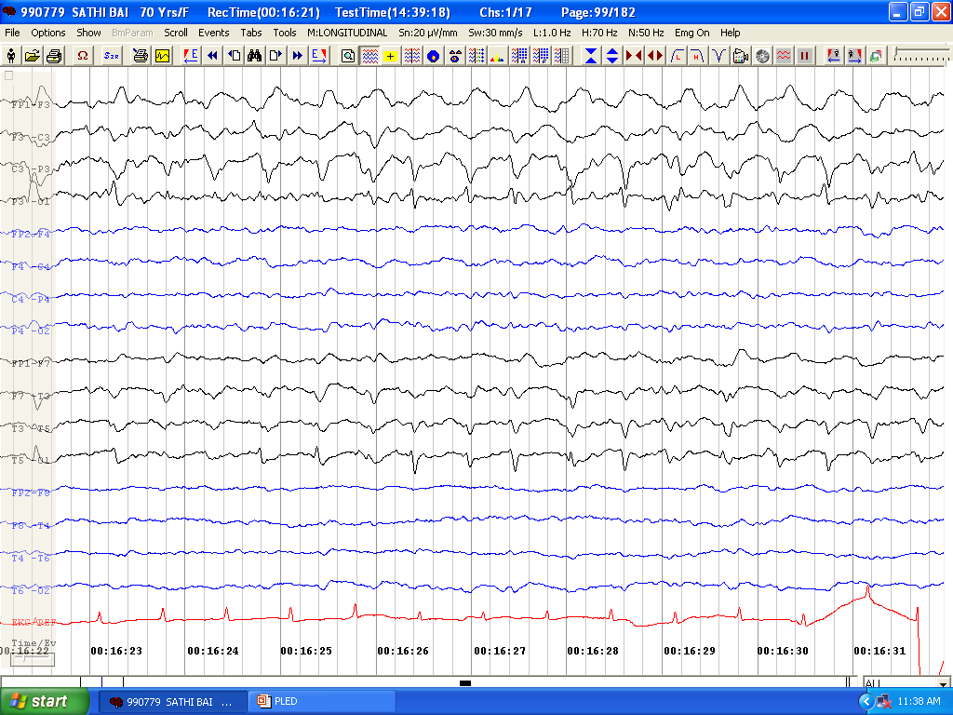
LFF1 Hz./ HFF 70 Hz / 10 µV
Notes:
Taken in NMICU. showed a BGA of 7 Hz better expressed over right. left hemisphere showing periodic spike discharges better expressed over PHR @ freq of 2 Hz with phase reversal at P3 (maximum amplitude in common average in T5 and P3).

Slide 47
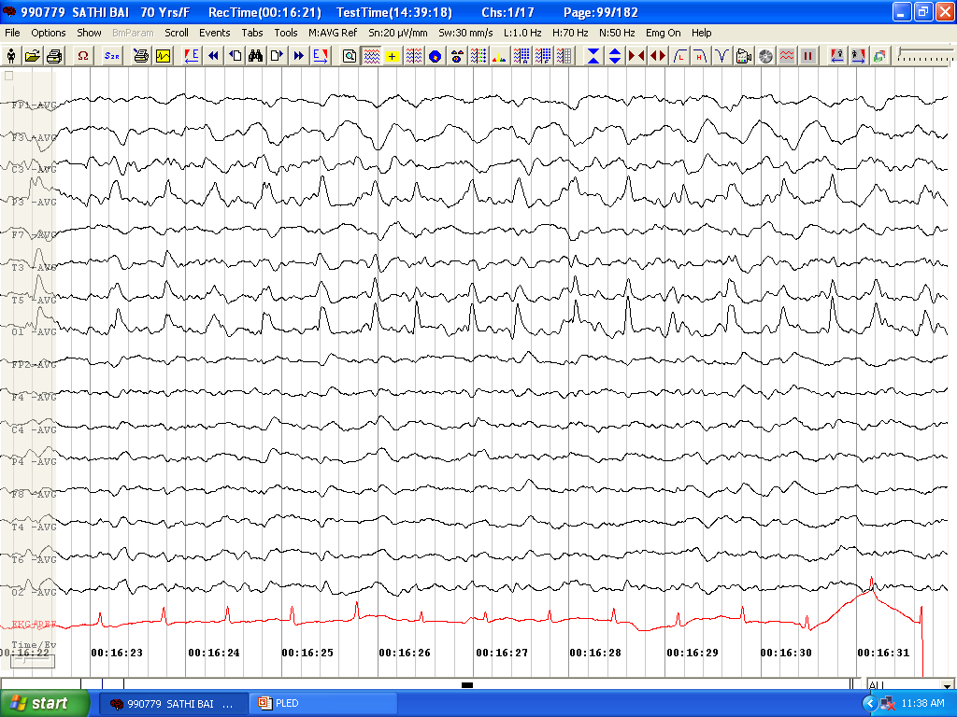
LFF1 Hz./ HFF 70 Hz / 10 µV
Notes:
Again in the average montage the maximum amplitud is over the left occipital and parietal area

Slide 48
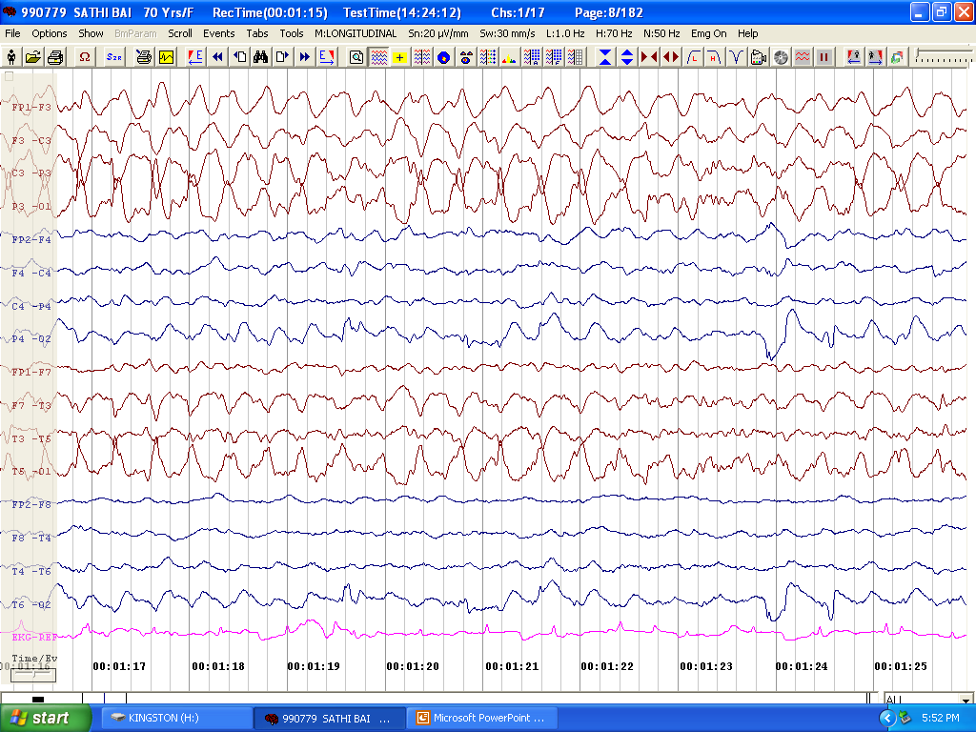
LFF1 Hz./ HFF 70 Hz / 10 µV
Notes:
The interval decreases and frequency increases to 3hz this associated with significant RD with PLEDsthis will gradually evolve in to a class V PLED

Slide 49
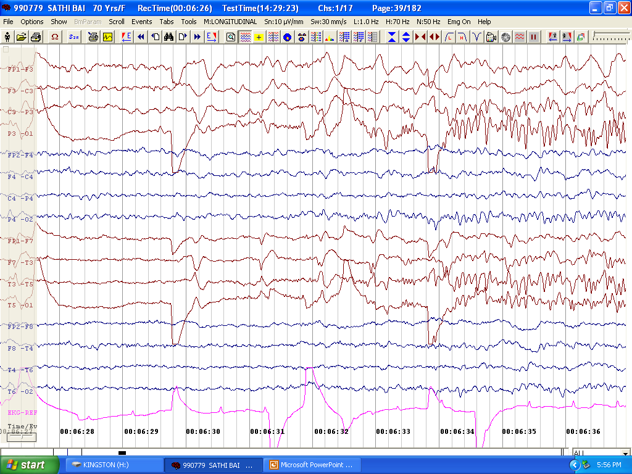
LFF1 Hz./ HFF 70 Hz / 10 µV
Notes:
RD start over the PHR

Slide 50
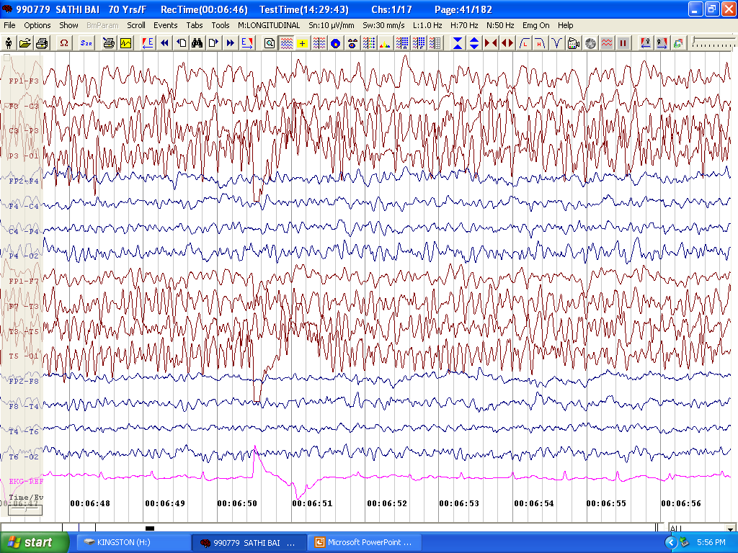
LFF1 Hz./ HFF 70 Hz / 10 µV
Notes:
The activity cintinues for few seconds

Slide 51
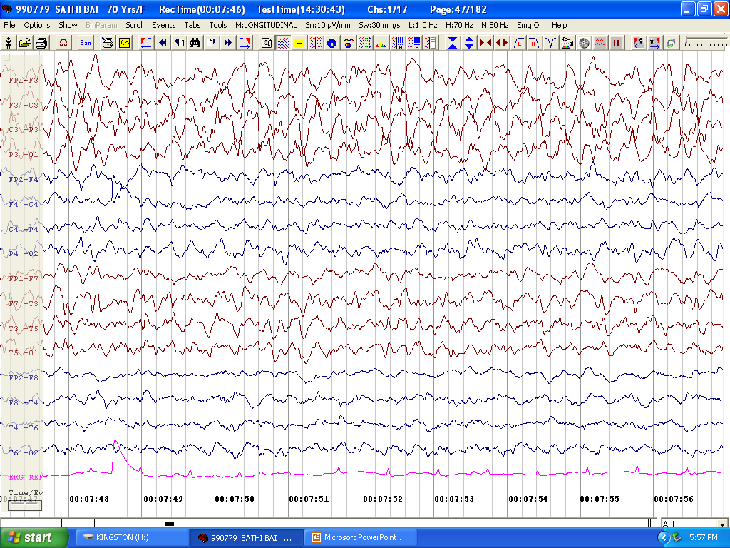
Class V PLEDs
IV LZP 2mg
LFF1 Hz./ HFF 70 Hz / 10 µV
Notes:
Patient was given LZP at this stge after which the Class V pled subsided

Slide 52
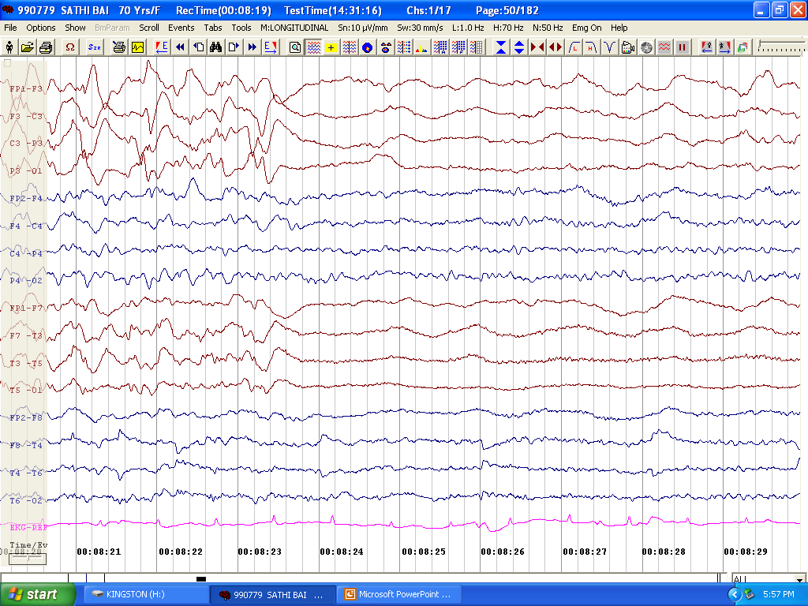
LFF1 Hz./ HFF 70 Hz / 10 µV

Slide 53
PLEDs Plus: the cycle
PLEDs Proper
PLEDs PLUS
Class V PLEDs
Electrographic seizure
Clinical seizure
To intervene
HSV, acute stroke
To intervene

Slide 54
Does presence of PLEDs indicate a ‘twilight’ zone?
Controversy exists whether PLEDs are an ictal or interictal pattern.
Sz occur in ~80%- focal Sz most common
Case reports of PLEDS which are time-locked to focal clonic jerks
Case reports of elderly with PLEDS with confusional state which resolved on rx with BZD
PET/ SPECT studies → Hypermetabolism

Slide 55
Ictal rhythm v/s Interictal
‘Unstable state in an irritable brain lying along an ictal-interictal continuum’
Whether needs to be treated?
How aggressive rx?
Case-to-case basis
Higher frequency, Evolution

Slide 56
PLEDs Mimics
EKG artifact:
ECG channel, ECG artifact usually b/l
ECG artifact max in Temporal
PLEDs usually not as regular
Others: Ext device artefact, Electrode artefact

Slide 57
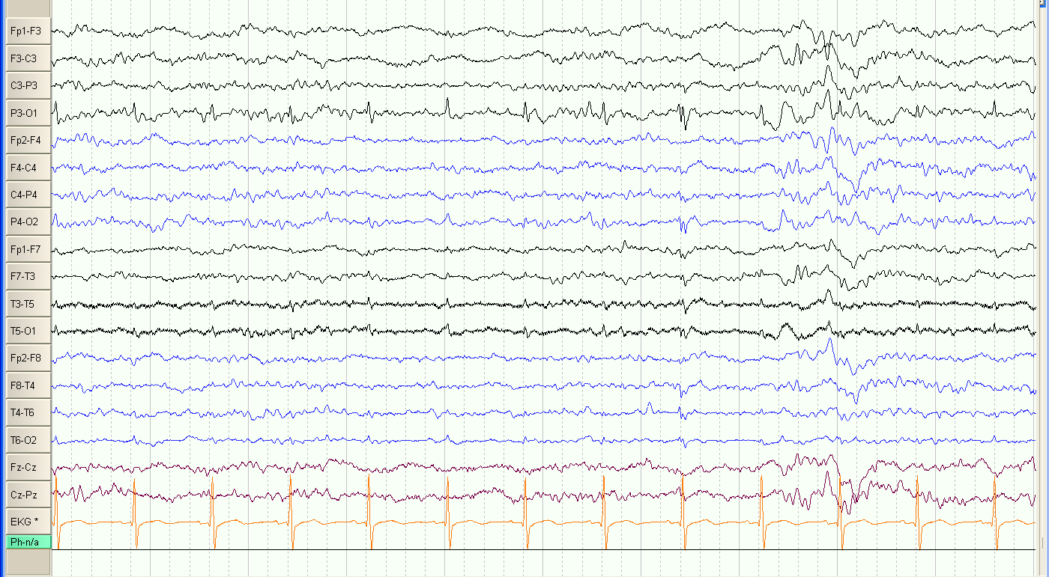
50/M, c/o Sz Vs Syncope
LF1Hz/HF70Hz/5μV
Notes:
Bipolar montage, patient asleep( spindles, vertex seen). EKG artefact mimicking periodic discharges in p3-o1. some of them have spike wave morphology. On closer look all leads have the artefacts

Slide 58
ILLUSTRATIVE EXAMPLES

Slide 59
PLEDs in HSE
Usually in 1st week
Rare after 2nd week
Seen in ~80% of adults at some point during illness
Centered over temporal
Recurrence interval usually 1.5 – 2.5 s- more periodic
No correlation with mortality/ prognosis
Whitley RJ et al, JAMA, 1982

Slide 60
CASE # 7
9/ M
Fever & seizures- May 2011
Altered sensorium- 1 week later
CSF- 35 lymphocytes, P- 75, S- 71/96, HSV PCR neg
MRI Brain- bilateral mesial temporal HI

Slide 61
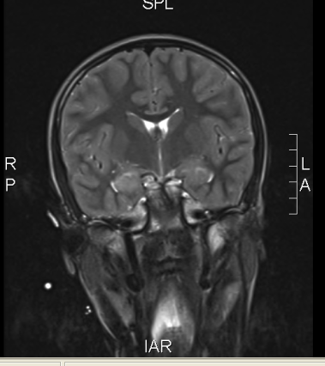
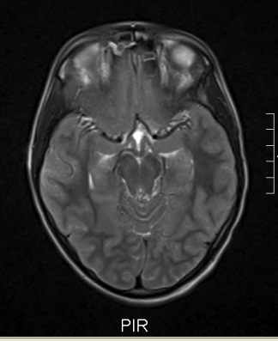
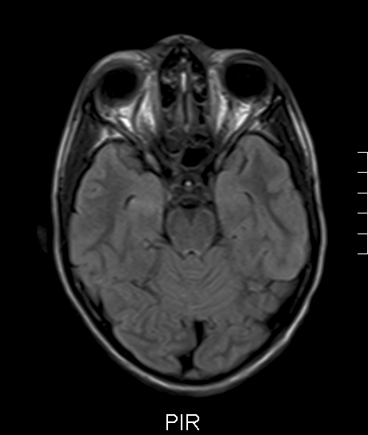
T2 W
FLAIR

Slide 62
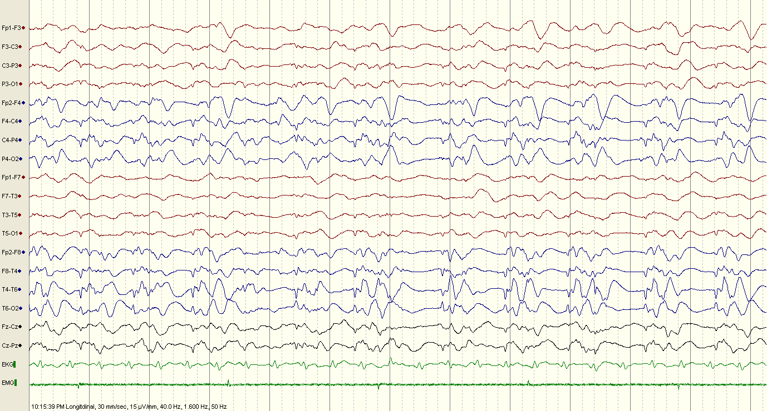
EEG on day 1 of admission
LF1.6Hz/HF50Hz/15μV
Notes:
Bipolar montage, overall attenuated BGA, on right side periodic bimorphic discharges, smaller amp reversing at T6, larger amp at rt F-P IPSIPLEDS

Slide 63
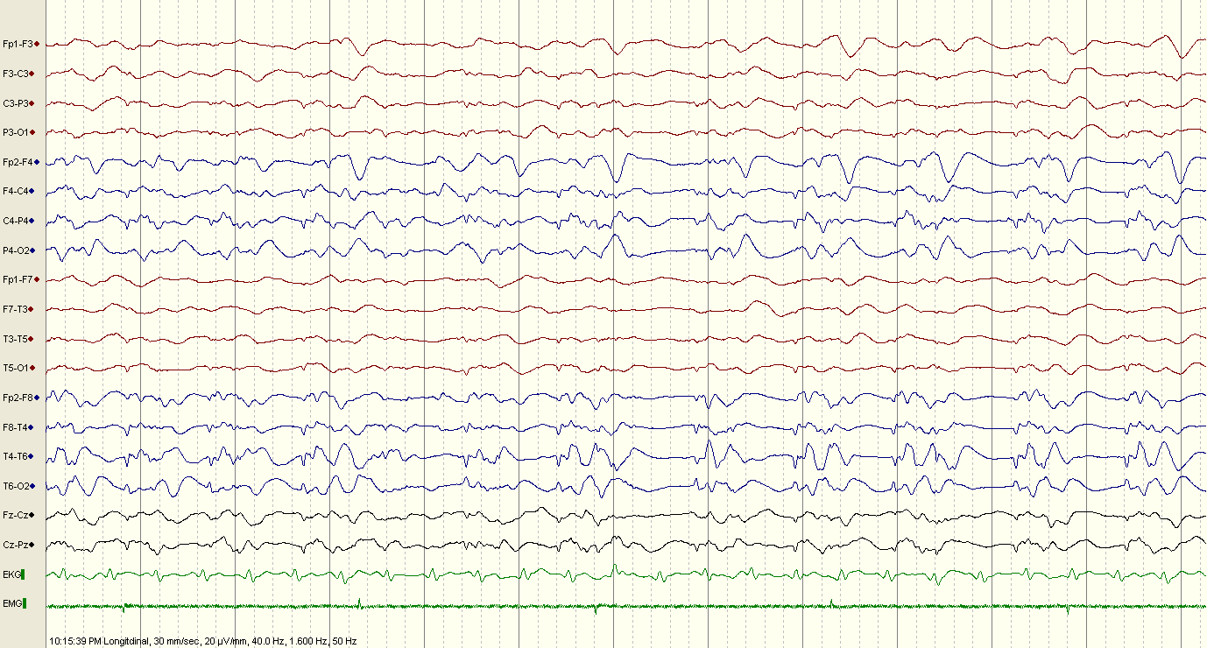
LF1.6Hz/HF50Hz/20μV
Notes:
Same epoch at sens of 20, better appreciated

Slide 64
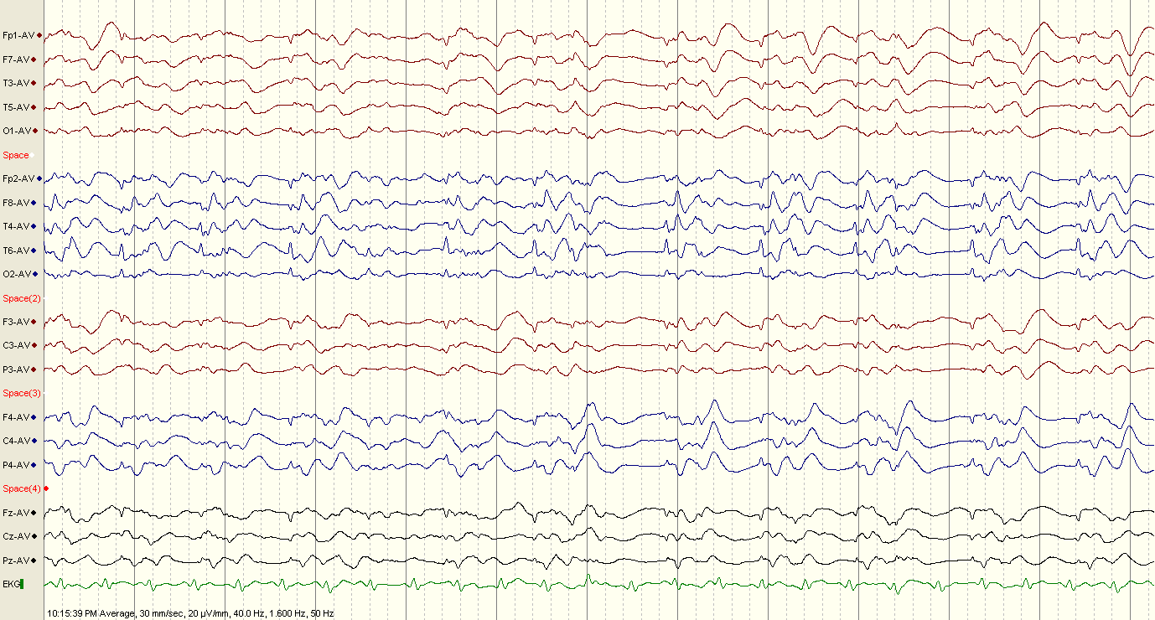
Avg montage
LF1.6Hz/HF50Hz/20μV
Notes:
Few RDs present

Slide 65
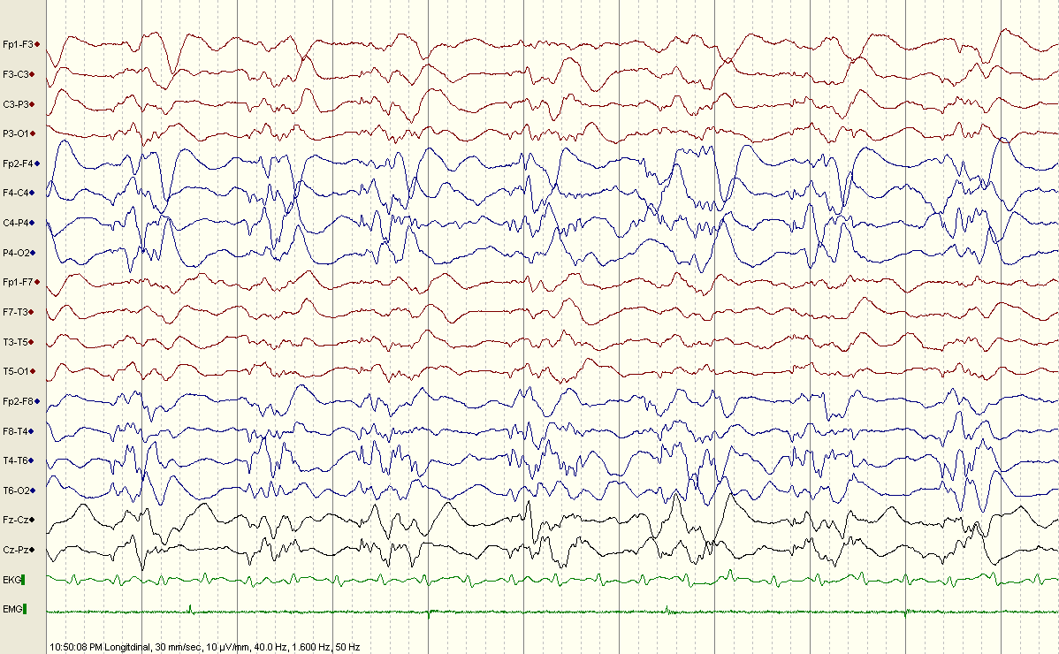
Pleds plus- RDs present
LF1.6Hz/HF50Hz/10μV
Notes:
Increased appearance of RDs

Slide 66
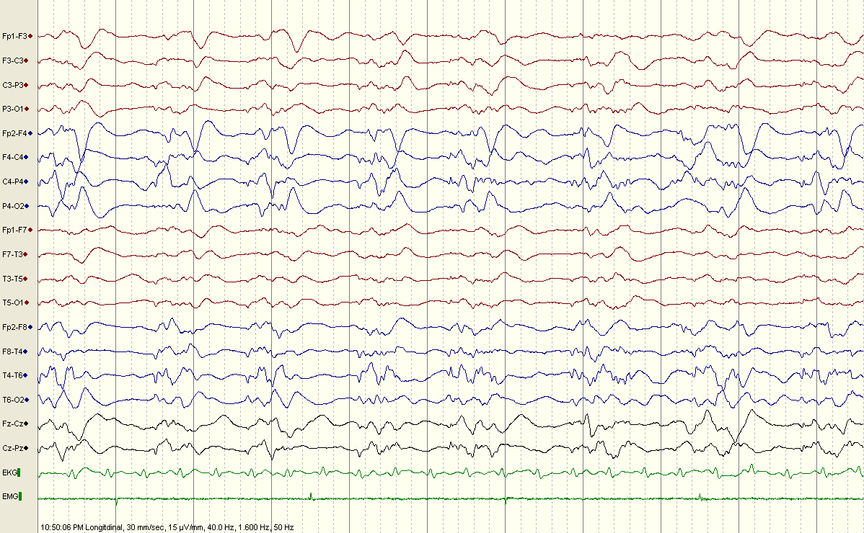
LF1.6Hz/HF50Hz/15μV

Slide 67
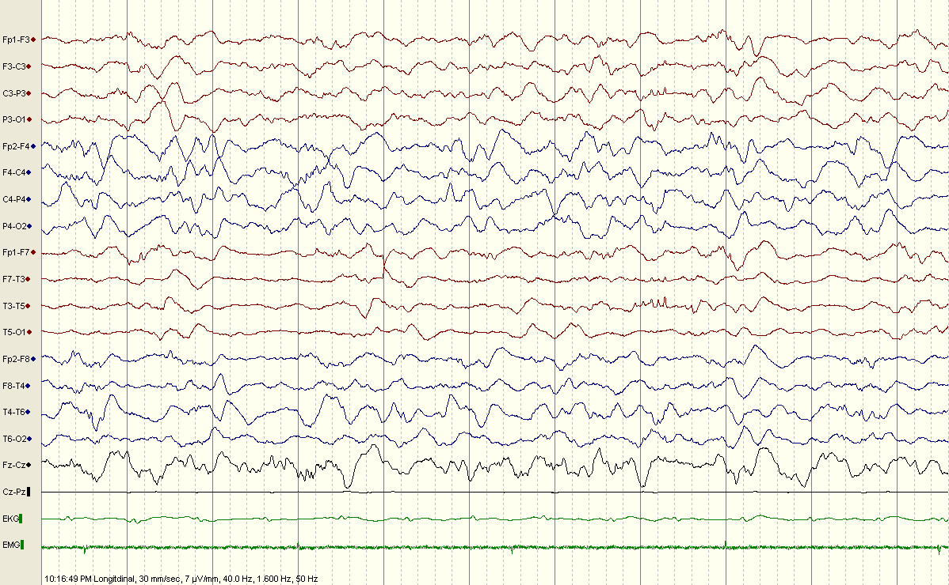
Day3:Evolving in PDA
LF1.6Hz/HF50Hz/7μV

Slide 68
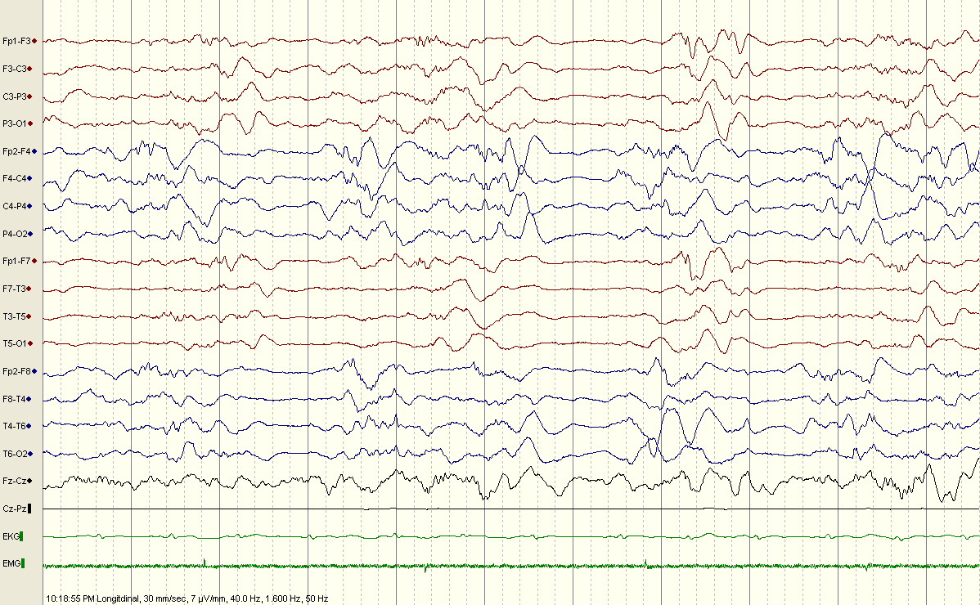
Evolving to a burst supp patern
LF1.6Hz/HF50Hz/7μV

Slide 69
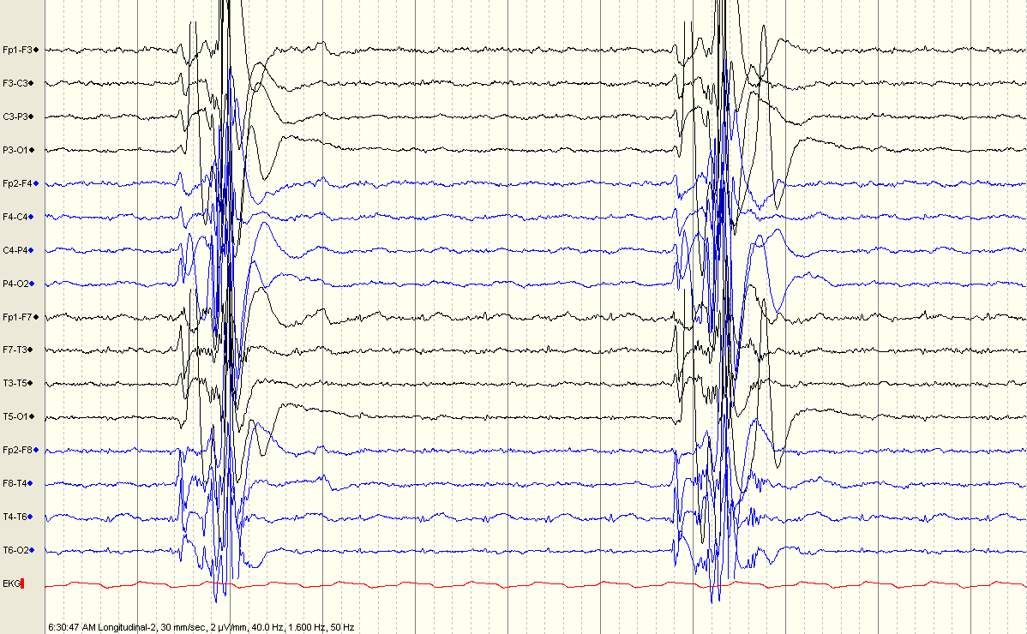
Day 7: burst suppression pattern,
LF1.6Hz/HF50Hz/2μV

Slide 70
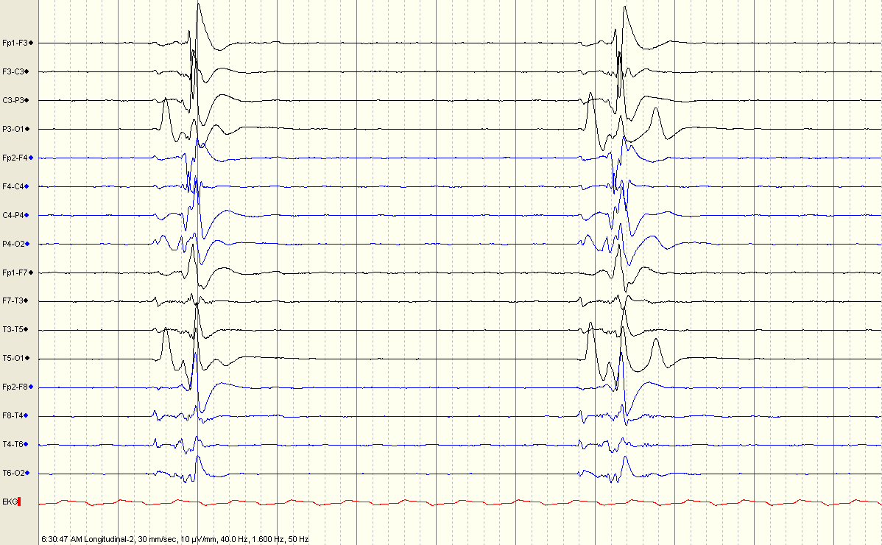
10 uV, 10 sec/page
LF1.6Hz/HF50Hz/2μV

Slide 71
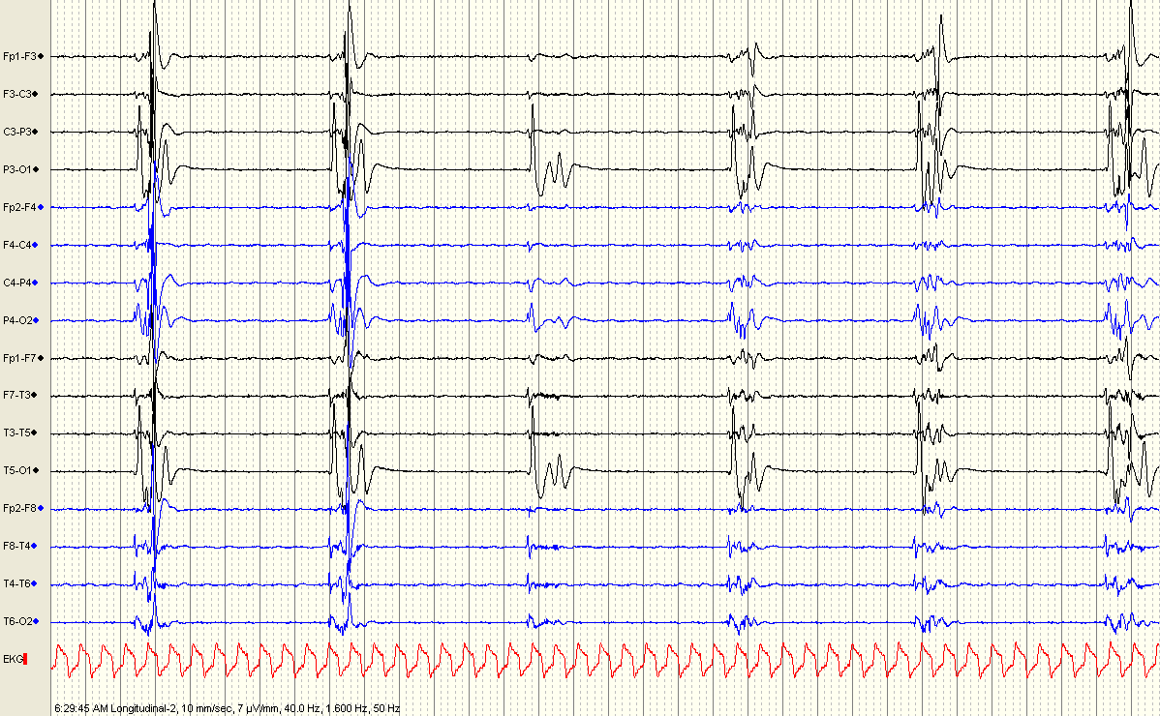
30 sec per page
LF1.6Hz/HF50Hz/7μV

Slide 72
PLEDs in CJD
Usually in early stage (within 12 weeks of onset)
Recurrence interval 0.5 – 2 s
Usually only in wakefulness
Evolve into BiPEDs or GPEDs ( PSWC in CJD)
Cambiera et al. Clin neurophysiology 2003;114(9):1724-28.

Slide 73
CASE # 8
55/F
4 weeks history of apathy foll by progressive aphasia
2 weeks history of myoclonus
MRI Brain showed…

Slide 74
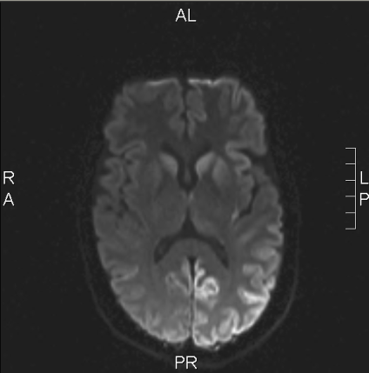
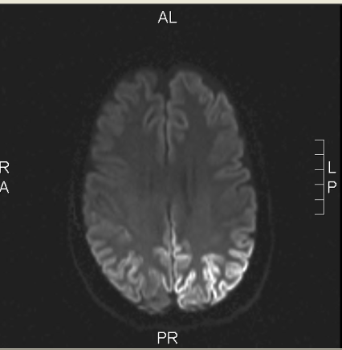
DWI Images

Slide 75
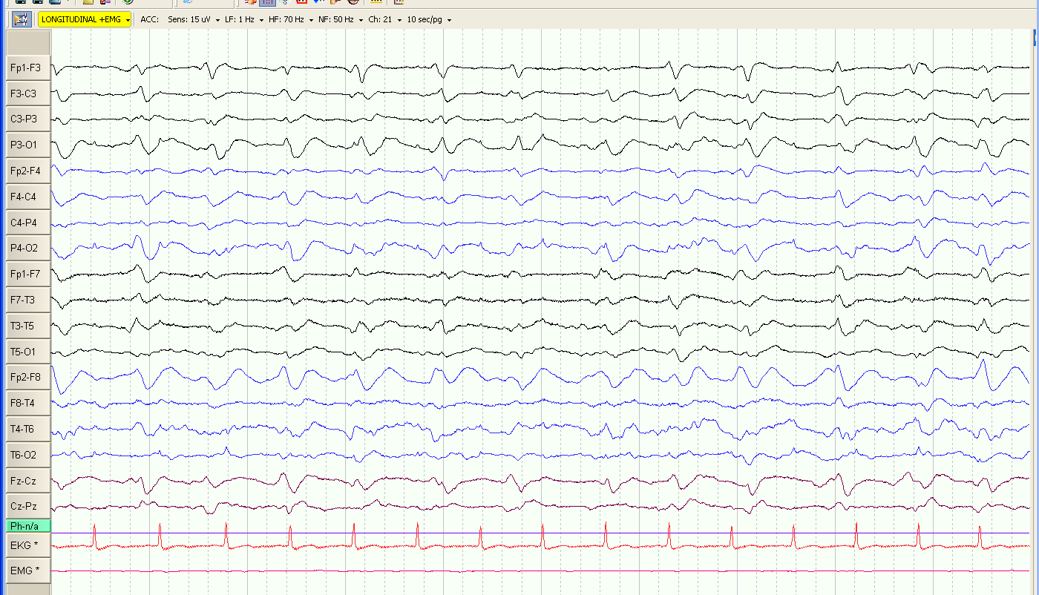
EEG on D2 of admission
LFF1Hz/HFF70Hz/15μV
Notes:
Rec in bipolar montage , sens of 15uV, Delta II gen; Lt hemis 1.5 Hz per sec broad sharp wave discharges with reversal at F3. some suggestion of GPED but discharges still better expressed on left

Slide 76
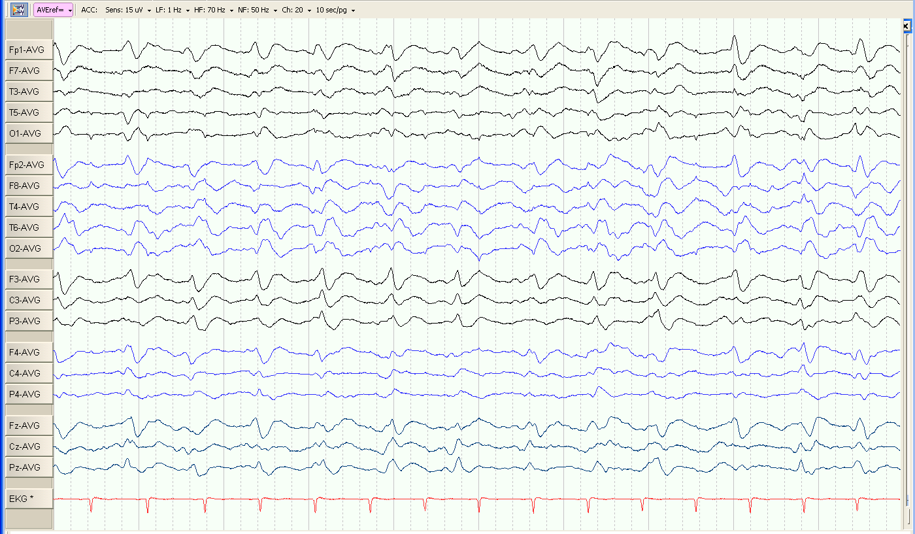
IN Avg montage
LFF1Hz/HFF70Hz/15μV

Slide 77
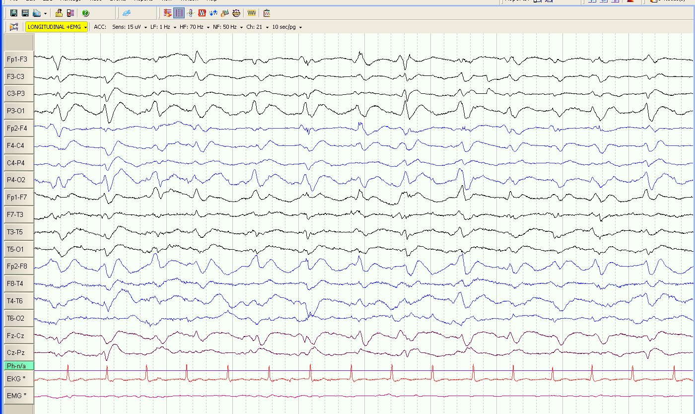
On day 4 of admission
LFF1Hz/HFF70Hz/15μV

Slide 78
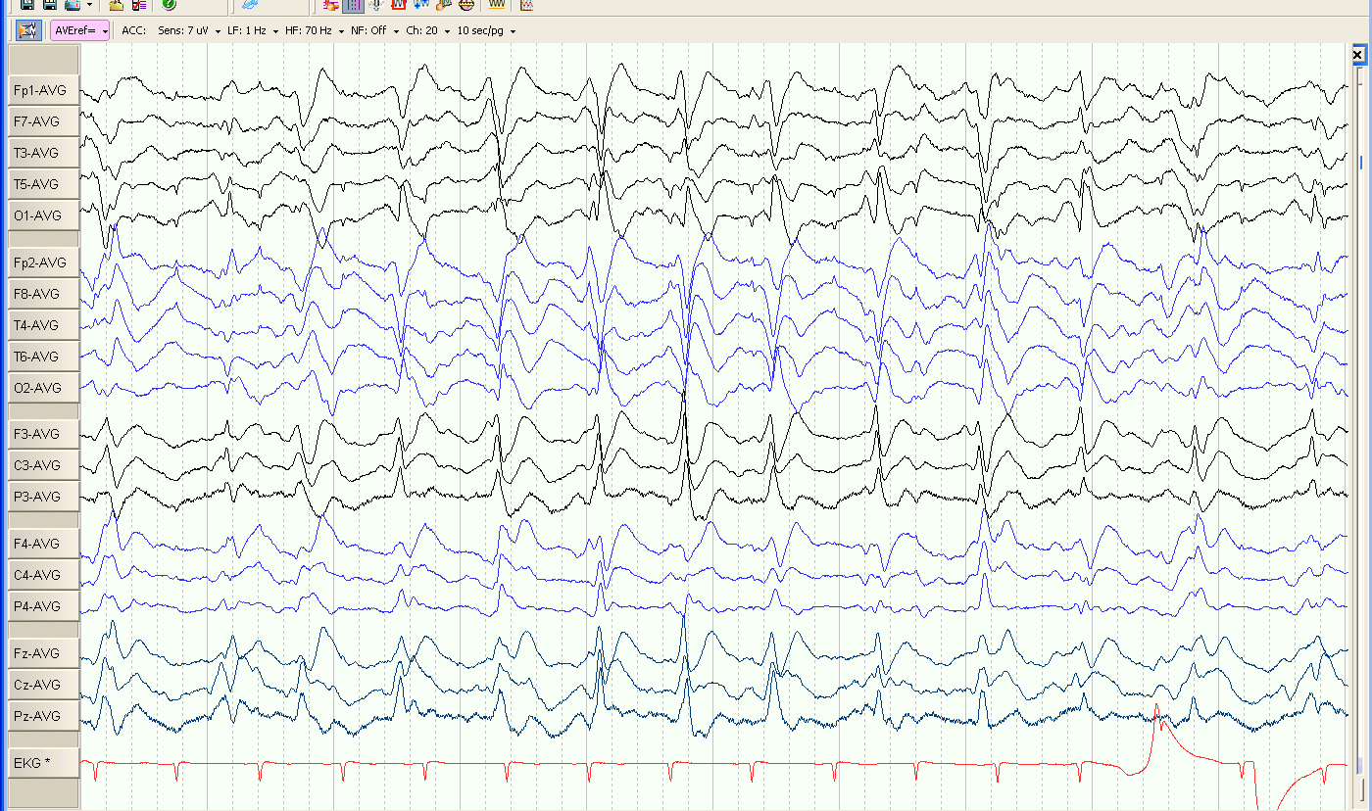
Day 7: PSWCs
LFF1Hz/HFF70Hz/7μV
Notes:
Evolution in periodic sharp wave complexes

Slide 79

Avg montage
LFF1Hz/HFF70Hz/10μV

Slide 80

Case # 9
16/M
c/o Lt transverse sinus region DAVF
Underwent multiple embolisations
Intractable seizures
EEG done in NMICU showed..

Slide 81

EEG in November
LF1.6Hz/HF50Hz/7μV
Notes:
Bipolar montage, BGA better on Rt, left slow,1-2 Hz periodic discharges of S & W morphology with reversal at F3

Slide 82

LF1.6Hz/HF50Hz/7μV
Notes:
In Avg montage F3 dischrges seen

Slide 83

LF1.6Hz/HF50Hz/7μV
Notes:
During sleep, freq of pleds decreased

Slide 84

EEG in December
LF1.6Hz/HF50Hz/10μV
Notes:
SEEG in dec shows PLEDs from diff site- left PHR region, no phase reversal due to end of chain effect

Slide 85

LF1.6Hz/HF50Hz/15μV

Slide 86
Variants

Slide 87
Chronic PLEDs
Classified separately as these PLEDs persist in serial recordings for several weeks to months /years.
Found in patients with chronic cerebral lesions or long standing epilepsy.
Described with old stroke, tuberous sclerosis, chronic abscess, porencephalic cyst.
Requires serial EEGs to document PLEDs.
(Tellez-Zenteno JF, Pillai SN, Hill MD, Pillay N. Chronic PLEDs in remote stroke.
Epileptic Disord. 2007)

Slide 88
Chronic PLEDs
No definite differentiating characters vs. acute PLEDs.
Background in between discharges usually normal.
Chronic PLEDs are stereotyped in serial records.
Tend to persist throughout the record
Different from recurrent PLEDs

Slide 89
Case # 10
10/M
Infantile (L) hemiparesis
Recurrent seizures since 2year of age
Mild learning disability

Slide 90

1 Hz./ 70 Hz / 10 µV
Notes:
BG- 9.5 Hz posteriorly dominant better expressed over left side.
Periodic spikes over right hemisphere frontally dominant phase reversal across F4 Freq 1 Hz.

Slide 91

1 Hz./ 70 Hz / 10 µV

Slide 92
Bilateral & Independent PLEDs (BIPLEDs)
Independently & Asynchronously over the 2 hemispheres
Differ in Morphology, Amplitude, Repetition, Rate and site of maximum involvement
Far less common than PLEDs
First described in HSE

Slide 93
PLEDs vs BiPLEDs
PLEDS
  Stroke – most common
  Focal seizures ↑↑
  FND ↑↑
  Coma ↑
  Mortality - ↓
  Focal imaging abnormalities frequent ↑↑
BiPLEDs
  Anoxia,
  CNS inf-HSE)
  Generalized seizures
  FND - less
  Coma ↑↑↑
  Mortality ↑, Poor prognosis
  Imaging B/L lesions
Most
Common
Daniel de la paz et al - Arch Neurol 1981

Slide 94
EEG # 11
47 year old lady
4 day h/o fever with sz followed by altered sensorium
EEG done on D5 of illness

Slide 95

LF1.6Hz/HF50Hz/5μV
Notes:
bilateral independent periodic discharges seen at F7 , F8

Slide 96

LF1.6Hz/HF50Hz/5μV
Notes:
Which continue in the record

Slide 97
Ipsilateral Independent PLEDs
Rare subtype , First described in 1996
Ipsilateral but independent in temporal & topographical relationship
Associated with
  Acute cerebral lesions
  Altered consciousness & seizures
  Resolution with time
Silbert P , Kurupath Radhakrishnan , Sharbrough , Klass. EEG and Clinical neurophysiology. 1996;98:223-226

Slide 98

Independent Rt central and Rt Post temporal PLEDs

Slide 99
Cerebral Bigeminy
2 separate foci are present in the same area of an hemisphere
Alternating morphology of these 2 ipsilateral PLEDs
Madison & Niedermeyer. JNNP 1970;33:381-86

Slide 100



Slide 101
Multifocal PLEDs
3 or more independent foci of PLEDs located over both hemispheres.
3 foci are also called TriPLEDs.
Detection may be facilitated by use of Laplacian montages & increasing paper speed
Reflect severe brain dysfunction and a/w significant mortality rate.
Lawn, Westmoreland & Sharbrough. Clin Neurophysiology 2000;111(12): 2125-2129

Slide 102


Slide 103
Case # 12
6-year-old boy
History of birth asphyxia
Back ground history of focal seizure
Fever for 4 days
Altered sensorium for 2 days

Slide 104

LFF1 Hz./ HFF 70 Hz / 30 µV
Notes:
Back ground activity 4-5 hz same on both sides. Sleep spindles are seen frontally suggestive stage II sleep
Independent sharp activity can be seen over the left hemisphere at freq 0.3hz phase reversing over T5 P3 focus
Over the right hemisphere there is 1.5 hz periodic activity phase reversing over the P4 T4 focus

Slide 105

LFF1 Hz./ HFF 70 Hz / 30 µV
Notes:
In the average montage we can see the maximum amplitude over the left side is over t5, P3
On right it is over T4 & P4

Slide 106
PEDIMs
Periodic epileptiform discharges in the mid line
Described by Frere et al – 1989
Underlying etiology: stroke, seizures
Same characteristics as commonly encountered PLEDs

Slide 107
Cortical Vs. Subcortical PLEDs
“Cortical” PLEDs are differentiated from “subcortical” PLEDs in being significantly:
longer in duration
more variable in morphology
Giridhar P. Kalamangalam et al. Epilepsia 2007;48(7):1396–1405.

Slide 108

Case # 13
1yr 8 m girl child
c/o CPS-ET for evaluation
MRI- left G-C HI on Flair, no mass effect
CSF normal
Sr Lactate normal

Slide 109

LFF1Hz/HFF70Hz/35µV
Notes:
Bipolar montage, BGA relatively normal for age, left hemis 2 Hz per sec disch reversing at F7- left F-T PLEDs

Slide 110

At 20 uV
LFF1Hz/HFF70Hz/20µV

Slide 111

Average montage
LFF1Hz/HFF70Hz/35µV
Notes:
Left F-T PLEDs

Slide 112
THANK YOU

Slide 113
Referrences
Pholmann-Eden et al PLED-critical review J Clin Neurophysiol 1996
Irene Garcia et al PLEDS-Etiology,clinical aspects,seizures & evolution in 130 patients Journal of clinical neurophys. 2002
Stern and Engel Atlas Of EEG Patterns 1st ed 2005 LWW
Gross DW, Wiebe S, Blume WT. The periodicity of lateralized epileptiform discharges. Clin Neurophysiol. 1999.
Reiher J, Rivest J, Grand’Maison F, Leduc CP. Periodic lateralized epileptiform discharges with transitional rhythmic discharges: association with seizures. Electroencephalogr Clin Neurophysiol. 1991.

Slide 114


Slide 115
Background & Study aim
Significance of PEDs (apart from them being abnormal) on EEGs is not completely known.
Objective: To investigate long term outcome in patients with PEDs ( including PLEDs, BIPLEDs & GPEDs) particularly in relation to intrinsic characteristics, clinical situation & imaging findings.

Slide 116
Materials & Methods
PEDs classified into PLEDs, BIPLEDs & GPEDs as per laid down definitions. (PLEDs plus not sought for)
GPED- defined as the occurrence of periodic complexes occupying at least 50% of a std 30-min EEG over both hemispheres in a symmetric, diffuse, and synchronized manner; also c/as BiPEDs
BIPLEDs- defined as bilateral independent PLEDs
Various morphological parameters were calculated and analysed.

Slide 117
Materials & Methods
CT/MRI findings noted; cortical &/or subcortical abnormalities identified.
Acuteness of patient’s disease classified as acute (< 4 weeks), subacute (4-8 weeks), chronic ( >8 weeks) or acute on chronic.
Patient’s functional outcome on follow up for 1 yr post eeg was put in 3 categories: independent, partially dependent & death
Odds ratio & related CI were calculated.

Slide 118
Results
162/25000 EEGs from yr 2000 to 2007 had PEDs amounting to a prevalence of 0.6 %
122 EEGs were available for morphological analysis.
67 % EEGs had PLEDs (82/122),
19 % had BIPLEDs(23/122),
14 % had GPEDs (17/22)
Prevalence of chronic PLEDs was not determined in this study

Slide 119

Clinical findings
Median age in all the 3 groups was in the 60s.
50 % of cases having PLEDs had chronic etiology.
~ 70 % of those with BIPLED, GPED had acute/sub-acute presentation

Slide 120

Clinical findings
Stroke m.c cause in PLED & BIPLED; both stroke and metabolic causes in GPED
Seizures in GPED group were due to underlying metabolic cause.

Slide 121


Clinical findings
Highest mortality was in BIPLED group.
Mortality lower in PLED gr.
50% of those with PLED & GPED were left disabled.

Slide 122

Neuroimaging findings
Most patients had coexistent cortical/subcortical abnormalities.
94 % of PLED gr, 98% of BIPLED, & 100% of GPED gr had abnormal imaging.
In PLED gr, of the 5 with normal imaging, 4 had only CT scan done.

Slide 123
Discussion
Clinically relevant findings in the study:
In patients with PLEDs, occurrence of seizures was less likely to be assoc with death as an outcome. ( Odds ratio 0.21; 95 % CI 0.04-0.97)
Chronic etiology of PLEDs less assoc with death as compared with acute etiology (OR 0.14; CI 0.03 - 0.72)
PLEDs having a vascular etiology had a more dependent functional outcome in comparison to a neoplastic etiology

Slide 124
Discussion
The age and sex distribution of patients in this study was consistent with previous descriptions.
Patients with BIPLEDs and GPEDs had a higher mortality range than the PLEDs group.
Cerebrovascular disease was m.c common cause in PLEDs group.

Slide 125
Discussion
This study showed that in PLEDs group, a non neoplastic etiology was assoc with better long term outcome.
Apart from the obvious reasons the authors propose that PLEDs in cases of tumor may have an independent risk role in relation to mortality.

Slide 126
Discussion
Incidence of seizures was seen more in PLEDs gr ( 57 of 82, 70%) compared to BIPLED (43%) or GPED (29%) groups.
Probably due a more severe and global cerebral injury in those without seizures.
Coma was more common in BIPLED/GPED gr , PLEDs gr had more focal deficits.
Location of imaging abn was not related to death or functionall outcome.

Slide 127
Conclusion
The study results are in agreement of the previously reported opinions regarding-
- higher mortality assoc with PEDs
- Stroke as the commonest cause of PLEDs
- Diffuse cerebral dysfunction in those with BIPLED
& GPEDs.
- Higher mortality in GPED/BIPLED gr.
However presence/ proportion of burst suppression pattern in the GPED gr does not find a mention in the study

Slide 128
THANK YOU!

Slide 130

vp

Slide 131

Baruah long sens 10 uV

Slide 132


Slide 133


Slide 134


Slide 135

Few on Rt but not enough for pleds

Slide 136

Mr Baruah

Slide 137


Slide 138
Case # 13
22/F
k/c/o CPS-ET
Admitted in Status epilepticus
CT Brain- normal, MRI not done
SEEG recorded in NMICU

Slide 139

LFF1.6Hz/HFF50Hz/7µV
Notes:
Bipolar montage, BGA diffuse slow, bilateral midline equal amplitude pseudoperiodic discharges
In avg montage..

Slide 140

LFF1.6Hz/HFF50Hz/7µV
Notes:
On Avg montage midline and b/l F-P discharges are evident

