Slide 1
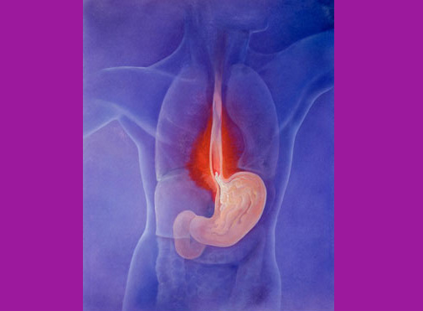
Gastro Esophageal Reflux Disease G.E.R.D./GORD

Slide 2
Today’s Talk
Definition of GERD
Pathophysiology of GERD
Clinical Manifestations
Diagnostic Evaluation
Treatment
Complications

Slide 3
Definition of GERD
“a condition which develops when the pathological reflux of stomach contents in to the esophagus causes troublesome symptoms and/or complications”
Troublesome— when reflux interferes with lifestyle of patient

Slide 4
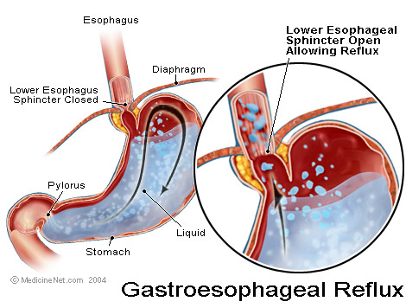
Definition
American College of Gastroenterology (ACG)
  Symptoms OR mucosal damage produced by the abnormal reflux of gastric contents into the esophagus
  Often chronic and relapsing
  May see complications of GERD in patients who lack typical symptoms

Slide 5
Physiologic v/s Pathologic reflux
Physiologic GERD
  Postprandial
  Short lived
  Asymptomatic
  No nocturnal symptoms
  During vomiting
  Belching gas
Pathologic GERD
  Symptoms
  Mucosal injury
  Nocturnal symptoms
Notes:
--distinction between normal and GERD is blurred because some degree of reflux is physiologic is all folks
Physiologic—postprandially, short lived, asymptomatic, not during sleep
Pathologic—symptoms or mucosal injury and often with nocturnal symptoms

Slide 6
GERD is increasing while ulcer disease reduced in recent time.

Slide 7
Pathophysiology
Primary barrier to gastro esophageal reflux is the lower esophageal sphincter
LES normally works in conjunction with the diaphragm
If barrier is disrupted, acid goes from stomach to esophagus
Notes:
--At level of diaphragmatic hiatus—main deterrant to reflux
--disruption due to –review slide--multifactorial

Slide 8
Aetiology of GERD
Variation in anatomy and physiological factors produce G.E.R.D.
ANATOMICAL FACTORS
Obesity
Length of intra abdominal oesophagus:
more length …..less reflux
less length …more reflux

Slide 9
Changes in phreno-oesophageal ligament
Alterered angle of HIS
Altered pinching action of rt. Crus of diaphragm
Change in volume of mucosal rossette at G.E. junction
Altered sling mechanism of gastric musculature

Slide 10
Delayed gastric emptying due to D.M…..gastroparesis……medications…..
Increased gastric acid secretion..
Gastric distension.
Associated sliding or rolling hiatus hernia

Slide 11
PHYSIOLOGICAL FACTORS
Reduced LES pressure resting 10-15mm Hg and on swallowing 1-3 mm Hg

Slide 12
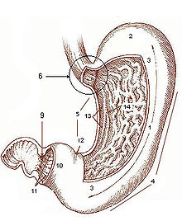
ANGLE OF HIS ….cardio esophageal notch

Slide 13
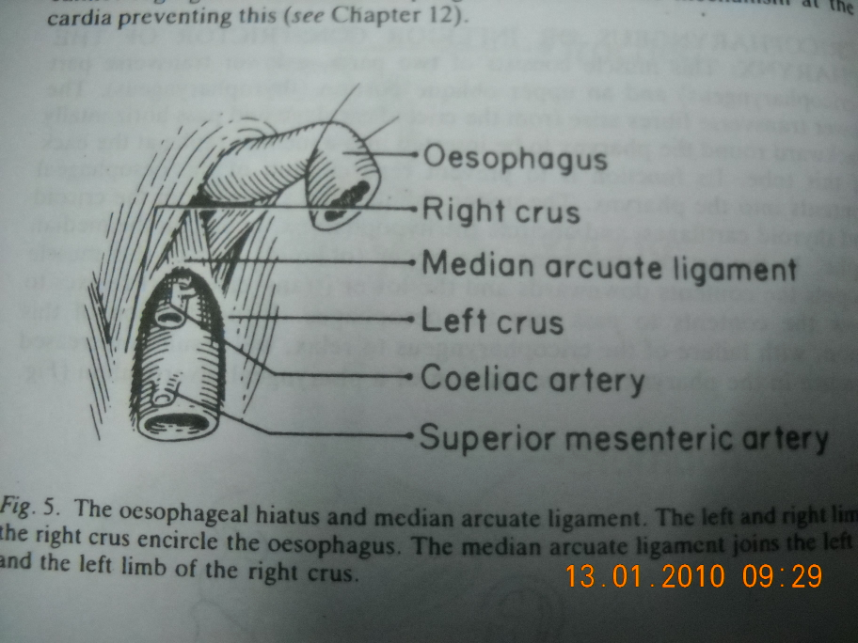
LOWER OESOPHAGUS
The oesophageal opening in the diaphragm lies within fibres of the left crus of diaphragm
Median arcuate ligament is main site for anchoring in HILL anti reflux operation

Slide 14
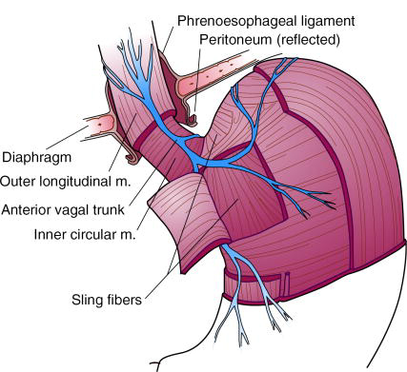
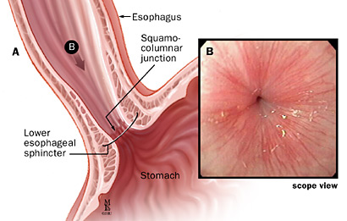
Lower Esophageal Sphincter
  Intrinsic distal esophageal muscles – tonically contracted
  Muscular Sling fibers of the gastric cardia
  Diaphragmatic crura – pinch action
  Transmitted pressure of the abdominal cavity

Slide 15
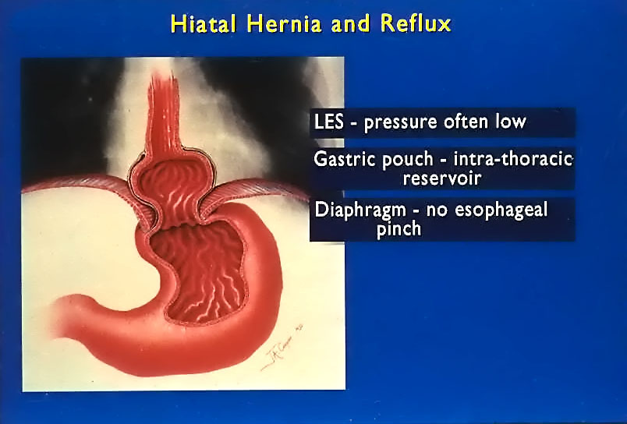

Slide 16
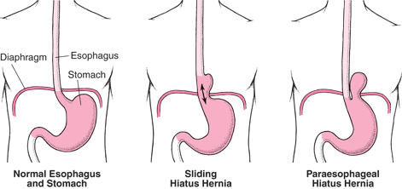

Slide 17
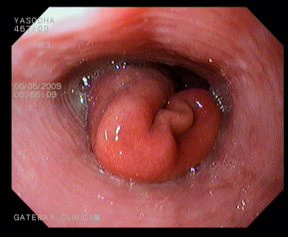
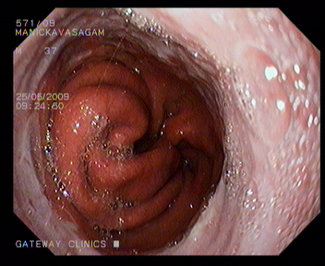
Hiatus Hernia on endoscopy

Slide 18
Clinical features
Classical triad is
1 : heart burn- retro sternal burning sensation
2 : epigastric pain
3 : regurgitation
Pain increase after food…spicy and fatty
Or with exercise ….Or with stooping…alcohol…smoking

Slide 19
Symptoms of GERD
Esophageal
  Heartburn
  Dysphagia-difficulty
  Odynophagia-pain
  Regurgitation
  Belching
Extra esophageal
  Cough
  Wheezing
  Hoarseness
  Sore throat
  Globus-spherical sensation
  Epigastric pain
  Non-cardiac chest pain(NCCP)

Slide 20
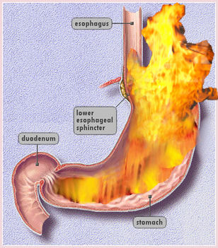

Slide 21
Symptoms
Symptom | Predominance (%)
Heartburn | 80
Regurgitation | 54
Abdominal Pain | 29
Cough | 27
Dysphagia for solids | 23
Hoarseness | 21
Belching | 15
Aspiration | 14
Wheezing | 7
Globus-spherical | 4
Notes:
The most common presentation of patients with GERD includes a long-standing history of heartburn and a shorter history of regurgitation.

Slide 22
Factors That Can Aggravate GERD
Diet – Caffeine, fatty/spicy foods, chocolate, coffee, peppermint, citrus, alcohol
Position/Activity – Bending, straining
External Pressure – pregnancy, tight clothing

Slide 23
Diagnostic Evaluation
  If classic symptoms of heartburn and regurgitation exist in the absence of “alarm symptoms” the diagnosis of GERD can be made clinically and treatment can be initiated emperically
Notes:
--heartburn +/- regurgitation high specificity, low sensitivity

Slide 24
  Alarming Signs & Symptoms
    Dysphagia- difficulty in swallowing, not pain usually due to stricture
    Early satiety
    GI bleeding-haemetemesis
    Odynophagia—pain on swallowing
    Vomiting
    Weight loss
    Iron deficiency anemia
Notes:
--need further eval if any present—egd--

Slide 25
Diagnostic Tests for GERD
Barium swallow/ barium meal
Endoscopy and mucosal biopsy
Ambulatory pH monitoring
Impedance-pH monitoring
Esophageal manometry

Slide 26
Types of Hiatal Hernia
1. Sliding hiatal hernia:
Herniation of both the stomach and the gastroesophageal(GE) junction into the thorax.
90% of esophageal hernias
2. Paraesophageal hiatal hernia:
Herniation of all or part of the stomach through the esophageal hiatus into the thorax with an undisplaced GE junction
Least common esophageal hernia (<10%)
3 mixed : sliding and rolling hernia

Slide 27
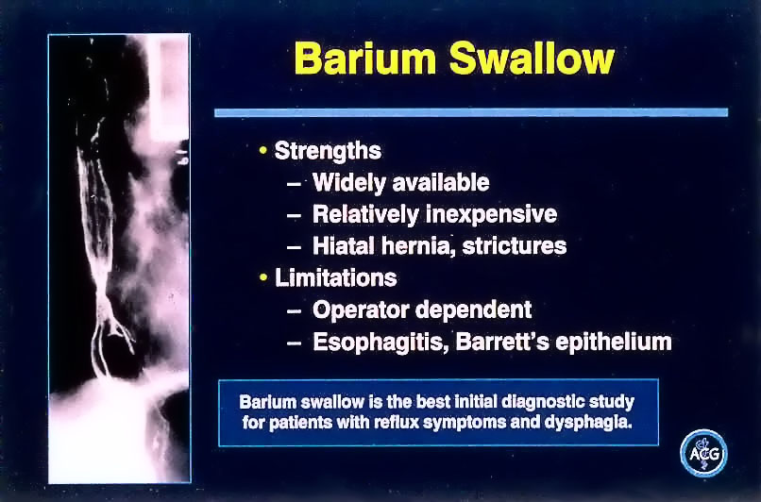
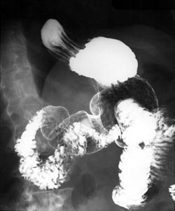
Barium Swallow
Useful first diagnostic test for patients with dysphagia
  Stricture (location, length)
  Mass (location, length)
  Hiatal hernia (size, type)
Limitations
  Detailed mucosal exam for erosive esophagitis, Barrett’s esophagus can’t see

Slide 29
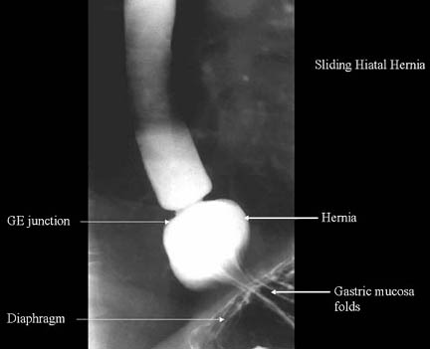
Barium swallow demonstrates hiatal hernia:

Slide 30
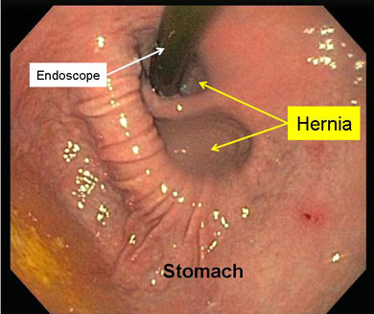
Endoscopic view:

Slide 31
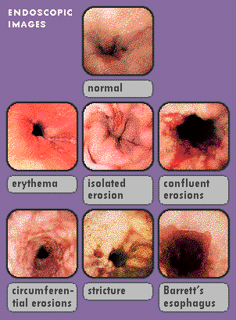
Endoscopy
Indications
  Alarming symptoms
  Empirical therapy failure
  Preoperative evaluation
  Detection of Barrett’s esophagus

Slide 32
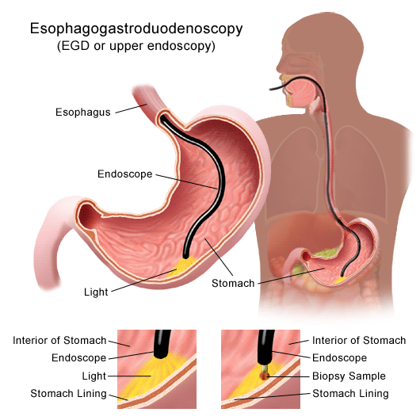
Esophagogastroduodenoscopy
Endoscopy (with biopsy if needed)
  In patients with alarm signs/symptoms
  Those who fail a medication trial
  Those who require long-term tx
Absence of endoscopic features does not exclude a GERD diagnosis
Allows for detection, stratification, and management of esophageal manifestations or complications of GERD
Notes:
--if trial of med did not work or if alarm symptoms or long term 5yrs need egd 1a evidence—dysphagia/early satiety/gi bleed/odynophagia/vomiting/wt loss/anemia
--50-70% of patient’s with gerd will have a neg egd.

Slide 33
pH
24-hour pH monitoring-----Physiologic study
Mandatory to stop PPI at least 7 days before PH monitoring
  Accepted standard for establishing or excluding presence of GERD for those patients who do not have mucosal changes
  Trans-nasal catheter or a wireless capsule shaped device
Notes:
--Transnasal catheter or a wireless capsule shaped device affixed to distal esophagus
--cather positioned 5cm above manometrically defined upper limit of les
--capsul attached 6cm proximal to endoscopically defined squamocolumnar jxn
--if mucosal changes—have dx and do not need 24hph.

Slide 34
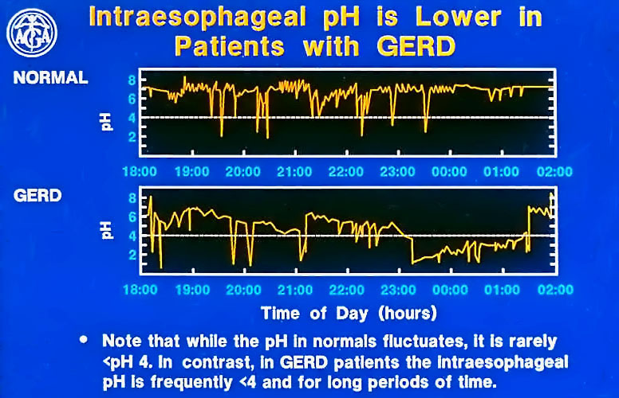
Ambulatory 24 hr. pH Monitoring
Normal
GERD

Slide 35
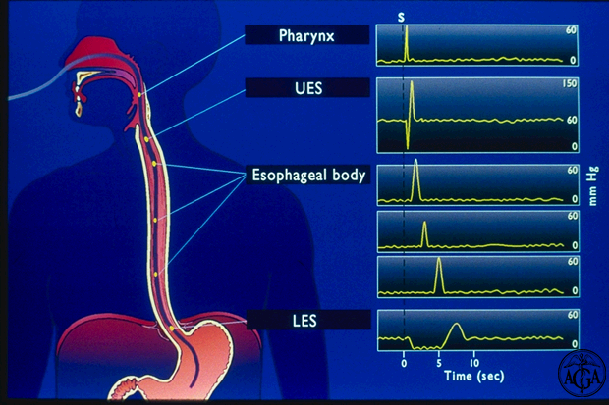
Esophageal Manometry
Limited role in GERD
Assess LES pressure, location and relaxation
  Assist placement of 24 hr. pH catheter
Assess peristalsis
  Prior to antireflux surgery

Slide 36
Complications of GERD
Erosive esophagitis
Stricture
Barrett’s Esophagus-columnar Metaplasia
Adenocarcinoma
Sliding hiatal hernia
Notes:
--dysphagia, odynophagia, early satiety, gi bleed, anemia, vomit, wt loss

Slide 37
D.D.
Achalasia cardia - dilated proximal oesophagus, beak deformity
Carcinoma oesophagus.. irregular narrowing
Peptic ulcer
Gall stone disease
Pancreatitis
Gastritis
Cardiac angina

Slide 38
Treatment
Goals of therapy
  Symptomatic relief
  Heal esophagitis
  Prevent & Treat complications
  Maintain remission

Slide 39
Lifestyle Modifications
Weight reduction if overweight
Avoid clothing that is tight around the waist
Modify diet
  Eat more frequent but smaller meals
  Avoid fatty/fried food, peppermint, chocolate, alcohol, carbonated beverages, coffee and tea, onions, garlic.
  Stop smoking
Elevate head of bed 4-6 inches
Avoid eating within 2-3 hours of bedtime

Slide 40
Treatment
Antacids
    Quick but short-lived relief
    Neutralize acid
  Approx 1/3 of patients with heartburn-related symptoms use at least twice weekly
  More effective than placebo in relieving GERD symptoms
Notes:
--Tums, rolaids, maalox
--$1 billion in yearly expenditures
--aluminum/calcium—constipation
Mag--diarrhea

Slide 41
Treatment
Histamine H2-Receptor Antagonists
  More effective than placebo and antacids for relieving heartburn in patients with GERD
  Faster healing of erosive esophagitis when compared with placebo
  Can use regularly or on-demand

Slide 42
Treatment for minimum 8 weeks
AGENT DOSAGE
Famotidine 20-40mg twice daily
Ranitidine 150mg twice daily
Lafutidine 10mg twice daily
Notes:
--otc dose uniformly half of standard lowest prescription dose
--similar clinical efficacy

Slide 43
Collaborative Care
Drug therapy (cont’d)
  Prokinetic drugs-metaclopramide
    Promote gastric emptying
    Reduce risk of gastric acid reflux
    Simethicone(Defoaming)
    Sucralphate- protection of mucosa by cover
    Etopride – esophageal motility regulator

Slide 44
Treatment
Proton Pump Inhibitors at least 8 weeks or more as pt. refuse to stop
  Better control of symptoms with PPIs than H2RAs and better remission rates
  Faster healing of erosive esophagitis with PPIs v/s H2RAs

Slide 45
Treatment
AGENT EQUIVALENT DOSAGE
DOSAGES
Esomeprazole 40mg daily 20-40mg daily
Omeprazole 20mg daily 20mg daily
Lansoprazole 30mg daily 15-10mg daily
Pantoprazole 40mg daily 40mg daily
Rabeprazole 20mg daily 20mg daily
Notes:
--no significant differences in symptomatic tx of GERD or healing of erosive esophagitis 1a evidence
--works only on active pumps—take 30-60min prior to meals
--long-term tx generally benefits outweigh risks

Slide 46
Effectiveness of Medical Therapies for GERD
Treatment Response
Lifestyle modifications/antacids 20 %
H₂-receptor antagonists 50 %
Single-dose PPI 80 %
Increased-dose PPI up to 100 %

Slide 47
Treatment
Antireflux surgery
  Failed medical management
  Patient preference ( if pt. ask for op.)
  GERD complications
  Medical complications attributable to a large Hiatal hernia
  Atypical symptoms with reflux documented on 24-hour pH monitoring
Notes:
candidacy
--esophagitis—by egd
--need normal manometry/motility
--partial response to acid suppression
--reduce hh, repair diaphragm, strengthen ge jxn—antireflux barrier
--75-90% effective at alleviating hrtburn/regurg
--better at helping with hrtburn/regurg than atypical sx

Slide 48
Treatment
Antireflux surgery candidates
  endoscopic proven esophagitis
  Normal esophageal motility
  Partial or incomplete response to acid suppression

Slide 49
Treatment
Endoscopic surgical treatment
  Relatively new
  - only in cases of small or no hernia but symptoms are there
  Select well-informed patients with well-documented GERD responsive to PPI therapy may benefit
Three categories
  Radiofrequency application to increase LES reflux barrier
  Endoscopic sewing devices of gastric mucosal folds
  Injection of a non resorbable polymer into LES area in the sub mucosa

Slide 50
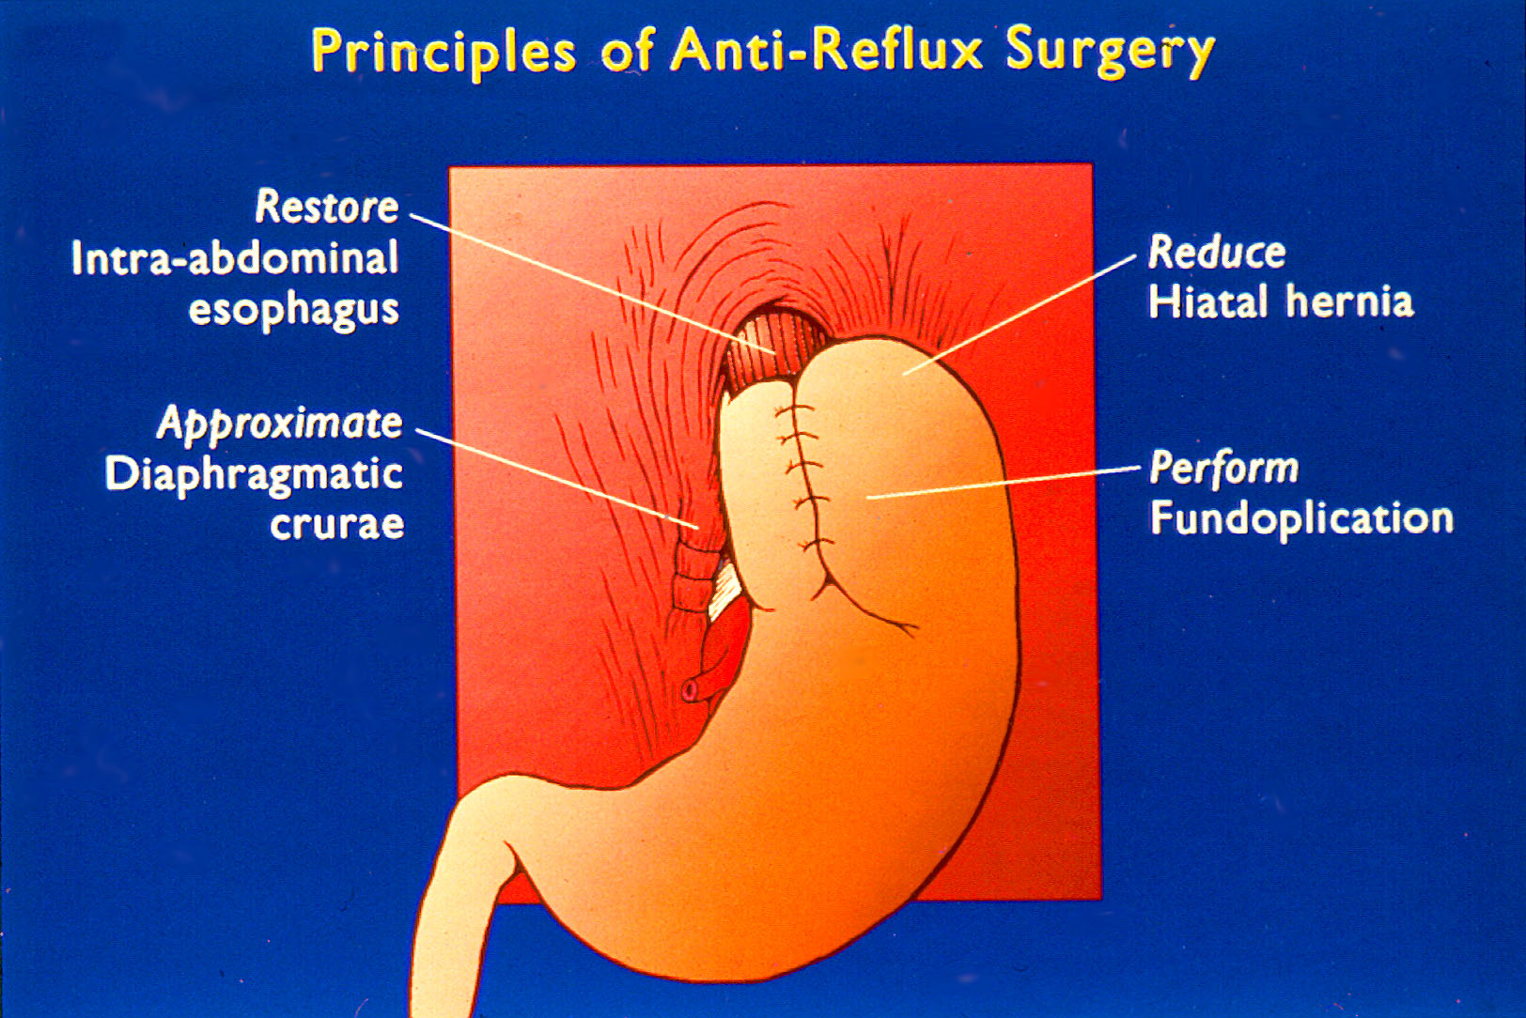

Slide 51
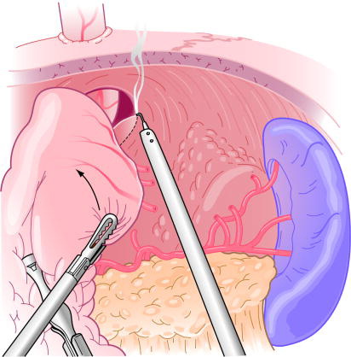
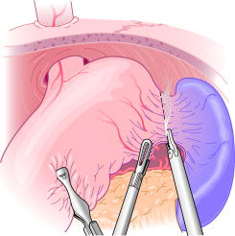
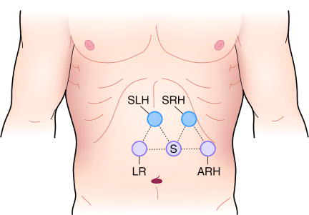
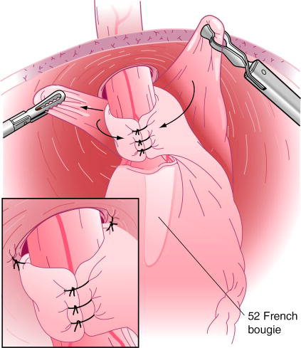
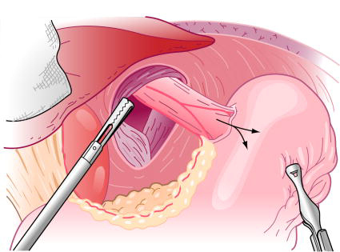
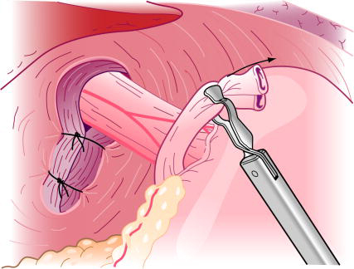
Nissen Fundoplication
Laparoscopic

Slide 52
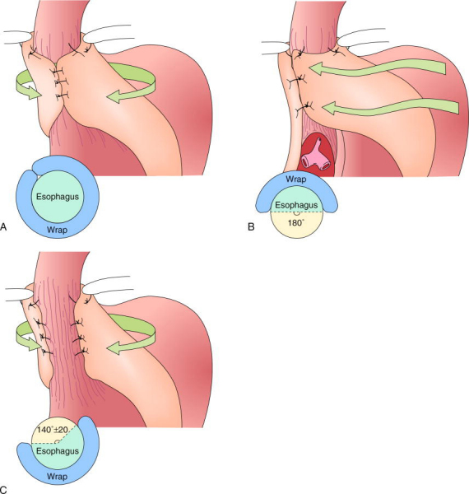
Complete vs. partial fundoplication
Ant. partial fundoplication
→ Thal/Dor procedure
Post. partial fundoplication
→ Toupet procedure

Slide 53
Treatment
Post surgery
  10% have solid food dysphagia
  2-3% have permanent symptoms
  7-10% have gas, bloating, diarrhoea, nausea, early satiety

Slide 54
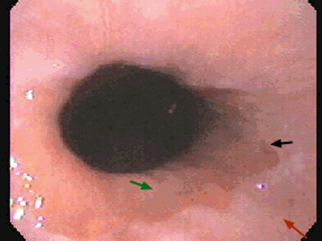
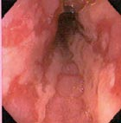
Complications
Erosive esophagitis
  Responsible for 40-60% of GERD symptoms
  Severity of symptoms often fail to match severity of erosive esophagitis
Notes:
--black arrow squamo-columnar jxn—Z-line
--Z-line has undulating smooth contours
--green arrow—gastric columnar epithelium above round black sphincter
--red arow—pink white esophageal squamous epithelium
--ulcerations in 2-7%

Slide 55
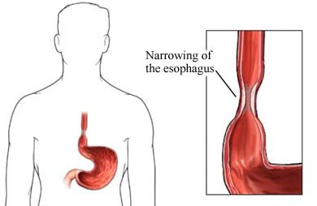
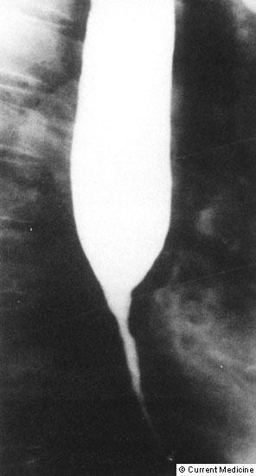
Complications
Esophageal stricture
  Result of healing of erosive esophagitis
  May need dilation
Notes:
4-20% of patients

Slide 56
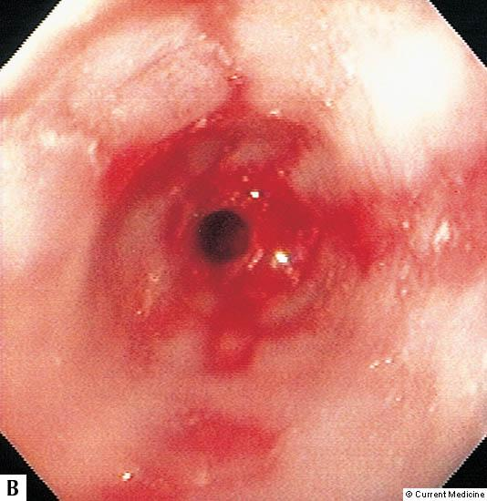
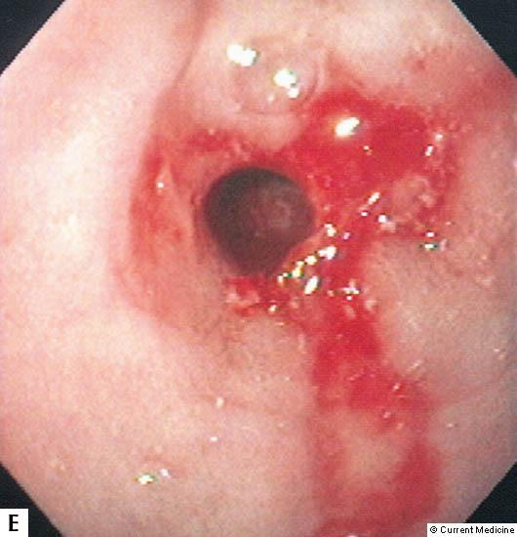
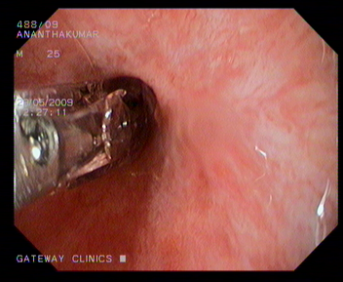
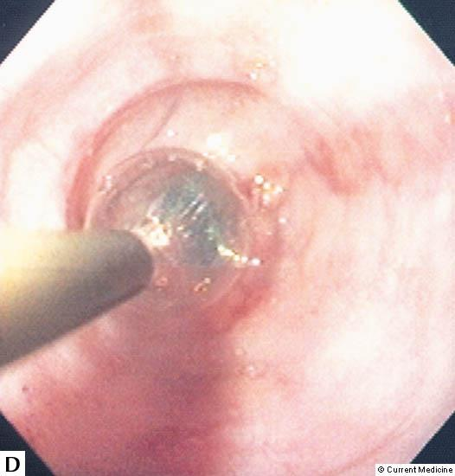
TTS Balloon Dilation of a Peptic Stricture
Notes:
Figure 11-21. Types of dilators: balloons. Balloon dilators are an additional option for the endoscopist approaching an esophageal stricture. They may be placed over a guidewire or through the scope (TTS). Theoretically, balloons have the advantage of being safer because of the radial application of force, and elimination of the shearing effect of rigid dilators. Moreover, dilation can be performed under direct visualization using the TTS balloon. Recent balloon innovations facilitating their use include longer balloons that avoid the tendency for slippage with inflation, and high-pressure balloons that should provide a truer diameter for the dilation of more resistant strictures. In the limited number of randomized studies comparing Savory-type dilators with balloon dilators, they appeared equally safe. Efficacy, as assessed by symptom improvement and luminal patency, has been variably reported in the literature favoring either technique [18], [19], [20]. A, Range of available balloons and an inflation gun. B–E, A peptic stricture before and after balloon dilation, thus demonstrating the direct visualization that is possible with the TTS technique.
References:
[18]. Saeed ZA, Winchester CB, Ferro PA, et al. Prospective randomized comparison of polyvinyl bougies and through-the-scope balloons for dilation of peptic strictures of the esophagus. Gastrointest Endosc 1995 41 189-195
[19]. Cox JGC, Winter RK, Maslin SC, et al. Balloon or bougie for dilation of benign oesophageal stricture? An interim report of a randomized controlled trial. Gut 1988 29 1741-1747
[20]. Shemesh E, Czerniak A, Comparison between Savary-Gilliard and balloon dilatation of benign esophageal strictures. World J Surg 1990 14 518-522

Slide 57
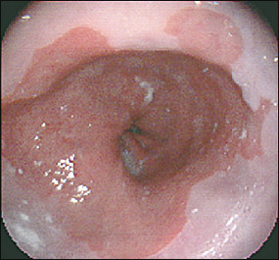
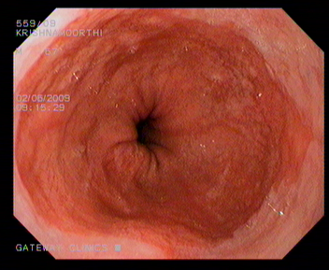
Complications
Barrett’s Esophagus
  Columnar metaplasia of the esophagus mucosa
  Associated with the development of adenocarcinoma
Notes:
--1950—Norman Barrett
--10-15%
--black arrow squamo-columnar jxn—Z-line
--Z-line has undulating smooth contours
--green arrow—gastric columnar epithelium above round black sphincter
--red arow—pink white esophageal squamous epithelium
--RFs—male, smoker, age, obese

Slide 58
On endoscopy the barrett esophagus with sliding hernia can be identified by stomach mucosa will show longitudinal mucosal folds, but barrett esiphagus will show flat mucosa with columnar epithelium.
both are columnar mucosa so it may cause confusion.

Slide 59
Classic Barrett ………………>3 cm length of columnar epithelium
Short segment Barrett….. < cm of columnar epithelium
Cardiac metaplasia………..intestinal metaplasia without macroscopic change on endoscopy

Slide 60
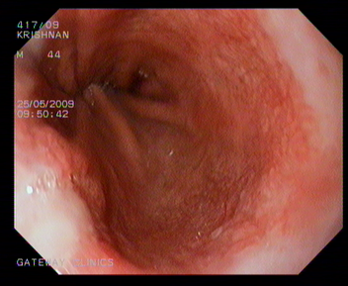
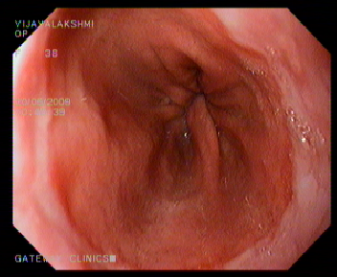
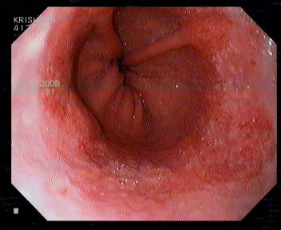
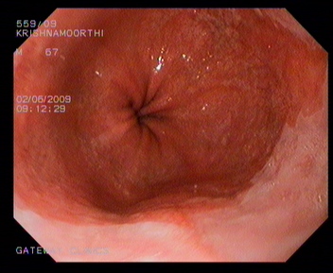
Barrett’s Esophagus

Slide 61
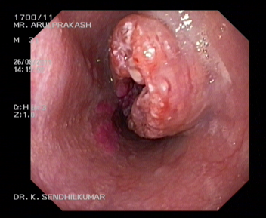
Complications
Barrett’s Esophagus
  Acid damages lining of esophagus and causes chronic esophagitis
  Damaged area heals in a metaplastic process and abnormal columnar cells replace squamous cells
  This specialized intestinal metaplasia can progress to dysplasia and adenocarcinoma
Notes:
Adenoca with barretts 0.5%/yr--------without barretts 0.07%/yr

Slide 62
Barrett’s Esophagus management
  Manage in same manner as GERD
  Endoscopy every 1-2 years in patient’s without dysplasia
  In patients with dysplasia annual to biannual interval surveillance
  Goblet cells in Barrett’s esophagus-intestinal metaplasia- produce high risk of adenocarcinoma of esophagus

Slide 63
If not responding to PPI , then treat by
Endoscopic resection of mucosa
Photo dynamic therapy
Argon beam plasma coagulation

Slide 64
Summary
Definition of GERD
Epidemiology of GERD
Pathophysiology of GERD
Clinical Manisfestations
Diagnostic Evaluation
Treatment
Complications and its management

Slide 65
Key of mcq
Mcq no. Key
1 …………………….. A
2 ……………………… D
3 ……………………….. C
4 ……………………….. A
5 ……………………….. A

Slide 66
Lafutidine

Slide 67
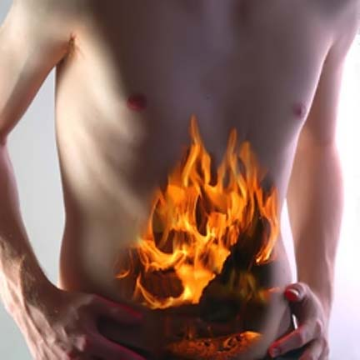
Acid breakthrough symptoms

Slide 68
Nocturnal Acid Breakthrough
Nocturnal acid breakthrough is defined as the presence of intragastric pH < 4 during the overnight period for at least 60 continuous minutes in patients taking a proton-pump inhibitor¹
1. MedGenMed. 2004; 6(4): 11.

Slide 69
The need for H2RA
Acid suppression of most PPIs, administered once daily wanes during the night-time hours¹
PPIs are unable to eliminate nighttime heartburn completely¹
1. Rev Gastroenterol Disord. 2008 Spring;8(2):98-108

Slide 70
Lafutidine
1. World J Gastrointest Pharmacol Ther 2010 October 6; 1(5): 112-118
LAFUTIDINE is a synthetic H₂ receptor antagonist for oral administration
Newly developed second generation H₂ receptor antagonist¹
Receptor binding affinity upto 80 times that of other H2RAs
Daytime and night-time acid inhibition
Gastroprotective activity independent of acid antisecretory activity
Has multimodal mechanisms of action

Slide 71
Lafutidine and H. pylori
Lafutidine inhibits the adherence of Helicobacter pylori to gastric cells¹
Lafutidine also inhibits subsequent IL-8 release -protects against the mucosal inflammation associated with H. pylori infection¹
1. 1 J. Gastroenterol. Hepatol, 2004, 19: 506-511.

Slide 72
Conclusions
LAFUTIDINE is a newly developed second generation H₂ receptor antagonist and has multimodal mechanisms of action
LAFUTIDINE rapidly binds to gastric cell histamine H₂ receptors, results in decreased acid production

