Slide 1
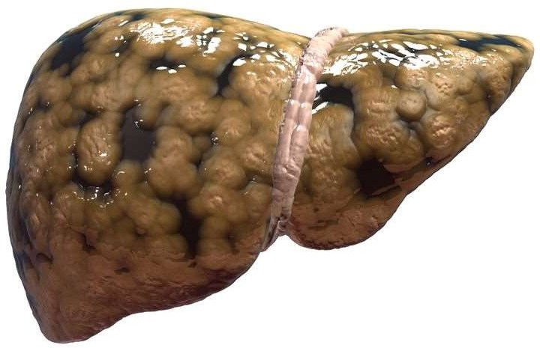
THE HEPATOBILIARY SYSTEM
Dr. Ketul Shah

Slide 2
Learning Objectives
Introduction
Chronic Venous Congestion of Liver
Fatty Change in Liver
Alcoholic Liver Disease
Cirrhosis of Liver
Cholelithiasis and Chronic Cholecystitis
Tumors

Slide 3
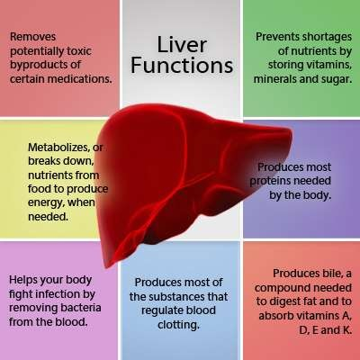
Introduction

Slide 4
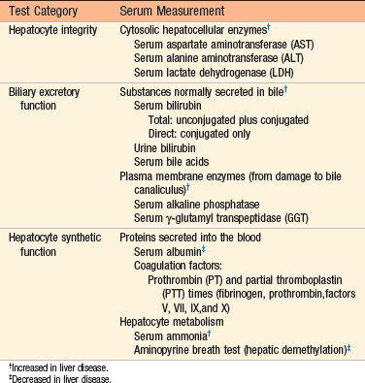
Laboratory Evaluation of Liver Disease

Slide 5
Learning Objectives
Introduction
Chronic Venous Congestion of Liver
Fatty Change in Liver
Alcoholic Liver Disease
Cirrhosis of Liver
Cholelithiasis and Chronic Cholecystitis
Tumors

Slide 6
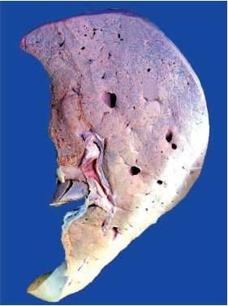
Chronic Venous Congestion of Liver
GROSS
The liver is enlarged and tender.
The cut surface shows characteristic alternate dark areas representing congested centre of each lobule, and light areas being the fatty peripheral part, so called nutmeg liver

Slide 7
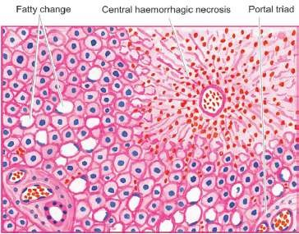
Chronic Venous Congestion of Liver
Microscopy
The central vein and the sinusoids in the centrilobular region are distended with blood.
The hepatocytes in the centrilobular region undergo degeneration and atrophy, probably as a result of anoxia.
Eventually, the centrilobular zone shows central haemorrhagic necrosis.
The peripheral hepatocytes are either normal or may show fatty change.

Slide 8
Learning Objectives
Introduction
Chronic Venous Congestion of Liver
Fatty Change in Liver
Alcoholic Liver Disease
Cirrhosis of Liver
Cholelithiasis and Chronic Cholecystitis
Tumors

Slide 9
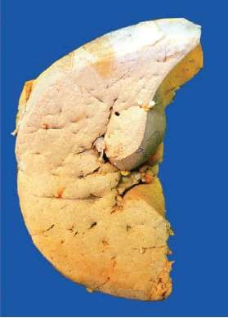
Fatty Change in Liver
Gross
The liver is enlarged and yellow with tense, glistening capsule and rounded margins.
The cut surface bulges slightly and is pale-yellow and greasy to touch.

Slide 10
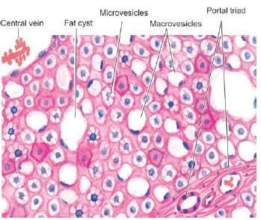
Fatty Change in Liver
Microscopy
i.
Fat in the cytoplasm of the hepatocytes is seen as clear area which may vary from minute droplets in the cytoplasm of a few hepatocytes (microvesicular) to distention of the entire cytoplasm of most cells by coalesced droplets (macrovesicular) pushing the nucleus to periphery of the cell.
ii.
When steatosis is mild, centrilobular hepatocytes are mainly affected, while the progressive accumulation of fat involves the entire lobule.
iii.
Occasionally, the adjacent cells containing fat rupture and produce fatty cysts.
iv.
Infrequently, lipogranulomas may appear consisting of collection of macrophages, lymphocytes and multinucleate giant cells.
v.
Special stains such as Sudan III, Sudan IV, Sudan Black and Oil Red O can be employed to demonstrate fat in the tissue.

Slide 11
Learning Objectives
Introduction
Chronic Venous Congestion of Liver
Fatty Change in Liver
Alcoholic Liver Disease
Cirrhosis of Liver
Cholelithiasis and Chronic Cholecystitis
Tumors

Slide 12
Alcoholic Liver Disease
Hepatic steatosis | Alcoholic hepatitis | Alcoholic cirrhosis
Also called fatty liver | Having hepatocyte swelling and necrosis (ballooning degeneration) | Irreversible form of alcoholic liver disease
Characterized by the presence of small (microvesicular) or large (macrovesicular) lipid droplets inside the hepatocytes | Neutrophilic infilitration in lobule | Initially, liver is enlarged and later there is presence of micronodules and macronodules
Initial centrilobular involvement followed by entire lobule involved | Perivenular and periportal fibrosis (due to ito cell in space of Disse) | Later, the whole liver has tough, pale scar tissue (Laennec Cirrhosis).
Reversible if there is abstinence from alcohol | Some hepatocytes show the presence of eosinophilic, cytokeratin filaments called ‘Mallory Hyaline bodies’.

Slide 13
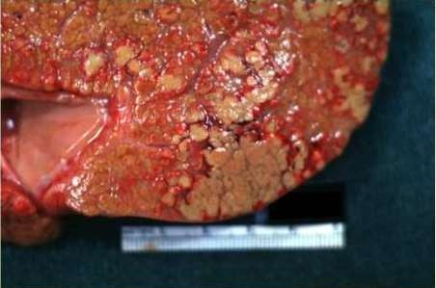
Alcoholic Liver Disease
Gross
The liver is swollen, enlarged, soft and greenish.
If repeated attacks of alcoholic hepatitis have superimposed on preexisting fatty liver, changes of fatty liver in the form of yellow, greasy and smooth appearance may be present.

Slide 14
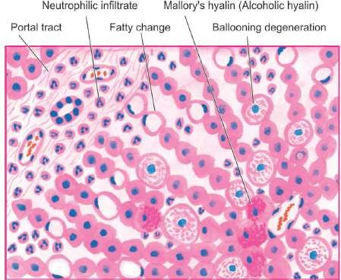
Alcoholic Liver Disease
Microscopy
Hepatocellular necrosis is seen in the form of ballooned out hepatocytes, especially in the centrilobular zone.
Mallory body or alcoholic hyaline is seen as eosinophilic intracytoplasmic inclusions in the perinuclear location
in the swollen and ballooned
hepatocytes.
Inflammatory cell infiltrate of polymorphs admixed with some mononuclear cells is seen in the area of necrosis.
There is web-like or chickenwire-like appearance of pericellular and perivenular fibrosis

Slide 15
Learning Objectives
Introduction
Chronic Venous Congestion of Liver
Fatty Change in Liver
Alcoholic Liver Disease
Cirrhosis of Liver
Cholelithiasis and Chronic Cholecystitis
Tumors

Slide 16
Cirrhosis Liver
It is the end stage liver disease characterized by disruption of the liver architecture by fibrotic bands that divide the liver into nodules of regenerating liver parenchyma.
It can be
micronodular ( if nodule is <3mm) or
macronodular (if nodule is >3 mm)
Or mixed.

Slide 17
Cirrhosis Liver
Causes
Alcoholic liver disease (most common cause)
Viral hepatitis
Biliary tract disease
Hemochromatosis
Cryptogenic/idiopathic (non alcoholic fatty liver disease is its commonest cause)
Wilson disease
Alpha-1-antitrypsin deficiency

Slide 18
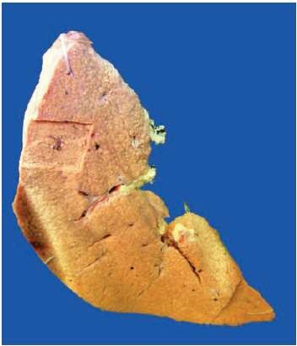
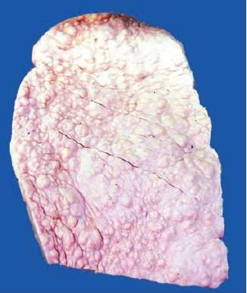
Cirrhosis Liver
Gross
Cirrhosis is morphologically categorised by the size of nodules—
  micronodular, if the nodules<3mm
  macronodular if the nodules>3 mm
  mixed if both small and large nodules are seen.
On sectioned surface, the grey- brown nodules are separated from one another by grey-white fibrous septa.

Slide 19
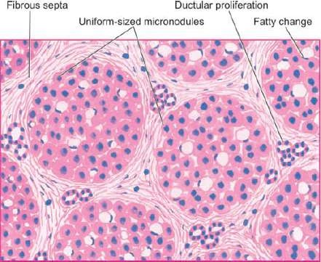
Cirrhosis Liver
Microscopy
Lobular architecture of hepatic parenchyma is lost and central veins are hard to find.
Fibrous septa divide the hepatic parenchyma into nodules.
The hepatocytes in the surviving parenchyma form regenerative nodules having disorganised masses of hepatocytes.
Alcoholic (micronodular) cirrhosis.

Slide 20
Learning Objectives
Introduction
Chronic Venous Congestion of Liver
Fatty Change in Liver
Alcoholic Liver Disease
Cirrhosis of Liver
Cholelithiasis and Chronic Cholecystitis
Tumors

Slide 21
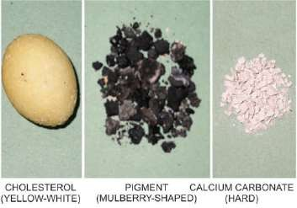
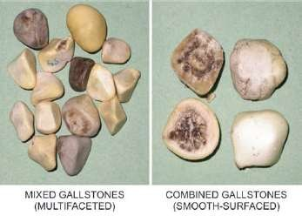
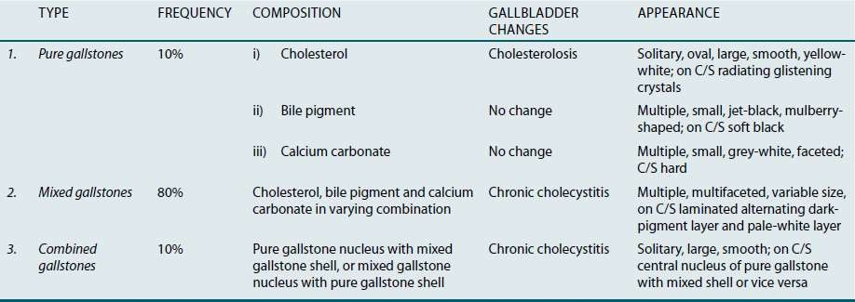
Cholelithiasis (Gallstones)

Slide 22
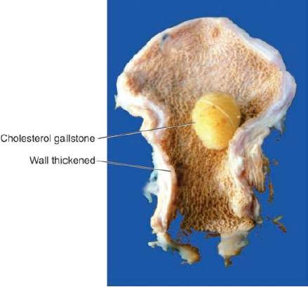
Chronic Cholecystitis
Gross
The gallbladder is generally contracted and the wall is thickened.
Cut section of wall of gallbladder is grey-white due to dense fibrosis. The mucosal folds may be thickened, atrophied or flattened.
The lumen commonly contains gallstones, most often multiple multifaceted mixed type; others are pure gallstones (cholesterol, pigment and calcium containing) and combined type gallstones

Slide 23
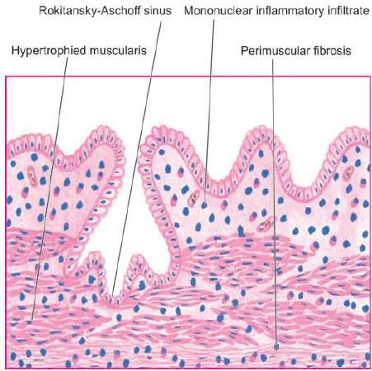
Chronic Cholecystitis
Microscopy
i.
Penetration of mucosa deep into the wall of the gallbladder up to the muscularis layer to form Rokitansky- Aschoff sinuses.
ii. Variable degree of chronic inflammatory cells (lymphocytes,plasma cells and macrophages) in the lamina propria and subserosal layer.
iii.
Variable degree of fibrosis and
thickening of perimuscular layer

Slide 24
Learning Objectives
Introduction
Chronic Venous Congestion of Liver
Fatty Change in Liver
Alcoholic Liver Disease
Cirrhosis of Liver
Cholelithiasis and Chronic Cholecystitis
Tumors

Slide 25
Tumors
Benign | Malignant
A. Hepatocellular tumours Hepatocellular (liver cell) adenoma | Hepatocellular (liver cell) carcinoma Hepatoblastoma (Embryoma)
B. Biliary tumours Bile duct adenoma (Cholangioma) | Cholangiocarcinoma Combined hepatocellular and cholangiocarcinoma Cystadenocarcinoma
C. Mesodermal tumours Haemangioma | Angiosarcoma Embryonal sarcoma

Slide 26
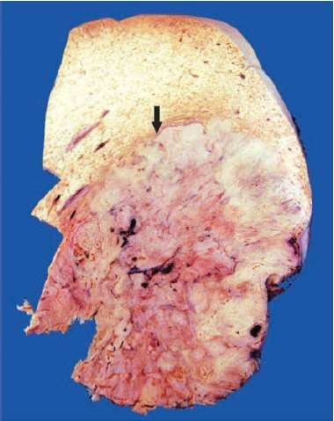
Hepatocellular Carcinoma
Gross
The HCC may form one of the three
patterns of growth
(in decreasing order of frequency)
Expanding type as a single large mass with central necrosis and haemorrhage.
Multifocal type as multiple masses scattered throughout the liver.
iii.
Infiltrating type is a diffusely
spreading type and is less common.
Sectioned surface of the slice of liver shows a single, large mass (arrow) with irregular borders and having central areas of necrosis. The rest of the hepatic parenchyma shows many nodules of variable sizes owing
to co-existent macronodular (postnecroitc) cirrhosis.

Slide 27
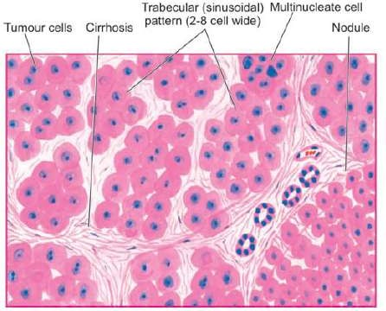
Hepatocellular Carcinoma
Microscopy
The tumour cells may be arranged in a variety of patterns.
Most common is trabecular or sinusoidal pattern composed of 2-8 cell wide layers of tumour cells separated by endothelium- lined vascular spaces.
Other patterns include pseudoglandular or acinar,compact and scirrhous.

Slide 28
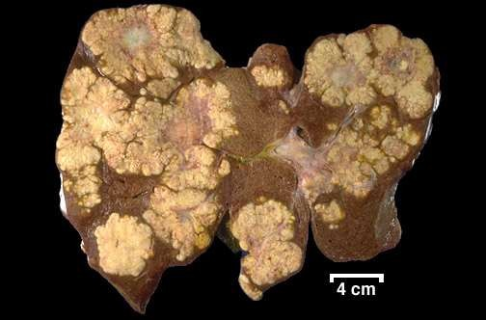
Metastases to the Liver
Gross
Most metastatic carcinomas form multiple, spherical, nodular masses which are of variable size.
Liver is enlarged and heavy, weighing 5 kg or more.
The tumour deposits are white, well demarcated, soft or haemorrhagic.
The surface of the liver shows characteristic umbilication due to central necrosis of nodular masses

Slide 29
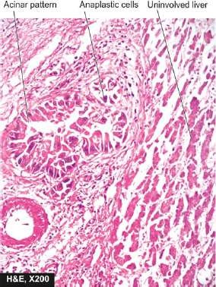
Metastases to the Liver
Microscopy
The metastatic tumours generally reproduce the structure of the primary lesions.
A sinusoidal growth pattern is seen with tumor cells growing in sinusoids at the boundary, compressing the liver cell cords.
A replacement growth pattern is also seen when the tumor cells replaces hepatocytes along the liver cell cords.

