Slide 1
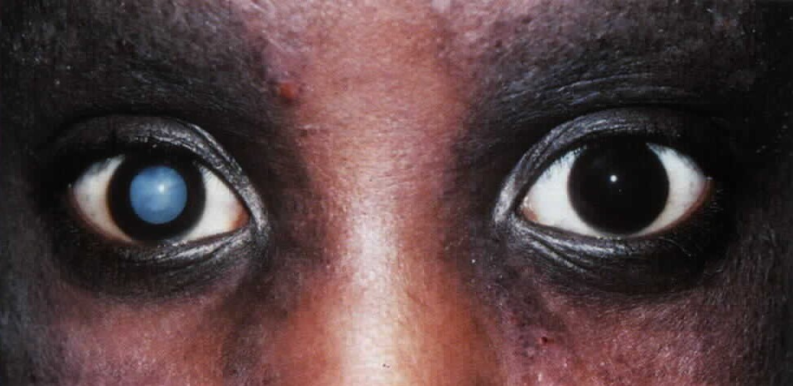
Cataract
By-Dr.R.N.Kothari

Slide 2
Definition
Opacity on or within the lens due to loss of transparency due to :
Hydration of lens fibres.
Denaturation of lens protein.

Slide 3
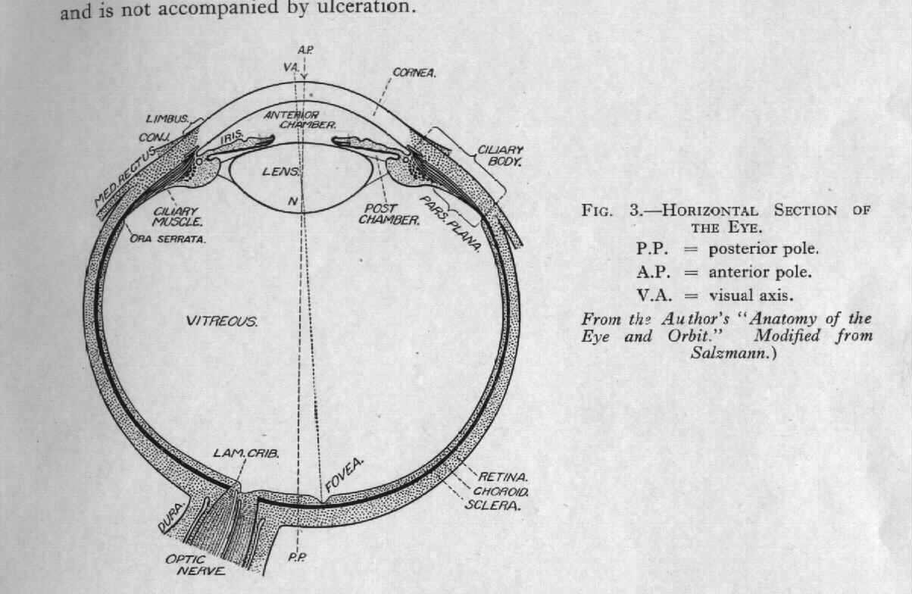
Anatomy

Slide 4
Anatomy
Developed from surface ectoderm.
Biconvex, avascular transparent structure suspended by zonules behind the iris.
Parts◊central nucleus, cortex, anterior and posterior capsule.
Composition: 65% water., 35% protein and traces of minerals.

Slide 5
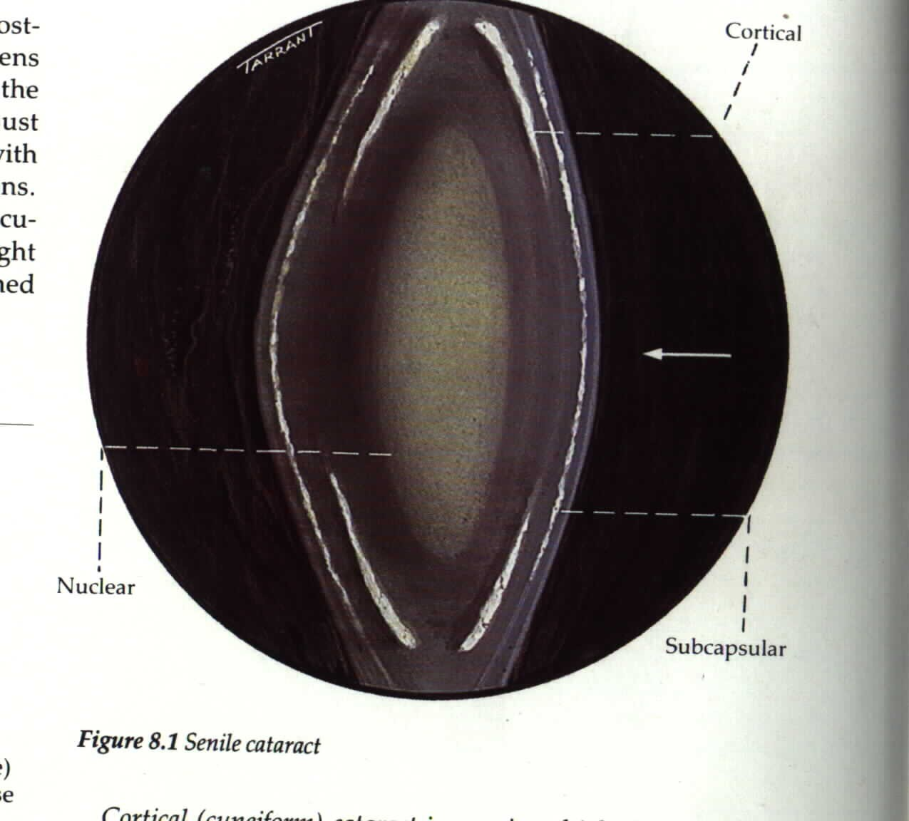
Anatomy

Slide 6
Function
Acts as refractory surface.
Helps in the act of accomodation.

Slide 7
Classification (Aetiological)
Senile
Traumatic: Penetrating injuries Blunt injuries Infrared radiation Ionising radiation

Slide 8
Classification (Aetiological)
3. Metabolic: Diabetes Mellitus Galactosemia Hypocalcemia Wilson’s disease
Galactokinase Deficiency

Slide 9
Classification (Aetiological)
Toxic: Corticosteroids Chlorpromazine Miotics
Secondary (complicated) Anterior Uveitis
High myopia
Chronic vitreo retinal disorders

Slide 10
Classification (Aetiological)
Congenital & Developmental Hereditary
Maternal Prenatal Infections as Rubella/ Toxoplasmosis.
Maternal drug ingestion Inborn errors of metabolism
Presenile Cataract
Dystrophia myotonica Atopic Dermatitis

Slide 11
Classification according to
the stage of maturity
Immature Mature
Intumuscent (swollen lens) ◊Leads to Phacomorphic glaucoma
Hypermature◊ Leads to subluxation/ dislocation of lens and phacolytic glaucoma.
Morgagnian cataract

Slide 12
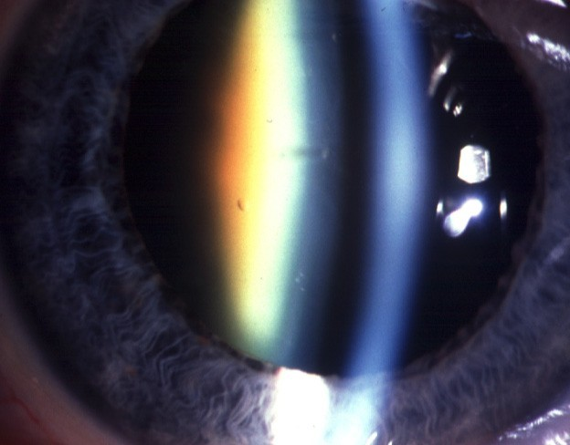
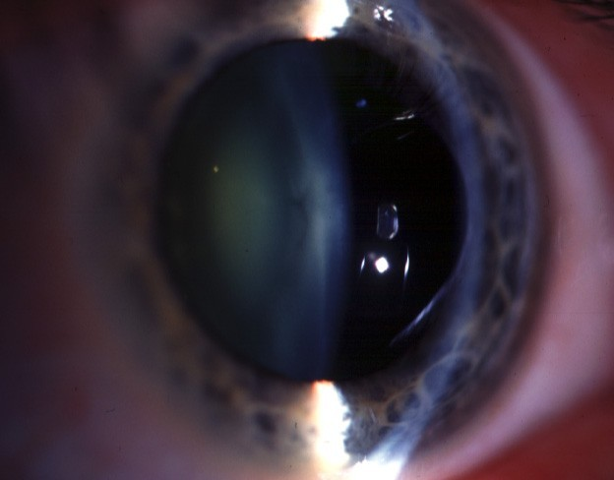

Slide 13
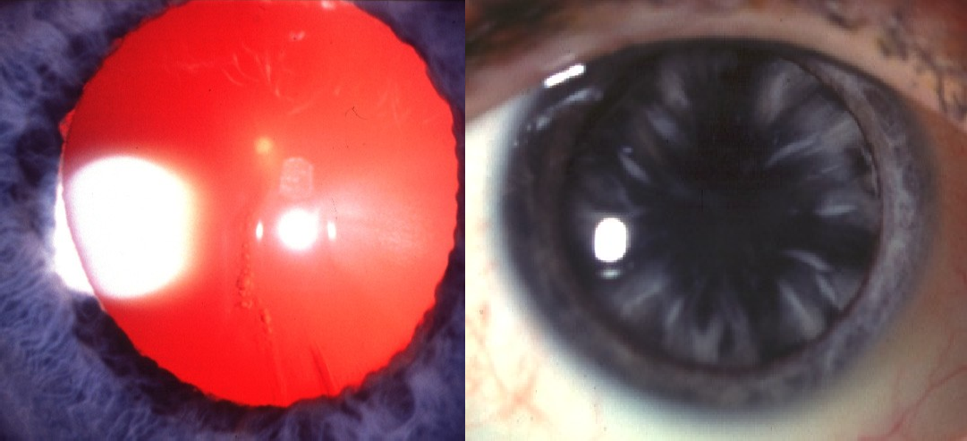
Cortical cataract
Progression
Initially vacuoles and clefts
Progressive radial spoke-like opacities

Slide 14
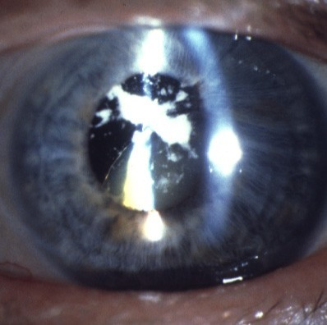
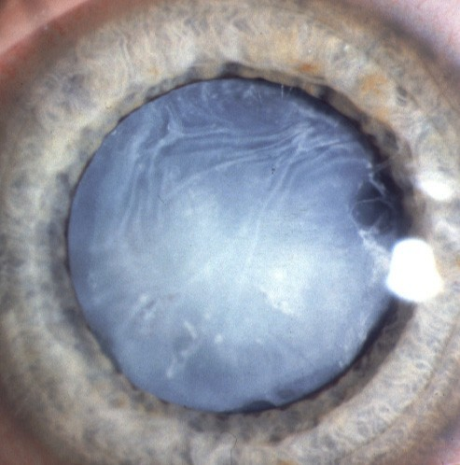
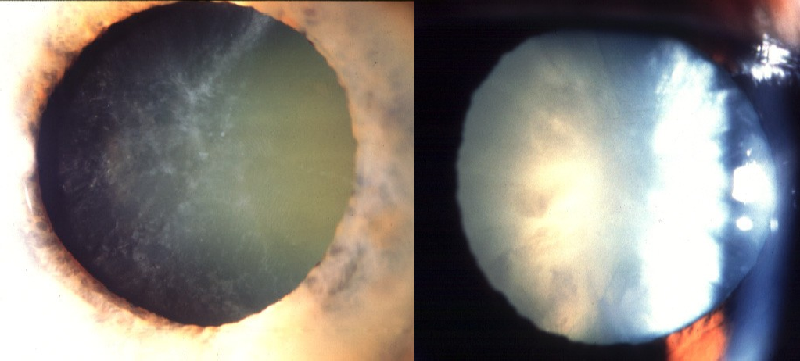

Slide 15
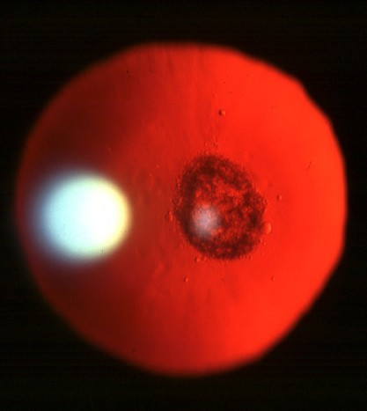
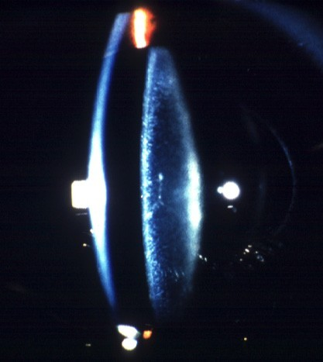

Slide 16
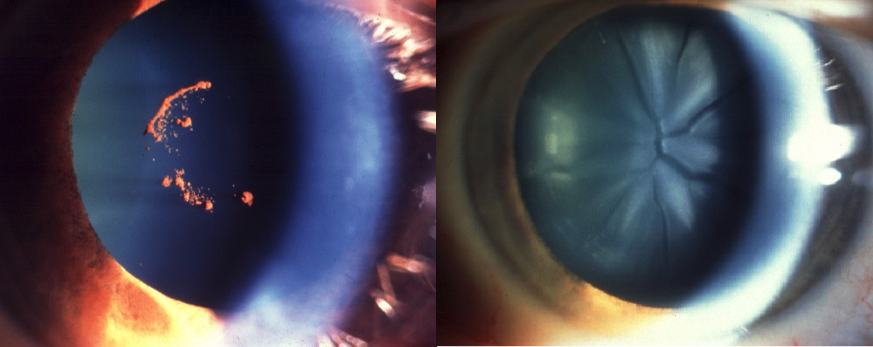
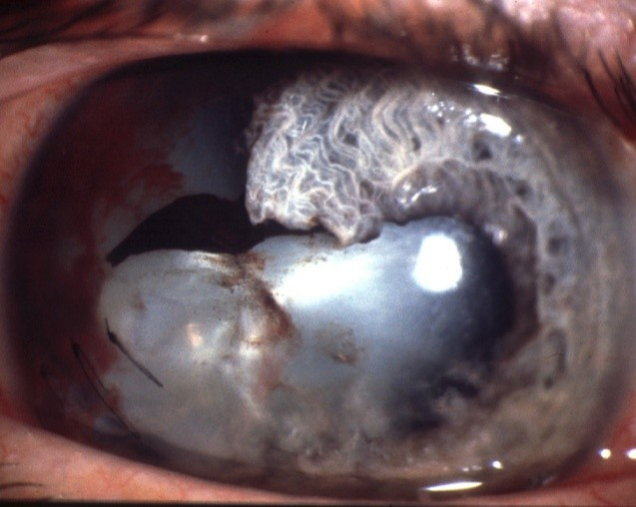
Causes of traumatic cataract
Concussion
‘Vossius’ ring from
imprinting of iris pigment
Flower-shaped
Penetration
Other causes
•
Ionizing radiation
•
Electric shock
•
Lightning

Slide 17
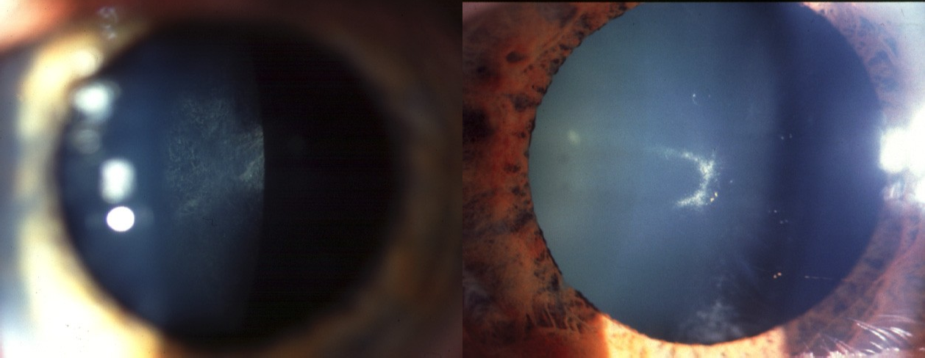
Drugs
Systemic or topical steroids
Chlorpromazine
- initially posterior subcapsular
- central, anterior capsular
granules
Other drugs
•
Long-acting miotics
Amiodarone
Busulphan

Slide 18
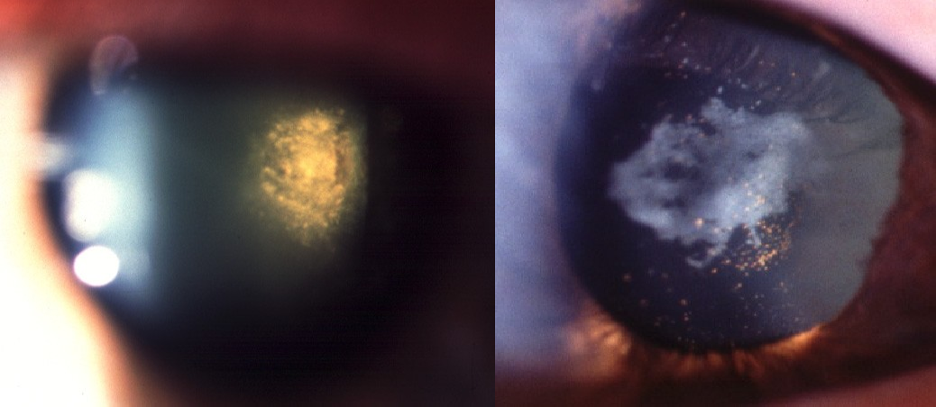

Slide 19
Symptoms
Progressive decrease in visual acuity for near and distant.
Glare in bright light and sun light.◊ difficulty in driving.
Uniocular diplopia or polyopia. Fixed dark spots in field of vision.
Nuclear sclerosis◊ making the patient short sighted (good near vision).aka myopic shift

Slide 20
Signs
Reduction in visual acuity.
Diminished red reflex on ophthalmoscopy.
Opacity covering the pupillary area.
Slit lamp examination◊ details and location of cataract.

Slide 21
Treatment: Surgical
Indications:
Decreased visual acuity which causes disturbance in his or her daily work.
Lens induced glaucoma
Phacomorphic/ Phacolytic To permit photocoagulation.
If cataract blocks the posterior segment for posterior segment surgery.
Cosmetic◊ to obtain black pupil.

Slide 22
Management In Children
Unilateral◊ should be removed as early as possible to avoid amblyopia.
Bilateral dense cataracts◊ immediate surgery.
Bilateral immature cataract◊ if fundus details seen, op can be postponed until lens becomes more denser.
Vision should be corrected with contact lens or intraoular lens.

Slide 23
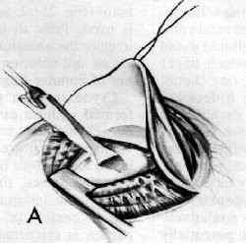
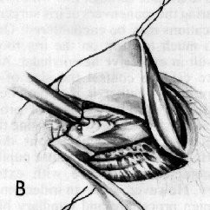
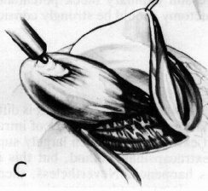
Surgical techniques (1/3)
Intracapsular cataract extraction with IOL (ICCE).
The entire lens is removed using cryo probe.
Anterior chamber IOL.
This method is for subluxated cataractous lens.

Slide 24
Surgical techniques (2/3)
Extracapsular cataract extraction with IOL. (ECCE)
Open the anterior capsule.
Nucleus expression.
Aspiration of lens cortex.
Posterior chamber IOL implant.
Incision size is about 10 mm.

Slide 25
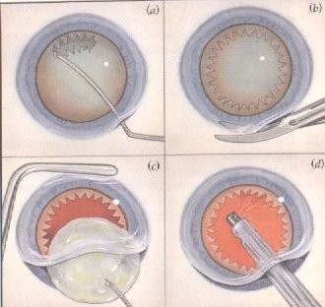
ECCE

Slide 26
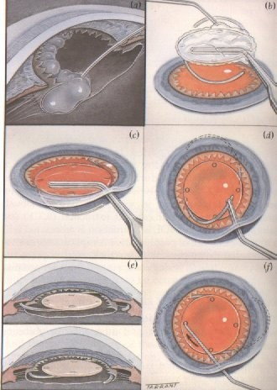
ECCE with IOL

Slide 27
ECCE
Step 1- Incision

Slide 28
ECCE
Step 2- Anterior capsulotomy

Slide 29
ECCE
Step 3- Deepening the wound

Slide 30
ECCE
Step 4- Nucleus expression

Slide 31
ECCE
Step 5- Cortex aspiration

Slide 32
ECCE
Step 6- IOL insertion

Slide 33
ECCE
Step 7- Suture

Slide 34
ECCE
Complete suture

Slide 35
Surgical techniques (3/3)
Phacoemulsification (sophisticated form of ECCE) with IOL:
Open the anterior capsule
Using the ultrasonic power nucleus is fragmented and removed.
Aspiration of lens cortex.
Posterior chamber IOL implant.
Incision size◊ 3mm only.

Slide 36
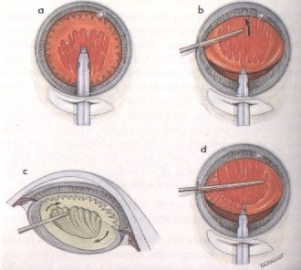
Phaco

Slide 37
Phaco
Step 1- Incision

Slide 38
Phaco
Step 2- ccc- Anterior capsulorhexis

Slide 39
Phaco
Step 3- Nucleofractis

Slide 40
Phaco
Step 4- Fragments removal

Slide 41
Phaco
Step 5- Aspiration of cortex

Slide 42
Phaco
Step 6- IOL Insertion

Slide 43
Phaco
Complete

Slide 44
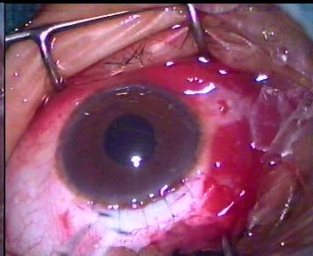
ECCE Vs Phaco

Slide 45
Advantages of Phaco
Small incision.
Fewer wound problems. Less astigmatism.
More rapid physical rehabilitation.

Slide 46
Disadvantages of Phaco
Machine dependent. Larger learning curve. Expensive equipment. Difficult with hard nucleus.

Slide 47
Intraocular lenses
Optical advantage of its natural counterpart when it is placed in the eye.
IOL power is calculated by measuring the curvature of cornea and length of the eye (measured by ultrasonography).
Types of IOL:
posterior chamber IOL :
  rigid PMMA.
    foldable silicone/acrylic.
anterior chamber IOL.

Slide 48
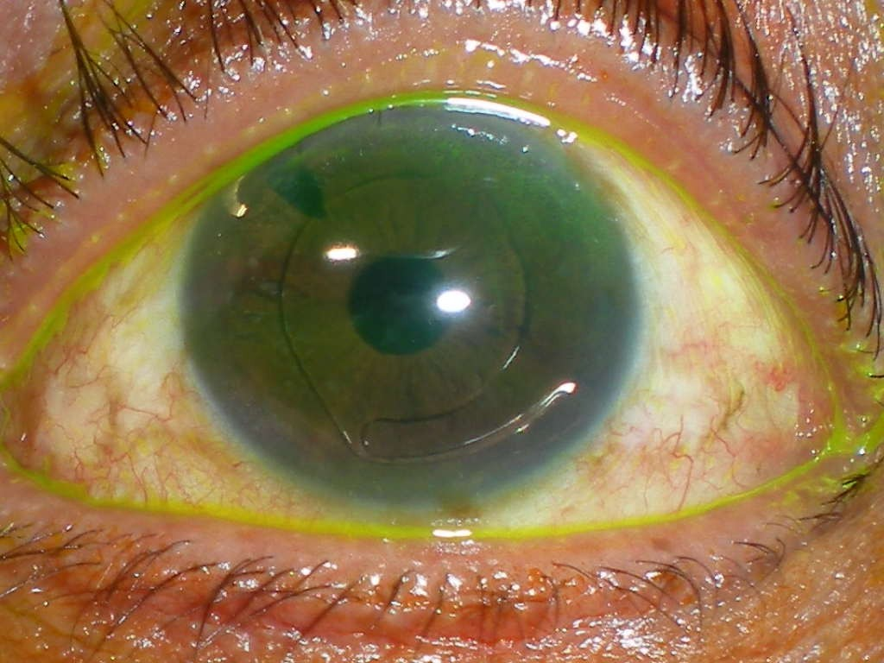

Slide 49
Optical Correction (1/3)
If no IOL◊ correction should be made with aphakic glasses or contact lenses.
Problems with aphakic glasses:
Thick and heavy
The corrected image is 30% larger than that seen with the normal eye with increased distortion hence image cannot be fused with that from the unoperatedByeDryBaenu.mathi Gurusamy, HPP

Slide 50
Optical correction (2/3)
Objects are perceived closer than they are.
Eg: pouring tea into one’s lap rather than into the cup.
Corrective glasses are maximally effective only when the patient looks through the optical centre.
The field of vision is restricted and there is blind area all round within this field.

Slide 51
Optical Correction (3/3)
Contact lenses:
Size of image is only 10% larger than the image in the unoperated eye
Disadvantages:
most of the patients are elderly with inadequate tearfilm, so difficult to use CL.
difficulty in handling/ risk of infection.

Slide 52
Post op management
Steroid drops to reduce inflamation. Antibiotic drops to treat infection.
Relative contra indications for IOL:
Intraocular inflamation.
Severe diabetic retinopathy.

Slide 53
Complications of Cataract Surgery (1/4)
During surgery:
1. Posterior capsule rupture with vitreous loss will lead to:
Updrawn pupil
Vitreous touch syndrome with sec. Glaucoma/ pupillary block glaucoma.
Uveitis
Chronic cystoid macular oedema Retinal detachment

Slide 54
Complications of cataract
surgery (2/4)
In phaco emulcification nucleus can drop into the vitreous when the posterior capsule ruptures.
Expulsive chroidal haemorrhage (caused by rupture of choroidal vessels).◊EXTREMELY RARE

Slide 55
Complications of cataract
surgery (3/4)
Early Post op. complications:
Wound leak .
Hyphaema.
Iris prolapse.
Uveitis
Increase IOP.
Bacterial endophthalmitis.

Slide 56
Complications of cataract
surgery (4/4)
Late complications:
Chronic cystoid macular oedema.
Posterior capsule opacity. (Elschnig’s pearls)
To be treated with YAG laser capsulotomy.
Retinal detachment.
Displacement of IOL◊ pupillary capture/ sunset syndrome.

Slide 57
Thank You

