Slide 1
Stool Examination :Questions and Answers (Viva)
Ms Sangita Vasava
Assistant Professor
Department of Microbiology

Slide 2
1)Which are the intestinal parasites?
Entamoeba histolytica
Giardia lamblia
Isospora spp
Microsporidium
Cyclospora
Cryptosporidium spp ,
Balantadium coli
Opportunistic Parasitic infection(HIV/AIDS) they cause chronic diarrhoea.

Slide 3
Helminths:
Nematodes :Enterobius vermicularis
Trichuris trichuria
Ascaris lumbricoides
Necator americanus
Ancyclostoma duodenale
Strongyloides stercoralis
Cestodes : Taenia saginata ,
Taenia solium,
Hymenolepis nana,
Diphyllobothrium latum
Trematodes :Fasciolopsis buski

Slide 4
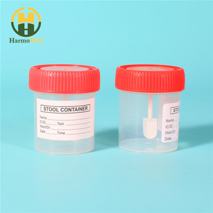
2) Specimen (Stool) collection
Clean container without contamination with urine, water or disinfectants.
Faeces specimen should be immediately examined to see the motility.

Slide 5
3)Macroscopic and Microscopic examination of stool specimen
Macroscopic examination
Microscopic examination
Consistenacy
Colour
Odour
pH
Presence of blood or mucus
Adult round worm (Ascaris lumbricoides)
Segment of tapeworms may be seen.
Note:The presence of blood and mucus is suggestive of amoebic dysentery.
Pus cells
RBCs
Eosinophils
Macrophage
Charcot leyden crystals
Haematophagus trophozoites
Trophozoite
Cyst of intestinal protozoa
Eggs
Larvae of helminths
can be detected and identified.

Slide 6
4) Methods of microscopic diagnosis
a)Wet mount (normal saline ):
To see the Motility of larvae and trophozoites .
Worm eggs
RBCs and WBCs
Cysts
It can differentiated bile staining eggs.

Slide 7
b)Iodine mount:
Stain glycogen and the nuclei of cysts.
So it can be differentiated between cyst of Entamoeba histolytica and Entamoeba coli.
Note: Motility of larvae and trophozoites is inhibited by iodine.
It also gives better colour to identify it.

Slide 8
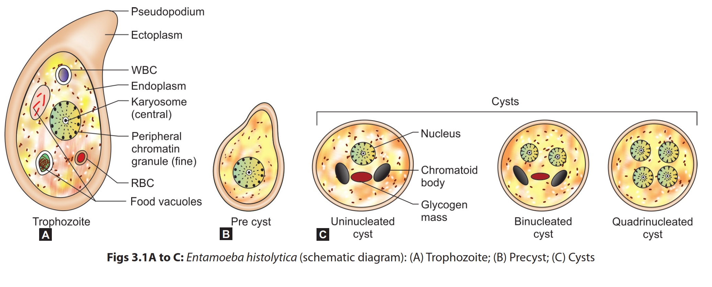

Slide 9
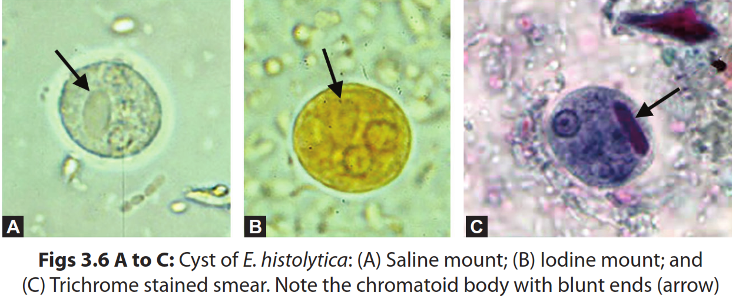

Slide 10
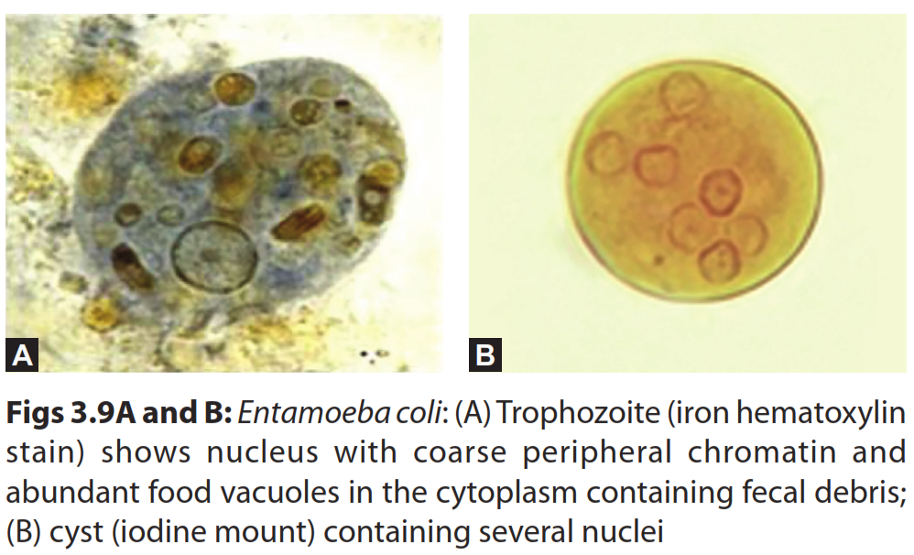

Slide 11
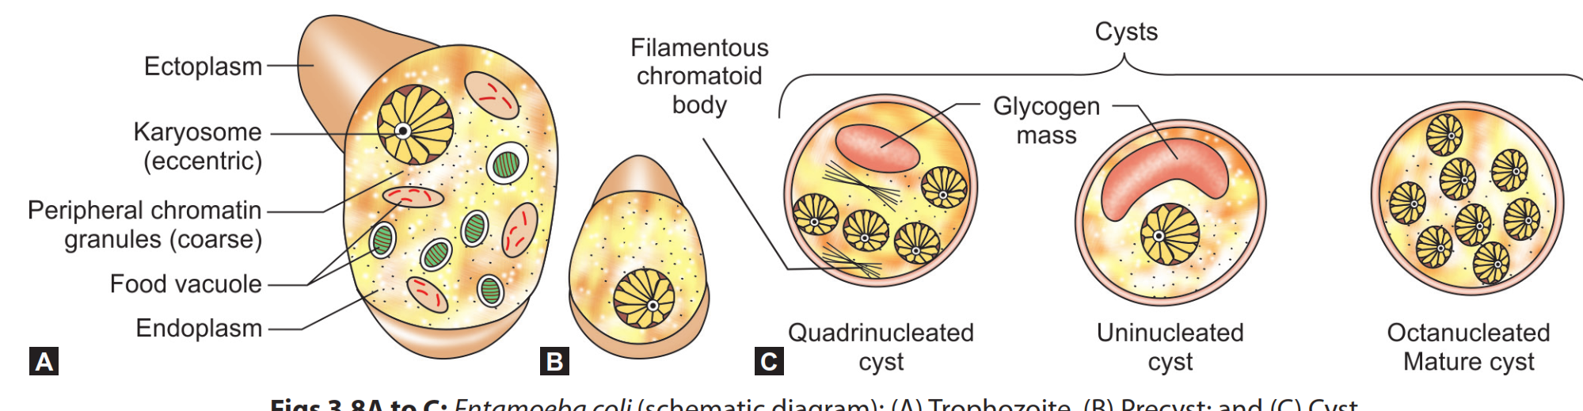

Slide 12
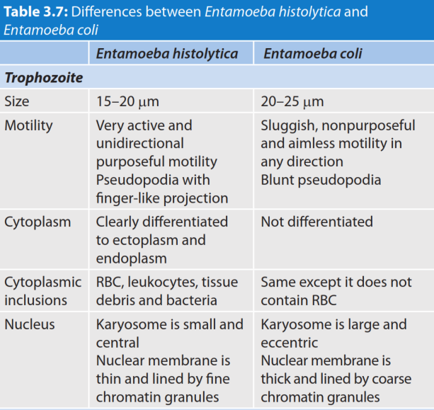

Slide 13
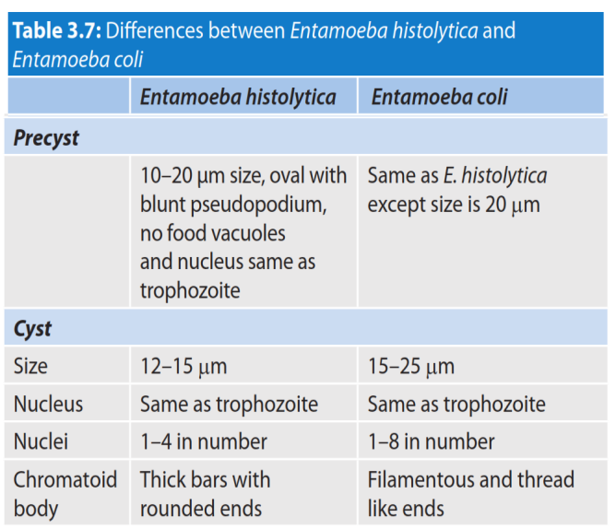

Slide 14
5)Which are the concentration techniques?
The concentration techniques commonly used are:
1)Sedimentation techniques:
Formal ether concentration technique
2)Flotation techniques:
Zinc sulphate flotation technique
examples:fertilized eggs of A.lumbricoides
Necator americanus
Ancyclostomma duodenale

Slide 15
6)What is NIH swab/cellophane adhesive tape?
NIH Swab is collected by the perianal region.
The eggs that are deposited in the perianal region by the motile proglottids.
Eggs deposited in the perianal region are detected by applying a transparent cellulose acetate type(cellophone tape).The eggs stick to the cellophane tape.The tape is placed on a microscope slide and examined.
Examples:Enterobius vermicularis(pin worm)
Notes:
NIH: National Institutes of Health

Slide 16
7)What is modified ZN stain ? Where do we use it?
Concentration of decolorizer is 1 % instead of 20% H2SO4 in ZN stain procedure.
Acid fast staining for Oocysts is useful to demonstrate Cryptosporidium spp and Isospora belli.
Cryptosporidium oocysts in a modified acid-fast stain.
Notes:
Oocysts:The infected human excretes the most oocysts during the first week. Oocysts can be excreted for weeks after the diarrhea subsides from infections by C. parvum or C. hominis; however, immunocompetent individuals with C. muris infections have been observed excreting oocysts for seven months.
a cyst containing a zygote formed by a parasitic protozoan such as the malaria parasite.

Slide 17
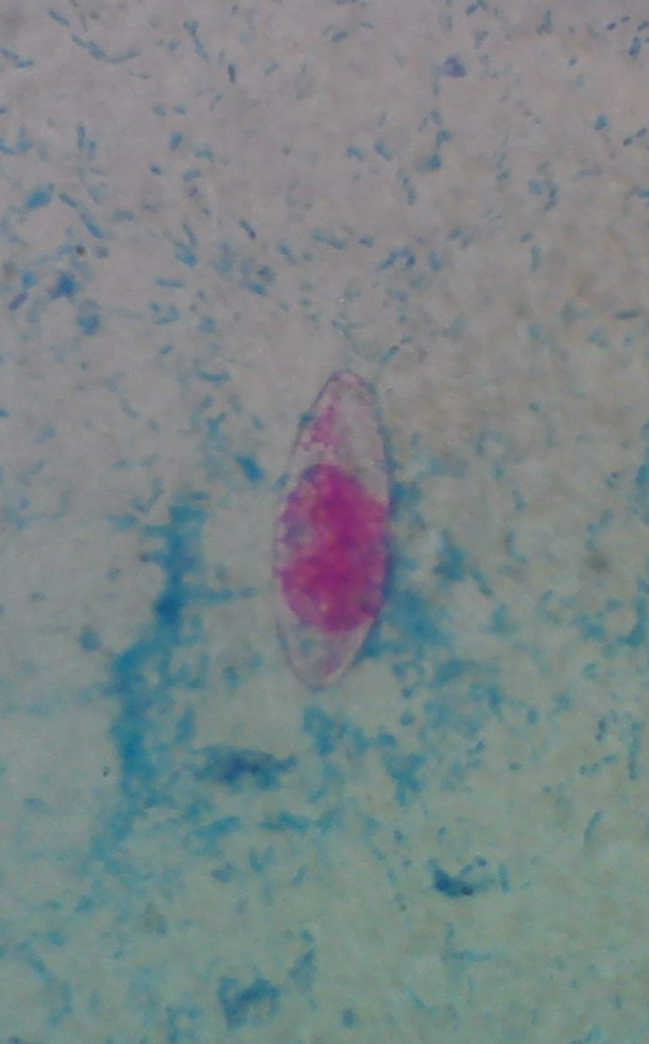
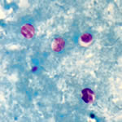
Cryptosporidium oocysts in a
modified acid-fast stain.
Oocyst of Isospora belli in modified ZN stain

Slide 18
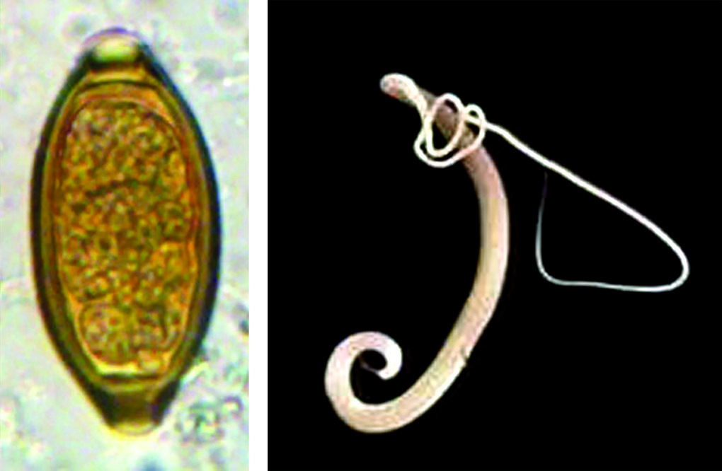
Trichuris trichiura (Whip worm)
Barrel-shaped; surrounded by a shell, bear mucus plug at both the poles.
50 µm X 25 µm wide
Bile stained
Float in saturated salt solution.
Trichuris trichiura
(A) Egg in saline mount;
(B) Adult female

Slide 19
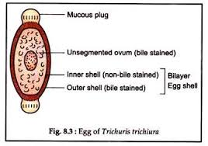
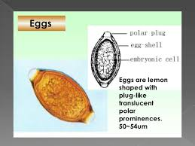
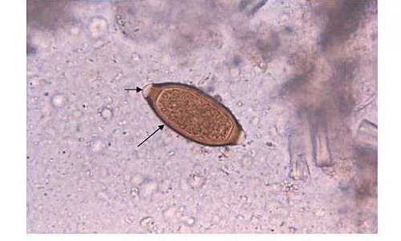

Slide 20
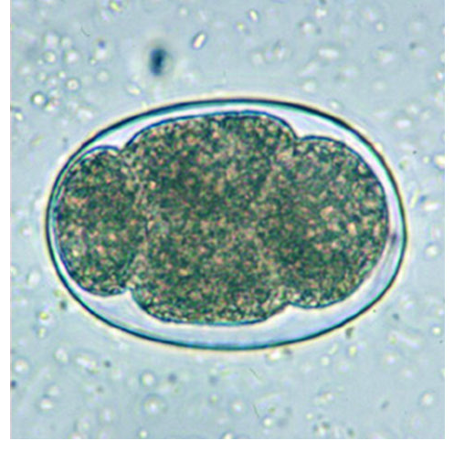
Ancylostoma duodenale(Hook worm)
Oval-shaped
Measures 60 × 40 µm
Not bile stained, appear colorless in saline mount
Egg shell
Ovum (embryo) is segmented; comprises of 4 to 32 blastomeres
Floats on saturated salt solution

Slide 21
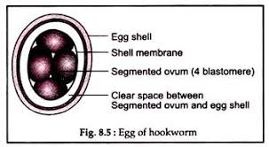

Slide 22
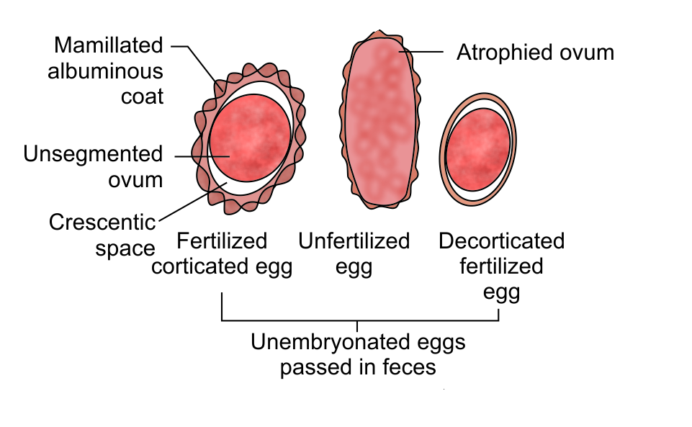
Ascaris lumbricoides(Round worm)

Slide 23
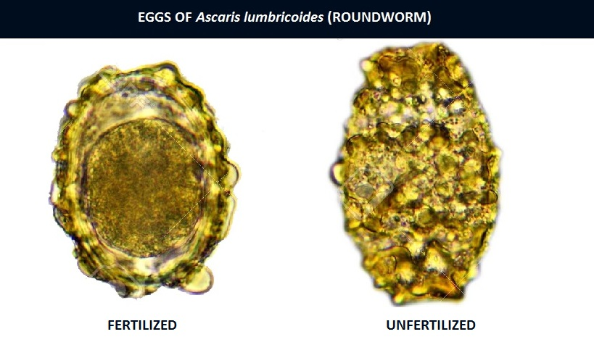
Ascaris lumbricoides(Round worm) eggs

Slide 24
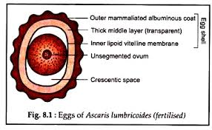
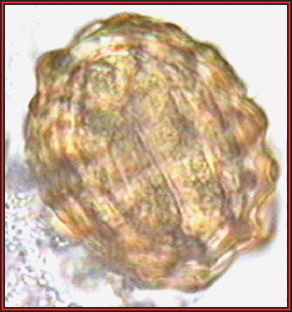

Slide 25
 | Fertilized eggs | Unfertilized eggs
Shape | Round to oval | Elongated
Size | 60 umX40um | 90umX45um
Covering(egg shell) | Surrounded by a thick mamillated,albuminous coat | albuminous coat is thin,disorted and scanty
Cresentric space at poles | Clear ,Present | Absent
Bile staining | Yes, yellow- brown in saline mount | Yes, yellow- brown in saline mount
Saturated salt solution | Floats | Do not floats
Ovum | Egg contains a large unsegmented ovum of granular mass with clear space at both the end | Egg contains an segmented, Small atrophied ovum with a mass of disorganized highly refractile granules

Slide 26
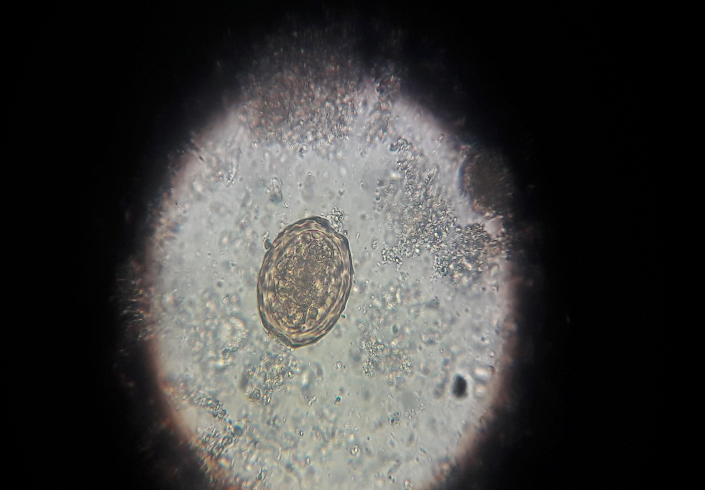

Slide 27
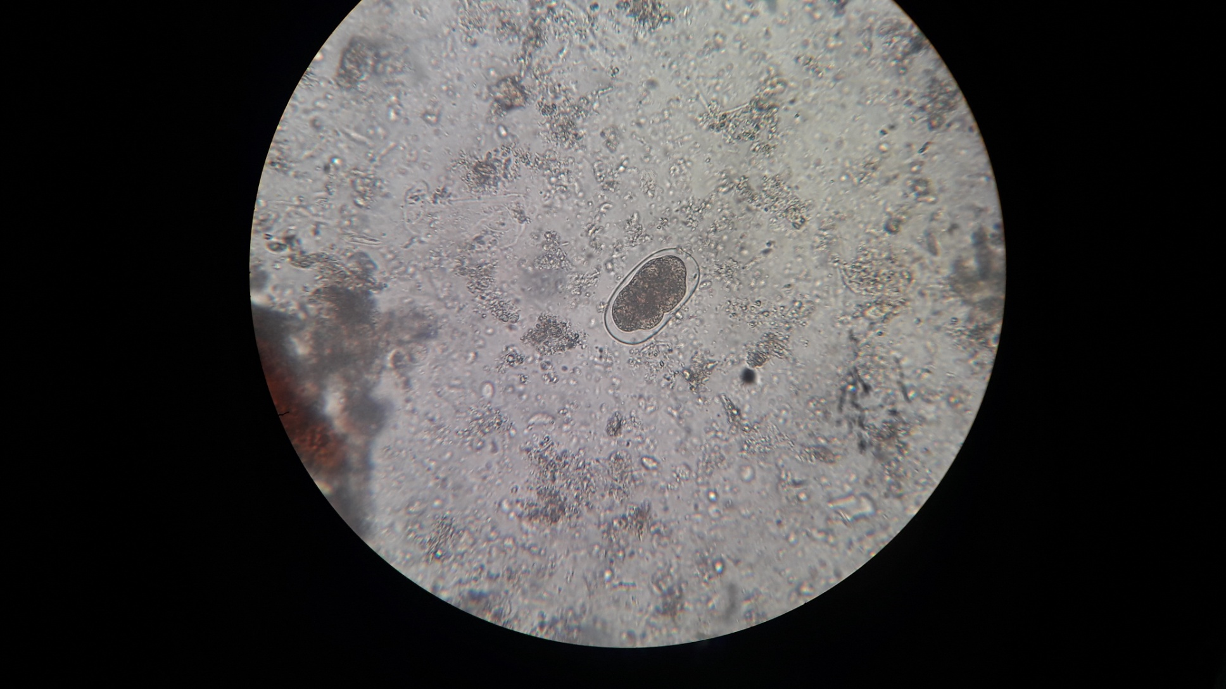

Slide 28
