Slide 1
Culture Method
Ms Sangita Vasava
Assistant Professor
Microbiology Department
SBKS MI & RC

Slide 2
Culture Media
Required to grow the organisms from infected material to identify the causative agent

Slide 3
CULTURE MEDIA
Culture media - pure culture
Liquid media - obtain growth from large volume
Diffuse growth
Solid media - bacteria form colonies
Distinct colony morphology
Pigmentation, hemolysis

Slide 4
Basic constituents of culture media
Water: source of hydrogen & oxygen
Electrolyte : Sodium chloride or other electrolyte
Peptone
Meat extract :Protein degradation products, inorganic salts, carbohydrates & growth factors
Blood or serum
Agar

Slide 5
PEPTONE
Complex mixture of partially digested protein
Obtained from lean meat or other protein material such as heart muscle,casein,fibrin
Proteoses, polypeptides, amino acids
Inorganic salts
Phosphates, potassium, magnesium
Accessory growth factors
Notes:
Lean meat :low fat content(skinless)

Slide 6
AGAR
Sea weed
Long-chain polysaccharide
Varying amounts of inorganic salts
No nutritive value
Melts at 98°C and sets at 42°C
Solid media 2% agar

Slide 7
TYPES OF MEDIA
Solid, liquid, semisolid
Simple media
Complex media
Synthetic or defined
Semidefined

Slide 8
TYPES OF MEDIA
Special
  Enriched
  Enrichment
  Selective
  differential
  Indicator
  Transport
  Sugar
Aerobic, anaerobic

Slide 9
SIMPLE MEDIA
Basal media – Example: nutrient broth
Peptone + meat extract(1%) + chloride + water
Glucose broth :Peptone + meat extract(1%) + water + glucose(0.5%)
Nutrient agar = nutrient broth + 2% agar
Semisolid agar = Agar concentration
0.2–0.5%
Increasing the concentration of agar to 6% prevents swarming

Slide 10
OTHER MEDIA
COMPLEX
Added ingredients bring out certain characteristics
SYNTHETIC or DEFINED
Pure chemical substances
Exact composition documented
Special studies – metabolic requirements

Slide 11
Brain–heart infusion broth
Buffered fluid culture medium
Calf brain and cow heart + peptone and dextrose

Slide 12
SPECIAL MEDIA
Enriched Media
Blood agar
Solid media – sheep blood
When basal medium is added with some nutrients such as Blood, serum, egg.
Blood agar: blood is added to nutrient agar
Eg.Streptococcus which requires blood for its growth
Enriched non - selective
Hemolysis - beta, alpha, no hemolysis

Slide 13
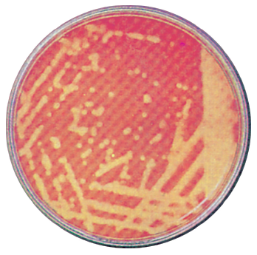
BLOOD AGAR – BETA HEMOLYSIS
Blood agar: S.pyogenes showing beta hemolysis

Slide 14
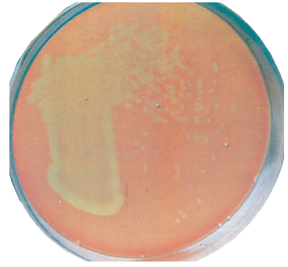
BLOOD AGAR – ALPHA HEMOLYSIS
Blood agar with alpha hemolytic viridans streptococci

Slide 15
ENRICHED MEDIA
Chocolate agar
Solid culture media
Heating blood agar - release hemin (X factor) and nicotinamide adenine dinucleotide (NAD), also called V factor
Useful for fastidious organisms – H.influenzae, N.meningitidis, N.gonorrhoeae
Loeffler’s serum slope-Corynebacterium diphtheriae
LJ medium:egg

Slide 16
ENRICHMENT MEDIA
Substances are added to a liquid medium -have a stimulating effect on bacteria to be grown or an inhibitory effect on the bacteria to be suppressed
Eg.Salmonella being overgrown by E.coli
Example: tetrathionate broth (tetrathionate inhibits coliforms)grow typhoid bacilli
Selenite F broth
Alkaline peptone water:Vibrio cholerae

Slide 17
SELECTIVE MEDIA
SELECTIVE MEDIA
Inhibitory substances added to a solid media
Greater number of required bacteria multiply
Example:
  DCA – dysentery bacilli
  TCBS or BSA – Vibrio species
TCBS agar with green colonies of
V.parahaemolyticus
Notes:
Slide heading?

Slide 18
SELECTIVE MEDIA
Thayer-Martin medium
Addition of antimicrobials (vancomycin, colistin and nystatin) to chocolate agar makes the medium selective for N.gonorrhoeae
Lowenstein-Jensen medium
Contains mineral salts, asparagine, glycerol, malachite green and hen’s eggs
Used for Mycobacterium species

Slide 19
INDICATOR MEDIA
Changes colour when bacteria grow
Example: Wilson Blair - S.Typhi - black colonies (sulphite to sulphide)
McLeod’s medium –
diphtheria bacilli –
black colonies (potassium
tellurite to tellurium)
Blood tellurite agar showing black colonies of C.diphtheriae

Slide 20
DIFFERENTIAL MEDIA
Bring out differentiating characters of bacteria
Distinguish between bacteria
Example: MacConkey medium
Lactose fermentor – pink colonies
Non–lactose fermentors – colourless colonies
Notes:
Slide heading?

Slide 21
MEDIA – TWO PROPERTIES
TWO PROPERTIES
MacConkey medium-differential/indicator
Blood agar – enriched/indicator (hemolysis)
Notes:
Slide heading?

Slide 22
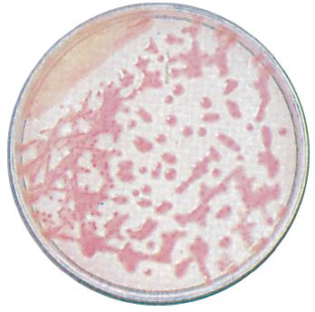
MacConkey agar
MacConkey agar with large, mucoid K.pneumoniae colonies

Slide 23
MacConkey agar
MacConkey agar with smooth, pink colonies of Escherichia coli

Slide 24
MEDIA
SUGAR MEDIA
1% sugar in peptone + indicator(Andrade’s)
Durham’s tube – gas production
ANAEROBIC MEDIA
Robertson’s cooked media
Thioglycolate broth
Notes:
Slide heading?

Slide 25
Thank u

Slide 26
CULTURE METHODS
CULTURE depends on purpose
Isolate bacteria in pure culture
Demonstrate properties
Growth for preparation of antigens
Bacteriophage, bacteriocin susceptibility
Sensitivity to antibiotics
Estimate viable counts
Maintain stock cultures

Slide 27
CULTURE METHODS
Streak culture
Lawn culture
Stroke culture
Stab culture
Pour plate
Liquid culture

Slide 28
STREAK CULTURE (SURFACE PLATING)
Routine isolation of bacteria
Loop–Platinum/Nichrome (24 SWG)
Specimen transferred with a loop
Spread over a small area - distributed over the plate in a series of parallel streak lines
Loop flamed and cooled between different sets of streaks

Slide 29
STREAK CULTURE
Streak cultures

Slide 30
LAWN CULTURE
Lawn or carpet culture
Uniform surface growth
Bacteriophage typing/antibiotic sensitivity testing
Prepared by
  Flooding the surface of the plate with liquid culture, pipetting off excess.
  Surface of the plate inoculated by applying a swab soaked in bacterial culture or suspension

Slide 31
STROKE AND STAB CULTURE METHODS
STROKE CULTURE
Made in tubes containing agar slope (slant)
Pure culture of bacteria
STAB CULTURE
Puncture the medium with a straight charged wire
Used for demonstration of
  Gelatin liquefaction
  Oxygen requirement
Maintenance of stock cultures
Notes:
Slide heading? Please check sublevels for ‘Used for demonstration of’

Slide 32
POUR PLATE CULTURE
Tubes containing 15 ml of agar, melted and left to cool in a water bath 45-50°C.
Appropriate dilutions of inoculum (1 ml) added to molten agar.
Mixed and poured into sterile petri dish, allowed to set.
After incubation, colonies are enumerated using colony counters.
Estimates viable count of bacteria in a suspension.

Slide 33
SWEEP PLATE/LIQUID CULTURES
SWEEP PLATE
Edges of petridish containing culture media – rubbed over fabric.
Dust particles stirred up – settle on culture medium.
Colonies develop on incubation.
LIQUID CULTURES
Tubes, bottles or flasks – inoculated by touching with charged loop or pipettes
Notes:
Slide heading?

Slide 34
ANAEROBIC CULTURE METHODS
McIntosh–Fildes anaerobic jar
Stout glass or metal jar
Metal lid – clamped airtight with screws
Lid – inlet and outlet
two terminals – electric supply
underside of lid – grooved porcelain
spool palladinised asbestos

Slide 35
MCINTOSH-FILDES JAR
McIntosh and Fildes anaerobic jar

Slide 36
MCINTOSH-FILDES JAR
Culture plates – placed in the jar - medium in bottom half of the plate.
Outlet tube connected to vacuum pump, air inside evacuated, outlet tap closed.
Inlet tube connected to hydrogen supply.
Electric terminals connected to current supply - palladinised asbestos heated (catalyst).
Hydrogen combines with residual oxygen in the jar – anaerobiosis.

Slide 37
GASPAK
Commercially available disposable envelope
Contains chemicals which generate hydrogen and carbon dioxide on addition of water
Simple and effective, eliminating the need for drawing vacuum and adding hydrogen

Slide 38
ANAEROBIC CULTURE METHODS
PRE-REDUCED ANAEROBIC SYSTEM (PRAS)
Fastidious anaerobes
Quantitative cultures
ANAEROBIC CHAMBER
Airtight, glass-fronted cabinet filled with inert gas
Entry lock for introducing and removing material and gloves for hands
Notes:
Slide heading?

Slide 39
REDUCTION OF OXYGEN
Reducing agents
1% glucose
0.1% thioglycollate
0.1% ascorbic acid
0.05% cysteine
Growth in thioglycolate broth:
(a) uniform turbidity; (b) surface growth; (c) granular turbidity

Slide 40
ANAEROBIC MEDIA
Broth containing fresh animal tissue supports the growth of anaerobes
Example: rabbit kidney, spleen, heart
(Smith-Noguchi medium)

Slide 41
ANAEROBIC MEDIA
ROBERTSON’S COOKED MEAT MEDIA
Most widely used
Contains fat-free minced cooked meat in broth
Permits growth of even strict anaerobes
Indicates saccharolytic or proteolytic properties

Slide 42
ISOLATION OF PURE CULTURES
Surface plating
Enrichment, selective and indicator media
Pretreatment with appropriate bactericidal substances
Separation by incubation at different temperatures
Heating a mixture containing vegetative and spore forming bacteria at 80°C

Slide 43
ISOLATION OF PURE CULTURES
Craige’s tube – separation of motile from non-motile bacteria
Tube of semisolid agar, with a narrow tube open at both ends placed in the centre of the medium such that it projects above the level of the medium
Mixture inoculated into central tube
On incubation, motile bacteria alone traverse the agar and appear at the top of the medium outside the central tube
Used to obtain phase variants in Salmonella

Slide 44
MEDIA
MCQ
1.Which is an enriched media?
a)Selenite f broth b)Peptone water
c)MacConkey agar d)Chocolate agar
2.Agar concentration required to prepare nutrient agar is;
a)2%,b)6% c)0.25% d)0.5%
Notes:
Slide heading?

Slide 45
MCQ
3.Which enrichment medium is preferred to grow Vibrio cholerae?
a)tetrathionate broth,b)selenite f broth
c)Alkaline peptone water d)all of the above
4.Robertson cooked meat broth is an example of:
a)Enriched media, b)enrichment media,
c)Anaerobic media d) nutrient media
Notes:
Slide heading?

Slide 46
MEDIA
MCQ
5.Which culture method is used for the Routine isolation of bacteria:
a) Streak culture
b) Lawn culture
c) Stroke culture
d) Stab culture
Notes:
Slide heading?

Slide 47
MEDIA
MCQ-ANSWER
1.D
2.A
3.C
4.C
5.A
Notes:
Slide heading?

